Slide 1
Credit Card Default Prediction

Slide 2
Objective :
The credit card default prediction is a Machine Learning based project. It help in prediction of the people who will be going the default their payments .
Benefits :
The growing number of credit card users, banks have been facing an escalating credit card default rate.
As such data analytics can provide solutions to tackle the current phenomenon and management credit risks.
This provides a performance evaluation of credit card default prediction as such data analytics to have the higher accuracy.

Slide 3
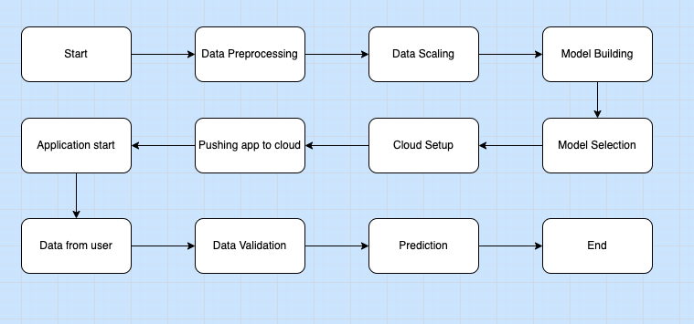
Architecture

Slide 4
Data From User
ID: ID of each client
LIMIT_BAL: Amount of given credit in NT dollars (includes individual and family/supplementary credit
SEX: Gender (1=male, 2=female)
EDUCATION: (1=graduate school, 2=university, 3=high school, 4=others, 5=unknown, 6=unknown)
MARRIAGE: Marital status (1=married, 2=single, 3=others)
AGE: Age in years
PAY_0: Repayment status in September, 2005 (-1=pay duly, 1=payment delay for one month, 2=payment delay for two months, ... 8=payment delay for eight months, 9=payment delay for nine months and above)
PAY_2: Repayment status in August, 2005 (scale same as above)
PAY_3: Repayment status in July, 2005 (scale same as above)
PAY_4: Repayment status in June, 2005 (scale same as above)
PAY_5: Repayment status in May, 2005 (scale same as above)
PAY_6: Repayment status in April, 2005 (scale same as above)

Slide 5
BILL_AMT1: Amount of bill statement in September, 2005 (NT dollar)
BILL_AMT2: Amount of bill statement in August, 2005 (NT dollar)
BILL_AMT3: Amount of bill statement in July, 2005 (NT dollar)
BILL_AMT4: Amount of bill statement in June, 2005 (NT dollar)
BILL_AMT5: Amount of bill statement in May, 2005 (NT dollar)
BILL_AMT6: Amount of bill statement in April, 2005 (NT dollar)
PAY_AMT1: Amount of previous payment in September, 2005 (NT dollar)
PAY_AMT2: Amount of previous payment in August, 2005 (NT dollar)
PAY_AMT3: Amount of previous payment in July, 2005 (NT dollar)
PAY_AMT4: Amount of previous payment in June, 2005 (NT dollar)
PAY_AMT5: Amount of previous payment in May, 2005 (NT dollar)
PAY_AMT6: Amount of previous payment in April, 2005 (NT dollar)

Slide 6
Model Training
Dataset Information :
This dataset contains information on default payments, demographic factors, credit data, history of payment, and bill statements of credit card clients in Taiwan from April 2005 to September 2005.
Data Pre-processing :
In data Pre-processing we have made dummy columns of education, gender and married. We also removed all negative values from our data set.

Slide 7
Model Building :
After scaling of data, we divided train data set and test data set in 80:20 ratio. And tested these data set on different Machine learning models like
1. Linear Regression
2. Support Vector Regressor 3. Decision Tree Regressor 4. Random Forest Regressor Random Forest
Regressor
5. Logistic Regression

Slide 8
Model selection :
After considering factors like Mean Absolute Error, Mean Squared Error and Root Mean Squared Error we found that Logistic Regression performed best.
Prediction :
This model will predict whether the client is going to default his/her payment or not.

