Slide 1

CreditSense
Decentralised
ML BASED CREDIT SCORING
Secured data sharing

Slide 2



The Problem
High Risk of Identity Theft
Centralized Credit Scoring
Redundant Paperwork

Slide 3


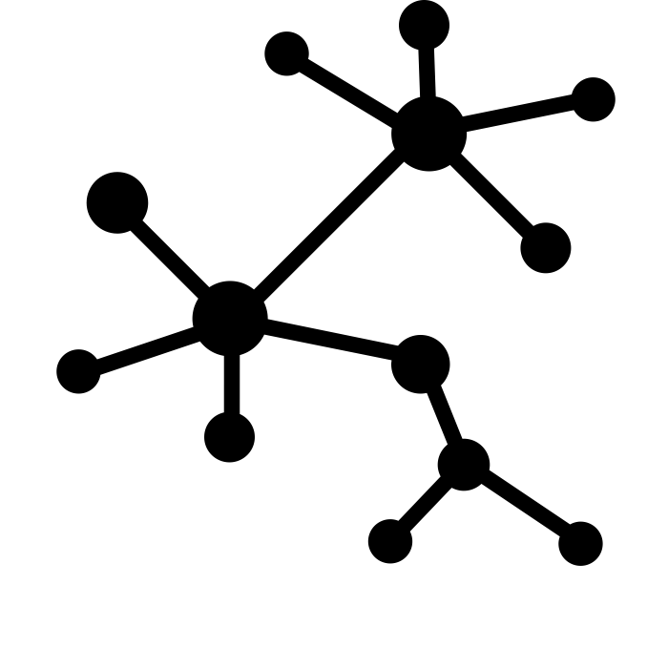
Why CreditSense make sense?
Decentralization- Anonymous Data Sharing using Blockchain
Intelligent Credit Scoring – No more third party credit rating agencies
Data Security – Prime features of blockchain implementation
Notes:
Our Uniqueness : 1. Decentralised – a.) security data sharing b.) anonymity maintained
2.) Machine Learned – a.) Intelligent credit score

Slide 4




System Workflow
A simple and user-friendly dashboard for efficient processing.
2 Layer Deep Learning Model with 35 hidden neurons trained with over 10 million loan applications.
Strato Blockchain deployed as service on Azure.
Additional data analysis of the data derived from the distributed ledger.
Checkout a quick demo here: https://vimeo.com/253112175

Slide 5


The Credit Story of Spidey and Hulk
Has a good credit standing
Never owned a credit card before
Spidey seems to love credit cards and shopping for his girlfriend and Aunt. His job as a photographer enables him to pay his bills on time and hence makes him a good investment for the banks
Hulk on the other hand is very new to the world of credit cards and always spent most of his time in the lab as Dr. Banner . So technically he should too have a high credit score because he never had any credit history
Now when both apply for a loan at the same bank, who do you think the bank would consider a safer investment ??

Slide 6

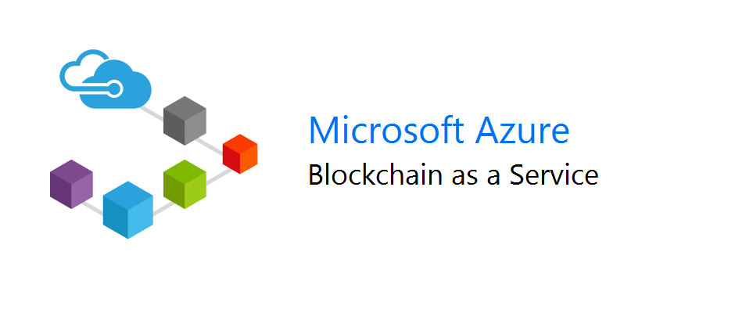
Blockchain
A Decentralized Web App
Deployed as a node on Strato Blockchain as a service by Azure
Private Blockchain Network
Employs Smart Contract

Slide 7

Deep Learning
Dataset contains around 75 variables with more than 10 million data points
Data retrieved from a peer-to-peer lending website called Lending Club
1 million datapoints upon augmentation resulted in 10 million datapoints
Used 2 layered neural network with 35 neurons in the hidden layer

Slide 8



Stakeholders
Banks
Customers
Government

Slide 9
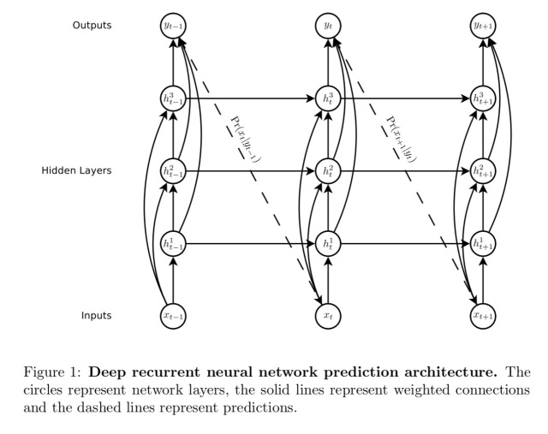
Current Scaling Up
Machine Learning Model
Transition to Reinforced Learning Model – Making use of the Recurrent Neural Network leveraging LSTM – Long Short Term Memory networks.
A dedicated machine learning node using mutual consensus to approve changes on the Machine Learning Model for bank’s transparency.

Slide 10

Current Scaling Up
Blockchain Infrastructure
Migrating to MultiChain Blockchain for efficient data storing on Microsoft Azure
Removing the latency due to gas run out caused due to BlockApps Strato
Making it more scalable for a larger data set.

Slide 11
Hope that
makes sense ;)

