Slide 1

GeNERIC DRUG SUPPLY PORTAL

Slide 2
GeNERIC DRUG SUPPLY PORTAL

Slide 3
PROJECT INTRODUCTION
PURPOSE OF PROJECT :
Project provides online platform to buy and sell generic medicines at cheaper rate The main objective of this project is reduction in expenditures without compromising health outcomes. The most important benefit of generic medicines is not cost-savings, but increased health gain.
NEED :
There is no computerized system for the generic medical to sell their product. Currently, the Patients goes to nearest Generic Medical Store to buy medicines at cheaper rate. There is no way for the patients to get alternate generic medicine other than prescribed by doctor.

Slide 4
PROJECT ARCHITECTURE
Used for
User Interfacing
Basic data validation
Used for
Server side validations,if needed
Request Handling
Business logic
Database Operations
Front end layer
Used for
Permanent data storage
Database level validations
Database access
Server Layer
Database Layer
Technologies used
Bootstrap
React JS
Technologies used
Spring boot
Hibernate
Technologies used
MySQL

Slide 5
Technology platform
Technologies used
In this project for front end BOOTSTRAP, REACT-JS technologies are used
For backend mainly hibernate and mainly spring boot technologies are used
For Database MySQL database management system is used

Slide 6
Technology platform
Why Spring boot ??
Rapid application development
It avoids writing boiler plate code
It avoids tedious development steps
Spring boot starter parent dependency is automatically added to application and it brings basic jar files

Slide 7
Technology platform
Why ReactJS ??
ReactJS is extremely intuitive to work with and provides interactivity to the layout of any UI. Plus, it enables fast and quality assured application development
Excellent cross-platform support
UI focused designs
Easy to adopt
ReactJS works as a mediator which represents the DOM and assists to decide which component needs changes to get the exact results

Slide 8
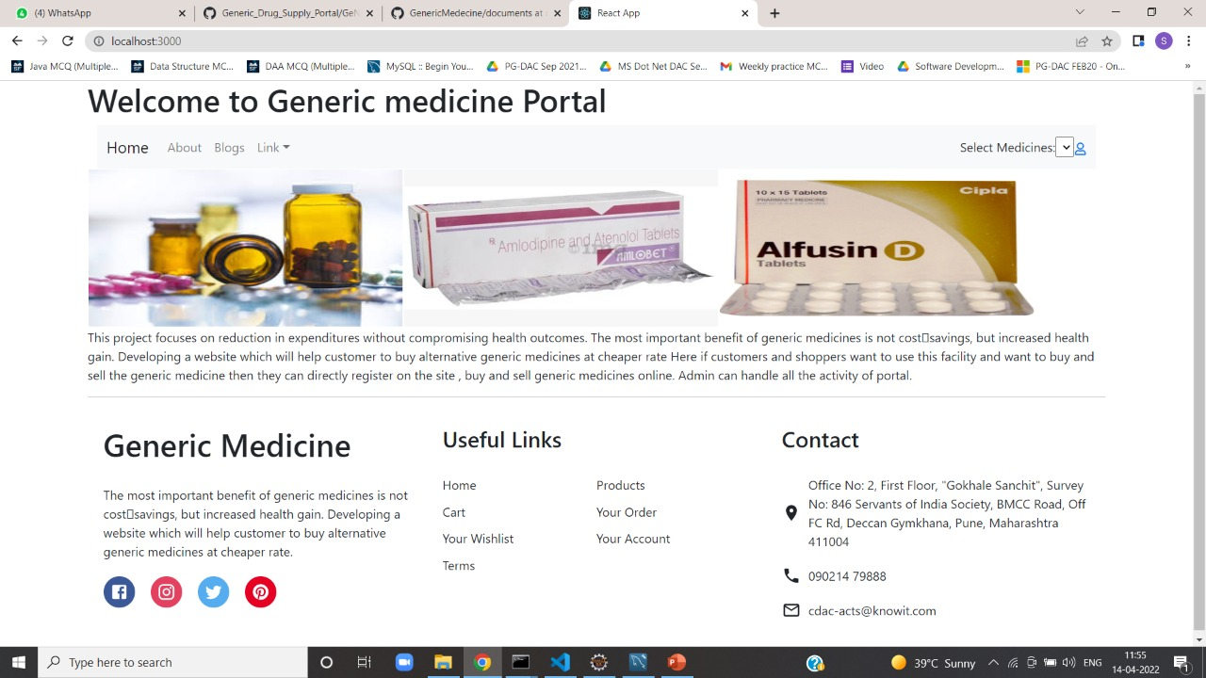
HOME PAGE

Slide 9
USER ROLES AND RESPONSIBILITIES
ADMIN :
Admin can add the products,company.
Admin is administrator of the system .
No one could select The Administrator, because Administrator is implemented Generic Medicine Portal in advance.
Admin should able to manage all the accounts
1. Enable accounts
2. Disable accounts
Admin should be able to view shopper info, shipper info.

Slide 10
USE CASES FOR ADMIN
Admin:
In Admin use case diagram Admin is the Actor.
Admin can handle following use cases:
Login
Report Generation
Controls account
Add products
Add company
Fig. Use case diagram for admin
gLoginGI
Add Product
Control Account
Generate Reportg
Add Company

Slide 11
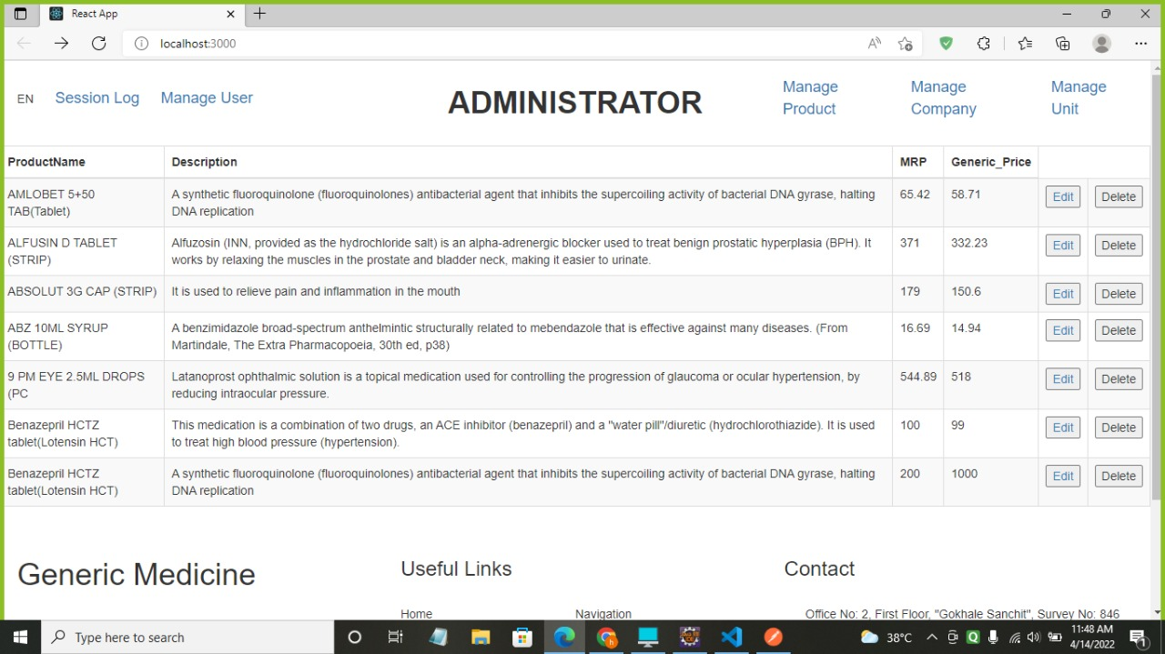
ADMIN HOME

Slide 12
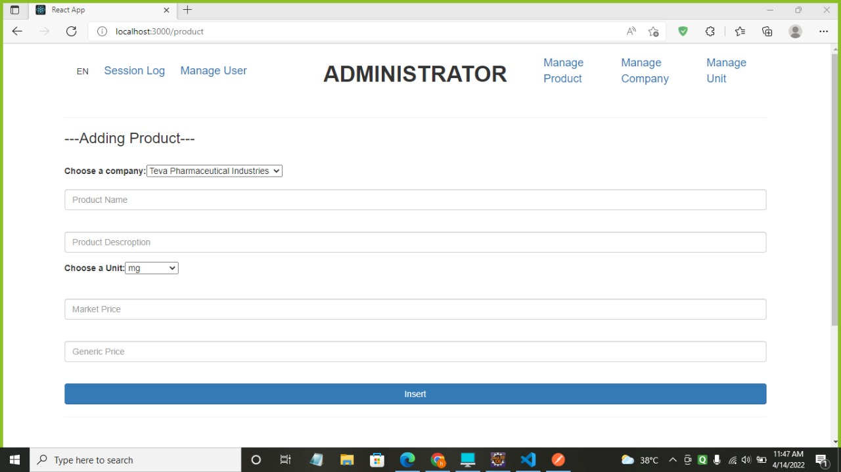
ADD product

Slide 13
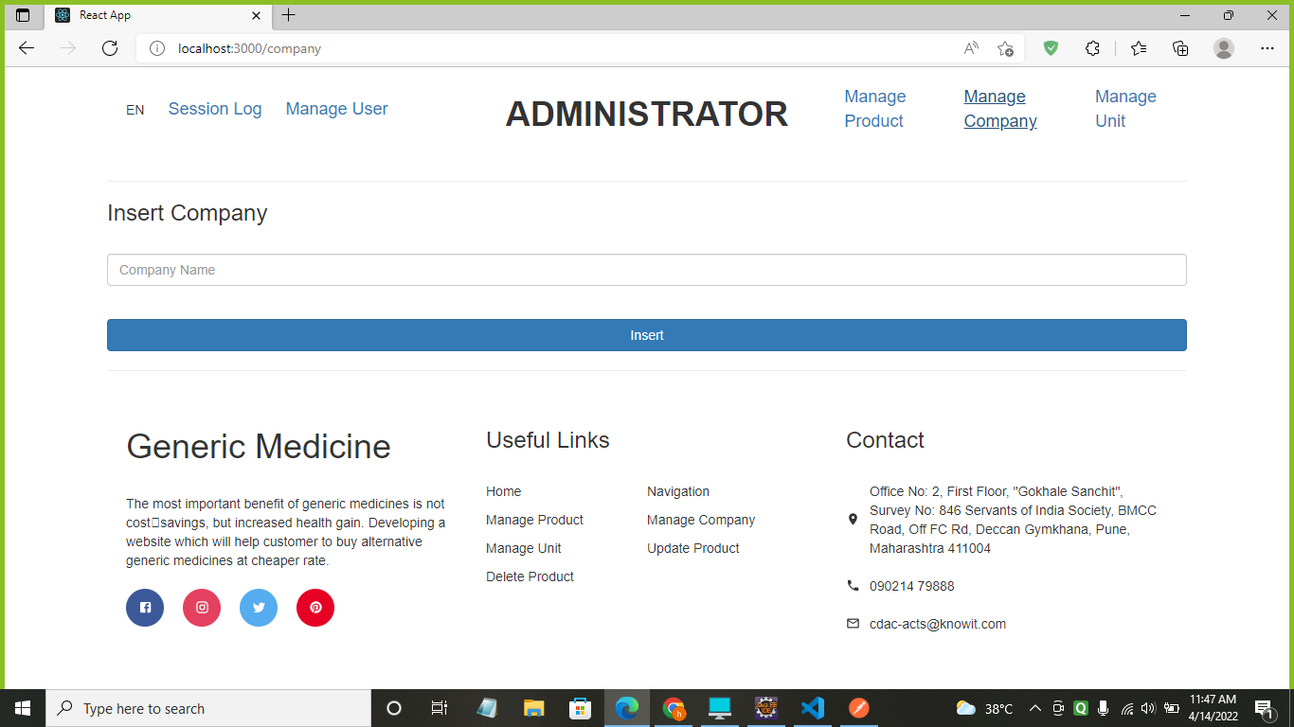
Add company

Slide 14
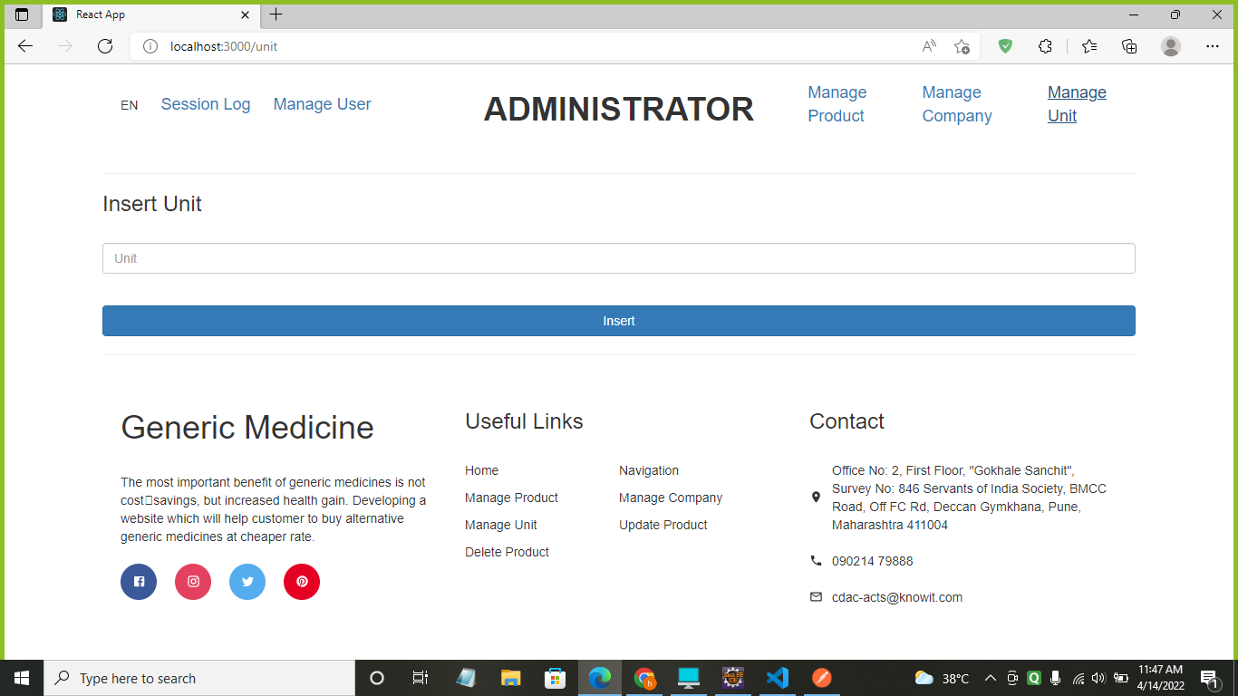
Add unit

Slide 15
USER ROLES AND RESPONSIBILITIES
SHOPPER :
Shopper will maintain the product stock
Shopper is assigned by admin
Generic Medicine Portal always compels Shopper authentication before using itself except when a new account is successfully created.
The user authentication demands UserID and Password
The Shopper account should alive for so long as the duration decided by Admin.
Retail license number is required for shopper to create account.
Shopper can modify his account if required.
Shopper will receive orders placed by customers.

Slide 16
USE Cases FOR SHOPPER
Shopper:
Create account
Account Creation Process
Login Process
Update Account Process
Maintain Stock
Update Stock
Accepting Order
Assigning Shipper
Login
Maintain stock
Update account
Update Stock
Accept order
Cancel order
Assign shipper
Fig. Use case diagram for Shopper

Slide 17
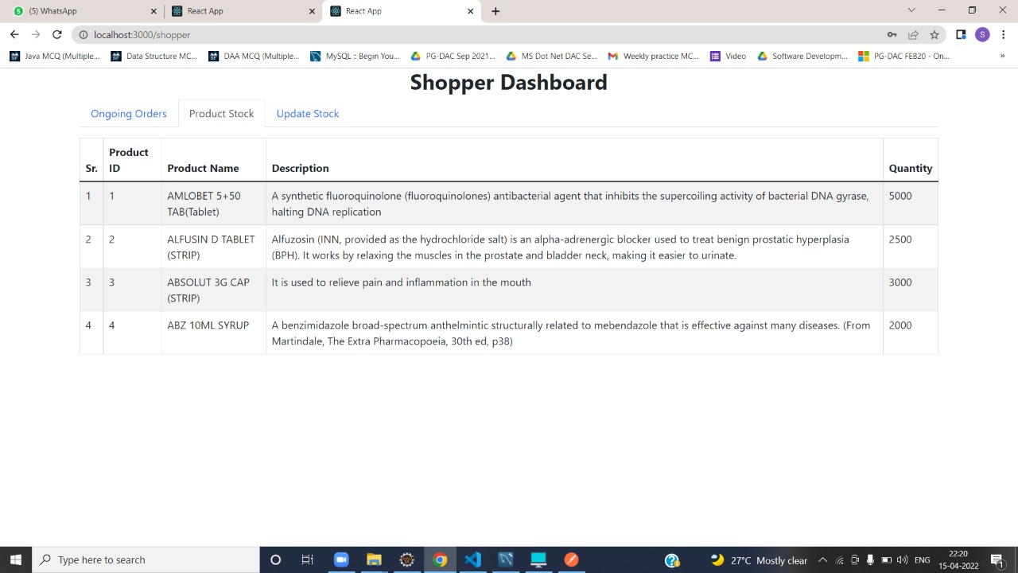

Slide 18
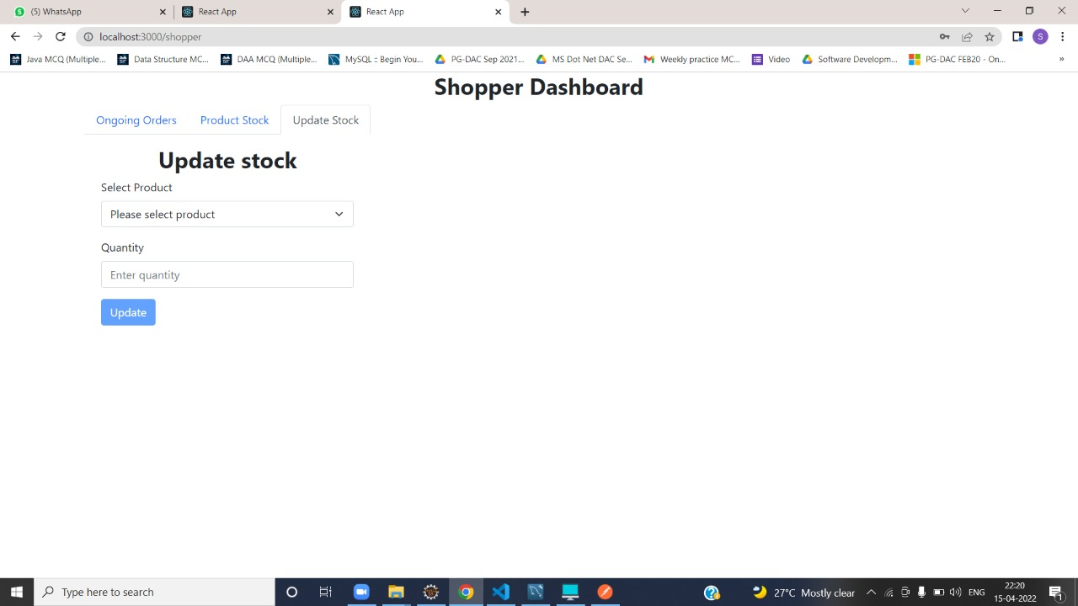

Slide 19
USER ROLES AND RESPONSIBILITIES
There are 4 types of users in this project Admin user, Customer user,Shopper user and Shipper user.
CUSTOMER :
Customer is the user of system who wants to buy the medicine.
He is also able to view the market price of products.
He can view products and place order .
Generic Medicine Portal always compels user authentication before using itself except when a new account is successfully created.
The user authentication demands UserID and Password.
Customer can update his account.

Slide 20
USE CASES FOR CUSTOMER
Customer:
In Customer use case diagram customer is the Actor.
Customer can handle following use cases:
ccc
h
Create Account
Browse Price
Login
Search Product
Account Creation Process
Login Process
Update info (Sing up)
Search Product
View Product
Add to Cart
View Cart
Remove Product From Cart
Confirm Order
Cancel Order
Order History
Browse existing Market price
Update info
View product
Add to cart
Confirm Order
Remove product
Cancel Order
Order history
Fig. Use case diagram for customer

Slide 21
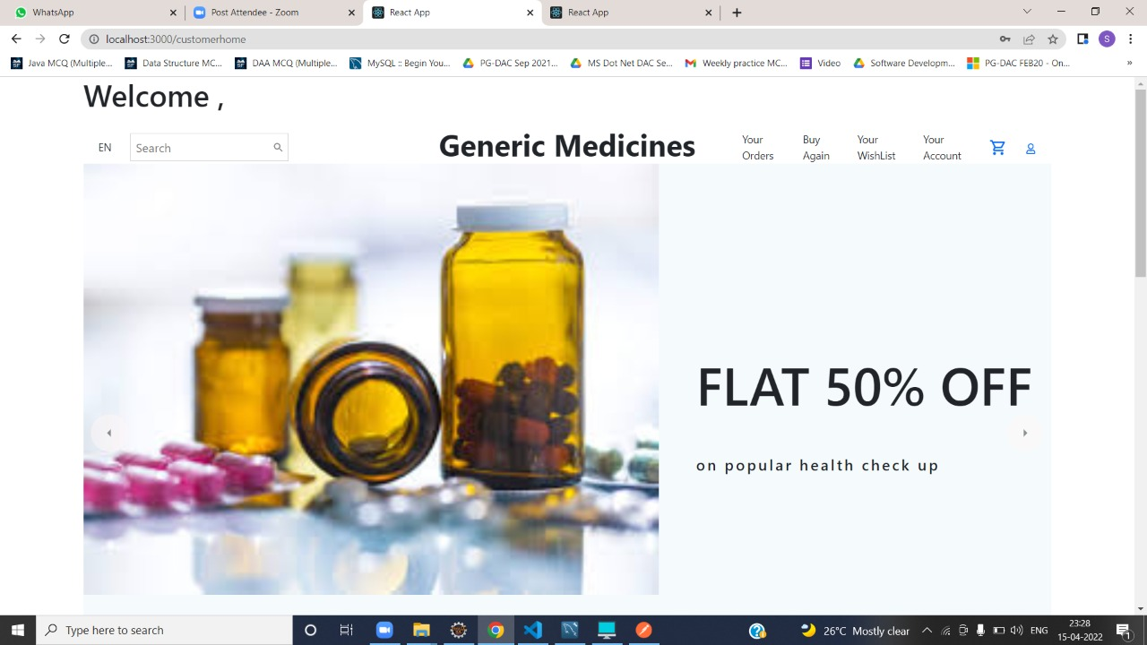
Customer home page

Slide 22
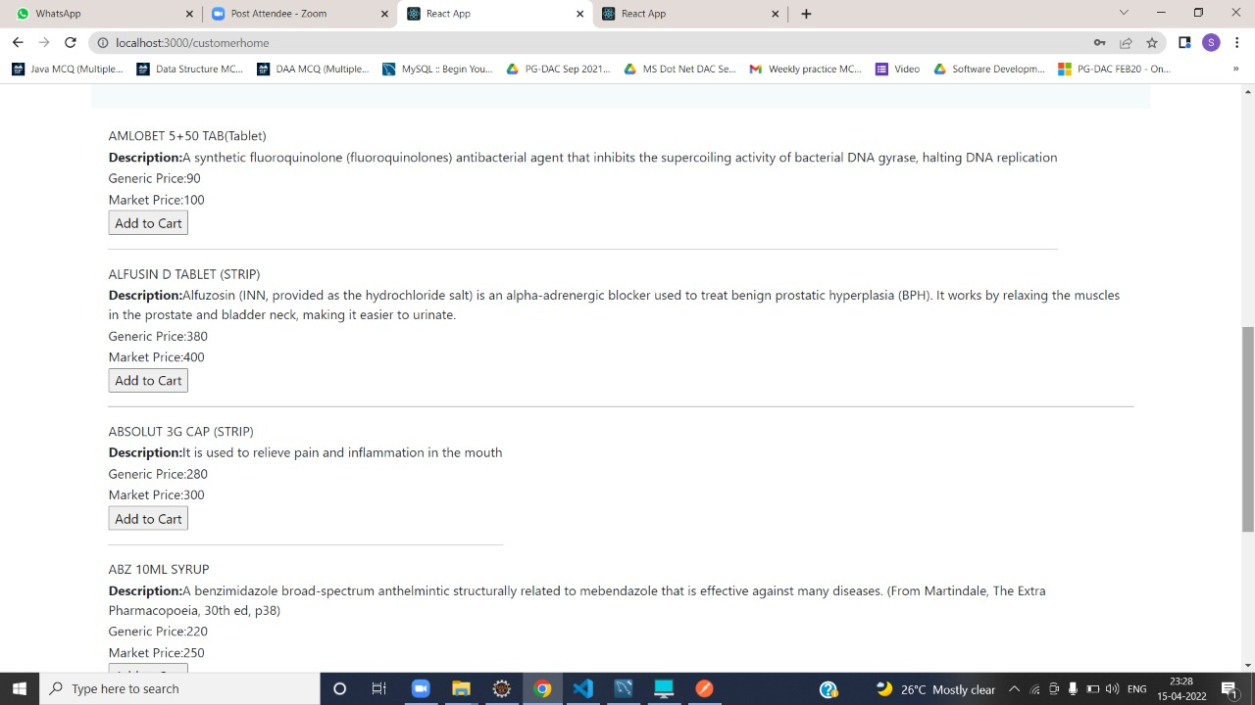
ADD to cart

Slide 23
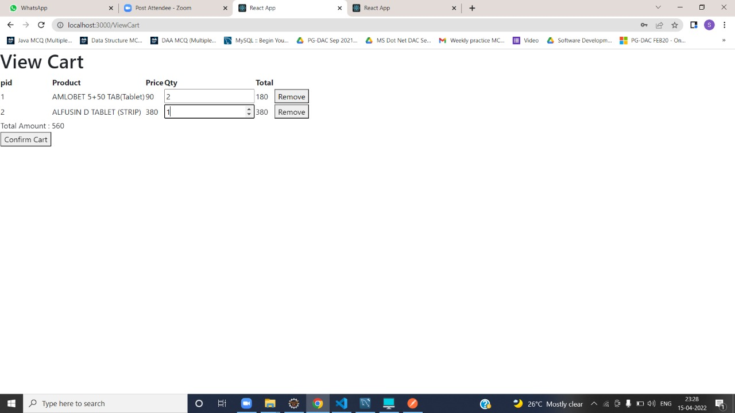
View cart

Slide 24
USER ROLES AND RESPONSIBILITIES
SHIPPER :
There will be one shipper assigned for one shopper.
Shipper will deliver the order placed by customer
Generic Medicine Portal always compels Shipper authentication
The Shipper account should alive for so long as the duration decided by Admin or Shopper.
As soon as delivery received by customer delivery status and payment status will be updated.

Slide 25
Use cases for shipper
Shipper:
Update Delivery Status
Log in
Login
Update Delivery status
Fig. Use case diagram for Shipper

Slide 26
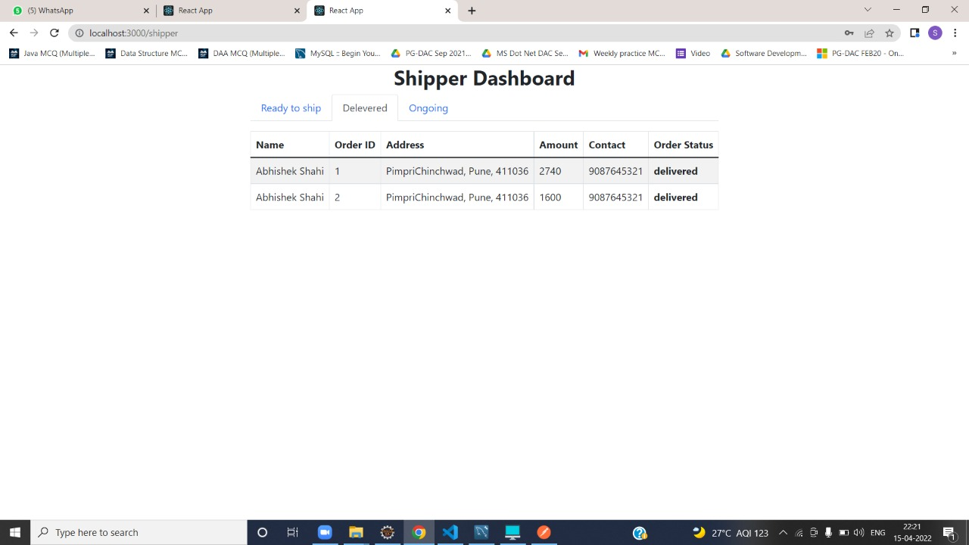

Slide 27
Details of contribution
All our project members have contributed in project for different layers
Specially ABHISHEK SHAHI has great contribution in front end design
We have divided every task and accordingly worked on function and implementation
During project design we created outline including project description,a schedule,goals,outcomes,objective.
We did brain storming before deciding our project and have set goals
We did detail analysis how we can implement the features
In all 3 layers databse design,frontend and backend everybody contributed as per individual’s knowledge
We assigned diff user cases to everyone so that we could devide the task and make development fast

Slide 28
Known issues and bugs
There are some bugs in updating and deleting products from cart
We are working to fix this problem and will be solved soon

Slide 29
Future extensions
Future Scope :
Future scope of this project is to extend the project for more states as currently is for only Maharashtra
Currently only cash on delivery service is provided for this project future scope is also to add online payment which will
provide customers online payment service
Also future scope involves sending response to customer through mobile sms ,emails so that they will get details of order
Possible time estimate to implement this is three months

Slide 30
conclusion
Our overall experience during project phase was very good though we faced many challenges while working with diff technologies
we learned lot of things
Debugging,finding errors designing database with proper relations and implementing them was really challenging part during
Project phase
We learn how to design database how to make ER diagrams ,data flow diagrams
We learned how to work with backend and frontend technologies ,how to do UI design.
Also team building collaboration while working in team was also part of our learning
Though we were not perfect but overall learning experience was very good
Last but not least our project mentors helped us throughout the project phase and they provided every possible help which can give
us idea about overall application development

Slide 31
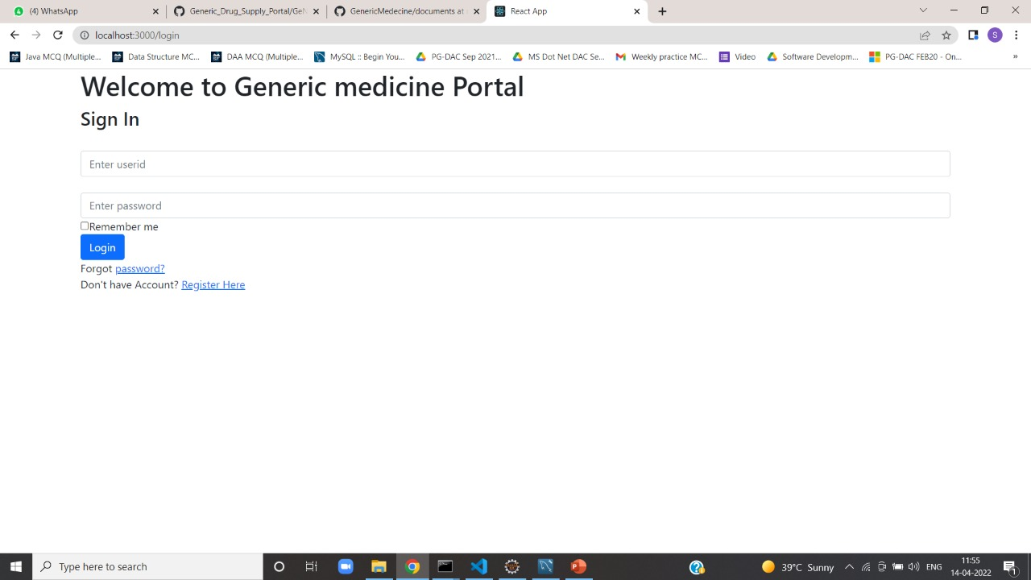
LOGIN

Slide 32
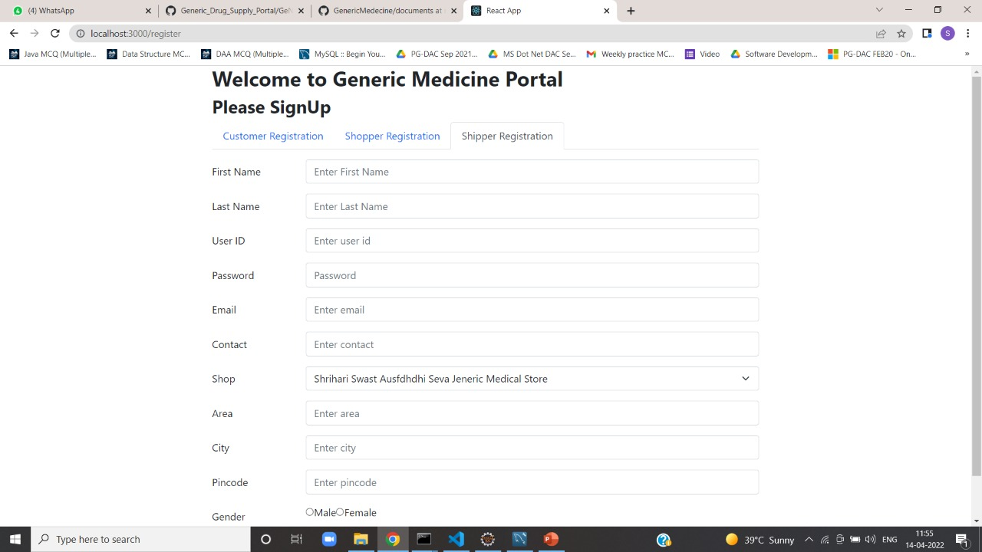
RESIstration

Slide 33
END
Thank you

