Slide 1

Group Members: Arslan Ali 01-243211-002 Shahid Hussain 01-243211-009 Waseem Tahir 01-243211-010
Ad-Hoc Data Analytics to DataOps

Slide 2
Introduction
Data Analytics :
Data analytics helps individuals and organizations make sense of data. Data analysts typically analyze raw data for insights and trends by using different tools.
DataOps :
DataOps is a set of practices, processes and technologies that combines an integrated and process-oriented perspective on data with automation and methods from agile software engineering to improve quality, speed, and collaboration and promote a culture of continuous improvement in the area of data analytics

Slide 3
Why there is need of DataOps?
It deliver analytics with speed and agility, without compromising on data quality.
DataOps is streamlined, effective process
Coherent DataOps System
It promote agile-development
The process is adaptable & easy to control
Data came from controlled system

Slide 4
Folds Of Paper
Analyses various definitions of DataOps literature.
Case study with a large mobile telecommunication organization, we analyze how multiple data analytic teams evolve their infrastructure and processes towards DataOps.
Create a stairway of the evolution process and The evolution model demonstrates the essential requirements to climb a step in the stairway and lists the set of challenges encountered while moving from one stage to the next.

Slide 5
METHODOLOGY
Identify the phases of DataOps evolution
Setting the RQs
RQ1. How do practitioners define “DataOps”?
RQ2. What are the different stages Ericsson has gone through
ad-hoc data analysis to DataOps?
Multi-Vocal Literature Review

Slide 6
Multi-Vocal Literature Review
Form of a Systematic Literature Review (SLR)
Includes the Grey literature
Gain more understanding of DataOps practices
Formal literature of DataOps is highly limited
Need for MLR
Formal academic literature (Google Scholar, IEEE Explore, ACM digital library)

Slide 7
Process of MLR
String based search to select relevant studies from the literature
All retrieved literature was exported
Inclusion Criteria
Papers and Google links describing the steps of the DataOps
Components of DataOps
Benefits and challenges.
Exclusion Criteria
Duplicates and non-English

Slide 8
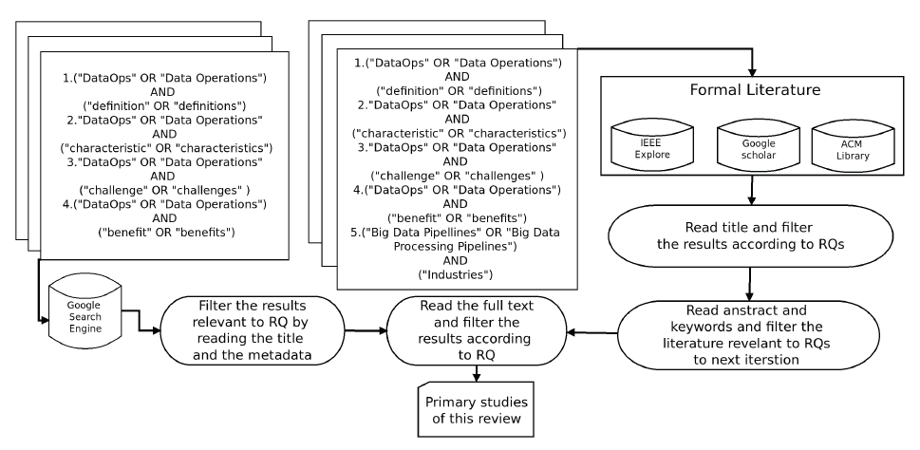
Cont..

Slide 9
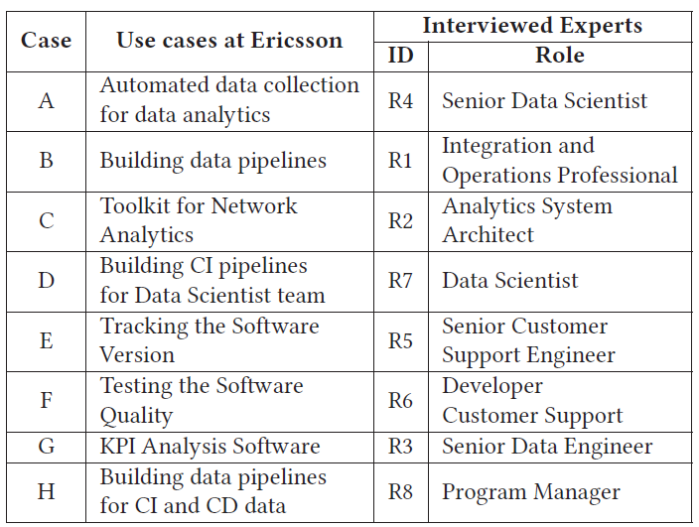
Exploratory Case study
Explore the essential stages of the Data Analytic approach which Ericsson follows
Investigate its similarity to the popular DataOps approach

Slide 10
Data Collection
Data was collected through semi-structured interviews
Five sections was formulated
The first and second sections concentrated on the background of the interviewee
The third and fourth sections focused on the data collection and processing in various use-cases
Last section detail about data testing and monitoring practices

Slide 11
Findings
Five stage evolution model was constructed, adopted by Erricsson.
This study was based on eight use cases.
Requirements for moving from one step to the next and impediments encountered at each phase are identified and described.

Slide 12
Definition of DataOps
Author found out that different practitioners have different understandings about DataOps:
"a process which fills the gap between data and operations team“
"an efficient way of managing the activities in the entire data life cycle“.
"a method to showcase the interdependence of end to end data analytic process“.
"an approach to eliminate data silos by connecting different data pipelines“

Slide 13
Cont.
DataOps definition by the authors:
"DataOps can be defined as an approach that accelerates the delivery of high-quality results by automation and orchestration of data life cycle stages. DataOps adopts the best practices, processes, tools and technologies from Agile software engineering and DevOps for governing analytics development, optimizing code verification, building and delivering new analytics thereby promoting the culture of collaboration and continuous improvement.“
DataOps merges two data pipelines namely value pipeline and innovation pipeline.
Value pipeline: series of activities that produces value or insights.
Innovation pipeline: process through which new analytic ideas are introduced in value pipeline.

Slide 14
Cont.
DataOps and Big Data analytics are used interchangeably but DataOps can be applied to any size of data.
DataOps follows Agile methodology and as a result data team publishes new or updated analytics which is pushed into the value pipeline.
DataOps borrows the best practices, technologies and tools and hand tailor it so that it fits to the unique context of data analytics.

Slide 15
Use cases at Ericsson
Automated data collection for data analytics.
Building data pipelines
Toolkit for Network Analytics
Building CI pipelines for Data Scientist teams
Tracking the software version
Testing the software quality
KPI analysis Software
Building data pipelines for CI and CD data

Slide 16
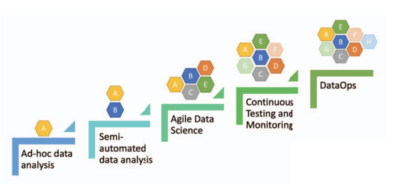
DataOps evolution Model

Slide 17
Phase 5: DataOps
DataOps shortens the end-to-end cycle time of data analytics, from the ideation phase to the insight development.
It incorporates Agile Development practices into data analytics according to the organization’s requirement.
DataOps also adopts DevOps principles to effectively manage the artifacts like data, metadata and code.
Erricsson is moving towards the last phase of evolution stairway i.e. DataOps.

Slide 18
Conclusion
DataOps is becoming increasingly popular in the industry due its ability to accelerate the production of high quality data insights.
This paper proposed an evolution model describing a strairway with five steps showing how DataOps was evolved.
Main contribution of this paper was the five phases of “DataOps Evolution Model”.
Researchers and practitioners can use this model to position other case companies and guide them to the next phase by suggesting the necessary features.

Slide 19

Thankyou
Questions & Answers

