Slide 1
Reference

Slide 2
Lesson Plan
01
Day 1 - 8
Understanding The Fundamentals
Day 9 - 16
Microsoft Excel - Excel from Beginner to Advanced
02
03
Day 17 - 24
PowerPoint Masterclass - Presentation Design & Animation
04
Test / Assessment

Slide 3
introduction To Microsoft Word
Microsoft word is a word processing Application software developed by Microsoft in 1983. It is the most commonly used word processor software. It is used to create professional quality documents, letters, reports, resumes, etc. and also allows you to edit or modify your new or existing document.
The file saved in MS Word has .docx extension.
In this lesson we will learn the features of MS Word, but first we learn how to open MS Word?

Slide 4
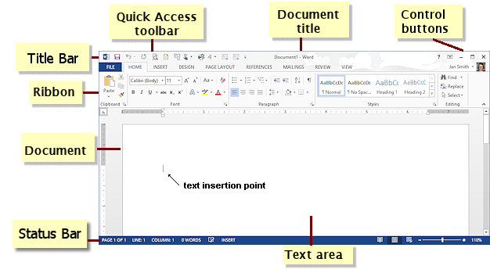
0 1 ) Word 2019 ─ let’s Explore the Window

Slide 5
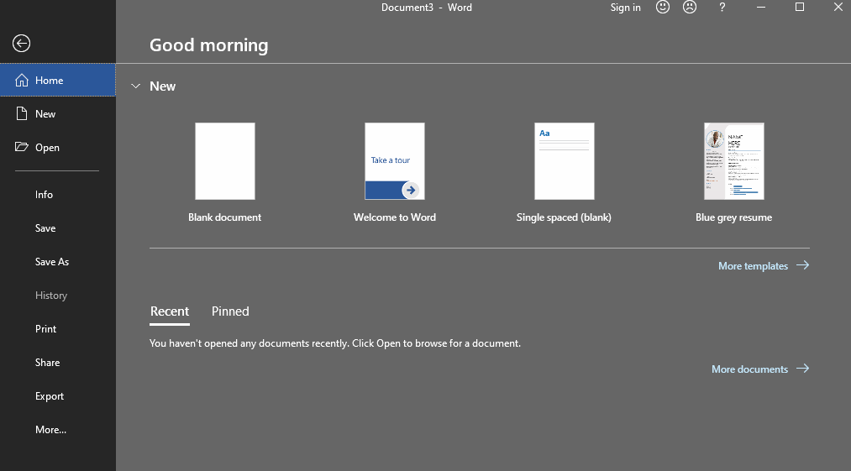
0 2 ) File Menu

Slide 6
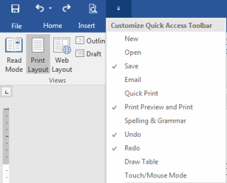
0 3 ) Create, Save, Formatting text 0 4 ) Quick Access Toolbar, Navigating the Page

