Slide 1
Switch Statements
By
Manish Verma

Slide 2
Multiple Selection:
The switch Statement
multiway
expression
value1
action 1
value2
action 2
value3
action 3
value4
action 4

Slide 3
The Switch Statement
The switch statement provides another way to decide which statement to execute next
The switch statement evaluates an expression, then attempts to match the result to one of several possible cases
The match must be an exact match.
switch ( expression ){
case value1 :
statement-list1
case value2 :
statement-list2
case value3 :
statement-list3
case ...
}

Slide 4
The Switch Statement
Each case contains a value and a list of statements
The flow of control transfers to statement associated with the first case value that matches
switch ( expression ){
case value1 :
statement-list1
case value2 :
statement-list2
case value3 :
statement-list3
case ...
}

Slide 5
Switch - syntax
The general syntax of a switch statement is:
switch
and
case
are
reserved
words
switch ( expression ){
case value1 :
statement-list1
case value2 :
statement-list2
case value3 :
statement-list3
case ...
}
If expression
matches value3,
control jumps
to here

Slide 6
The Switch Statement
The break statement can be used as the last statement in each case's statement list
A break statement causes control to transfer to the end of the switch statement
If a break statement is not used, the flow of control will continue into the next case
switch ( expression ){
case value1 :
statement-list1
break;
case value2 :
statement-list2
break;
case value3 :
statement-list3
break;
case ...
}

Slide 7
Switch Example
Examples of the switch statement:
switch (option){
case 'A':
aCount++;
break;
case 'B':
bCount++;
break;
case 'C':
cCount++;
break;
}

Slide 8
Switch – no breaks!!!
Another Example:
switch (option){
case 'A':
aCount++;
break;
case 'B':
bCount++;
break;
case 'C':
cCount++;
break;
}
switch (option){
case 'A':
aCount++;
case 'B':
bCount++;
case 'C':
cCount++;
}

Slide 9
Switch - default
A switch statement can have an optional default case
The default case has no associated value and simply uses the reserved word default
If the default case is present, control will transfer to it if no other case value matches
If there is no default case, and no other value matches, control falls through to the statement after the switch

Slide 10
The switch Statement
Switch with default case:
switch (option){
case 'A':
aCount++;
break;
case 'B':
bCount++;
break;
case 'C':
cCount++;
break;
default:
otherCount++;
break;
}

Slide 11
To Switch or not to Switch
The expression of a switch statement must result in an integral type, meaning an integer (byte, short, int, long) or a char
It cannot be a boolean value or a floating point value (float or double)
The implicit boolean condition in a switch statement is equality
You cannot perform relational checks with a switch statement

Slide 12
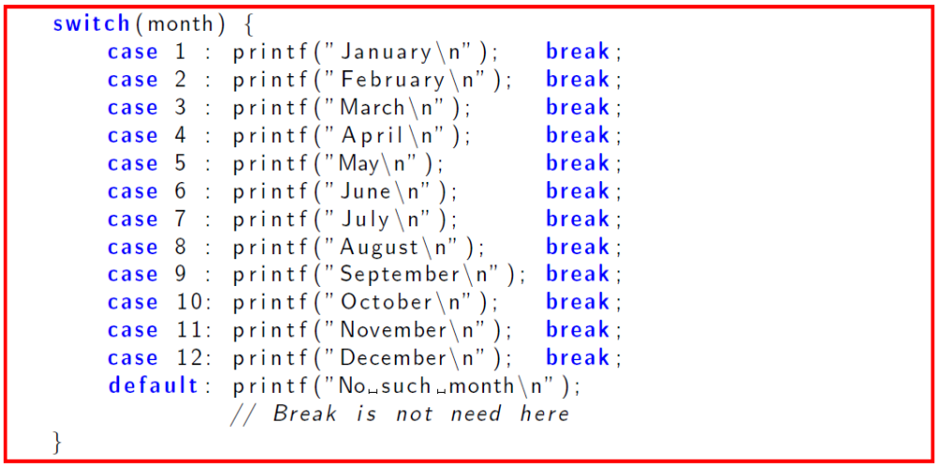

Slide 13
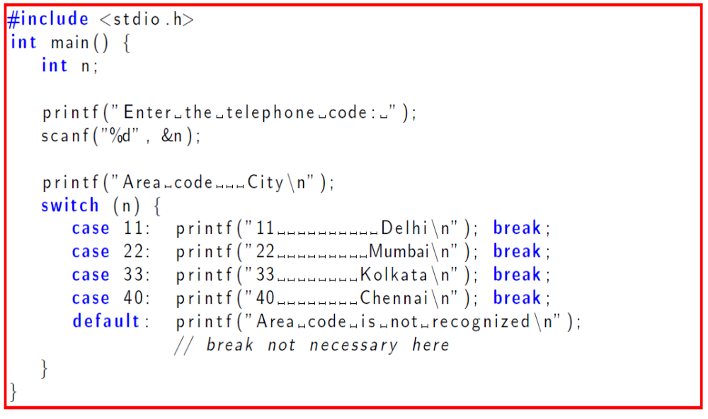

Slide 14
Creating Menus
When you want to give your user a choice on what to do next, you can display a set of choices (a menu). The user then enters his or her choice. You must validate the choice to make sure it is valid before you continue the program!

Slide 15
Sample Program (cont’d)
switch( choice )
{
case 1: printf( “Do edit\n” );
break;
case 2: printf( “Do delete\n” );
break;
case 3: printf( “Done\n” );
break;
default: printf( “Invalid choice!\n” );
break;
}

Slide 16
Good Programming Practices
Include a default case to catch invalid data.
Inform the user of the type of error that has occurred (e.g., “Error - invalid day.”).
If appropriate, display the invalid value.
If appropriate, terminate program execution (discussed in CMSC 201).

Slide 17
switch Example
switch ( day )
{
case 0: printf (“Sunday\n”) ;
break ;
case 1: printf (“Monday\n”) ;
break ;
case 2: printf (“Tuesday\n”) ;
break ;
case 3: printf (“Wednesday\n”) ;
break ;
case 4: printf (“Thursday\n”) ;
break ;
case 5: printf (“Friday\n”) ;
break ;
case 6: printf (“Saturday\n”) ;
break ;
default: printf (“Error -- invalid day.\n”) ;
break ;
}

Slide 18
Practice Questions
Write a C program to print day of week name using switch case.
Write a C program print total number of days in a month using switch case.
Write a C program to check whether an alphabet is vowel or consonant using switch case.
Write a C program to find maximum between two numbers using switch case.

Slide 19
Practice Questions
Write a C program to check whether a number is even or odd using switch case.
Write a C program to check whether a number is positive, negative or zero using switch case.
Write a C program to find roots of a quadratic equation using switch case.
Write a C program to create Simple Calculator using switch case.

Slide 20
Questions??

