Slide 1

Overview of Team Pedestrian Safety System – APCA1
Software Engineering CSE435
Michigan State University
Fall 2012
Team members:
  Project Manager: Matthew Tarnowsky
  Facilitator: Ryan Burr
  Customer Liason: David Culham
  Configuration Manager: Bobak Shahidehpour
Customer: Mr. David Agnew
Instructor: Dr. Betty H.C. Cheng*
*Please direct all inquiries to the instructor.

Slide 2
Project Overview
APCA is made for an autonomous vehicle for the purpose of avoiding pedestrians automatically.
  Produces zero collisions.
  Minimizes time lost by safety maneuvers.

Slide 3
Overview of Features
Detects pedestrians.
Determines if collision with pedestrian is imminent.
Sends request to braking system to avoid the collision.

Slide 4
Domain Research
Investigated other pedestrian avoidance systems.
Applied domain knowledge of a forward looking camera.
System Constraints
  Can only detect one pedestrian at a time.
  Braking is the only maneuver used to avoid pedestrians.
  Doesn’t consider pedestrian that would hit the side of the car as a imminent collision.

Slide 5
Part II: Sequence Diagrams of System

Slide 6
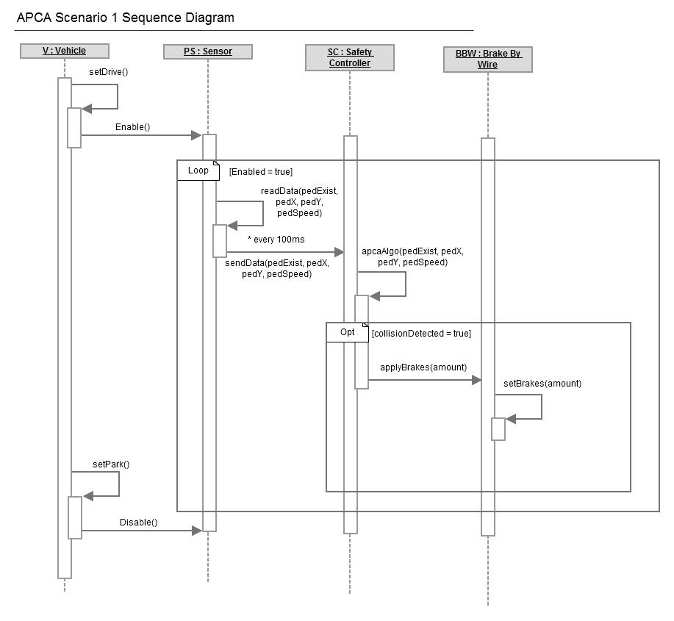
Scenario #1: Detecting a Collision

Slide 7
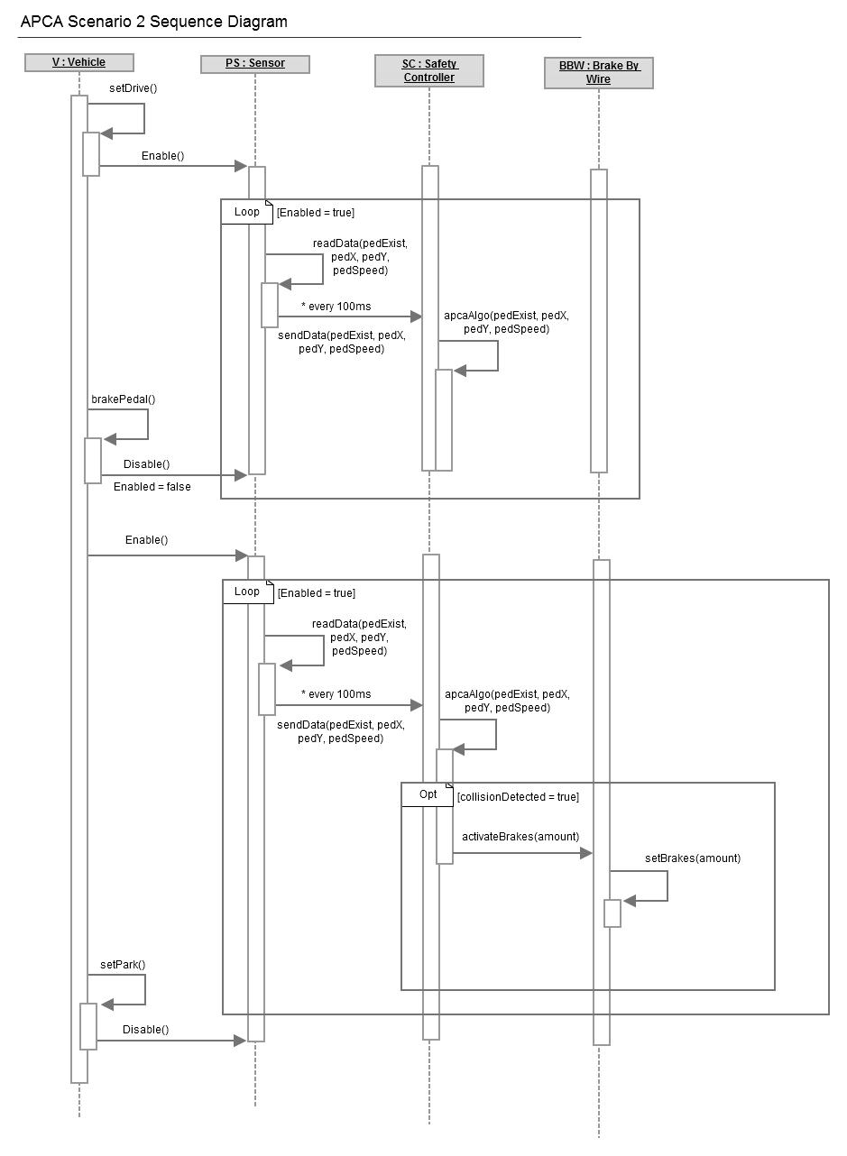
Scenario #2: Enabling/ Disabling

Slide 8
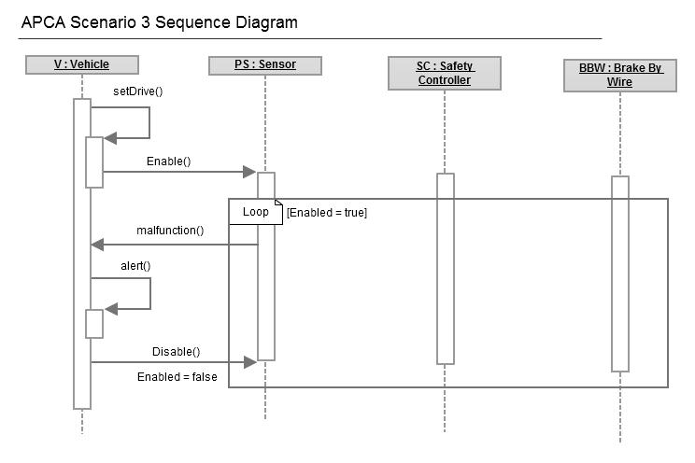
Scenario #3: System Malfunction

Slide 9
Part III: Demonstration

Slide 10
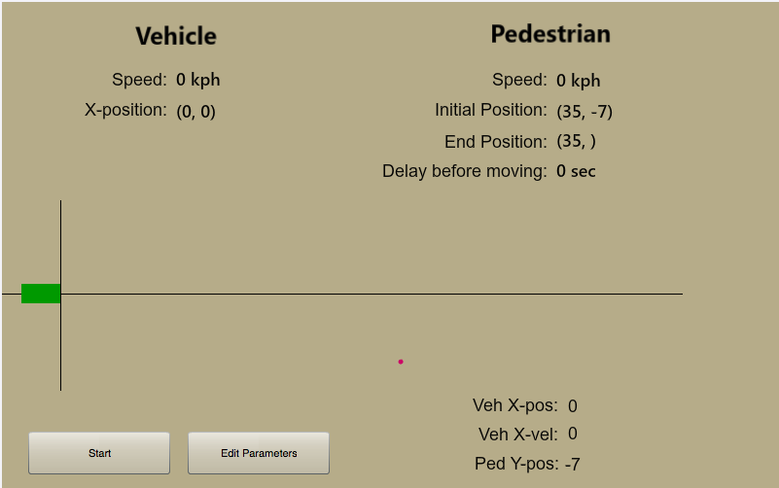
Prototype: Interface

Slide 11
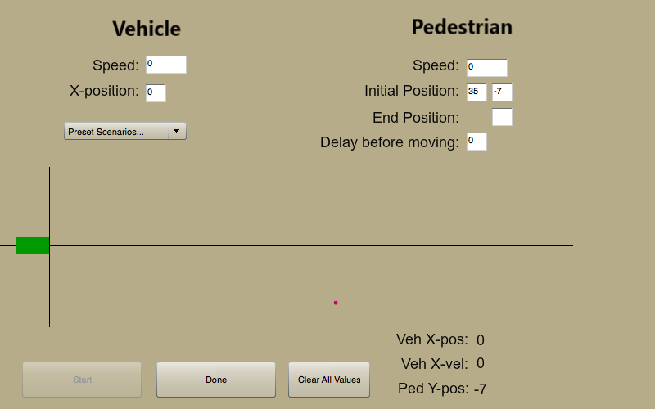
Prototype: Interface (cont.)

Slide 12
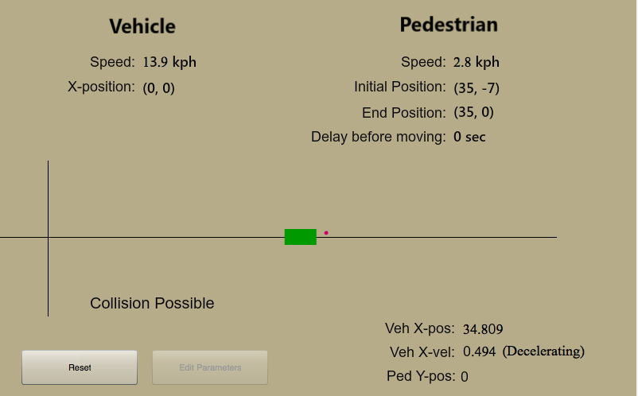
Prototype: Scenario #1

Slide 13
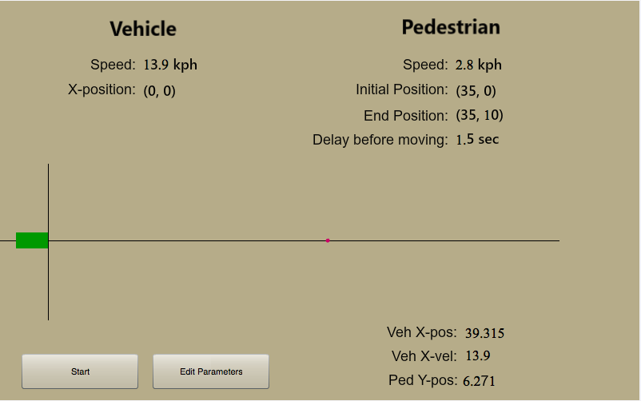
Prototype: Scenario #2

Slide 14
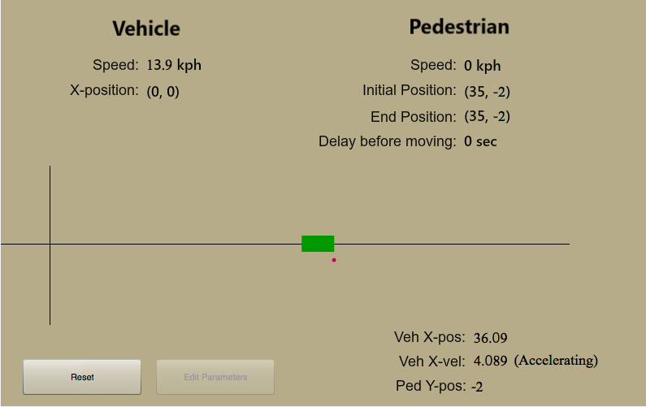
Prototype: Scenario #3

Slide 15
Acknowledgements
We gratefully acknowledge and appreciate the participation of our customer, Mr. David Agnew from Continental Automotive Systems, Inc.

