Slide 1


KINDORA
A Modern Web Project

Slide 2

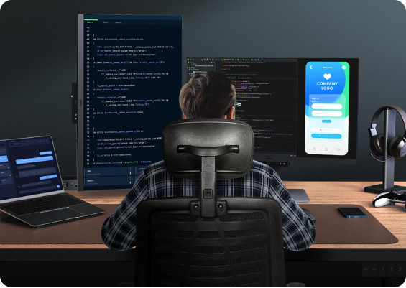
Introduction
Kindora is a student-created website project designed to explore the fundamentals of web design and development.
The goal was to build a platform that feels:
Modern & Professional
Smooth & Responsive
User-Friendly
Visually Clean

Slide 3








About Kindora
Student Project
Creativity Focus
A purely academic project to learn coding.
Emphasis on layout, colors, and flow.
Skill Practice
Clean Interface
Real-world practice for development skills.
Simple flow that is easy to navigate.

Slide 4


IMPORTANT NOTE
"Kindora is only a project website.
It is NOT a real business."
It is made strictly for learning and practice purposes.

Slide 5

Booking Features
Kindora simulates a travel booking platform to demonstrate form handling and logic:
Trip Booking Form (HTML input)
Data Processing (Simple PHP)
Booking Confirmation Page
Basic User Input Validation
Note: This is a concept demo. No actual tickets are booked.

Slide 6



Real World vs Project
Real World Website
Kindora
Real Business
Student Project
Actual Payments
No Payments involved
Live Ticket Booking
Demo/Simulation Only
Customer Service
HTML/CSS/PHP Learning

Slide 7












Website Sections
Homepage
Booking Form
About Page
Search Destination
Review
Contact

Slide 8
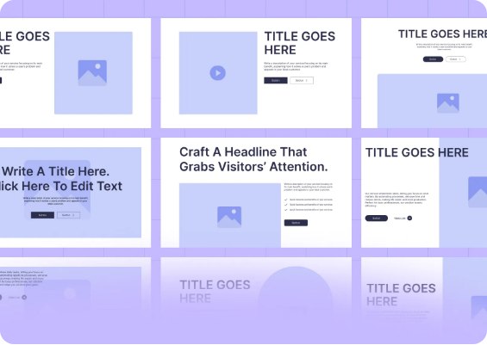
Homepage Overview
The homepage serves as the main entry point, featuring:
Logo & Nav Bar: Easy access to all pages.
Hero Banner: Large Video with intro text.
Feature Cards: Highlights of what we offer.
Call-to-Action Buttons: "Book Now" links.
Footer: Copyright and links.

Slide 9









Key Website Features
Responsive Design
Fast Loading
Smooth Scroll
Modern Icons
Clean Layout
Attractive Theme

Slide 10
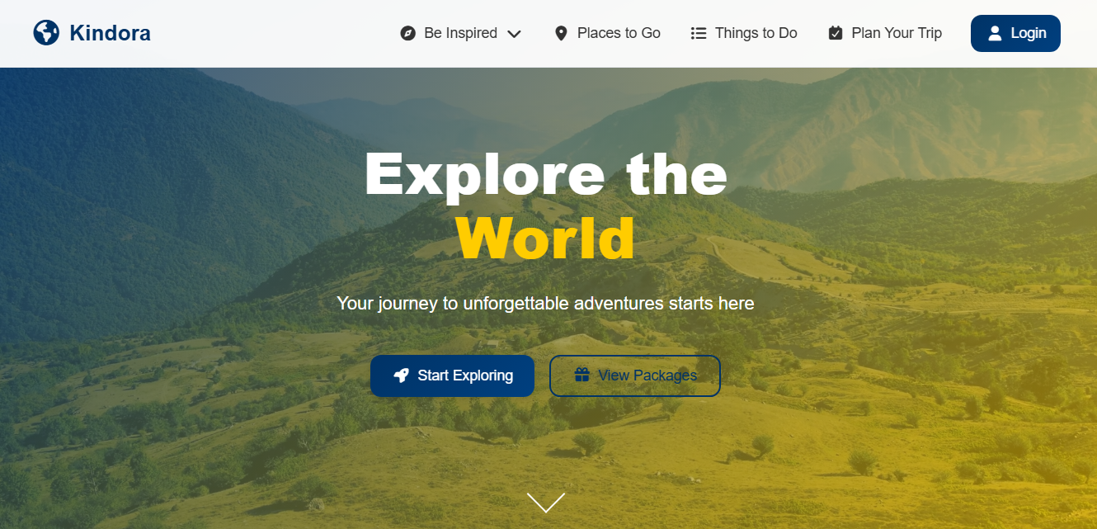
Design Philosophy
The look and feel of Kindora is based on minimal principles:
Clean & Minimal: No clutter, just content.
Balanced Spacing: Elements can breathe.
Soft Colors: Easy on the eyes (Pastels/Whites).
Rounded Shapes: Friendly and modern UI.
Neat Typography: Using Poppins for readability.

Slide 11










Technology Stack
HTML5
CSS3
JavaScript
Structure
Styling
Interactivity
PHP
Google Fonts
FontAwesome
Backend Logic
Poppins
Icons
*The project is built using simple and beginner-friendly code.*

Slide 12
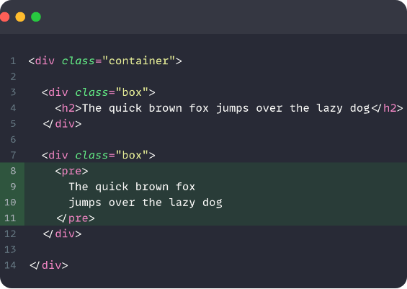
How the Real Booking System Works
The simulation follows a simple data flow:
User fills out the trip details form.
User clicks the "Book Now" button.
PHP validates and processes the data.
Booking is stored in the MySQL database.
System generates a confirmation page.
Admin panel shows the new booking.

Slide 13



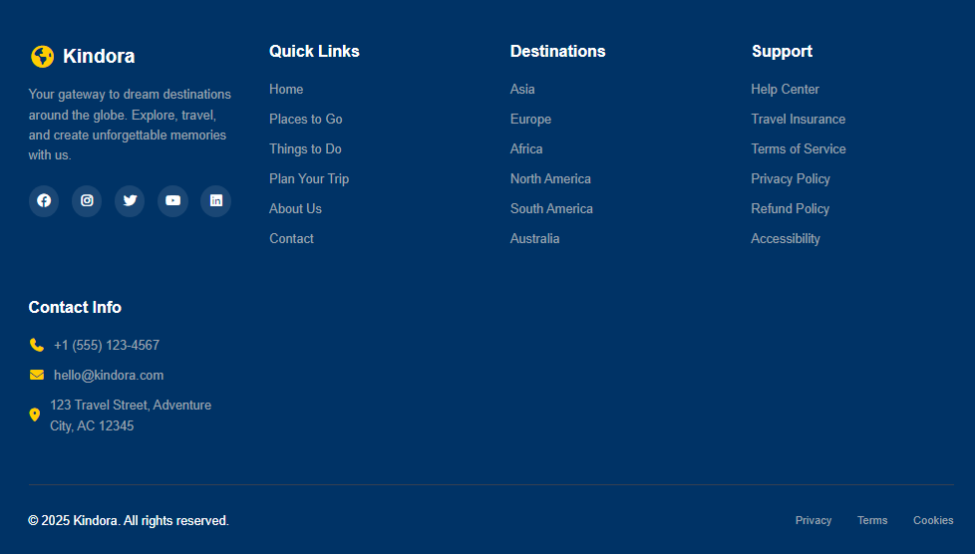
Project Screenshots
Confirmation Page

Slide 14
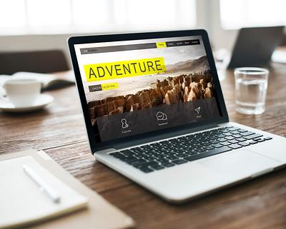
Future Improvements
To make Kindora a fully functional system, I plan to add:
AI Trip Recommendations: To suggest personalized travel plans.
Live Maps Integration: To preview routes and locations in real-time.
Multi-Language Support: To make the site usable globally.
Multi-Language Support: To make the site usable globally.

Slide 15

Thank You!
For Viewing Our Kindora Project

