Slide 1
Computer Architecture EE 520 / CS 622 Fall 2025
Course Outline Presentation
Shahid Masud

Slide 2
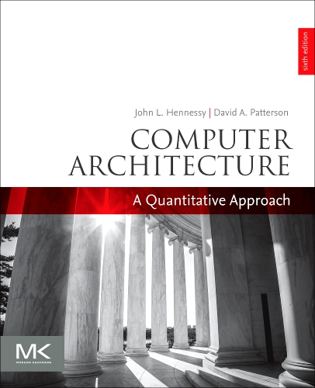
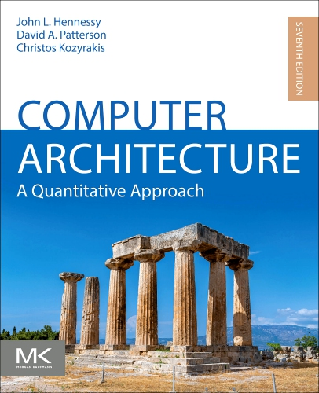


Text Book – Used worldwide
Computer Architecture A Quantitative Approach
Authors: Hennessy and Patterson
6th Edition - 2019
7th Edition – July 2025 – Just out

Slide 3
New Topics in Computer Architecture
Post Moore’s Law Computing
Exploiting Parallelism
Instruction Level
Data Level
Vector / GPU
Thread Level
Multiprocessor and Coherence
Computer Quantitative
Performance Analysis
1st Aspect of
Computing
Memory Hierarchy Design and Performance
Different Flavour
Warehouse Computing
Clusters
Domain Specific Architectures, Eg. AWS Accelerators
2nd Aspect of
Computing

Slide 4
Focus Areas of Computer Architecture
Exploiting Parallelism
Instruction Level
Data Level
Vector / GPU
Thread Level
Multiprocessor and Coherence
1st Aspect of
Computing
Computer Quantitative
Performance Analysis
Memory Hierarchy Design and Performance
Different Flavour
Warehouse Computing
Clusters
Domain Specific Architectures, Eg. AWS Accelerators
2nd Aspect of
Computing

Slide 5
Focus Areas of Computer Architecture
Exploiting Parallelism
Instruction Level
Data Level
Vector / GPU
Thread Level
Multiprocessor and Coherence
Pre Midterm
1st Aspect of
Computing
Computer Quantitative
Performance Analysis
Memory Hierarchy Design and Performance
Post Midterm
Different Flavour
Warehouse Computing
Clusters
Domain Specific Architectures, Eg. AWS Accelerators
2nd Aspect of
Computing

Slide 6
Course Description
This course extends the concepts of computer organization and microprocessor architecture to more advanced topics.
Hence a strong background in undergraduate level computer design is mandatory to take this course. The students are assumed to have taken EE/CS-320, EE-324, CS-225 or similar courses in their undergraduate studies.
The topics taught in this course include advanced pipelining, Instruction Level Parallelism (ILP), dynamic scheduling, thread level parallelism (TLP), multi-processors, memory systems, storages, and I/O devices.
The course provides the students with current trends and future insight into modern computer architecture design.
Course will help in the areas of Computer Systems, Computer Hardware, Compilers, OS, Embedded Systems, Chip Design, etc.

Slide 7
Course Learning Outcomes (CLO)
Sr. | Description | Mapped to PLO
CLO 1 | Describe the performance evaluation criteria of computers and compare performance of different computing systems | PLO 1 / Cog-2
CLO 2 | Describe advanced concepts for performance improvement in computer architecture like multi-cycle pipeline, dynamic scheduling, dynamic branch prediction, loop unrolling, multi-issue, multi-threading, multi-cores, etc. and analyze their impact on a given machine. | PLO 1 / Cog-2
CLO 3 | Appreciate existing bottlenecks in computer architecture designs (e.g., control and data hazards, exceptions, limited ILP, etc.) and suggest potential solutions. | PLO 2 / Cog-4
CLO 4 | Describe the concepts of memory hierarchy, caches and virtual memory, and analyze their optimizations and contribution toward performance improvement of a computing machine. | PLO 2 / Cog 5

Slide 8
Course Enrolment and Delivery
Core Course for MS DES
Recommended Elective for MS EE, MS CS
Recommended Elective for BS EE, BS CS
2 x Weekly Lectures of 75 minutes each

Slide 9
Course Assessment
Class quizzes: (5 – 6 quizzes, one dropped): 20%
Assignments: (1 - 2): 10%
Midterm exam (75 minutes): 30%
Final exam (Comprehensive, 120 minutes): 40%

Slide 10
Chapterwise Contents and Arrangement
Chapter 1: Quantitative Design and Analysis
Performance Parameters and Effects
Chapter 2: Memory Hierarchy
Caches and Virtual Memory
Chapter 3: Instruction Level Parallelism
Branch Prediction, Dynamic Scheduling, Multi-Issue
Chapter 4: Data Level Parallelism
Vector processing, SIMD, GPU
Chapter 5: Thread Level Parallelism
Multiprocessor, Synchronization and Coherence
Chapter 6: Warehouse Scale Computing
Chapter 7: Domain Specific Architectures
Week 01 - 02
Week 10 - 11
Week 03- 04
Week 05- 06
Week 07 - 09
Week 12 - 13
Week 14

Slide 11
Contents of Textbook Chapters 1 – 2
Chapter 1 Fundamentals of Quantitative Design and Analysis
Chapter 2 Memory Hierarchy Design
1.1 Introduction 2
1.2 Classes of Computers 6
1.3 Defining Computer Architecture 11
1.4 Trends in Technology 18
1.5 Trends in Power and Energy in Integrated Circuits 23
1.6 Trends in Cost 29
1.7 Dependability 36
1.8 Measuring, Reporting, and Summarizing Performance 39
1.9 Quantitative Principles of Computer Design 48
1.10 Putting It All Together: Performance, Price, and Power 55 1.11 Fallacies and Pitfalls 58
1.12 Concluding Remarks 64
1.13 Historical Perspectives and References 67 Case Studies and Exercises by Diana Franklin 67
2.1 Introduction 78
2.2 Memory Technology and Optimizations 84
2.3 Ten Advanced Optimizations of Cache Performance 94
2.4 Virtual Memory and Virtual Machines 118
2.5 Cross-Cutting Issues: The Design of Memory Hierarchies 126 2.6 Putting It All Together: Memory Hierarchies in the ARM Cortex-A53 and Intel Core i7 6700 129
2.7 Fallacies and Pitfalls 142
2.8 Concluding Remarks: Looking Ahead 146
2.9 Historical Perspectives and References 148

Slide 12
Contents of Textbook Chapters 3 – 4
Chapter 3 Instruction-Level Parallelism and Its Exploitation
Chapter 4 Data-Level Parallelism in Vector, SIMD, and GPU Architectures
3.1 Instruction-Level Parallelism: Concepts and Challenges 168
3.2 Basic Compiler Techniques for Exposing ILP 176
3.3 Reducing Branch Costs With Advanced Branch Prediction 182
3.4 Overcoming Data Hazards With Dynamic Scheduling 191
3.5 Dynamic Scheduling: Examples and the Algorithm 201
3.6 Hardware-Based Speculation 208
3.7 Exploiting ILP Using Multiple Issue and Static Scheduling 218
3.8 Exploiting ILP Using Dynamic Scheduling, Multiple Issue, and
Speculation 222
3.9 Advanced Techniques for Instruction Delivery and Speculation 228
3.10 Cross-Cutting Issues 240
3.11 Multithreading: Exploiting Thread-Level Parallelism to Improve
Uniprocessor Throughput 242
3.12 Putting It All Together: The Intel Core i7 6700 and ARM Cortex-A53 247
3.13 Fallacies and Pitfalls 258
3.14 Concluding Remarks: What’s Ahead? 264
3.15 Historical Perspective and References 266
Case Studies and Exercises by Jason D. Bakos and Robert P. Colwell 266
4.1 Introduction 282
4.2 Vector Architecture 283
4.3 SIMD Instruction Set Extensions for Multimedia 304
4.4 Graphics Processing Units 310
4.5 Detecting and Enhancing Loop-Level Parallelism 336
4.6 Cross-Cutting Issues 345
4.7 Putting It All Together: Embedded Versus Server GPUs and
Tesla Versus Core i7 346
4.8 Fallacies and Pitfalls 353
4.9 Concluding Remarks 357
4.10 Historical Perspective and References 357
Case Study and Exercises by Jason D. Bakos 357

Slide 13
Contents of Textbook Chapters 5 – 6
Chapter 5 Thread-Level Parallelism
Chapter 6 Warehouse-Scale Computers to Exploit Request-Level and Data-Level Parallelism
5.1 Introduction 368
5.2 Centralized Shared-Memory Architectures 377
5.3 Performance of Symmetric Shared-Memory Multiprocessors 393
5.4 Distributed Shared-Memory and Directory-Based Coherence 404
5.5 Synchronization: The Basics 412
5.6 Models of Memory Consistency: An Introduction 417
5.7 Cross-Cutting Issues 422
5.8 Putting It All Together: Multicore Processors and Their Performance 426
5.9 Fallacies and Pitfalls 438
5.10 The Future of Multicore Scaling 442
5.11 Concluding Remarks 444
5.12 Historical Perspectives and References 445
Case Studies and Exercises by Amr Zaky and David A. Wood 446
6.1 Introduction 466
6.2 Programming Models and Workloads for Warehouse-Scale
Computers 471
6.3 Computer Architecture of Warehouse-Scale Computers 477
6.4 The Efficiency and Cost of Warehouse-Scale Computers 482
6.5 Cloud Computing: The Return of Utility Computing 490
6.6 Cross-Cutting Issues 501
6.7 Putting It All Together: A Google Warehouse-Scale Computer 503
6.8 Fallacies and Pitfalls 514
6.9 Concluding Remarks 518
6.10 Historical Perspectives and References 519
Case Studies and Exercises by Parthasarathy Ranganathan 519

Slide 14
Contents of Textbook Chapters 7, Appendices
Chapter 7 Domain-Specific Architectures
Appendices (useful stuff from old editions)
7.1 Introduction 540
7.2 Guidelines for DSAs 543
7.3 Example Domain: Deep Neural Networks 544
7.4 Google’s Tensor Processing Unit, an Inference Data
Center Accelerator 557
7.5 Microsoft Catapult, a Flexible Data Center Accelerator 567
7.6 Intel Crest, a Data Center Accelerator for Training 579
7.7 Pixel Visual Core, a Personal Mobile Device Image Processing Unit 579
7.8 Cross-Cutting Issues 592
7.9 Putting It All Together: CPUs Versus GPUs Versus DNN Accelerators 595
7.10 Fallacies and Pitfalls 602
7.11 Concluding Remarks 604
7.12 Historical Perspectives and References 606
Case Studies and Exercises by Cliff Young 606
Instruction Set Principles
Review of Memory Hierarchy
Pipelining
Storage Systems
Embedded Systems
Interconnection Networks
Vector Processors
Hardware and Software for VLIW and EPIC
Large Scale Multiproc for Scientific Applications
Computer Arithmetic
Survey of Instruction Set Architecture
Advanced Concepts on Address Translation

Slide 15
Thank you
Questions?

