Slide 1
VLIW Example 1

Slide 2
VLIW Example 1
CS6810 -- Lecture 17. Lectures on Compiler-Based ILP.
https://www.youtube.com/watch?v=Q45iEIq3V3w&list=PL8EC1756A7B1764F6&index=17

Slide 3
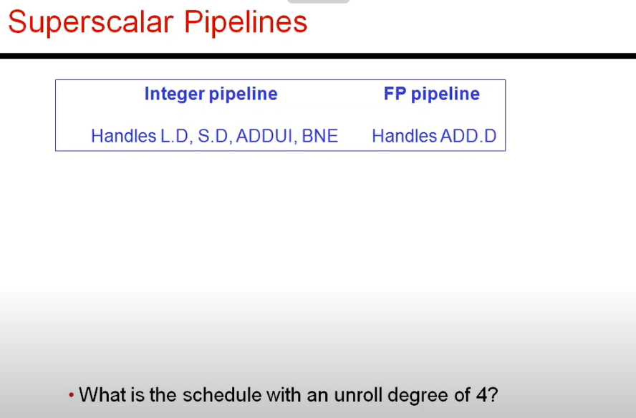
Two pipelines are available

Slide 4
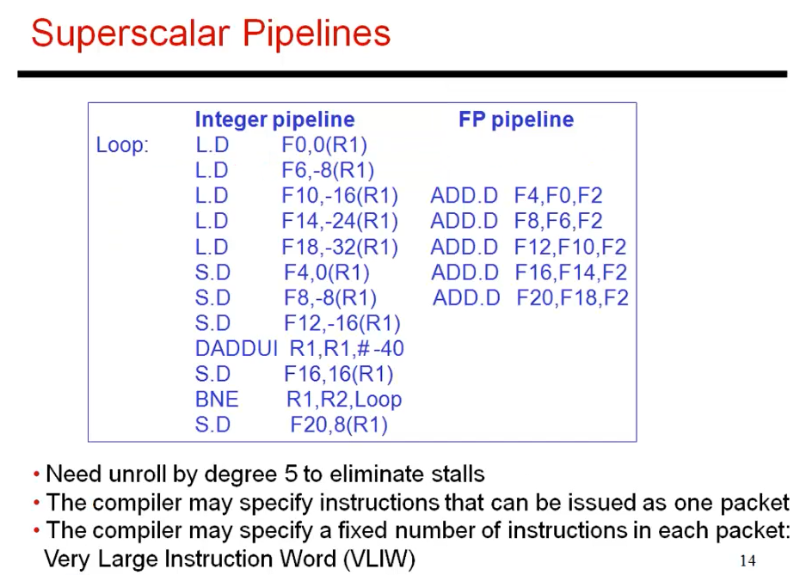
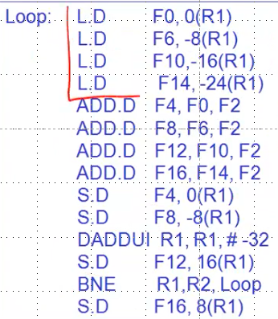
5 unrolled loop example
Similar to starting code.
Difference is 5 unrolled loops.
Below is 4 unrolled loop.

Slide 5
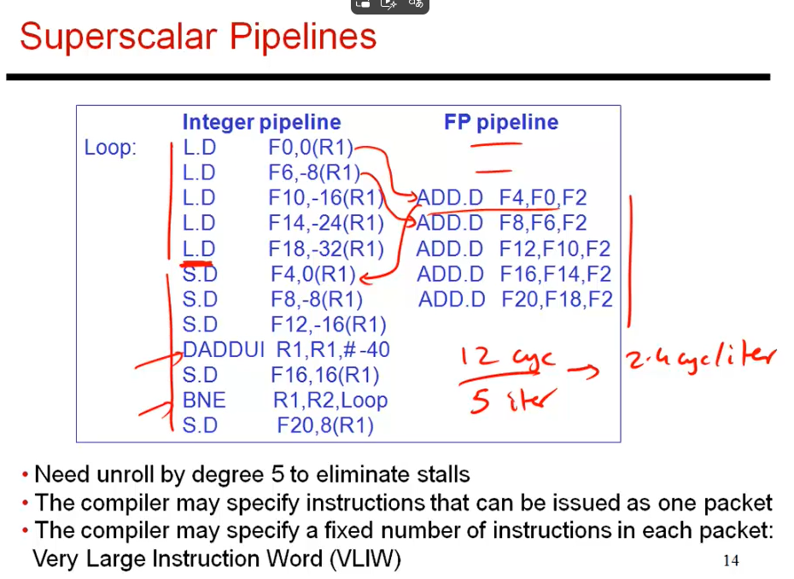

Slide 6
