Slide 1
VLIW Example 2
Without Speculation
With Speculation

Slide 2
VLIW Example 2
VLIW Without Speculation
VLIW With Speculation

Slide 3
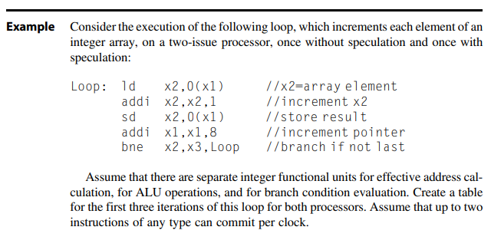

Slide 4
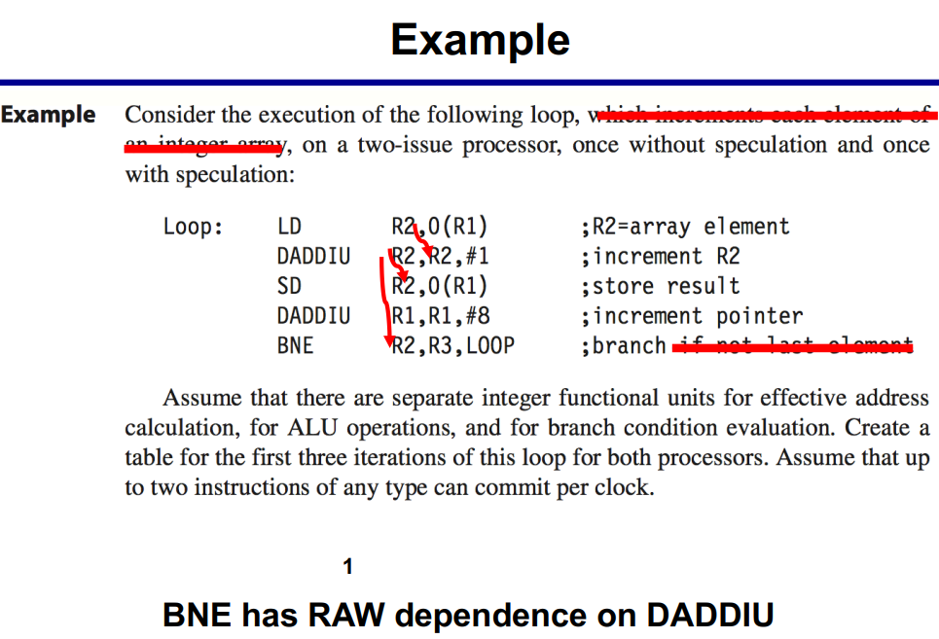

Starting code

Slide 5
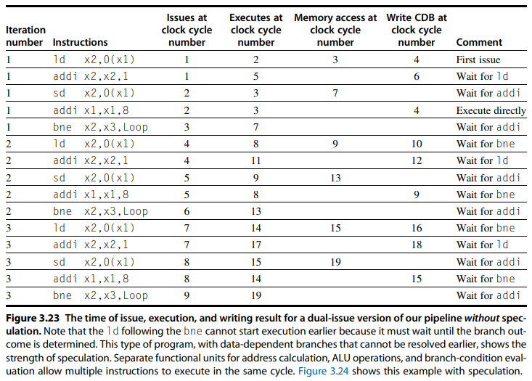
Without Speculation
First
Three
Iterations

Slide 6
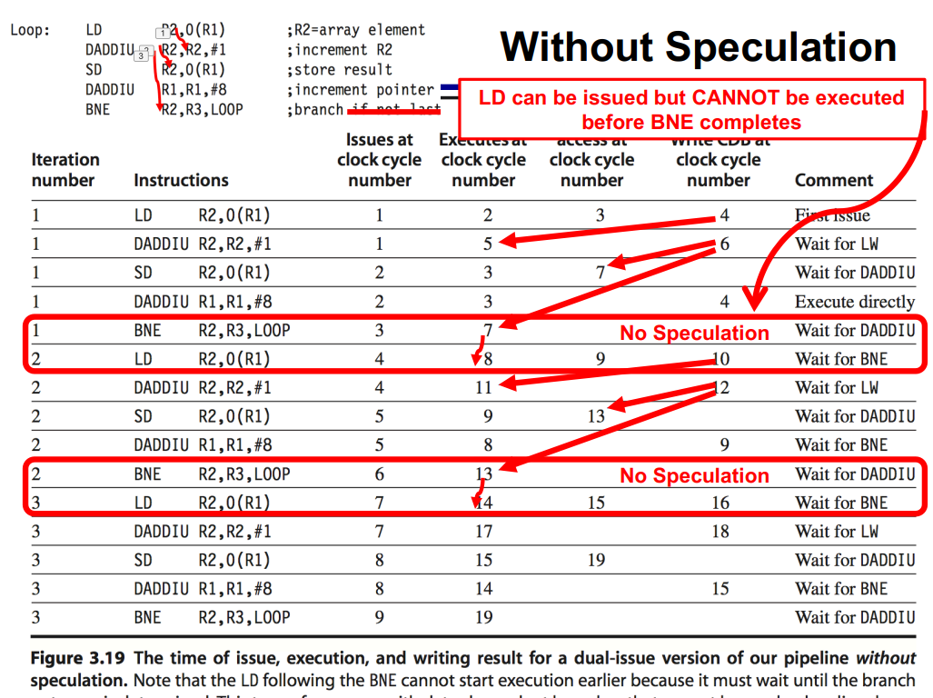

Slide 7
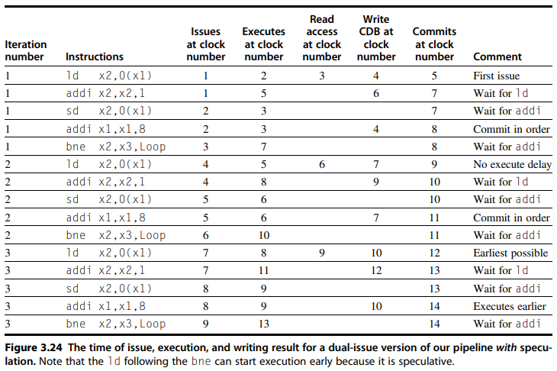
With Speculation
First
Three
Iterations

Slide 8
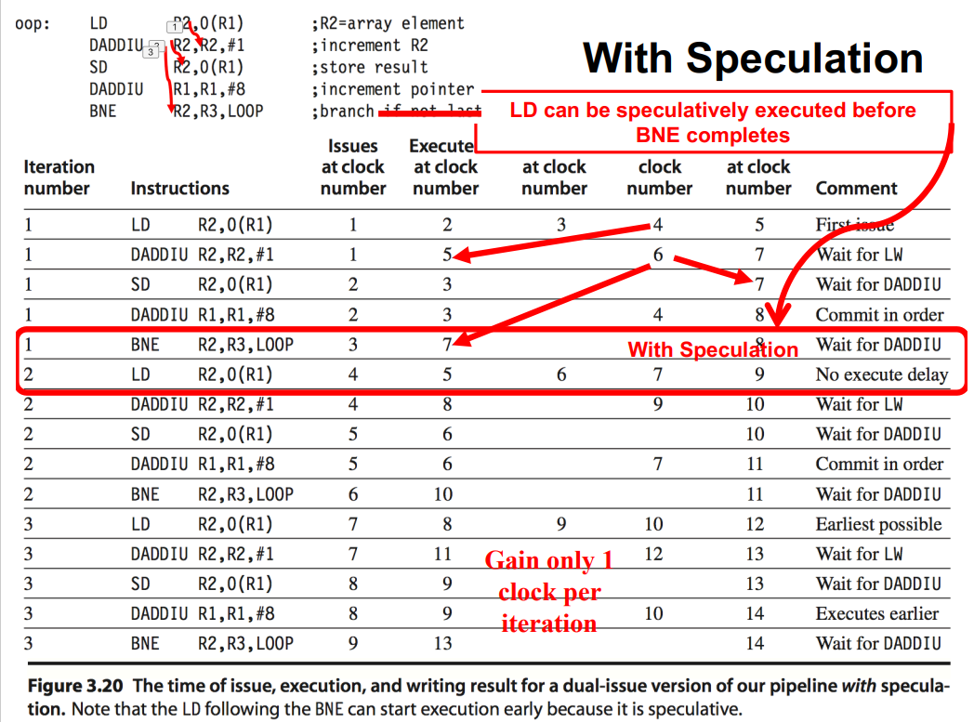

Slide 9

