Slide 1
Computer Architecture
CS 622 / EE 520
Spring 2026
Lecture 18
Shahid Masud

Slide 2
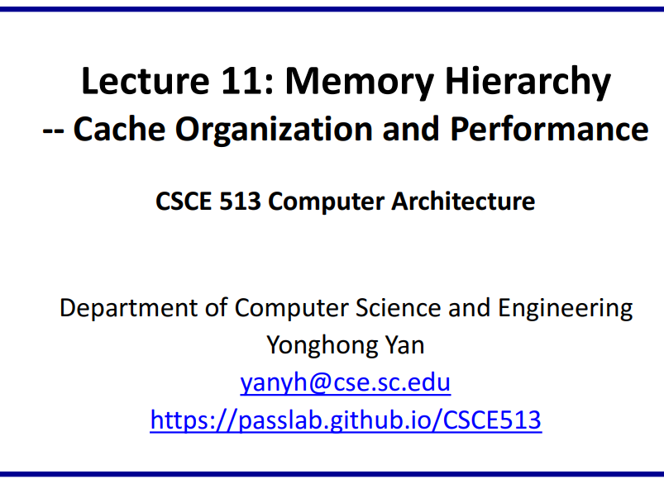
Further Readings
Reading Notes
Readings:
Appendix B of course textbook
Slide credits
Slides adapted from:
https://www.cs.nthu.edu.tw/~king/courses/cs5100/2014/N04-Cache-1.pdf

Slide 3
Topics
Caches
  Read/Write Mechanism
  Organization
  Replacement
  Performance
  Solved Questions

Slide 4
Cache Organization, Design and Access

Slide 5
Memory Hierarchy Design 1
Entire addressable memory space available in largest, slowest memory
Incrementally smaller and faster memories, each containing a subset of the memory below it, proceed in steps up toward the processor
eDRAM or
Emerging memory
DRAM
SRAM
Main
Memory
DISK
L4
Cache
Reg
File
L1
Cache
L3
Cache
L2
Cache

Slide 6
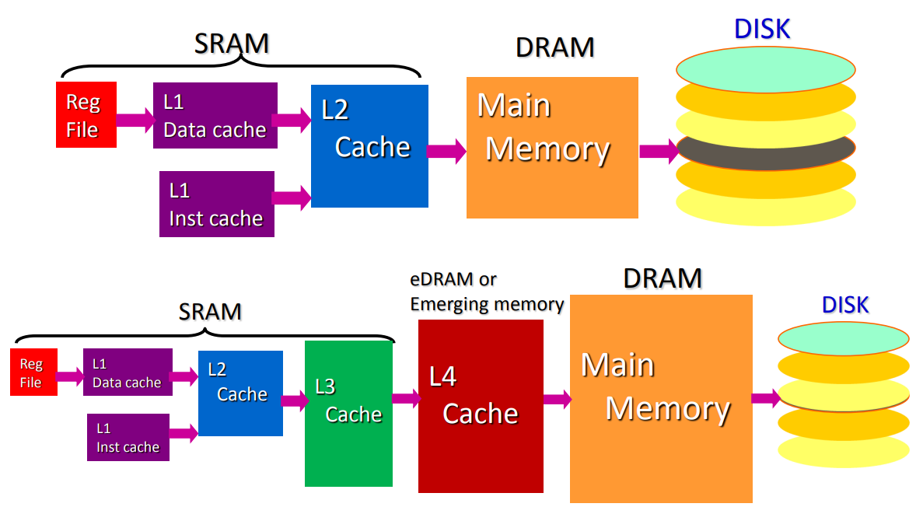
Another possible Memory Hierarchy
Separate Caches
Separate Caches

Slide 7
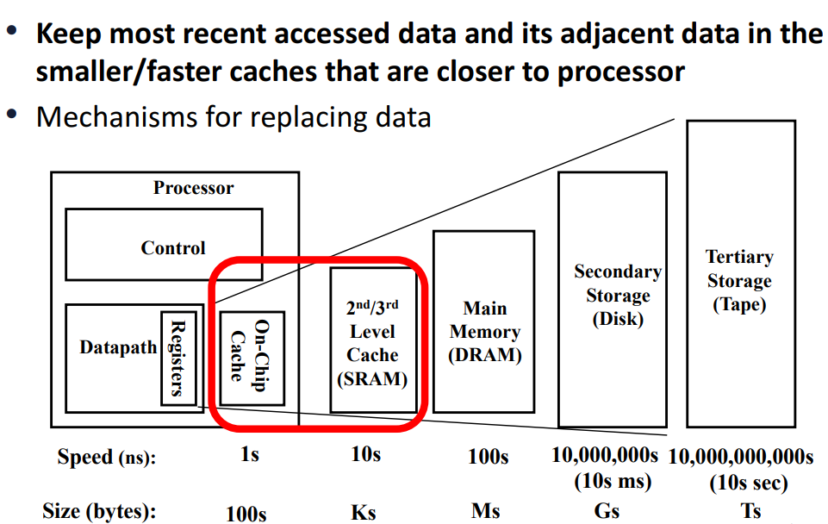
Memory Hierarchy Put to Use

Slide 8
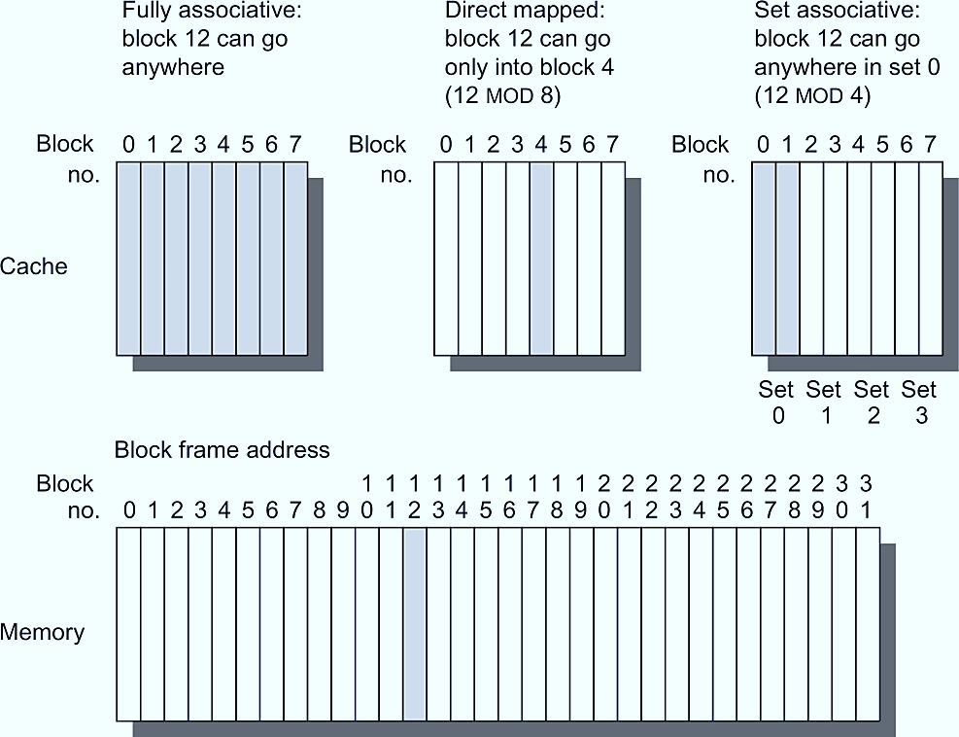
Cache and Memory Relation
Lines of cache
Figure B.2 This example cache has eight block frames and memory has 32 blocks. The three options for caches are shown left to right. In fully associative, block 12 from the lower level can go into any of the eight block frames of the cache. With direct mapped, block 12 can only be placed into block frame 4 (12 modulo 8). Set associative, which has some of both features, allows the block to be placed anywhere in set 0 (12 modulo 4). With two blocks per set, this means block 12 can be placed either in block 0 or in block 1 of the cache. Real caches contain thousands of block frames, and real memories contain millions of blocks. The set associative organization has four sets with two blocks per set, called two-way set associative. Assume that there is nothing in the cache and that the block address in question identifies lower-level block 12.

Slide 9
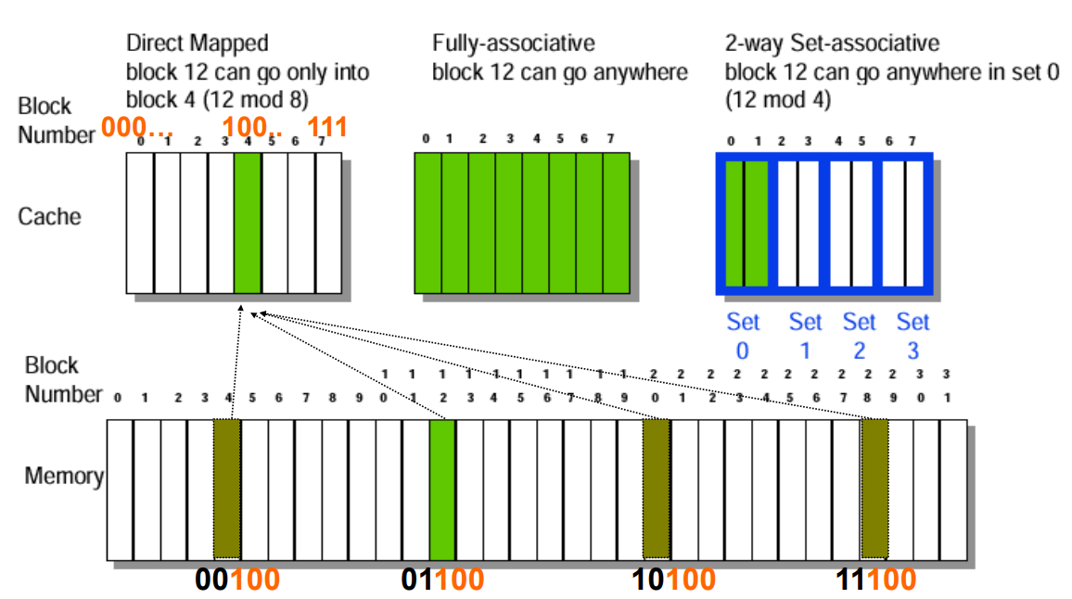
Cache Organization

Slide 10
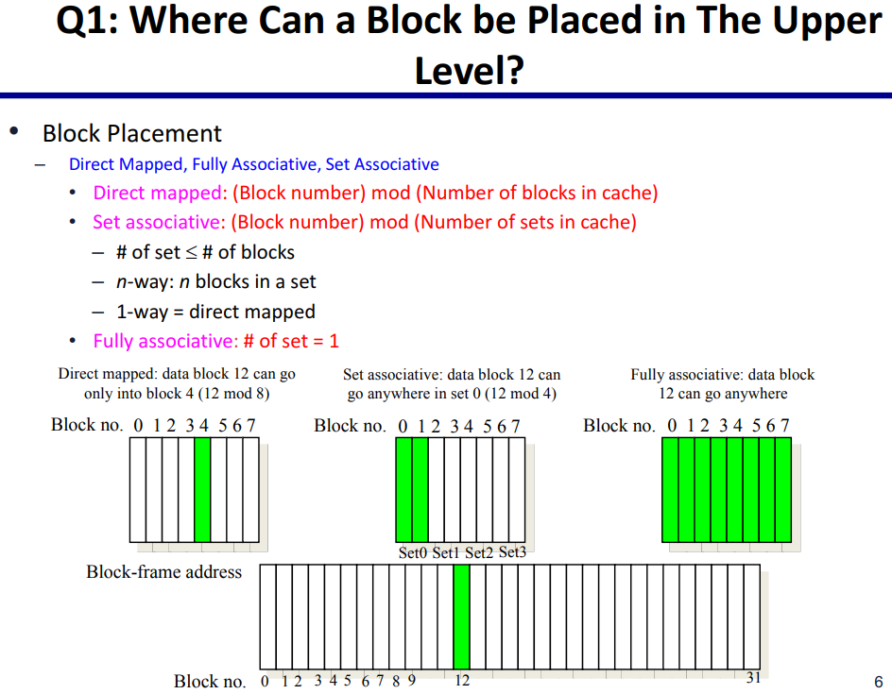
Where to place a Block (Line) of Data in Cache?

Slide 11
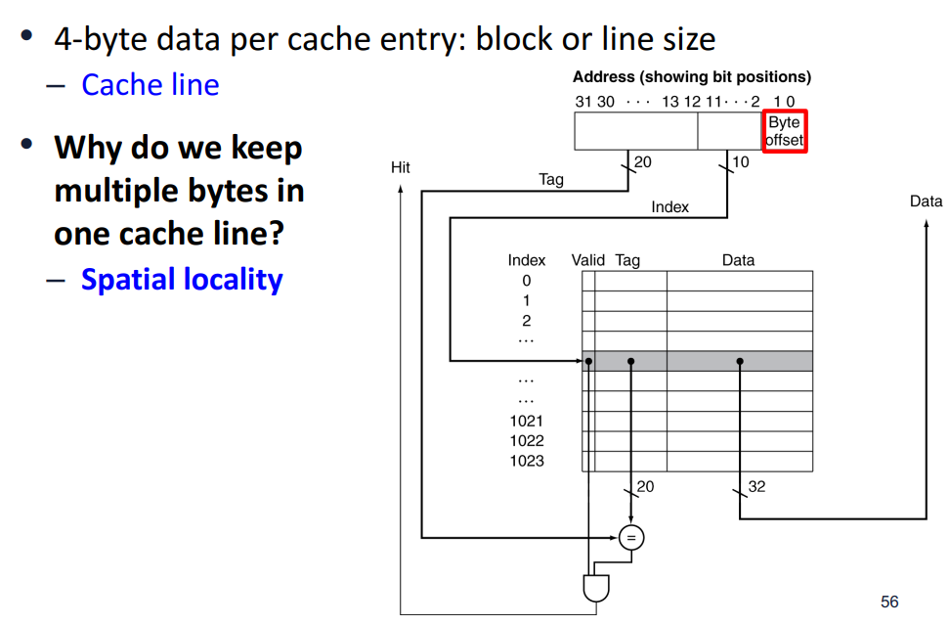
Cache Address Fields

Slide 12
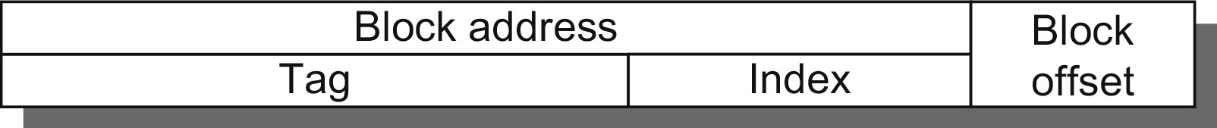
Parts of Cache Address
Figure B.3 The three portions of an address in a set associative or direct-mapped cache. The tag is used to check all the blocks in the set, and the index is used to select the set. The block offset is the address of the desired data within the block. Fully associative caches have no index field.

Slide 13
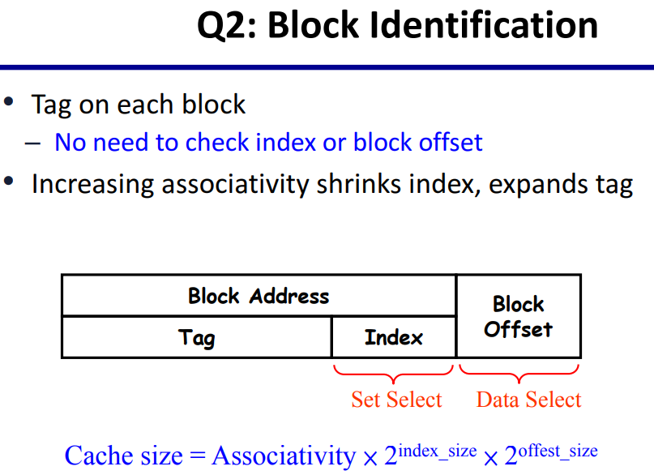

Identifying Data Location in a Cache
Cache Block
Cache Line

Slide 14
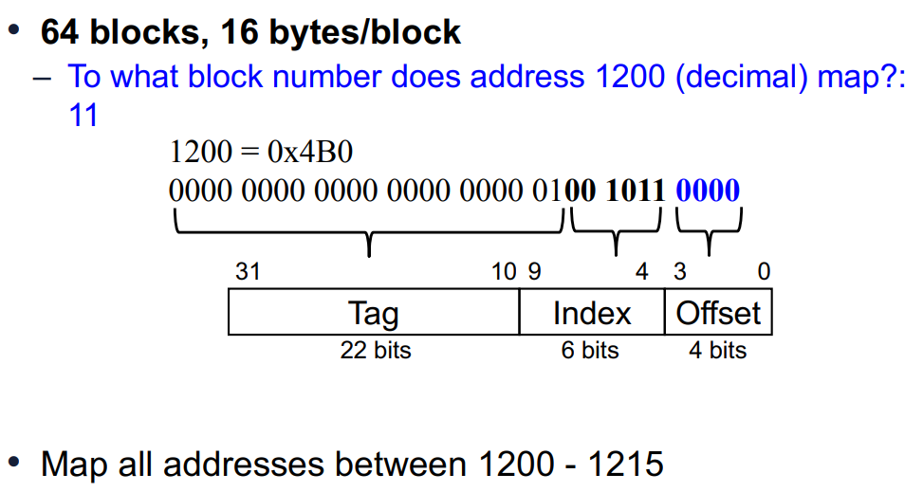
Example: Larger Block Size

Slide 15
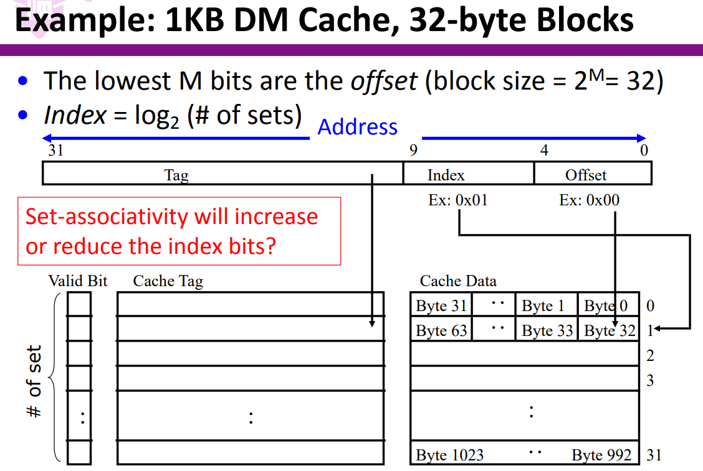

Example of Direct Mapped DM Cache
Block of Cache
Line of Cache

Slide 16
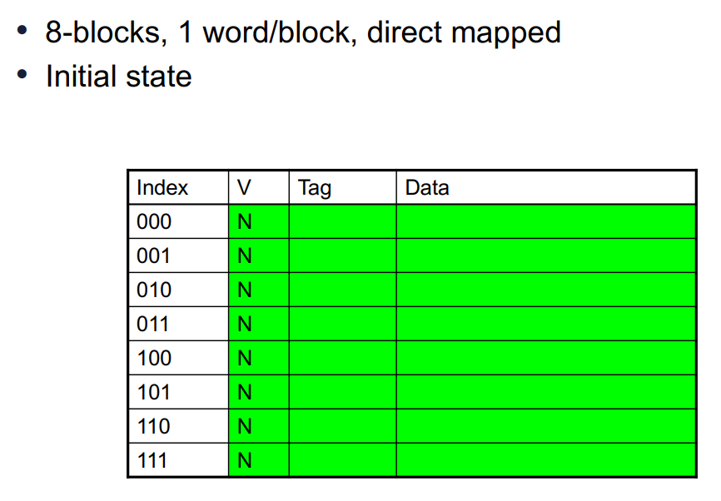
Cache Example

Slide 17
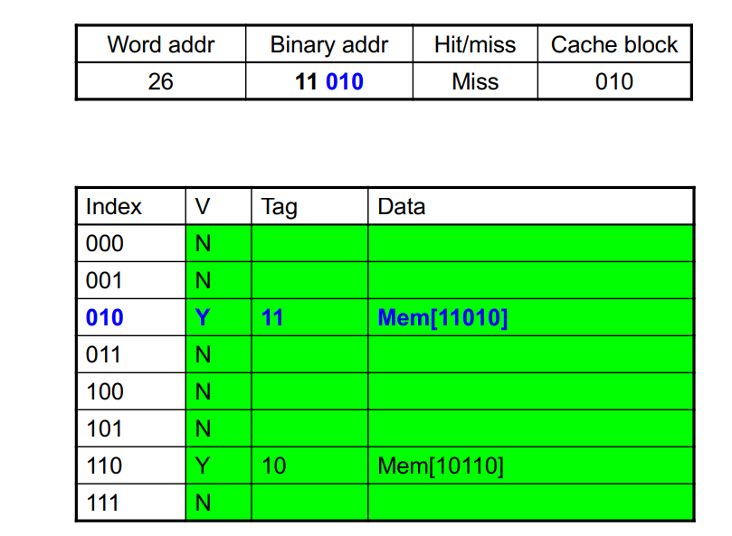
Cache Example 1

Slide 18
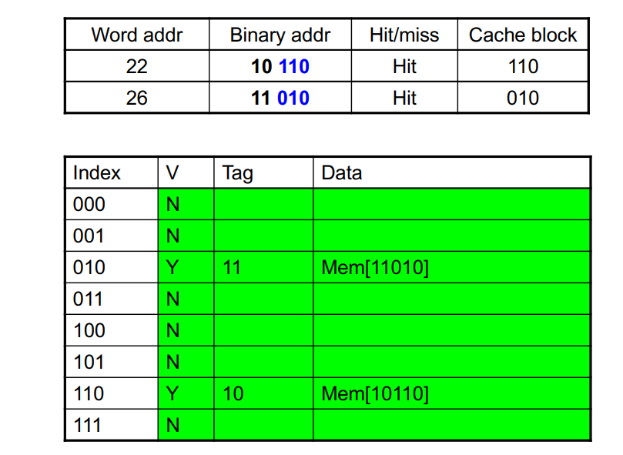
Cache Example 1

Slide 19
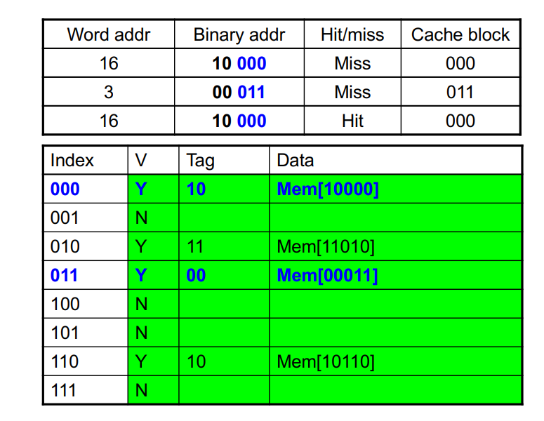
Cache Example 2

Slide 20
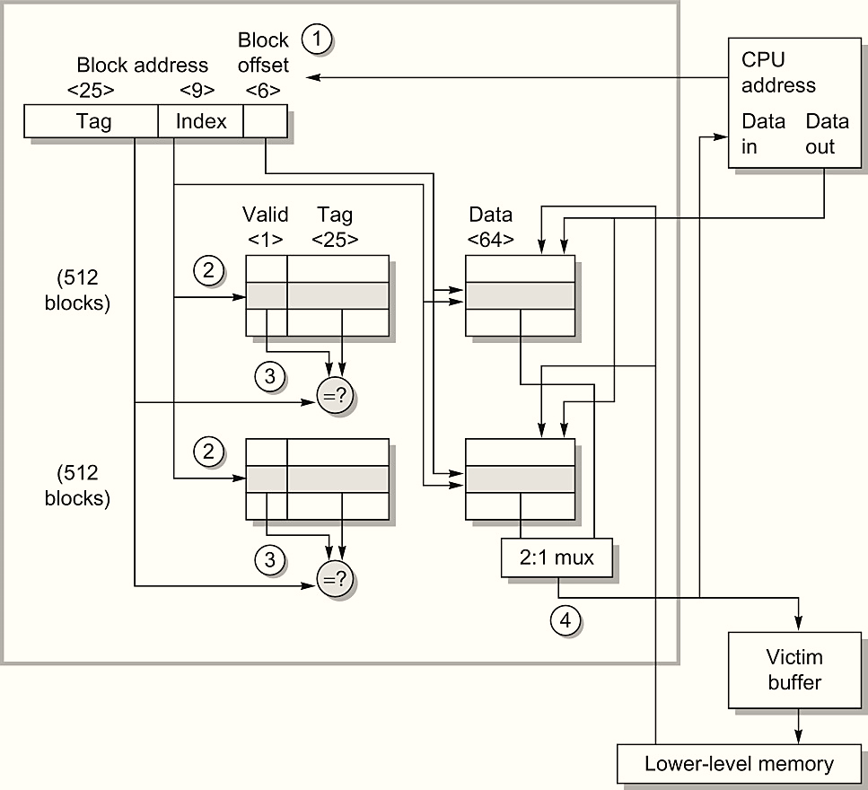
Organization of Cache in Opteron Processor
Figure B.5 The organization of the data cache in the Opteron microprocessor. The 64 KiB cache is two-way set associative with 64-byte blocks. The 9-bit index selects among 512 sets. The four steps of a read hit, shown as circled numbers in order of occurrence, label this organization. Three bits of the block offset join the index to supply the RAM address to select the proper 8 bytes. Thus, the cache holds two groups of 4096 64-bit words, with each group containing half of the 512 sets.

Slide 21
Example of Direct Mapped DM Cache
Block of Cache
Line of Cache

Slide 22
Comparison of Cache Architecture
Comparisons in terms of space and time:
Can access to tag and data arrays be done in parallel?
How many comparators and multiplexers are needed?
  How about wiring in IC layout?
How many bits of storage are needed in tag and data arrays?
  The index bits need not be stored!
What is the write overhead?

Slide 23
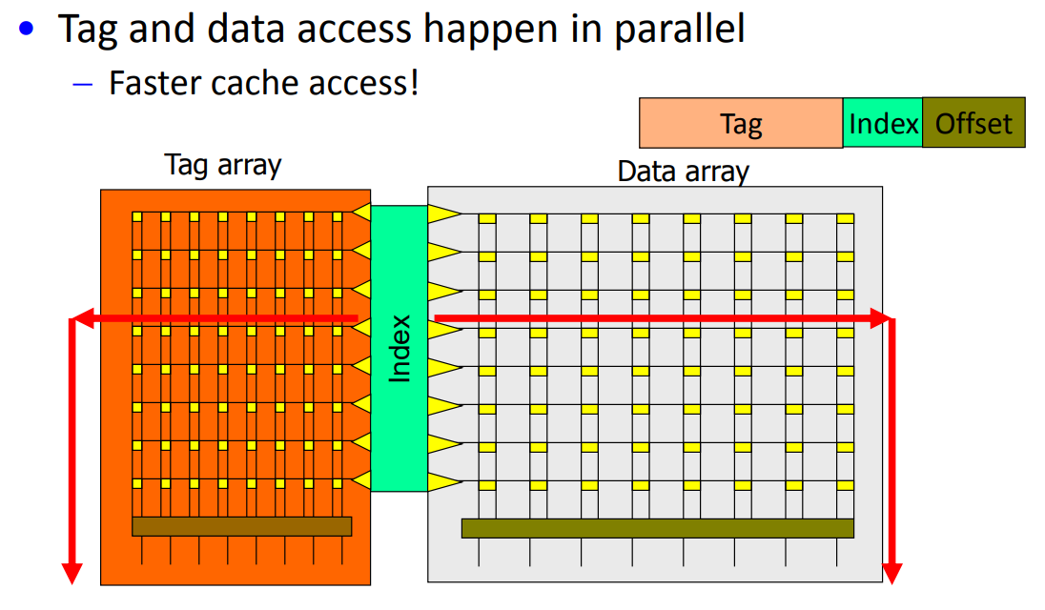
Fast – Direct Mapped Cache

Slide 24
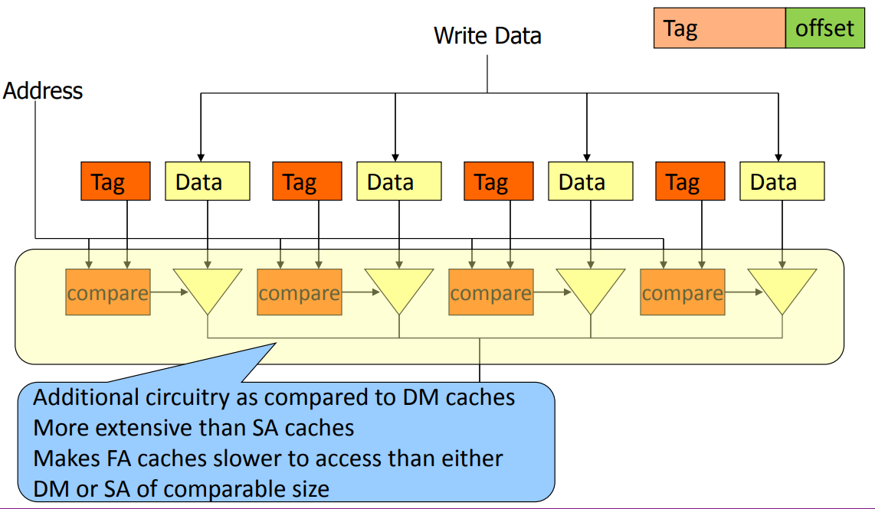
Overhead of Fully Associative Cache – 1

Slide 25
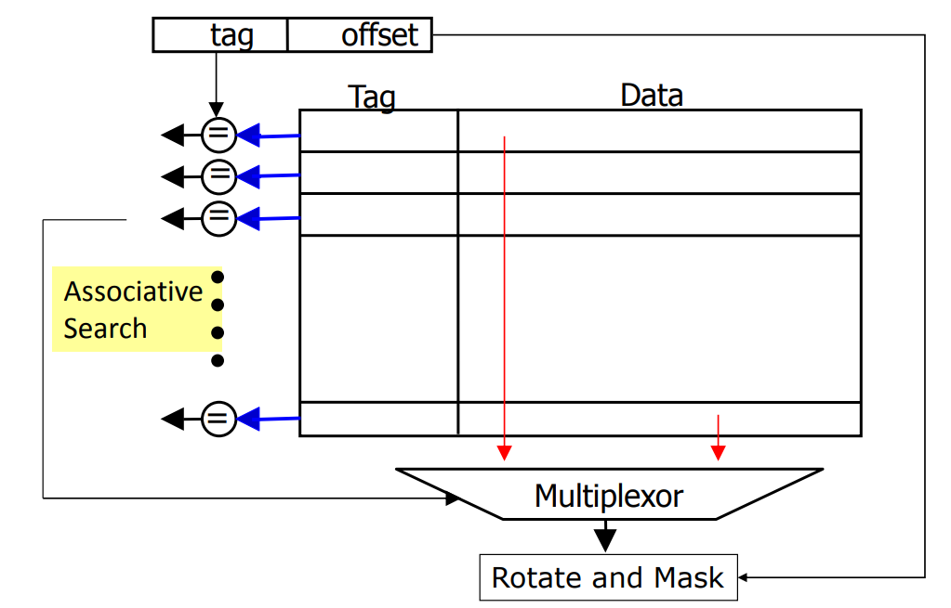
Overhead of Full Associative Cache – 2

Slide 26
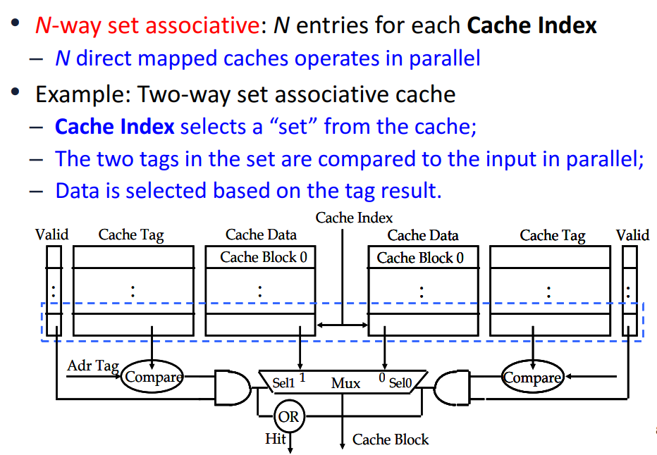
Architecture of Set Associative Cache - 1

Slide 27
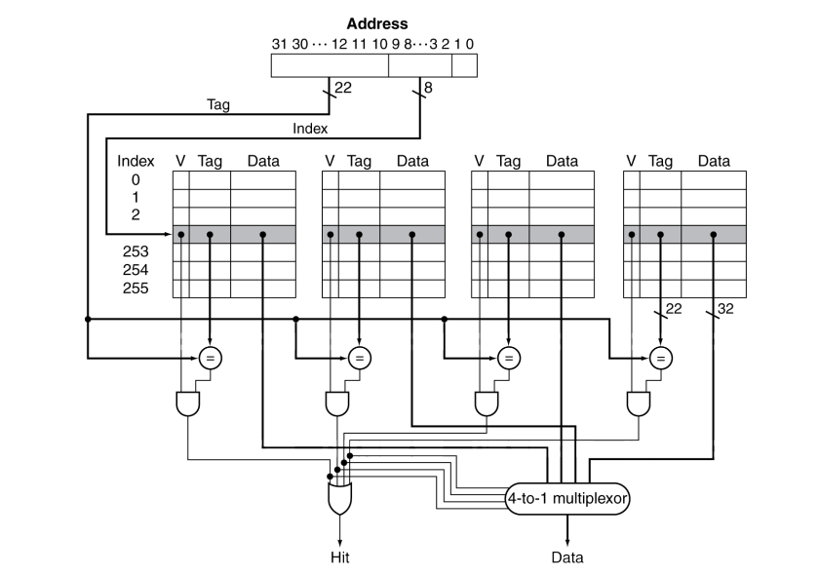
Architecture of Set Associative Cache - 2

Slide 28
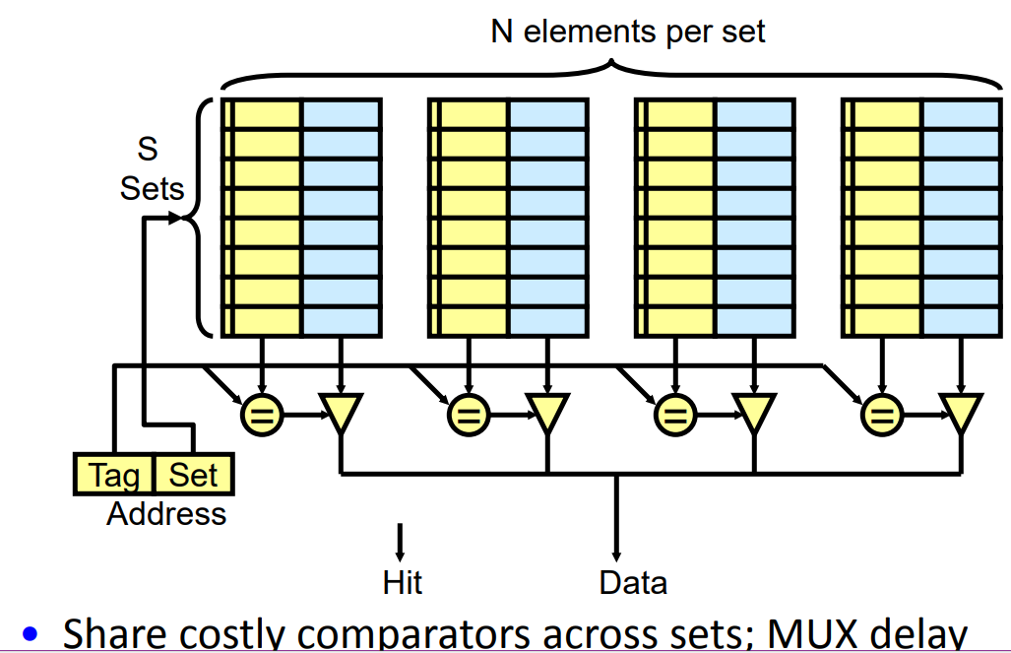
Set Associative Cache

Slide 29
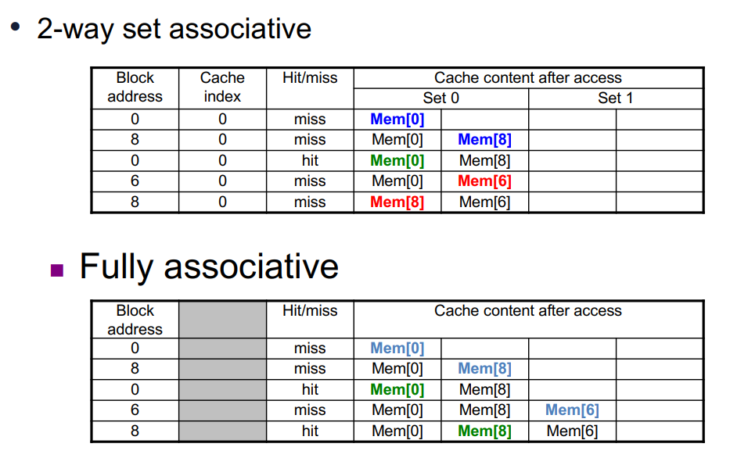
Examples of Associativity in Cache

Slide 30
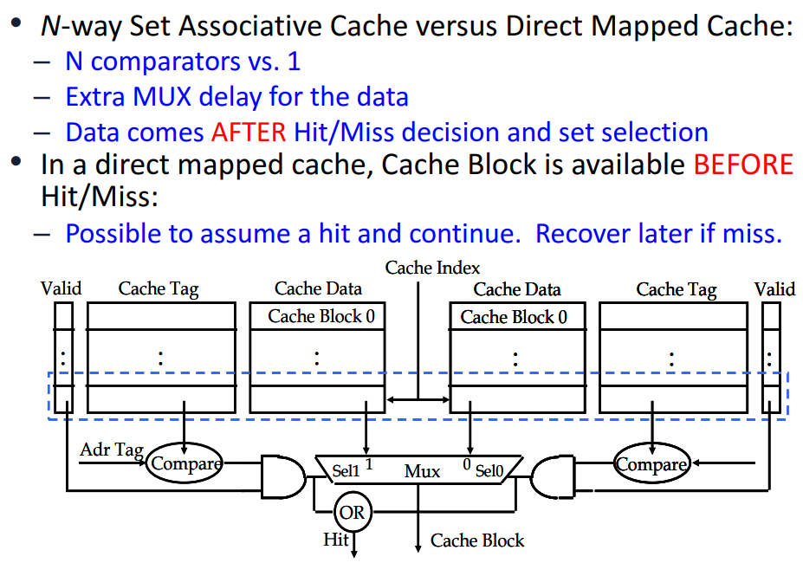
Disadvantage of Set Associative Cache

Slide 31
Questions on Cache Organization
Which cache organization can reduce compulsory misses?
Which cache organization can reduce capacity misses?
Which cache organization can reduce conflict misses?
Reduce cache misses = improve cache performance?

Slide 32
Cache Hit and Miss

Slide 33
What is Cache Hit and Miss?
To study the Memory Hierarchy behaviour when a Read
or Write Command finds:
that Data is available inside a Cache
Or
When the Data is Not Available inside a Cache

Slide 34
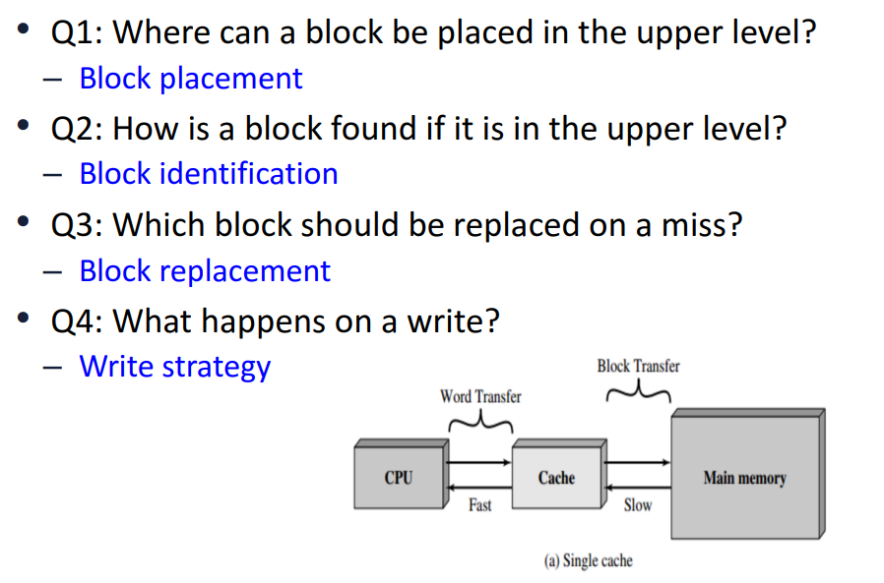

Considerations for Cache Design

Slide 35
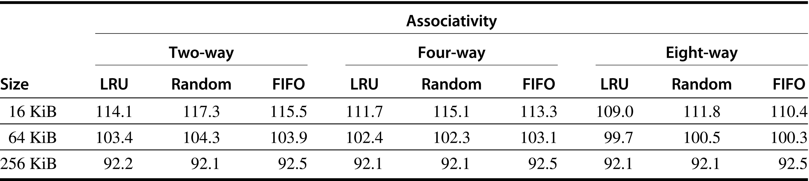
Studying Replacement Policies
Figure B.4 Data cache misses per 1000 instructions comparing least recently used, random, and first in, first out replacement for several sizes and associativities. There is little difference between LRU and random for the largest size cache, with LRU outperforming the others for smaller caches. FIFO generally outperforms random in the smaller cache sizes. These data were collected for a block size of 64 bytes for the Alpha architecture using 10 SPEC2000 benchmarks. Five are from SPECint2000 (gap, gcc, gzip, mcf, and perl) and five are from SPECfp2000 (applu, art, equake, lucas, and swim). We will use this computer and these benchmarks in most figures in this appendix.

Slide 36
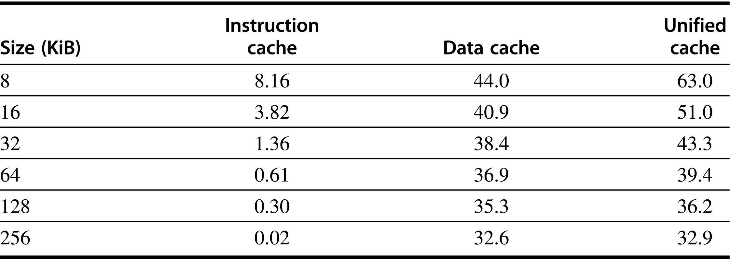
Study Cache Miss Behavior
Figure B.6 Miss per 1000 instructions for instruction, data, and unified caches of different sizes. The percentage of instruction references is about 74%. The data are for two-way associative caches with 64-byte blocks for the same computer and benchmarks as Figure B.4.

Slide 37
What is Hit and Miss?
To study the Memory Hierarchy behaviour when a Read
or Write Command discovers that the Data is available
inside a Cache

Slide 38
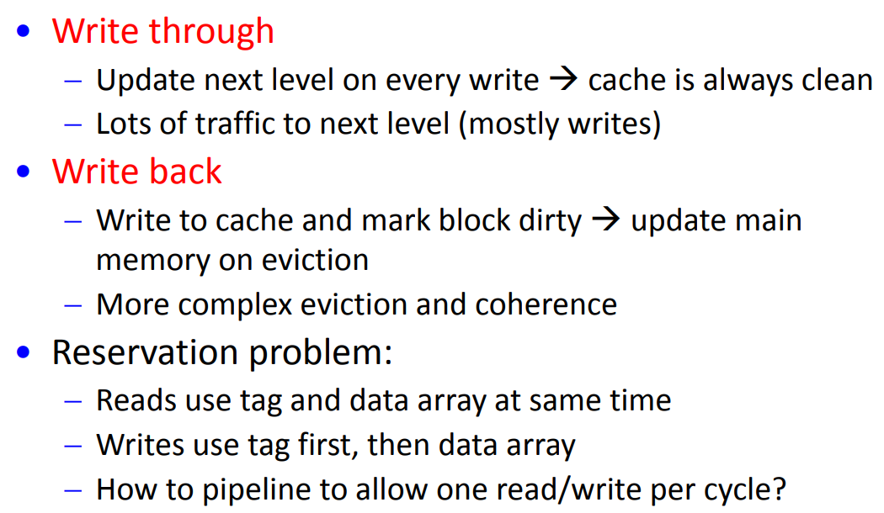

Write Hit Policy
Sequence of Updation?

Slide 39
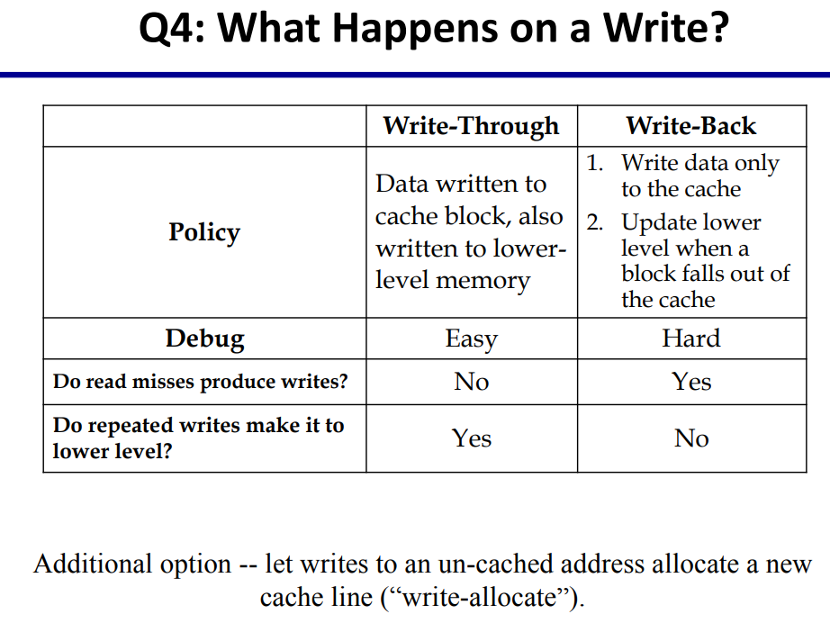

What Happens on a Write Command

Slide 40
Write Hit Approach
Write through
  Update next level on every write → cache is always clean
  Lots of traffic to next level (mostly writes)
Write back
  Write to cache and mark block dirty → update main memory on eviction (more complex eviction and coherence)
Write buffer for write through
  Processor: writes data into cache and write buffer
  Memory controller: write contents of buffer to memory
Processor
Cache
DRAM
Write Buffer
Notes:
We really didn't write to the memory directly. We are writing to a write buffer.
Once the data is written into the write buffer and assuming a cache hit, the CPU is done with the write. The memory controller will then move the write buffer’s contents to the real memory behind the scene.
The write buffer works as long as the frequency of write is not too high. Notice here, I am referring to the frequency with respect to time, not with respect to number of instructions.
Remember the DRAM cycle time we talked about last time. It sets the upper limit on how frequent you can write to the main memory.
If the writes are too close together or the CPU time is so much faster than the DRAM cycle time, you can end up overflowing the write buffer and the CPU must stop and wait.

Slide 41
What Happens on a Write Command

Slide 42
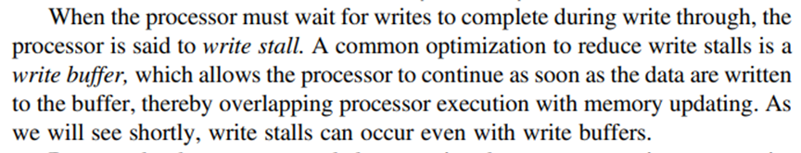
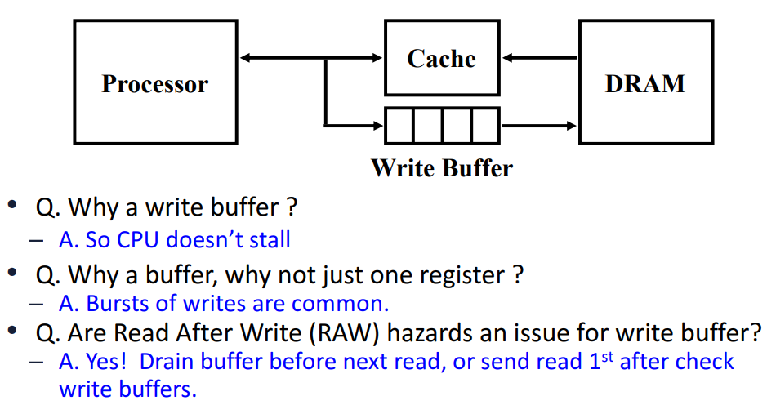
Write Stall

Slide 43
Cache Write Miss, Cache Replacement

Slide 44
Write Miss Policy
Write allocate:
  Allocate a new block on each write
  Fetch on write: fetch entire block, then write word into block
  No-fetch: allocate block but don’t fetch
    Requires valid bits per word, complex eviction
Write no-allocate:
  Write around cache; typically used by write through
Write invalidate (instead of update)
Sometimes like to have a read no-allocate
  irregular accesses on machine with large block size
Notes:
Read no-allocate: avoid the cost of bringing in the large block, while only use the single word

Slide 45
Types of Cache Miss
Cache miss as a metric:
(causes of cache misses)
  Compulsory:
    First access to a block
  Capacity:
    Block discarded due to limited
    cache size and later retrieved
  Conflict:
    Block discarded due to conflict
    in set and later retrieved
  Coherence:
    In multicore systems (Chapter 5)
0x1234
Processor
Cache
0x1234
0x5678
0x91B1
0x111
Processor
Cache
0x1234
0x5678
0x91B1
Processor
Cache

Slide 46
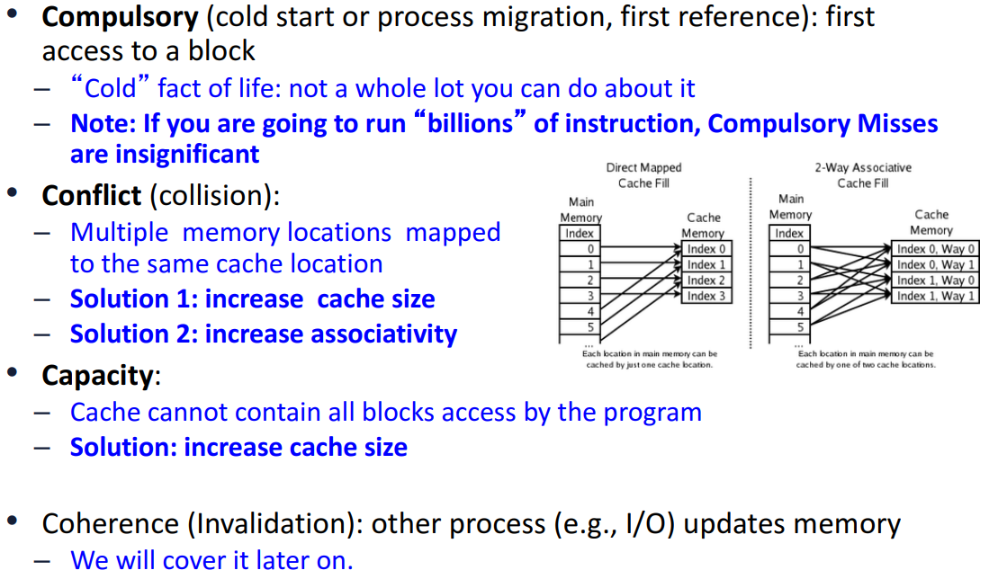
Sources of Cache Misses

Slide 47
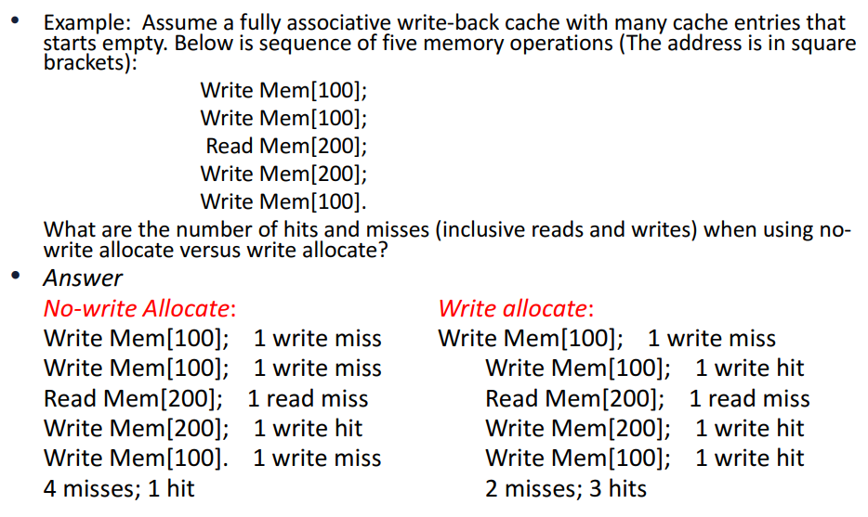
Example of Write Miss Policy

Slide 48
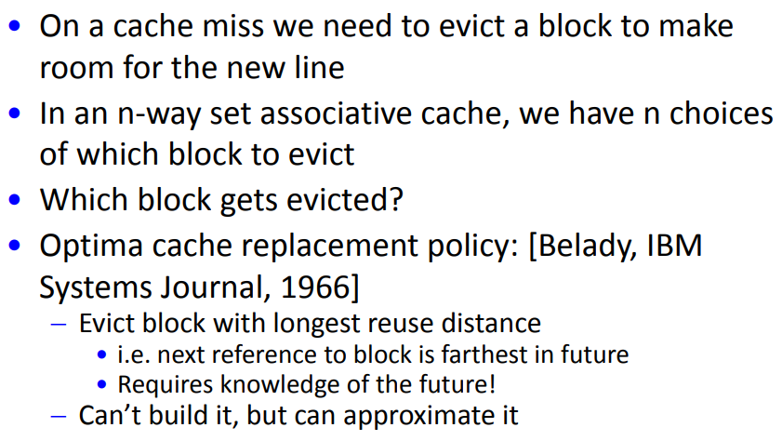
Cache Replacement Policy

Slide 49
Replacement Policy: NRU, Others
For 2-way set-associative cache
  1-bit per set indicates LRU/MRU; set/clear on each access
For >2-way, LRU is difficult/expensive in HW
  Need to maintain history of access order
Not recently used (NRU)
  A “used bit” is associated with every block, initially 0
  Whenever a block is accessed, its used bit is set to 1
    If on an access, all other used bits in a set are 1, they are reset to 0 except the bit of the block that is accessed
  A replacement pointer is used to look for a block whose used bit is 0 to be replaced
  Used by Intel Itanium, Sparc T2
Other policies: Pseudo LRU, LRU Insertion Policy (LIP)

Slide 50
Questions for Cache Hit and Miss
Block placement: where in upper hierarchy level?
  fully associative, direct mapped, set-associative
Block identification: find block in upper hierarchy level?
  search and match address tag:
  block address (= tag + index) + block offset
  valid bit: tag-index boundary and associativity
Block replacement: which block to replace on miss?
  easy for direct map; random/LRU for associative
Write strategy: what happens on a write?
  Write through and write back
  Write allocate and not allocate

Slide 51
Cache and CPU Performance

Slide 52
Memory Hierarchy Performance - AMAT
Average memory access time between levels
= Hit time + Miss rate x Miss penalty
Miss penalty: time to fetch a block from lower memory level
  Access time: time to lower level; function of latency
  Transfer time: function of bandwidth between levels
    Transfer one “cache line/block” at a time
    Transfer at the size of the memory-bus width

Slide 53
Cache and CPU Performance
CPU time = (CPU cycle + memory stall cycles) x clock cycle time
Memory stall cycles = memory access x miss rate x miss penalty
  Assumptions: memory stalls are due to cache misses, hit cycles included in CPU execution cycles, reads and writes have same miss rate and penalty
CPU time = instruction count x (CPI_{ideal} + memory access/instruction x miss rate x miss penalty) x clock cycle time
Cache design becomes more important for CPUs with lower CPI and higher clock rates

Slide 54
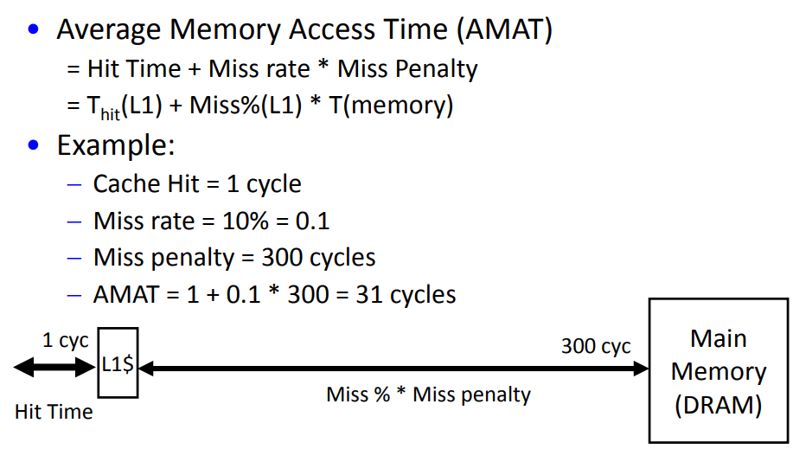
Average Memory Access Time

