Slide 1
Computer Architecture
CS 622 / EE 520
Fall 2026
Lecture 2
Shahid Masud

Slide 2
Topics
Look at 3 Papers for upcoming Computer Architectures
Evolution in Computing in post Moore’s Law era
RISC-V Instruction Set Architecture
Introducing Computer Performance

Slide 3
Parallelism in Computer Architecture

Slide 4

Amdahl’s Law
Some part of code can be processed in parallel
The remaining part of code must be processed in a sequential fashion

Slide 5

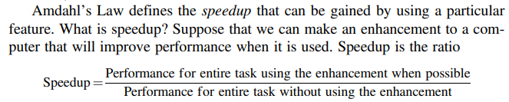
Amdahl’s Law – Parallel or Accelerator

Slide 6
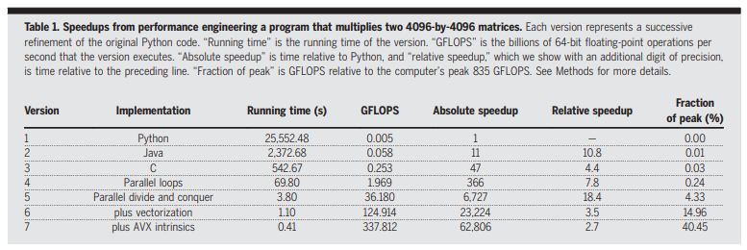
Example of Performance Gains through Architecture
AVX = Intel Advanced Vector Extension

Slide 7
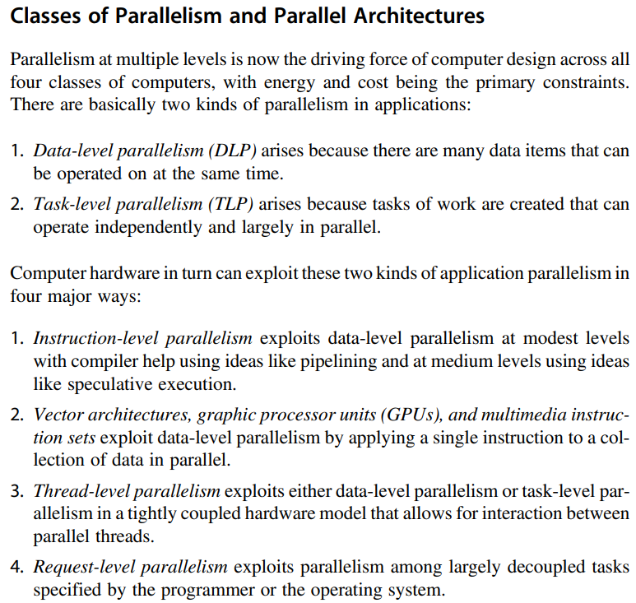
Types of Parallelism in Parallel Computers

Slide 8
Seven Great Ideas in Computer Architecture

Slide 9
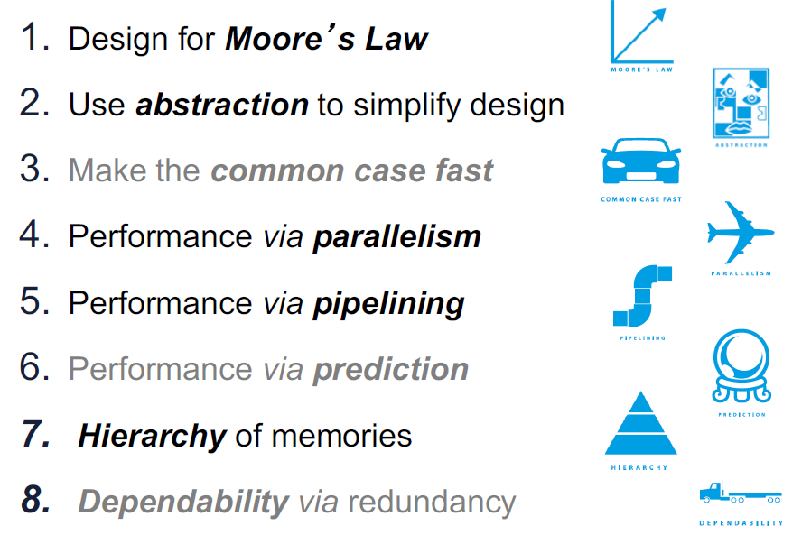
Significant Involvement in Computer Architecture
Explore further
In this course

Slide 10
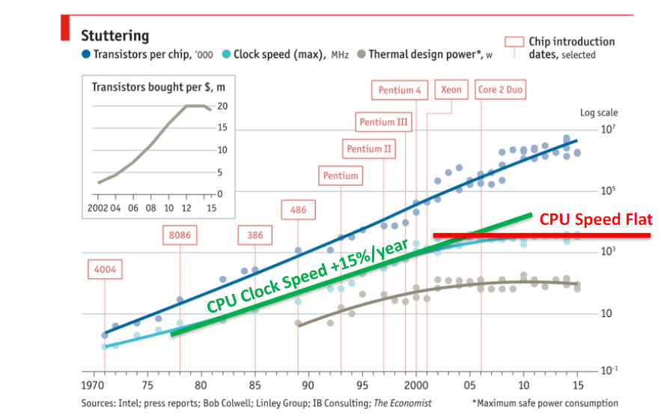
Why is Computer Architecture Exciting Today?

Slide 11
Remaining Lecture

Slide 12
Interesting Topics
1. Discussion on Moore’s Law, through paper ‘MORE THAN MOORE’ by M. Mitchell Waldrop, published
In Nature, February 2016
2. Computer Performance Graphs from National Academy, USA, report
3. Introduction to the specialization area of ‘Computer Architecture’ through paper by
Hennessy and Patterson, ‘A New Golden Age for Computer Architecture’, published in Communications
of the ACM, February 2019, pages 48 to 60.
  Important Directions for Computers of the future:
  Moore’s Law failing to keep up
  More Energy dissipation – too hot chips
  Domain Specific Architectures
  Enhanced security features inside microprocessors
  Open Instruction Sets and Extension of Instruction Sets through Customized Accelerators
  Agile Hardware Design for Microprocessors
  Combination of Domain Specific Languages and Domain Specific Architectures
4. Intel Processor Timeline
5. Reviewed course outline including detailed topics and grading breakup of lectures and labs.

Slide 13

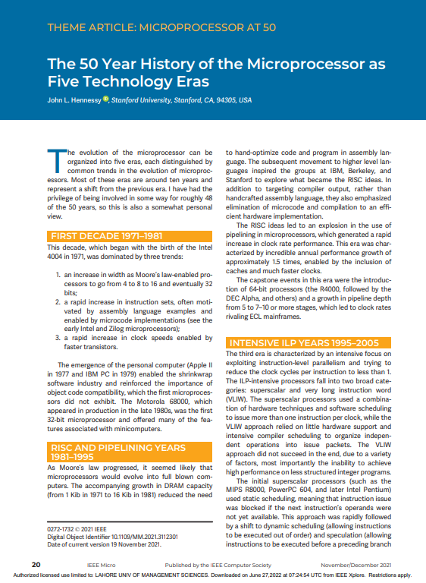
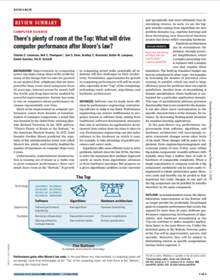
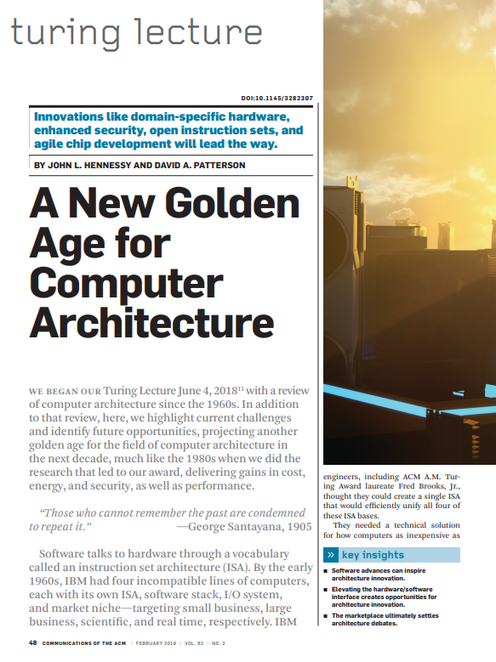
Look at some recent research papers for inspiration

Slide 14
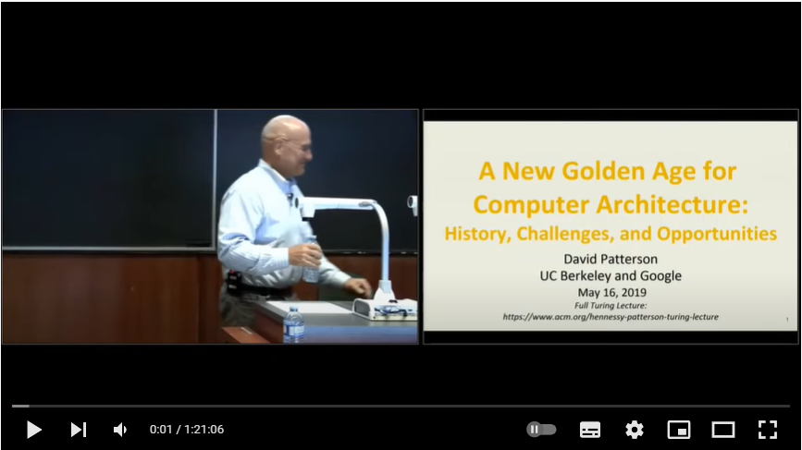
Video of Turing Lecture by Patterson, 2019
https://dl.acm.org/doi/10.1145/3282307
David Patterson - A New Golden Age for Computer Architecture: History, Challenges and Opportunities – YouTube

Slide 15




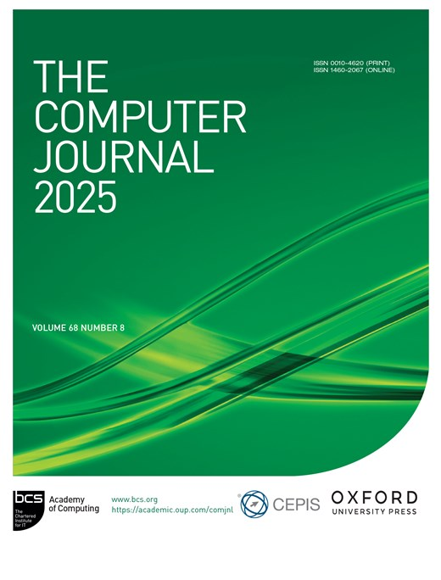
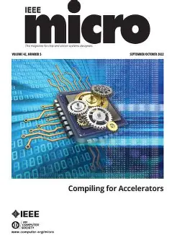
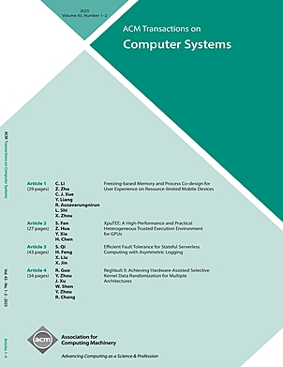
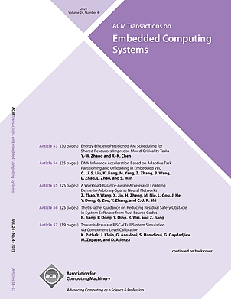
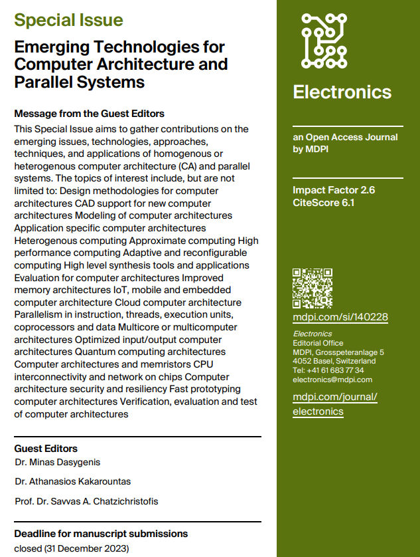
Some Computer Architecture Journals
IEEE Computer Society
ACM SIGARCH

Slide 16
Scale in Computing

Slide 17
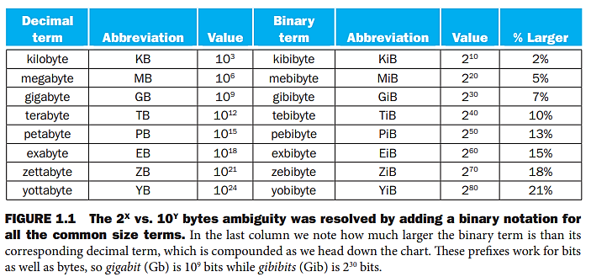
The Scale In Computing

Slide 18
Approximations in Huge Binary Numbers
2¹⁰ is approximately 1 Kilo (approx 1x10³)
2²⁰ is approximately 1 Mega (approx 1x10⁶)
2³⁰ is approximately 1 Giga (approx 1x10⁹)

Slide 19
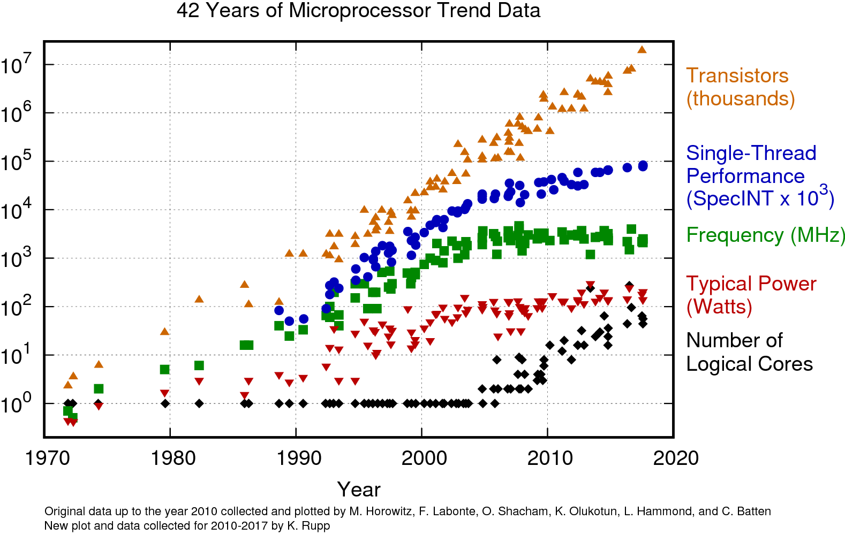

Slide 20
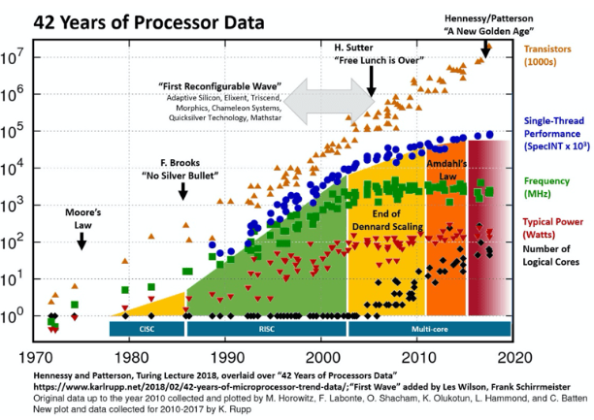

Slide 21
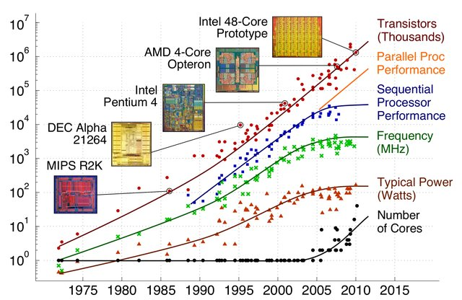

Slide 22
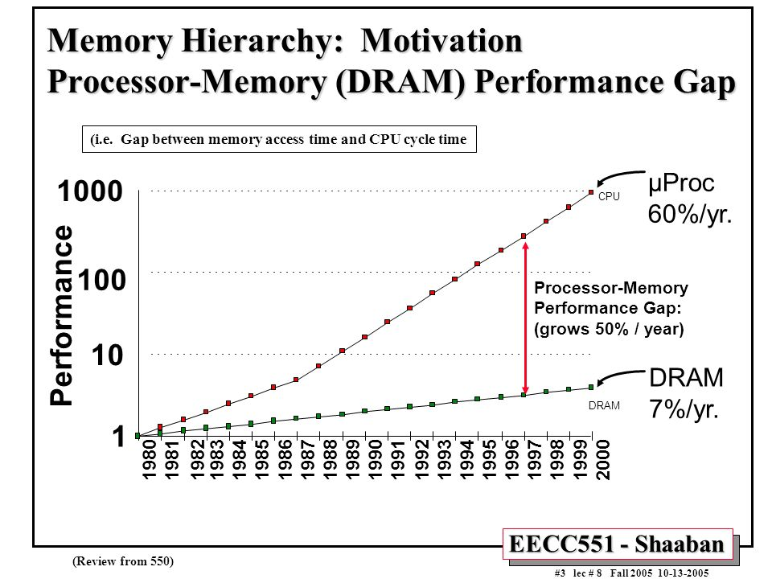


Slide 23
Introducing Instruction Set Architecture (ISA)

Slide 24
What is an Instruction Set Architecture?
Lowest level of Computer Architecture that is visible to a programmer
ISA comprises instructions in Assembly Language and
Corresponding Binary Machine Code
Primitive syntax compared to a high-level language
It is easily interpreted and understood by the CPU
Designed to maximize performance
Represents features and performance of a CPU
Designed to minimize cost and design time

Slide 25
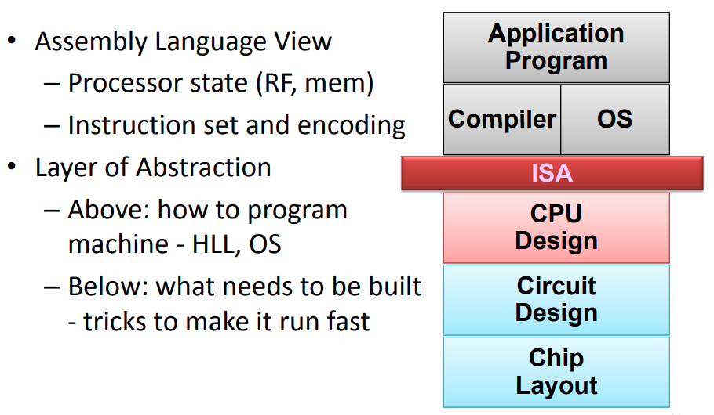
Role of ISA within a Computer
Key:
RF = Register File
Mem = Memory
HLL = High Level Language
OS = Operating System

Slide 26
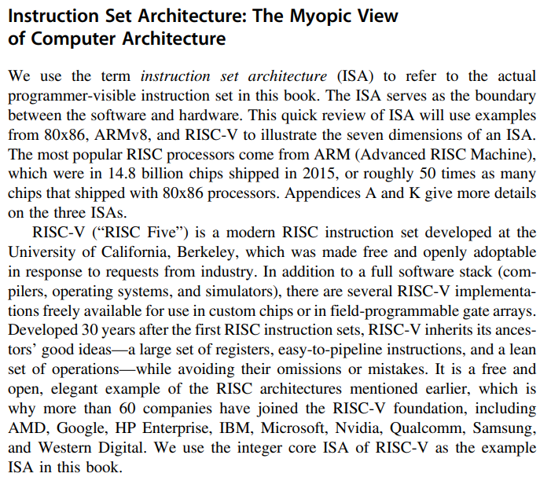



RISC-V ISA

Slide 27
RISC-V Instructions and Features
Data Alignment
  32-bit bus vs 8-bit memory
  Big Endian vs Little Endian
Addressing Modes
Type and Size of Operands
  I, R types
Operations available
  Arithmetic
  Logical
  Shift
Control Flow Instructions
  Branch
  Jump

Slide 28
Memory Access – Big Endian vs Little Endian
A CPU Register R0 is 32-bits wide.
It has data “1A2B3C4D” Hex.
Store the data in an 8-bit wide RAM that has 4 locations.
Store in Big-Endian style
or Store in Little-Endian Style
Location | Big Endian RAM
3
2
1
0
CPU Register
R0 Contents
1A 2B 3C 4D
MSB LSB
Location | Little Endian RAM
3
2
1
0

Slide 29
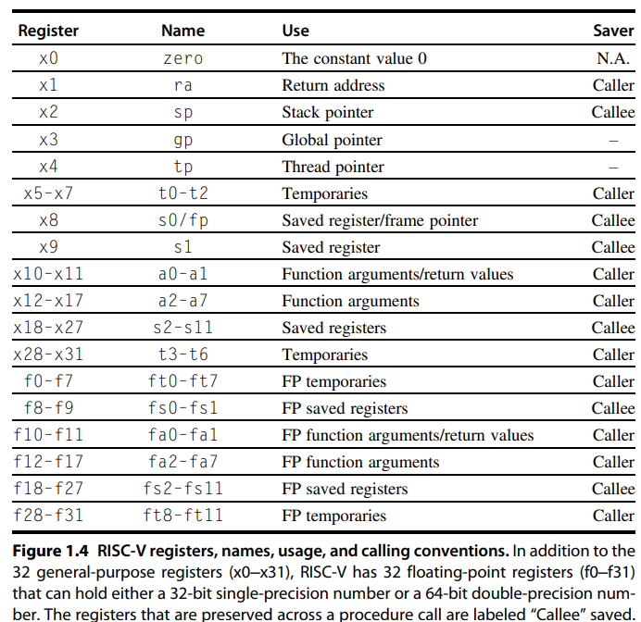
RISC-V Registers and Naming Conventions
RISC-V is a Register-rich
Architecture

Slide 30
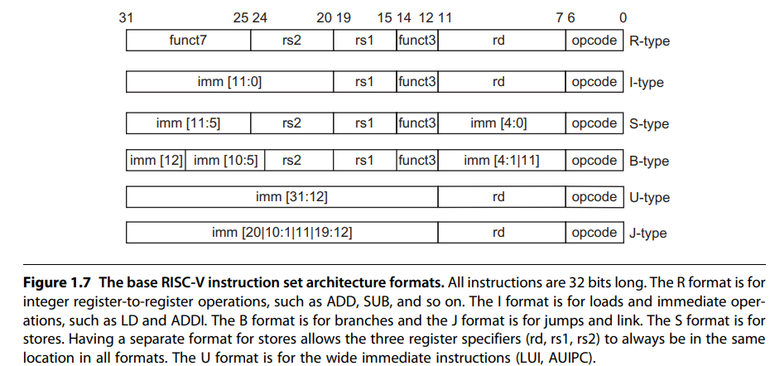












RISC-V Instruction Formats

Slide 31
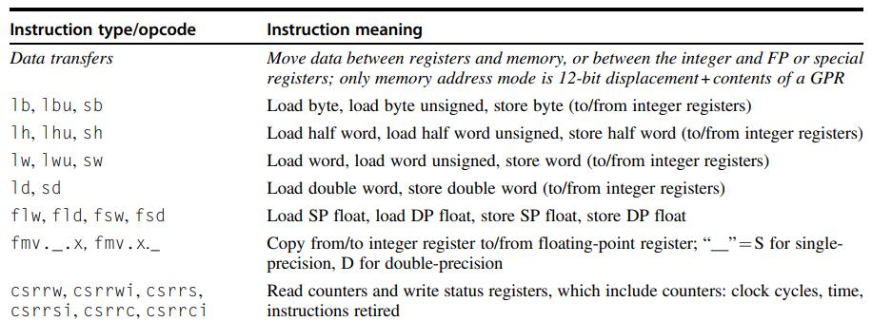
RISC-V Data type Instructions

Slide 32
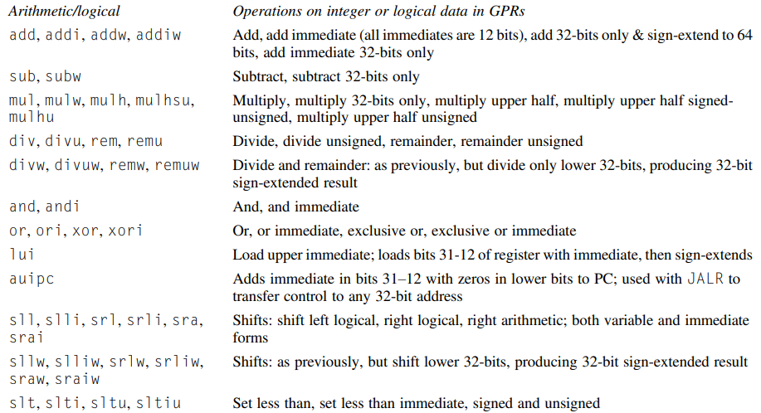
RISC-V Arithmetic / Logical Instructions

Slide 33
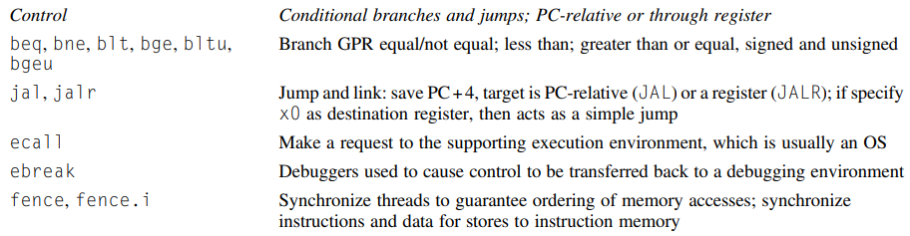



RISC-V Control Instructions

Slide 34
Performance of Computer Systems

Slide 35
Simple Computer Performance Measures
Time to execute a program – in seconds
Clock Speed of Computer – Mega Hertz or Giga Hz
Comparing Benchmarks
In terms of the width of Data Bus (16 bit, 32 bit, 64 bit)
In terms of the size of different memory (8GB / 256GB)
  Cache size
  RAM
  Hard disk
  SSD, etc.
In terms of multiple cores and multiple I/O available
Software
  Algorithm
  Language / Compiler
  Optimization – Parallel, Vector, etc.
In terms of
Resources

Slide 36
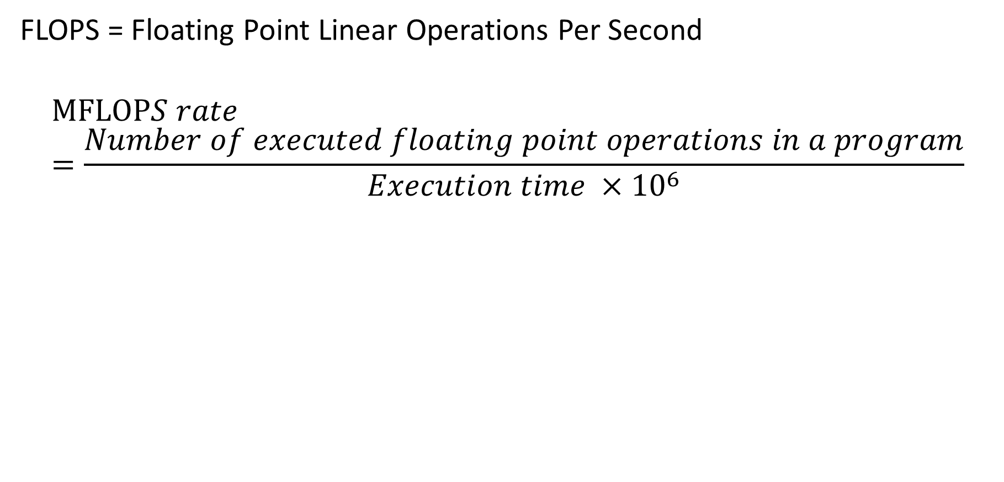
What is MFLOPS or Giga Flops or Tera Flops?
FLOPS = Floating Point Linear Operations Per Second
$$MFLOPS rate=\frac{Number of executed floating point operations in a program}{Execution time {×10}^{6}}$$

Slide 37

Principles of Modern Computer Design
Take Advantage of Parallelism
  e.g. multiple processors, disks, memory banks, pipelining, multiple functional units
Principle of Locality
  Reuse of data and instructions (i.e. in Caches)
Focus on the Common Case
  Amdahl’s Law

Slide 38
Energy and Power

Slide 39
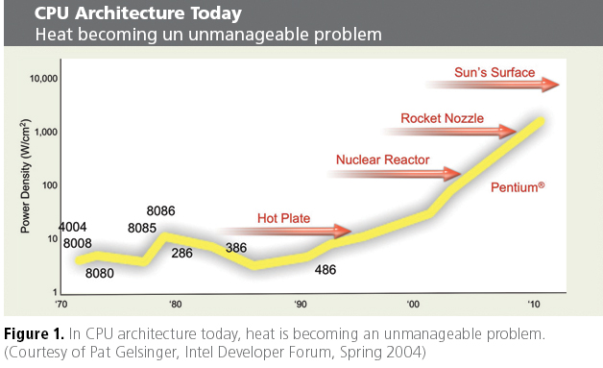
Power Wall

Slide 40
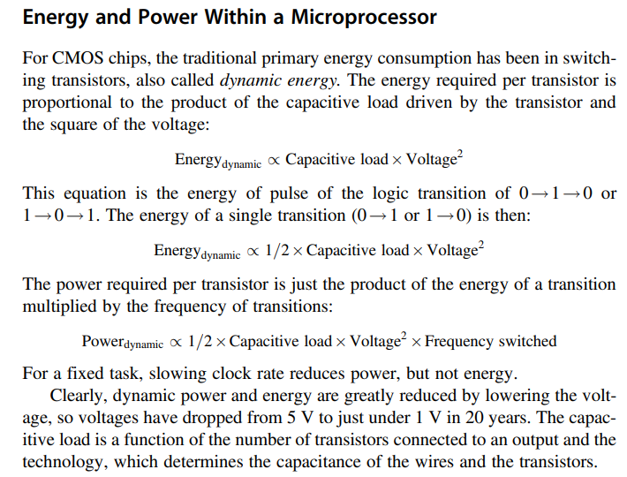

Energy and Power in a Microprocessor

Slide 41
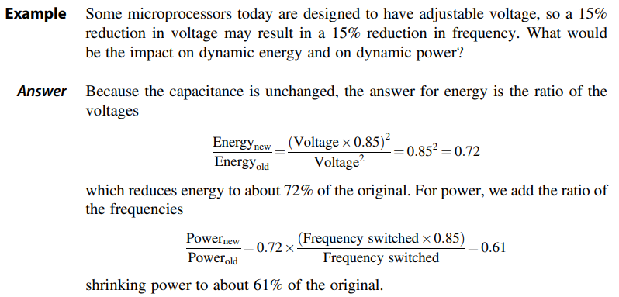
Example of Energy calculation

Slide 42
CPU Power Trends
In CMOS IC technology
×30
5V → 1V
×1000

Slide 43
Readings
H&P Computer Architecture Textbook chapter 1
Research Papers for new Computing architectures and paradigm
  Challenging Trends in Energy of Computing for Data Centers, IEEE Computer, 2024
  The 50 Year History of the Microprocessor as Five Technology Eras, IEEE Micro, 2021
  A New Golden Age for Computer Architecture, Turing Lecture, Communications of the ACM, 2019
See end of chapter questions from H&P textbook

