Slide 1
Computer Architecture
CS 622 / EE 520
Fall 2026
Lecture 6
Shahid Masud

Slide 2
Topics
Pipelining in Computer Architecture
  Basics of Pipelining
  RISC-V Architecture Without Pipelining
  Different Stages of a CPU Instruction Cycle
  5 stage pipeline
  Pipeline Performance
  Issues in Pipelined Architecture
  Performance Penalty Reasons
    Bubble Insertion
    Instruction Reordering
  Use of Forwarding
    Architecture Modification needed
  Problem with Branches
  Introducing Branch Prediction

Slide 3
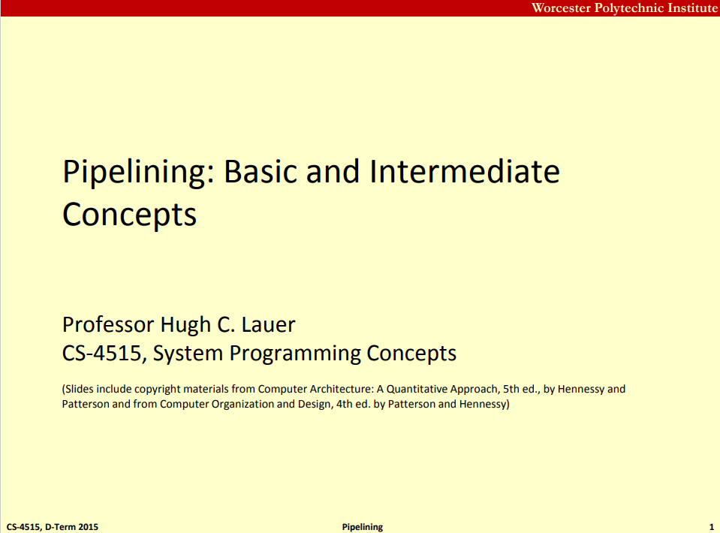
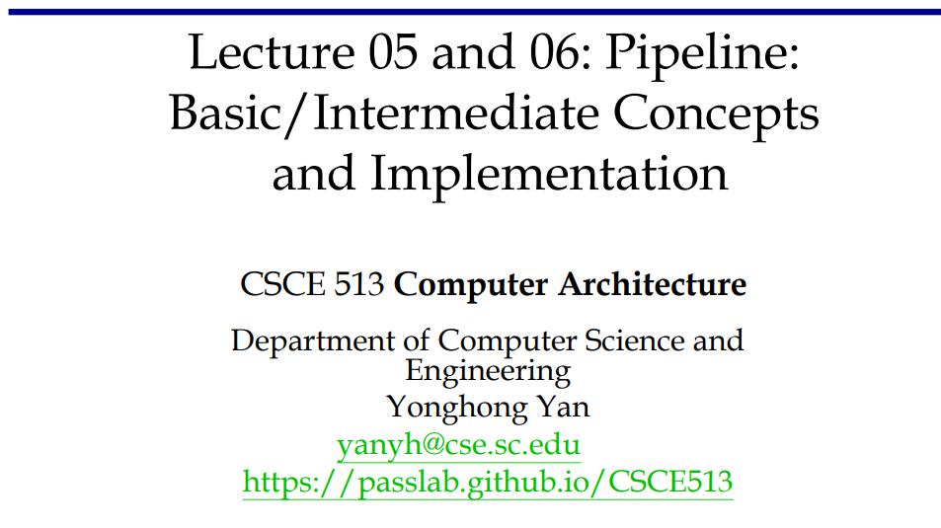
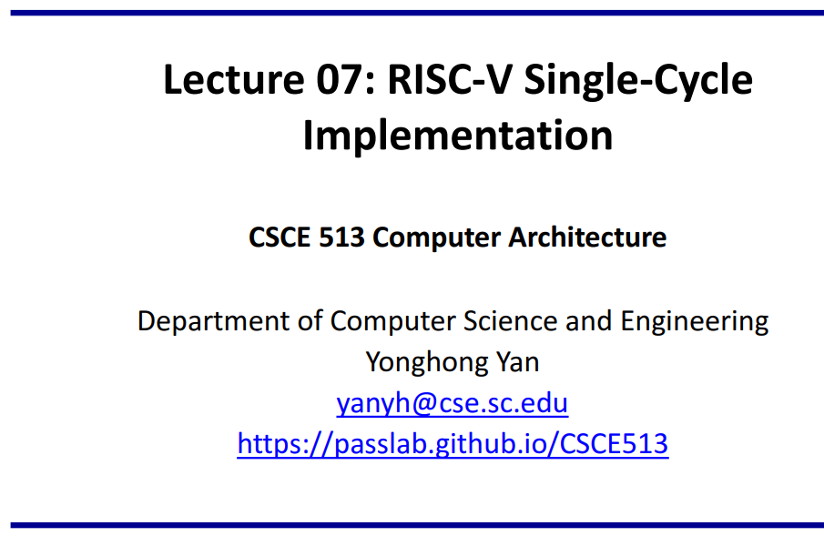
Slides Adapted from: (To read further)
Readings:
Appendix C of course textbook

Slide 4
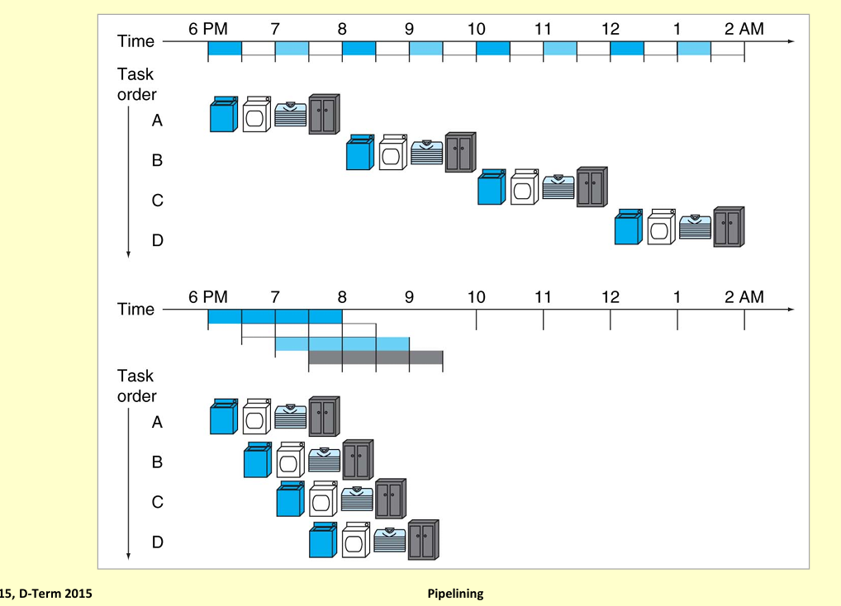
Clothes Wash Dry Iron Fold Example of Pipelining

Slide 5
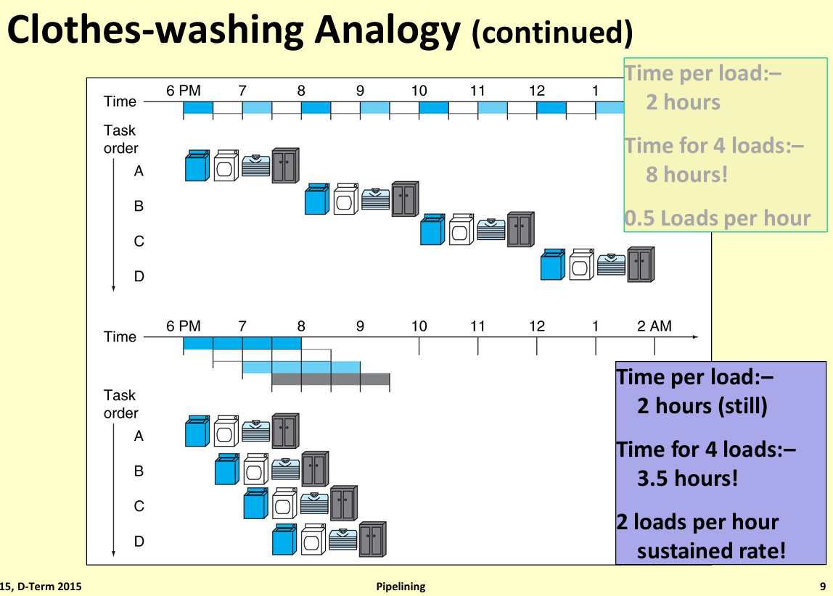
Processing Time Advantage

Slide 6
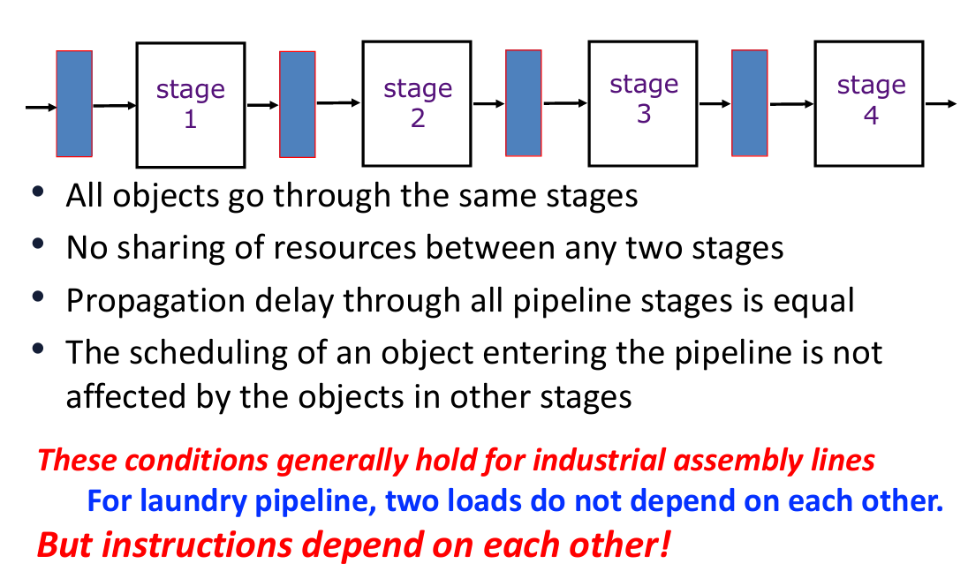
An Ideal Pipeline has…..
Pipeline
Register
Pipeline
Register
Pipeline
Register
Pipeline
Register

Slide 7
Unpipelined CPU Architecture

Slide 8
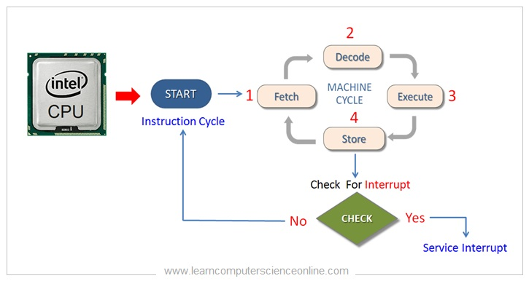
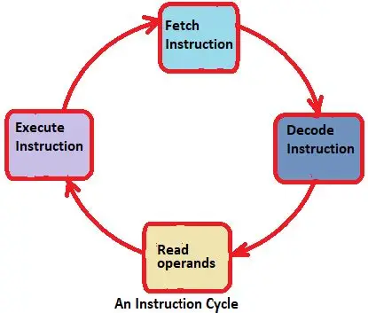
A Computer Instruction Cycle
Pipeline Cut

Slide 9
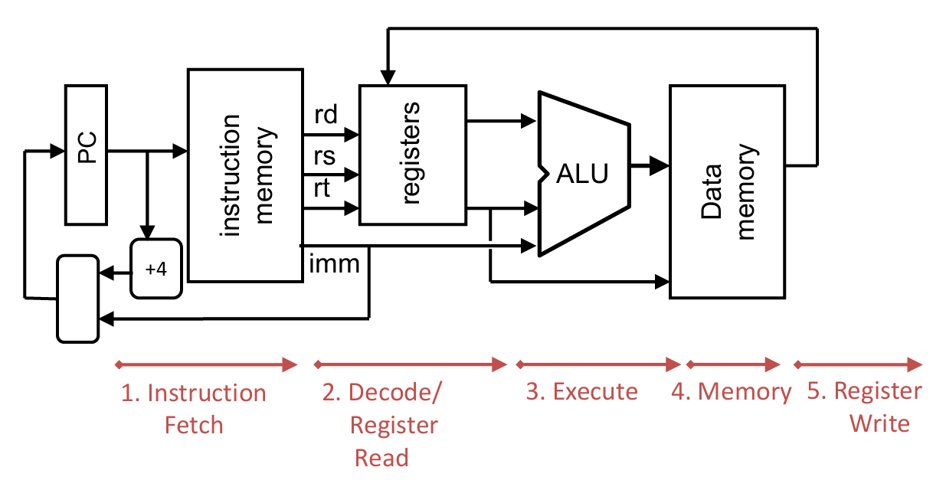
Stages of Instruction Execution in a CPU

Slide 10
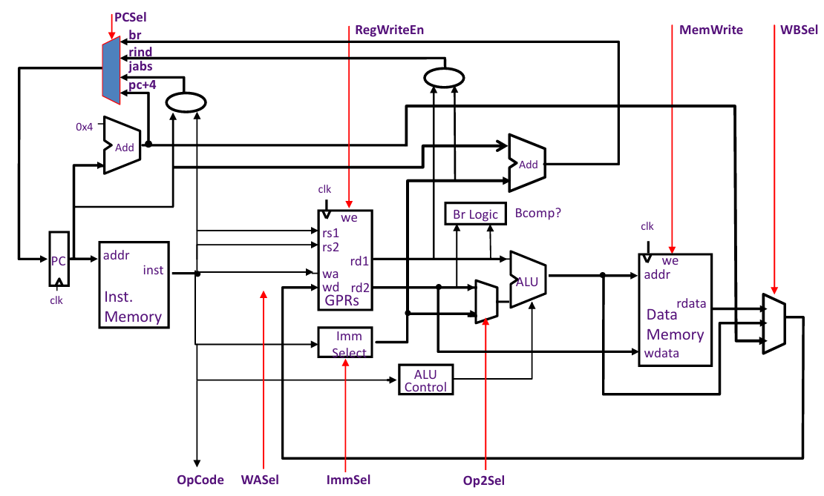
Unpipelined Datapath for RISC-V Base (Integer)

Slide 11
Introducing Pipelining in CPU Architecture

Slide 12
Pipeline in Computer Processing
Partition Instruction Execution into distinct stages
Each Stage uses a different set of hardware resources
Stages can execute concurrently, in a pipelined style

Slide 13
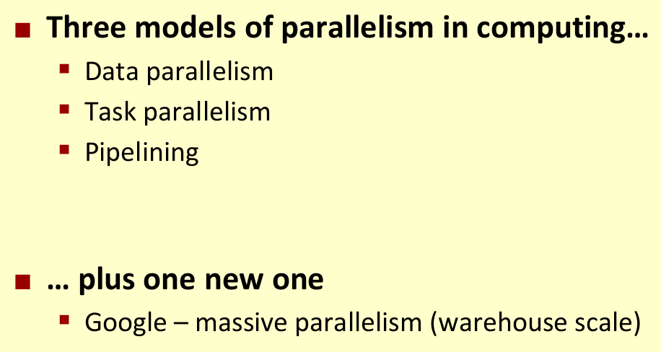
Recap – Models of Parallel Processing

Slide 14
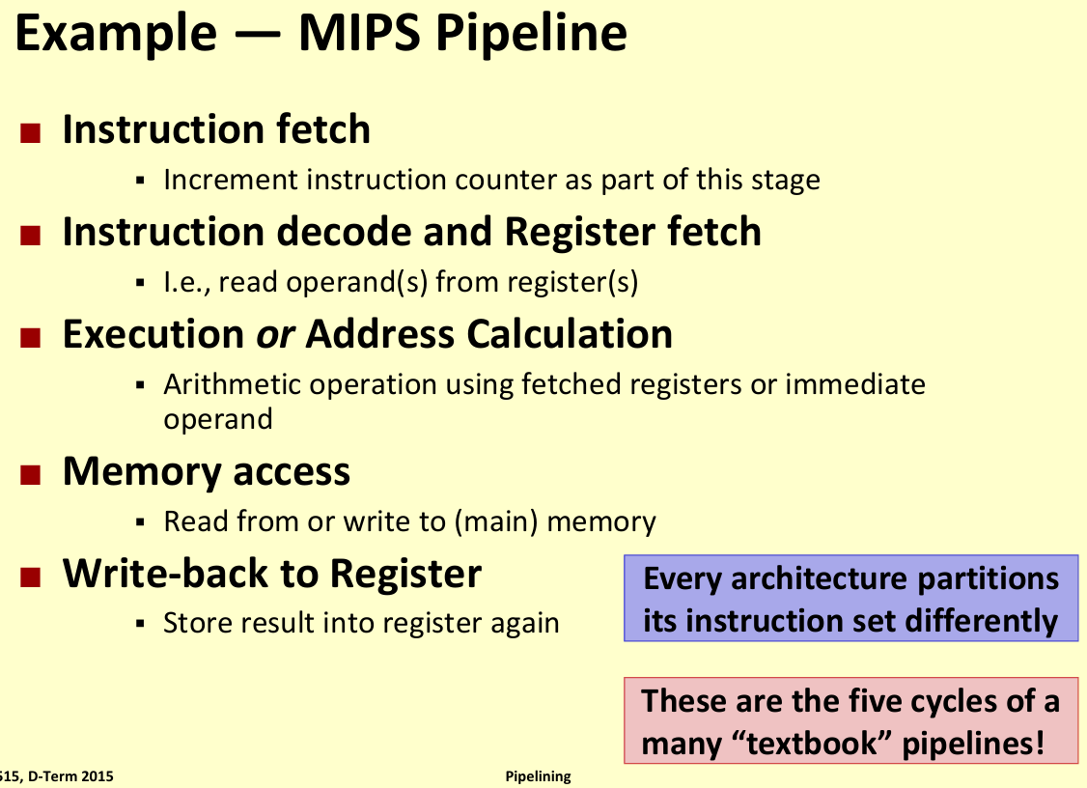
Example of a Simple MIPS Pipeline Architecture

Slide 15
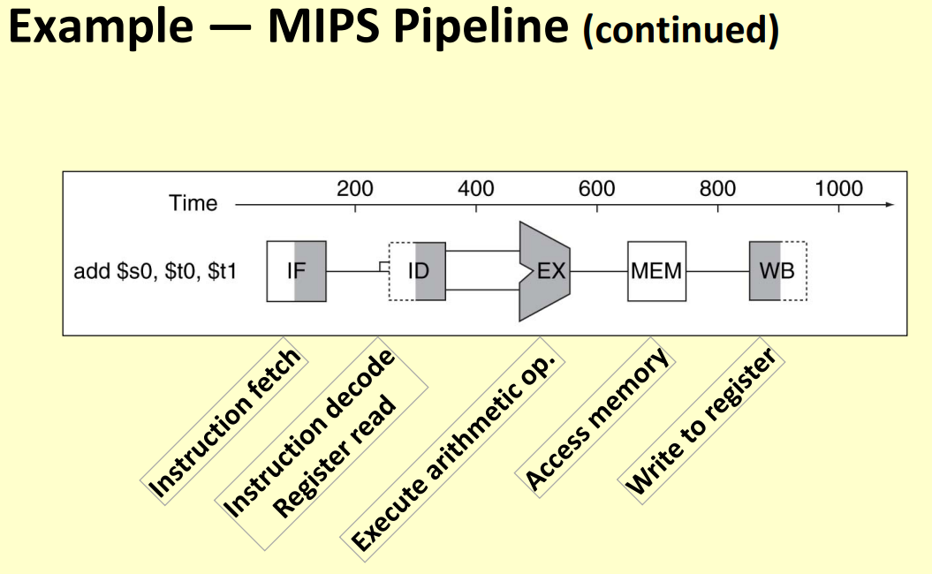
Block Level View of MIPS Pipeline Architecture

Slide 16
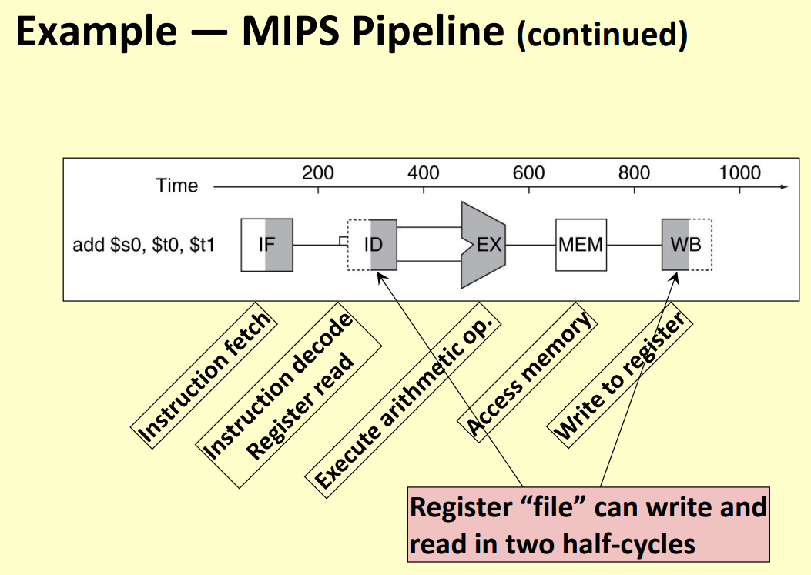
Assumption about Registers Read / Write

Slide 17
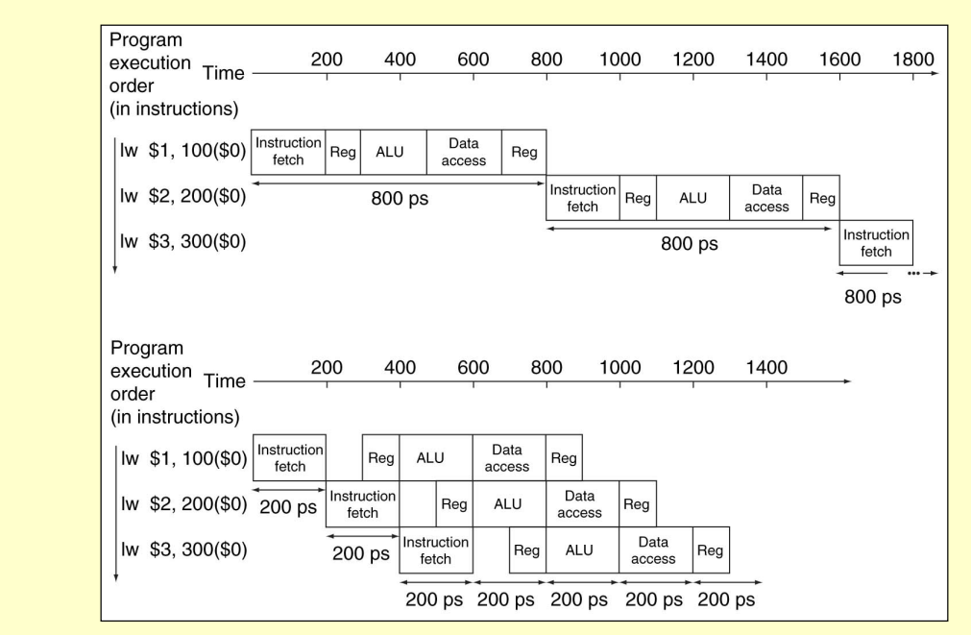
Example of MIPS Pipeline Operation

Slide 18
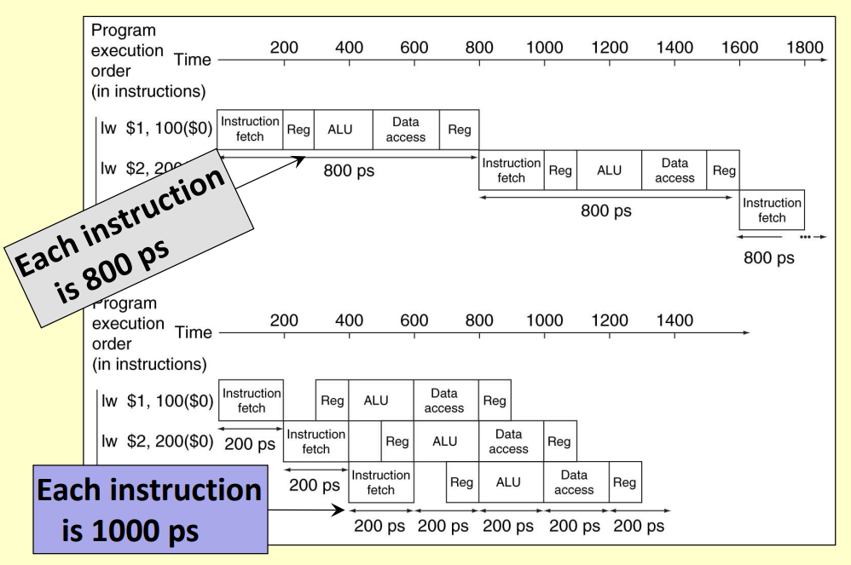
Pipeline Performance

Slide 19
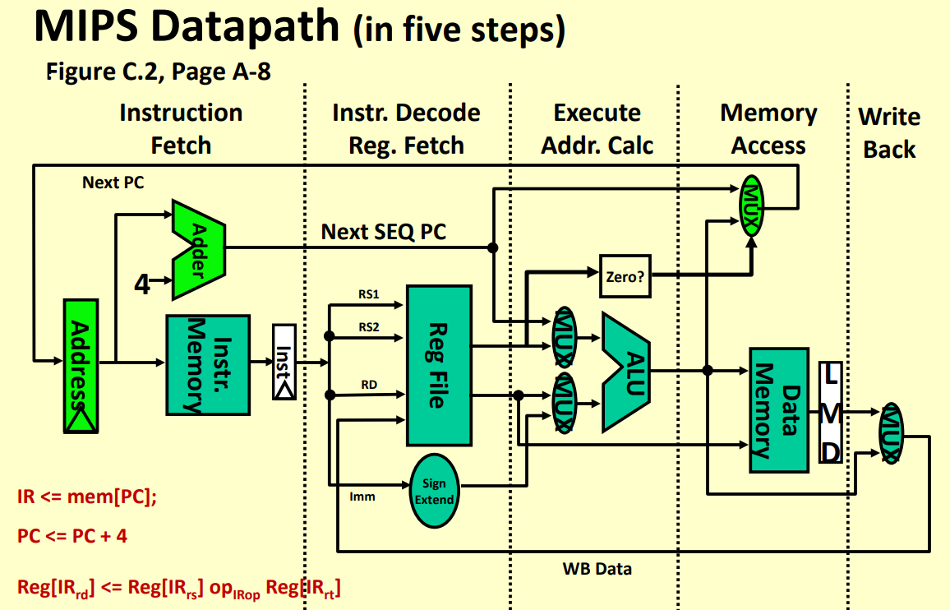
What is a Datapath?

Slide 20
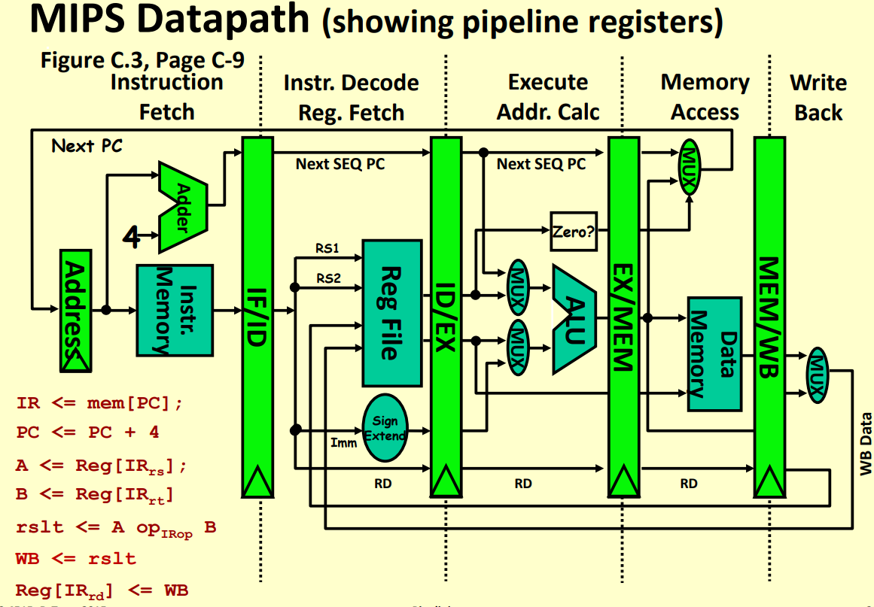
Datapath with Pipeline Registers

Slide 21
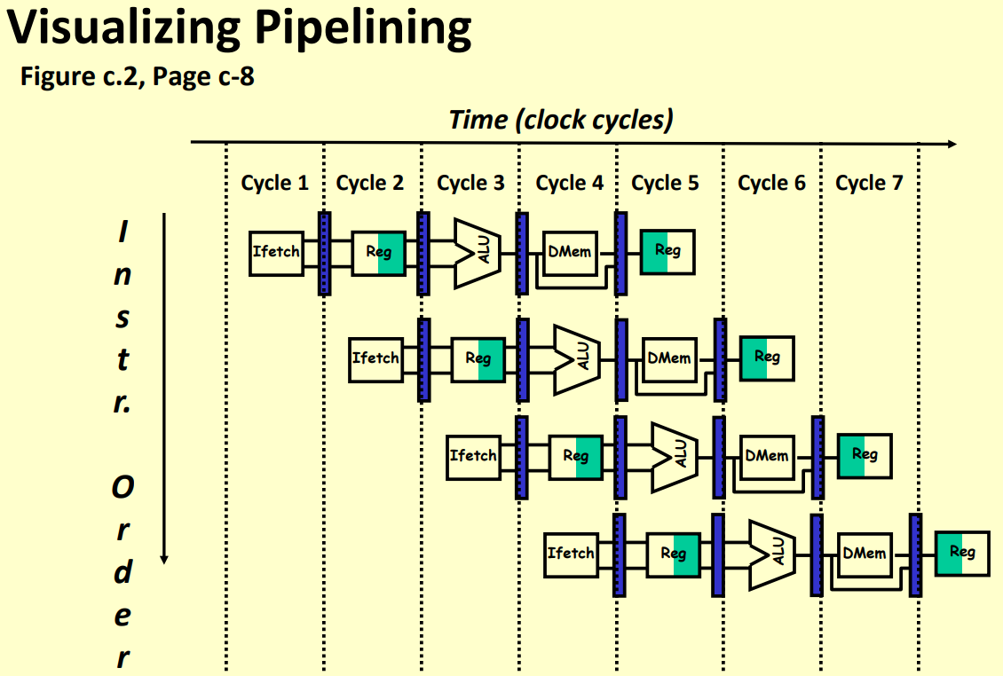
Visualizing Pipelining through diagram

Slide 22
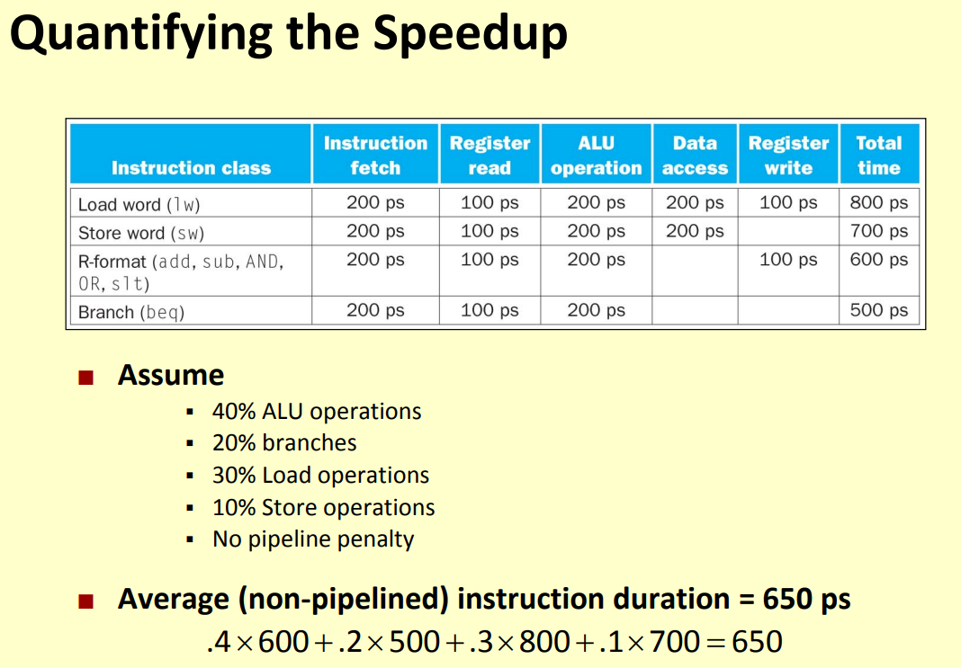
Quantitative Example of Pipeline Speedup

Slide 23
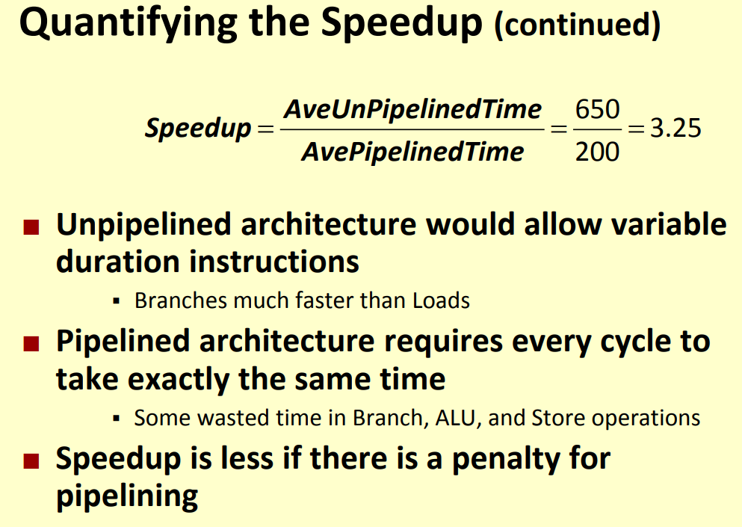
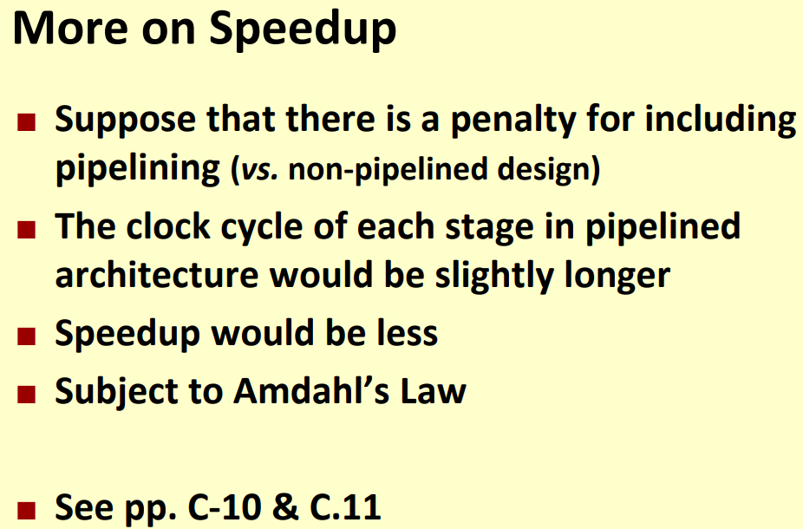
Quantifying Speedup - Comments

Slide 24
Pipeline Hazards

Slide 25
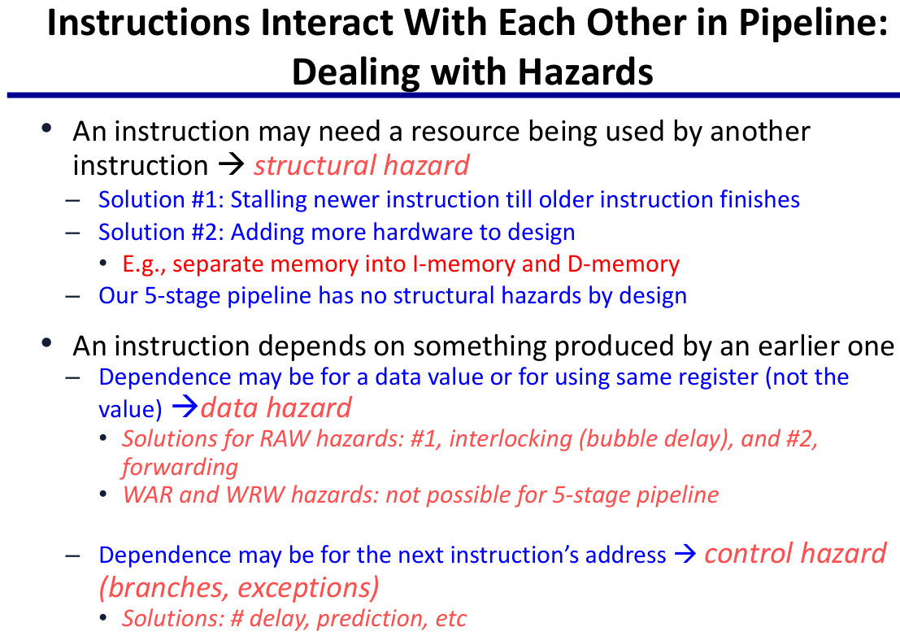
Why Pipeline Hazards?

Slide 26
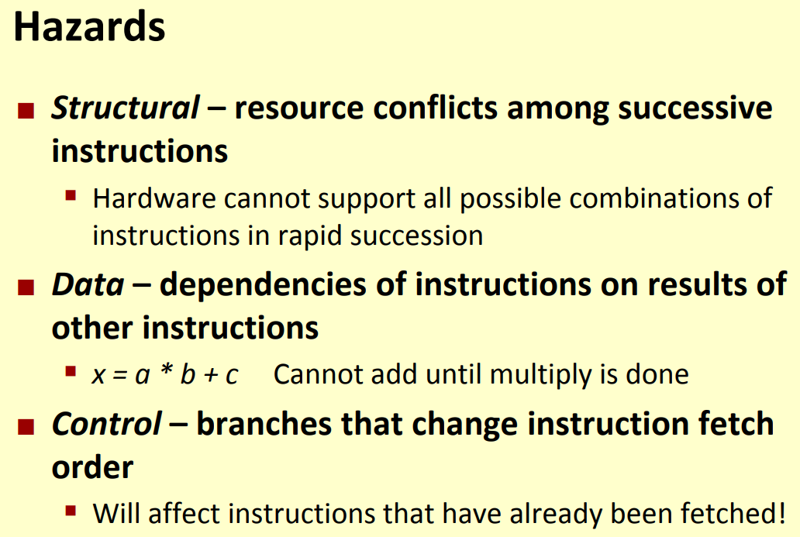
What are Pipeline Hazards?

Slide 27
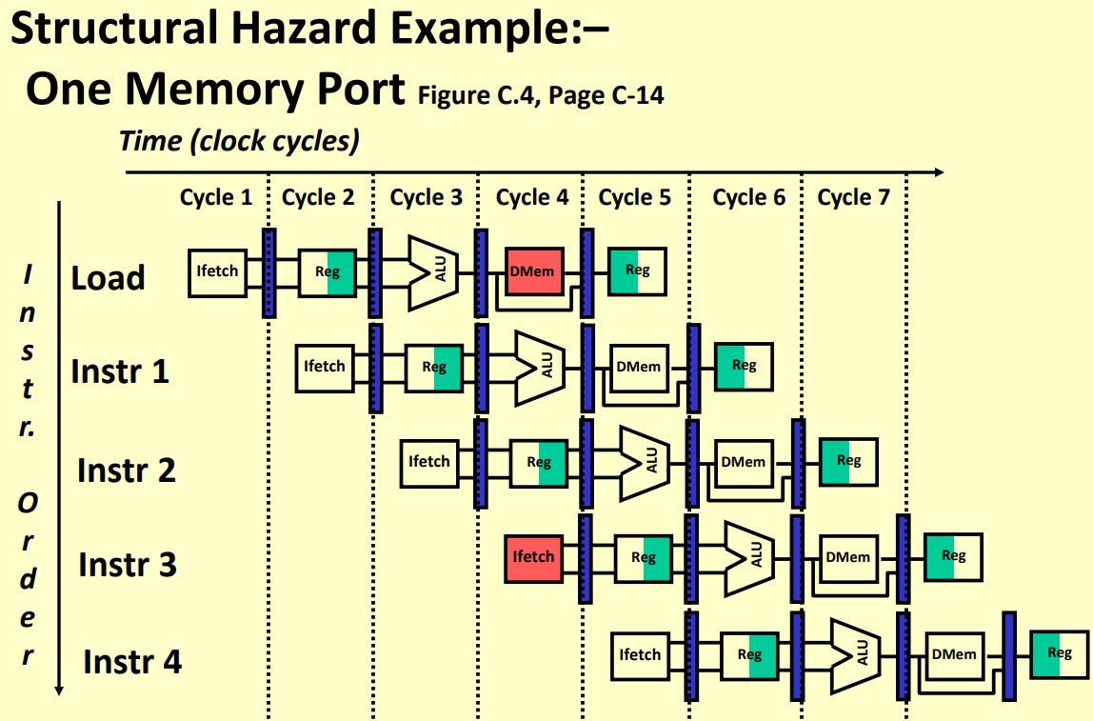
Structural Hazard due to Memory Access

Slide 28
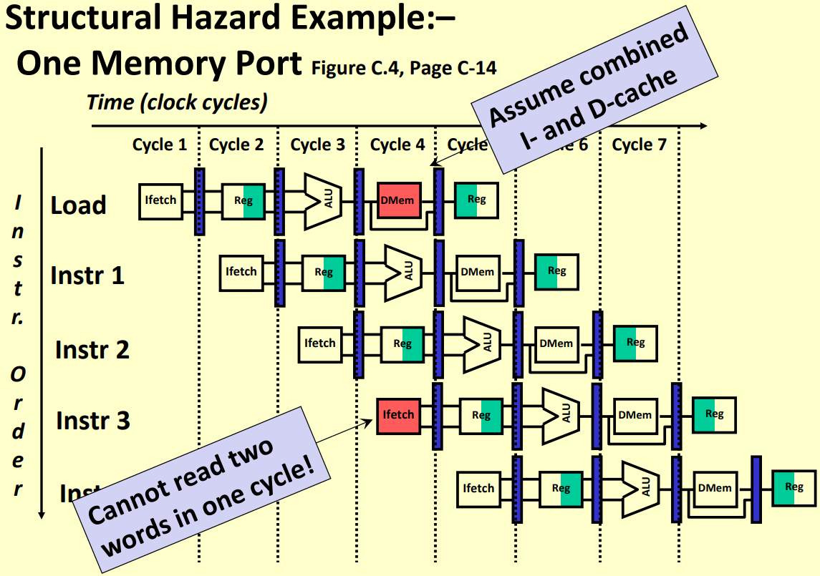
Hazard due to One Memory Port

Slide 29
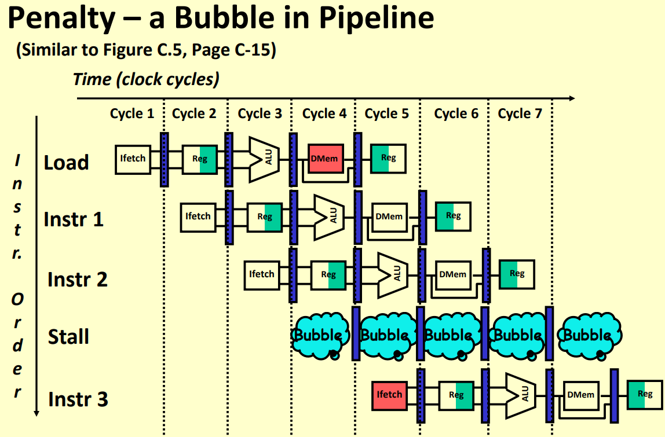
Introduce Bubble or Stall in Instructions

Slide 30
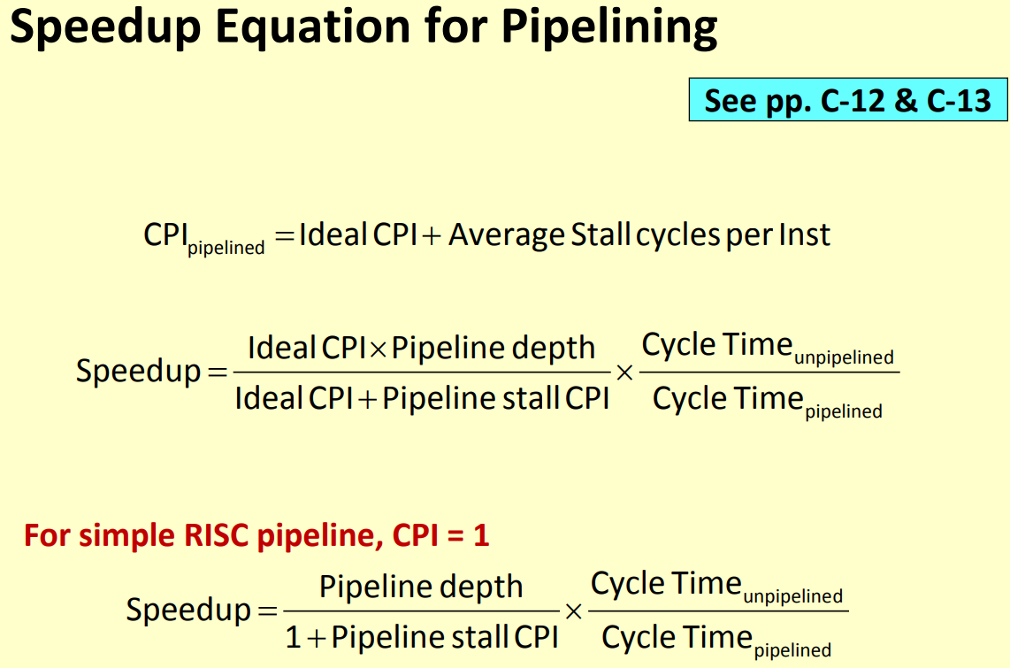
Speedup Equation in Presence of Stall

Slide 31
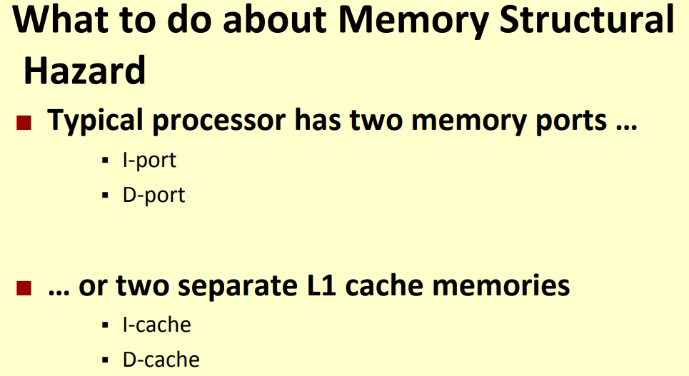
Improve Structural Hazard in Hardware?
Add Multiple Hardware Execution Blocks in Parallel
To Avoid Structural Hazard at EX Stage of Pipeline

Slide 32
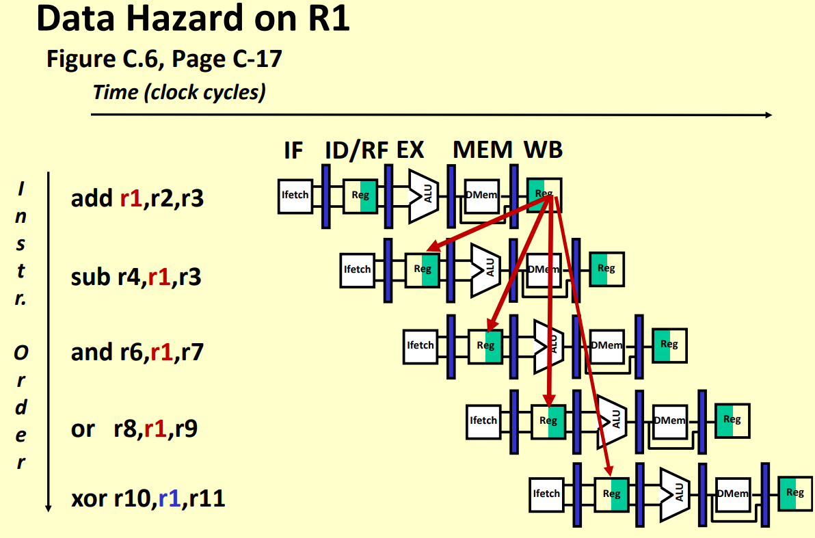
Data Related Pipeline Hazard

Slide 33
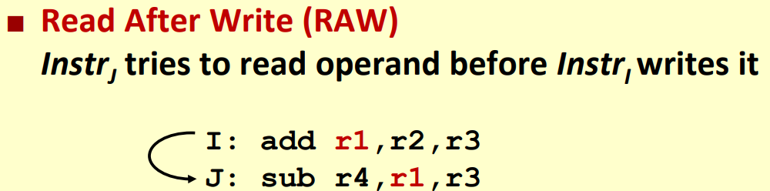
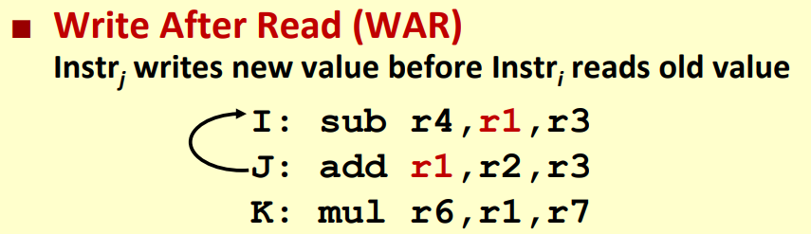
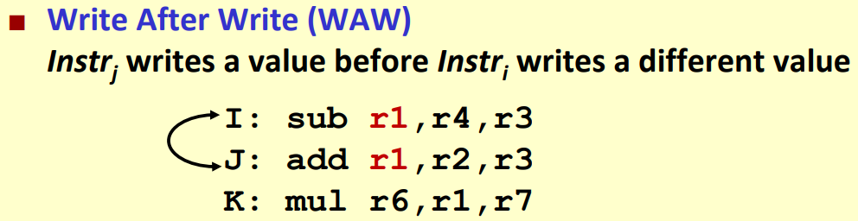
3 Types of Data Hazard

Slide 34
Forwarding in Pipeline Architecture

Slide 35
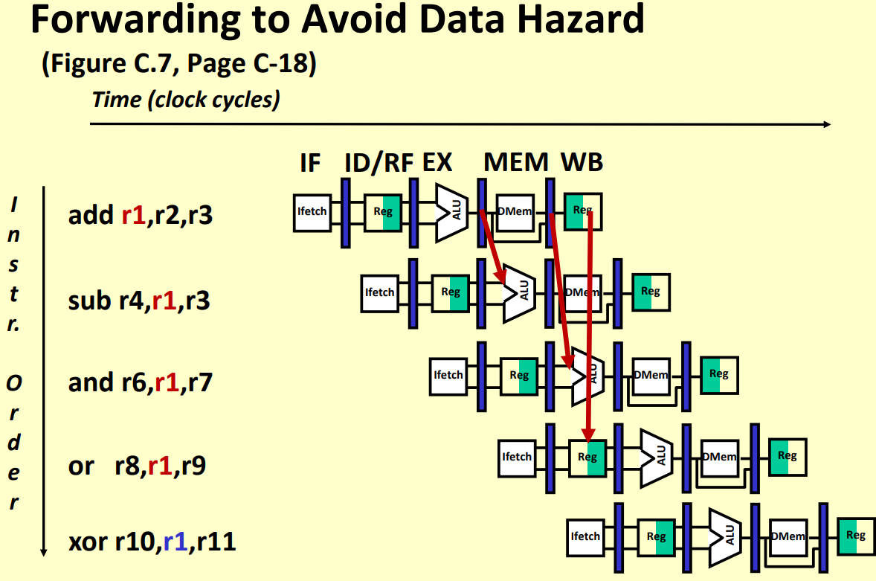
How does Forwarding Help?

Slide 36
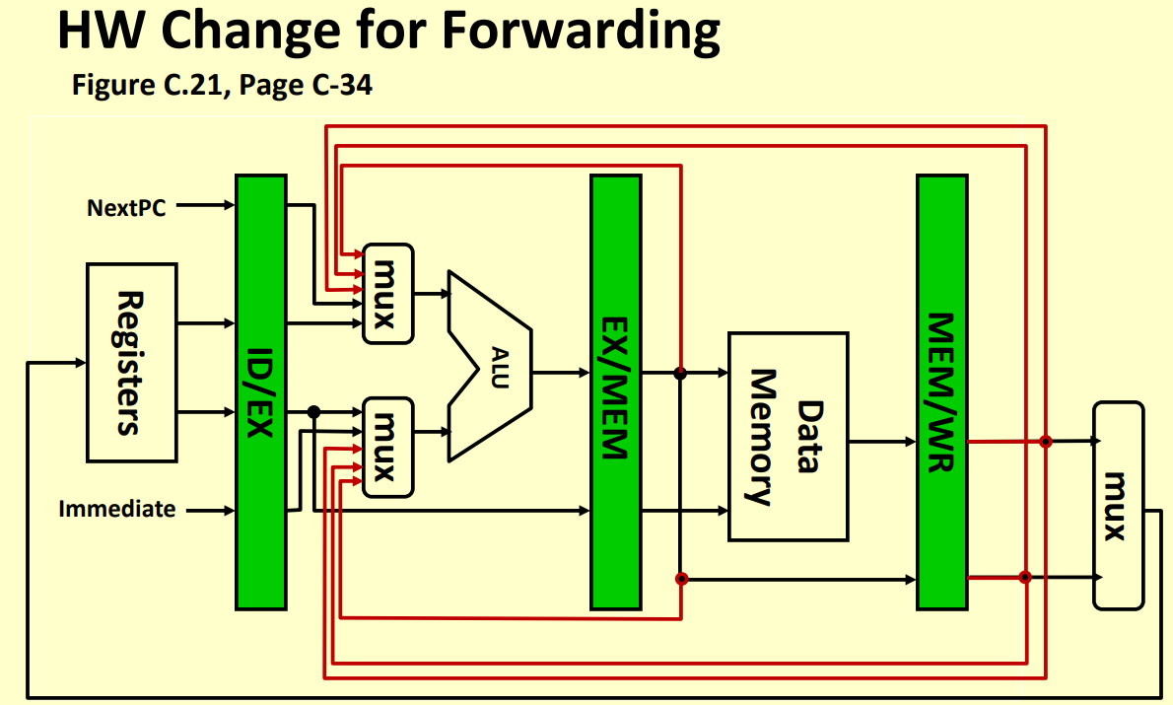
Hardware Addition for Forwarding

Slide 37
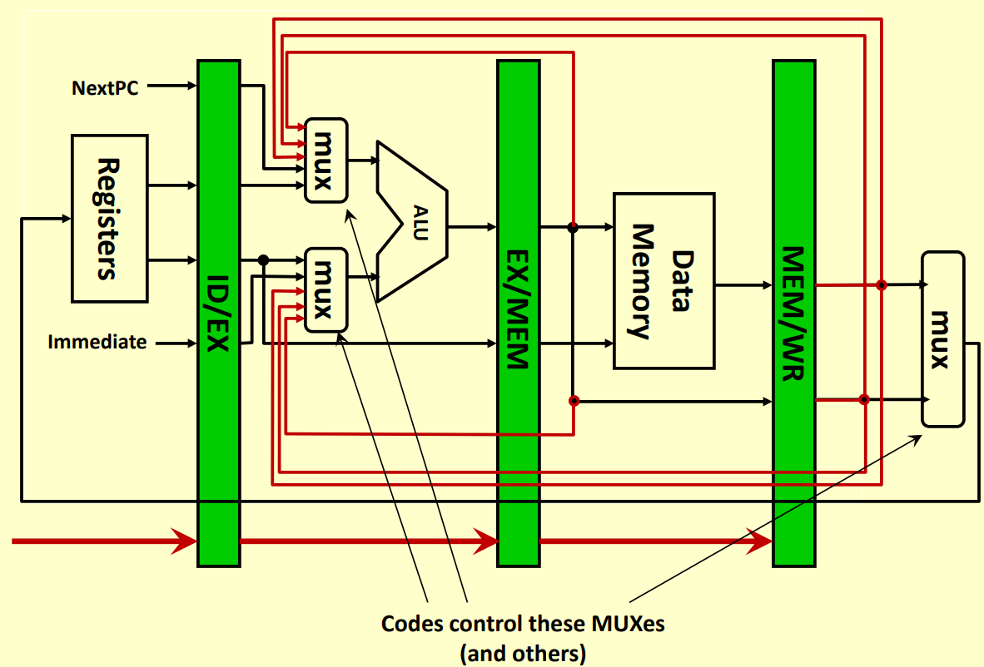
Corresponding Control Signals – Controlpath

Slide 38
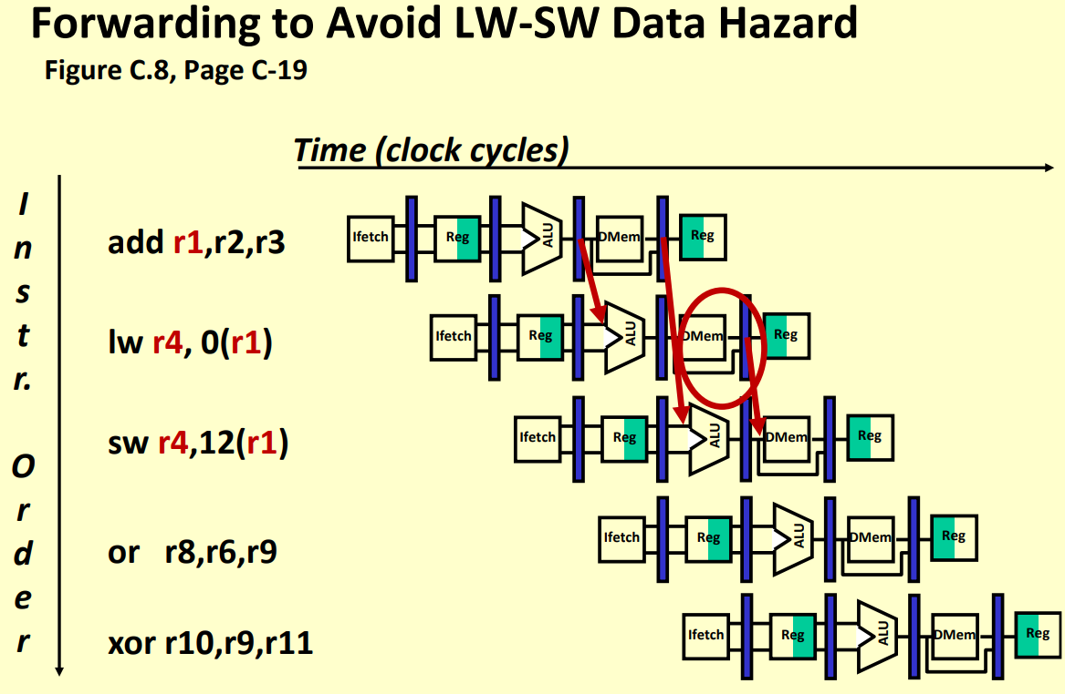
Avoid Data Hazard in Forwarding

Slide 39
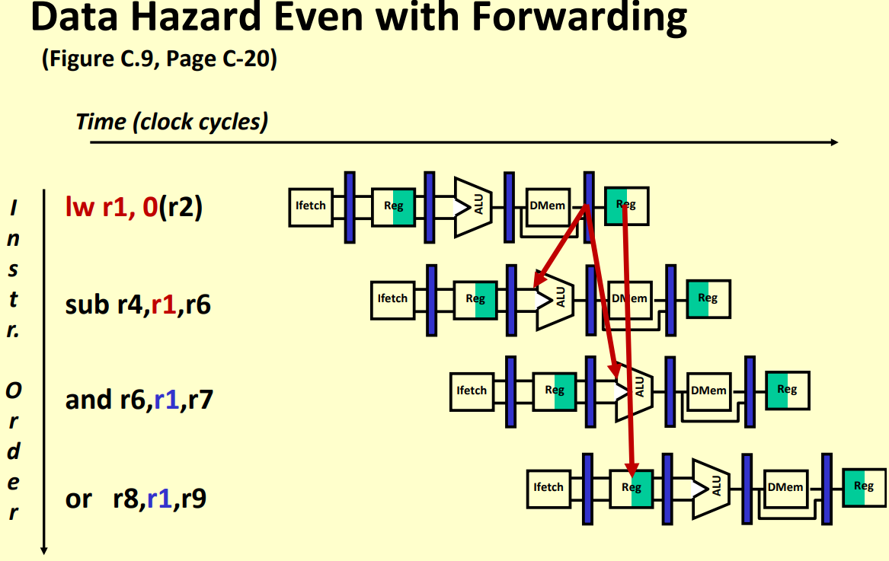
Hazard Possible with Forwarding

Slide 40
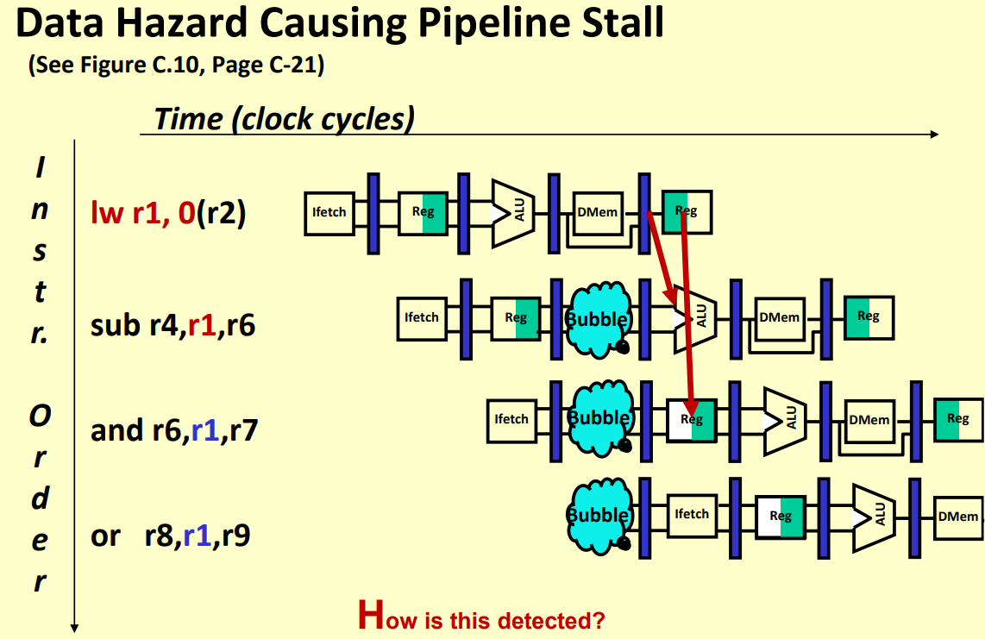
Use Bubble or NOP Instruction

Slide 41
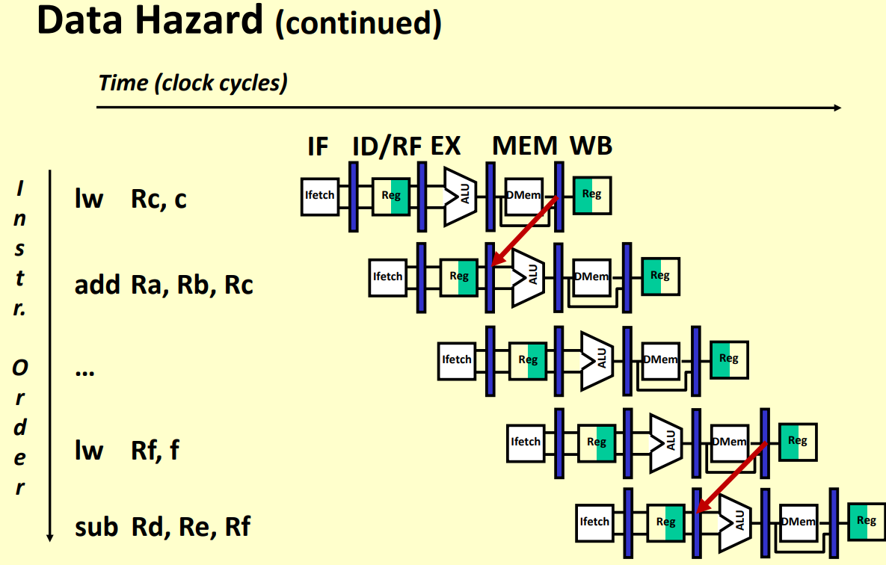
More on Data Hazard

Slide 42
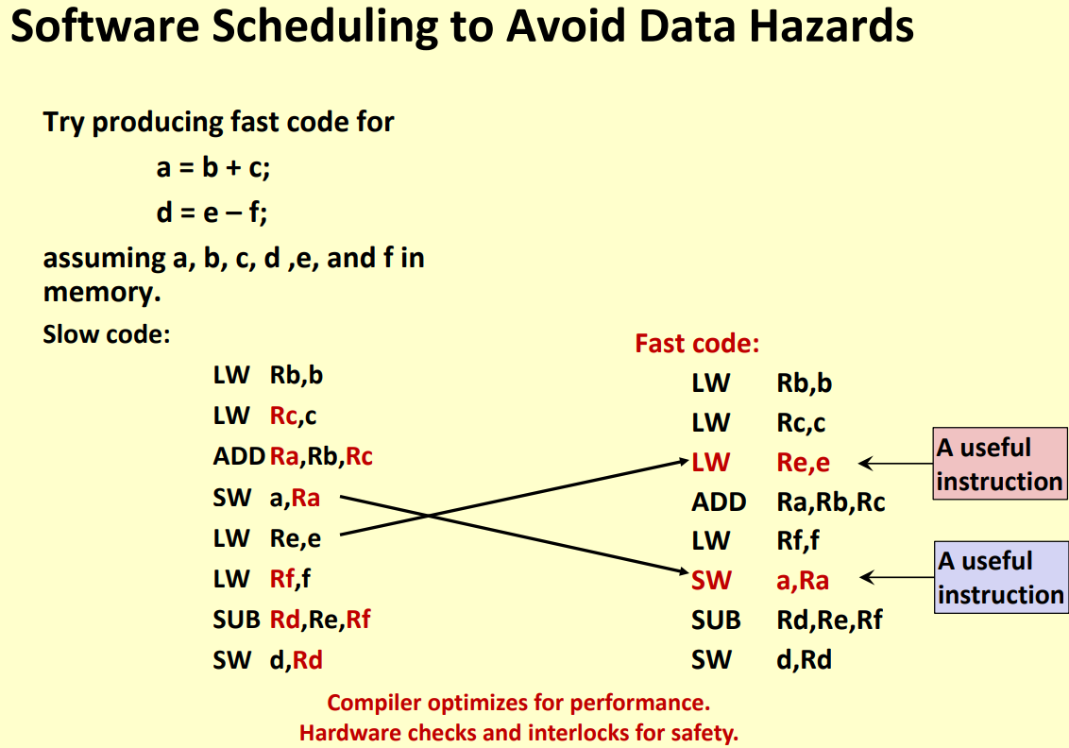
Instruction Reordering for Hazard Removal

Slide 43
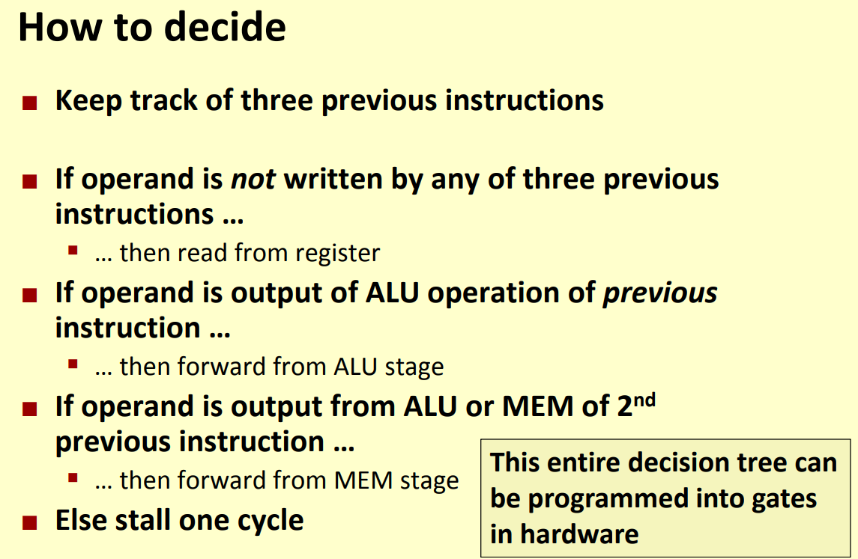
Possible Hardware Design to Avoid Hazard

Slide 44
Control Hazards

Slide 45
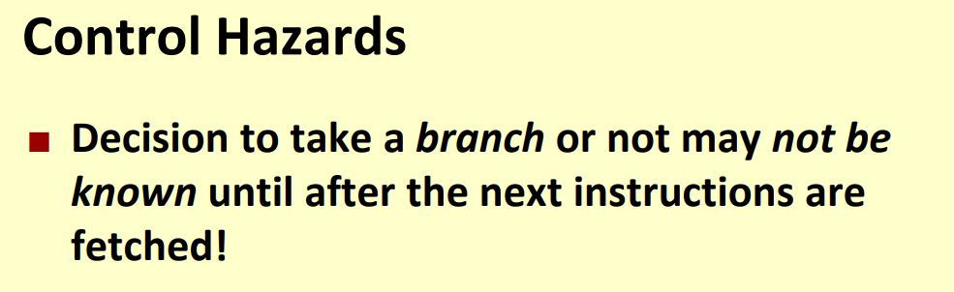
What are Control Hazards?

Slide 46
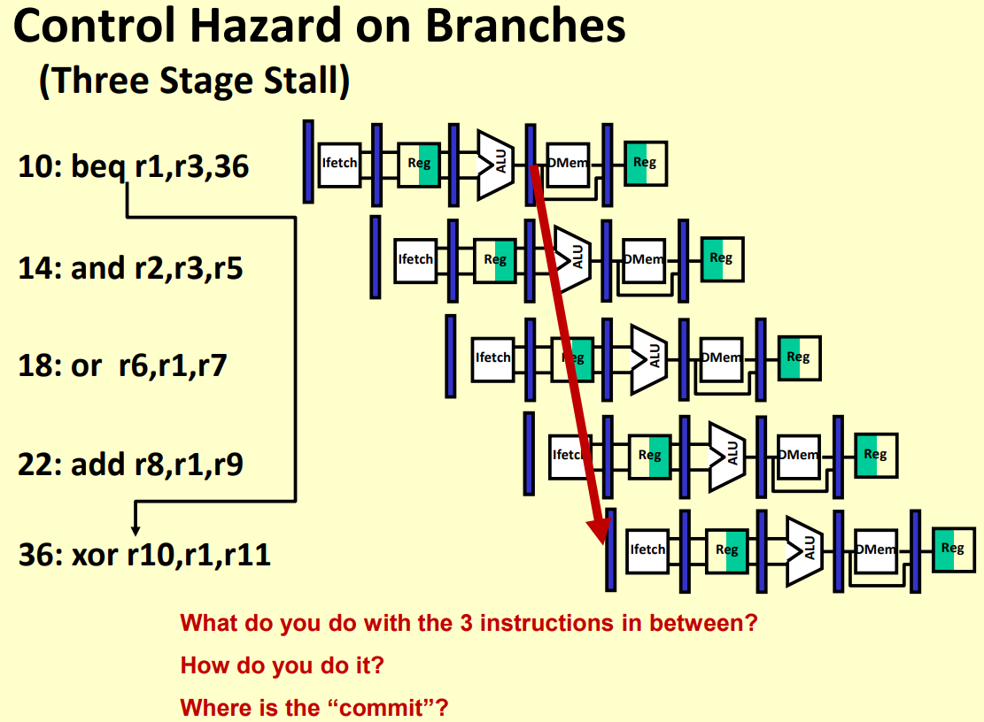
Control Hazard on Branches

Slide 47
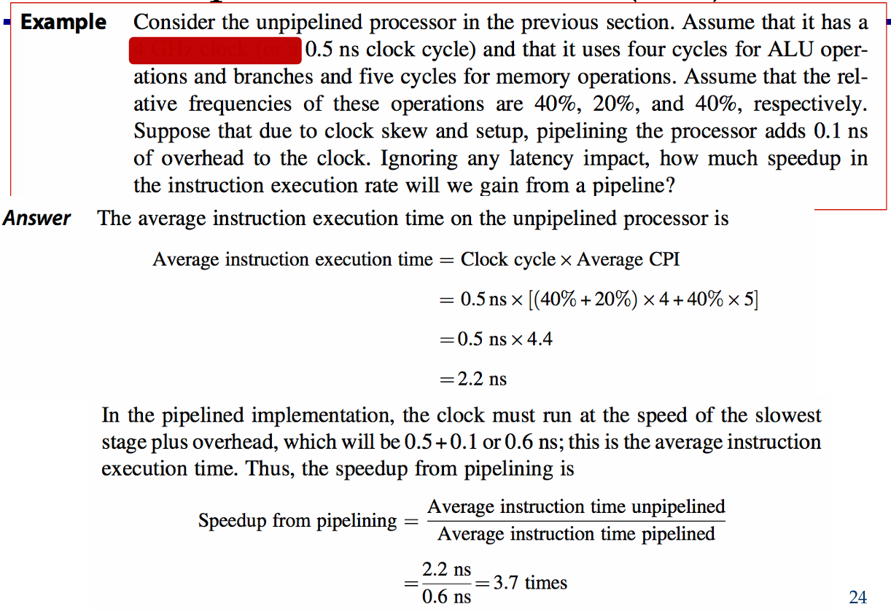
Example of Pipeline Performance

