Slide 1
Computer Architecture
CS 622 / EE 520
Spring 2026
Lecture 4
Shahid Masud

Slide 2
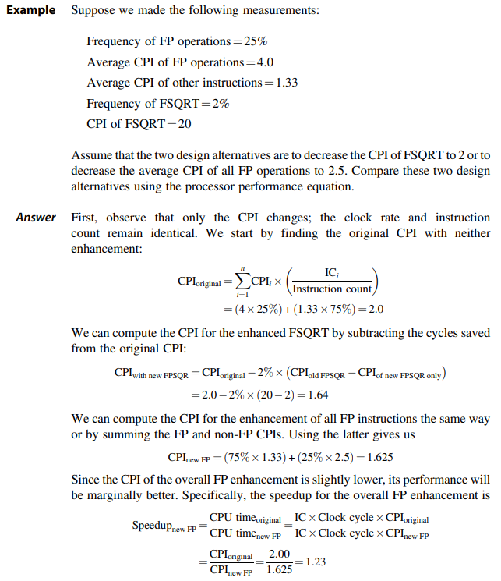
Book Example, pg 54
From last lecture
There are two possibilities for improvement:
Improve all FP operations
Improve FPSQRT operation

Slide 3
Topics
Development of Instruction Set Architecture
  Classifying Instruction Set Architectures
  Memory Access
  Role of CPU Registers in Architectures
  Data Types and Size of Operands
  Memory Addressing and Alignment
  Operations in the Instruction Set
  Instructions for Control Flow
  The Role of Compilers
  Introducing RISC-V ISA
Quiz 1
Next Lecture

Slide 4
RISC-V ISA from Appendix A
Instruction Set Architecture (ISA)

Slide 5
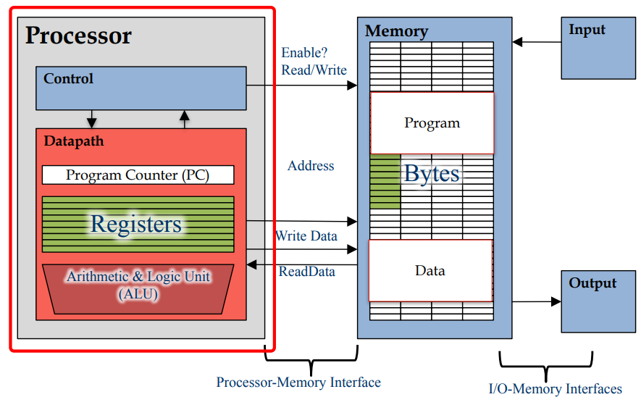



Components of a Computer

Slide 6
What is an Instruction Set Architecture?
Lowest level of Computer Architecture that is visible to a programmer
ISA comprises instructions in Assembly Language and
Corresponding Binary Machine Code
Primitive syntax compared to a high-level language
It is easily interpreted and understood by the CPU
Designed to maximize performance
Represents features and performance of a CPU
Designed to minimize cost and design time

Slide 7
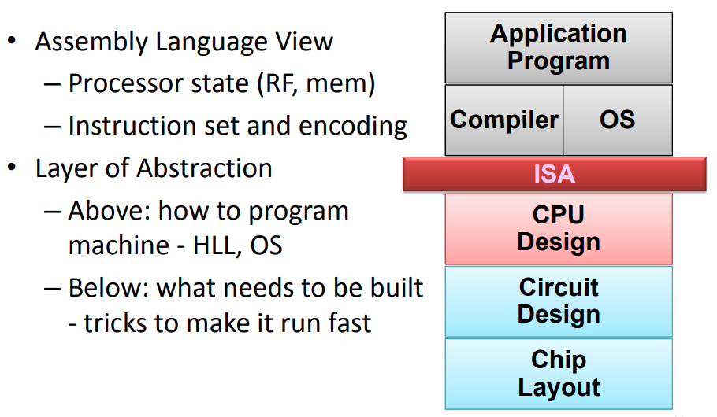
Role of ISA within a Computer
Key:
RF = Register File
Mem = Memory
HLL = High Level Language
OS = Operating System

Slide 8
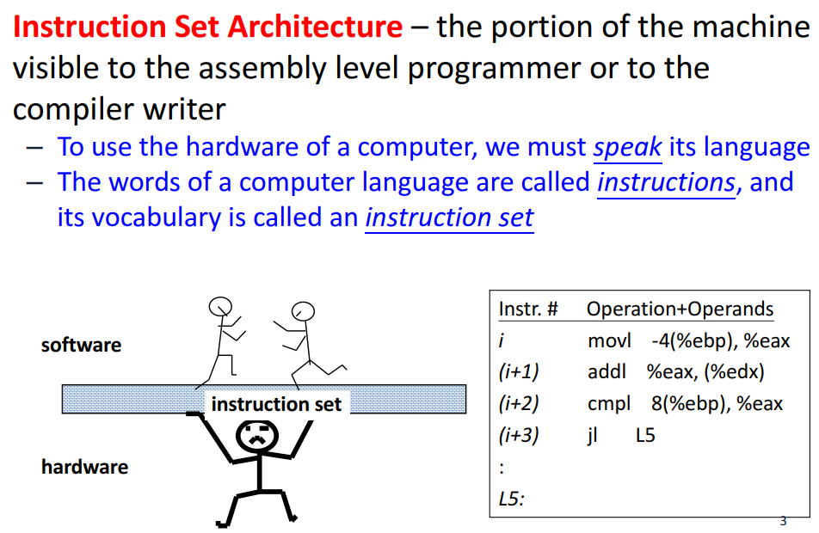
Instruction Set Architecture

Slide 9
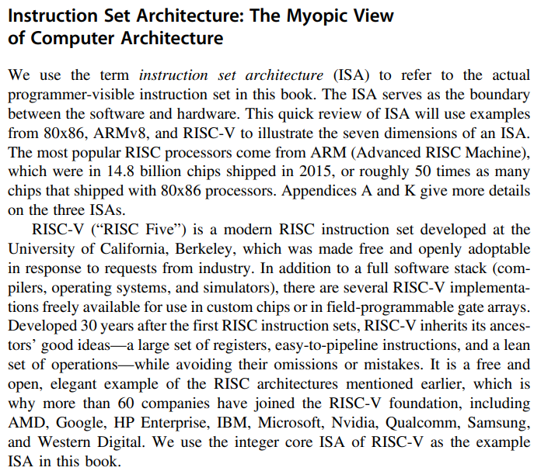



RISC-V ISA

Slide 10
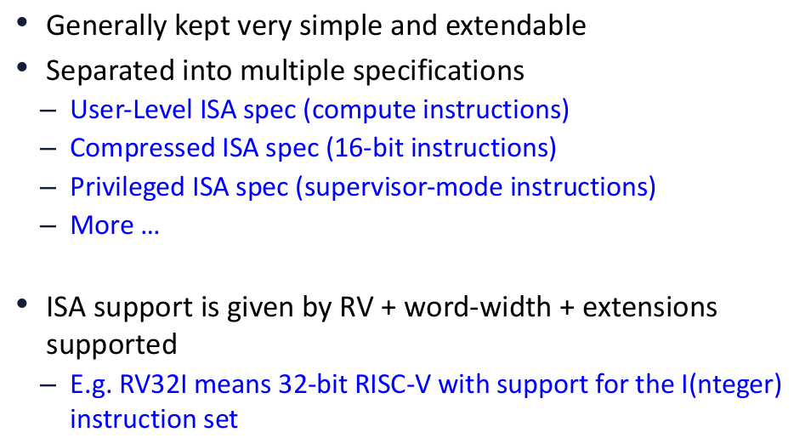
RISC-V ISA Principles

Slide 11
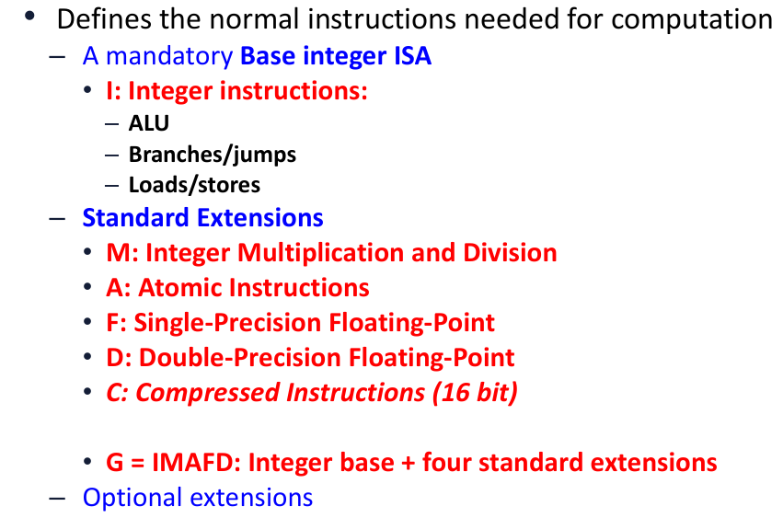
RISC-V Variations

Slide 12
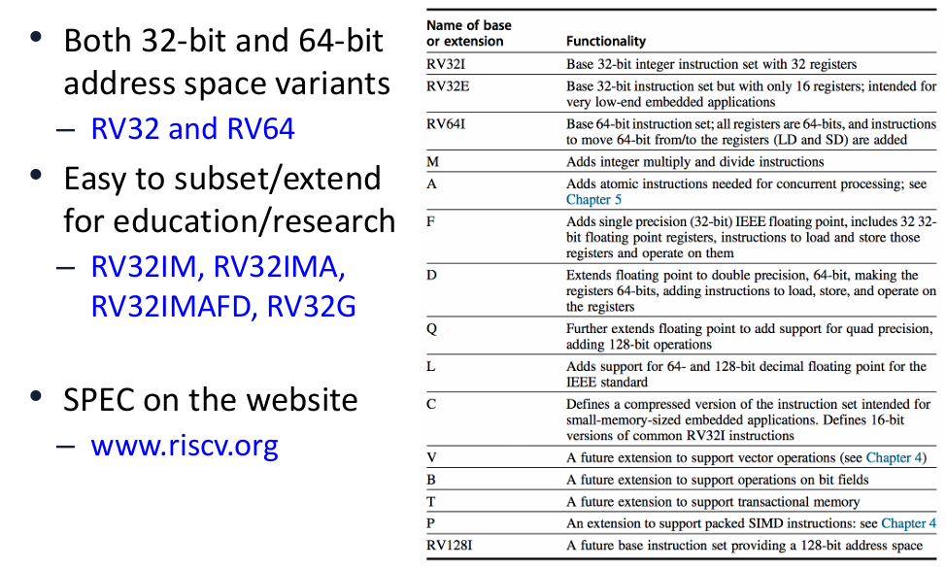
RISC-V Variants

Slide 13
RISC-V Instruction Types and Features
Data Alignment
  32-bit bus vs 8-bit memory
  Big Endian vs Little Endian
Addressing Modes
Type and Size of Operands
  I, R types
Operations available
  Arithmetic
  Logical
  Shift
Control Flow Instructions
  Branch
  Jump

Slide 14
Memory Alignment
CPU Registers

Slide 15
Memory Access – Big Endian vs Little Endian
A CPU Register R0 is 32-bits wide.
It has data “1A2B3C4D” Hex.
Store the data in an 8-bit wide RAM that has 4 locations.
Store in Big-Endian style
or Store in Little-Endian Style
Location | Big Endian RAM
3
2 | Byte width
1
0
CPU Register
R0 Contents
1A 2B 3C 4D
MSB LSB
32-bit Register
Location | Little Endian RAM
3
2 | Byte Width
1
0

Slide 16
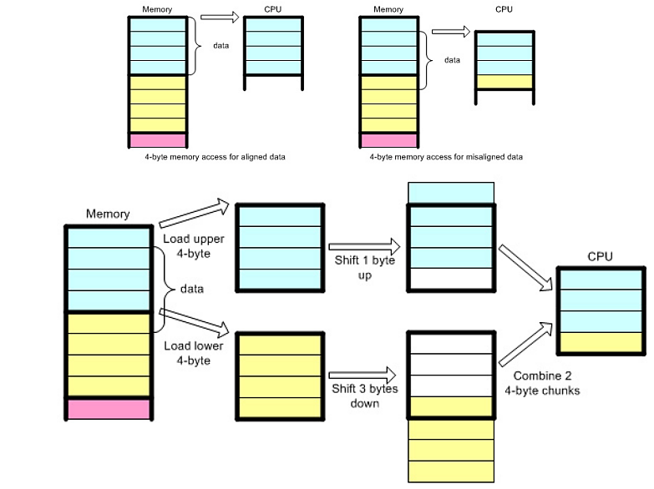
Memory Alignment

Slide 17
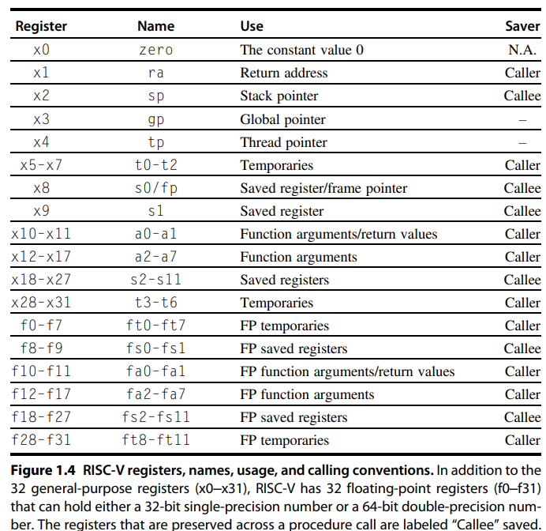
RISC-V Registers Naming Conventions
RISC-V is a Register-rich
Architecture
These Registers are Inside the
CPU and help in data processing
And Storage of Results from ALU

Slide 18
Instruction Fields and Types

Slide 19
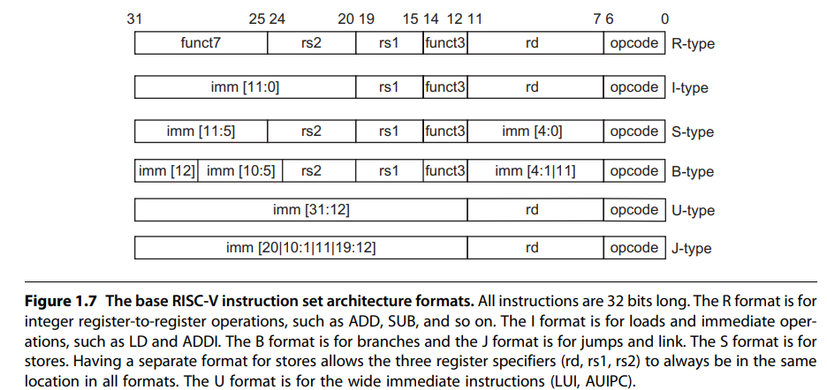












RISC-V Instruction Formats and Types
32-bit wide Instructions

Slide 20
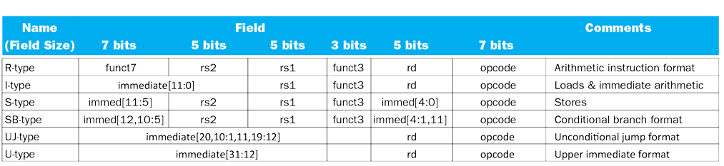
RISC-V Encoding Summary

Slide 21
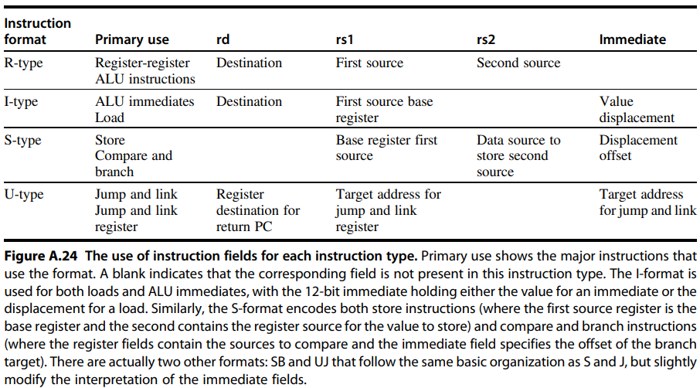
Use of Instruction Fields

Slide 22
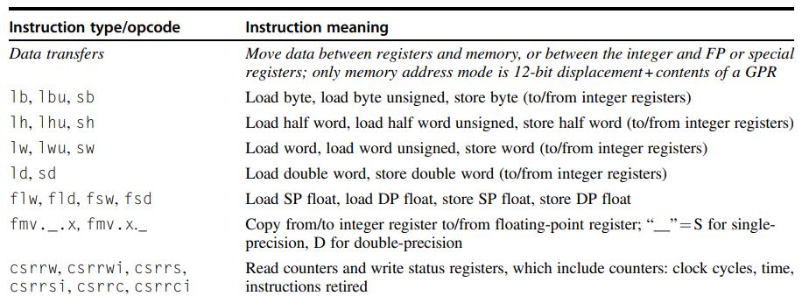


RISC-V Data Type Instructions

Slide 23
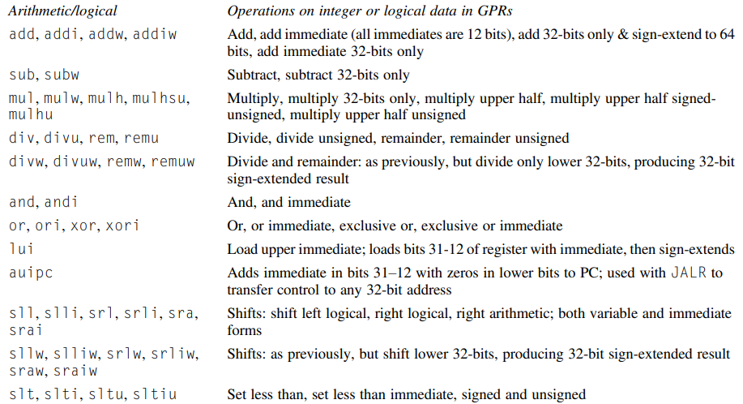
RISC-V Arithmetic / Logical Instructions

Slide 24
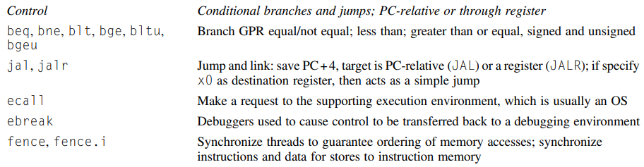



RISC-V Control Instructions

Slide 25
Classifying ISA

Slide 26
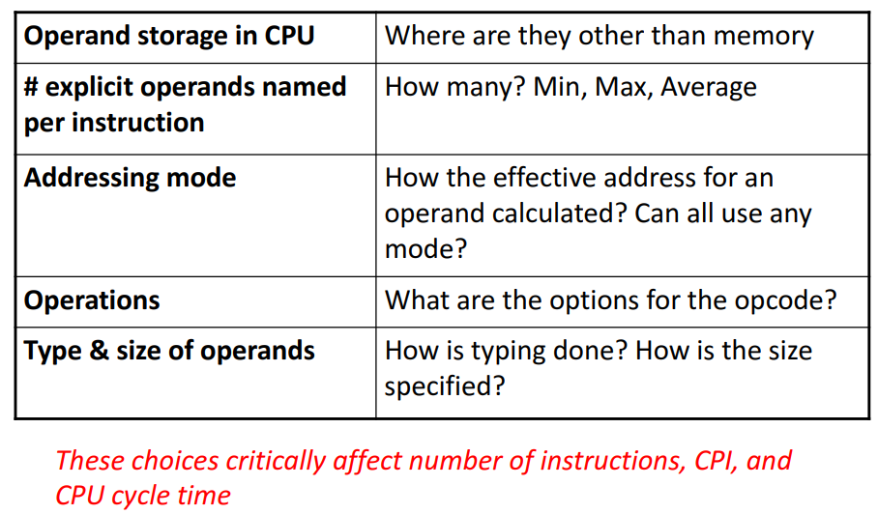
Classifying Instruction Set Architectures

Slide 27
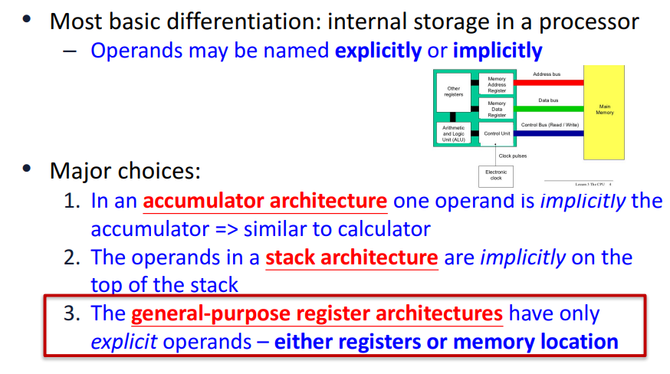
ISA Classification

Slide 28
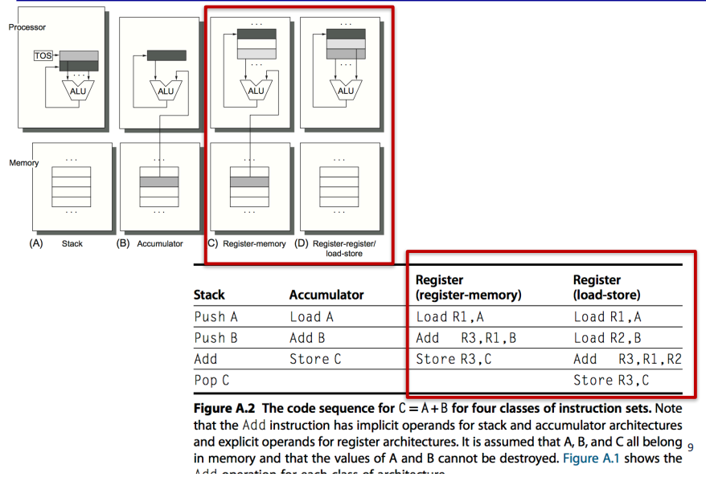
Four ISA Classes

Slide 29
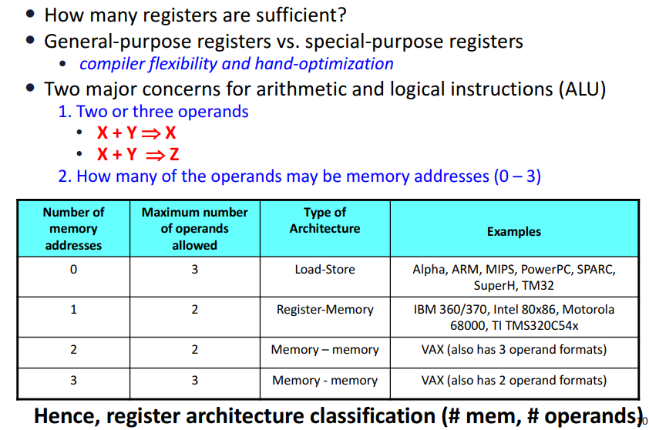
Register Machines

Slide 30
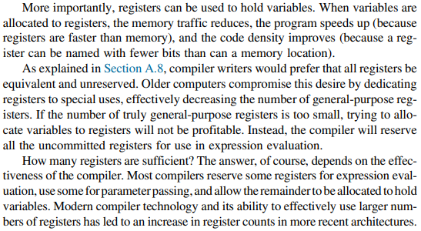

Advantages of Registers Rich CPU Architecture

Slide 31
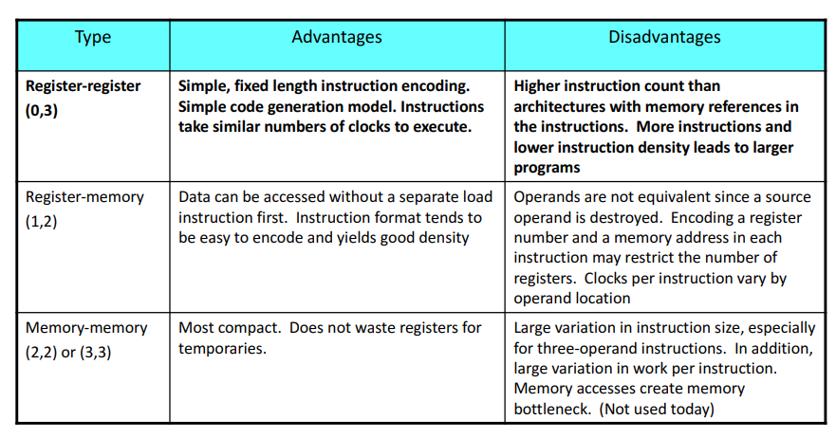




Tradeoffs for the ISA Classes

Slide 32
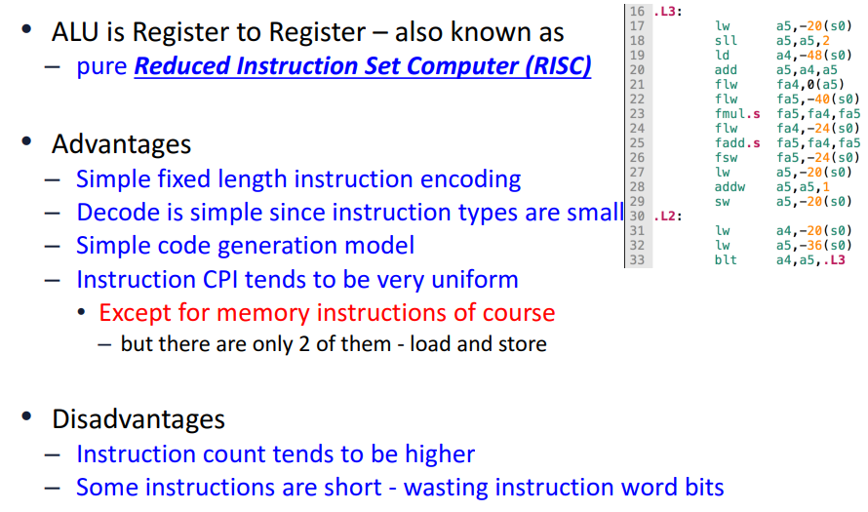
(0,3) Register-Register RISC Architecture

Slide 33
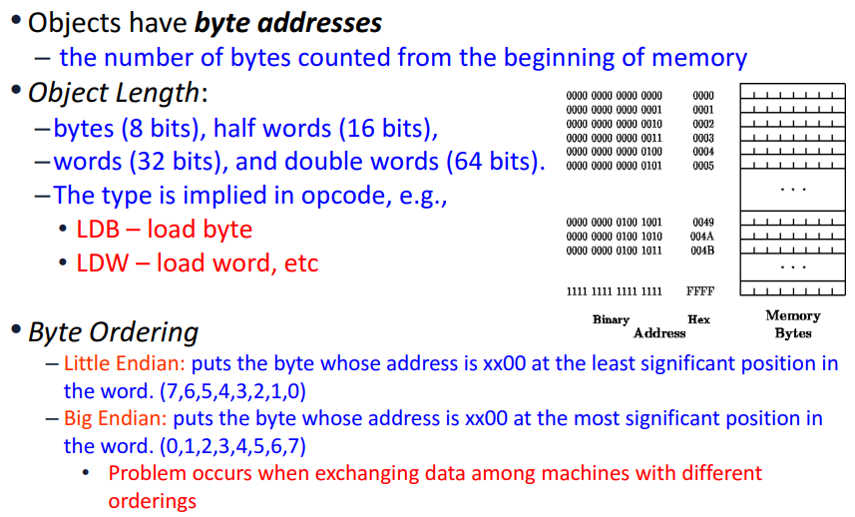
Memory Addressing

Slide 34
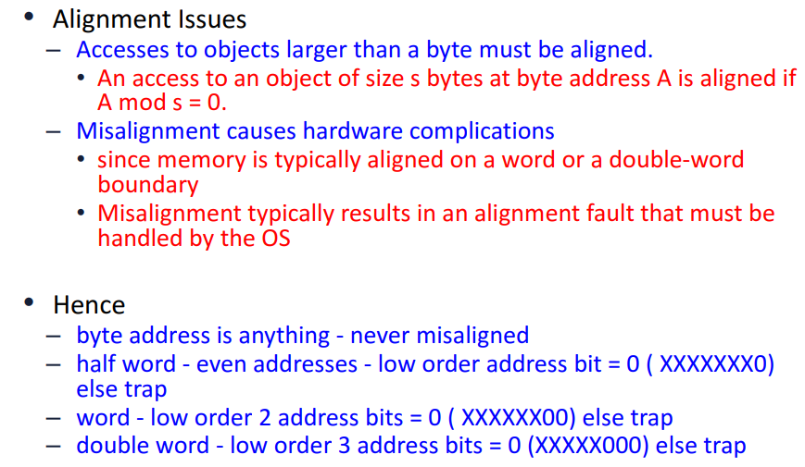
Interpreting Memory Addresses

Slide 35
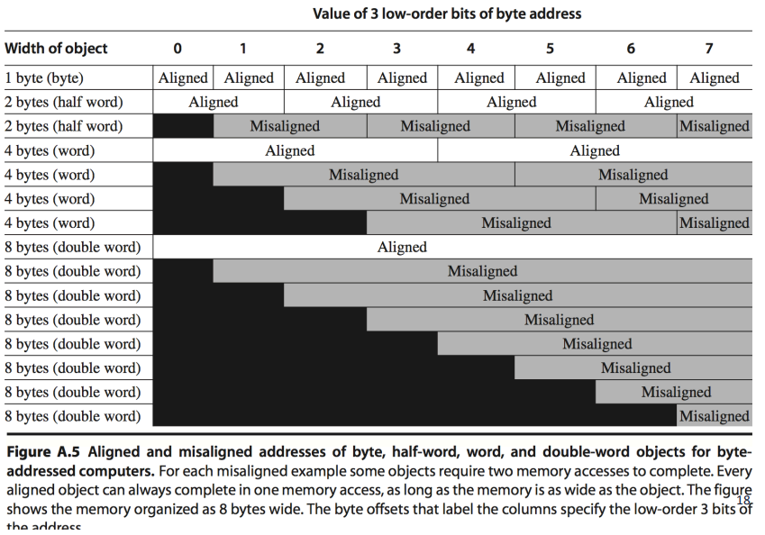
Aligned / Misaligned Addresses

Slide 36
Addressing Modes in RISC-V ISA

Slide 37
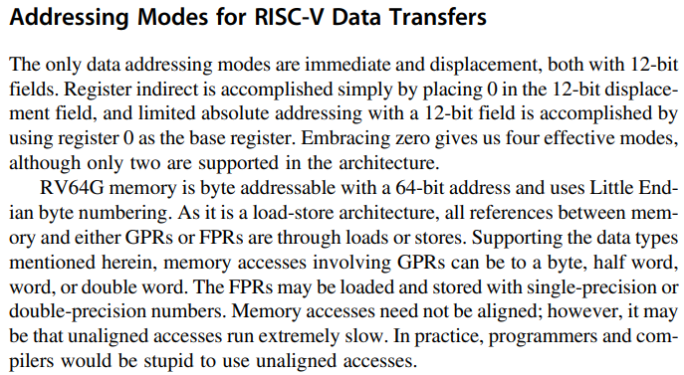

Addressing Modes in RISC-V

Slide 38
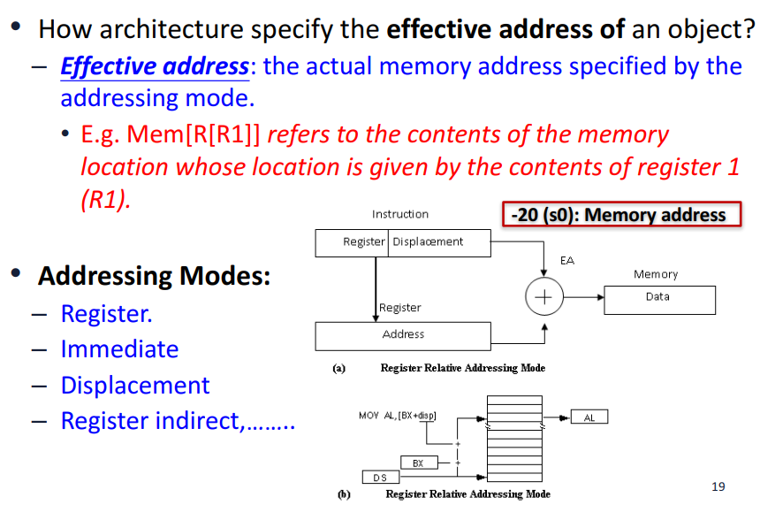
Addressing Modes

Slide 39
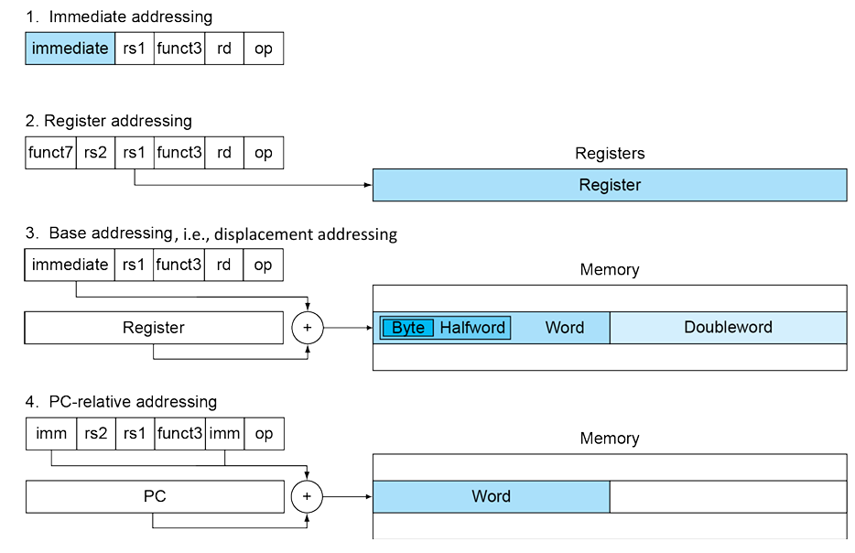
RISC-V Addressing Summary

Slide 40
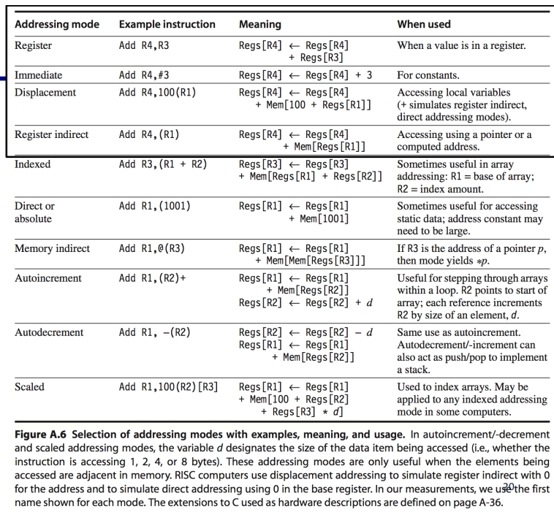
Addressing Modes Comparison

Slide 41
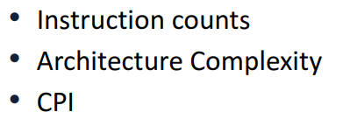
Impact of Addressing Modes

Slide 42
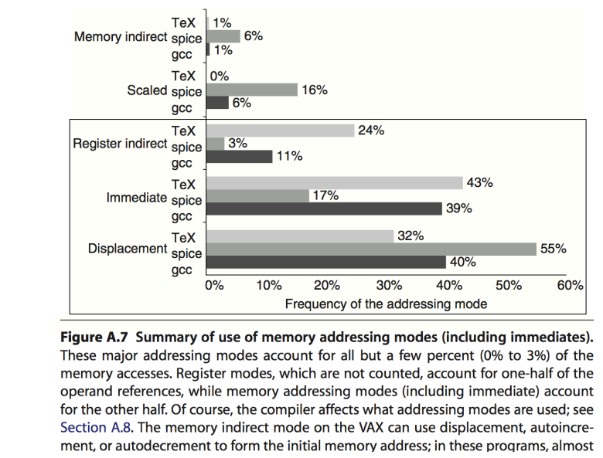
Summary of Usage of Addressing Modes

Slide 43
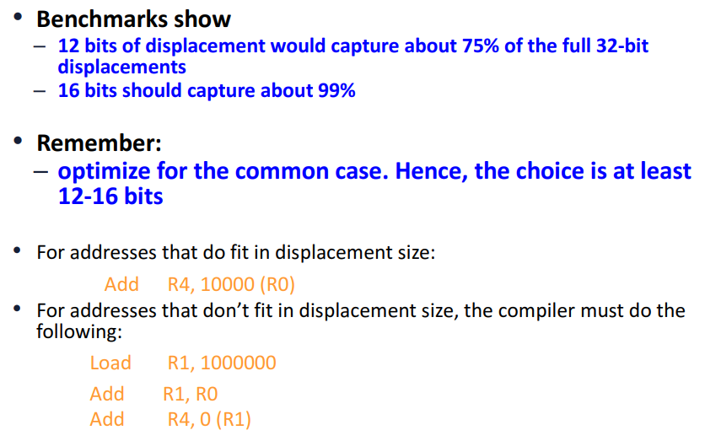
Displacement Addressing Mode

Slide 44
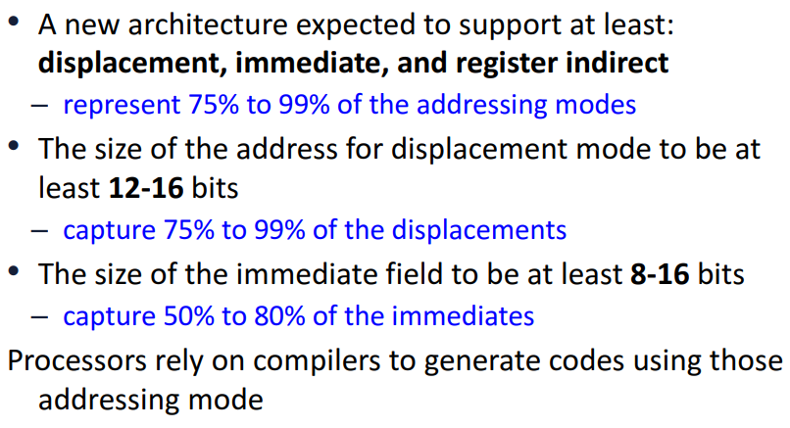
Experimental Determination

Slide 45
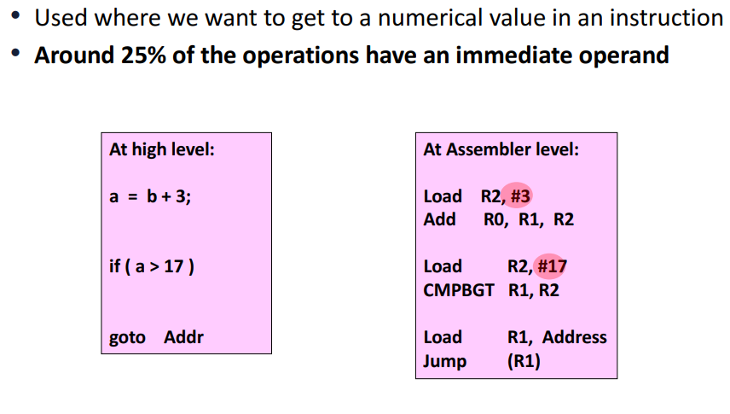
Immediate Addressing Mode

Slide 46
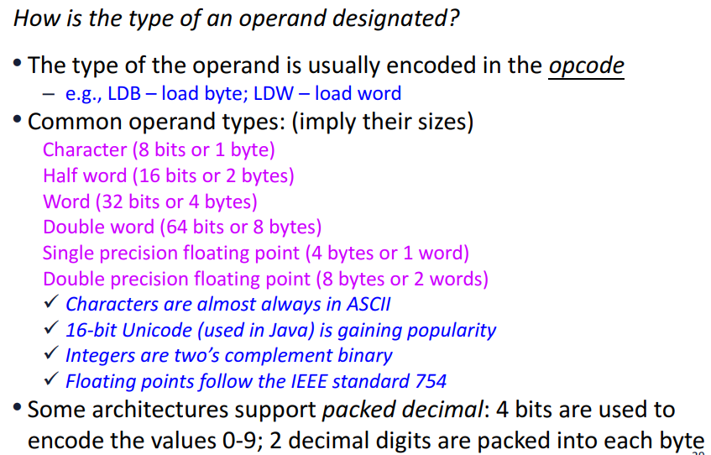
4 Types and Sizes of Operands

Slide 47
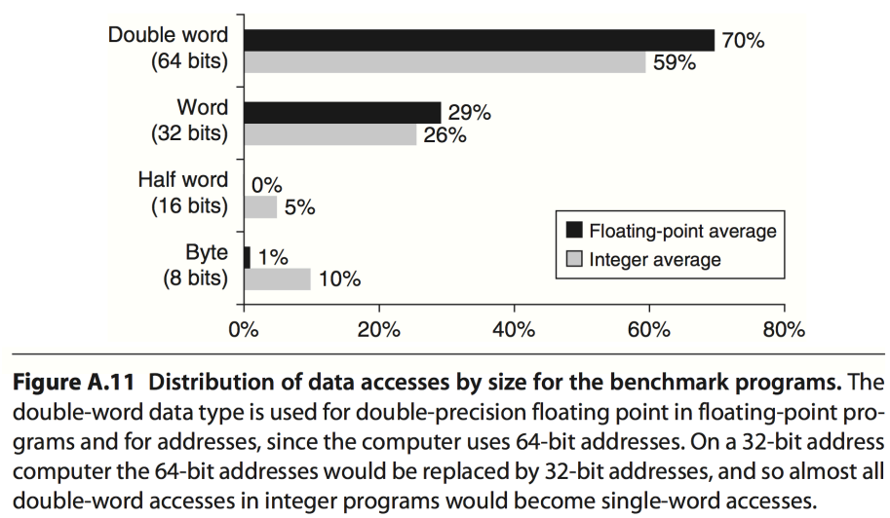
Distribution of Data Accesses vs Operand Size

Slide 48
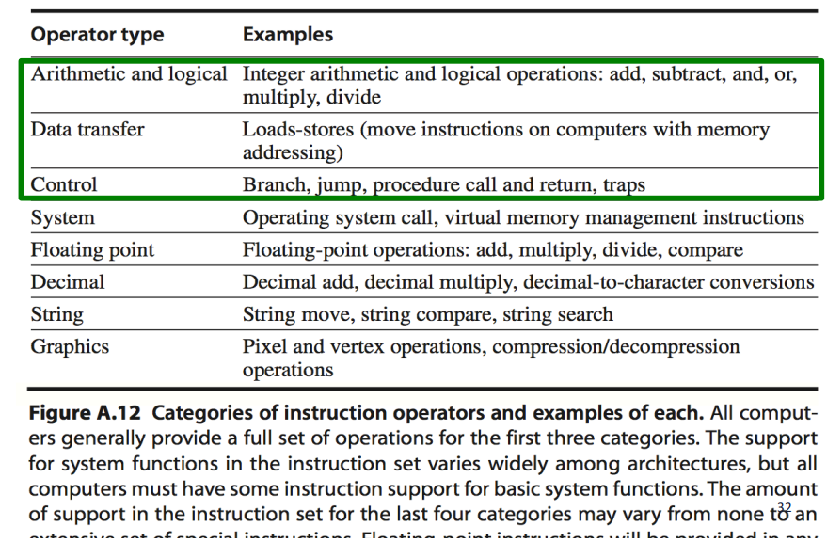
Operations in the Instruction Set

Slide 49
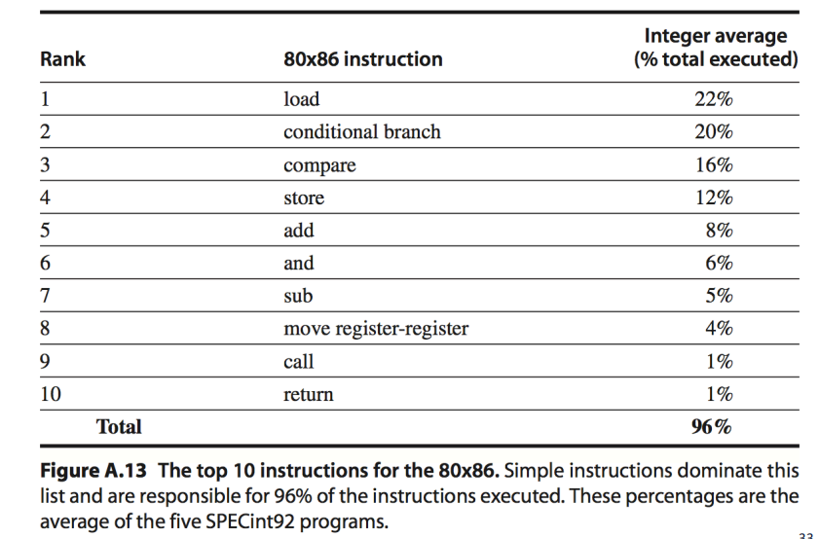
Top 10 Instructions for x86

Slide 50
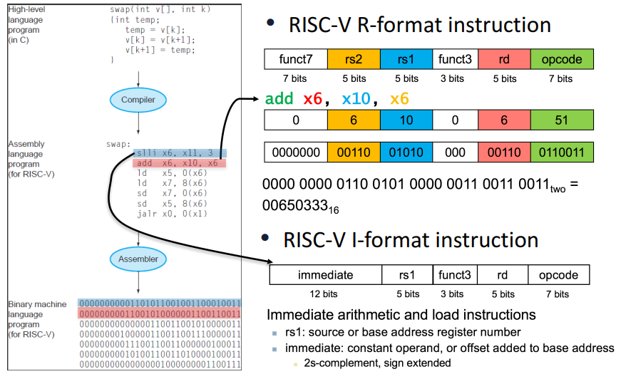
Instruction Encoding

Slide 51
Control Flow Instructions

Slide 52
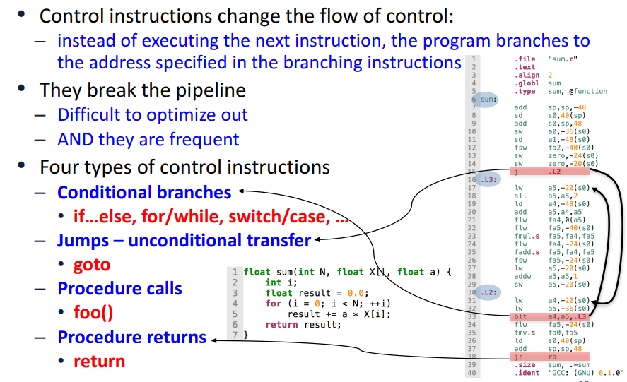
Instructions for Control Flow

Slide 53
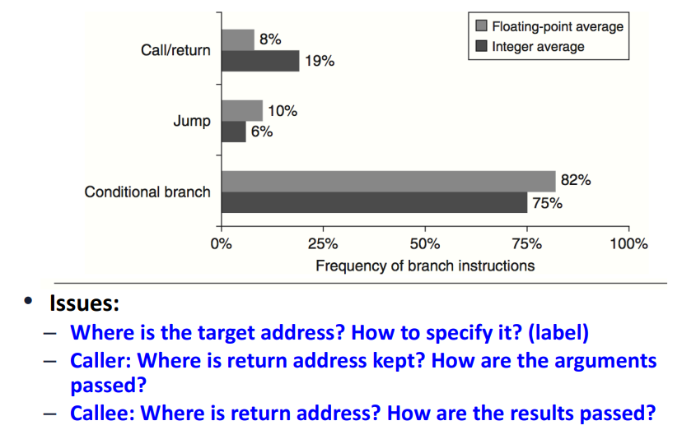
Breakdown of Control Flow Instructions

Slide 54
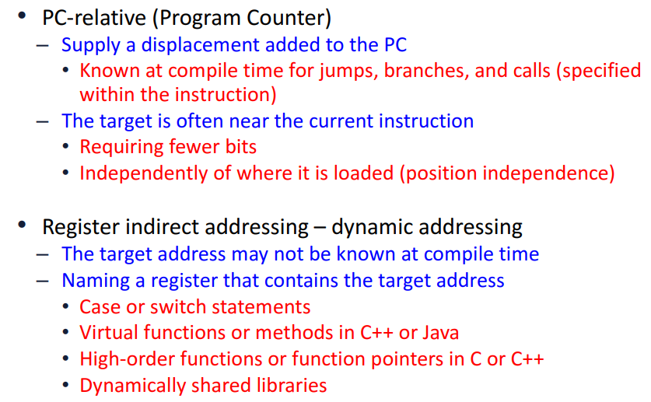
Addressing Modes for Control Instructions

Slide 55
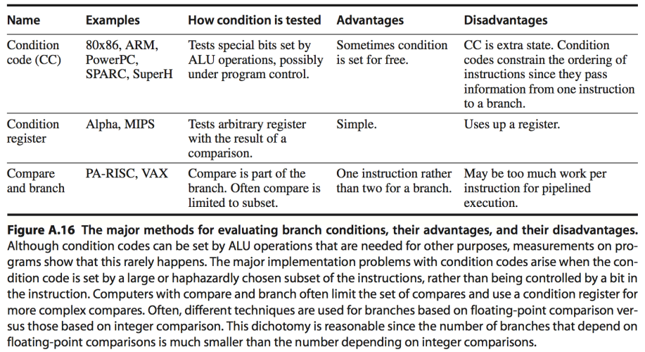
Conditional Branch Options

Slide 56
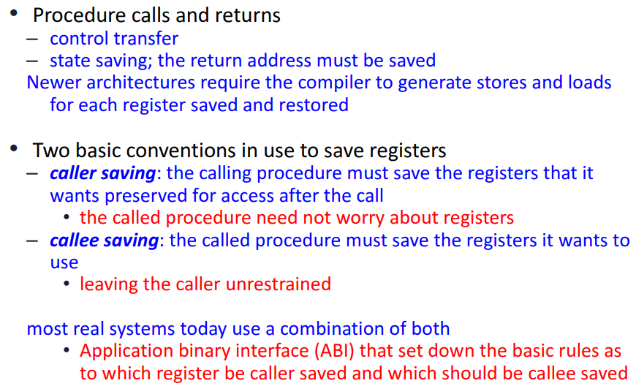
Procedures and Functions

Slide 57
Instruction Encoding and Role of Compilers

Slide 58
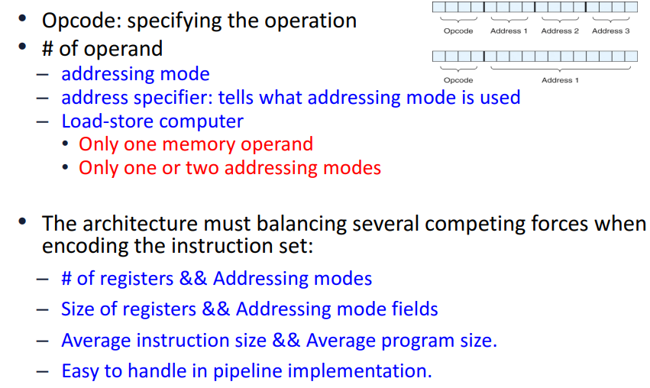
Encoding an Instruction Set

Slide 59
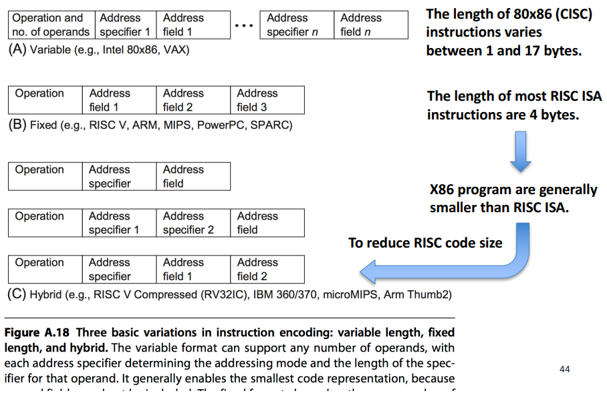
Three Basic Variations of Instruction Encoding

Slide 60
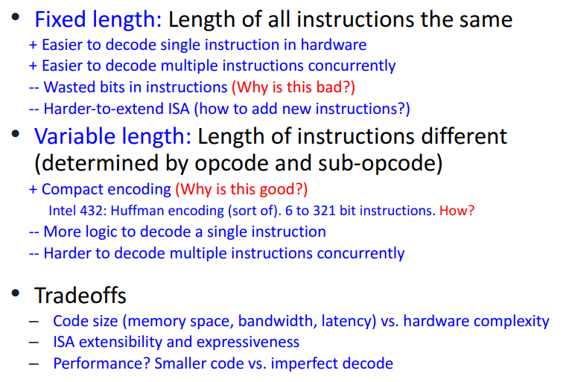
Instruction Length Tradeoff

Slide 61
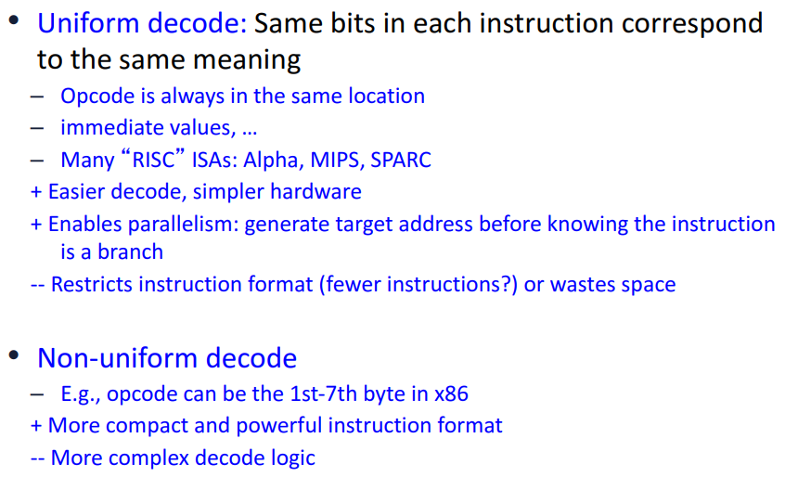
Uniform Decoding vs Non-Uniform Decoding

Slide 62
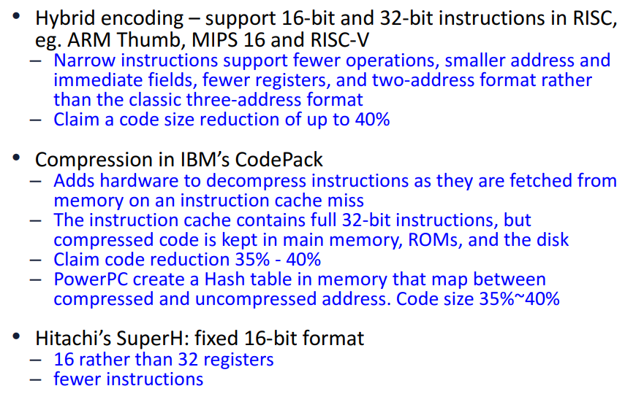
Reduced Code Size in RISC

Slide 63

Different Choices of Instruction Encoding

Slide 64

Role of Compilers

Slide 65

Modern Compiler Structure

Slide 66

Types of Compiler Optimizations

Slide 67

Major Types of Compiler Optimizations

Slide 68

Comparing Some Real ISA

Slide 69


Slide 70


Slide 71
EXTRA SLIDES – May Ignore Further slides

Slide 72

Operands in ISA

Slide 73

Add Instruction in different Operand architecture

Slide 74

Compare - Load Store Architecture

Slide 75

General Purpose Registers

Slide 76

Byte Addressed Computers

Slide 77

Addressing Modes

Slide 78

Memory Addressing Modes

Slide 79

Categories of Instruction Operators

Slide 80

Using SPEC Int Benchmark

Slide 81


Benchmark on Control Instructions

Slide 82







Procedures and Functions
int square(int x)
{
int square_of_x;
square_of_x = x * x;
return square_of_x;
}
PUSH and
POP Instructions
int square_of_10;
square_of_10 = square(10);

Slide 83

Suggestions for Architecture

Slide 84

Instruction Encoding Variety

Slide 85


Reduced Code Size in RISC

Slide 86

Compiler Optimizations

Slide 87


How Architecture Helps Compilers

Slide 88


Stack, Heap

Slide 89

Aims of RISC-V Architecture

Slide 90

Organization of RISC-V ISA

Slide 91





RISC-V Variants
RV64G

Slide 92

Data Types in RISC-V

Slide 93

Load and Store Instructions

Slide 94

Understanding Address Conventions

Slide 95

Basic ALU Instructions

Slide 96

Control Flow Instructions

Slide 97

Example Assembly code for FP sum function

Slide 98

Acknowledgement: Slides Adapted from:
Readings:
Appendix A of course textbook

