Slide 1
Loop Unroll and Schedule Example 3
https://www.youtube.com/watch?v=EzDGaxZFU8M

Slide 2
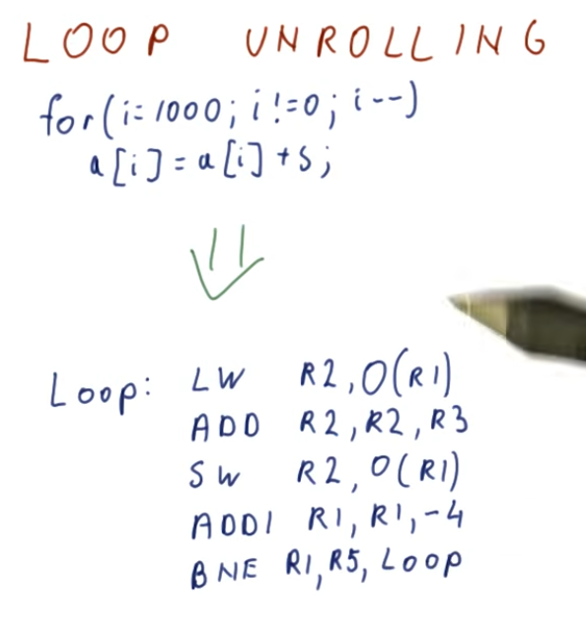

Slide 3
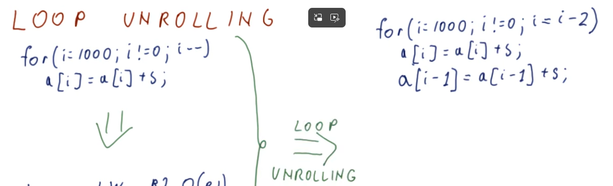
Loop Unrolling - Georgia Tech - HPCA: Part 3

Slide 4
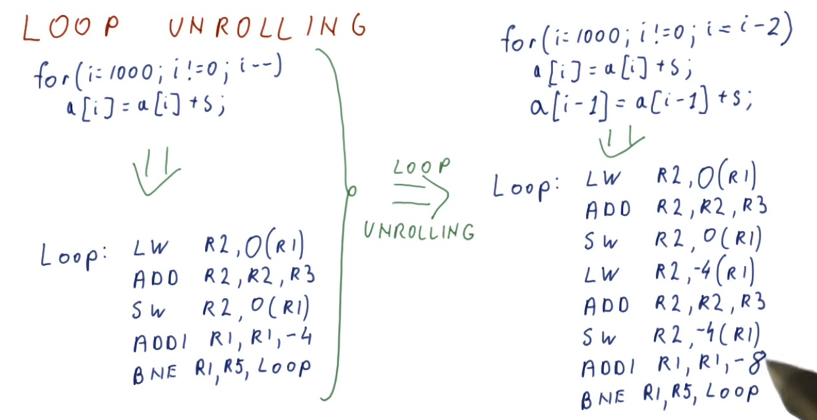
Unrolled
ONCE

Slide 5
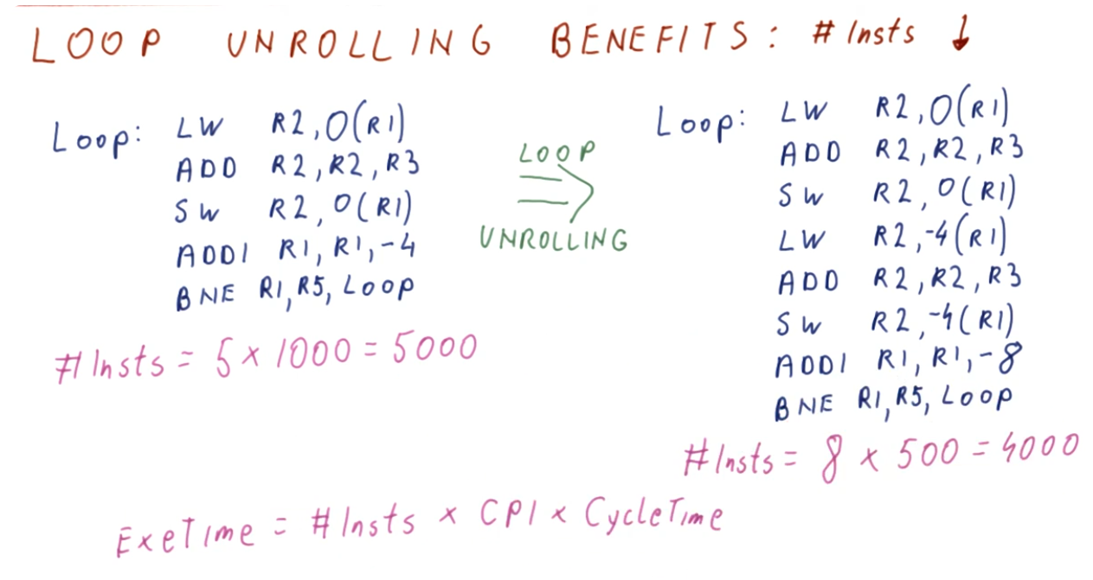

Slide 6
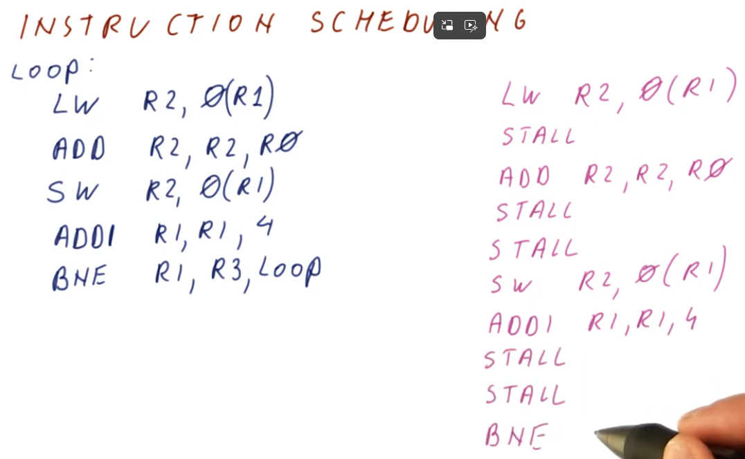
LW = 2 cycles
ADD = 3 cycles
10 Cycles

Slide 7
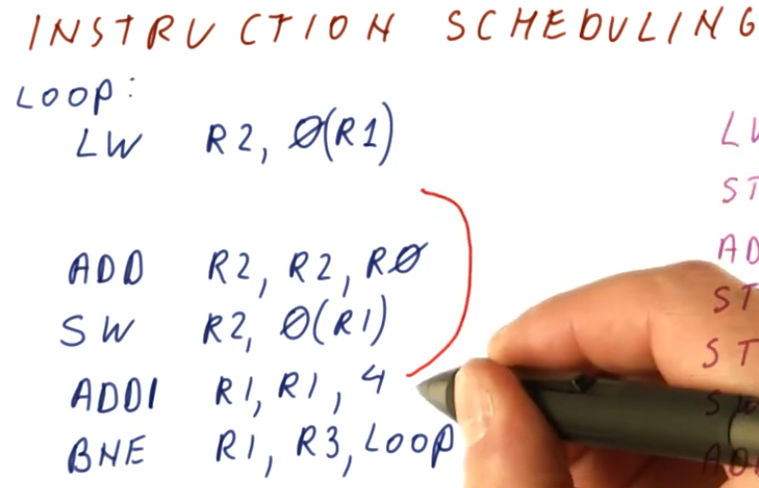
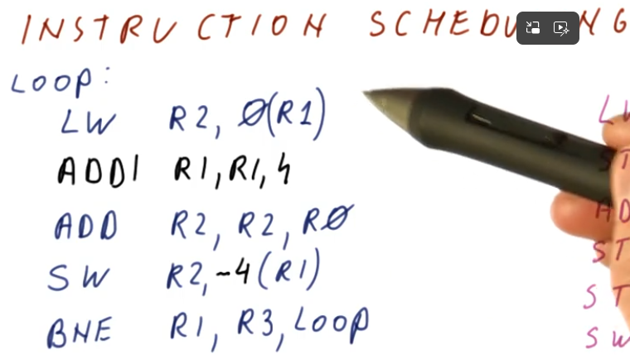

Slide 8
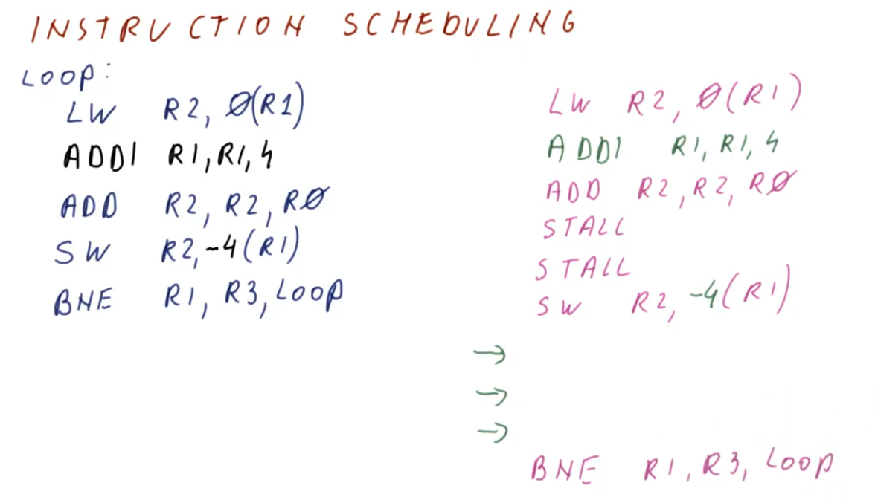

Slide 10
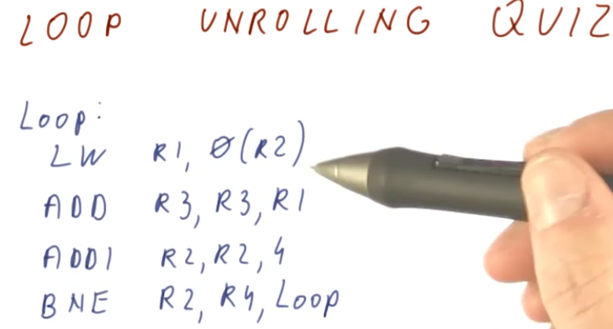

Slide 11
