Slide 1
Loop Unrolling Example 2

Slide 2
Loop Unrolling Example 2
Without Scheduling
With Scheduling
Clock Cycles / Time Improvement

Slide 3

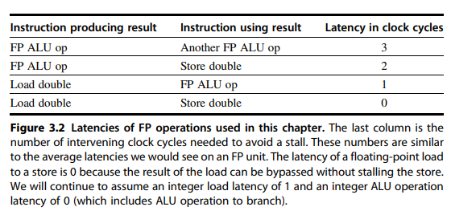
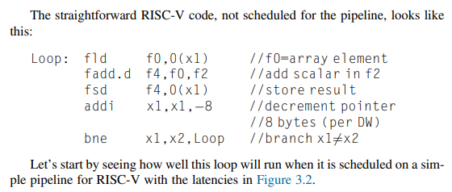





Architecture Features
Converted to Assembly

Slide 4
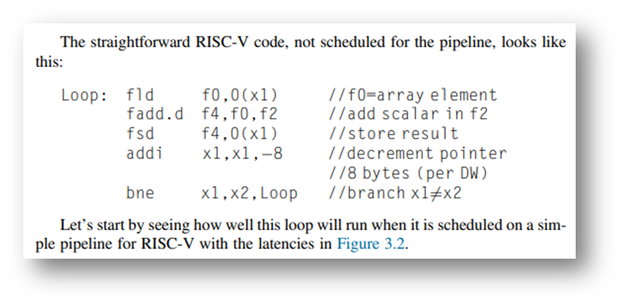
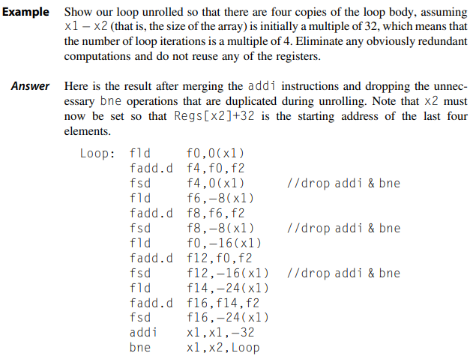
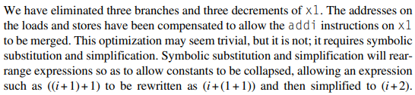
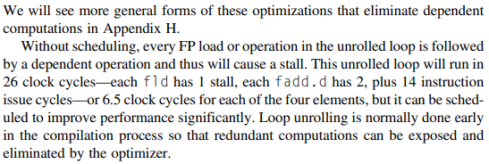



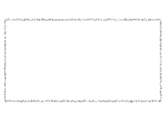




Unrolling without Schedule
Bne moved to end
Of unrolled code

Slide 5
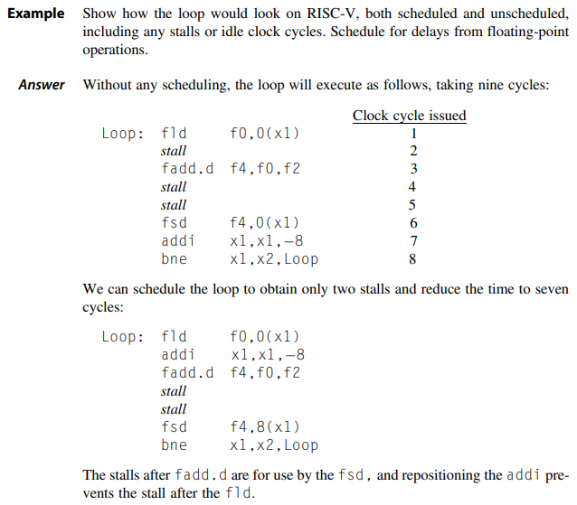
Unrolling with Schedule
Avoid Hazard

Slide 6
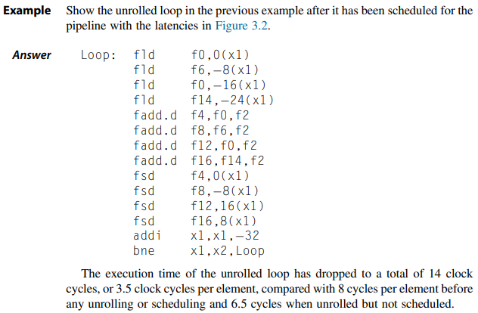
Reordering to Avoid Hazard

