Slide 1
Computer Architecture
CS 622 / EE 520
Fall 2026
Lecture 9
Shahid Masud

Slide 2
Topics
Quick Review of Pipeline and Hazards
MIPS R4000 Deep Pipeline Example
Scoreboard in Dynamic Branch Prediction
Instruction Level Parallelism – Chapter 3
Parallelism through Loop Unrolling
Quiz 2
Next Lecture

Slide 3
Slides Adapted from: (Further Readings)
Reading Notes
Readings:
Appendix C of course textbook
Chapter 3 of course textbook

Slide 4
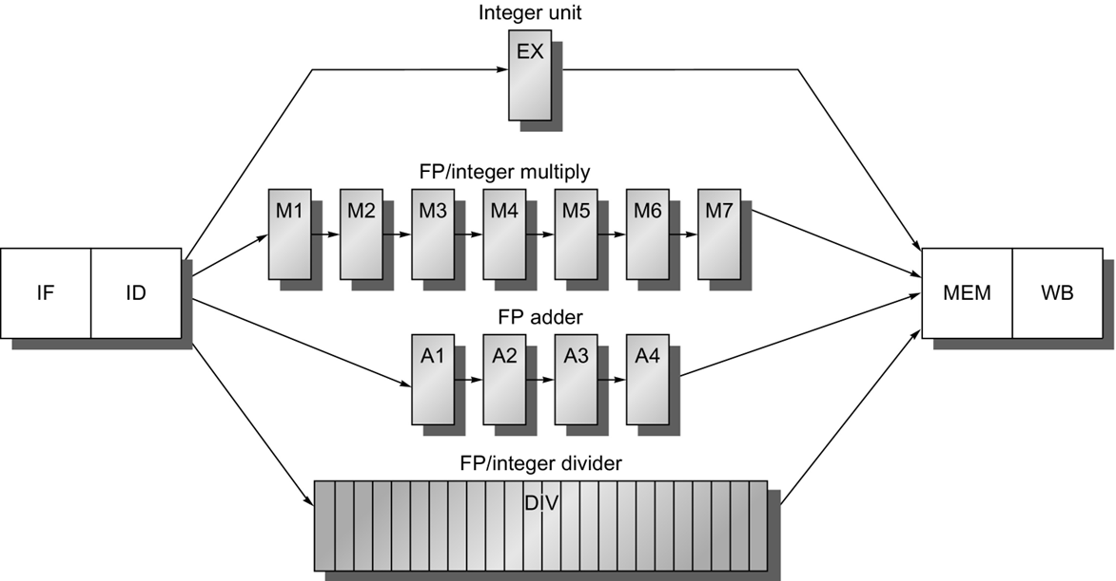

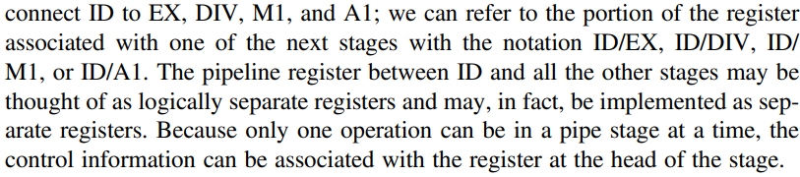
Adding Registers
Multicycle Pipeline

Slide 5

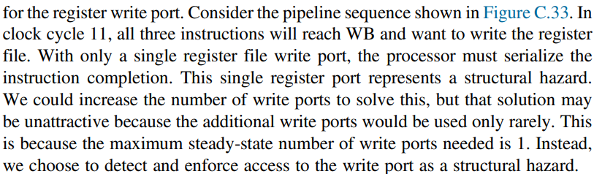
Problem With Writes in Multicycle Pipeline

Slide 6
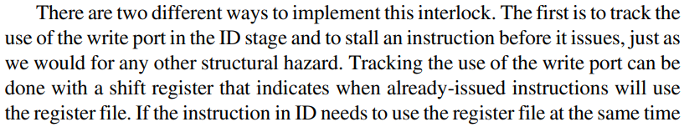
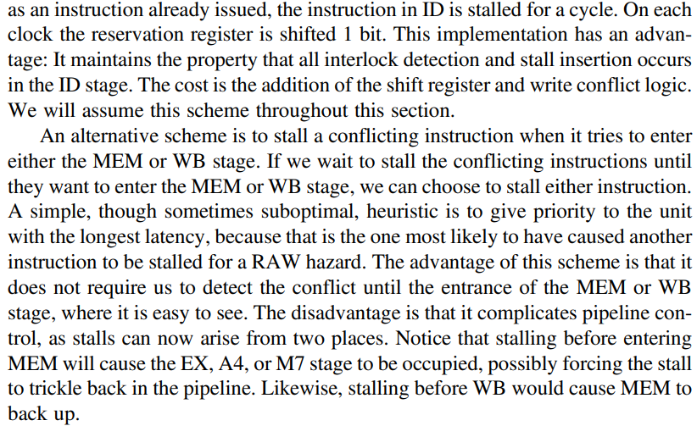


Implement this Interlock

Slide 7
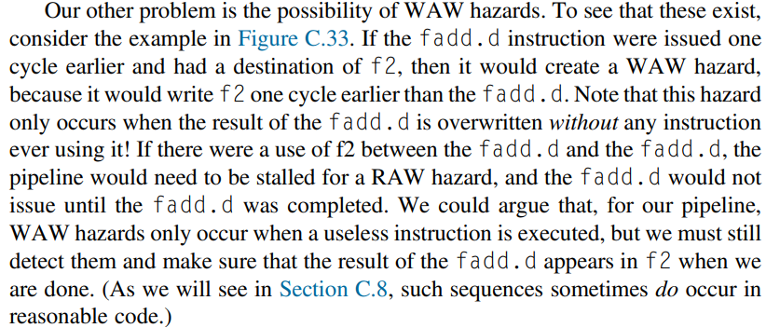
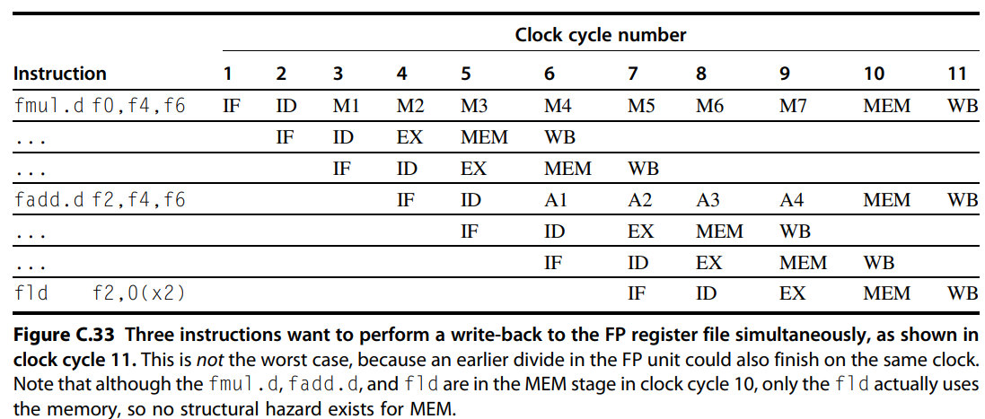



WAW Hazard

Slide 8
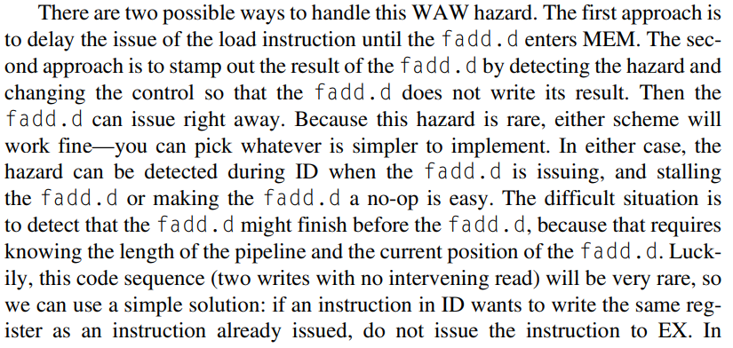


How to handle this WAW Hazard?

Slide 9
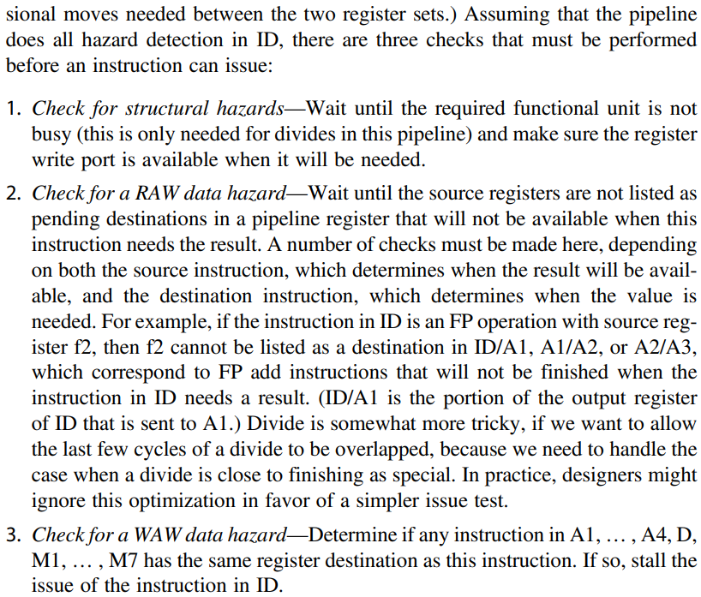


What To check while issuing an Instruction?

Slide 10
Out of Order Completion

Slide 11
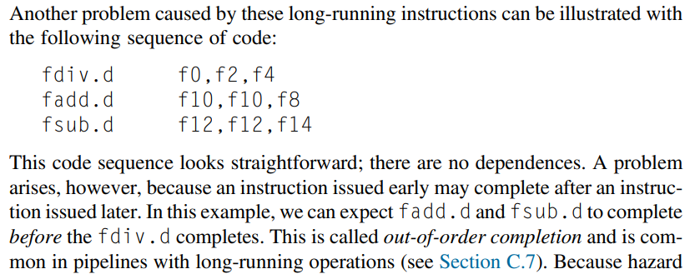

Out of Order Completion

Slide 12

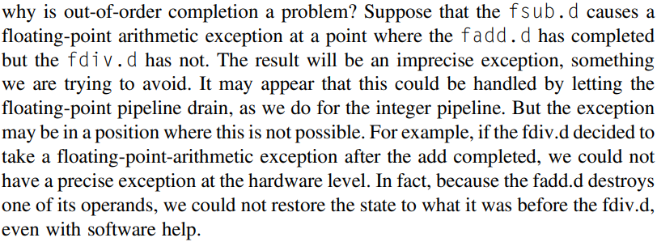

Problem with Out-of-Order Completion

Slide 13
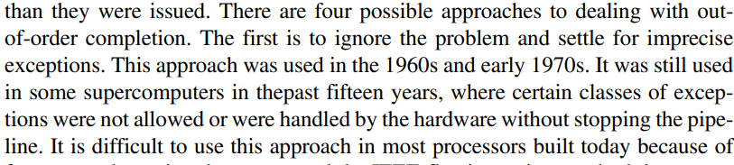
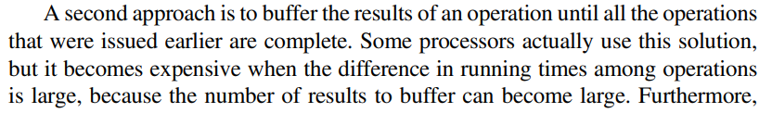
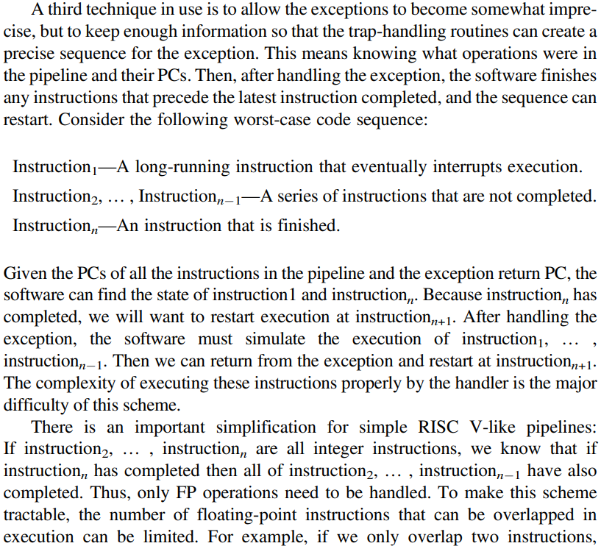
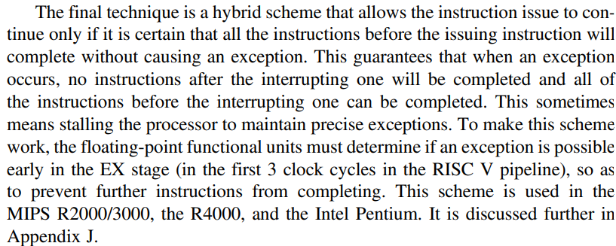


Solution to out of order completion

Slide 14
MIPS R4000 Deep Pipeline Example

Slide 15
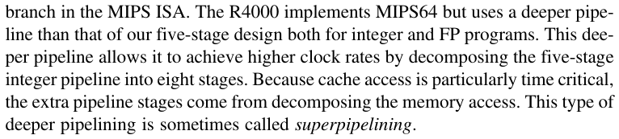
Superpipelining

Slide 16
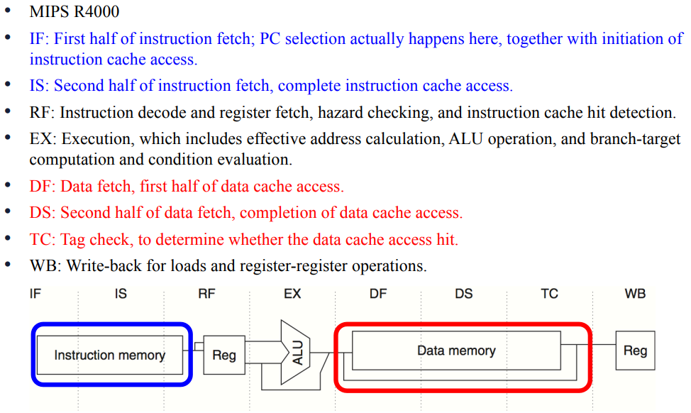
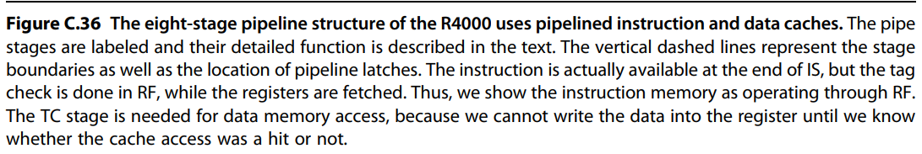
8 Stage Pipeline of MIPS R4000
SUPERPIPELINING

Slide 17
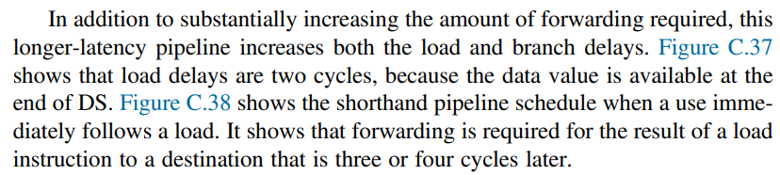
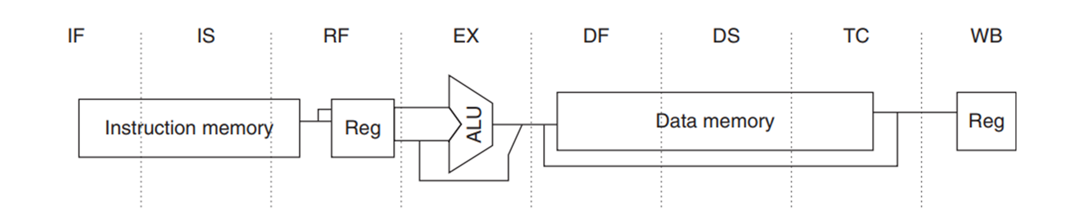
Complexity in Architecture

Slide 18
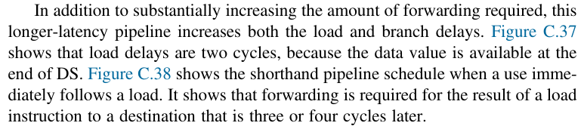

Slide 19
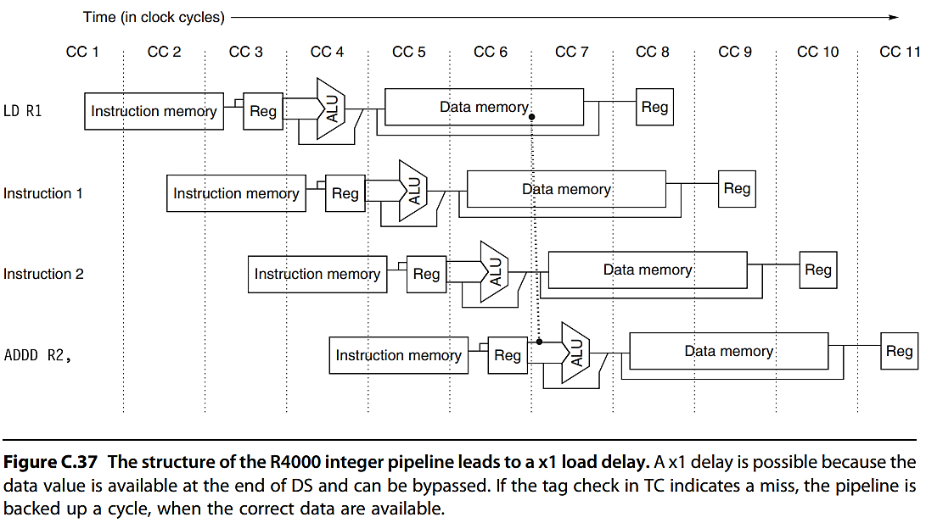
2 Cycle Load Delays

Slide 20
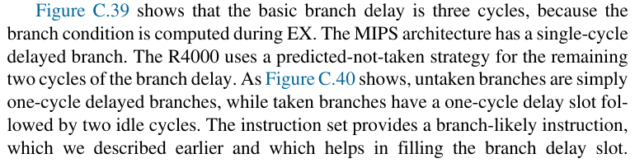

Slide 21
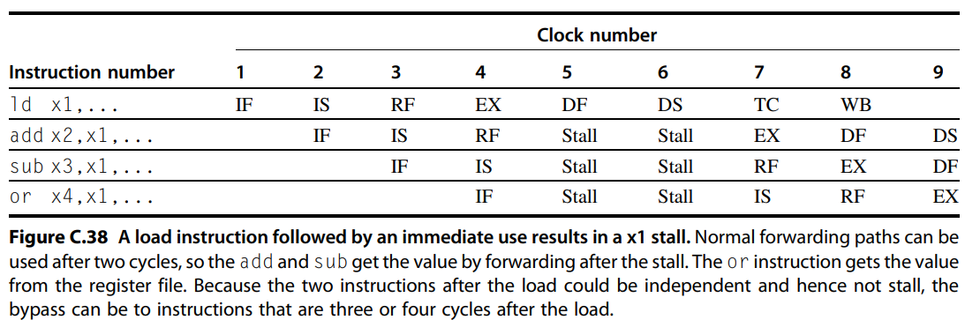

Forwarding Example MIPS 4000

Slide 22
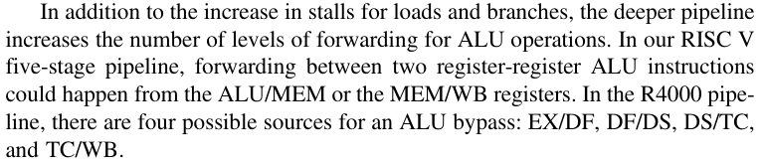

Slide 23
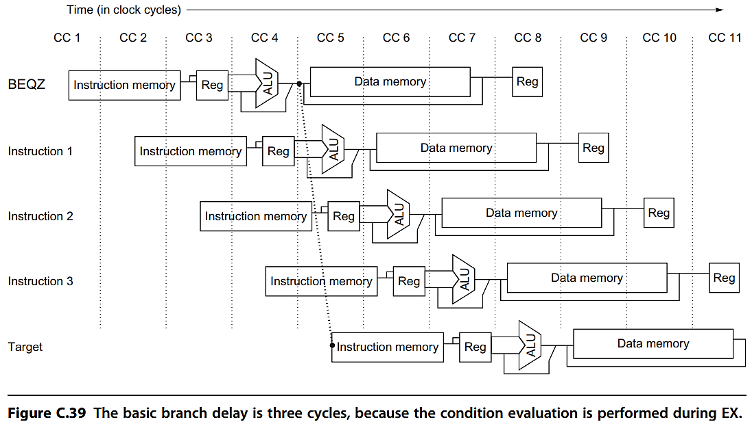

Basic Branch Delay

Slide 24
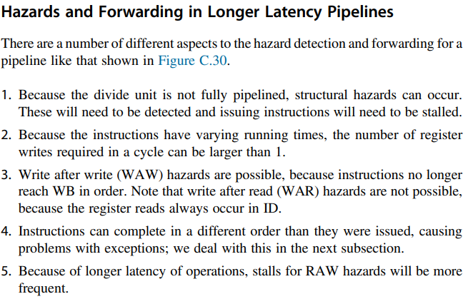
Hazards and Forwarding in Longer Pipelines

Slide 25
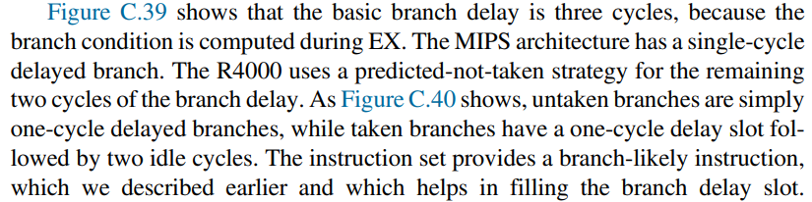

Branch Delays

Slide 26
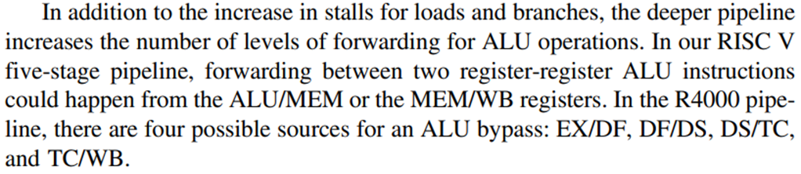

Deeper Pipelines and Forwarding

Slide 27
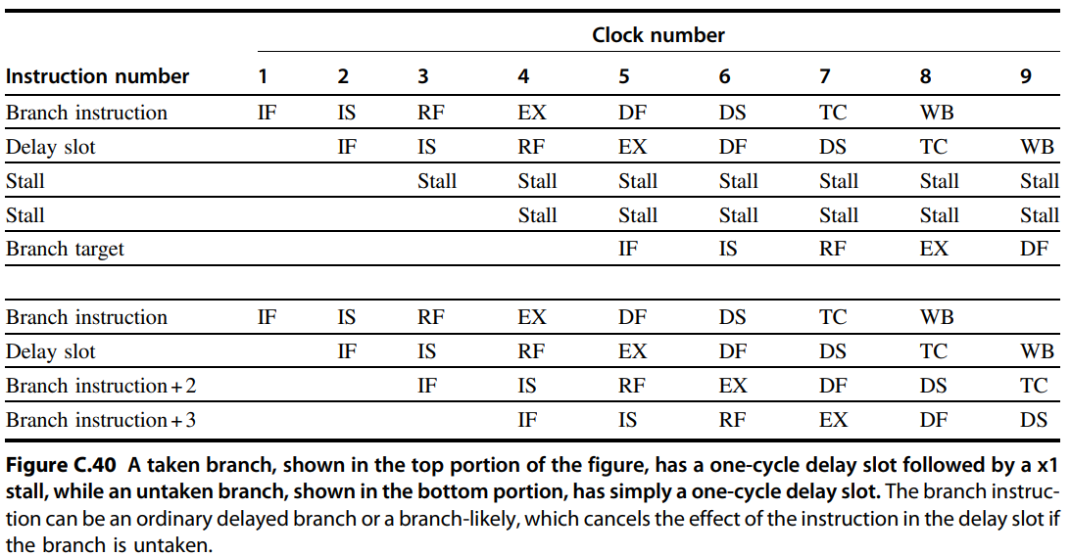

3 Cycle Branch Delay When Taken (x1 Interlock)

Slide 28
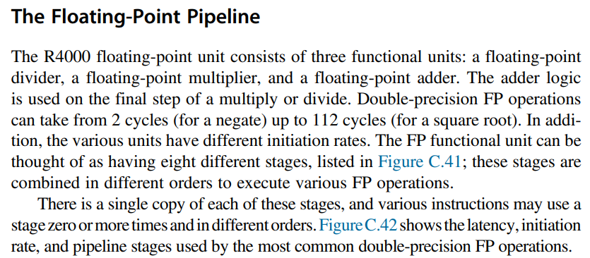
FP Pipeline

Slide 29
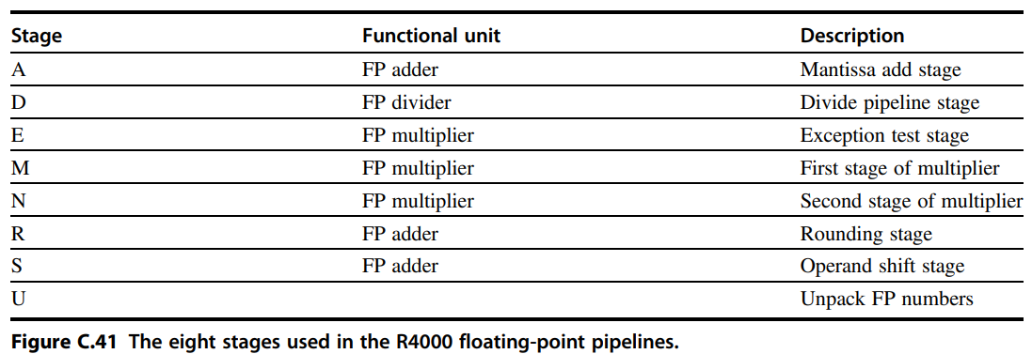
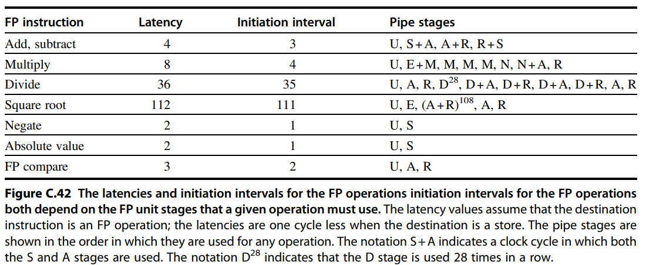




FP Stages
MIPS 4000

Slide 30
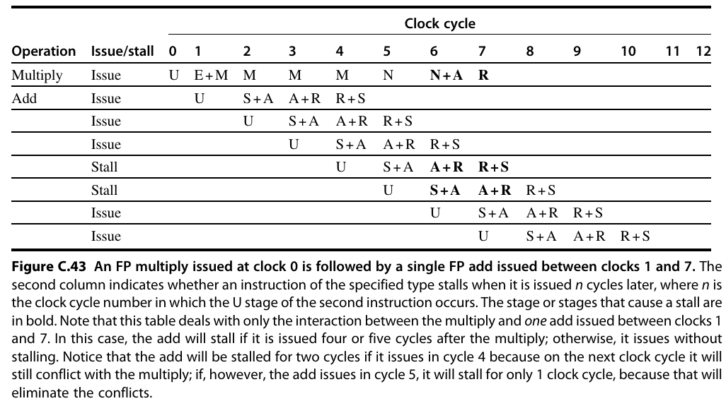

Slide 31
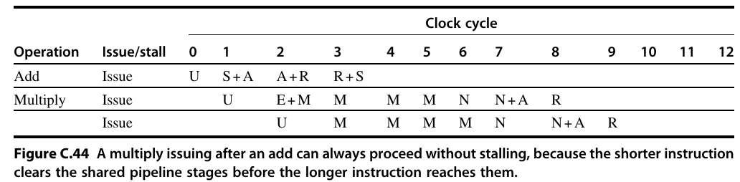

Slide 32
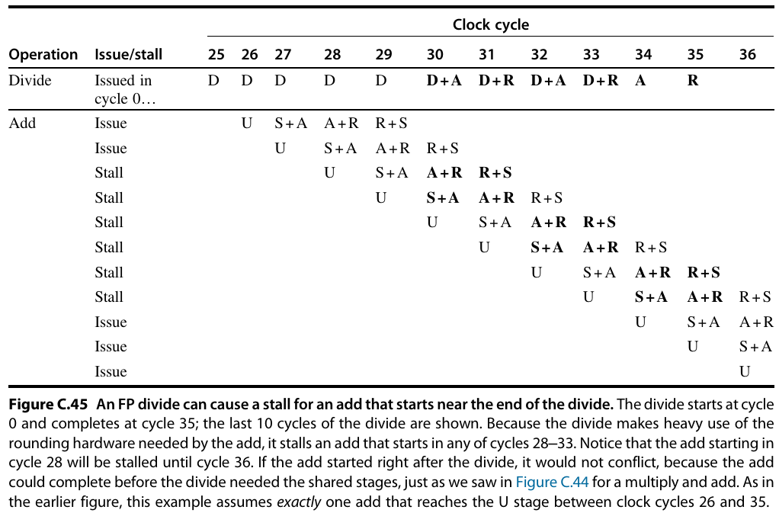

Slide 33
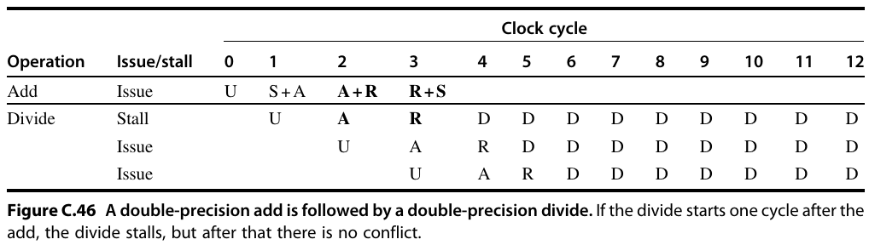

Slide 34
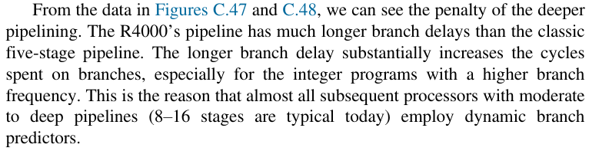
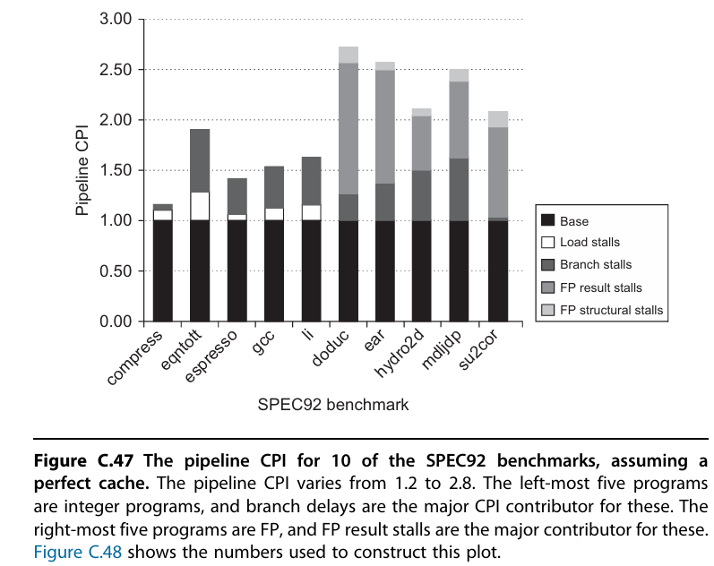

Slide 35
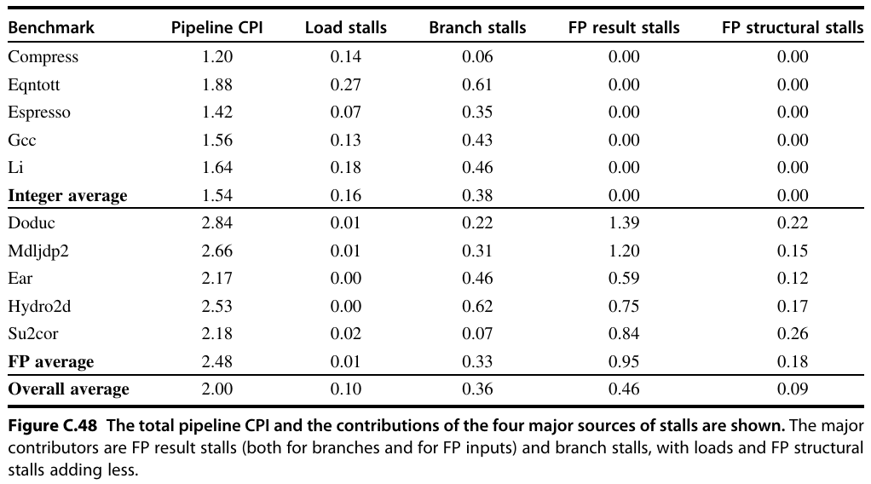

Slide 36
Pipelining topics covered so far
RISC ISA
5 stage Integer Pipelined CPU
  Performance
  Hazards
Stalls to improve RAW, WAR, WAW Data Hazards
Reordering and NoOp in Software / Compilers
Forwarding (or Bypassing) to Improve Data Hazards
Interlock feature in Pipelined Hardware Architecture
Control / Branch Hazards
  Static / Dynamic / Flush / Restart
  Branch Prediction
Dealing with Exceptions / Interrupts in Pipelined Architecture
  Status and Mask Registers
Multicycle Floating point Pipelined RISC Architecture
  Introduce Out of Order Execution
  Introduce Scheduling of Instructions
Case study of MIPS R4000 Pipeline
  Instruction Memory and Data Memory with Cache support

Slide 37
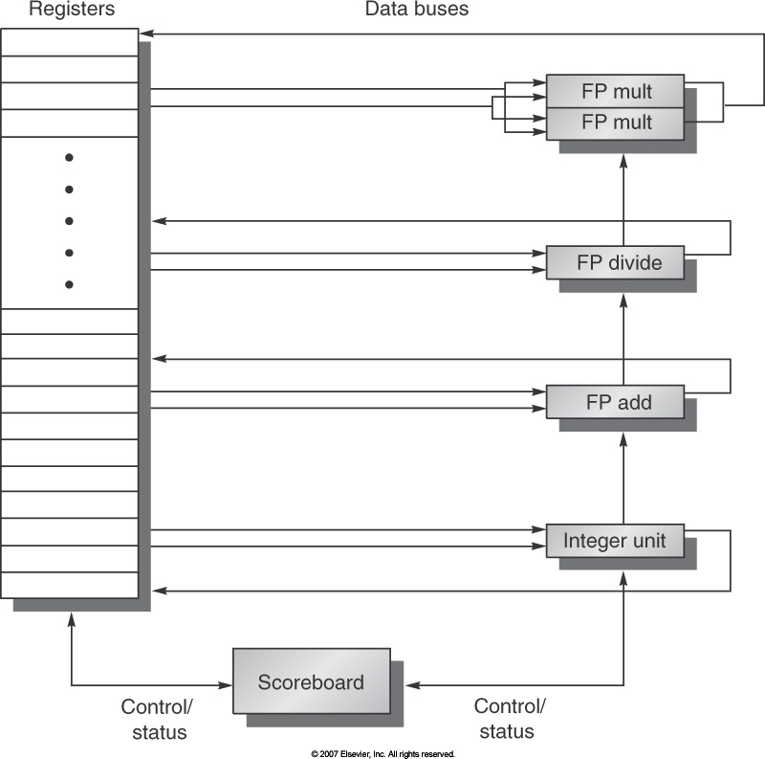

Slide 38
Scoreboard in Dynamic Scheduling in RISC-V

Slide 39
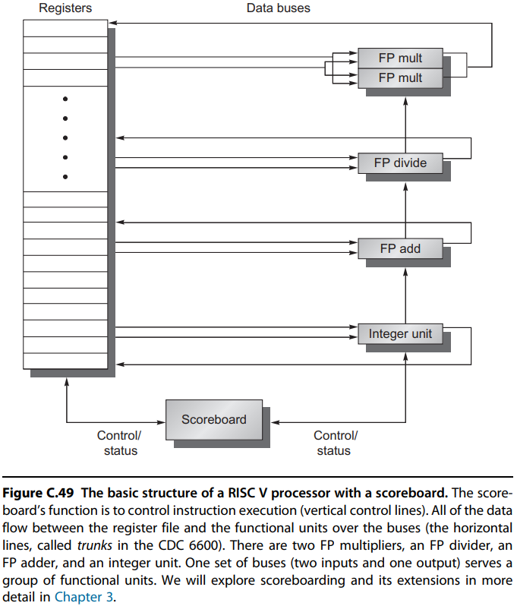


RISC-V with Scoreboard
Multicycle EX Stage

Slide 40
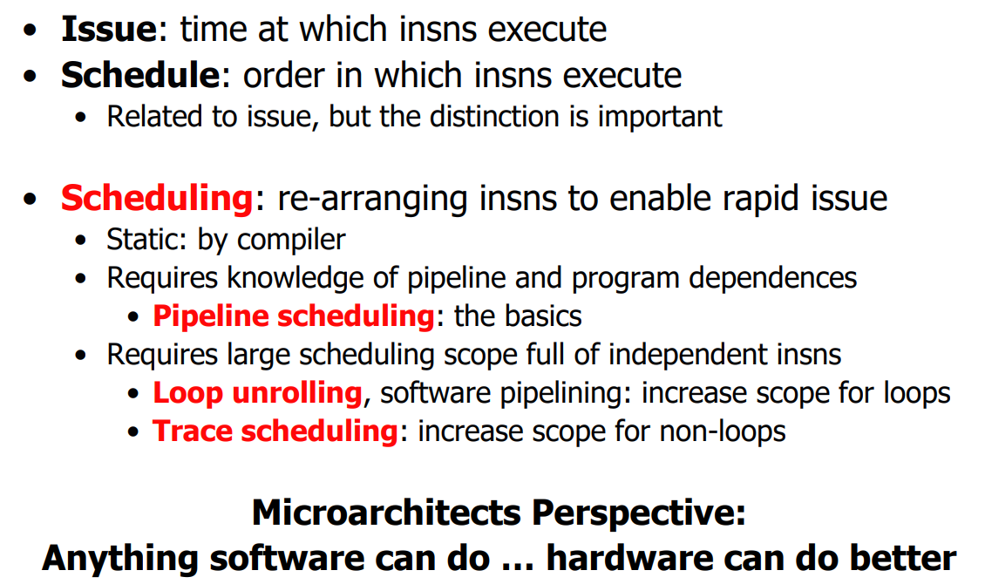
Static Instruction Scheduling
instruction
instruction
instruction
instruction

Slide 41
Dynamic Scheduling
Rearrange order of instructions to reduce stalls while maintaining data flow
Advantages:
  Compiler doesn’t need to have knowledge of microarchitecture
  Handles cases where dependencies are unknown at compile time
Disadvantage:
  Substantial increase in hardware complexity
  Complicates exceptions

Slide 42
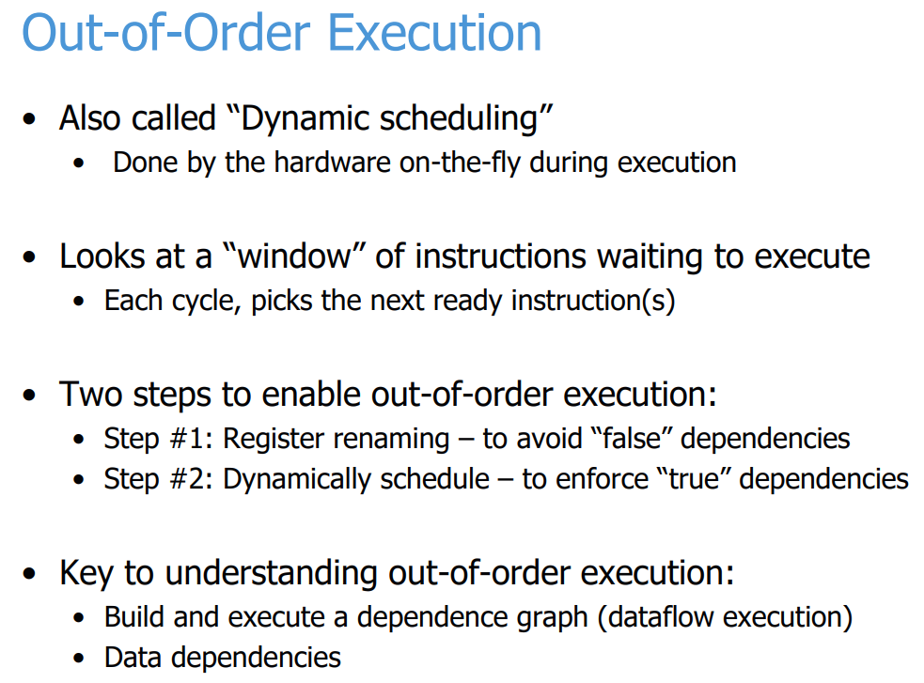

Out of Order / Dynamic Scheduling

Slide 43
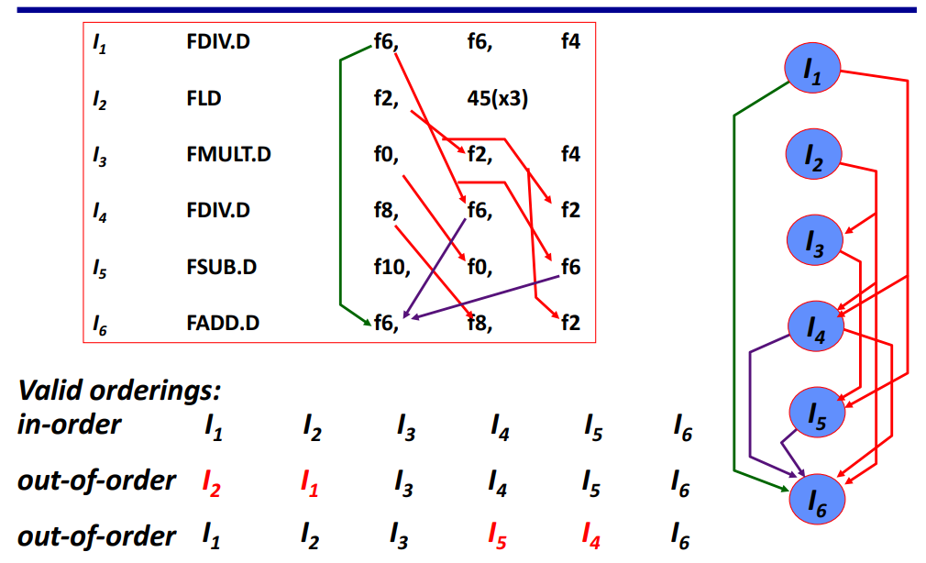
Instruction Scheduling Example

Slide 44





Dynamic Scheduling
Dynamic scheduling implies:
  Out-of-order execution
  Out-of-order completion
Example 1:
  fdiv.d f0,f2,f4
  fadd.d f10,f0,f8
  fsub.d f12,f8,f14
  fsub.d is not dependent, can be issued before fadd.d

Slide 45
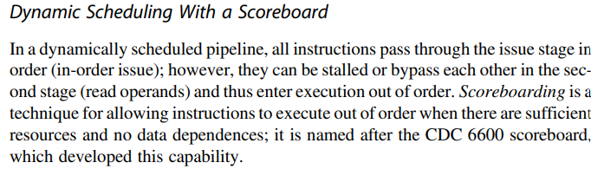

Dynamic Scheduling with a Scoreboard

Slide 46
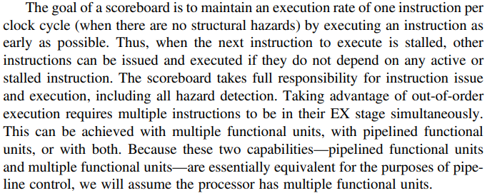


Goal of Scoreboard technique

Slide 47
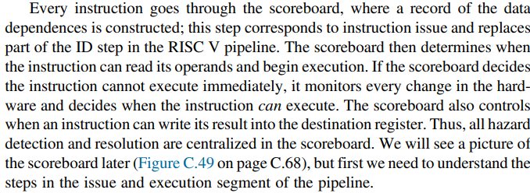
What happens in a Scoreboard

Slide 48
Four step Execution in Scoreboard
Issue
If a functional unit for instruction is free and no other active instruction has the same destination register, the scoreboard Issues the instruction to the functional unit and updates its internal data structure. Like IF stage.
Read Operands
The scoreboard monitors the availability of the source operands. A source operand is available if the earlier issued instruction is going to write it. When the source operands are available, the scoreboard tells the functional unit to proceed to read the operands from the registers and begin Execution. This step works together with Issue to form ID.
Execution
The functional unit begins execution upon receiving operands. When the result is ready, it notifies the scoreboard that it has completed the execution.
This step replaces EX step in RISC-V pipeline and takes multiple cycles.
Write Result
Once the scoreboard is aware that the functional unit has completed the execution, the scoreboard checks for WAR hazards and stalls the completing instruction, if necessary.
This is like WB stage in RISC-V.

Slide 49
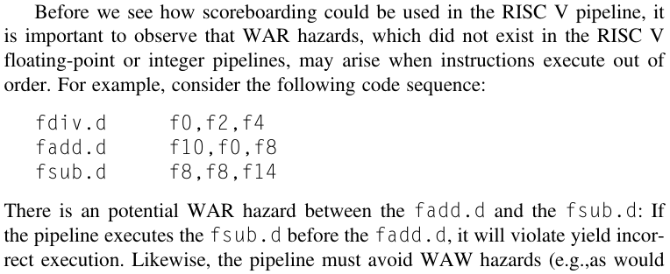





WAR Hazards in Out of Order Execution

Slide 50
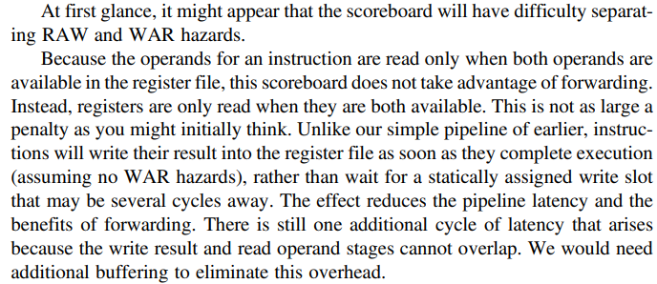
Scoreboard and Forwarding

Slide 51
Chap 3: Instruction Level Parallelism
Starting Chapter 3 of textbook

Slide 52

Where to add Features to Improve Performance

Slide 53

What Impacts CPI? Pipelines and Stalls

Slide 54


Instruction-Level Parallelism
When exploiting instruction-level parallelism, goal is to maximize CPI
  Pipeline CPI =
    Ideal pipeline CPI +
    Structural stalls +
    Data hazard stalls +
    Control stalls
Parallelism with basic block is limited
  Typical size of basic block = 3 – 6 instructions
  Must optimize across branches

Slide 55


How to go about ILP
Pipelining become universal technique in 1985
  Overlaps execution of instructions
  Exploits “Instruction Level Parallelism”
Beyond this, there are two main approaches:
  Hardware-based dynamic approaches
    Used in server and desktop processors
    Not used as extensively in IoT, Low Power, processors
  Compiler-based static approaches
    Not as successful outside of scientific applications

Slide 56


A Block of Code for ILP

Slide 57





Compiler Techniques for Exposing ILP
Pipeline scheduling
  Separate dependent instruction from the source instruction by the pipeline latency of the source instruction
Example:
  for (i=999; i>=0; i=i-1)
  x[i] = x[i] + s;

Slide 58


Pipeline Stalls
Loop: fld f0,0(x1)
addi x1,x1,-8
fadd.d f4,f0,f2
stall
stall
fsd f4,0(x1) bne x1,x2,Loop
Loop: fld f0,0(x1)
stall
fadd.d f4,f0,f2
stall
stall
fsd f4,0(x1)
addi x1,x1,-8
bne x1,x2,Loop
Compiler Techniques

Slide 59

Data Dependence
Dependencies are a property of programs
Pipeline organization determines if dependence is detected and if it causes a stall
Data dependence conveys:
  Possibility of a hazard
  Order in which results must be calculated
  Upper bound on exploitable instruction level parallelism
Dependencies that flow through memory locations are difficult to detect

Slide 60

Data Dependence Significance

Slide 61

Dependence - value stored in Registers or in Memory

Slide 62



Overcome Dependence

Slide 63
Dependence Types
Data Dependence
Name Dependence
Control Dependence

Slide 64
Other Factors
Data Hazards
  Read after write (RAW)
  Write after write (WAW)
  Write after read (WAR)
Control Dependence
  Ordering of instruction i with respect to a branch instruction
    Instruction control dependent on a branch cannot be moved before the branch so that its execution is no longer controlled by the branch
    An instruction not control dependent on a branch cannot be moved after the branch so that its execution is controlled by the branch

Slide 65
Examples
Example 1:
add x1,x2,x3
beq x4,x0,L
sub x1,x1,x6
L: …
or x7,x1,x8
Example 2:
add x1,x2,x3
beq x12,x0,skip
sub x4,x5,x6
add x5,x4,x9
skip:
or x7,x8,x9
or instruction dependent on add and sub
Assume x4 isn’t used after skip
  Possible to move sub before the branch

Slide 66
Dependence types – code examples
7
RAW (Read After Write) = “true dependence”
mul r0 * r1 -> r2
…
add r2 + r3 -> r4
WAW (Write After Write) = “output dependence”
mul r0 * r1-> r2
…
add r1 + r3 -> r2
WAR (Write After Read) = “anti-dependence”
mul r0 * r1 -> r2
…
add r3 + r4 -> r1
WAW & WAR are “false”, Can be totally eliminated by “renaming”

Slide 67

Register Renaming

Slide 68



Name Dependence and Output Dependence
An Antidependence between instruction i and instruction j occurs when instruction j writes a register or memory that instruction i reads.
  The original ordering must be preserved to ensure that i reads the correct value. In example, there is antidependence between fsd and addi on register x1.
An Output dependence occurs when instruction i and instruction j write the same register or memory location.
  The ordering between the instruction must be preserved to ensure that
  value finally written corresponds to instruction j.
Both Antidependence and Output Dependence are
Name Dependences, as opposed to True Dependences, as no
value is being transmitted between the two instructions.

Slide 69





Dependence Chain

Slide 70

More on Data Dependences

Slide 71
Loop Unrolling ILP

Slide 72


Basic Compiler ILP – Loop Unrolling

Slide 73



Summary of Loop Unrolling and Scheduling

Slide 74




Assembly Code of a Loop

Slide 75






Scheduling of Assembly Code

Slide 76



Loop Unrolled Assembly Code

Slide 77



Incorporating Scheduling in Unrolled Code

Slide 78
Loop Unrolling
Loop unrolling
  Unroll by a factor of 4 (assume # elements is divisible by 4)
  Eliminate unnecessary instructions
Loop: fld f0,0(x1)
fadd.d f4,f0,f2
fsd f4,0(x1) //drop addi & bne
fld f6,-8(x1)
fadd.d f8,f6,f2
fsd f8,-8(x1) //drop addi & bne
fld f0,-16(x1)
fadd.d f12,f0,f2
fsd f12,-16(x1) //drop addi & bne
fld f14,-24(x1)
fadd.d f16,f14,f2
fsd f16,-24(x1)
addi x1,x1,-32
bne x1,x2,Loop
Compiler Techniques
note: number of live registers vs. original loop

Slide 79
Loop Unrolling/Pipeline Scheduling
Pipeline schedule the unrolled loop:
Loop: fld f0,0(x1)
fld f6,-8(x1)
fld f8,-16(x1)
fld f14,-24(x1)
fadd.d f4,f0,f2
fadd.d f8,f6,f2
fadd.d f12,f0,f2
fadd.d f16,f14,f2
fsd f4,0(x1)
fsd f8,-8(x1)
fsd f12,-16(x1)
fsd f16,-24(x1)
addi x1,x1,-32
bne x1,x2,Loop
Compiler Techniques
14 cycles
3.5 cycles per element

