Slide 1
Computer Architecture
CS 622 / EE 520
Spring 2026
Lecture 14
Shahid Masud

Slide 2
Topics
Multi-issue and VLIW
Some solved Examples
  Loops / Unrolling
  VLIW
  Speculative Execution
Quiz 3
Today (Wed)
Midterm
26 Oct
Assignment
2 Due 9 Nov

Slide 3
Further Readings
Reading Notes
Readings:
Chapter 3 of course textbook

Slide 4
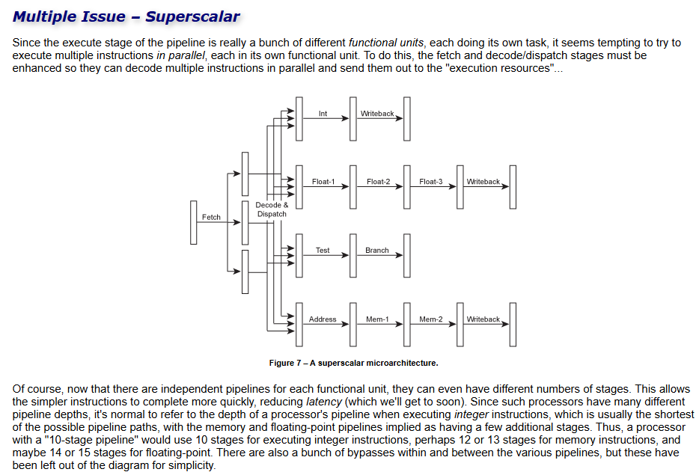
Multiple Issue Concept - Superscalar

Slide 5
VLIW Details

Slide 6
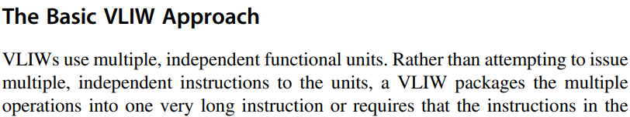
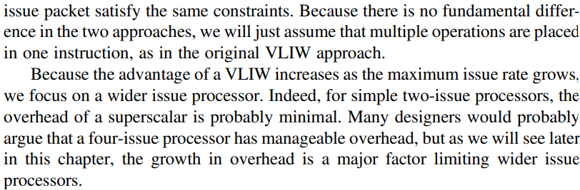










Basic VLIW Approach

Slide 7
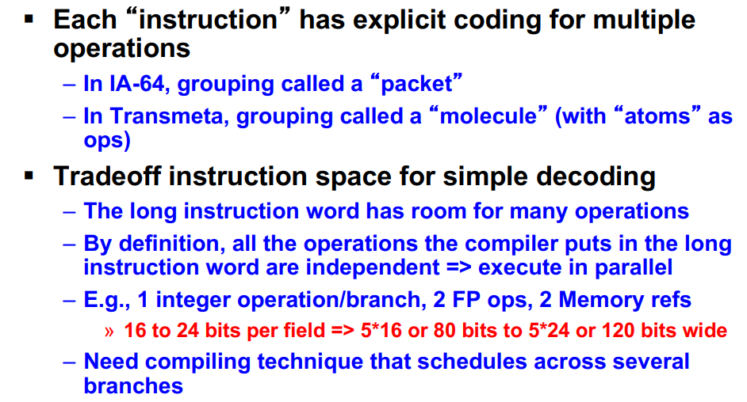
Very Long Instruction Word

Slide 8
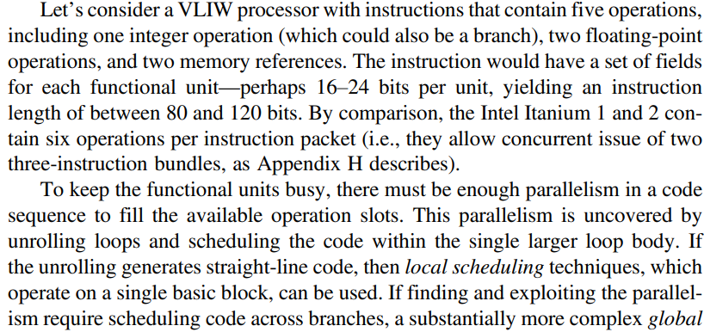
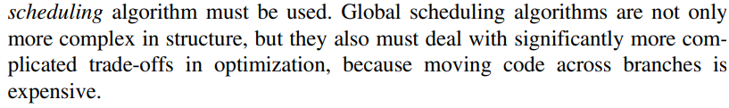



Parallelism needed for VLIW

Slide 9
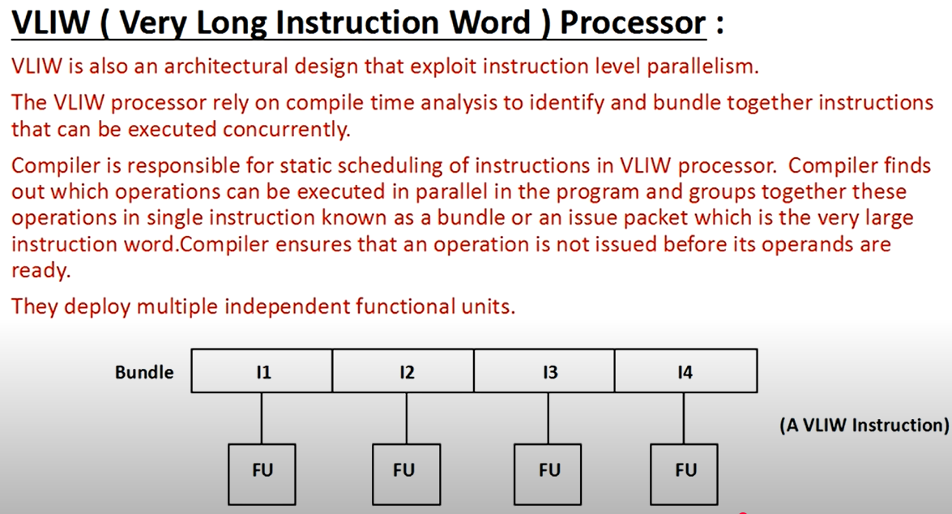
VLIW Processor

Slide 10
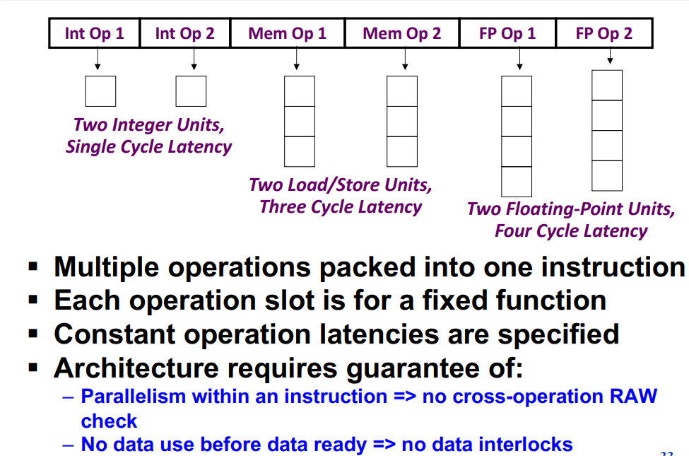



Form VLIW Instruction Word

Slide 11
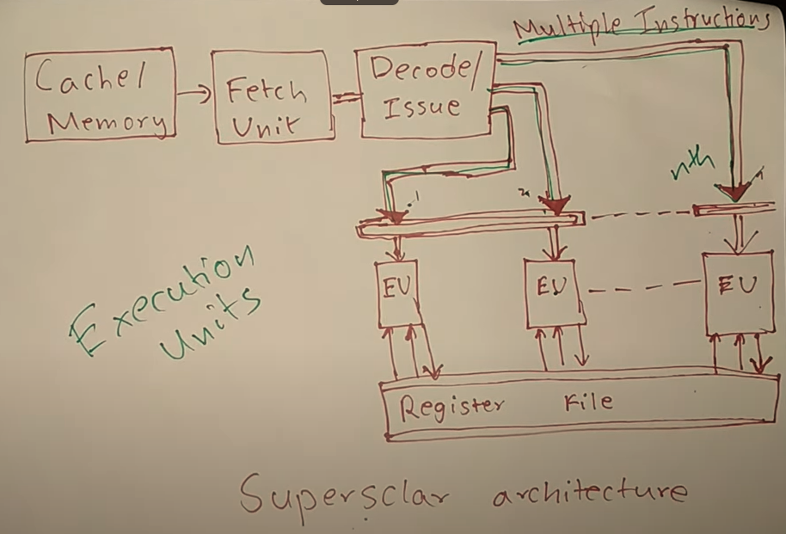
Superscalar Architecture

Slide 12
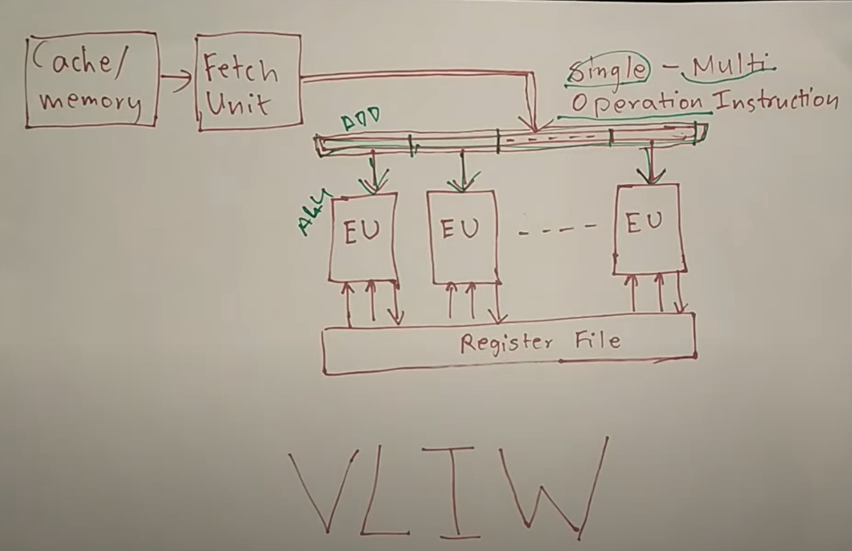
VLIW Architecture

Slide 13
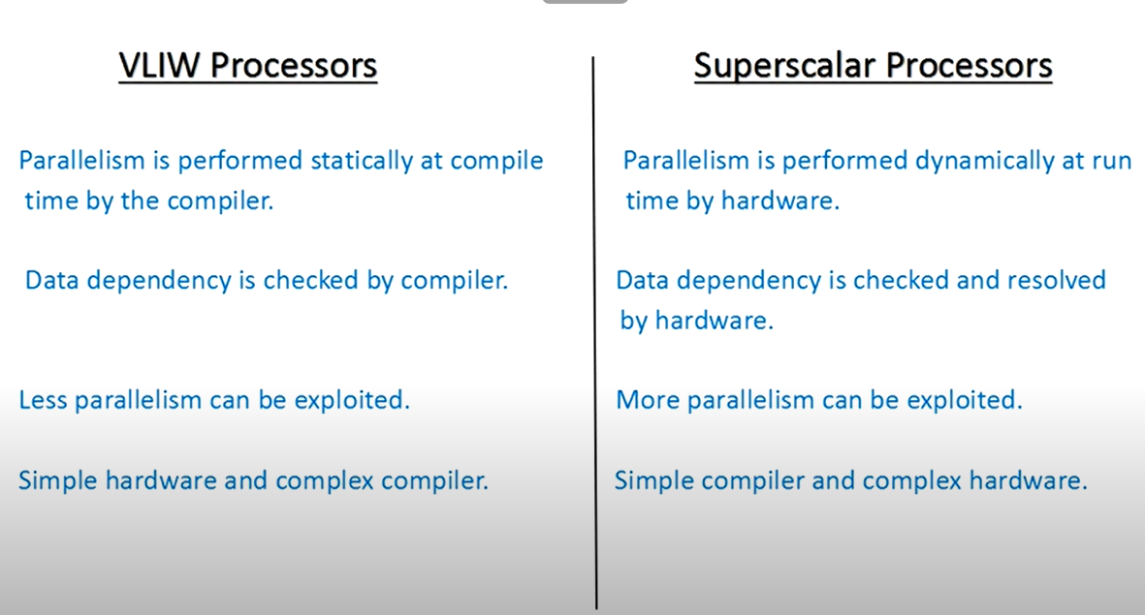
Compare VLIW and Superscalar

Slide 14
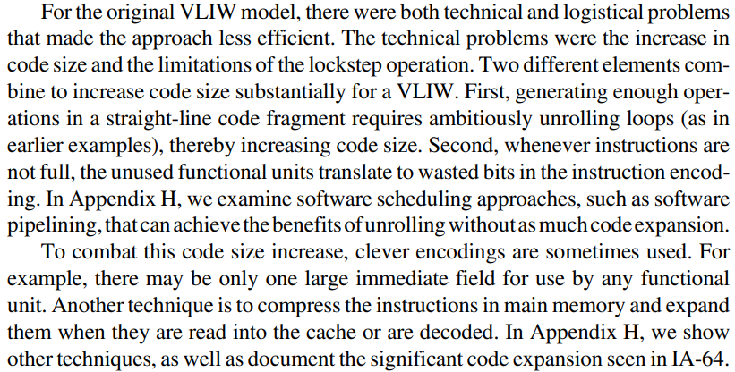


Problems in VLIW Approach

Slide 15
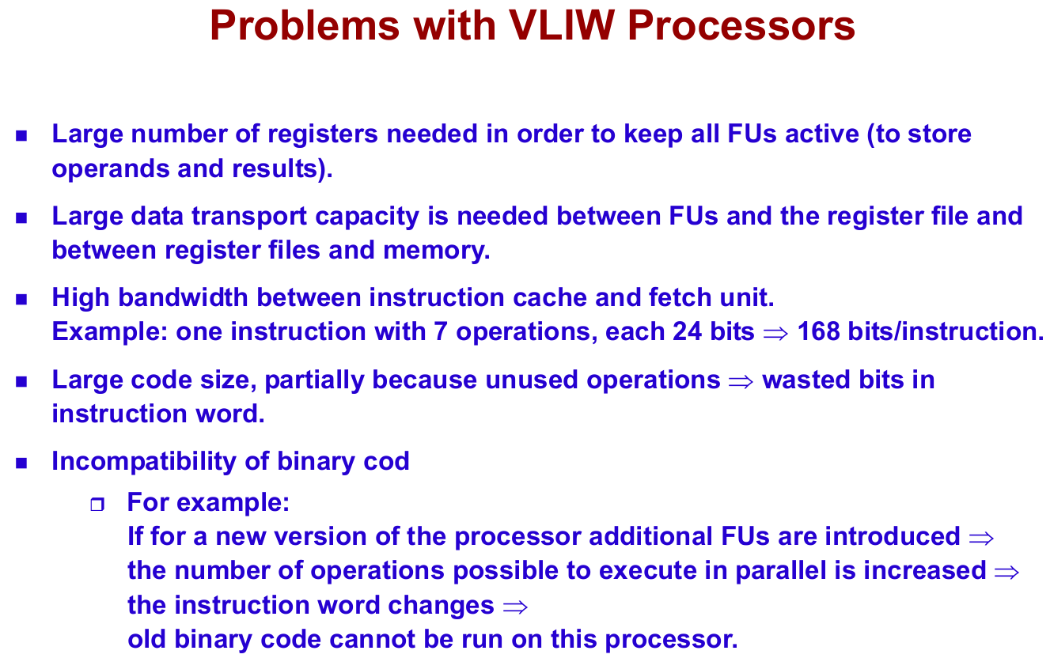
Problems with VLIW Processors

Slide 16
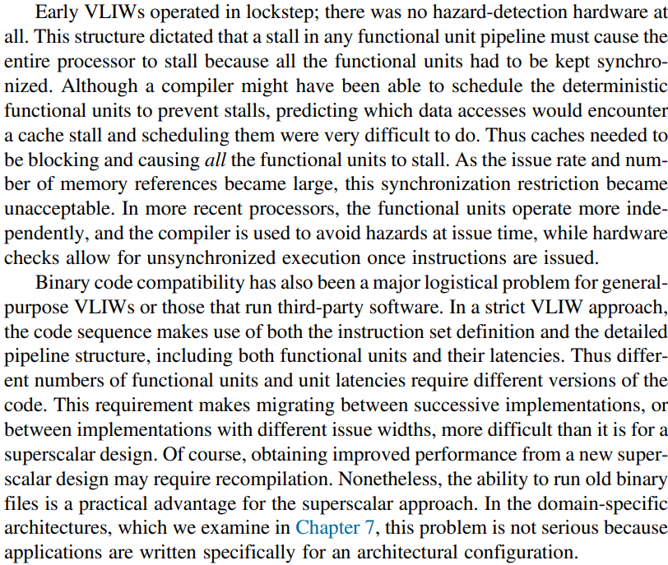

Hazard Detection in VLIW, Code Compatibility

Slide 17
Questions and Answers
Solved Examples from:
  Loop Unrolling 1
  Loop Unrolling 2
  VLIW Eg 1
  VLIW Eg 2
  VLIW Eg 3

Slide 18
Quiz 3

