Slide 1
Computer Architecture
CS 622 / EE 520
Fall 2026
Lecture 16
Shahid Masud

Slide 2
Topics
Memory Hierarchy in Computers
  Technology and Cost
Locality of Reference
Cache Organization
  Hierarchy
  Tags
  Mapping Techniques
Cache Operation
  Replacement
  Performance
Midterm Exam
Next Lecture

Slide 3
Further Readings
Readings:
Appendix B of course textbook
Reading Notes
Slides adapted from:
https://www.cs.nthu.edu.tw/~king/courses/cs5100/2014/N04-Cache-1.pdf

Slide 4
Memory Access Performance

Slide 5
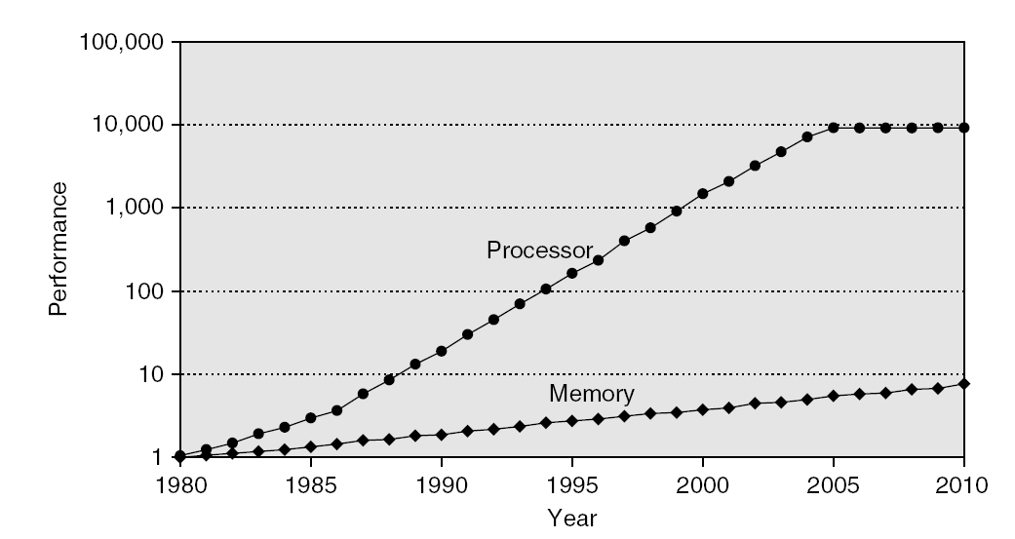
Memory Performance Gap
Fig. 2.2 Figure 2.2 Starting with 1980 performance as a baseline, the gap in performance, measured as the difference
in the time between processor memory requests (for a single processor or core) and the latency of a DRAM access, is
plotted over time. Note that the vertical axis must be on a logarithmic scale to record the size of the processor–DRAM
performance gap. The memory baseline is 64 KB DRAM in 1980, with a 1.07 per year performance improvement in
Latency.

Slide 6
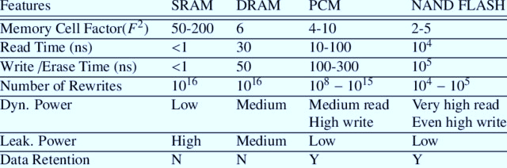
Memory Access Time Comparison

Slide 7
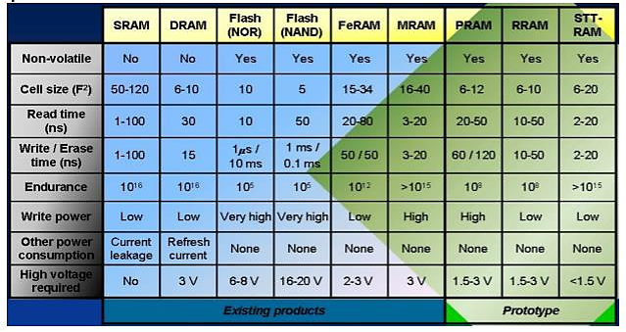

Memory Access Technology Comparison

Slide 8
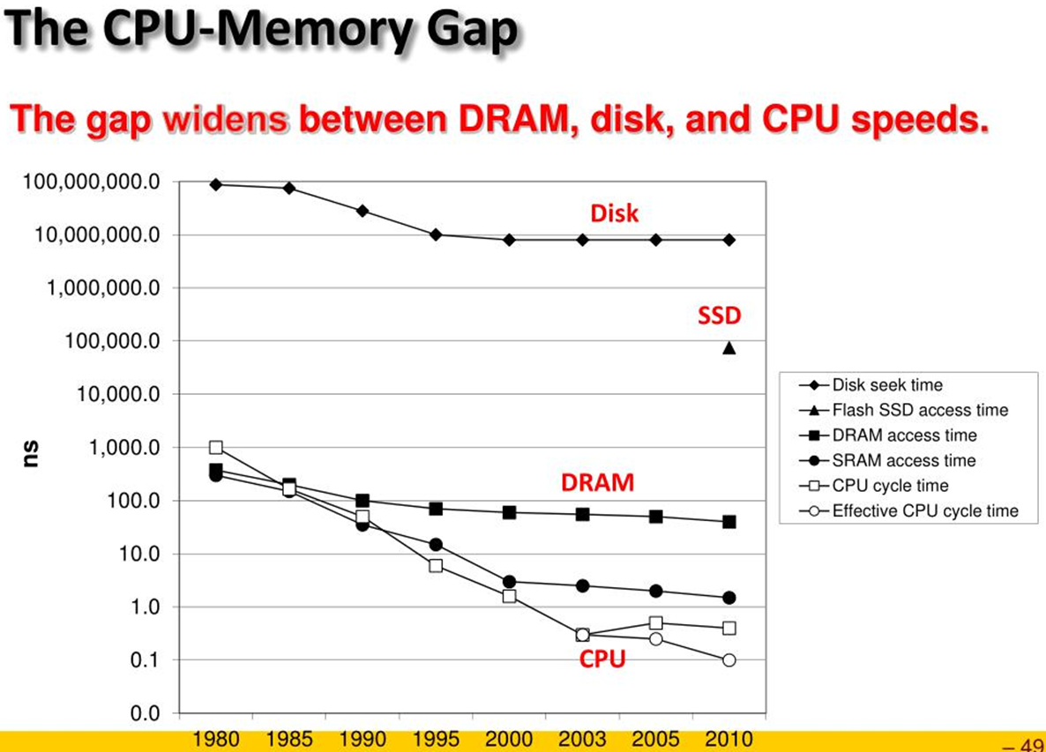
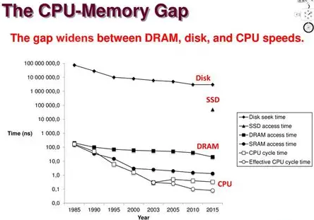






CPU Memory Gap

Slide 9
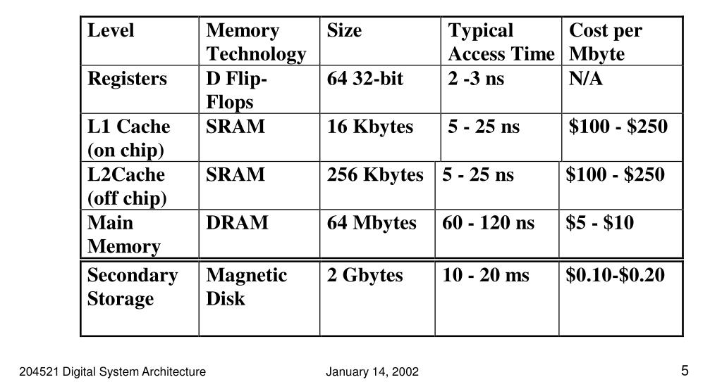



Variations in Memory Performance
Hierarchy Level

Slide 10
Memory Hierarchy

Slide 11
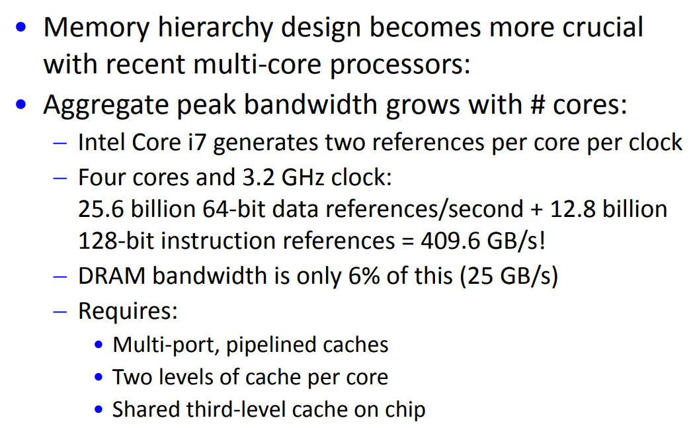
Memory Hierarchy Motivation

Slide 12
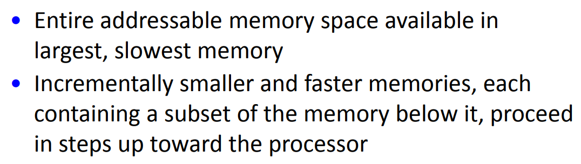
Thinking behind Memory Hierarchy Design

Slide 13
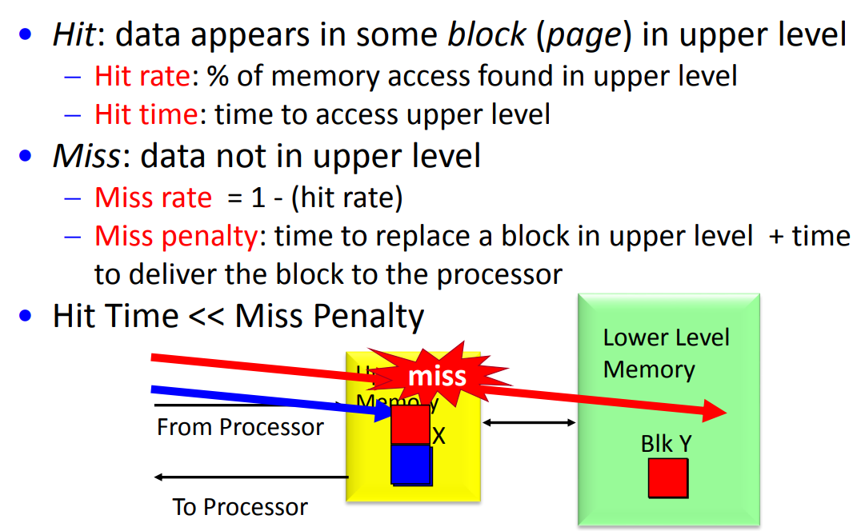

Memory Hierarchy Basics
Hierarchy

Slide 14
Motivation for Memory Hierarchy
Programmers want unlimited amounts of memory with low latency
  But fast memory more expensive than slower memory
Solution: small fast memory + big slow memory
= Looks like a big fast memory
Big
Fast
M_{M}
M_{C}
Small & Fast
Big & Slow
Notes:
Why does this work?

Slide 15
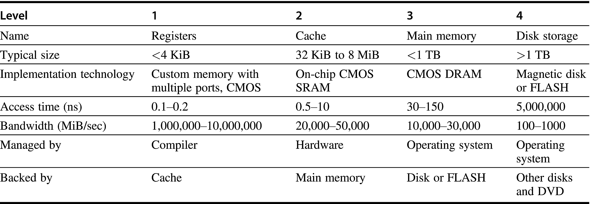
Memory Hierarch Access Time
Figure B.1 The typical levels in the hierarchy slow down and get larger as we move away from the processor for a large workstation or small server. Embedded computers might have no disk storage and much smaller memories and caches. Increasingly, FLASH is replacing magnetic disks, at least for first level file storage. The access times increase as we move to lower levels of the hierarchy, which makes it feasible to manage the transfer less responsively. The implementation technology shows the typical technology used for these functions. The access time is given in nanoseconds for typical values in 2017; these times will decrease over time. Bandwidth is given in megabytes per second between levels in the memory hierarchy. Bandwidth for disk/FLASH storage includes both the media and the buffered interfaces.

Slide 16
Cache Organization and Placement

Slide 17
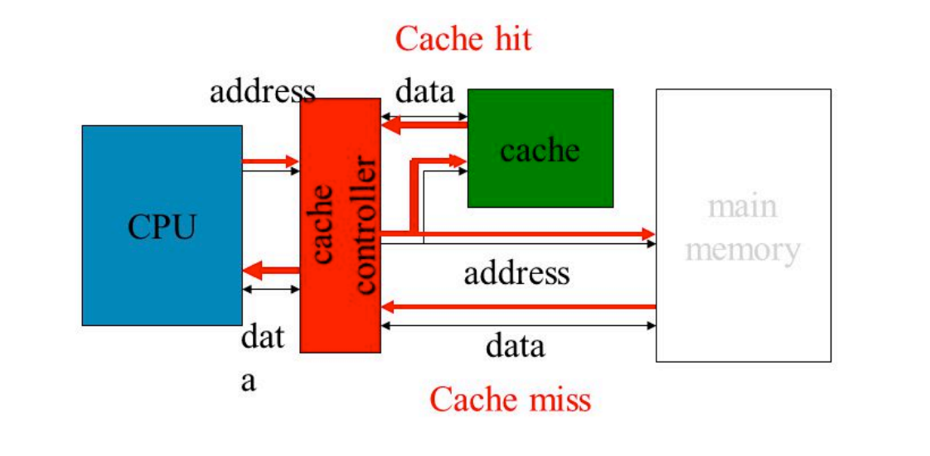
Cache Placement and Memory Access

Slide 18
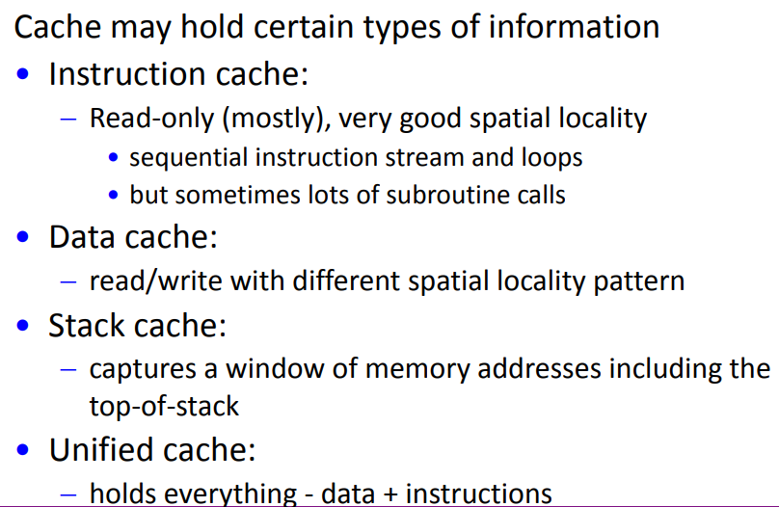
What goes in a Cache?

Slide 19
Memory Hierarchy Design 1
Entire addressable memory space available in largest, slowest memory
Incrementally smaller and faster memories, each containing a subset of the memory below it, proceed in steps up toward the processor
eDRAM or
Emerging memory
DRAM
SRAM
Main
Memory
DISK
L4
Cache
Reg
File
L1
Unified cache
L3
Cache
L2
Cache
Unified Cache

Slide 20
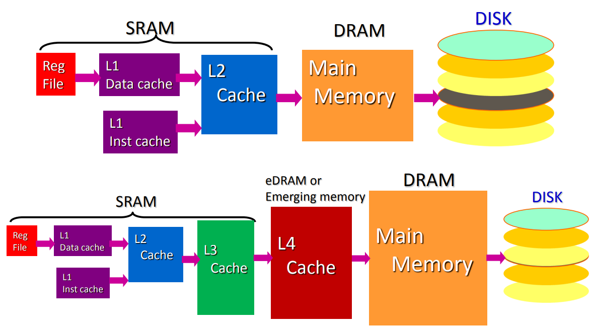
Another possible Memory Hierarchy
Split Caches
Split Caches

Slide 21
Model of Memory Hierarchy
Cycle Words/cycle Management
1 3-10 ?
1-3 1-2 ?
5-10 1 ?
30-100 0.5 ?
10⁶-10⁷ 0.01 ?
Registers
Compiler
Hardware
Hardware
OS
OS
CPU
Chip
Level 1 Cache
Level 2 Cache
Chips
DRAM
Mechanic
Disk
Hardware + Software

Slide 22
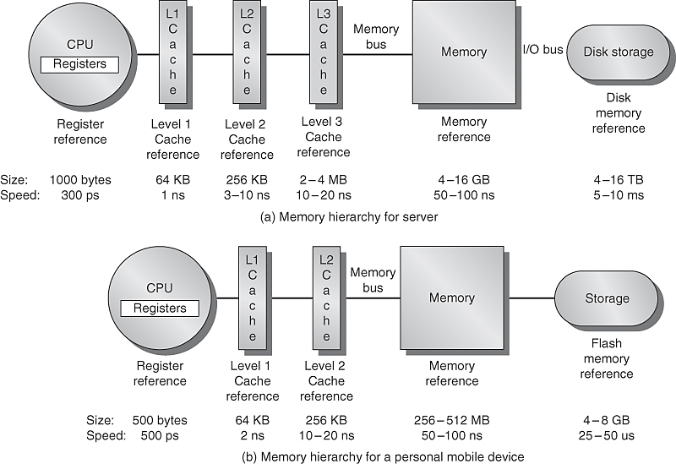
Model of Memory Hierarchy
Fig. 2.1 The levels in a typical memory hierarchy in a server computer shown on top (a) and in a personal mobile device (PMD) on the bottom (b). As we move farther away from the processor, the memory in the level below becomes slower and larger.

Slide 23
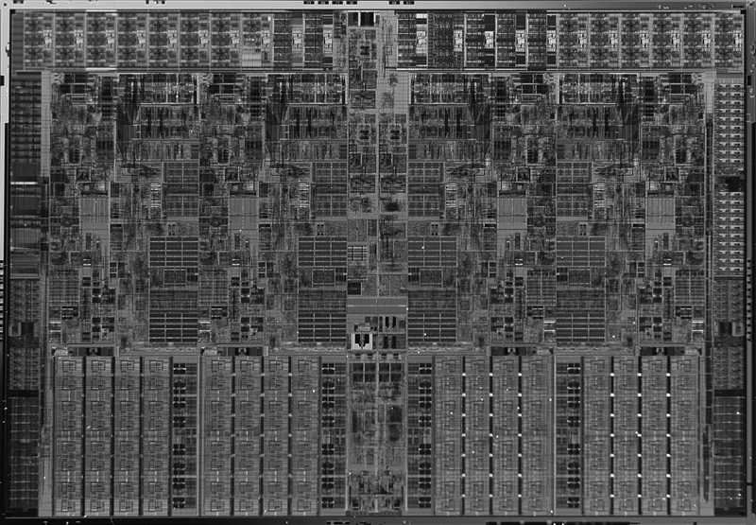
Cache Power Consumption
High-end μPs have >10 MB on-chip cache
  Consumes large amount of area and power budget
Intel Core i7
Cache example
L1 D$
L1 I$
L2
Shared L3

Slide 24
Principle of Locality

Slide 25
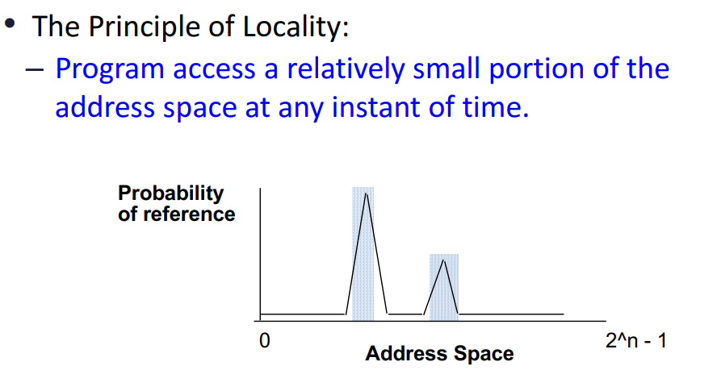
Why Hierarchy Works?

Slide 26



Underlying Principle: Locality of Reference
Locality of reference:
  Program access a relatively small portion of the address space at any instant of time → a program property
  Temporal locality: If an item is referenced, it will tend to be referenced again soon (e.g., loops, reuse)
  Spatial locality: If an item is referenced, items whose addresses are close by tend to be referenced soon (e.g., straightline code, array access)
Stack
Code
Array
P
P
t
Location
Notes:
The principle of locality states that programs access a relatively small portion of the address space at any instant of time.
This is kind of like in real life, we all have a lot of friends. But at any given time most of us can only keep in touch with a small group of them.
There are two different types of locality: Temporal and Spatial. Temporal locality is the locality in time which says if an item is referenced, it will tend to be referenced again soon.
This is like saying if you just talk to one of your friends, it is likely that you will talk to him or her again soon.
This makes sense. For example, if you just have lunch with a friend, you may say, let’s go to the ball game this Sunday. So you will talk to him again soon.
Spatial locality is the locality in space. It says if an item is referenced, items whose addresses are close by tend to be referenced soon.
Once again, using our analogy, we can usually divide our friends into groups. Like friends from high school, friends from work, friends from home.
Let’s say you just talk to one of your friends from high school and she may say something like: So did you hear so and so just won the lottery.
You probably will say NO, I better give him a call and find out more.
So this is an example of spatial locality. You just talked to a friend from your high school days. As a result, you end up talking to another high school friend. Or at least in this case, you hope he still remember you are his friend.
+3 = 10 min. (X:50)

Slide 27
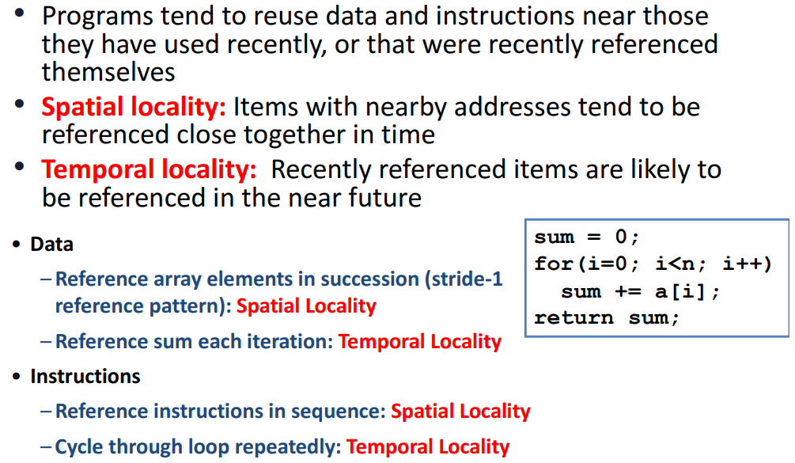
Locality Explained

Slide 28
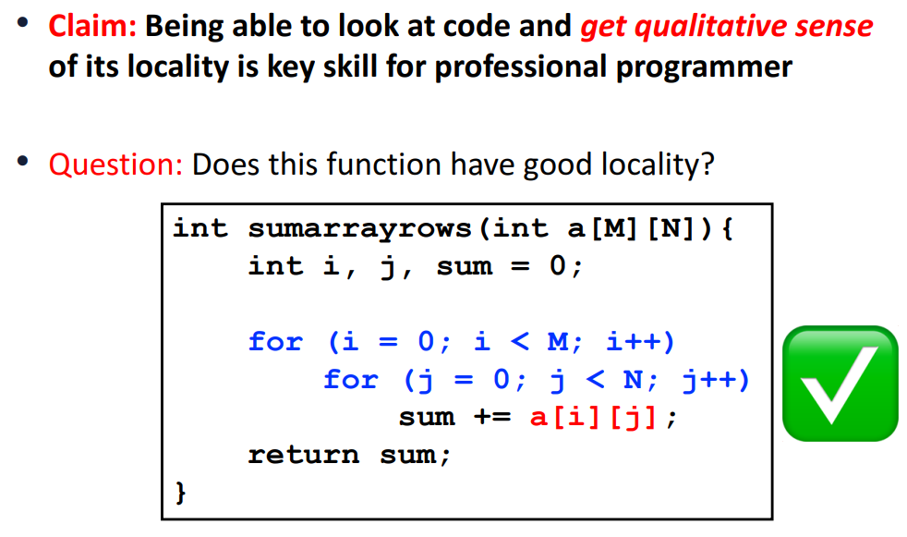
Locality Example 1

Slide 29
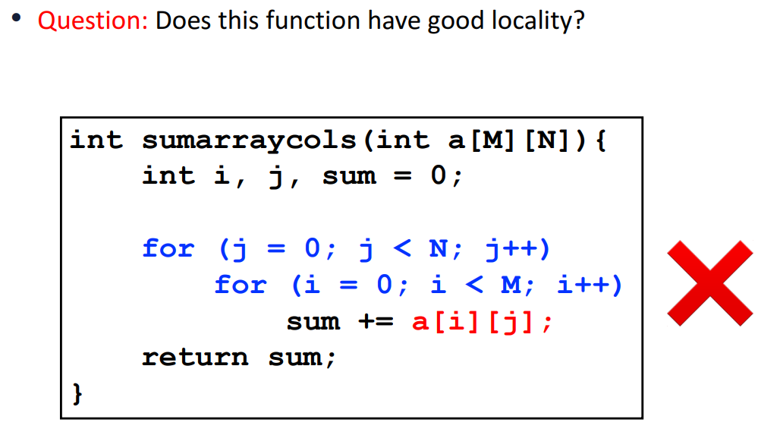
Locality Example 2

Slide 30
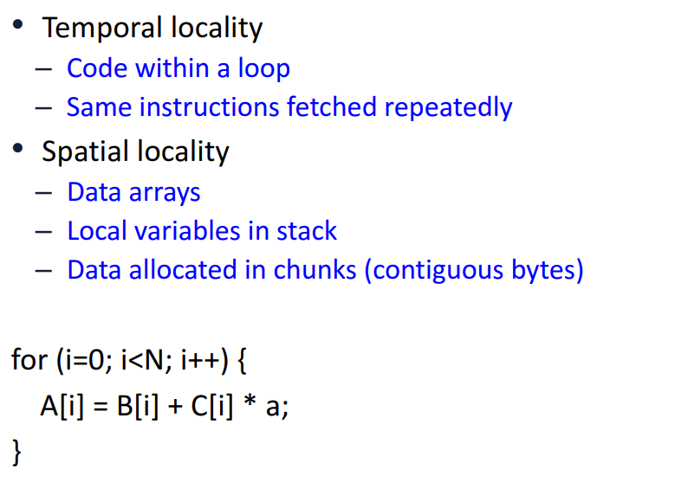
Source of Locality

Slide 31
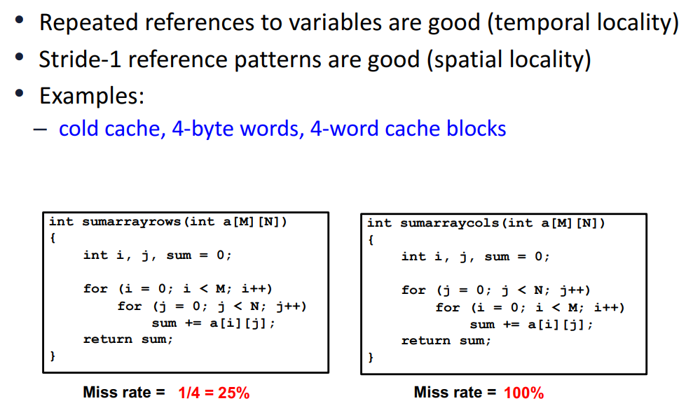
Writing Cache Friendly Code

Slide 32
Program Behavior Matters
Locality depends on type of program
Some programs ‘behave’ well
  Small loop operating on data on stack (towers of hanoi)
Some programs don’t
  Frequent calls to nearly random subroutines
  Traversal of large, sparse data set
    Pointer-based data structures
    Essentially random data references with no reuse
  Traversal of large sequential data
    Streaming and multimedia data
Notes:
Think in terms of instruction (program execution behavior) and data (program data access behavior)
Programs with subroutines or classes; Pointer-based data structures; Streaming data → good for spatial but not temporal

Slide 33
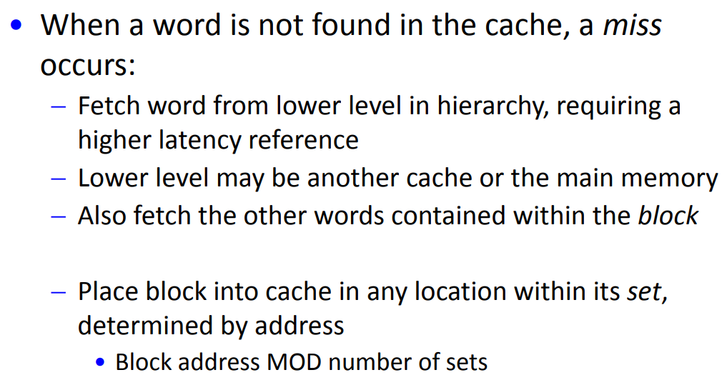
Basics of Cache

Slide 34
Cache Design and Access

Slide 35
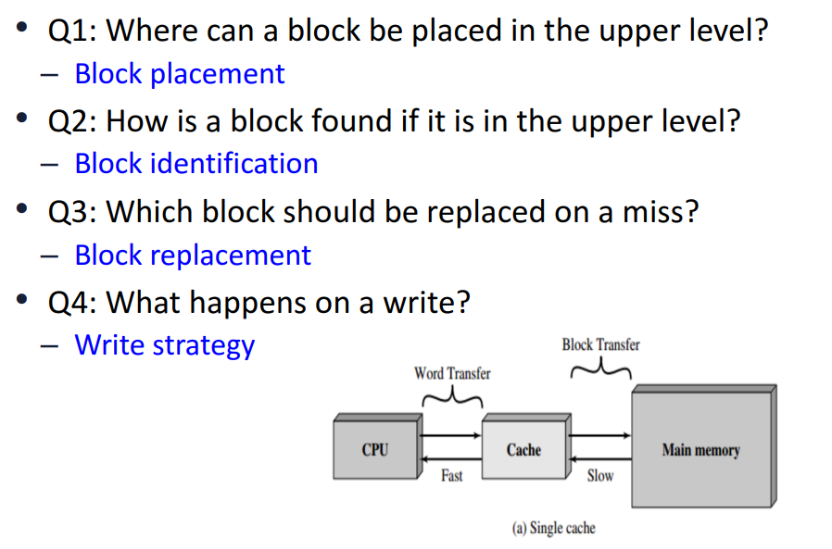

Considerations for Cache Design

Slide 36
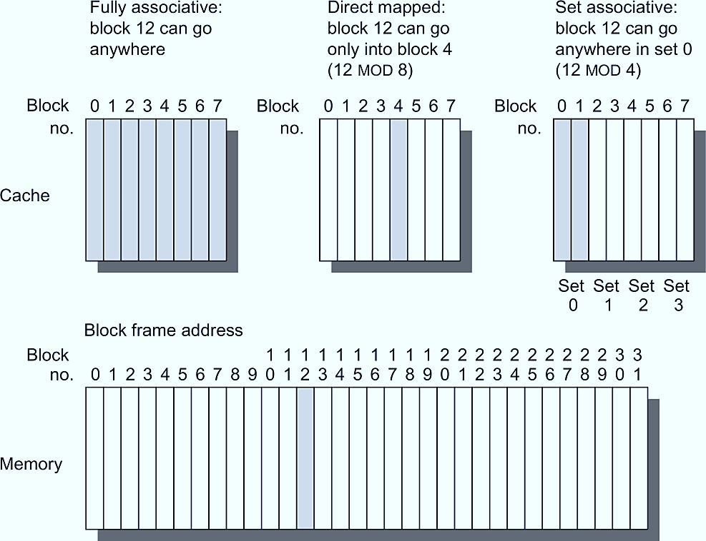
Cache and Memory Relation
Lines of cache
Figure B.2 This example cache has eight block frames and memory has 32 blocks. The three options for caches are shown left to right. In fully associative, block 12 from the lower level can go into any of the eight block frames of the cache. With direct mapped, block 12 can only be placed into block frame 4 (12 modulo 8). Set associative, which has some of both features, allows the block to be placed anywhere in set 0 (12 modulo 4). With two blocks per set, this means block 12 can be placed either in block 0 or in block 1 of the cache. Real caches contain thousands of block frames, and real memories contain millions of blocks. The set associative organization has four sets with two blocks per set, called two-way set associative. Assume that there is nothing in the cache and that the block address in question identifies lower-level block 12.

Slide 37
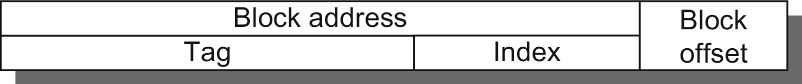
Parts of Cache Address
Figure B.3 The three portions of an address in a set associative or direct-mapped cache. The tag is used to check all the blocks in the set, and the index is used to select the set. The block offset is the address of the desired data within the block. Fully associative caches have no index field.

Slide 38
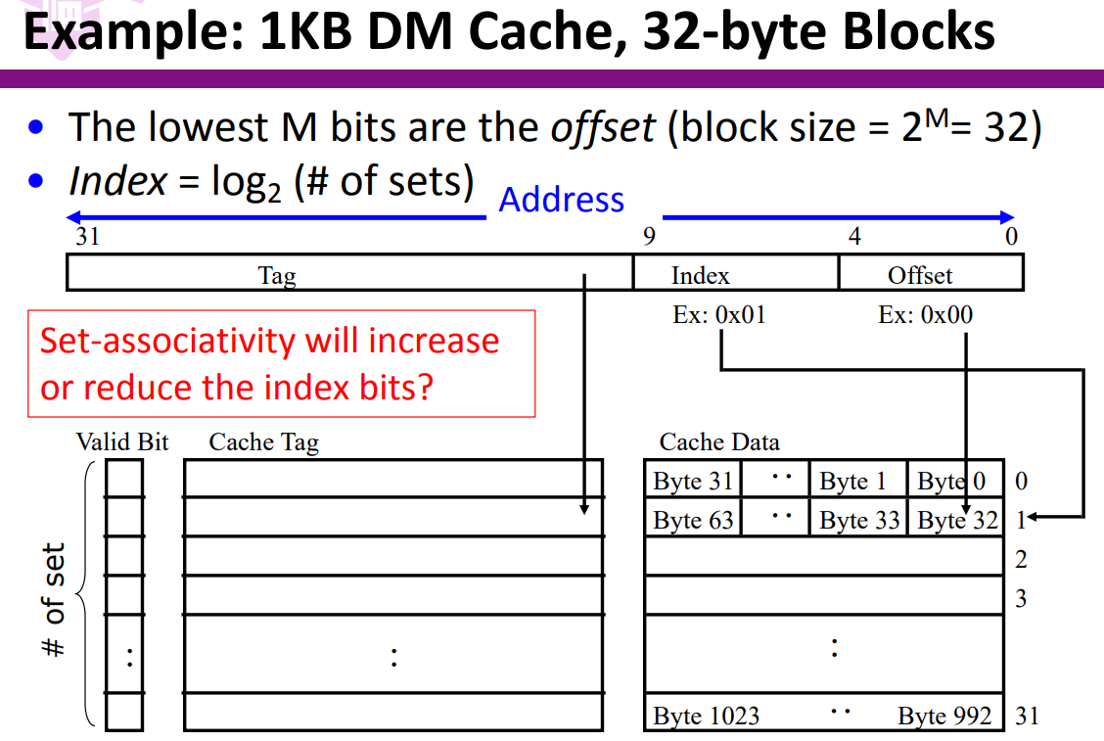

Example of Direct Mapped DM Cache
Block of Cache
Line of Cache

Slide 39
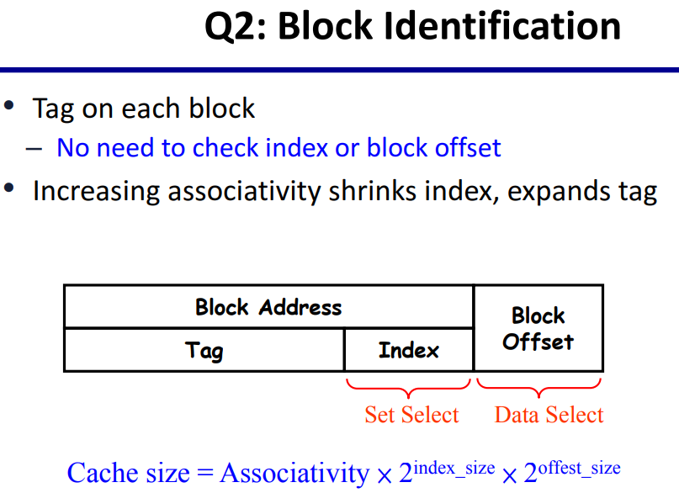
Identifying Data Location in a Cache
Cache Block
Cache Line

Slide 40
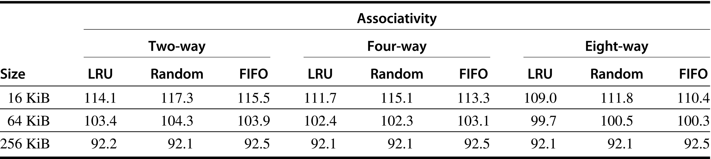
Studying Replacement Policies
Figure B.4 Data cache misses per 1000 instructions comparing least recently used, random, and first in, first out replacement for several sizes and associativities. There is little difference between LRU and random for the largest size cache, with LRU outperforming the others for smaller caches. FIFO generally outperforms random in the smaller cache sizes. These data were collected for a block size of 64 bytes for the Alpha architecture using 10 SPEC2000 benchmarks. Five are from SPECint2000 (gap, gcc, gzip, mcf, and perl) and five are from SPECfp2000 (applu, art, equake, lucas, and swim). We will use this computer and these benchmarks in most figures in this appendix.

Slide 41
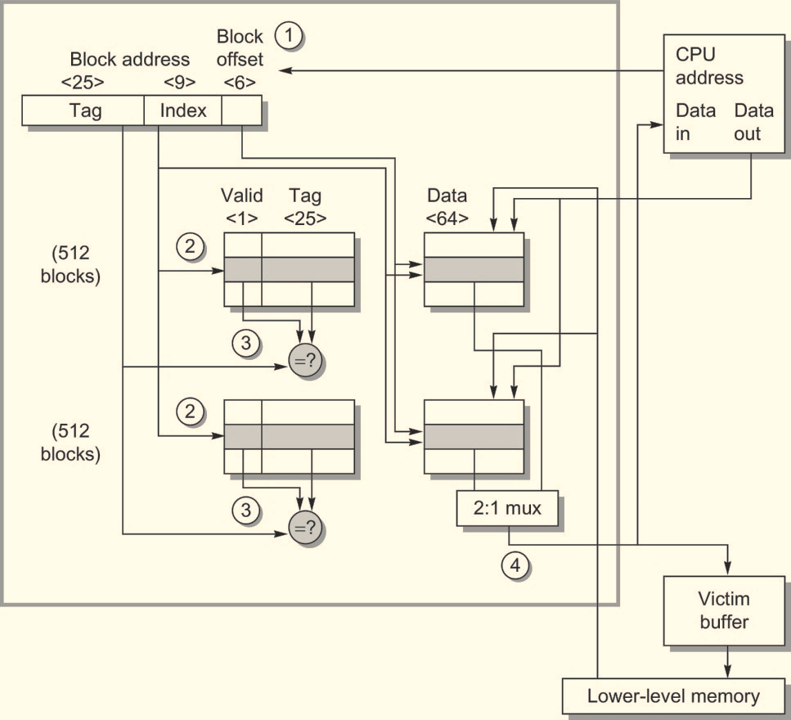


Organization of Cache in Opteron Processor
Figure B.5 The organization of the data cache in the Opteron microprocessor. The 64 KiB cache is two-way set associative with 64-byte blocks. The 9-bit index selects among 512 sets. The four steps of a read hit, shown as circled numbers in order of occurrence, label this organization. Three bits of the block offset join the index to supply the RAM address to select the proper 8 bytes. Thus, the cache holds two groups of 4096 64-bit words, with each group containing half of the 512 sets. Although not exercised in this example, the line from lower-level memory to the cache is used on a miss to load the cache. The size of address leaving the processor is 40 bits because it is a physical address and not a virtual address. Figure B.24 on page B-47 explains how the Opteron maps from virtual to physical for a cache access.

Slide 42
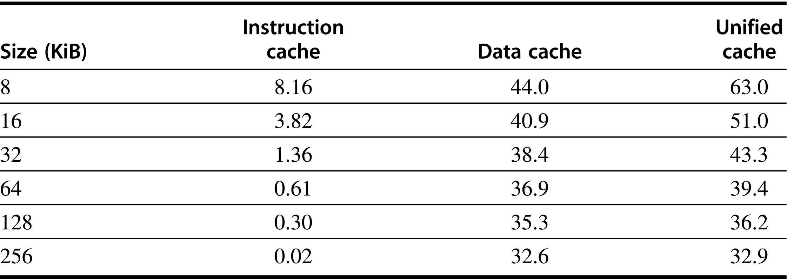
Study Cache Miss Behavior
Figure B.6 Miss per 1000 instructions for instruction, data, and unified caches of different sizes. The percentage of instruction references is about 74%. The data are for two-way associative caches with 64-byte blocks for the same computer and benchmarks as Figure B.4.

Slide 43
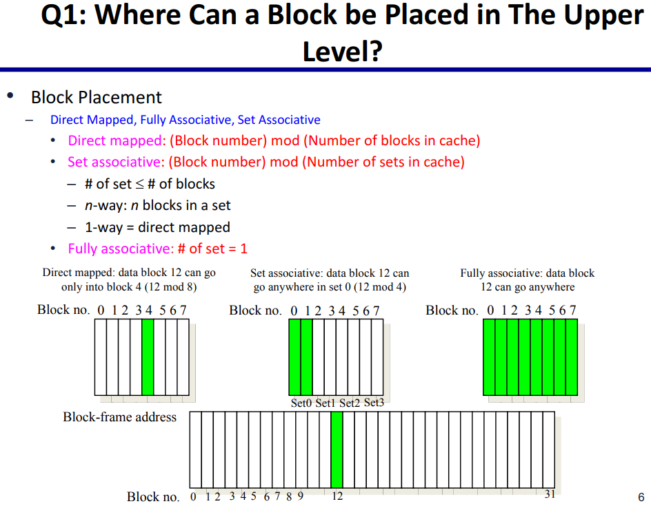
Where to place a Block (Line) of Data in Cache?

Slide 44
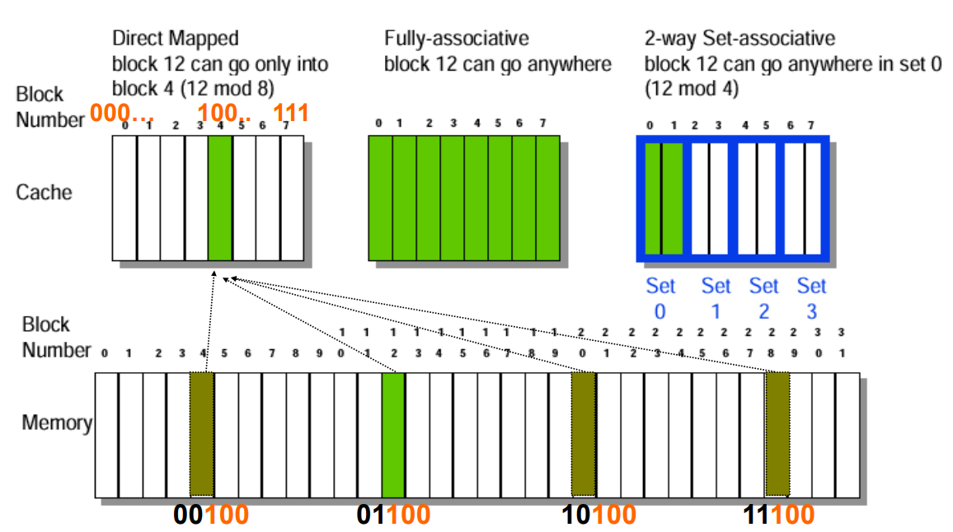
Cache Organization

Slide 45
Cache Hit, Miss and Replacement

Slide 46
What is Hit and Miss?
To study the Memory Hierarchy behaviour when a Read
or Write Command discovers that the Data is available
inside a Cache

Slide 47
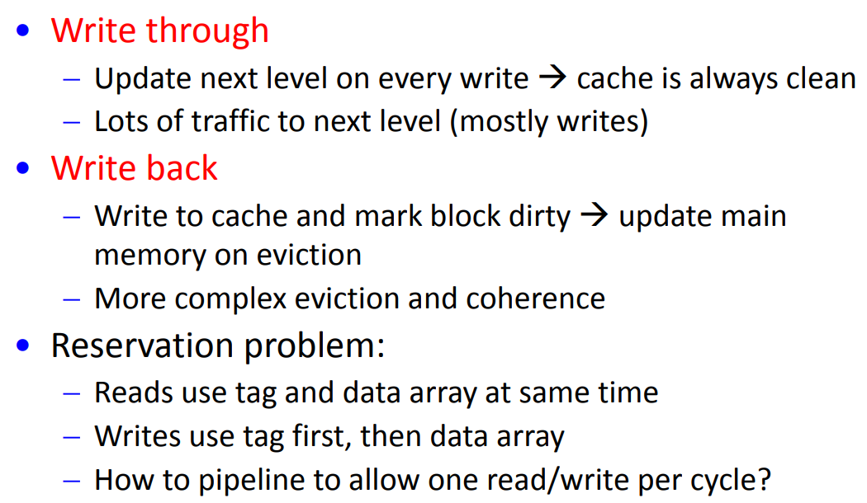
Hit Policy for Write operation

Slide 48
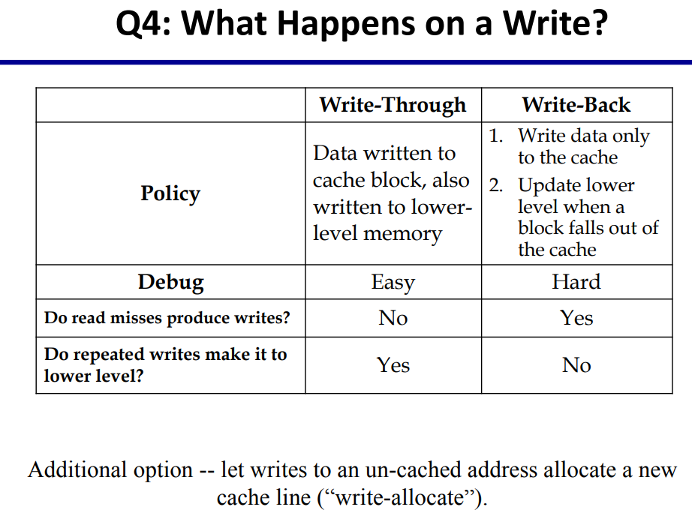

What Happens on a Write Command

Slide 49
Write Hit Approach
Write through
  Update next level on every write → cache is always clean
  Lots of traffic to next level (mostly writes)
Write back
  Write to cache and mark block dirty → update main memory on eviction (more complex eviction and coherence)
Write buffer for write through
  Processor: writes data into cache and write buffer
  Memory controller: write contents of buffer to memory
Processor
Cache
DRAM
Write Buffer
Notes:
We really didn't write to the memory directly. We are writing to a write buffer.
Once the data is written into the write buffer and assuming a cache hit, the CPU is done with the write. The memory controller will then move the write buffer’s contents to the real memory behind the scene.
The write buffer works as long as the frequency of write is not too high. Notice here, I am referring to the frequency with respect to time, not with respect to number of instructions.
Remember the DRAM cycle time we talked about last time. It sets the upper limit on how frequent you can write to the main memory.
If the writes are too close together or the CPU time is so much faster than the DRAM cycle time, you can end up overflowing the write buffer and the CPU must stop and wait.

