Slide 1
Computer Architecture
CS 622 / EE 520
Spring 2026
Lecture 7
Shahid Masud

Slide 2
Topics
Pipelining Hazards
  Structure Hazards (Some Recap)
  Control Hazards – related to Branching
Branch Prediction
  Static
  Dynamic
Quiz 2
Next Week

Slide 3
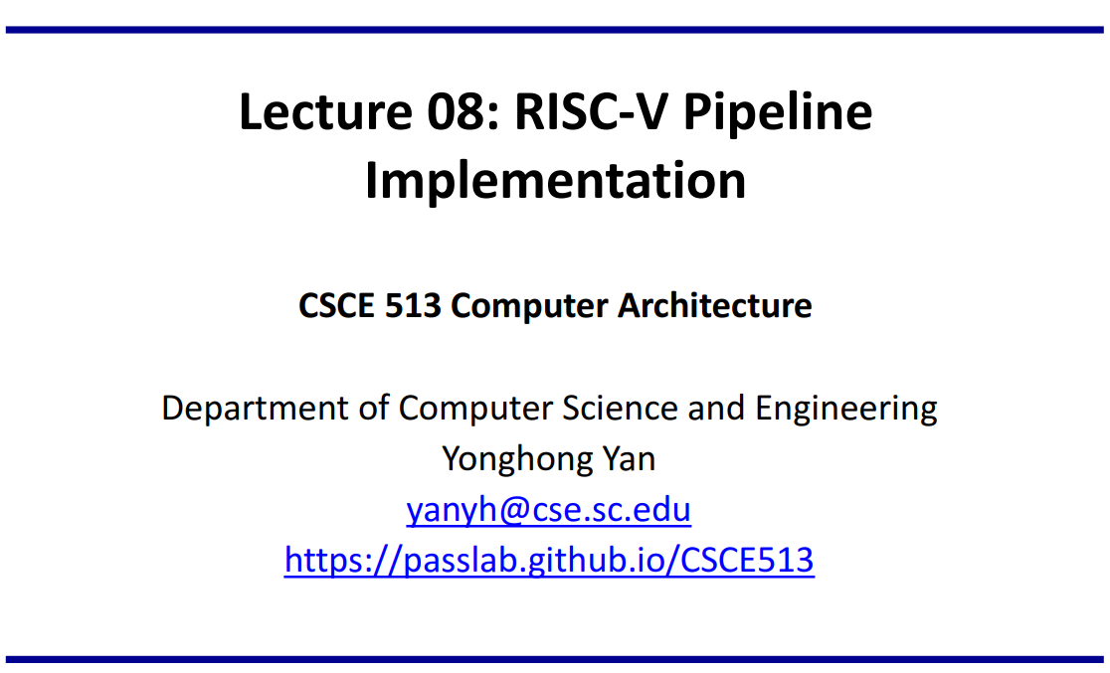
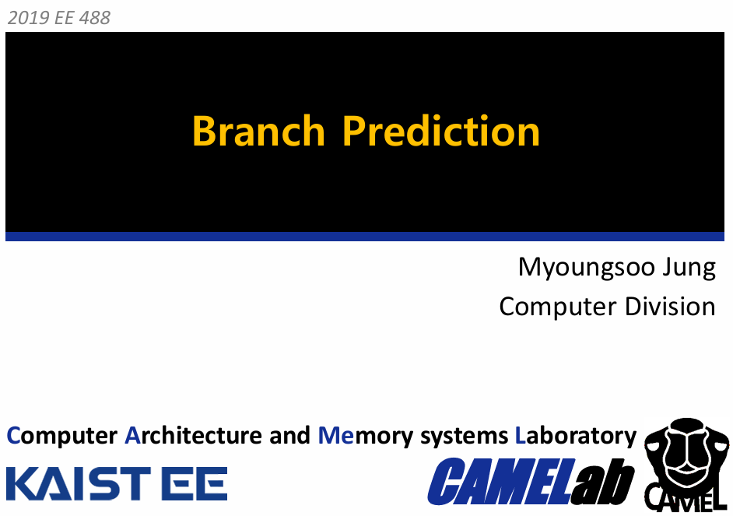
Slides Adapted from: (for further reading)
Readings:
Appendix C of course textbook

Slide 4
RISC V CPU – Internal View

Slide 5
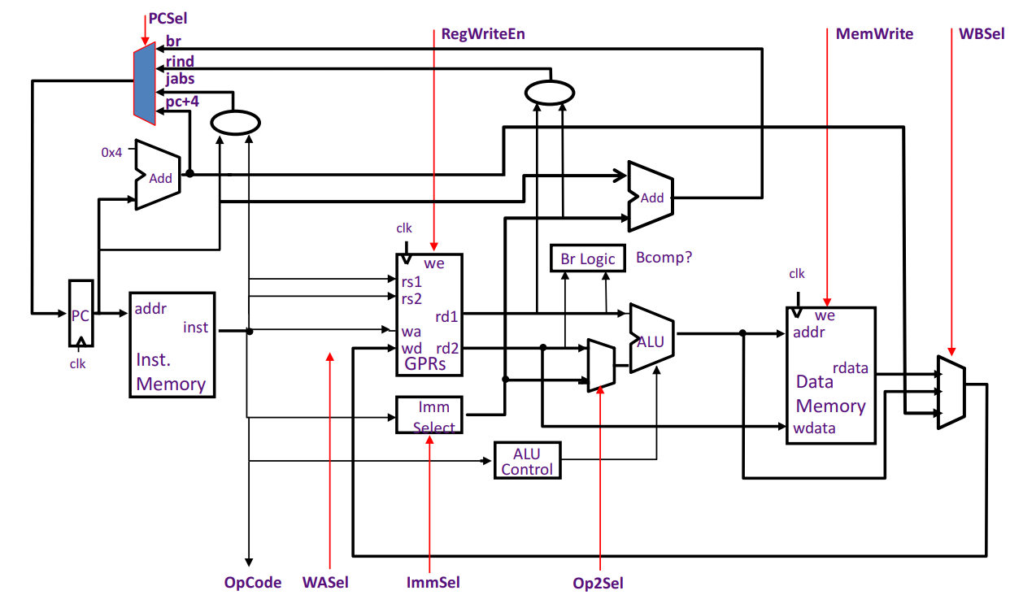
Starting Point –Unpipelined Processor with Control

Slide 6
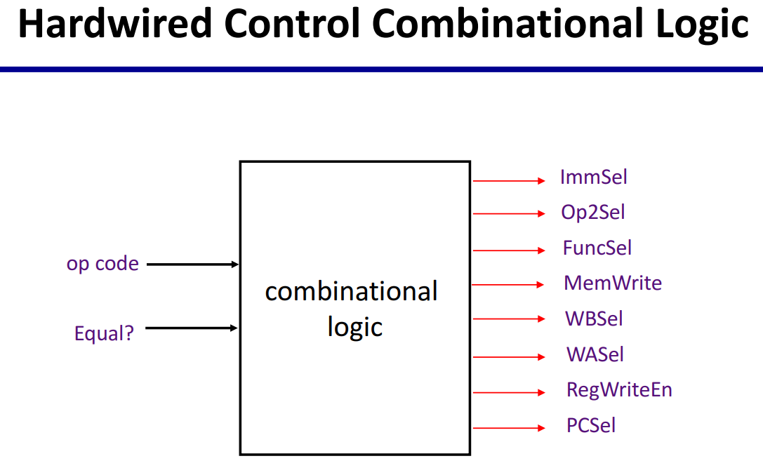
Corresponding Control path

Slide 7
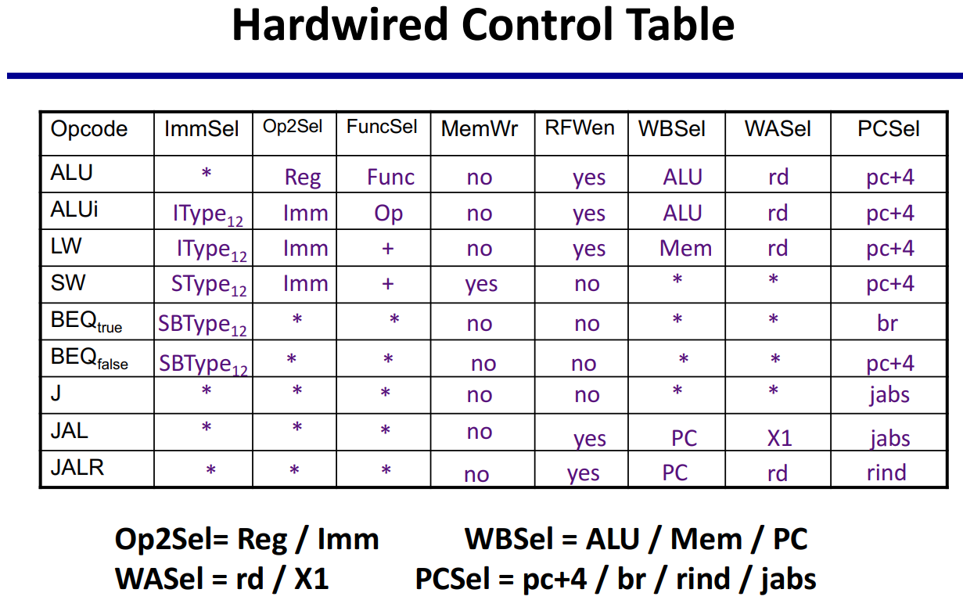
Control path Produces Control Words

Slide 8
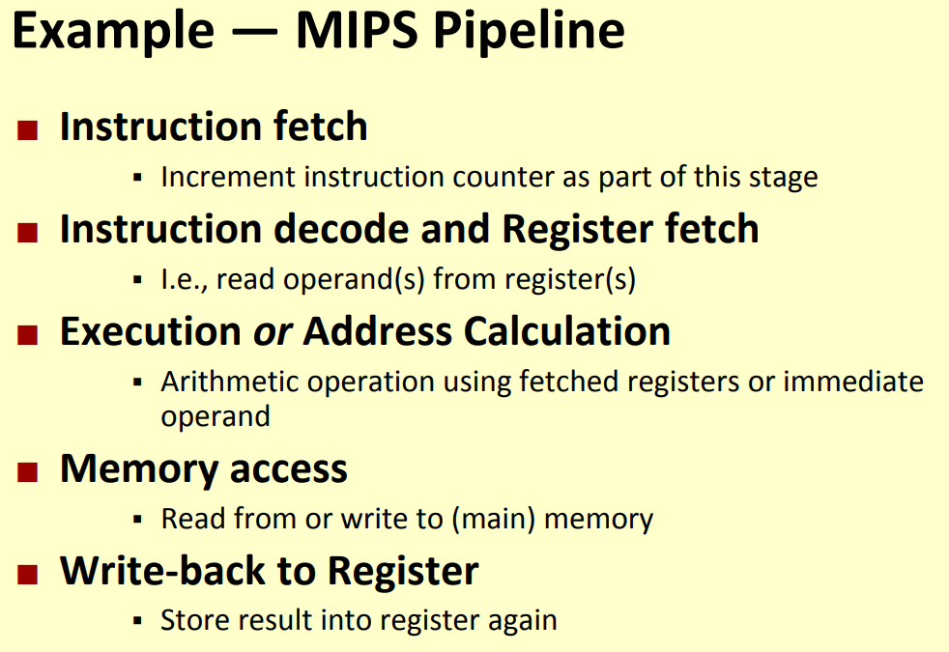
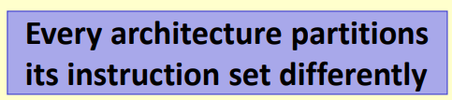
Example of MIPS / RISC Pipeline Architecture

Slide 9
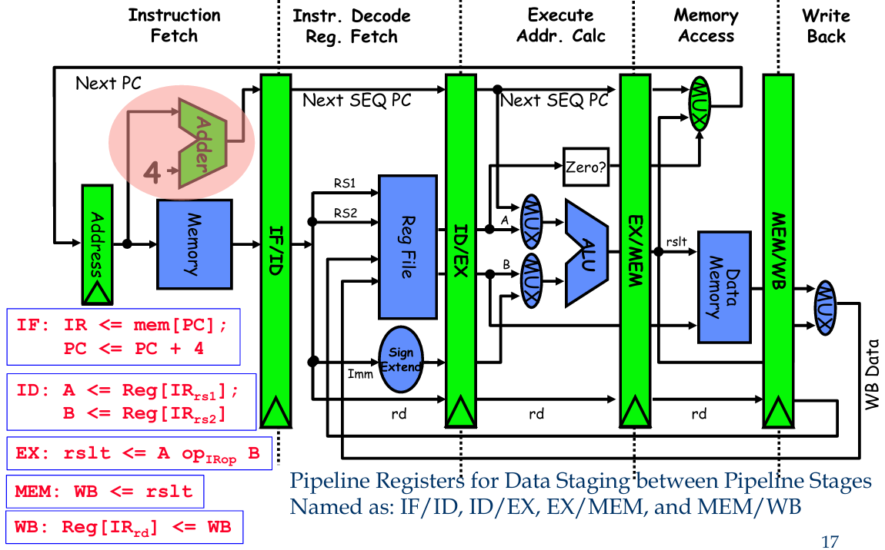


Main Operations in Each Pipeline Stage

Slide 10
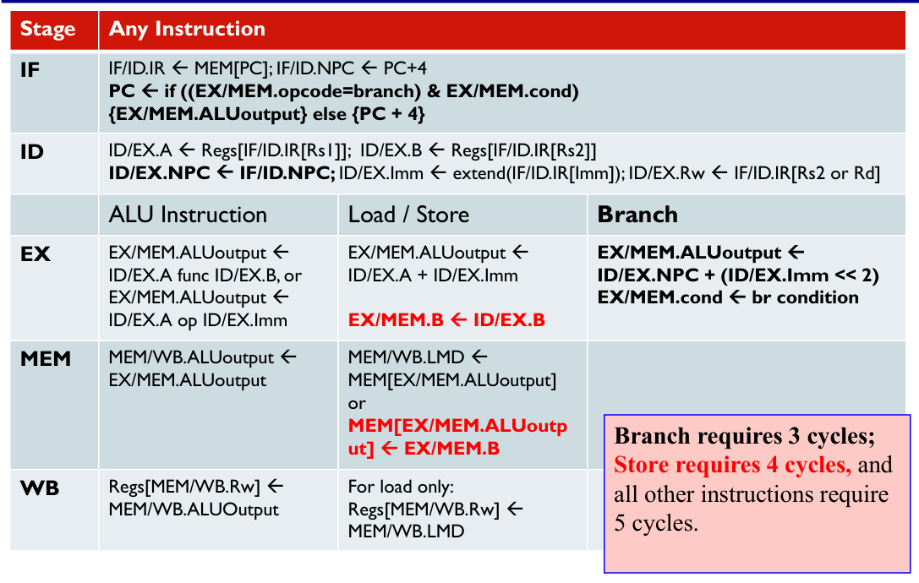
Detailed Operations in Pipeline Stages - Logic

Slide 11
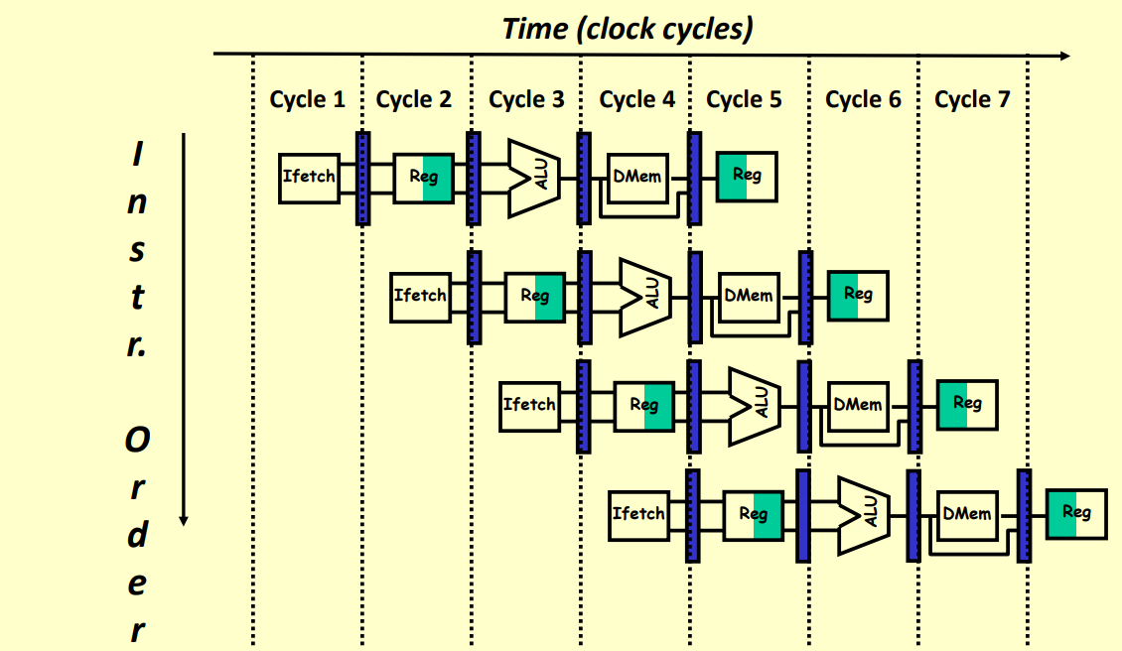
Visualizing Pipelining in a Diagram

Slide 12
Pipeline Hazards (Recap)

Slide 13
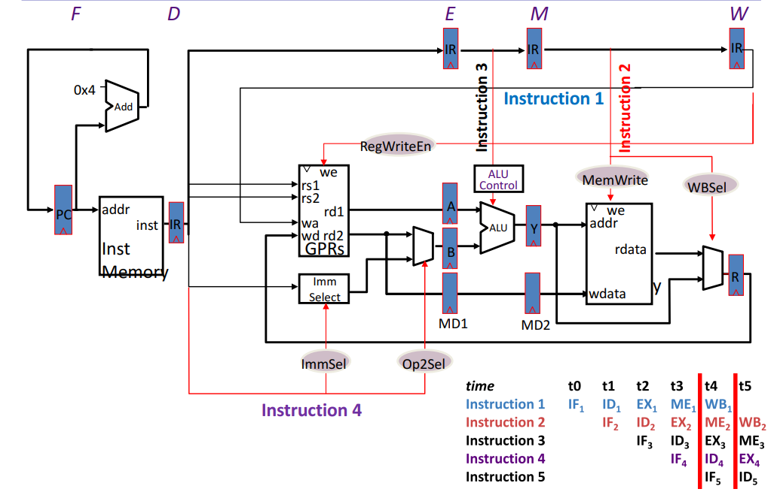

Multiple Instructions Interact inside Pipeline

Slide 14
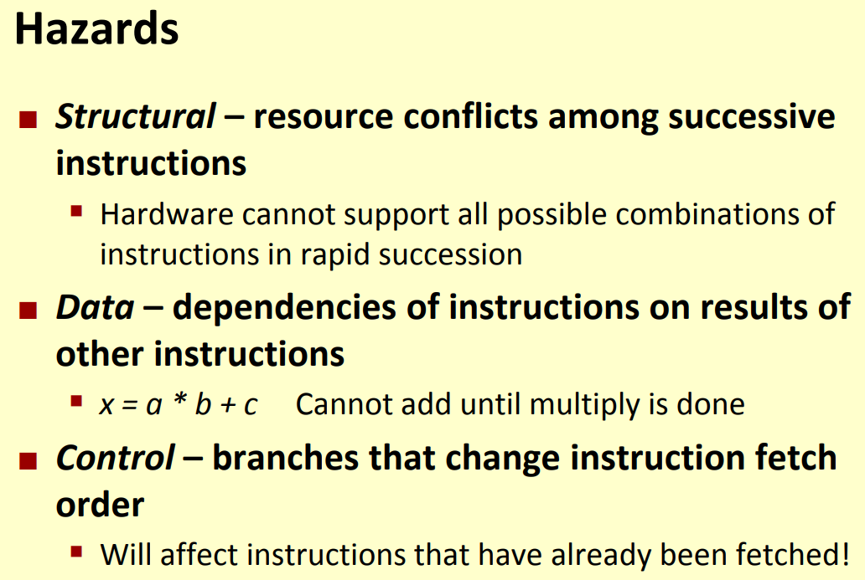

What are Pipeline Hazards?

Slide 15
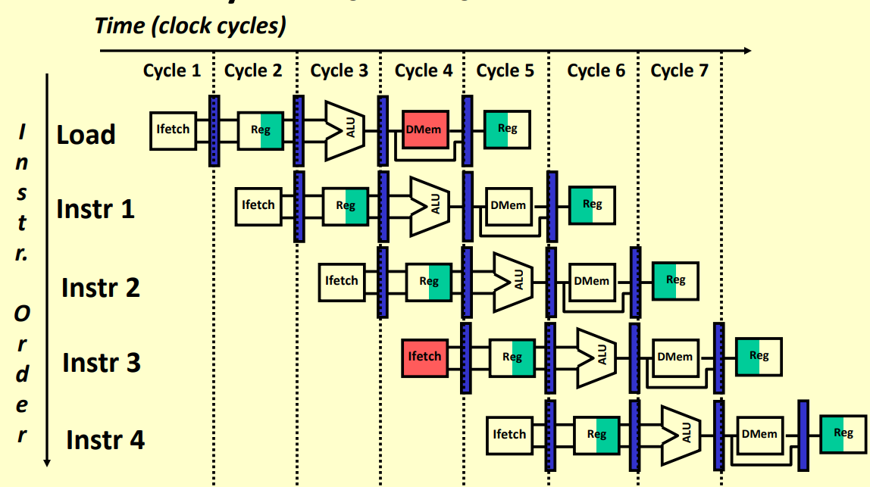
Structural Hazard due to Memory Access

Slide 16
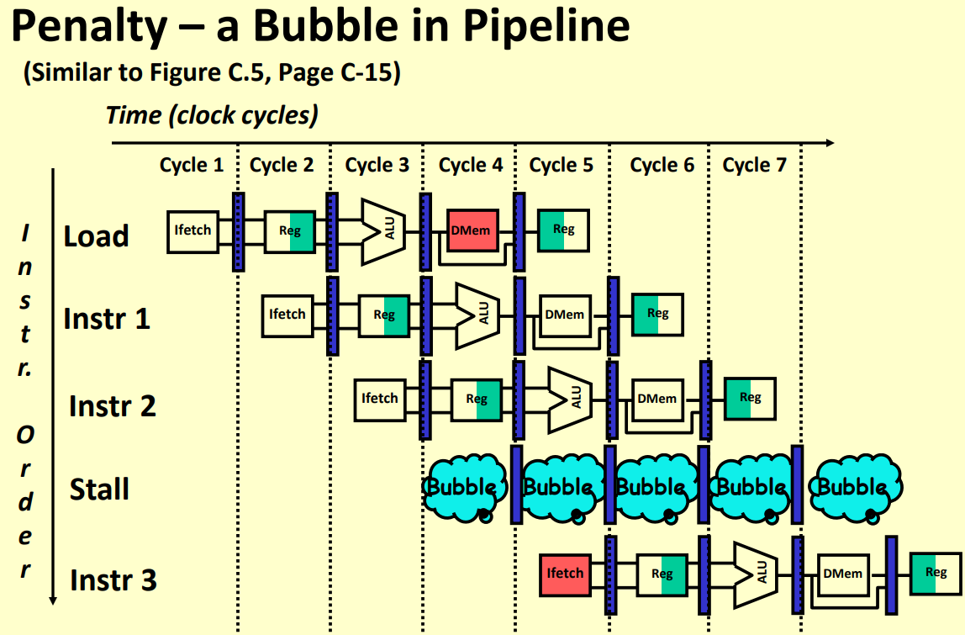
Introduce Bubble or Stall in Instructions

Slide 17
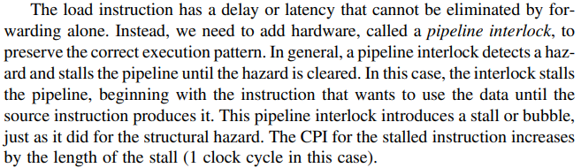
Pipeline Interlock

Slide 18
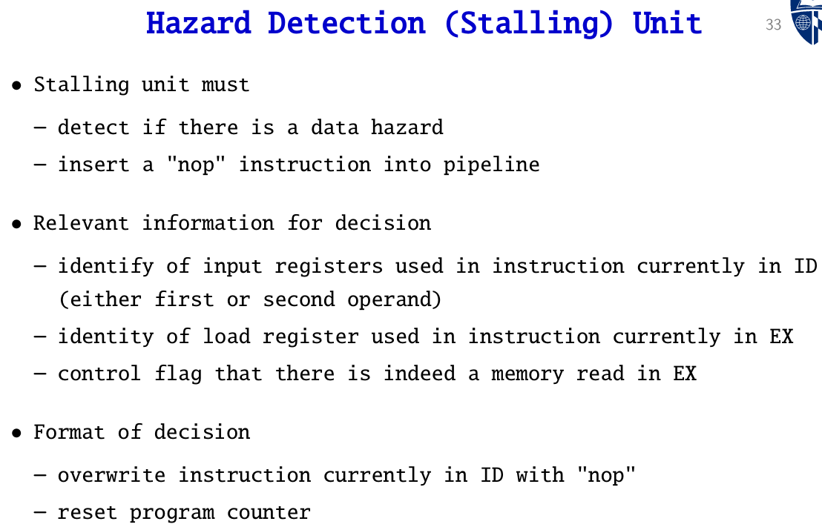
Hazard Detection and Stalling Unit

Slide 19
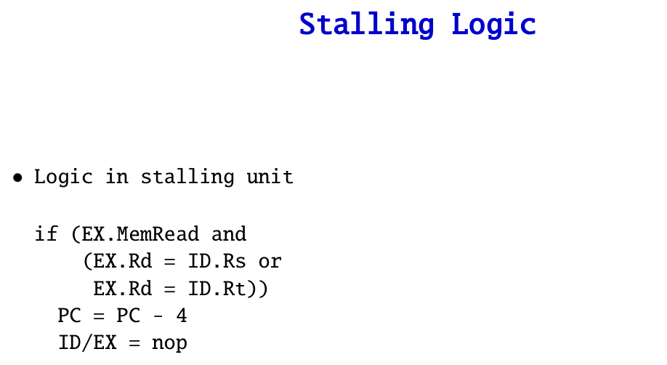
Stall Logic Operation

Slide 20
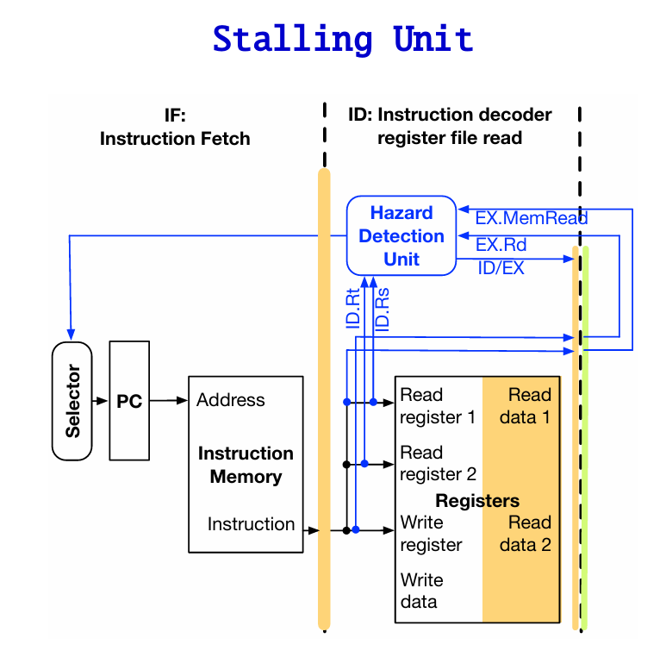
Stalling Unit in CPU Hardware

Slide 21
Forwarding to Minimize Data Hazard in Pipelining

Slide 22
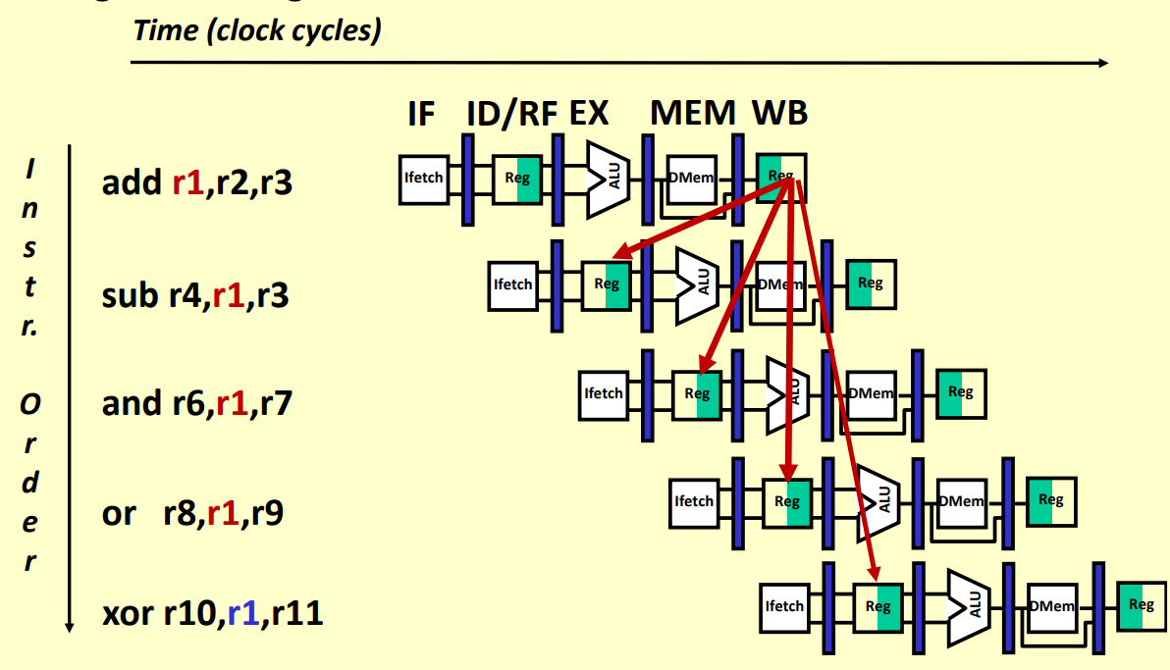
Data Related Pipeline Hazard on R1

Slide 23
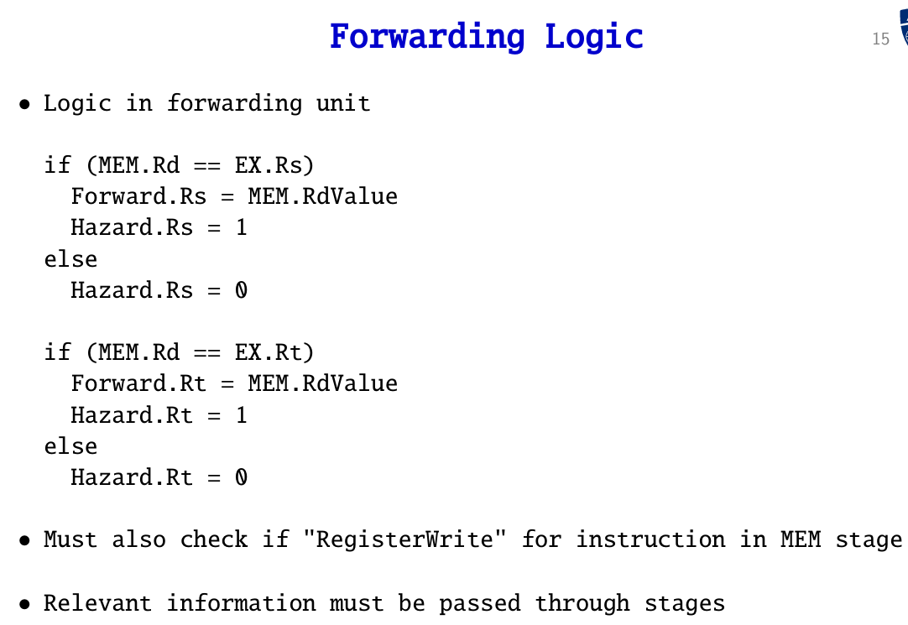
Forwarding Logic

Slide 24
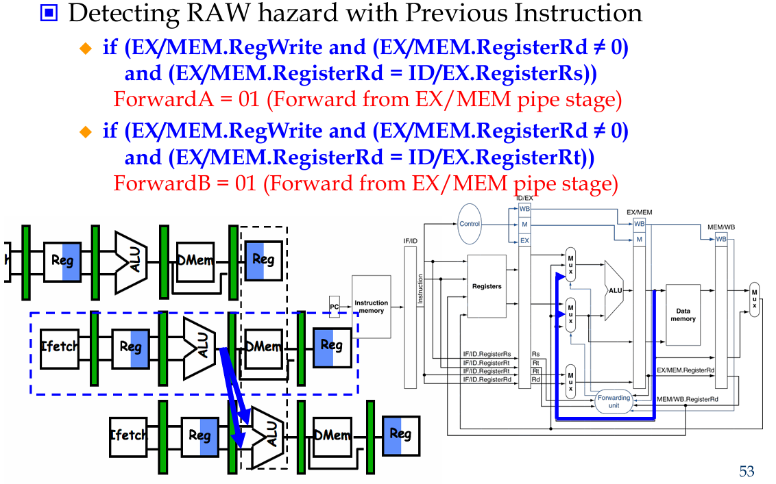
Forwarding Conditions

Slide 25
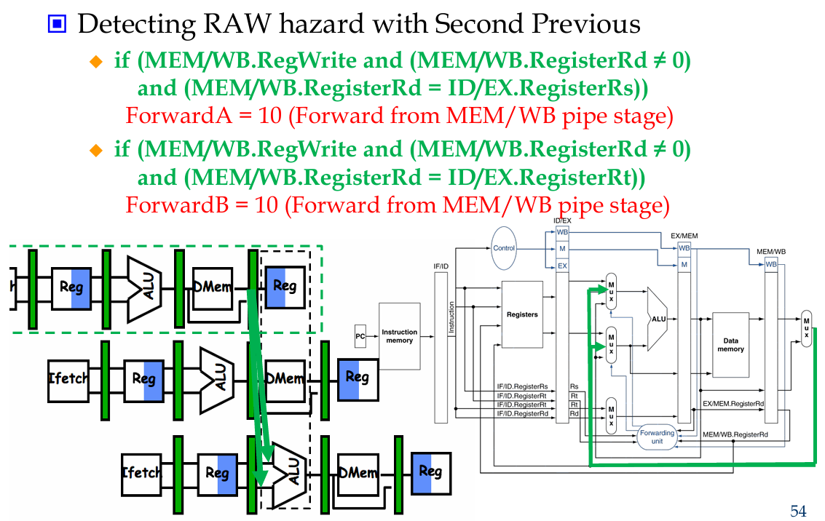
Forwarding Condition - I

Slide 26
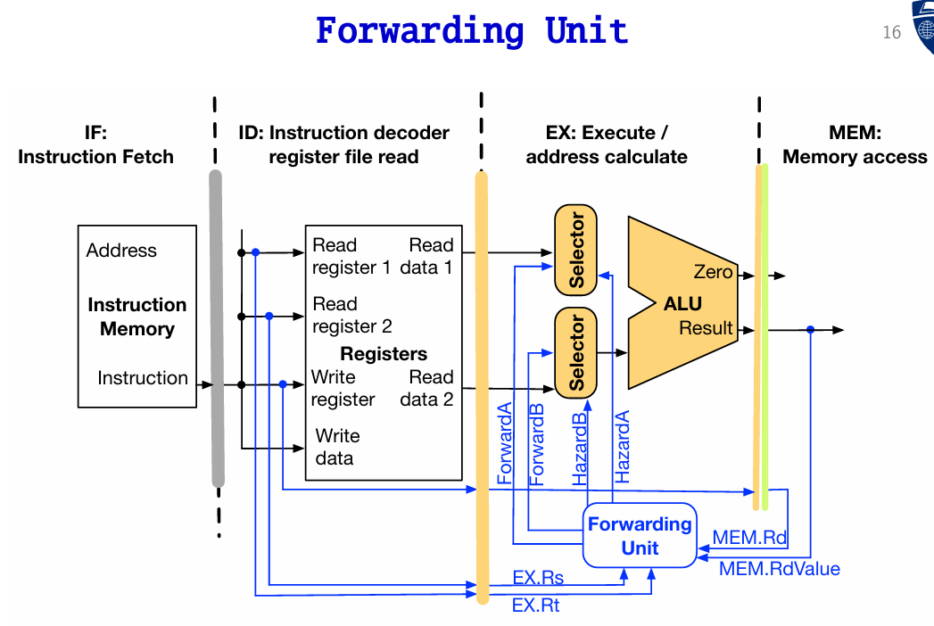
Forwarding Unit in CPU Hardware

Slide 27
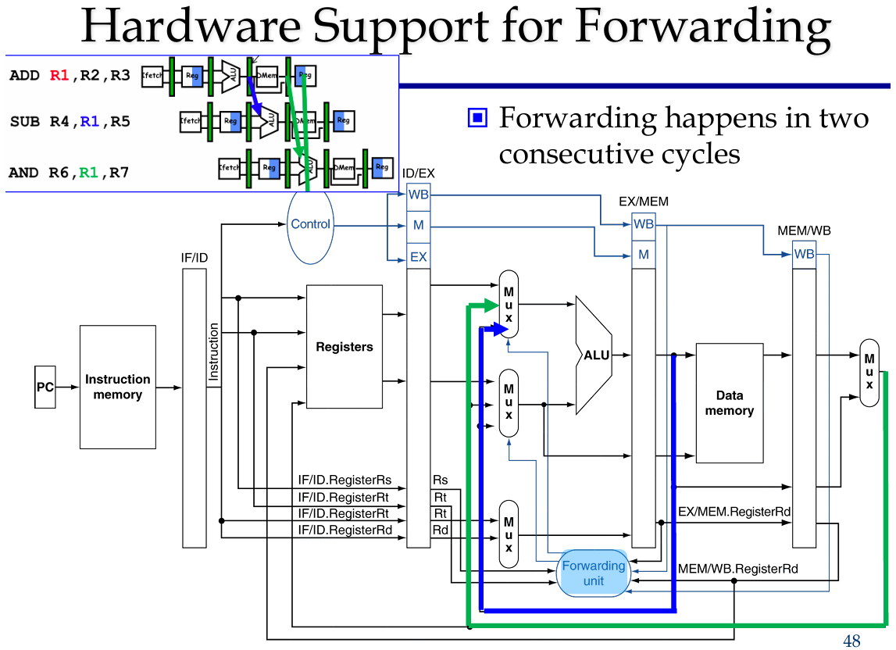
Hardware Support for Forwarding - another

Slide 28
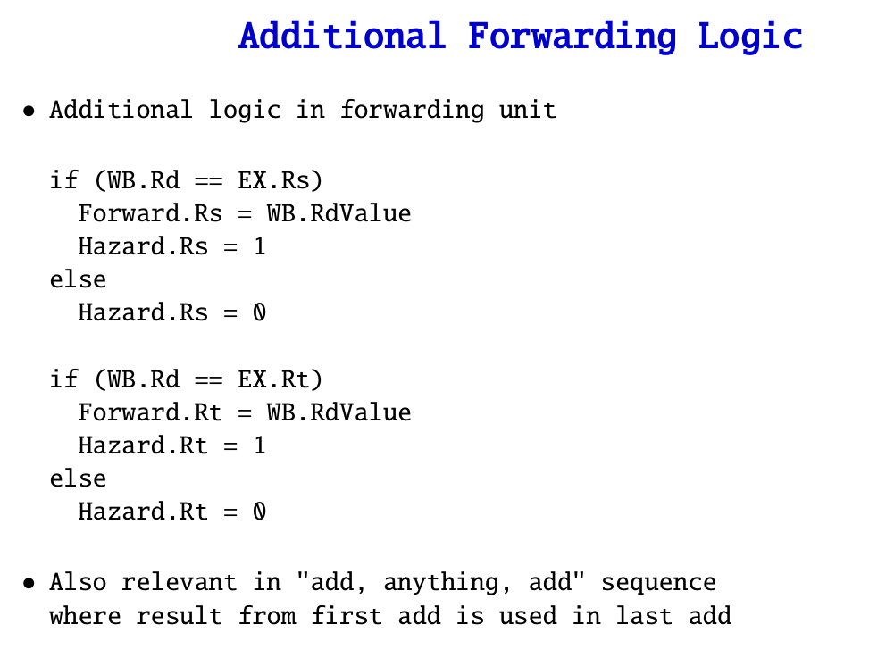

Slide 29
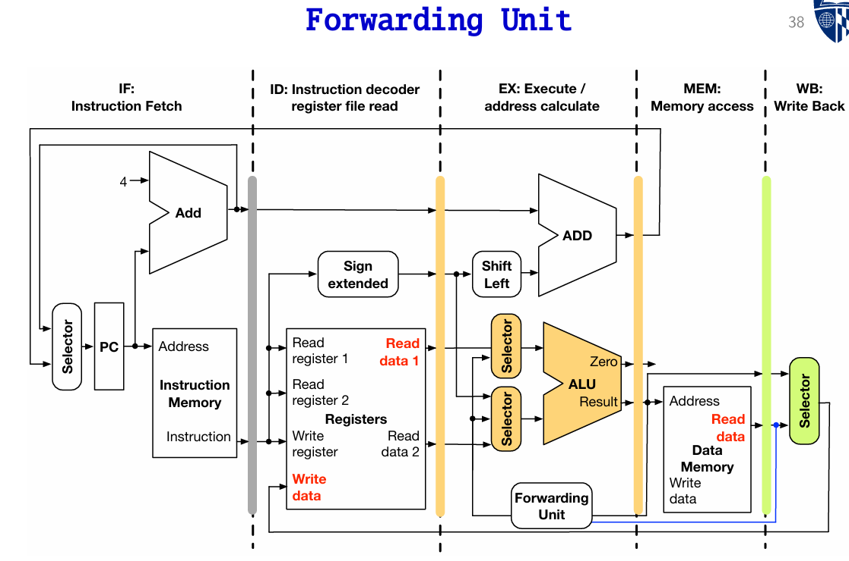

Slide 30
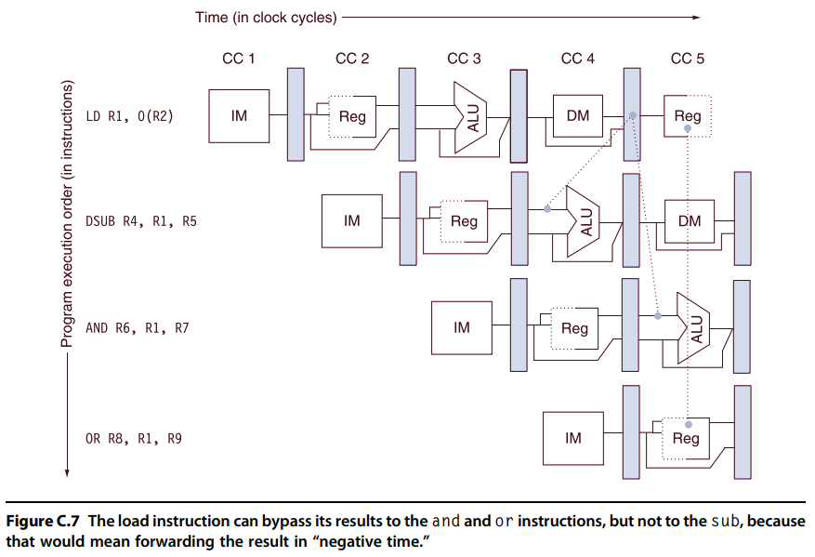
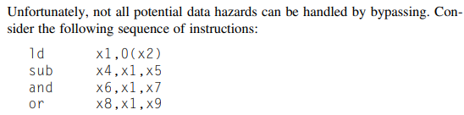
Forwarding Considerations – Negative Time

Slide 31
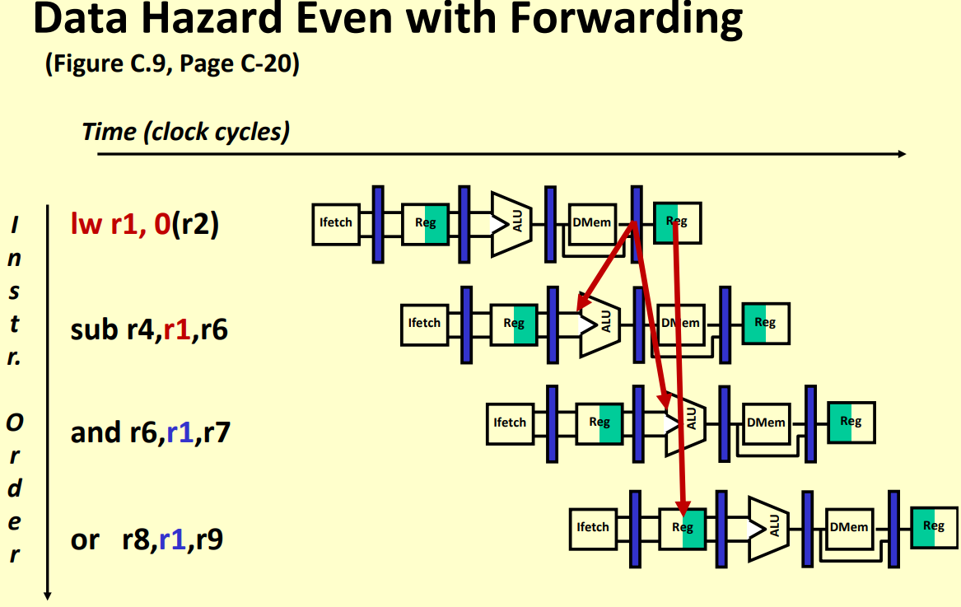
Hazard Possible with Forwarding

Slide 32
Control and Branch Hazards

Slide 33
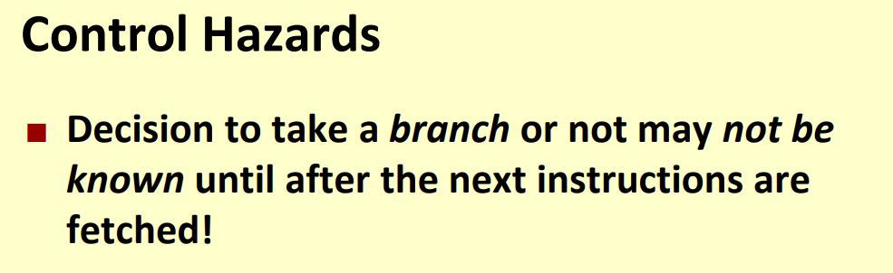
What are Control Hazards?

Slide 34
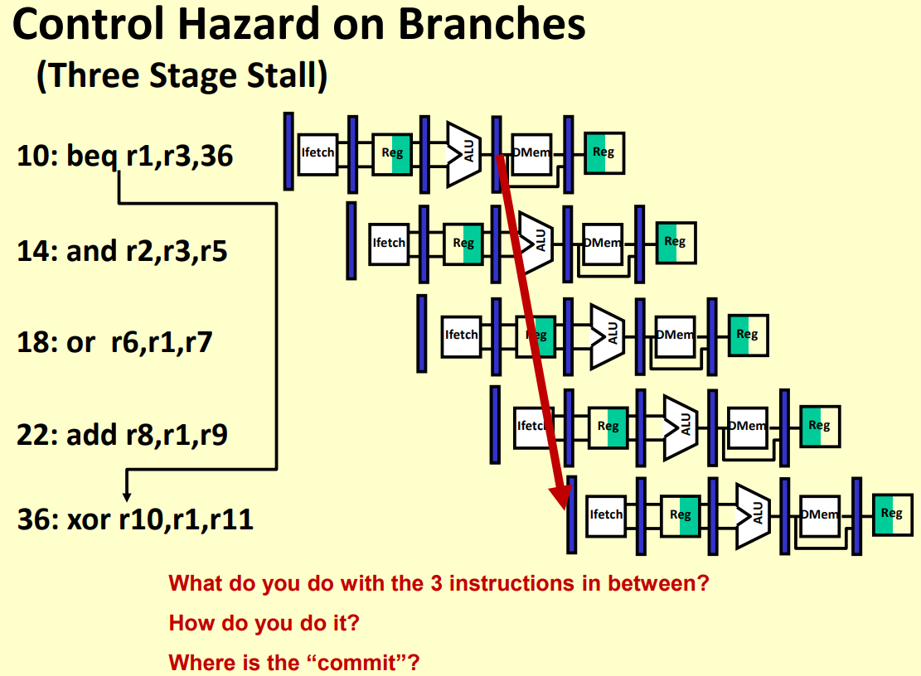
Control Hazard on Branches

Slide 35
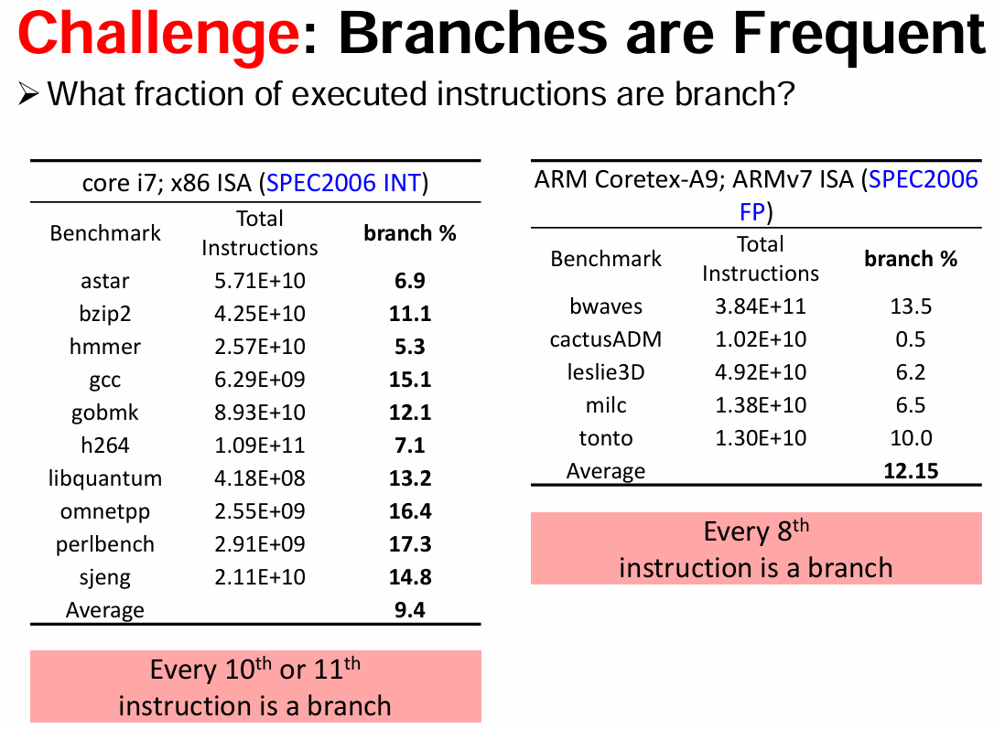
Branch Frequency through Benchmarks

Slide 36
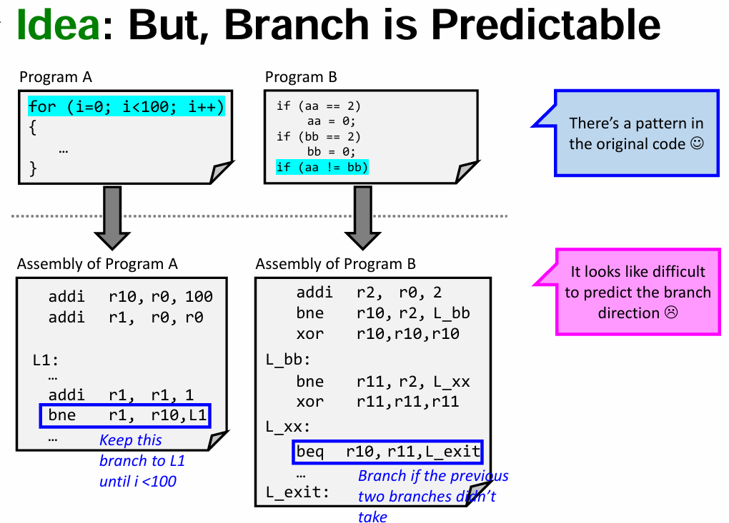
Branch is Predictable in Code

Slide 37
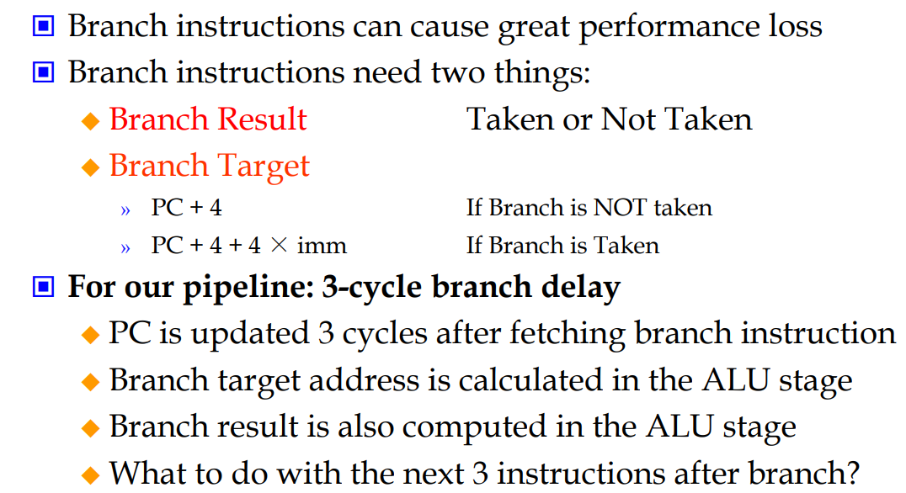
Branch / Control Hazards
Direction
Target Destination

Slide 38
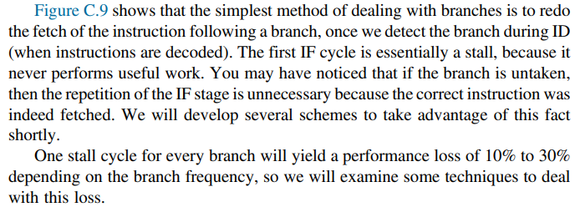
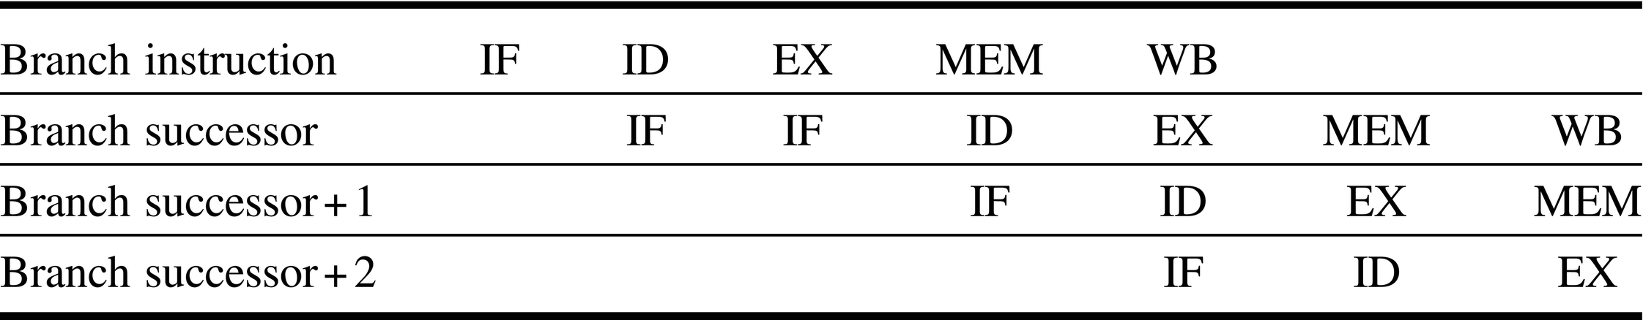
Restarting Fetch in Branch Instruction
Figure C.9 A branch causes a one-cycle stall in the five-stage pipeline. The instruction after the branch is fetched, but the instruction is ignored, and the fetch is restarted once the branch target is known. It is probably obvious that if the branch is not taken, the second IF for branch successor is redundant. This will be addressed shortly.

Slide 39
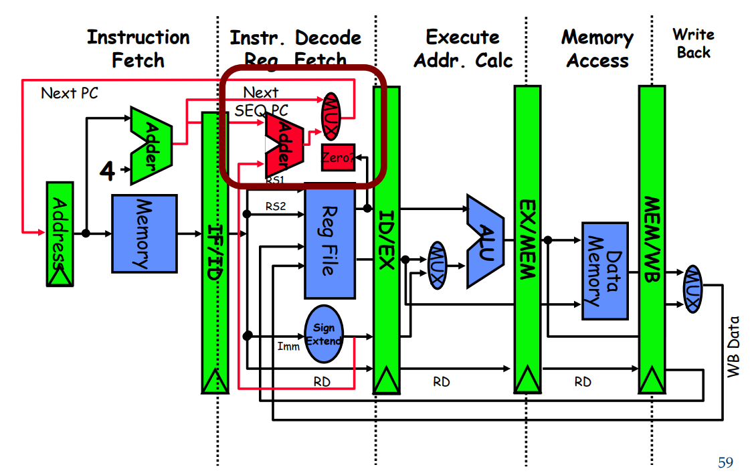
Extra Hardware for Branch in Pipelined Datapath

Slide 40
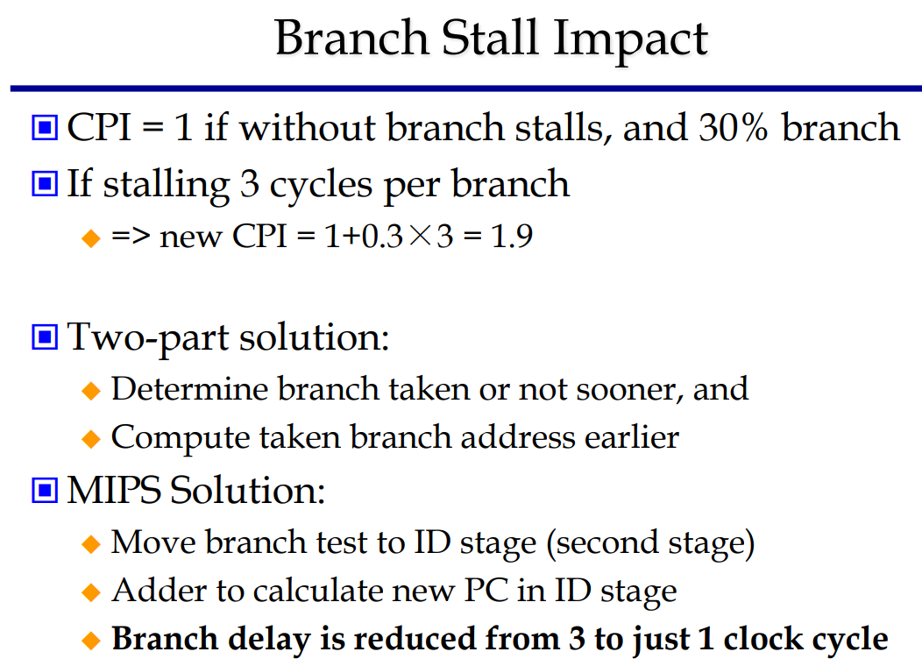
Branch Stall Impact

Slide 41
Static Branch Prediction

Slide 42
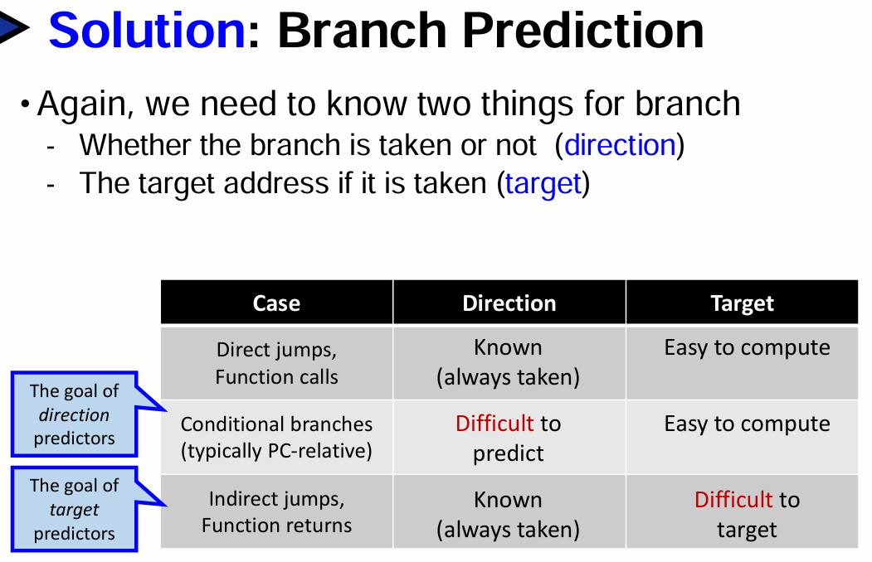
How to do Branch Prediction?

Slide 43
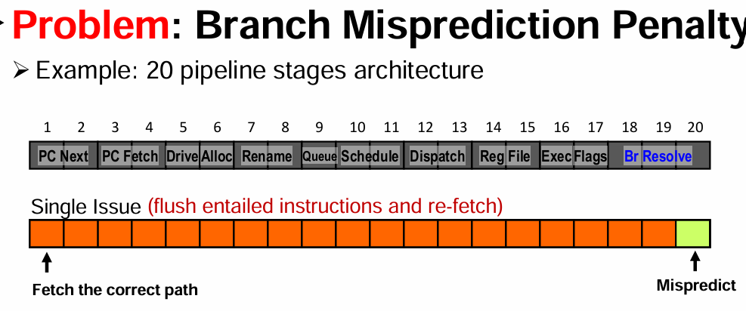
What happens in Misprediction?

Slide 44
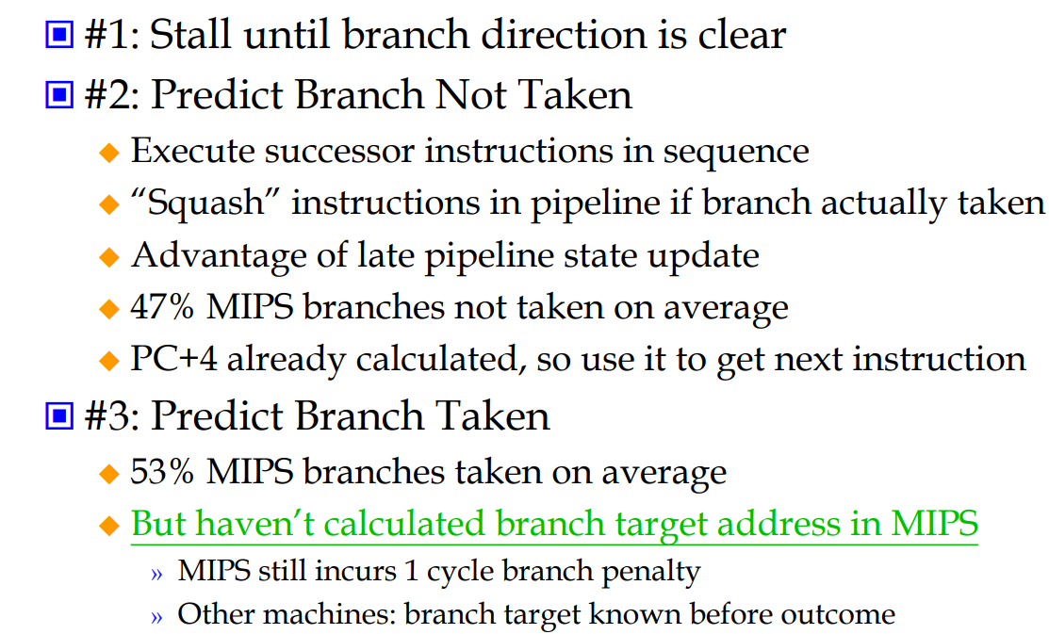
Static Alternatives for Branch Hazard in RISC

Slide 45
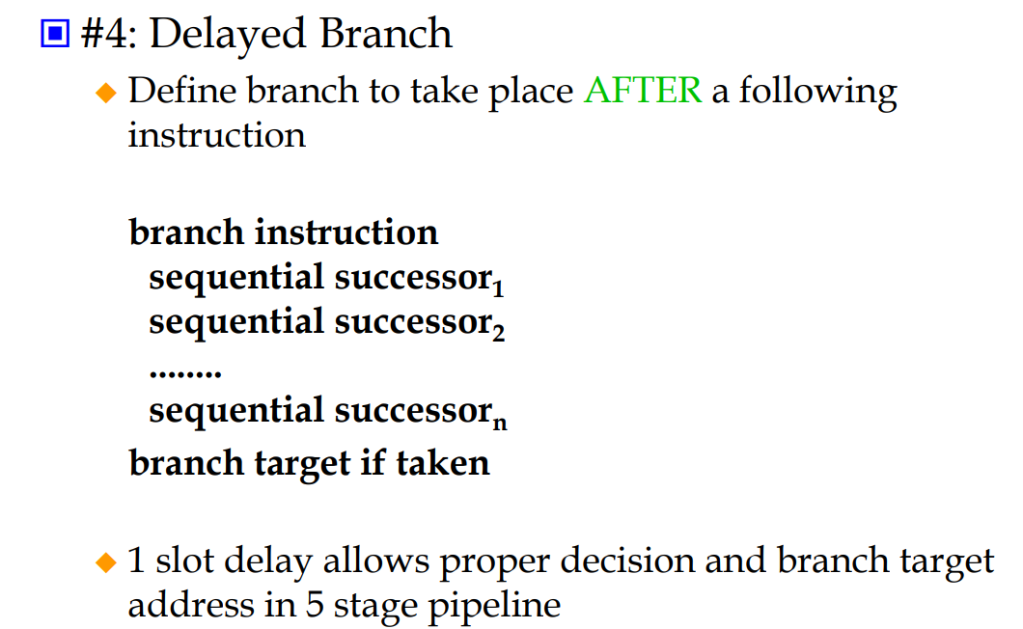
Continued – Four Branch Hazard Alternatives

Slide 46
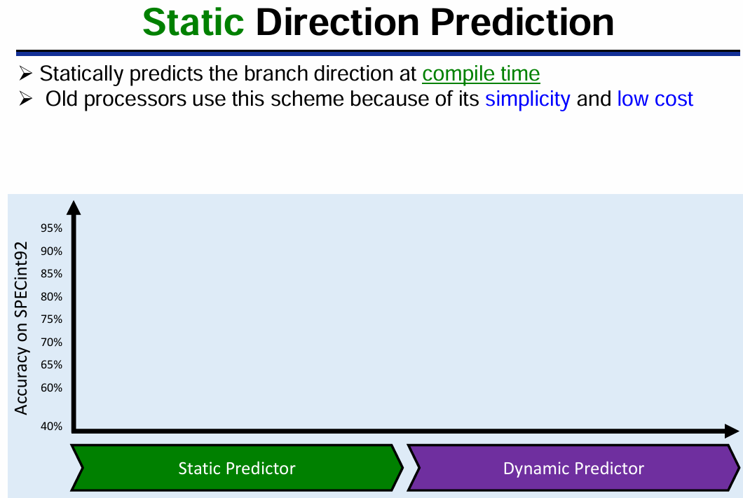
Static Direction Prediction

Slide 47
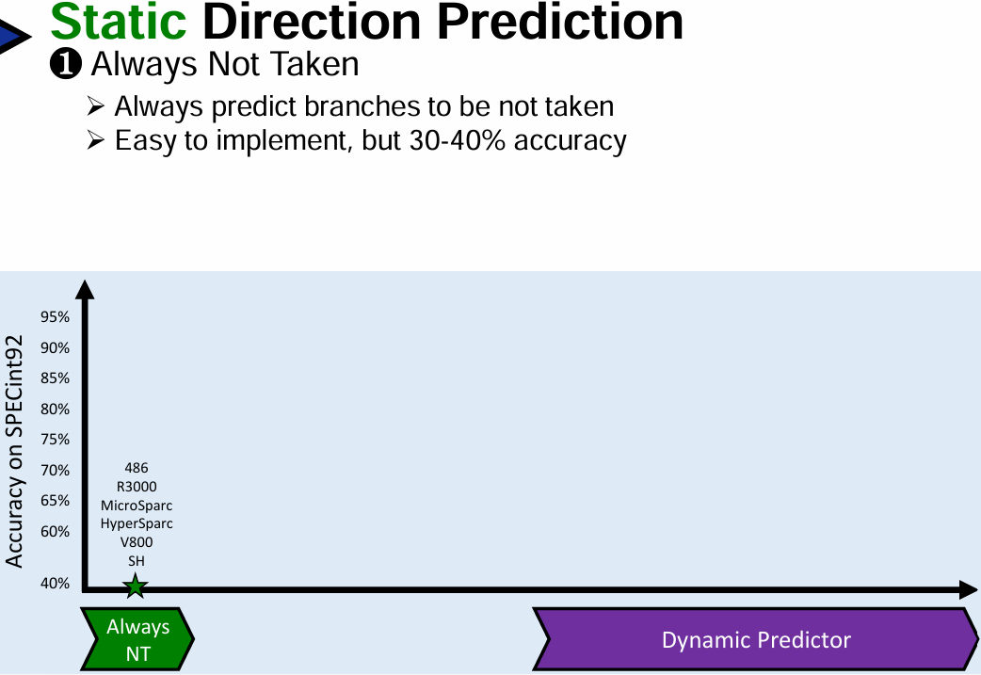
Predict Always Not Taken

Slide 48
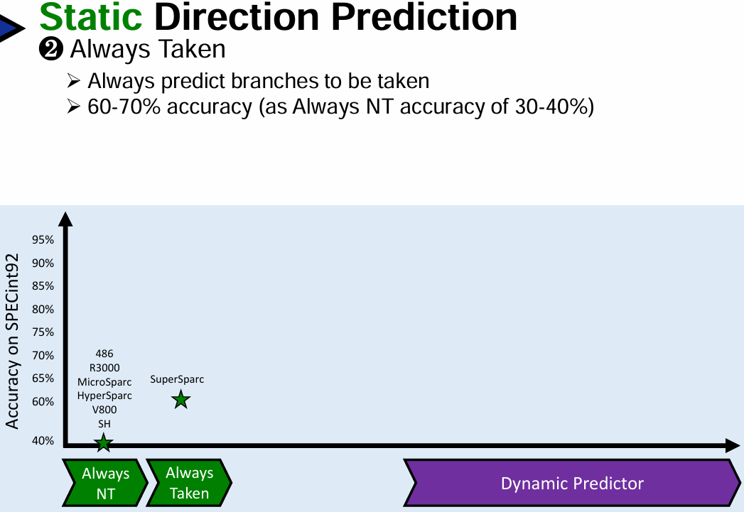
Predict Always Taken

Slide 49
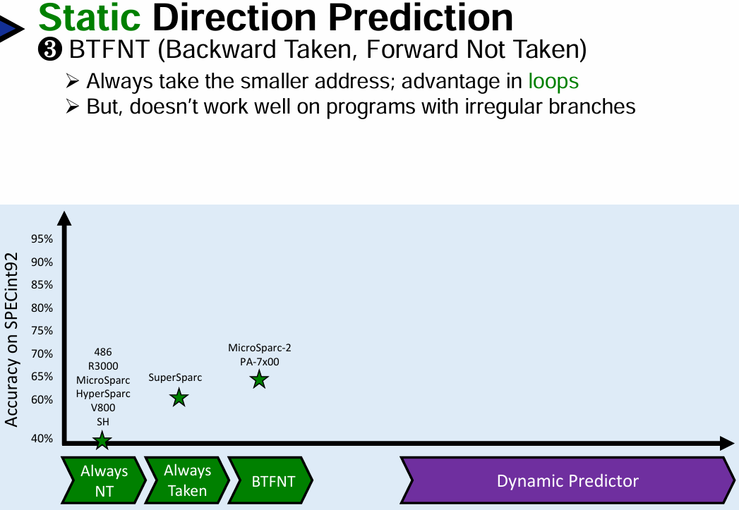
Predict Backward Taken, Forward Not Taken

Slide 50
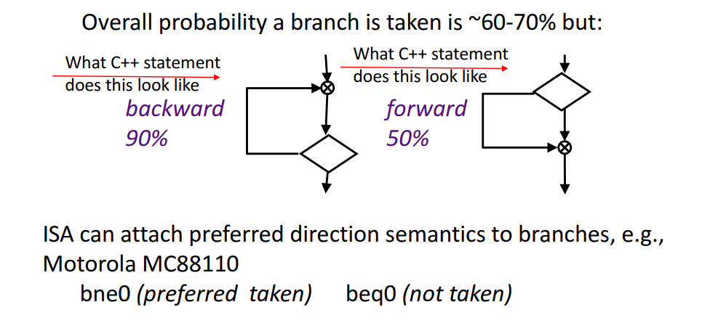
Static Branch Prediction – Backward and Forward

Slide 51
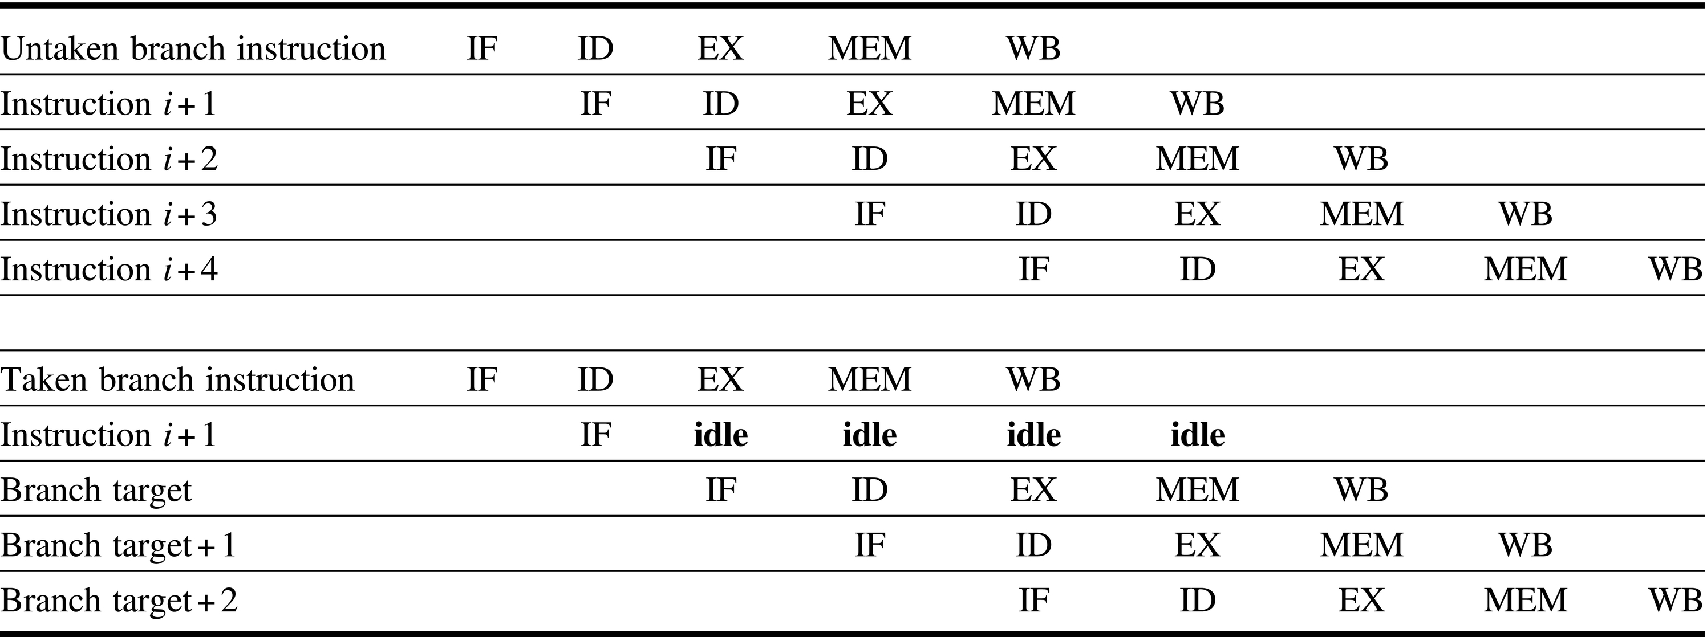
Predicted Taken / Not Taken – Pipeline Sequence
Figure C.10 The predicted-not-taken scheme and the pipeline sequence when the branch is untaken (top) and taken (bottom). When the branch is untaken, determined during ID, we fetch the fall-through and just continue. If the branch is taken during ID, we restart the fetch at the branch target. This causes all instructions following the branch to stall 1 clock cycle.

Slide 52
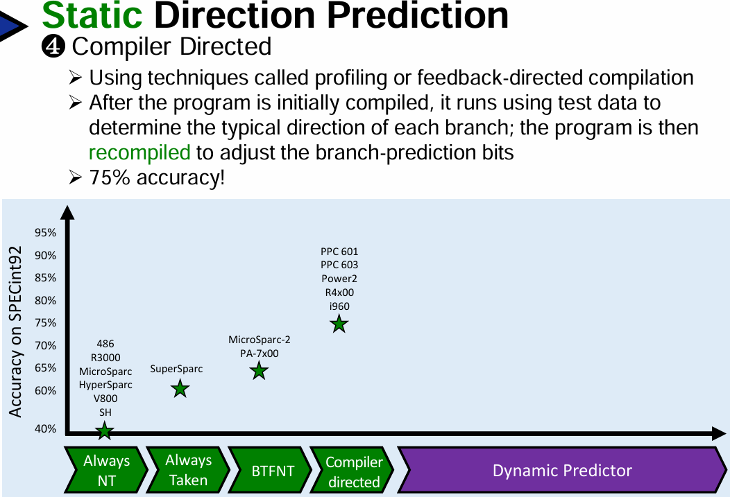
Predict Using Compiler Profiling

Slide 53
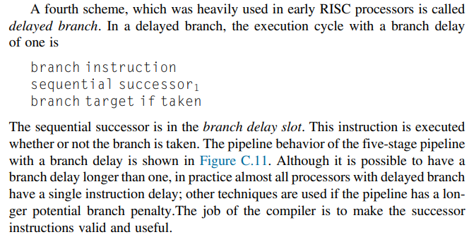

Behavior of Delayed Branch
Figure C.11 The behavior of a delayed branch is the same whether or not the branch is taken. The instructions in the delay slot (there was only one delay slot for most RISC architectures that incorporated them) are executed. If the branch is untaken, execution continues with the instruction after the branch delay instruction; if the branch is taken, execution continues at the branch target. When the instruction in the branch delay slot is also a branch, the meaning is unclear: if the branch is not taken, what should happen to the branch in the branch delay slot? Because of this confusion, architectures with delay branches often disallow putting a branch in the delay slot.

Slide 54

Control Instruction Details

Slide 55

When is Destination Known?

Slide 56

Control Hazard Delay Summary

Slide 57

Evaluating Branch Alternatives

Slide 58

Performance of Control Hazard

Slide 59

Performance of Control Hazard - continued

Slide 60
Dynamic Branch Prediction
1 Bit

Slide 61

Difference between Static and Dynamic Prediction

Slide 62

Using 1 Bit History in BHT

Slide 63

1 Bit Branch Predictor Architecture

Slide 64

Operation of 1 Bit Branch Predictor Architecture

Slide 65

Example 1: A loop using 1 Bit BHT

Slide 66

Challenge in 1 Bit Branch Predictor

Slide 67

Example 2: 1 Bit Predictor and Multiple Branches

Slide 68

Challenge of Multiple Branches in 1 Bit Predictor

Slide 69
Dynamic Branch Prediction
2 Bit

Slide 70

How Dynamic Branch Prediction is Performed?

Slide 71

2 Bit History in BHT

Slide 72

Basis of 2 Bit Branch Predictor

Slide 73

2 Bit Saturating Branch Predictor
Consider a loop
i = 0
Loop:
…
i = i + 4
if i < 400 go to loop
Branch Prediction trace
What state do we start in?
Assume something say SNT
i | State | Pred | Actual | Next State
0 | SNT | NT | Taken | WNT
1 | WNT | NT | Taken | WT
2 | WT | T | Taken | ST
3 | ST | T | Taken | ST
https://en.wikipedia.org/wiki/Branch_predictor

Slide 74

Example 1: 2 Bit Branch Predictor in a Loop

Slide 75

Compare 1 Bit vs 2 Bit History in BHT

Slide 76

Example of 1 Bit Branch Predictor

Slide 77

Example of 2 Bit Branch Predictor

Slide 78
Dynamic Branch Prediction
Correlated and Tournament

Slide 79

Two Level Branch Predictor using Correlation

Slide 80

Branch Correlation in BHT

Slide 81

Example of Global Correlation in Branches

Slide 82

Pattern History Table in Correlated Predictor

Slide 83

Contd - PHT

Slide 84

Deeper History Information

Slide 85

Design Policy of Correlated Predictors

Slide 86

2 Level Predictor

Slide 87

GHR Global History Register

Slide 88


Slide 89


Slide 90


Slide 91

Tournament Branch Predictor

Slide 92

Tournament Hybrid Predictor

Slide 93
Predict Branch Target Address
Design and Architecture

Slide 94

Predict Target Address of Branch

Slide 95

Branch Target Buffer

Slide 96

Challenge in Function Return

Slide 97

Return Address Stack

Slide 98


Slide 99


Slide 100

RAS used in many processors

Slide 101

Some Branch Prediction Examples in Processors

Slide 102


Slide 103


Some solved examples

Slide 104


Slide 105
Handling Complex EX Stage with Multiple cycles

Slide 106

Pipeline Architecture with Multiple Execution
Figure C.28 The RISC V pipeline with three additional unpipelined, floating-point, functional units. Because only one instruction issues on every clock cycle, all instructions go through the standard pipeline for integer operations. The FP operations simply loop when they reach the EX stage. After they have finished the EX stage, they proceed to MEM and WB to complete execution.

Slide 107

Latency of Different EX Units
Figure C.29 Latencies and initiation intervals for functional units.

Slide 108

Multiple Outstanding Operations in Pipeline
Figure C.30 A pipeline that supports multiple outstanding FP operations. The FP multiplier and adder are fully pipelined and have a depth of seven and four stages, respectively. The FP divider is not pipelined, but requires 24 clock cycles to complete. The latency in instructions between the issue of an FP operation and the use of the result of that operation without incurring a RAW stall is determined by the number of cycles spent in the execution stages. For example, the fourth instruction after an FP add can use the result of the FP add. For integer ALU operations, the depth of the execution pipeline is always one and the next instruction can use the results.

