Slide 1
Loop Unrolling Example 1

Slide 2
Loop Unroll Example 1
https://www.youtube.com/watch?v=3rydKkOWq7g
CS6810 -- Lecture 16. Lectures on Compiler-Based ILP

Slide 3
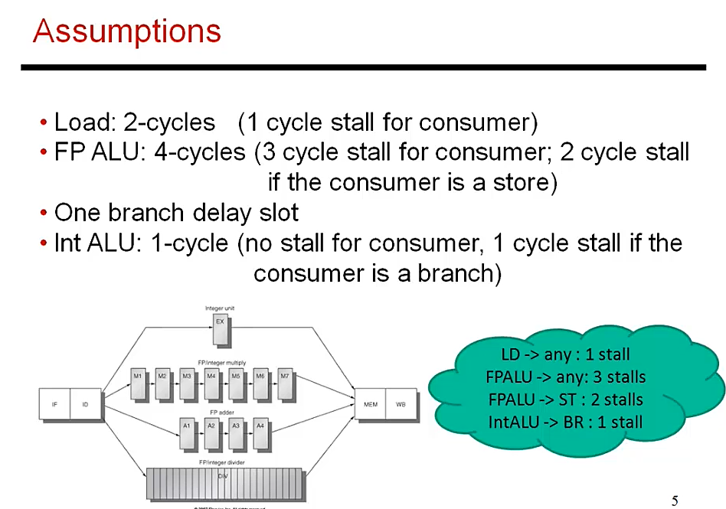





Slide 4
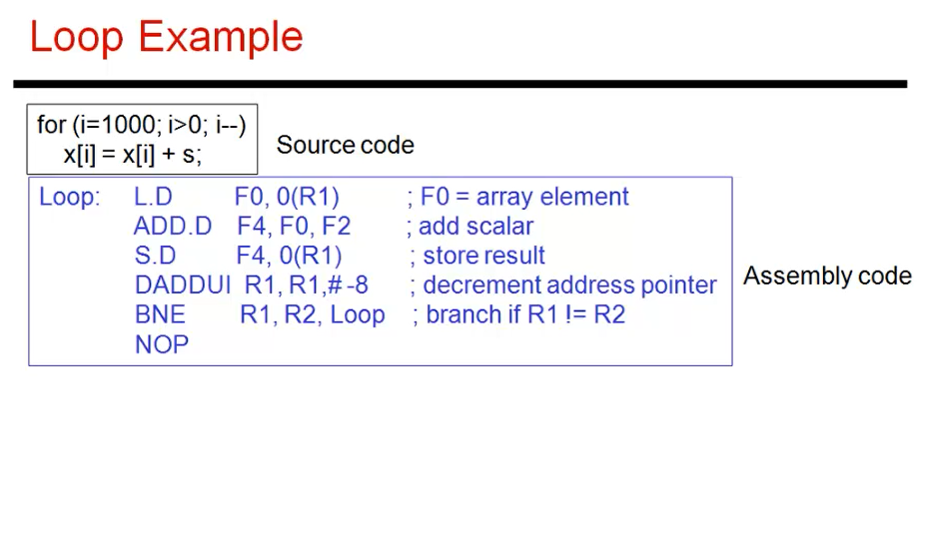
Convert C Code to Assembly Code

Slide 5
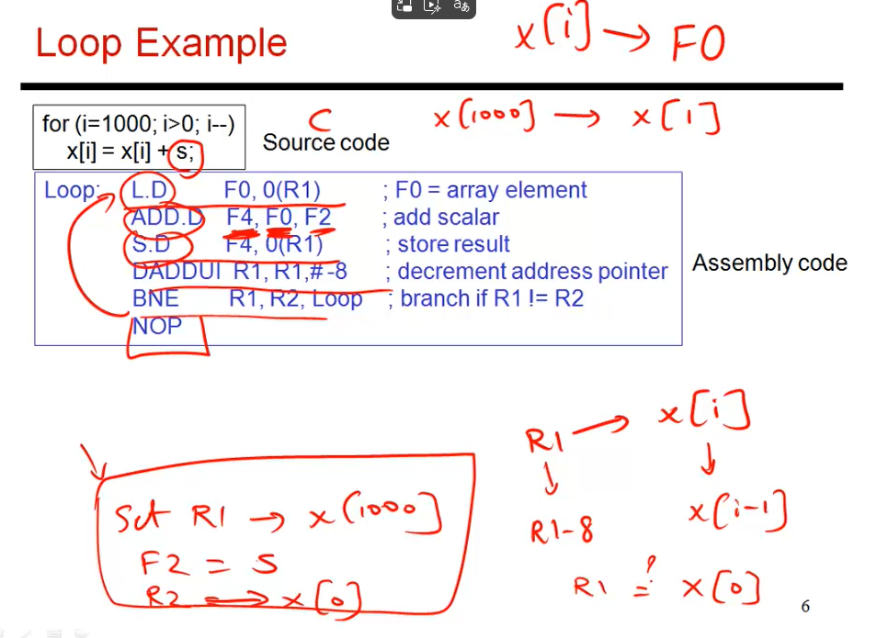

Slide 6
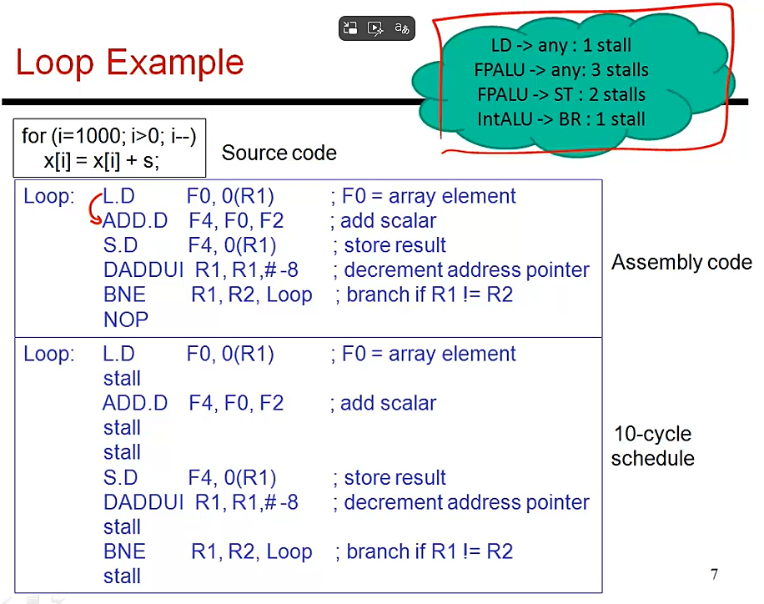




; Just any instruction

Slide 7
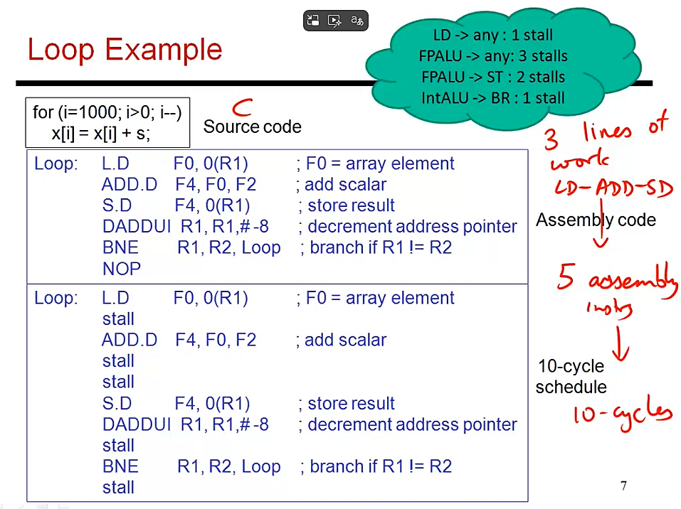





Slide 8
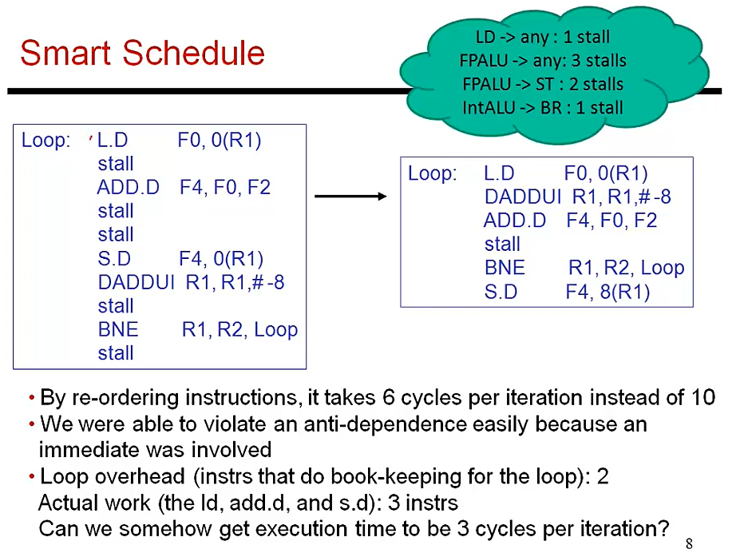


Slide 9
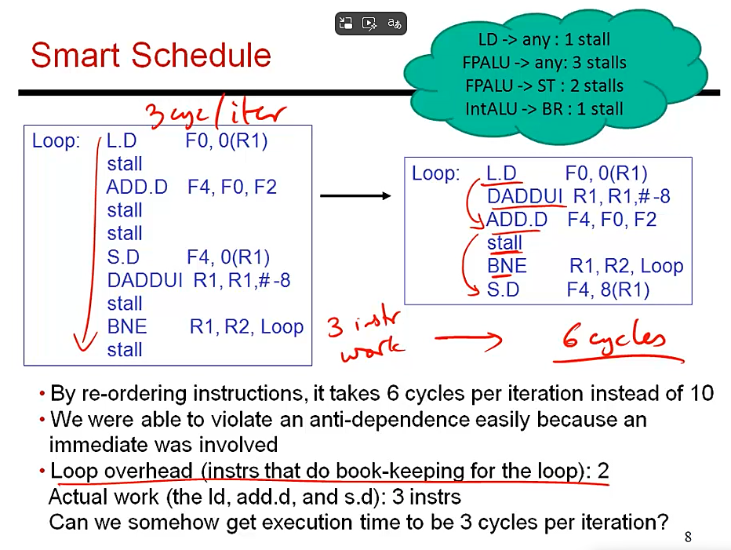



Slide 10
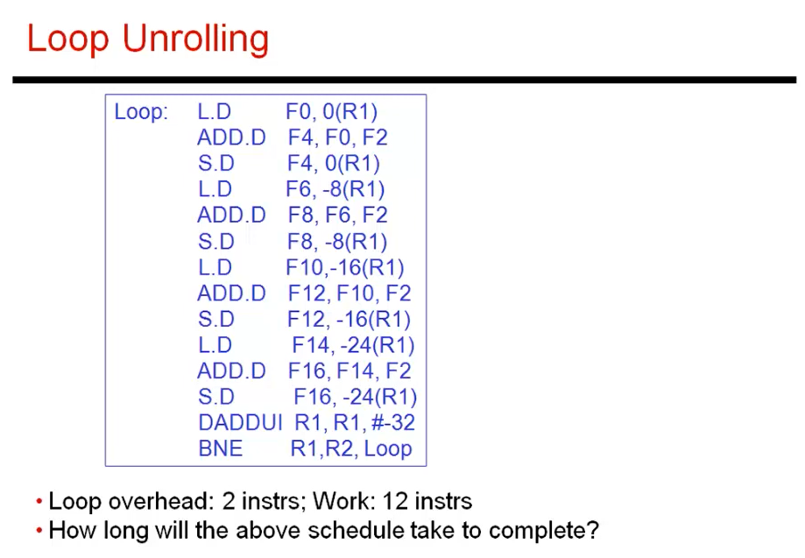
Check once when completing unroll, use -32 value

Slide 11
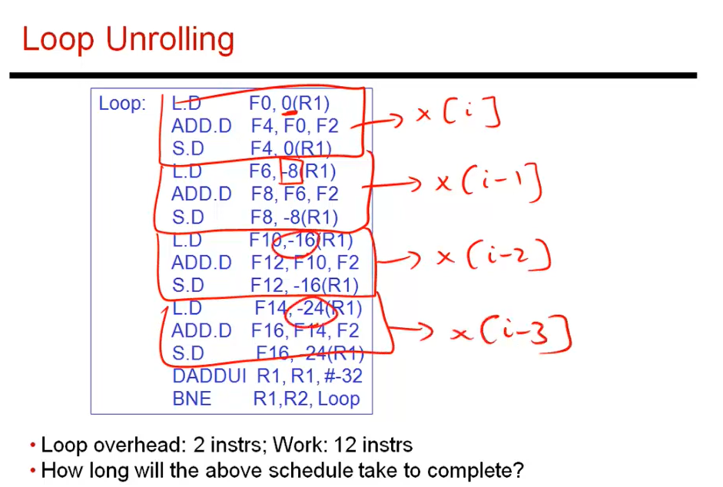

Slide 12
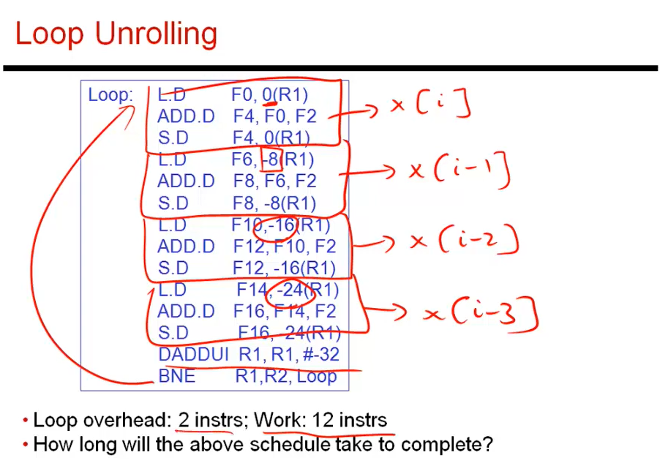

Slide 13
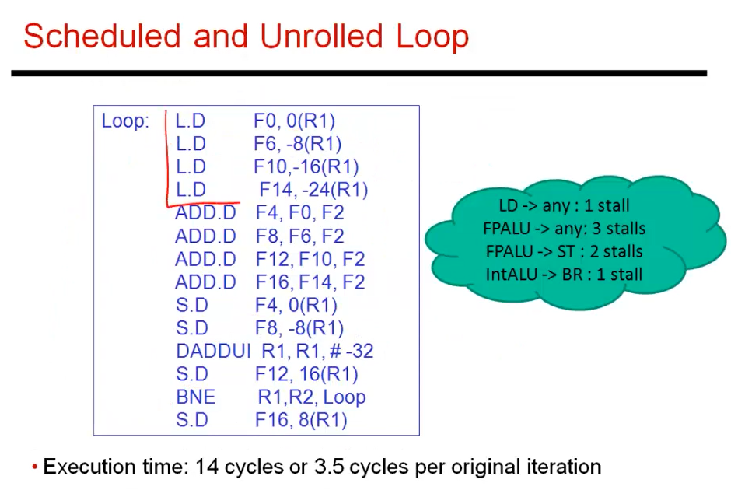
Instruction Reordering
To Prevent Data Hazard
BNE requires 1 STALL to Complete
Last Stall is replaced by S.D

Slide 14
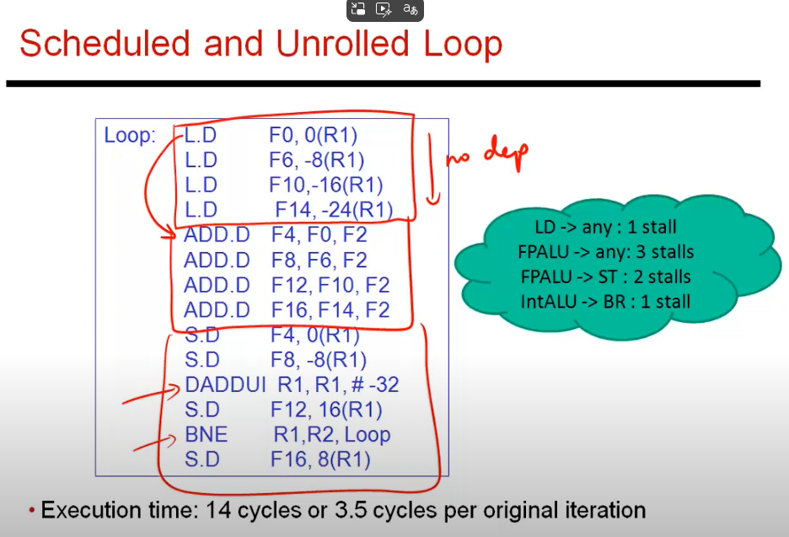

Slide 15
