Slide 1
Computer Architecture
CS 622 / EE 520
Spring 2026
Lecture 3
Shahid Masud

Slide 2
Topics
Performance of Computer Systems
Energy and Power Computations
CPI and MIPS Rating
Amdahl’s Law Calculations
SPEC Benchmarks
----
RISC-V ISA Description
Chap 1 of textbook

Slide 3
Simple Computer Performance Measures
Time to execute a program – in seconds
Clock Speed of Computer – Mega Hertz or Giga Hz
Comparing Benchmarks
In terms of the width of Data Bus (16 bit, 32 bit, 64 bit)
In terms of the size of different memory (8GB / 256GB)
  Cache size, Levels of Cache
  RAM, DRAM, SRAM
  Hard disk, Online, Offline, Cloud
  SSD, etc.
In terms of multiple cores and multiple I/O available
Software
  Algorithm
  Language / Compiler
  Optimization – Parallel, Vector, etc.
In terms of
Resources

Slide 4
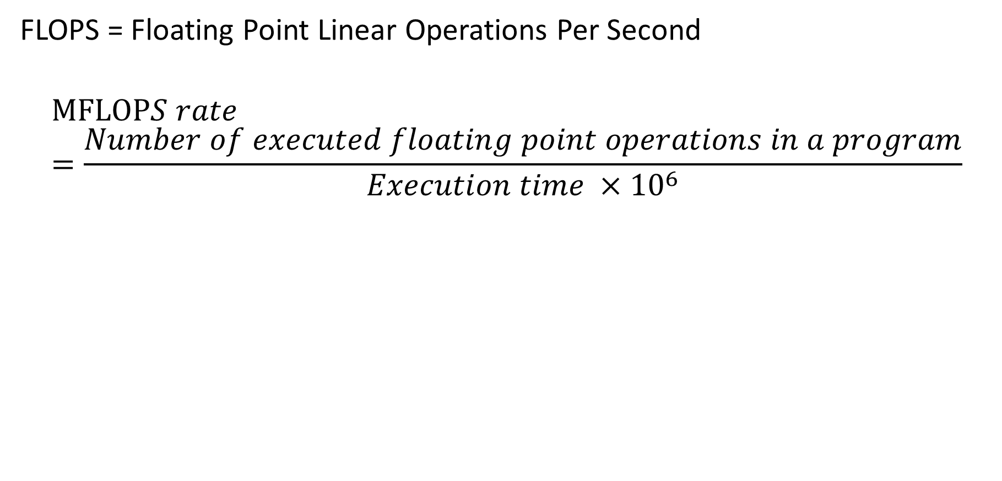
What is MFLOPS or Giga Flops or Tera Flops?
FLOPS = Floating Point Linear Operations Per Second
$$MFLOPS rate=\frac{Number of executed floating point operations in a program}{Execution time {×10}^{6}}$$

Slide 5

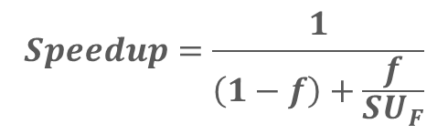
Design Principles of Modern Computers
Take Advantage of Parallelism
  e.g. multiple processors, disks, memory banks, pipelining, multiple functional execution units
Principle of Locality
  Reuse of data and instructions (i.e. in Caches)
Focus on the Common Case
  Make commonly used functions fast; accelerators and Amdahl’s Law
$$Speedup=\frac{1}{\left(1−f\right)+\frac{f}{{SU}_{F}}}$$

Slide 6
Energy and Power
Calculations and Comparison

Slide 7
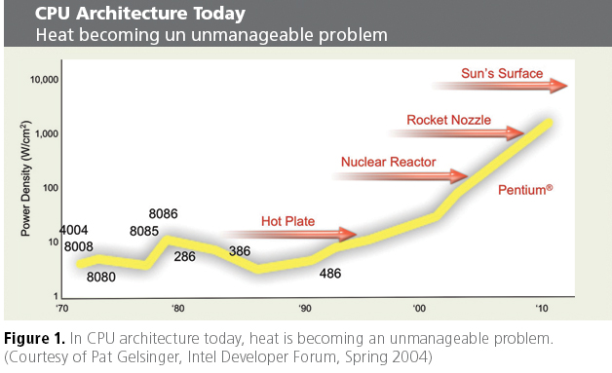
Power Wall
Heat dissipated per Unit Area

Slide 8
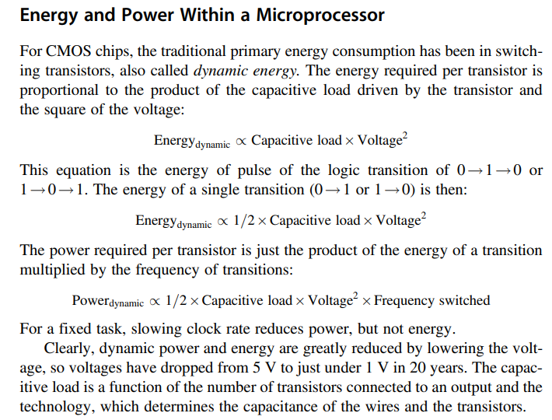

Energy and Power in a Microprocessor
(no frequency here)

Slide 9
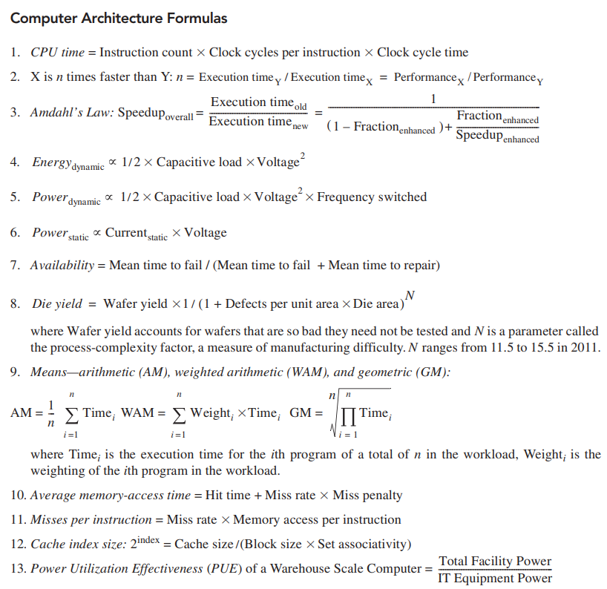







Inside Book cover

Slide 10
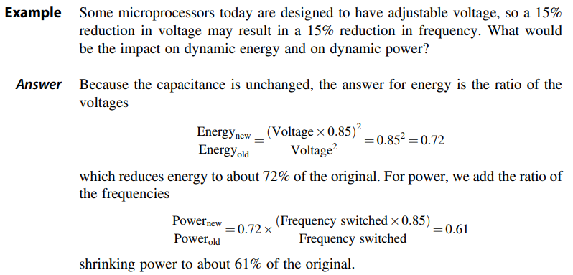
Example of Energy calculation

Slide 11
CPU Power Trends
In CMOS IC technology
×30
5V → 1V
×1000

Slide 12
Reducing Power
Suppose a new CPU has
  85% of capacitive load of old CPU
  15% voltage and 15% frequency reduction
The power wall
  We can’t reduce voltage further
  We can’t remove more heat
How else can we improve performance?

Slide 13
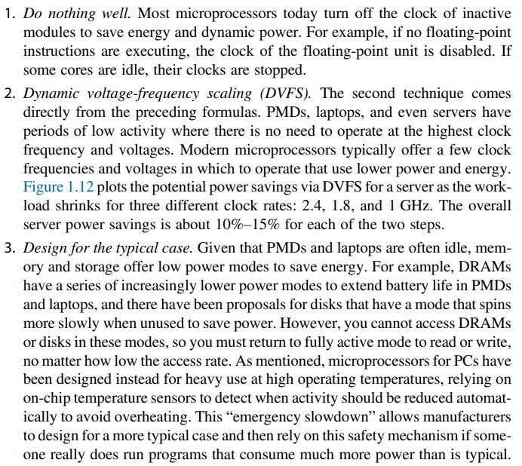



Dealing with Power Dissipation in Microprocessors
Clock control of
Inactive modules
Dynamic Voltage and
Frequency Sacling
Low Power Modes in:
DRAM
Clock Frequency
Disk Speed
CPU sleep mode

Slide 14
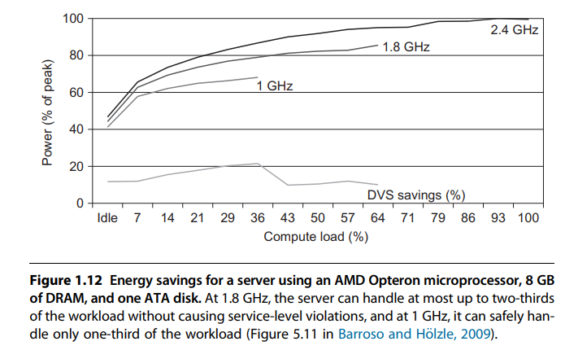
Eg. Energy Saving due to DVFS

Slide 15
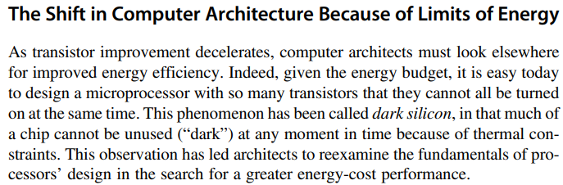


Dark Silicon in Computer Architecture
In the electronics industry, dark silicon is the amount of circuitry of an integrated circuit that cannot be powered-on at the nominal operating voltage for a given thermal design power (TDP) constraint. (Wikipedia)

Slide 16
Reliability and Availability

Slide 17
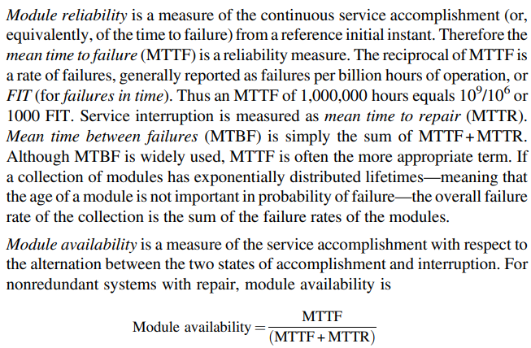








Reliability and Availability

Slide 18

Dependability
Module reliability
  Mean time to failure (MTTF)
  Mean time to repair (MTTR)
  Mean time between failures (MTBF) = MTTF + MTTR
  Availability = MTTF / MTBF

Slide 19
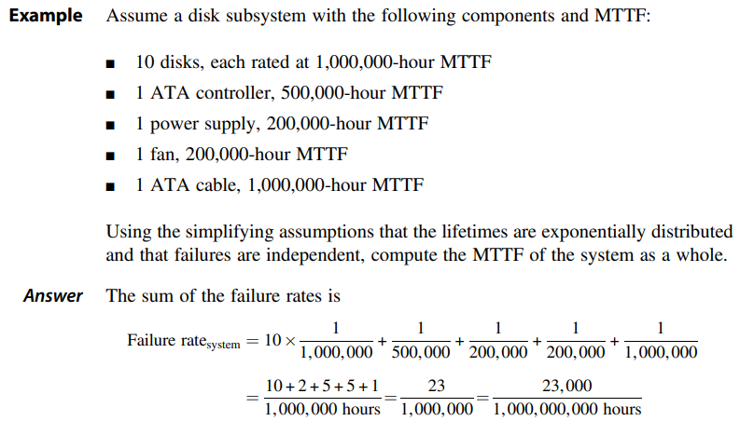
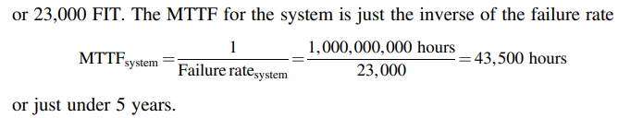
E.g. – Reliability of a Storage System
FIT = Failure in Time

Slide 20
CPI and MIPS as Performance Measures

Slide 21
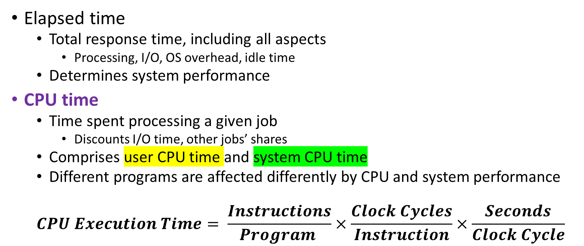
Performance in terms of CPU Execution Time
Elapsed time
  Total response time, including all aspects
    Processing, I/O, OS overhead, idle time
  Determines system performance
CPU time
  Time spent processing a given job
    Discounts I/O time, other jobs’ shares
  Comprises user CPU time and system CPU time
  Different programs are affected differently by CPU and system performance
  $$CPU Execution Time= \frac{Instructions}{Program }×\frac{Clock Cycles}{Instruction}×\frac{Seconds}{Clock Cycle}$$
Performance can be improved by:
  Reducing the number of clock cycles
  Increasing clock rate
  Hardware designer must find trade off of clock rate against cycle count

Slide 22
CPU Time - Example
Computer A: 2.0 GHz clock, 10s CPU time
Designing Computer B:
  Aim for 6s CPU time
  Causes 1.2 × clock cycles
How much fast the clock of Computer B should be?

Slide 23
CPI = Cycles Per Instruction
Each microprocessor specifies the number of Clock Cycles or Clock Ticks that specific type of instructions will consume
CPI is an average number considering occurrence of different types of instructions in a program

Slide 24
Instruction Count and CPI
$$Clock Cycles=Instruction Count×Cycles per Instruction$$
$$CPU Time=Instruction Count×CPI×Clock Cycle Time$$
$$=\frac{Instruction Count×CPI}{Clock Rate}$$
Instruction Count I_{c} for a program
  Determined by program, ISA and compiler
Average cycles per instruction
  Determined by CPU hardware
  Different instructions have different CPI
  Average CPI affected by instruction mix

Slide 25
CPU Time and CPI Example
Computer A: Cycle Time = 250ps, CPI = 2.0
Computer B: Cycle Time = 500ps, CPI = 1.2
Same ISA
Which computer is faster, and by how much?
A is faster…
…by this much

Slide 26
CPI - Averaging
As different instruction classes take different numbers of cycles, we use Average CPI
$$Clock Cycles=\sum_{i=1}^{n}{(CPI_{i}×Instruction Count_{i})}$$

Slide 27
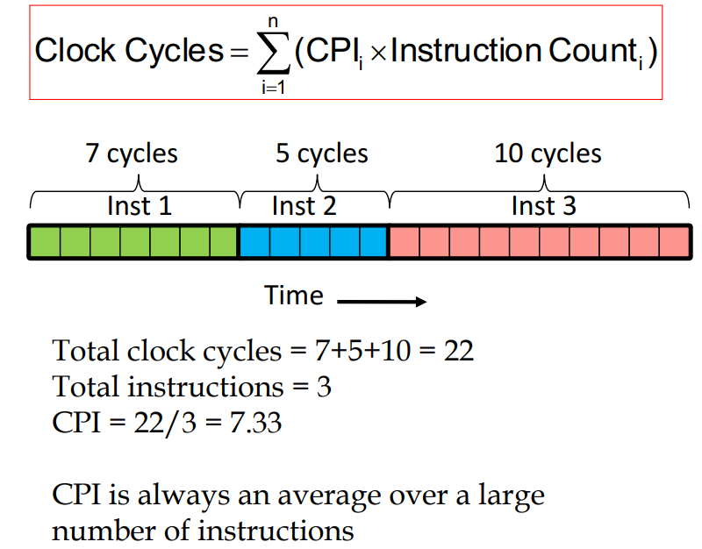
Average CPI Example

Slide 28
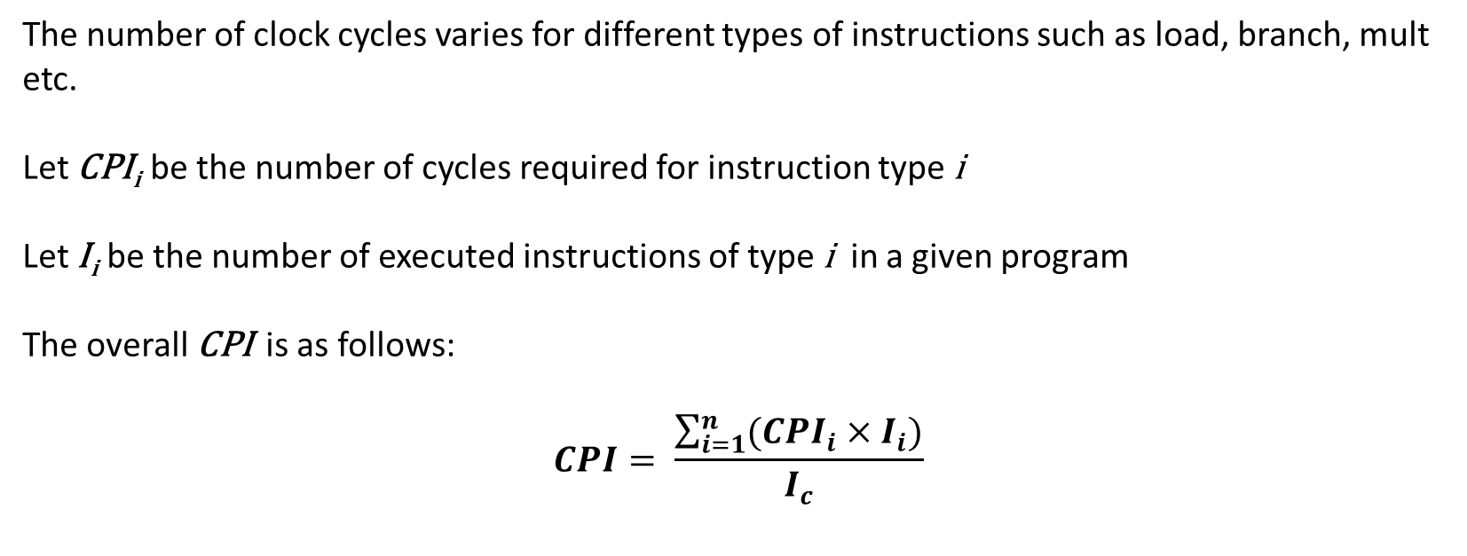
Formula for Overall CPI
The number of clock cycles varies for different types of instructions such as load, branch, mult etc.
Let CPI_{i} be the number of cycles required for instruction type i
Let I_{i} be the number of executed instructions of type i in a given program
The overall CPI is as follows:
$$CPI= \frac{\sum_{i=1}^{n}{({CPI}_{i}×I_{i})}}{I_{c}}$$
Ic = Instruction Count

Slide 29
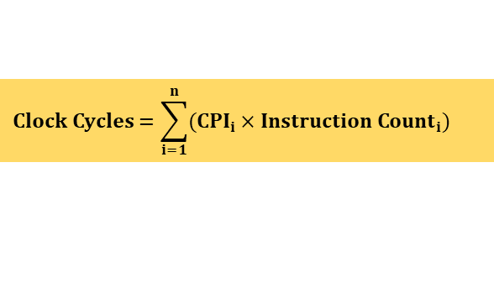
CPI Example
$$Clock Cycles=\sum_{i=1}^{n}{(CPI_{i}×Instruction Count_{i})}$$
Alternative compiled code sequences using instructions in classes (or types) A, B, C
Class | A | B | C
CPI for class | 1 | 2 | 3
I_{C} in sequence 1 | 2 | 1 | 2
I_{C} in sequence 2 | 4 | 1 | 1
Sequence 1: I_{C} = 5
  Clock Cycles
  = 2×1 + 1×2 + 2×3
  = 10
  Avg. CPI = 10/5 = 2.0
Sequence 2: I_{C} = 6
  Clock Cycles
  = 4×1 + 1×2 + 1×3
  = 9
  Avg. CPI = 9/6 = 1.5

Slide 30
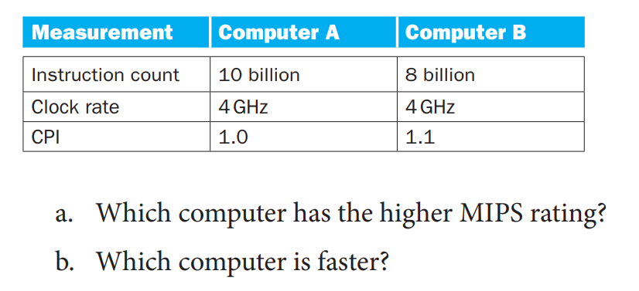
CPI Question
$$MIPS rate= \frac{I_{c}}{T×{10}^{6}}=\frac{f}{CPI×{10}^{6}}$$

Slide 31
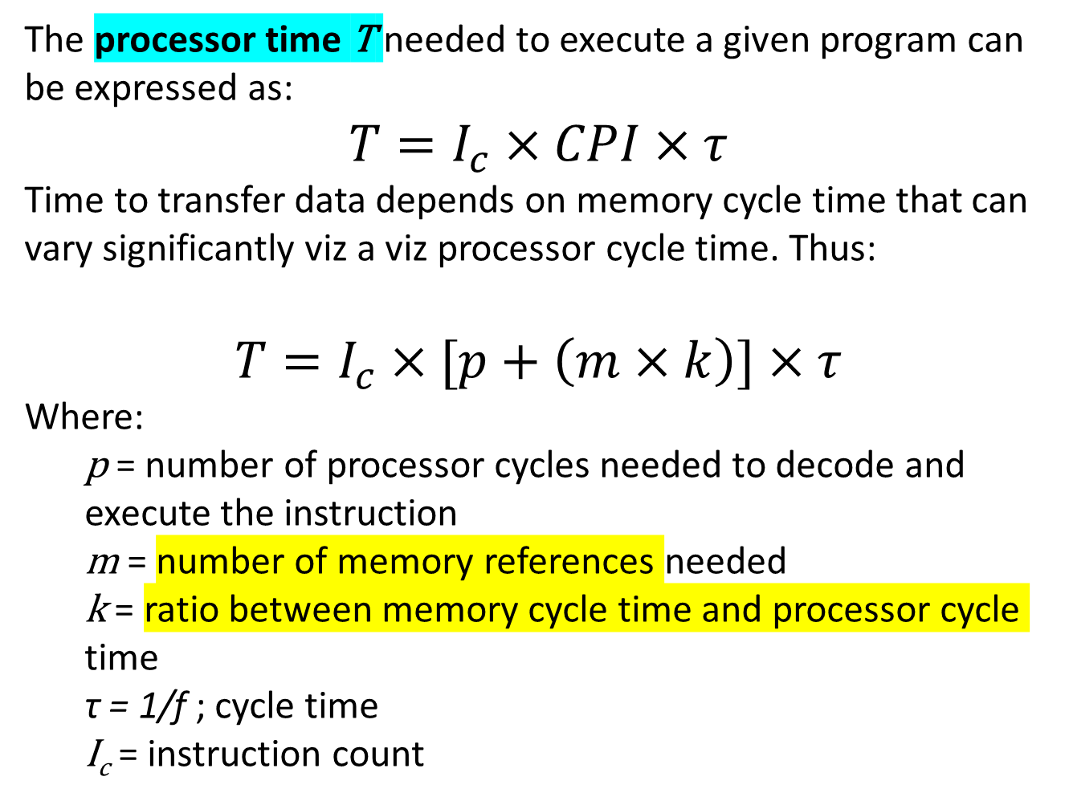
Factors Affecting CPI
The processor time T needed to execute a given program can be expressed as:
$$T=I_{c}×CPI×τ$$
Time to transfer data depends on memory cycle time that can vary significantly viz a viz processor cycle time. Thus:
$$T=I_{c}×[p+\left(m×k\right)]×τ$$
Where:
  p = number of processor cycles needed to decode and execute the instruction
  m = number of memory references needed
  k = ratio between memory cycle time and processor cycle time
  τ = 1/f ; cycle time
  I_{c} = instruction count

Slide 32
MIPS Formula and Example
A common measure of CPU performance is the rate at which instructions are executed
MIPS is abbreviation for Millions Instructions per second
How many MIPS can a CPU do is its MIPS rate?
In terms of equations:
$$MIPS rate= \frac{I_{c}}{T×{10}^{6}}=\frac{f}{CPI×{10}^{6}}$$

Slide 33
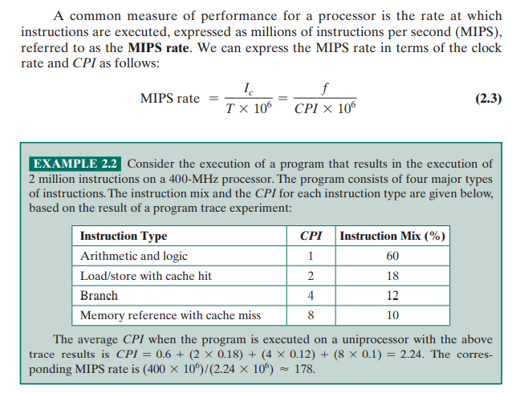
Example of MIPS and CPI

Slide 34
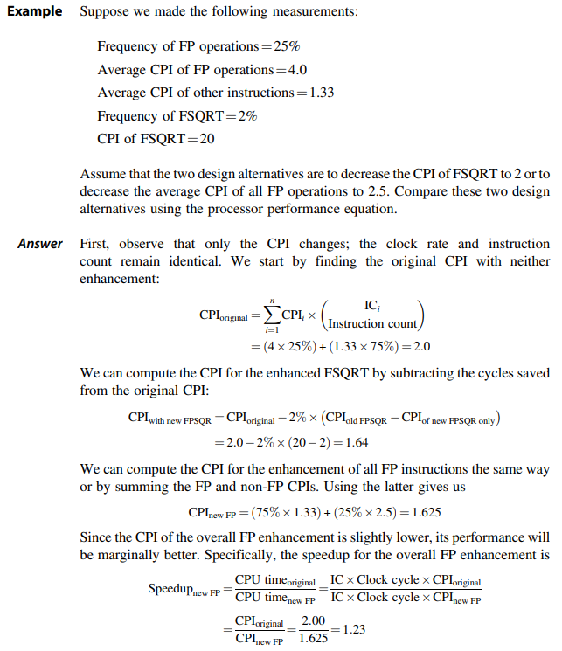
Book Example, pg 54
There are two possibilities for improvement:
Improve all FP operations
Improve FPSQRT operation

Slide 35
Amdahl’s Law for Performance

Slide 36
Accelerators, Multiprocessors and Multicores
Performance Enhancement through:
  Custom Hardware Accelerators
  Instruction Set Extension
Multicore Microprocessors
  More than one processor per chip
Requires explicitly parallel programming
  Compare with instruction level parallelism
    Hardware executes multiple instructions at once
    Hidden from the programmer
  Hard to do
    Programming for performance
    Load balancing
    Optimizing communication and synchronization

Slide 37
Scenarios for Amdahl’s Law
Scenario 1
Scenario 2
Program
Program
Portion of program
is executed fast here
Compiler and OS
CPU
Co-processor or Accelerator
Buses
CPU1
CPU2
CPU3
CPU4
Special / Complex operations:
Floating point
Matrix multiplication
Convolution for AI
Hashing for Crypto
Program is executed over multiple CPU in parallel

Slide 38
Amdahl’s Law for Enhanced Performance
Gives an idea of improvement in a program when more cores and additional hardware functionality is added.
Separates the fraction of program code that can be parallelized / improved and the fraction that cannot be parallelized / improved.
$$Speedup=\frac{Performance after enhancement}{Performance before enhancement}=\frac{Execution time before enhancement}{Execution time after enhancement}$$

Slide 39
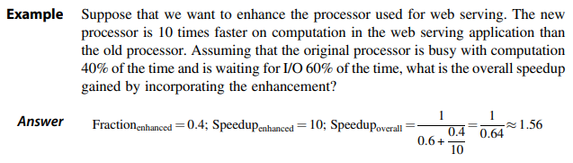
Formula for Amdahl’s Law for Customized Speedup
Suppose that a feature of the system is used during execution a fraction of the time f before enhancement
The speedup of that feature after enhancement is SU_{F}
Then overall speedup of the system is:
$$Speedup=\frac{1}{\left(1−f\right)+\frac{f}{{SU}_{F}}}$$

Slide 40
Amdahl’s Law for Multicore / Parallel Processing
Let T be the total execution time of the program using a single processor.
Then the speedup using a parallel processor with N processors that exploit the parallelizable portion of the program
$Speedup=\frac{Time to execute program on a single processor}{Time to execute program on N parallel processors}$
$=\frac{T\left(1−f\right)+Tf}{T\left(1−f\right)+\frac{Tf}{N}}$
$=\frac{1}{\left(1−f\right)+\frac{f}{N}}$
Important Observation:
When f is small, the use of parallel processors has little effect
As N approaches infinity, speedup is bound by 1/(1-f), so that there are diminishing returns for more processors

Slide 41
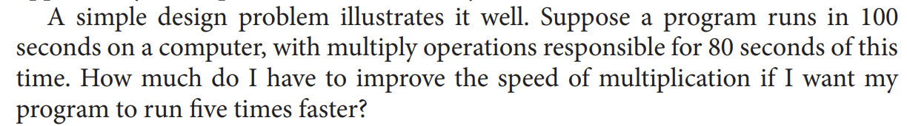
Question using Amdahl’s Law

Slide 42
Problem with Amdahl’s Law
Improving one aspect of a computer and expecting a proportional improvement in overall performance
$$T_{improved}=\frac{T_{affected}}{improvement factor}+T_{unaffected}$$

Slide 43
Practice Amdahl’s Law Questions
Question 1:
Suppose that a computing task makes extensive use of Floating point (FP) computations with 40% execution time consumed in FP. With a new co-processor, the FP is sped up by a factor k. What is the maximum speed up possible with this FP co-processor.
Question 2:
A program takes 100 sec to run on a computer. 80 sec out of 100 sec are spent on multiplication operation. How much speed of multiplication has to improve to make program execute 5 times faster.

Slide 44
SPEC Benchmarks and CPU Performance

Slide 45
SPEC Benchmarks
Benchmarks are used to evaluate performance of full computer systems. CPI measure is only for microprocessors.
SPEC benchmarks are standard in Computer Architecture study.
A benchmark contains several programs in a particular class of computing, i.e. integer calculations, floating-point computations, etc.
SPEC Rating = Geometric Mean (N^{th} root) of product of performance obtained from running all programs in a particular class in the benchmark.

Slide 46
Why Benchmarks?
Due to differences in instruction sets, the instruction execution rate is not a
valid means of comparing performance of different architectures in the form of
MIPS or MFLOPS.
Performance of a program may not be useful in determining how that processor
will perform on a very different type of application.
Benchmarks provide guidance to customers to decide which system to buy and
useful support to vendors and designers to design systems that meet benchmark goals
Characteristics of benchmark programs:
  Written in high-level languages hence portable across machines
  Representative of a particular kind of programming domain or paradigm
  Can be measured easily
  It has a wide distribution

Slide 47

SPEC Website

Slide 48
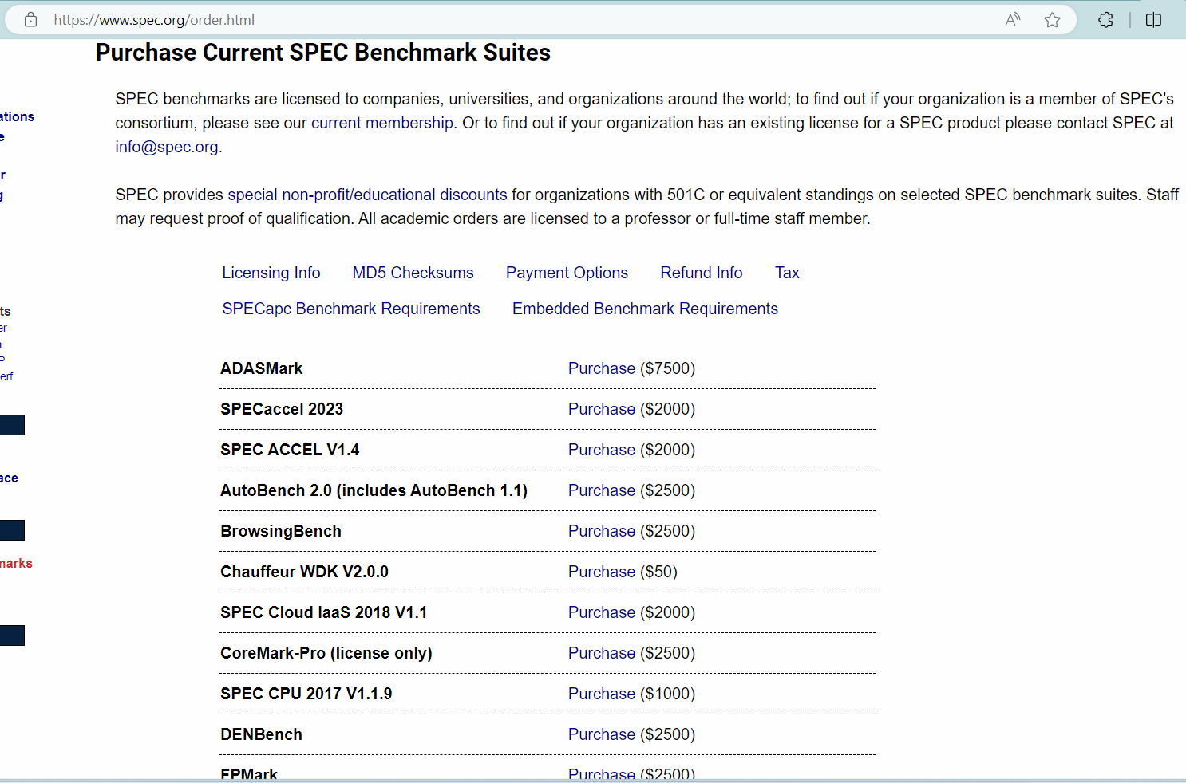
Cost of Spec benchmarks

Slide 49
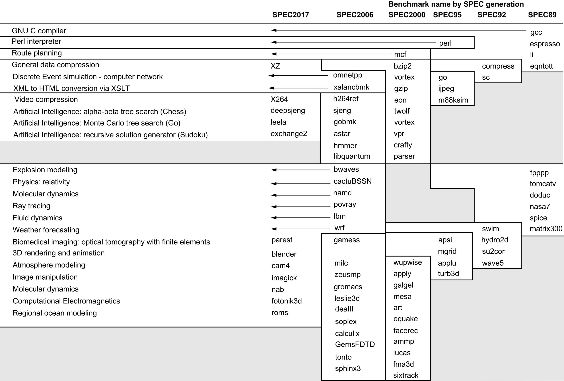
Figure 1.17 SPEC2017 programs and the evolution of the SPEC benchmarks over time, with integer programs above the line and floating-point programs below the line. Of the 10 SPEC2017 integer programs, 5 are written in C, 4 in C++., and 1 in Fortran. For the floating-point programs, the split is 3 in Fortran, 2 in C++, 2 in C, and 6 in mixed C, C++, and Fortran. The figure shows all 82 of the programs in the 1989, 1992, 1995, 2000, 2006, and 2017 releases. Gcc is the senior citizen of the group. Only 3 integer programs and 3 floating-point programs survived three or more generations. Although a few are carried over from generation to generation, the version of the program changes and either the input or the size of the benchmark is often expanded to increase its running time and to avoid perturbation in measurement or domination of the execution time by some factor other than CPU time. The benchmark descriptions on the left are for SPEC2017 only and do not apply to earlier versions. Programs in the same row from different generations of SPEC are generally not related; for example, fpppp is not a CFD code like bwaves.

Slide 50
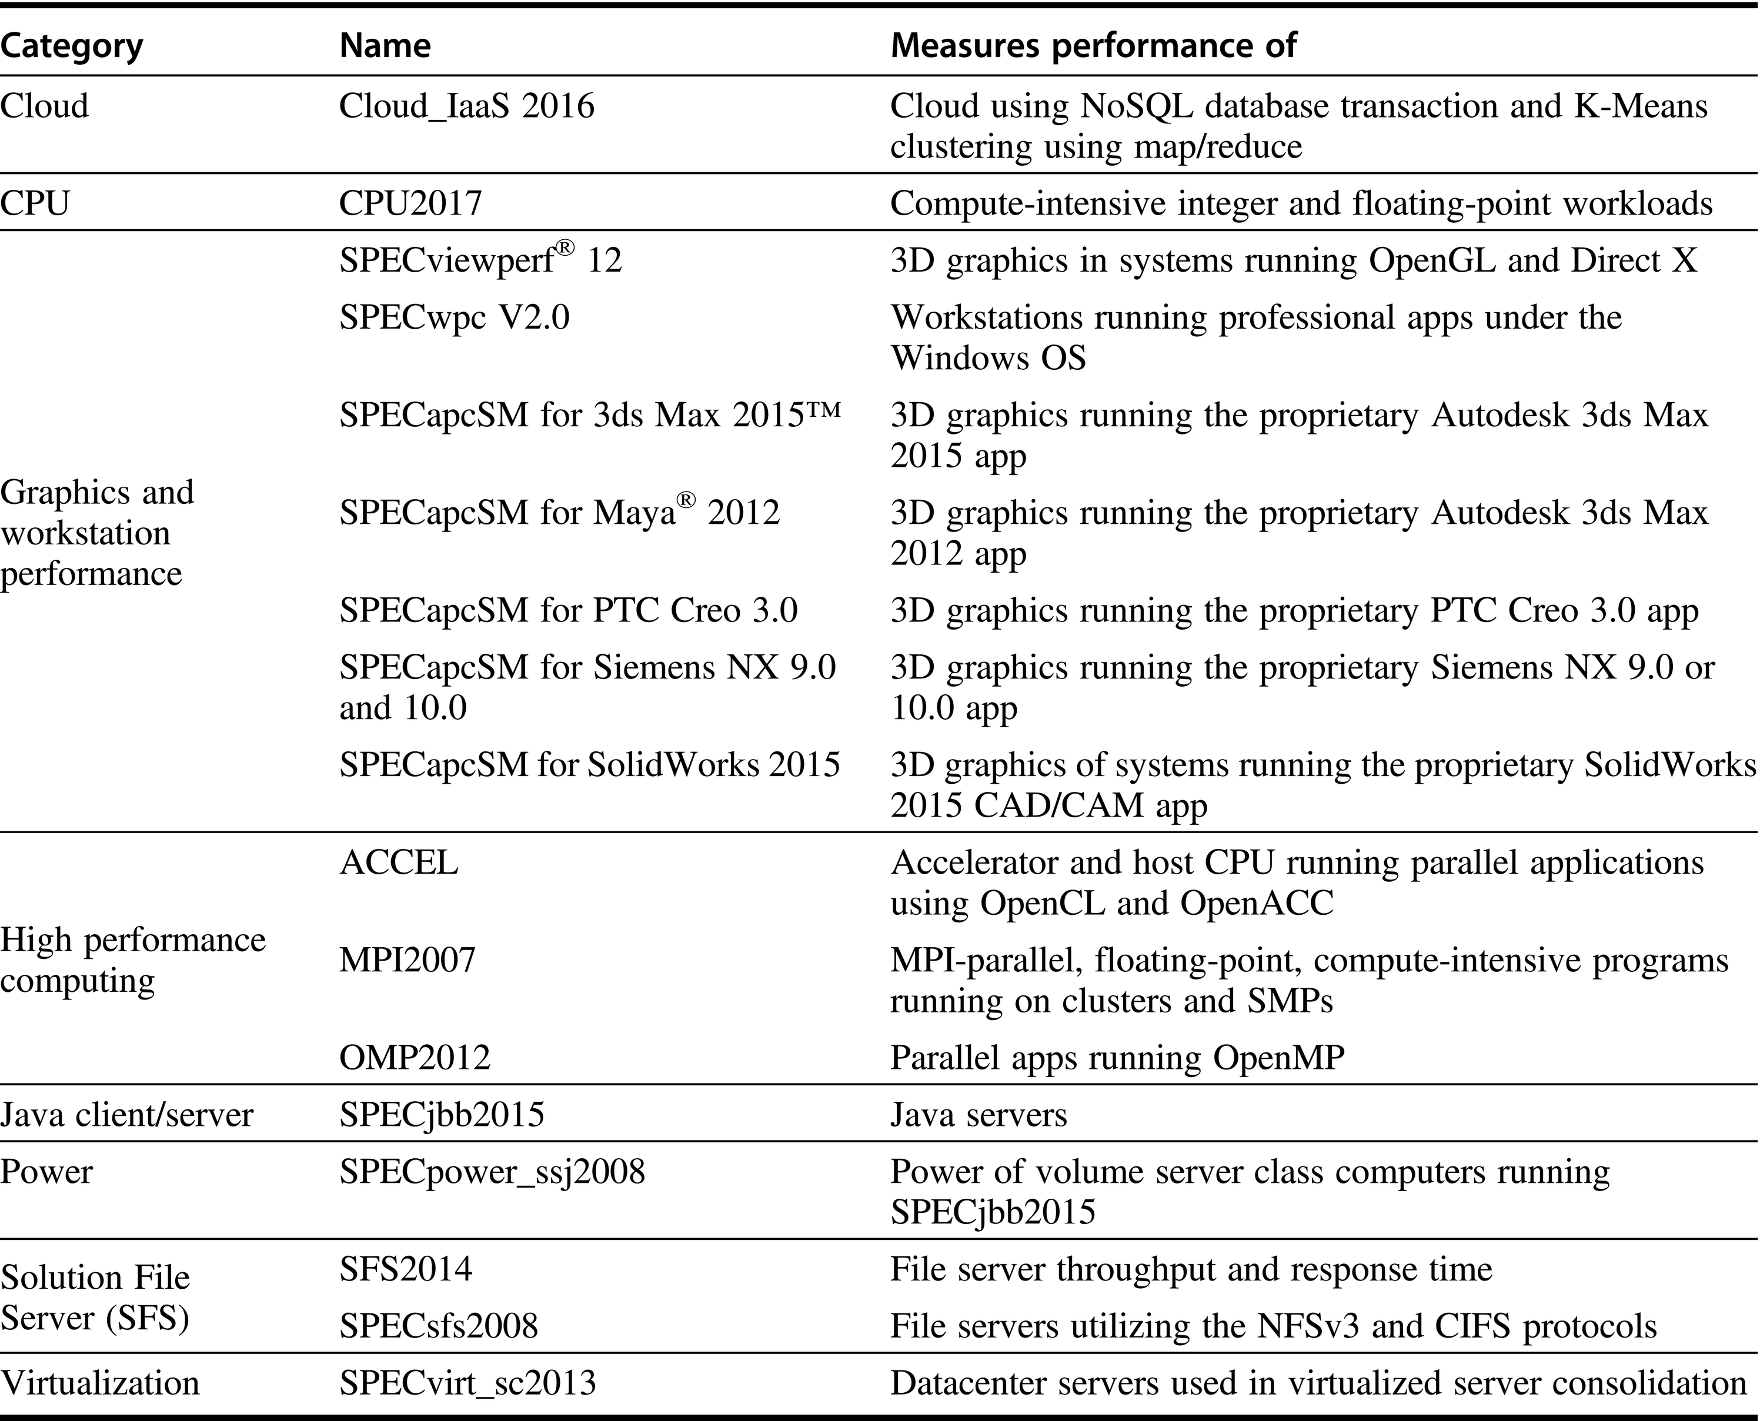
Figure 1.18 Active benchmarks from SPEC as of 2017.

Slide 51
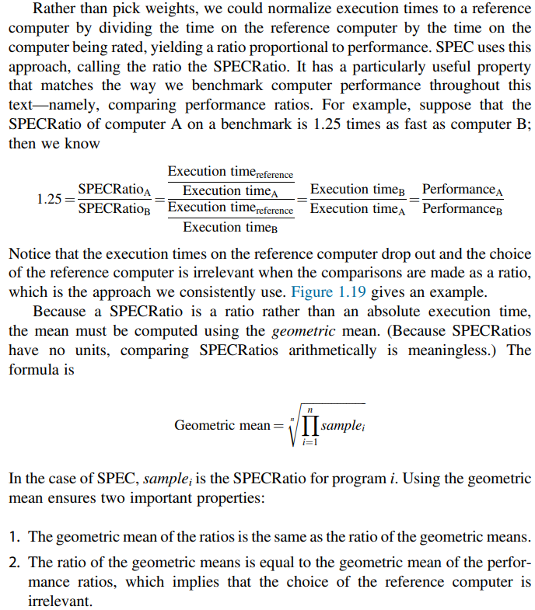










Spec Ratio

Slide 52
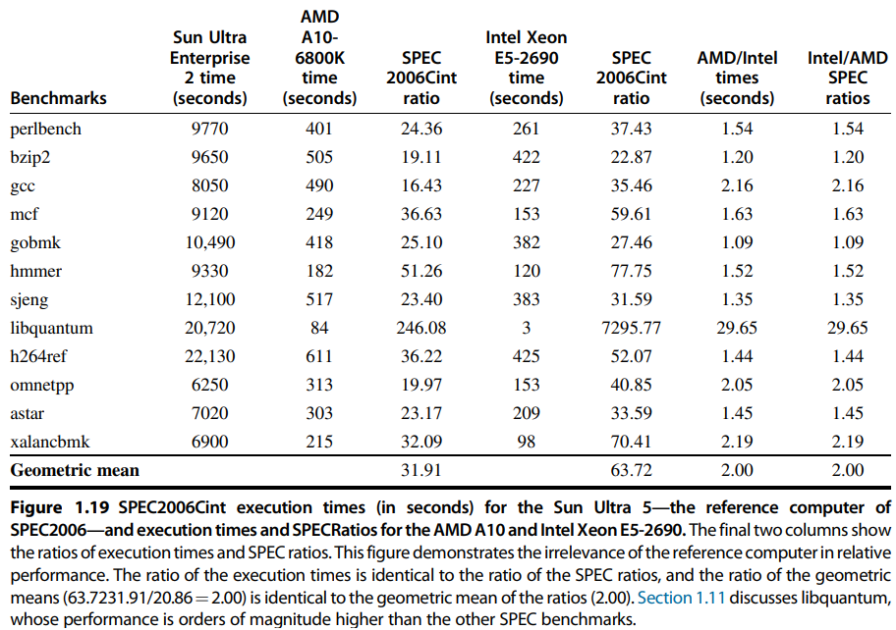
Example of Geometric Mean

Slide 53
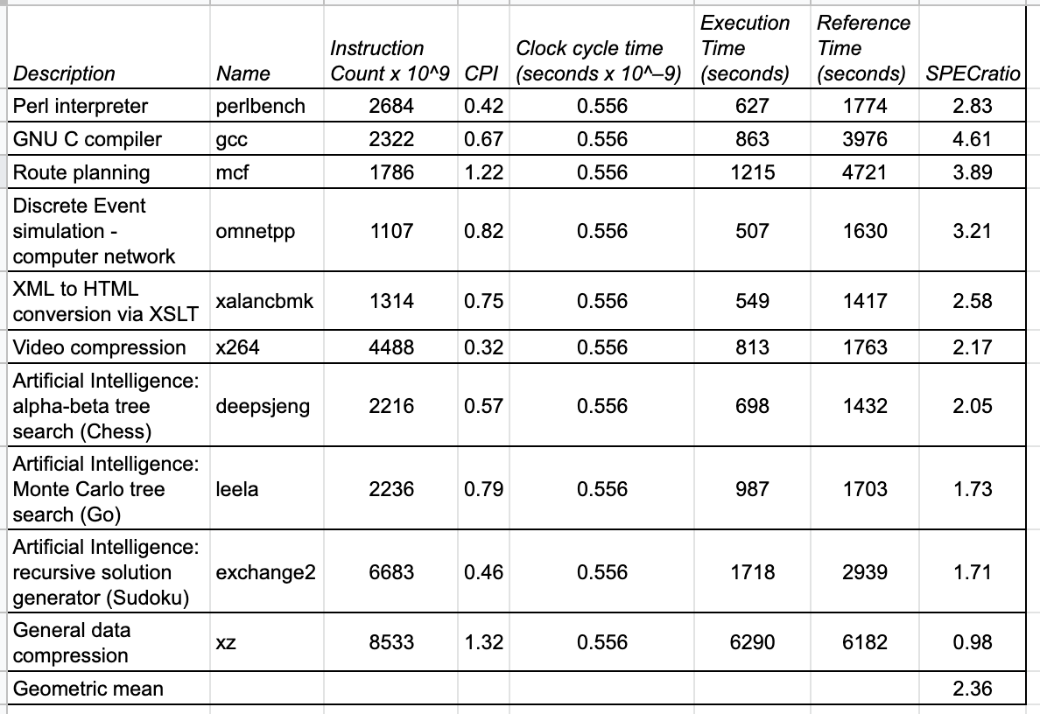
Example: SPECspeed 2017 Integer benchmarks on a 1.8 GHz Intel Xeon E5-2650L

Slide 54
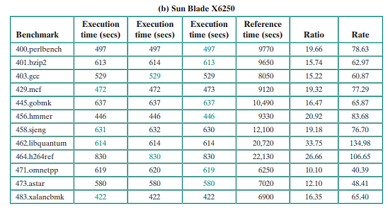
Spec Benchmark Question
Question: Given output of running Spec Benchmarks; find the Spec Rating of this computer?
Hint: Use Geometric Mean to combine all individual rates in last column and come up with one rating

Slide 55
RISC-V ISA from Appendix A
Instruction Set Architecture (ISA)

Slide 56
What is an Instruction Set Architecture?
Lowest level of Computer Architecture that is visible to a programmer
ISA comprises instructions in Assembly Language and
Corresponding Binary Machine Code
Primitive syntax compared to a high-level language
It is easily interpreted and understood by the CPU
Designed to maximize performance
Represents features and performance of a CPU
Designed to minimize cost and design time

Slide 57
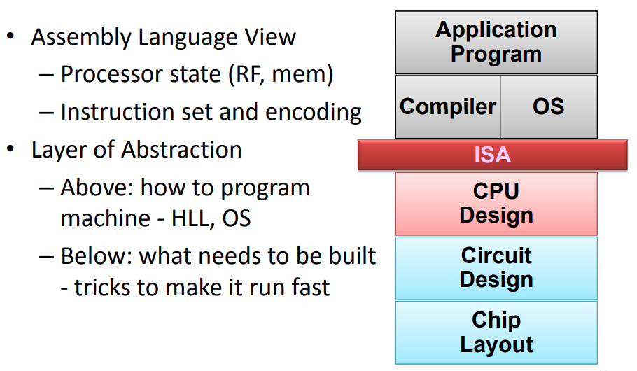
Role of ISA within a Computer
Key:
RF = Register File
Mem = Memory
HLL = High Level Language
OS = Operating System

Slide 58
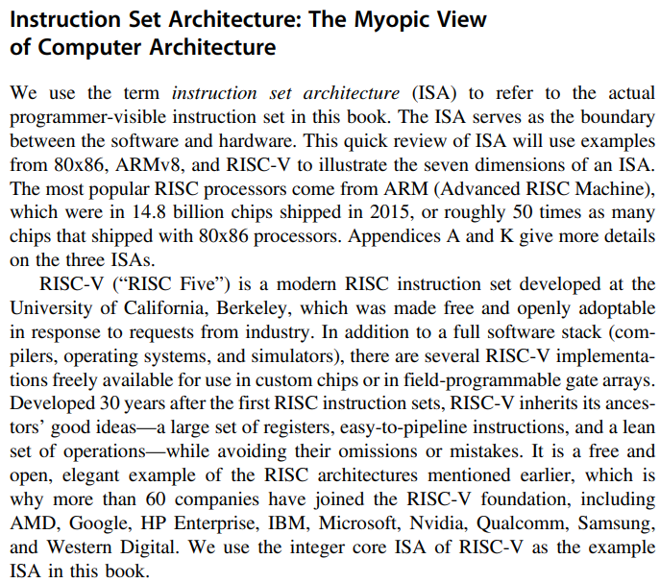



RISC-V ISA

Slide 59
RISC-V Instructions and Features
Data Alignment
  32-bit bus vs 8-bit memory
  Big Endian vs Little Endian
Addressing Modes
Type and Size of Operands
  I, R types
Operations available
  Arithmetic
  Logical
  Shift
Control Flow Instructions
  Branch
  Jump

Slide 60
Memory Access – Big Endian vs Little Endian
A CPU Register R0 is 32-bits wide.
It has data “1A2B3C4D” Hex.
Store the data in an 8-bit wide RAM that has 4 locations.
Store in Big-Endian style
or Store in Little-Endian Style
Location | Big Endian RAM
3
2
1
0
CPU Register
R0 Contents
1A 2B 3C 4D
MSB LSB
Location | Little Endian RAM
3
2
1
0

Slide 61
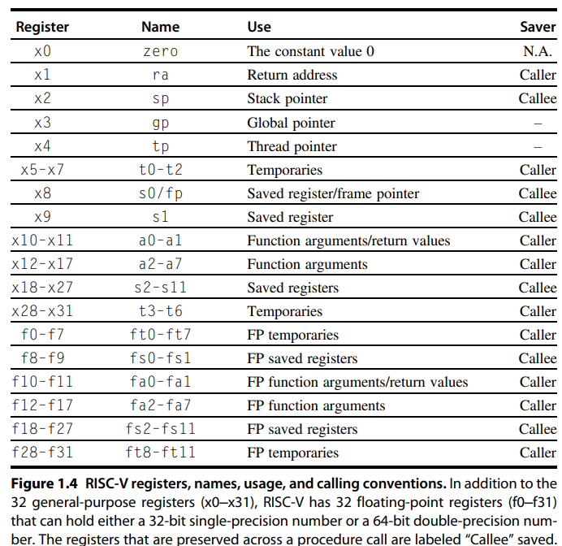
RISC-V Registers and Naming Conventions
RISC-V is a Register-rich
Architecture

Slide 62
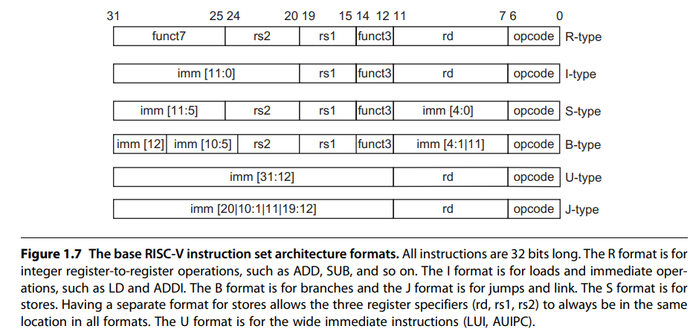












RISC-V Instruction Formats and Types

Slide 63
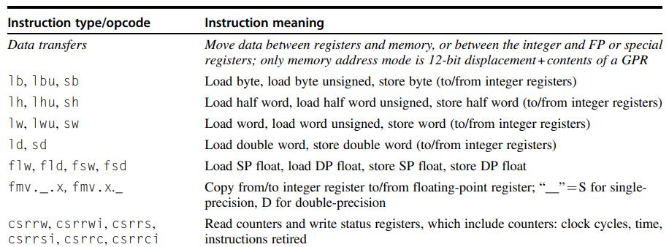
RISC-V Data type Instructions

Slide 64
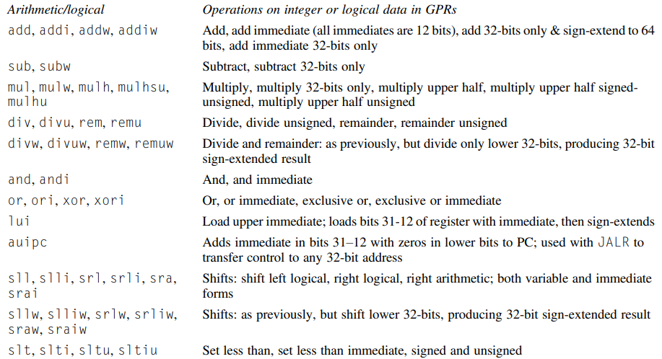
RISC-V Arithmetic / Logical Instructions

Slide 65
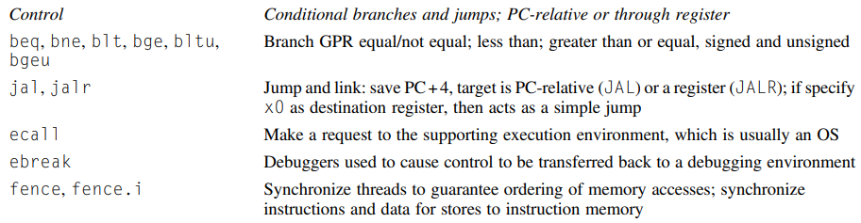



RISC-V Control Instructions

Slide 66
Readings
H&P Computer Architecture Textbook chapter 1
See end of chapter questions from H&P textbook
RISC ISA details from Appendix A

