Slide 1
Computer Architecture
CS 622 / EE 520
Spring 2026
Lecture 8
Shahid Masud

Slide 2
Topics
Some Peculiar aspects of RISC-V Architecture
Exception Handling in Pipeline Architectures
Multicycle EX stage
MIPS R4000 Pipeline
Solved Examples
Quiz 2
Next Week

Slide 3
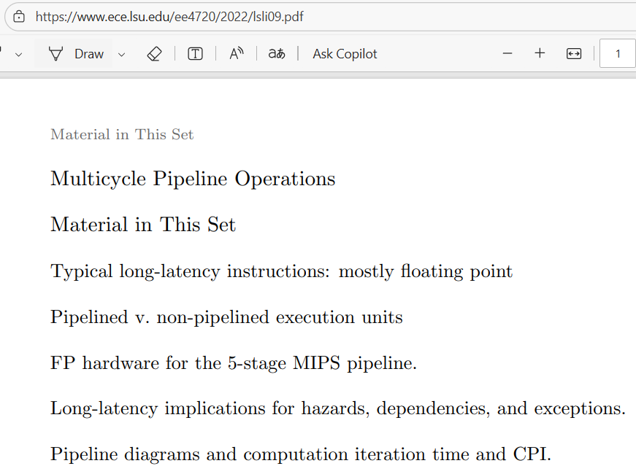
Slides Adapted from: (Further Readings)
Reading Notes
Readings:
Appendix C of course textbook

Slide 4
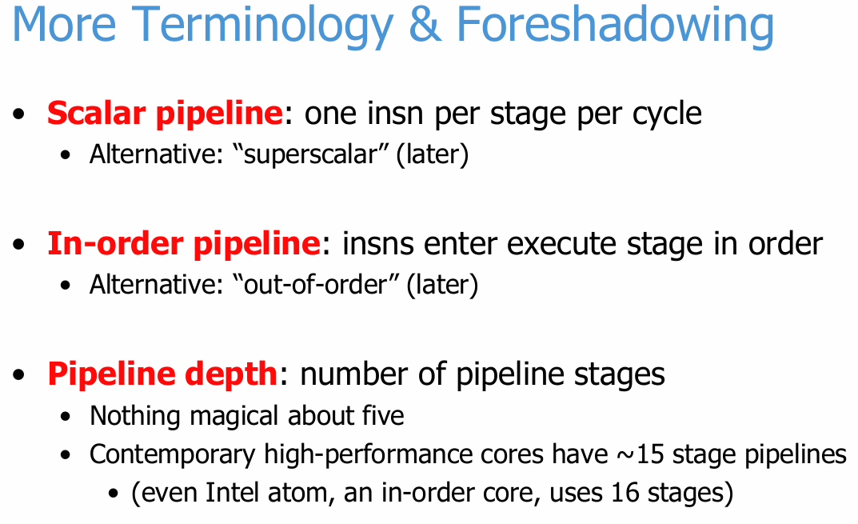
ILP Terminology

Slide 5
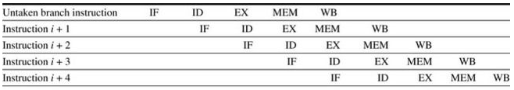
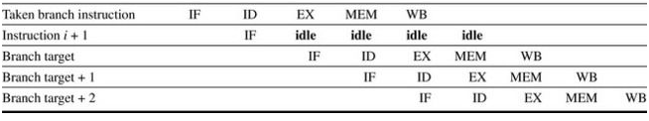
Branches predicted correctly and not Assuming Improved hardware Fig C-12
BNEZ R1, loop
Predict Branch not taken and it’s not taken
Predict Branch not taken and Woops! it’s taken
  The condition turns out we should take the branch

Slide 6
RISC-V Pipeline Peculiar

Slide 7
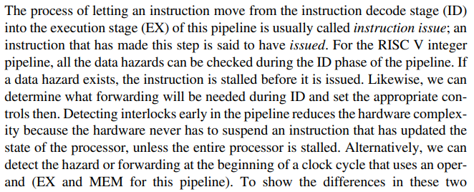


How Interlock and Forwarding in RISC-V

Slide 8
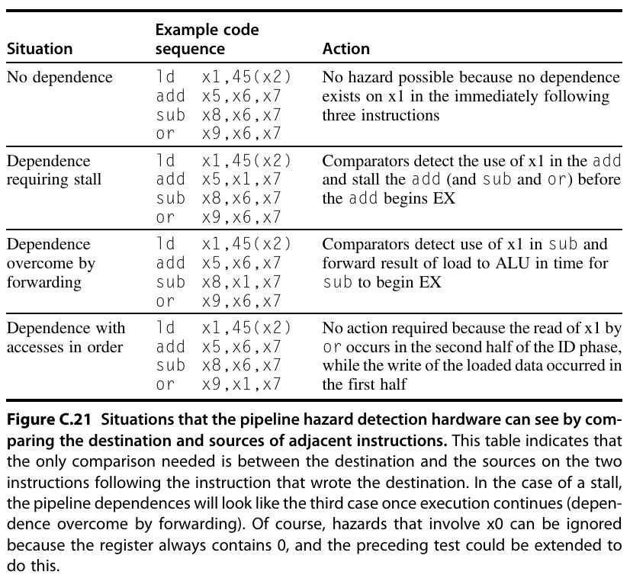
Pipeline Hazard

Slide 9
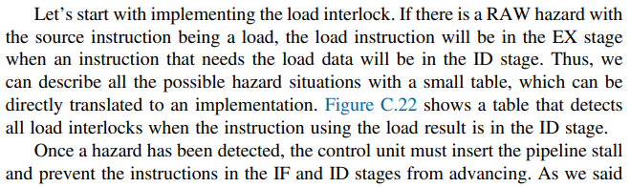
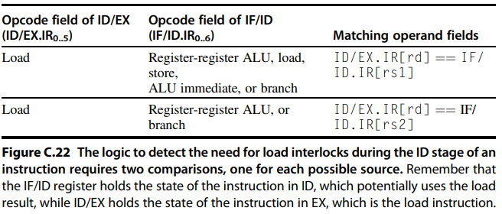
Eg. Load Interlock

Slide 10
Exceptions in Pipelines

Slide 11

Why it is really not that this easy? Interrupts, fault, and exception
The terms interrupt, fault, and exception are used, although not in a consistent fashion. We use the term exception to cover all these mechanisms, including the following:
  I/ O device request Invoking an operating system service from a user program
  Tracing instruction execution
  Breakpoint (programmer-requested interrupt)
  Integer arithmetic overflow FP arithmetic anomaly
  Page fault (not in main memory)
  Misaligned memory accesses (if alignment is required)
  Memory protection violation
  Using an undefined or unimplemented instruction
  Hardware malfunctions
  Power failure

Slide 12
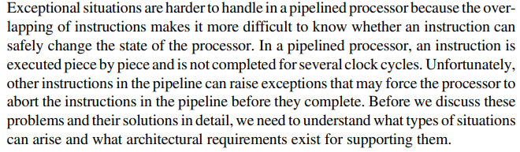
Exceptions in Pipeline Architectures

Slide 13

Characterization of Exceptions
Synchronous vs Asynchronous
  Event always occurs at the same place with same data and memory
  Asynchronous events are caused by devices external to the processor and memory
  Asynchronous exception can be dealt after completion of current instruction so easier
User Requested vs Coerced
  User requested is predictable and can be dealt after current instruction
  Coerced exceptions are due to hardware events that are not under user program
  Coerced are difficult to implement as they are unpredictable
User Maskable vs Non-Maskable
  The event can be hidden from CPU through Mask register bits
Within Instruction or Between Instruction
  Within instructions are usually synchronous
  Within Instructions are harder to implement as Instructions are stopped and restarted
  Asynchronous Exceptions that occur within instructions always cause program termination
Resume vs Terminate
  Program execution always stops after interrupt or continues after the exception

Slide 14
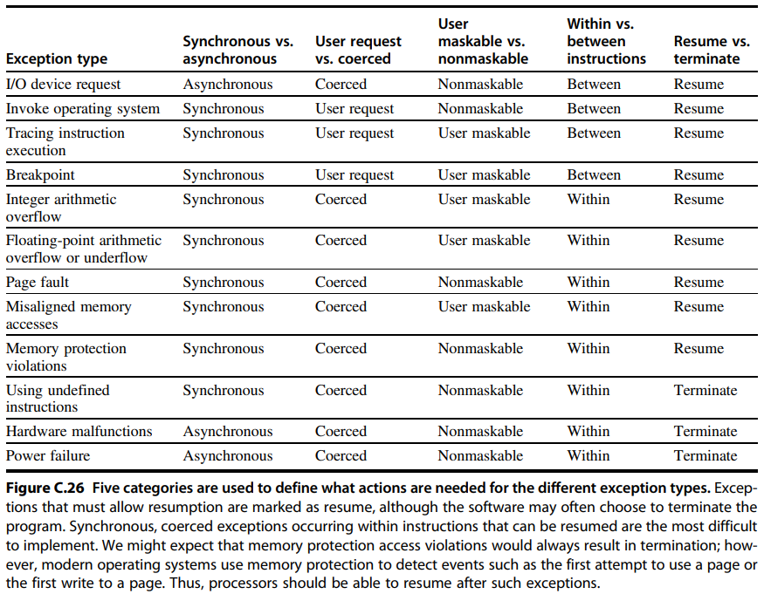
Five Categories
Actions Required for
Different Types
of Exceptions

Slide 15
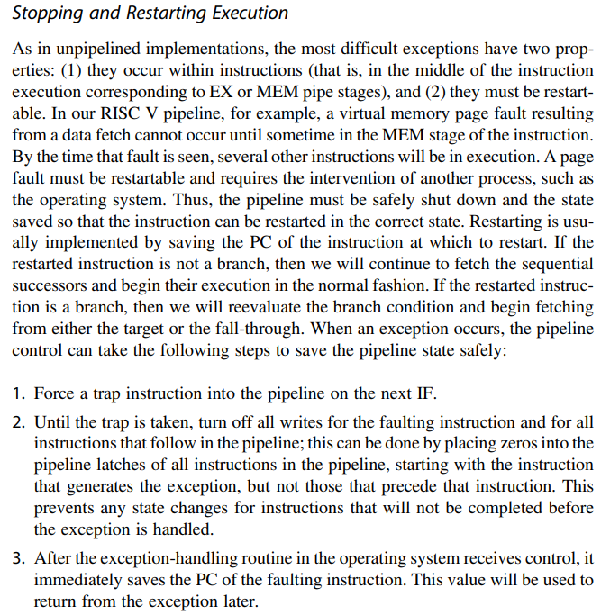
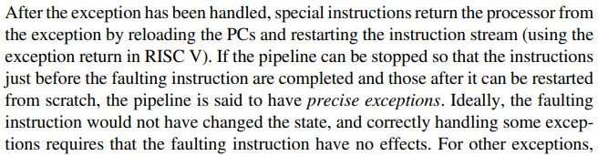


Pipeline Behaviour Under Exception

Slide 16
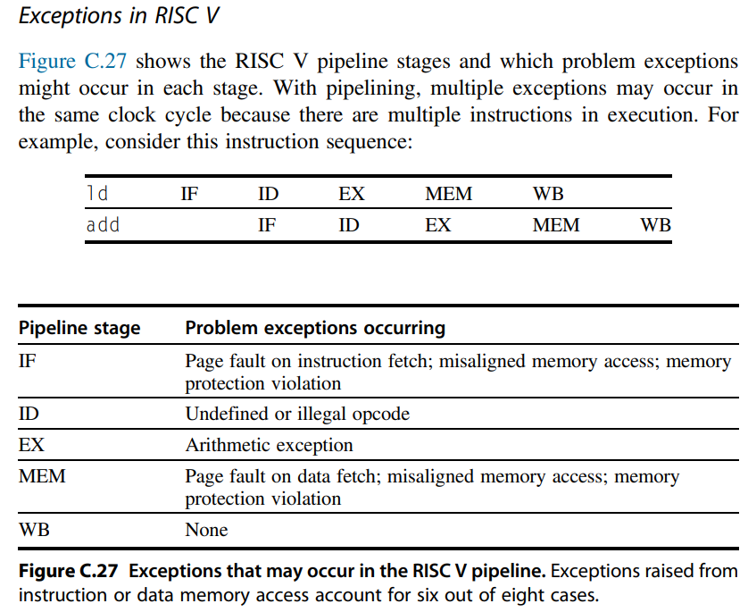
Exceptions in RISC-V

Slide 17

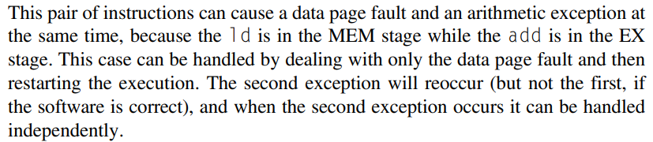



Data Page Fault – Multiple Exceptions

Slide 18
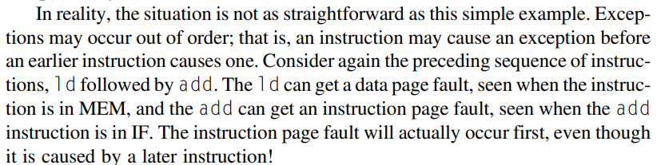


Exception that is Out of Order

Slide 19
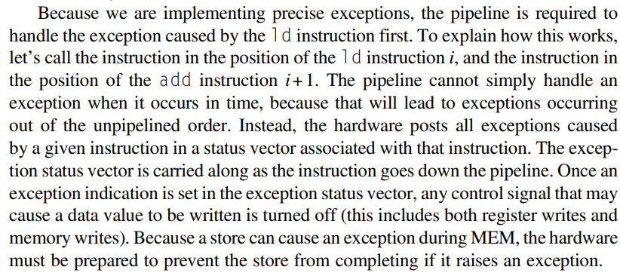
Exception Status Vector

Slide 20
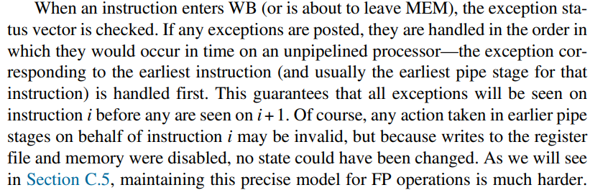
Exception Sequence

Slide 21
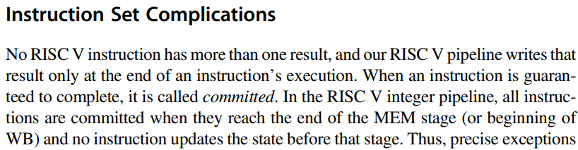
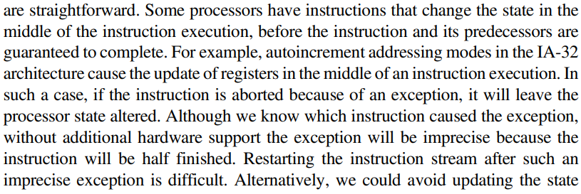


Committed Instructions

Slide 22
Handling Complex EX Stage with Multiple cycles
Complex Floating Point Stage in ALU

Slide 23
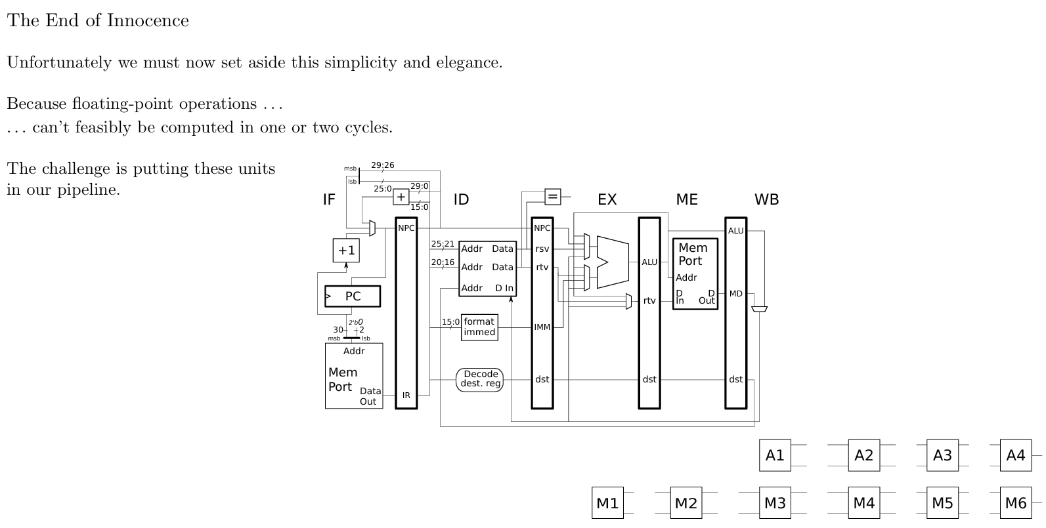
End of Innocence – Floating Point in 1 Cycle

Slide 24
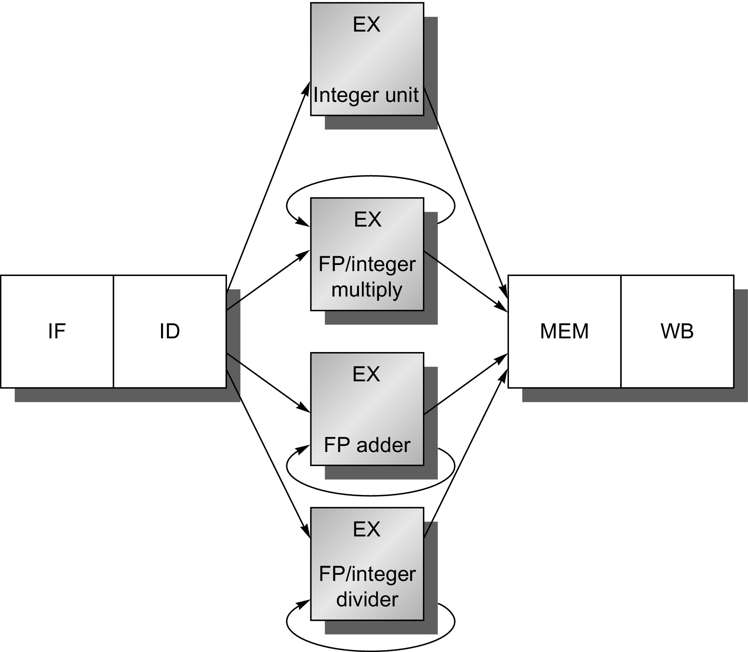
Pipeline Architecture with Multiple Execution
EX here is Not Pipelined
Figure C.28 The RISC V pipeline with three additional unpipelined, floating-point, functional units. Because only one instruction issues on every clock cycle, all instructions go through the standard pipeline for integer operations. The FP operations simply loop when they reach the EX stage. After they have finished the EX stage, they proceed to MEM and WB to complete execution.

Slide 25
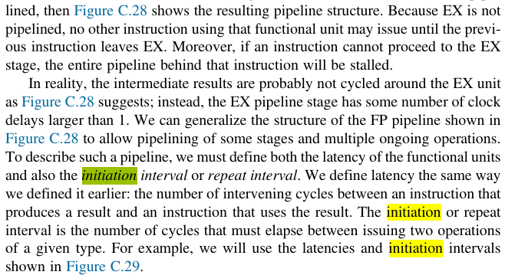

Initiation Interval

Slide 26
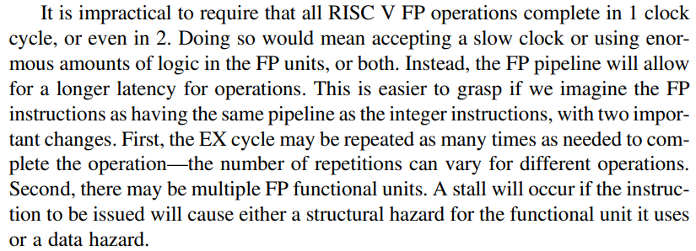
Multicycle EX stage – FP Example

Slide 27
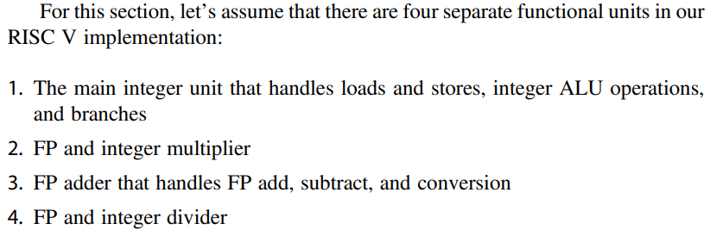
Assume Four Functional Units in EX

Slide 28
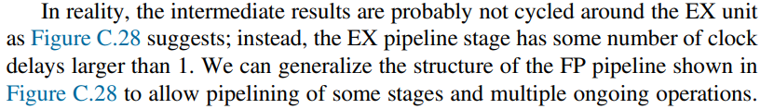
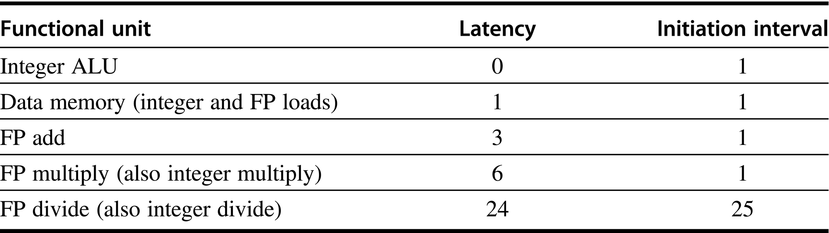
Latency of Different EX Units
Figure C.29 Latencies and initiation intervals for functional units.

Slide 29
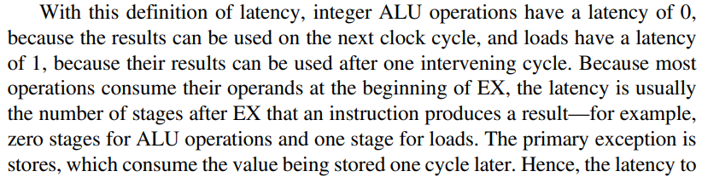
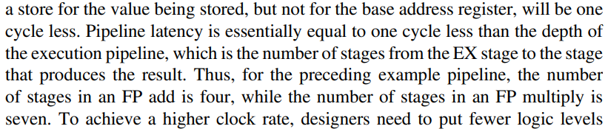

More on Latency

Slide 30
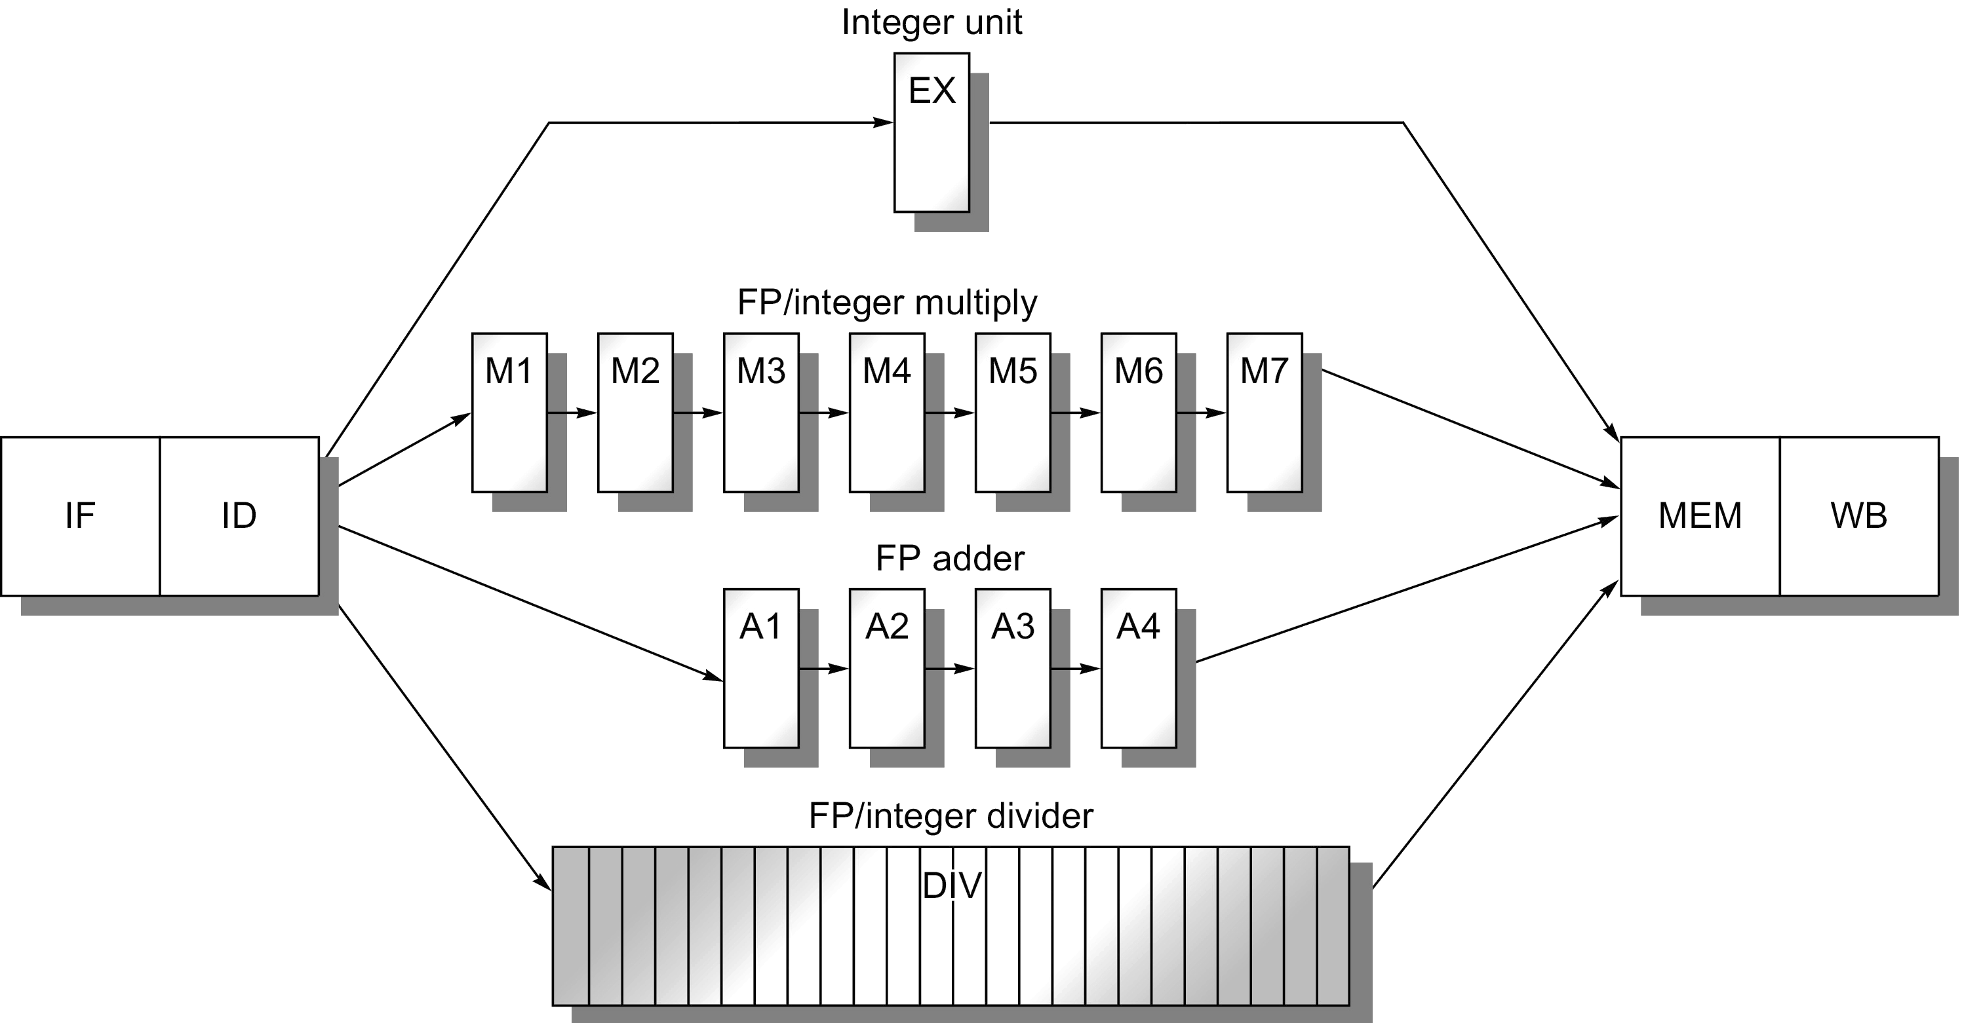
Include Multiple Operations in Pipeline

Slide 31
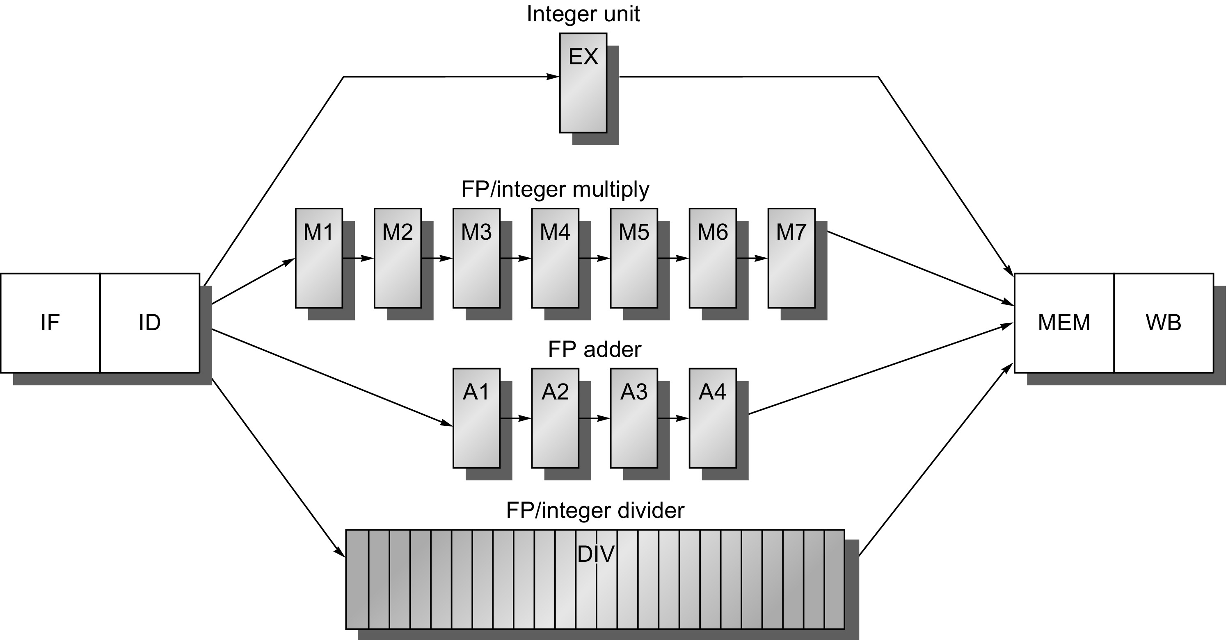

Multiple Outstanding FP Operations in Pipeline
Figure C.30 A pipeline that supports multiple outstanding FP operations. The FP multiplier and adder are fully pipelined and have a depth of seven and four stages, respectively. The FP divider is not pipelined, but requires 24 clock cycles to complete. The latency in instructions between the issue of an FP operation and the use of the result of that operation without incurring a RAW stall is determined by the number of cycles spent in the execution stages. For example, the fourth instruction after an FP add can use the result of the FP add. For integer ALU operations, the depth of the execution pipeline is always one and the next instruction can use the results.

Slide 32


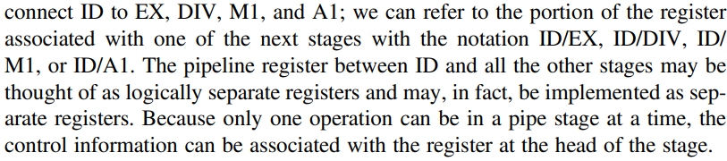


Adding Registers

Slide 33
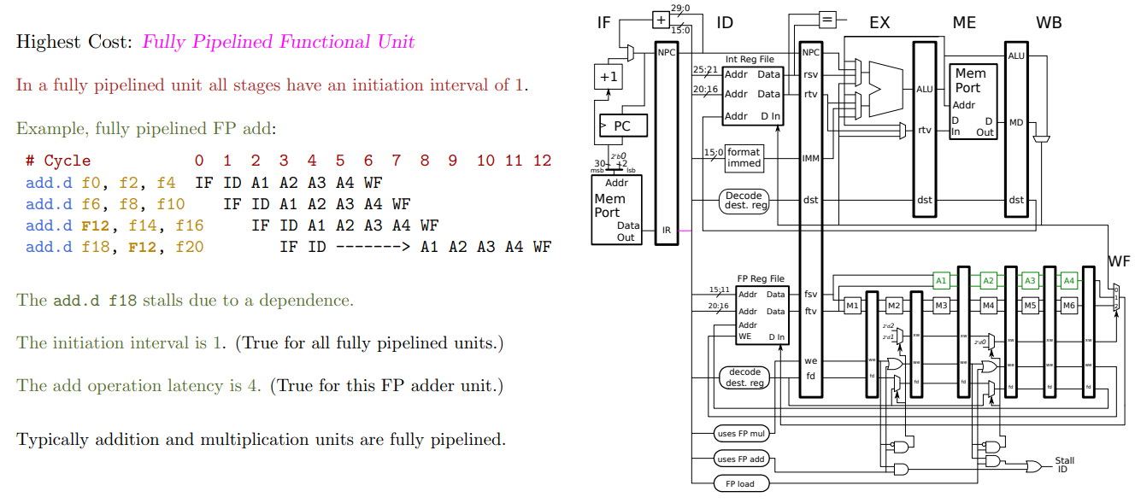
Complete Architecture incl MC FP instruction

Slide 34
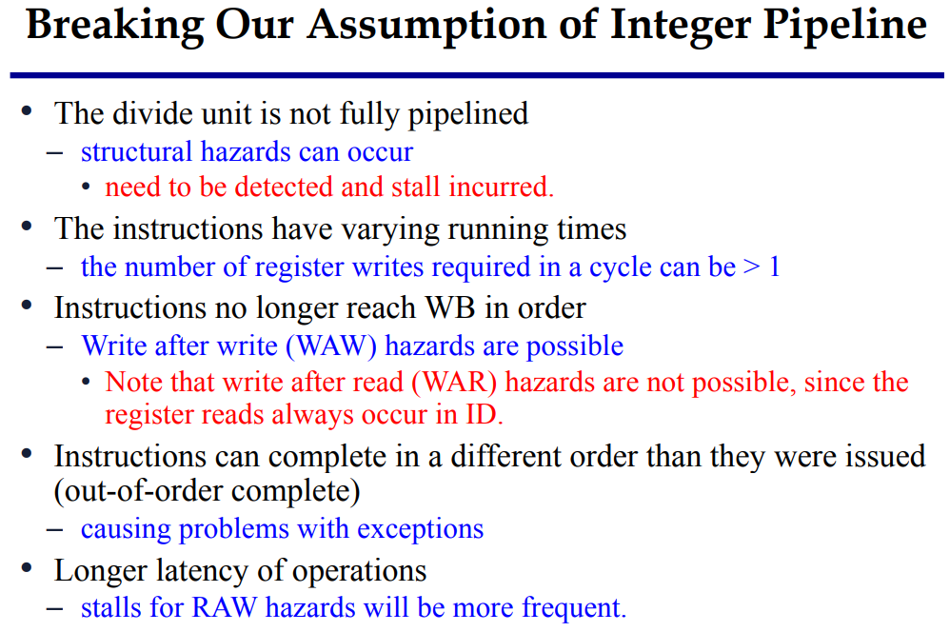
Differences from Integer Pipeline

Slide 35
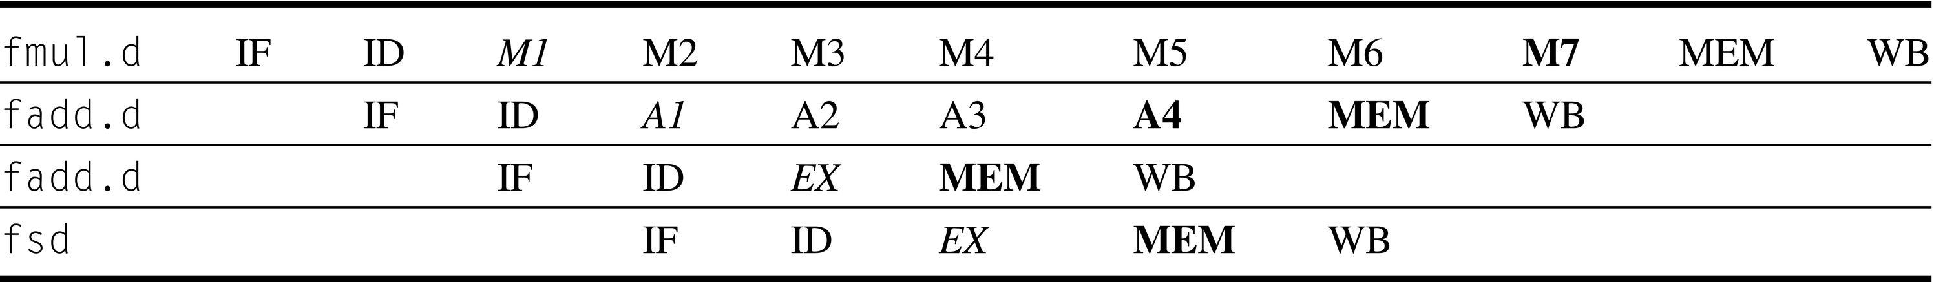


Timing of Independent Pipelined FP Operations
??
Figure C.31 The pipeline timing of a set of independent FP operations. The stages in italics show where data are needed, while the stages in bold show where a result is available. FP loads and stores use a 64-bit path to memory so that the pipelining timing is just like an integer load or store.

Slide 36
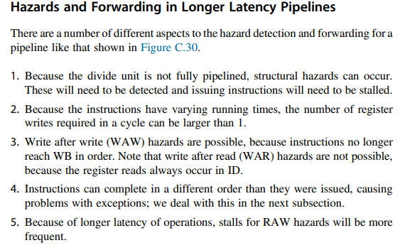
Hazard and Forwarding in Longer Latency EX

Slide 37
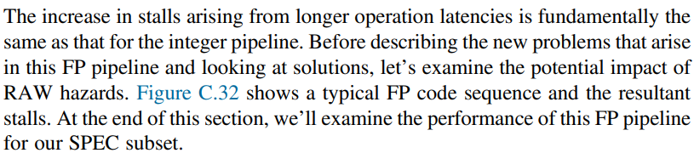
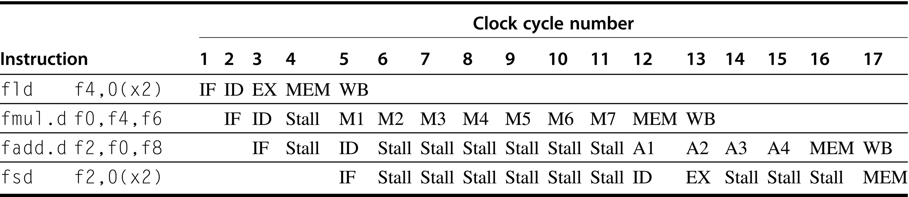
Stalls due to RAW Hazards in FP stage
Stored dbl prec
Figure C.32 A typical FP code sequence showing the stalls arising from RAW hazards. The longer pipeline substantially raises the frequency of stalls versus the shallower integer pipeline. Each instruction in this sequence is dependent on the previous and proceeds as soon as data are available, which assumes the pipeline has full bypassing and forwarding. The fsd must be stalled an extra cycle so that its MEM does not conflict with the fadd.d. Extra hardware could easily handle this case.

Slide 38

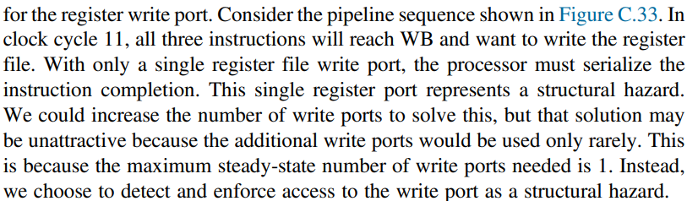
Problem With Writes

Slide 39
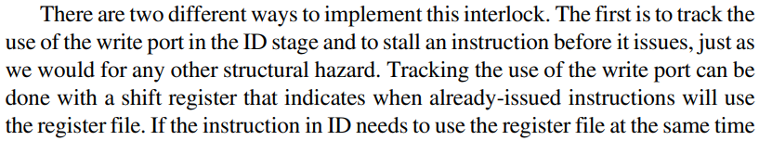
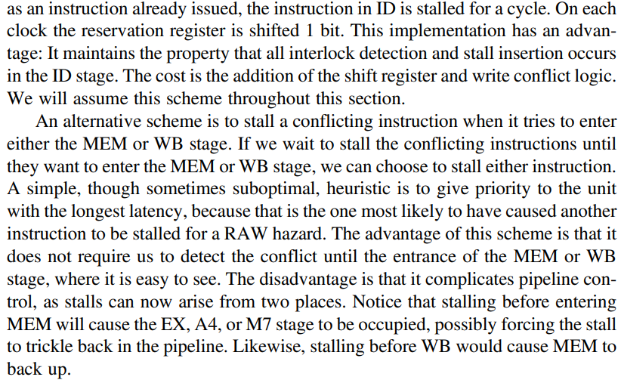


Implement this Interlock

Slide 40
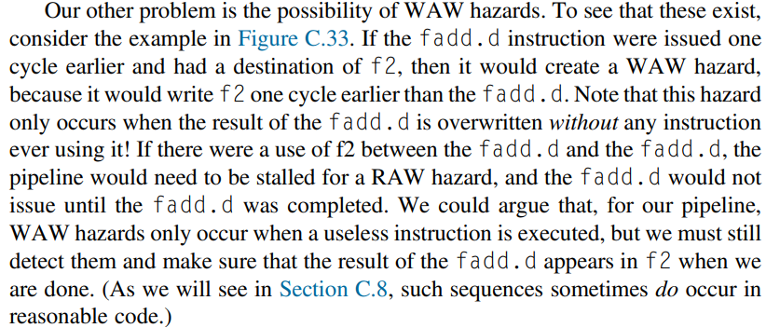
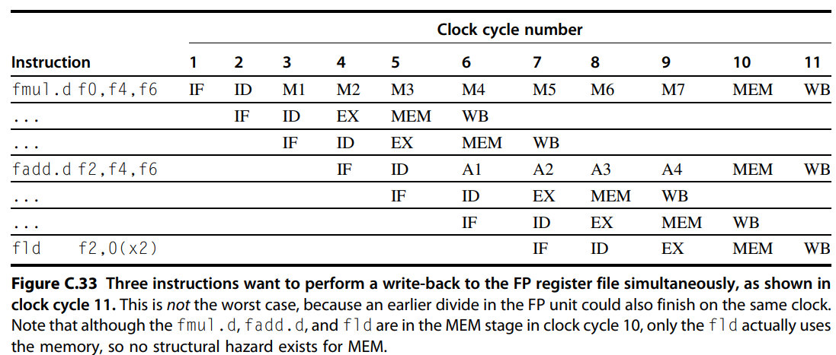

WAW Hazard

Slide 41
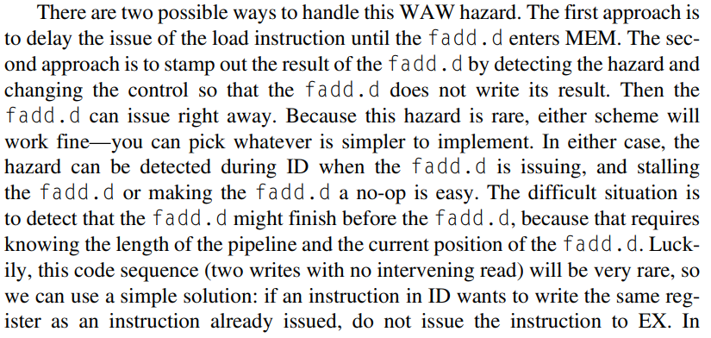
How to handle this WAW Hazard?

Slide 42
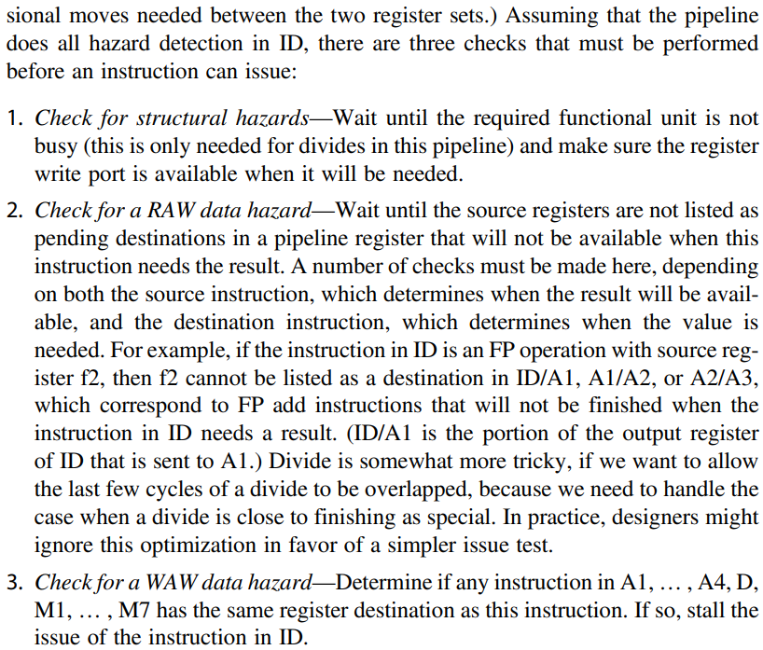
What To check while issuing an Instruction?

Slide 43
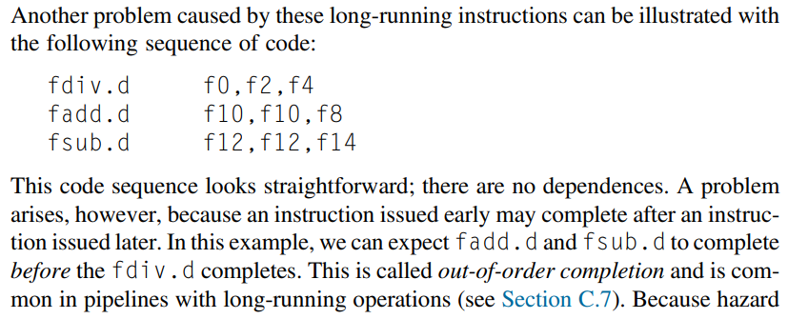

Out of Order Completion

Slide 44

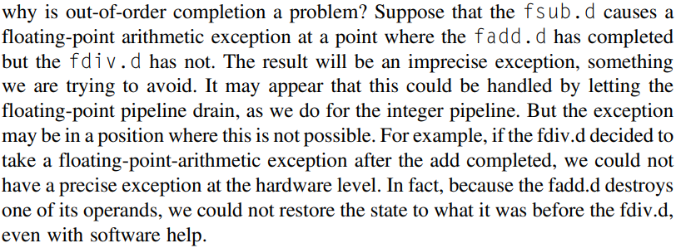

Problem with Out-of-Order Completion

Slide 45
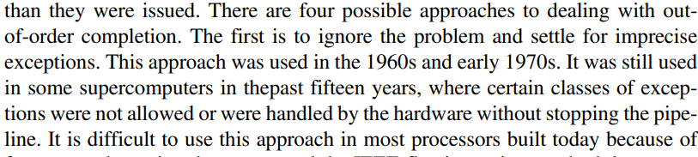
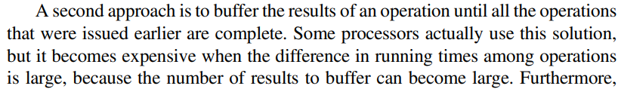
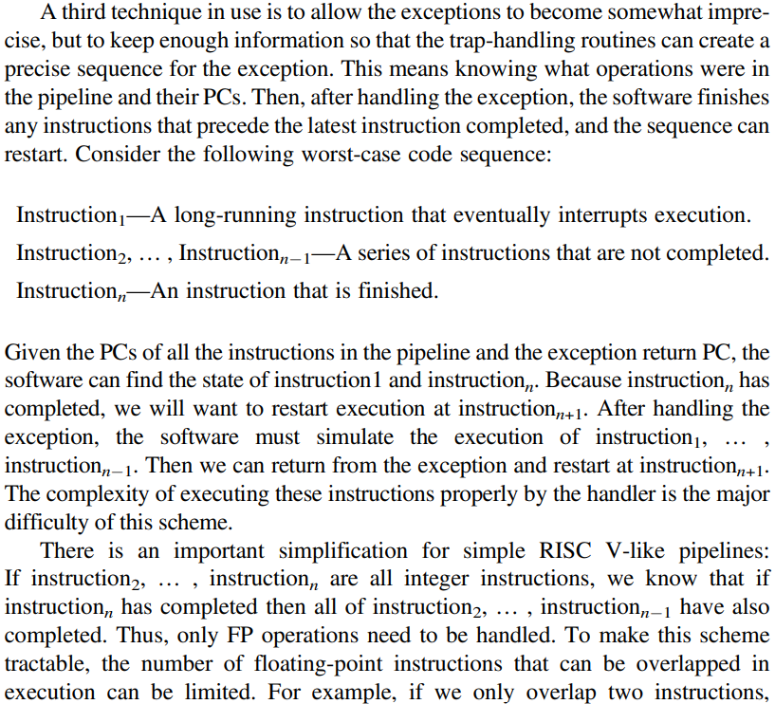
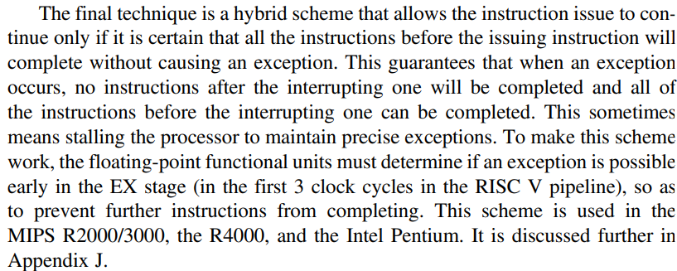


Solution to out of order completion

Slide 46
MIPS R4000 Deep Pipeline Case

Slide 47


8 Stage Pipeline of MIPS R4000

Slide 48


Complexity in Architecture

Slide 49

2 Cycle Load Delay

Slide 50


Forwarding Example MIPS 4000

Slide 51


Branch Delays

Slide 52


Basic Branch Delay

Slide 53

Deeper Pipelines and Forwarding

Slide 54


3 Cycle Branch Delay When Taken (x1 Interlock)

Slide 55

FP Pipeline

Slide 56





FP Stages
MIPS 4000

Slide 57


Slide 58
Computer Architecture
CS 622 / EE 520
Spring 2026
Lecture 9
Shahid Masud

Slide 59
Topics
Quick Review of Pipeline and Hazards
Scoreboard in Dynamic Branch Prediction
Instruction Level Parallelism – Chapter 3
Parallelism through Loop Unrolling
Advanced Branch Predictors
Quiz 2
Next Lecture

Slide 60
Slides Adapted from: (Further Readings)
Reading Notes
Readings:
Appendix C of course textbook
Chapter 3 of course textbook

Slide 61
Pipelining topics covered so far
RISC ISA
5 stage Integer Pipelined CPU
  Performance
  Hazards
Stalls to improve RAW, WAR, WAW Data Hazards
Reordering and NoOp in Software / Compilers
Forwarding (or Bypassing) to Improve Data Hazards
Interlock feature in Pipelined Hardware Architecture
Control / Branch Hazards
  Static / Dynamic / Flush / Restart
  Branch Prediction
Dealing with Exceptions / Interrupts in Pipelined Architecture
  Status and Mask Registers
Multicycle Floating point Pipelined RISC Architecture
  Introduce Out of Order Execution
  Introduce Scheduling of Instructions
Case study of MIPS R4000 Pipeline
  Instruction Memory and Data Memory with Cache support

Slide 62
Adding Registers
Multicycle Pipeline

Slide 63

Hazards and Forwarding in Longer Pipelines

Slide 64
8 Stage Pipeline of MIPS R4000
SUPERPIPELINING

Slide 65

Branch Delays

Slide 66
Basic Branch Delay

Slide 67

Deeper Pipelines and Forwarding

Slide 68
Forwarding Example MIPS 4000

Slide 69

3 Cycle Branch Delay When Taken (x1 Interlock)

