Slide 1
Computer Architecture
EE 520 / CS 622
Fall 2026
Lecture 1
Shahid Masud

Slide 2
Today’s Topics
Introducing Computer Organization vs Computer Architecture
Types of Computers and Computing
Where did Moore’s Law Take us?
Scaling of Clock, Voltage, Power
Dannard Scaling and Its Limitations
Power Wall
Post-Moore’s-Law-Computing
Notion of Performance in Modern Computers
Introducing Features in New Computer Paradigm
Seven Great Ideas and Room for Innovation in Computer Architecture

Slide 3
Introduction
Computer Organization vs Computer Architecture
Different Generations and Types

Slide 4
Difference between Computer Organization and Computer Architecture
Architecture: View from outside, high level specs (Programs looking towards CPU Instructions)
Organization: View from Inside (CPU looking outwards towards buses, memory and peripherals)

Slide 5
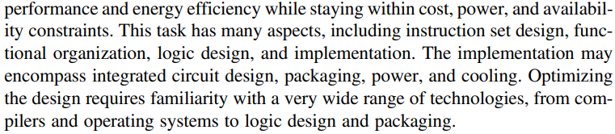
NEW - Difference between Computer Organization and Computer Architecture
Old Approach
Architecture: View from outside, high level specs (Programs looking towards CPU Instructions), Instruction Set Architecture (ISA)
Organization: View from Inside (CPU looking outwards towards buses, memory and peripherals)
New View

Slide 6
Main Classes of Computers
Personal Mobile Devices
Desktop Computing
Servers
Clusters / Warehouse Scale Computers

Slide 7
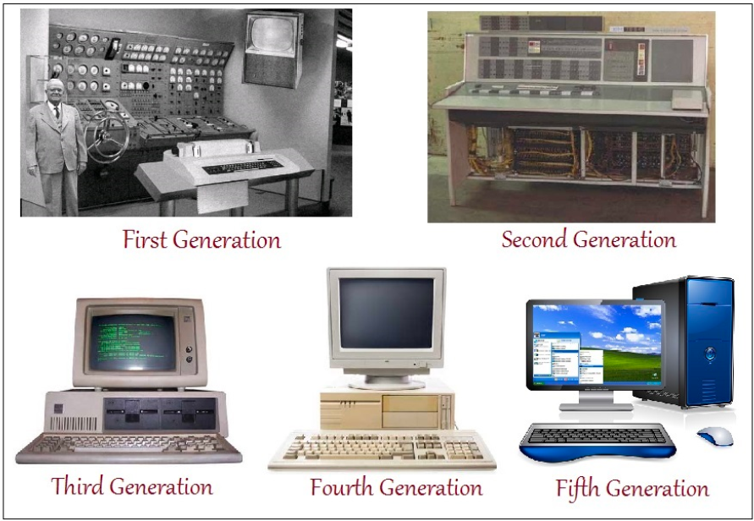
Traditional Computer Generations - Standalone
Developments in
CMOS Technology
Multi-Layer PCB
Memory Technology
Packaging & Ergonomics
Power Electronics
Storage & Hard-disk
And
Moore’s Law

Slide 8

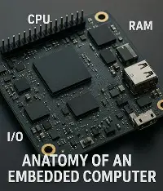
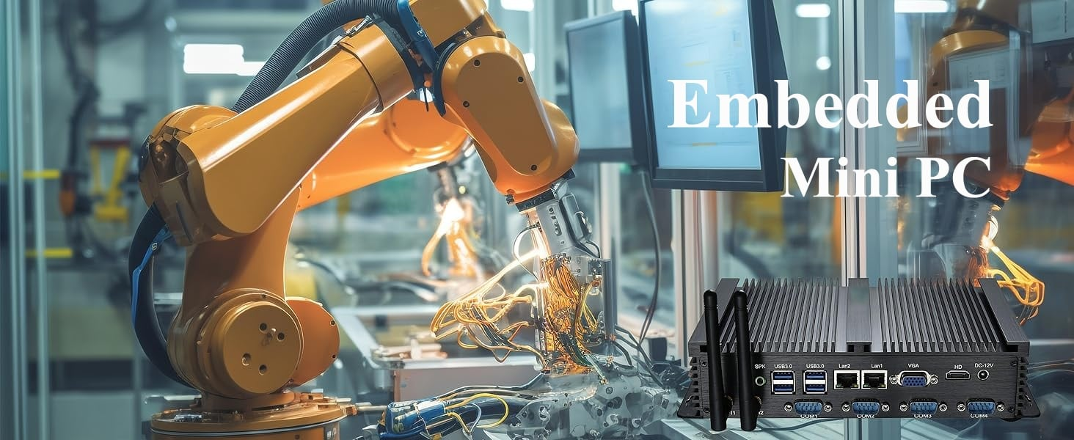
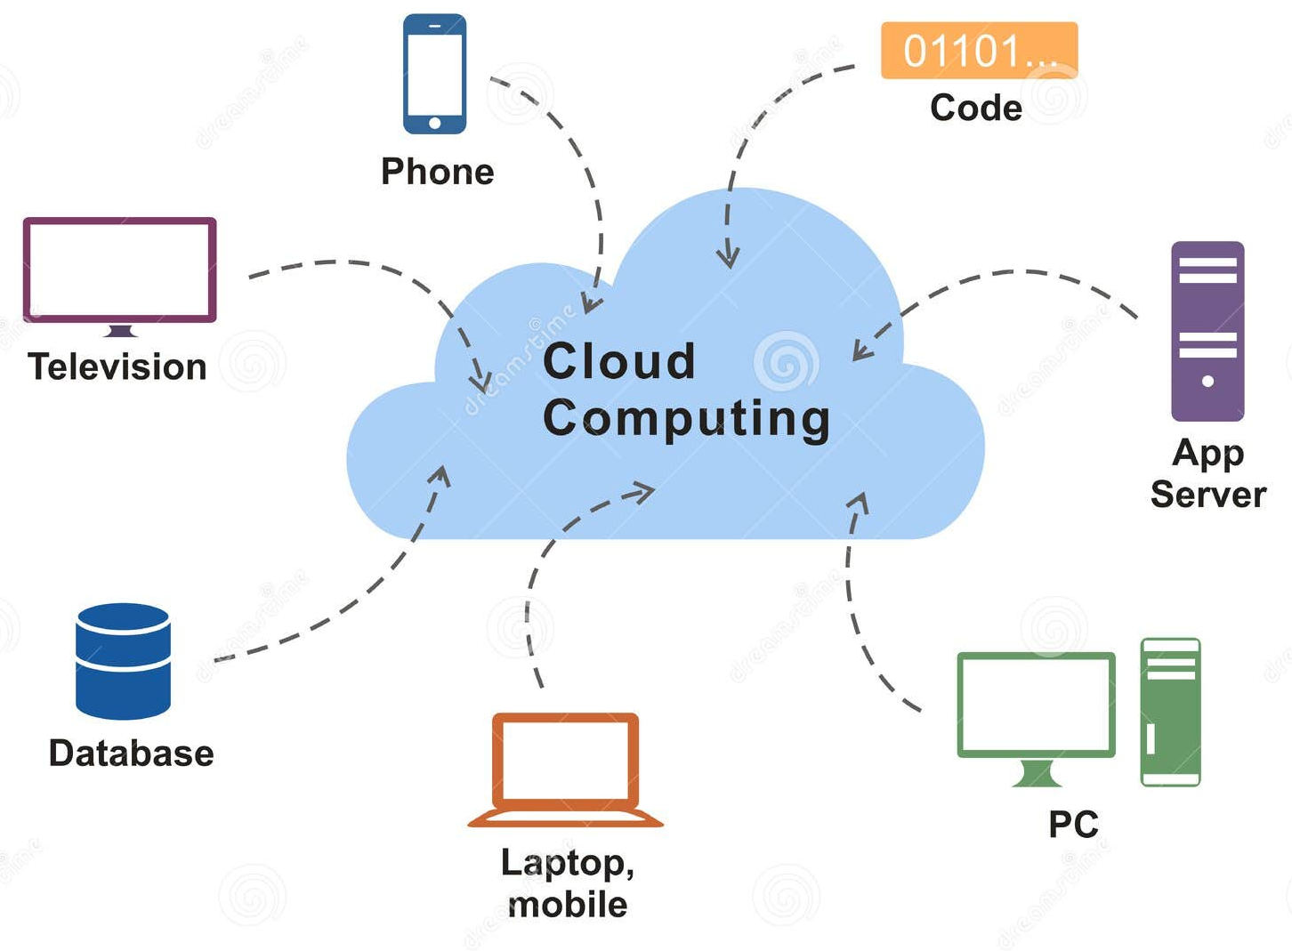
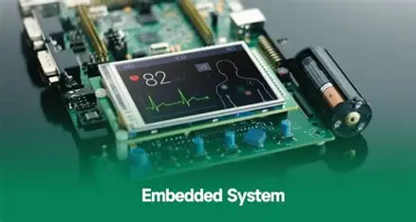
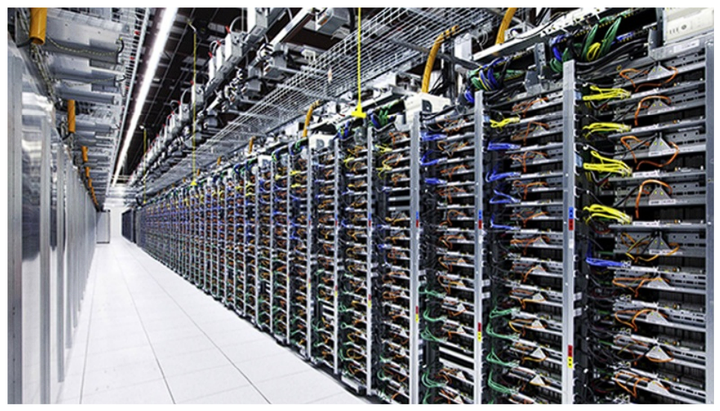
New Computer Types: Embedded, Cloud, WSC
Warehouse Scale Computing

Slide 9
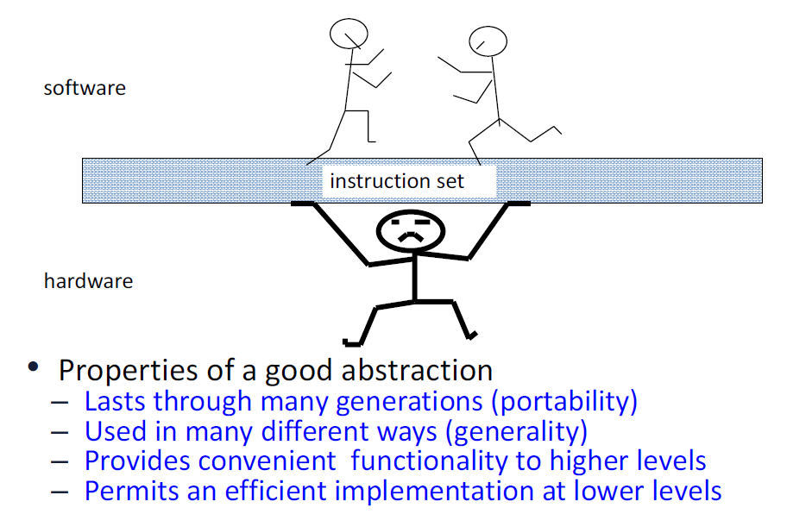
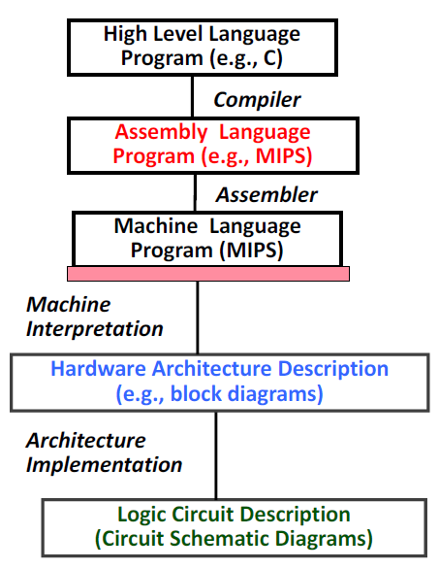
Instruction Set Architecture – HW/SW Interface

Slide 10
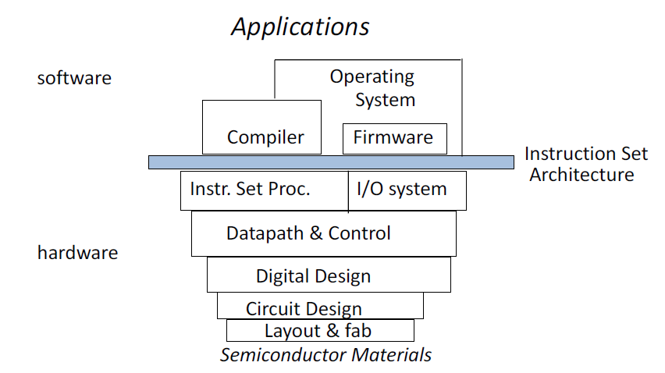
Computer Architecture Hierarchy

Slide 11
Where did Moore’s Law Take us?

Slide 12
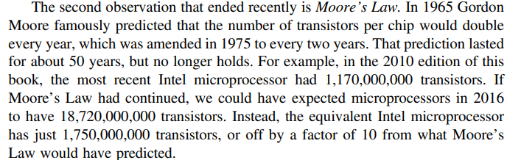
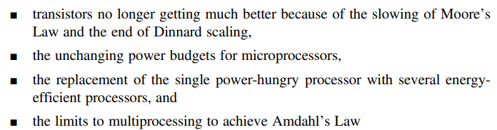




Moore’s Law

Slide 13

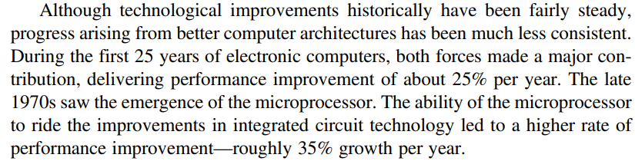
Quantitative Analysis

Slide 14
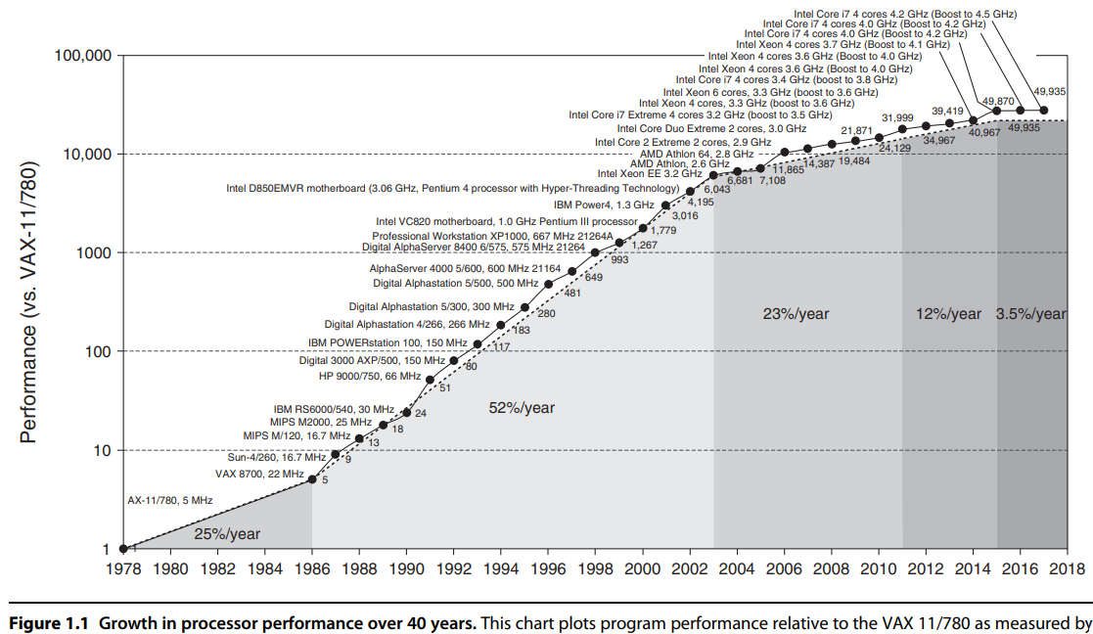
Growth in Computer Performance

Slide 15
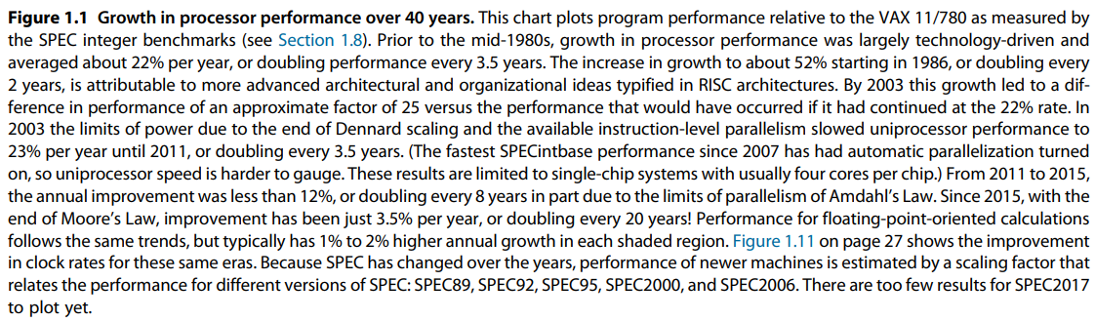
Explanation of Growth in Performance

Slide 16
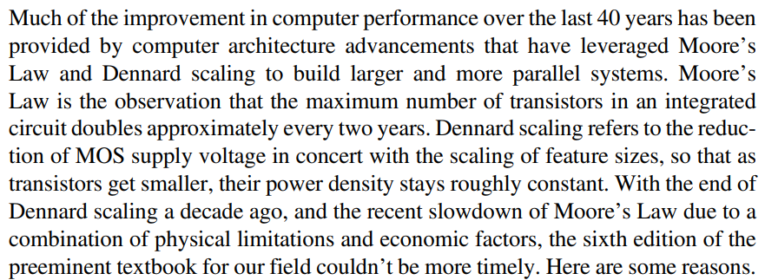
Technology Road-Blocks in last few years

Slide 17
Dannard Scaling
Effect on Computers

Slide 18


Dannard Scaling

Slide 19
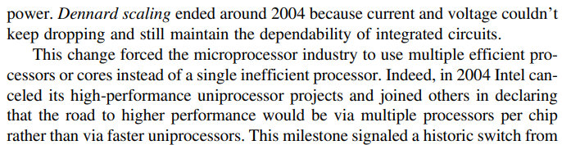



Dannard Scaling

Slide 20
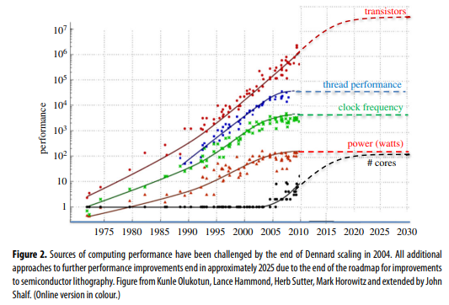
Depiction of Dennard Scaling Effects

Slide 21
Post Moore’s Law Computing

Slide 22
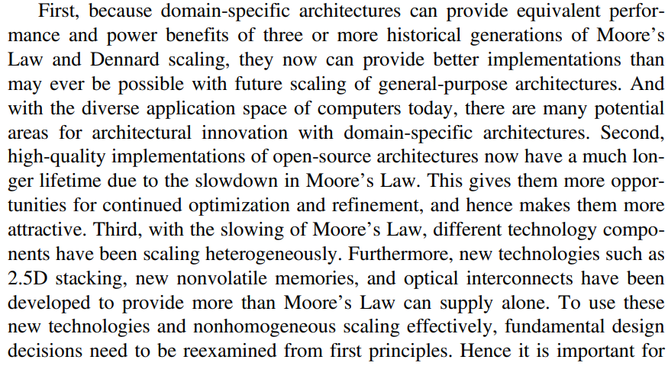
What is Post Moore’s Law Computing

Slide 23
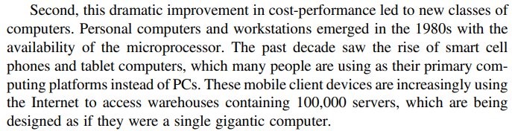
Introducing Post-Moore’s-Law Computing

Slide 24
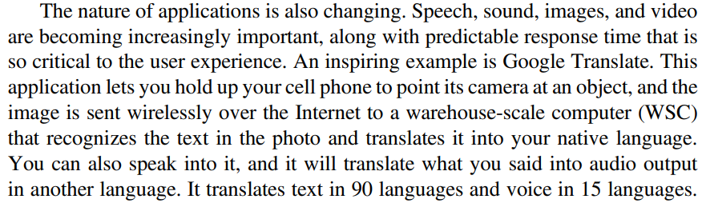
A Modern Computer System

Slide 25
Performance of Computer Systems
Quantitative vs Qualitative

Slide 26
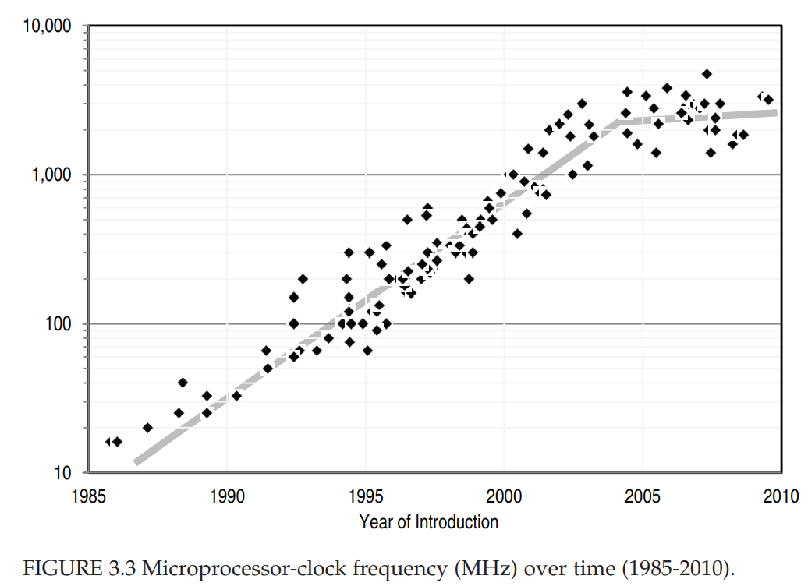

Slide 27
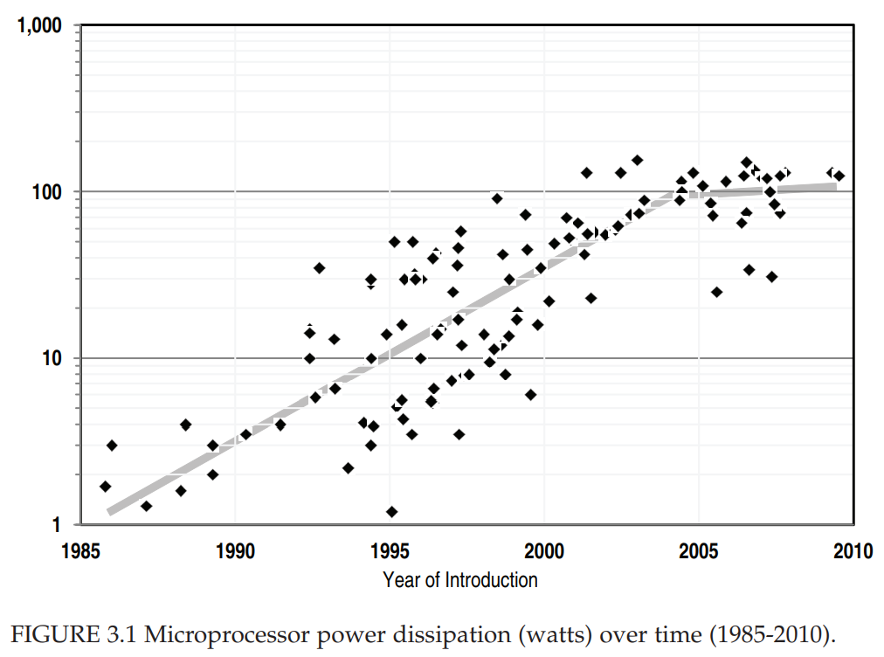

Slide 28
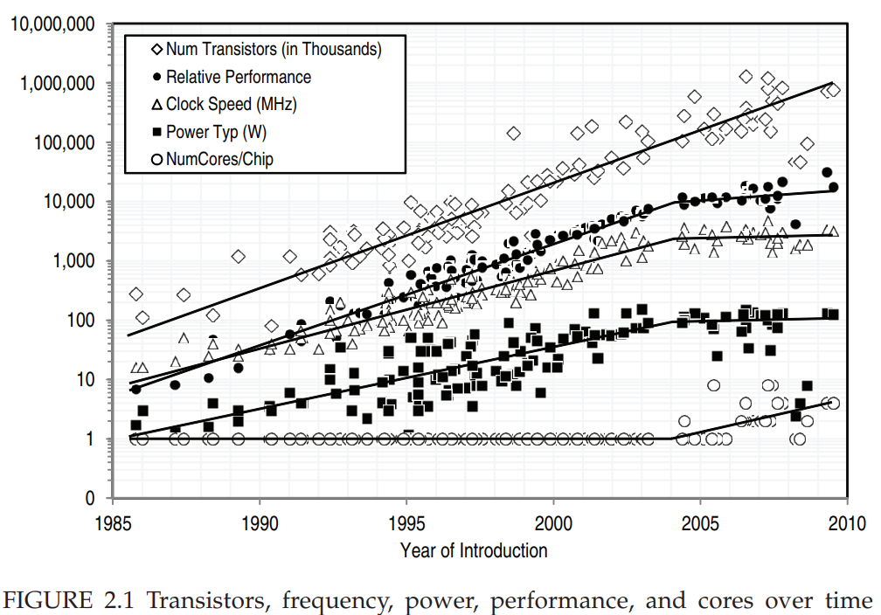

Slide 29
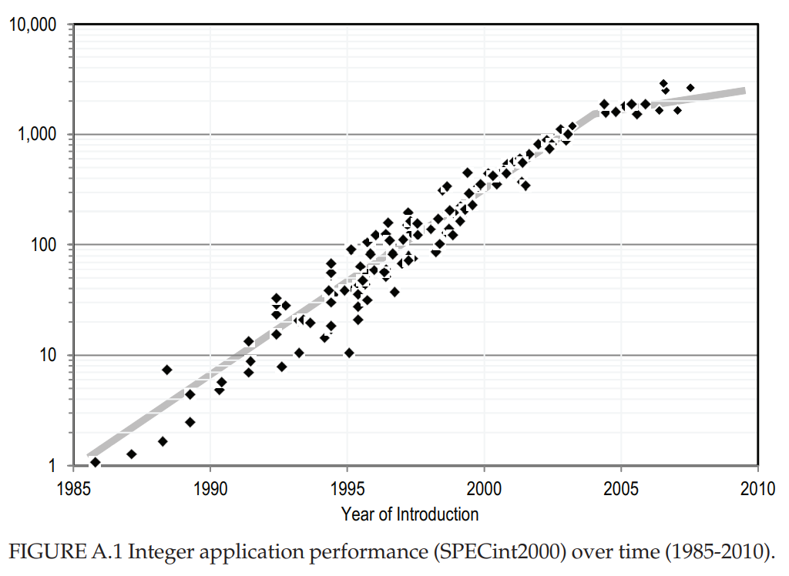

Slide 31
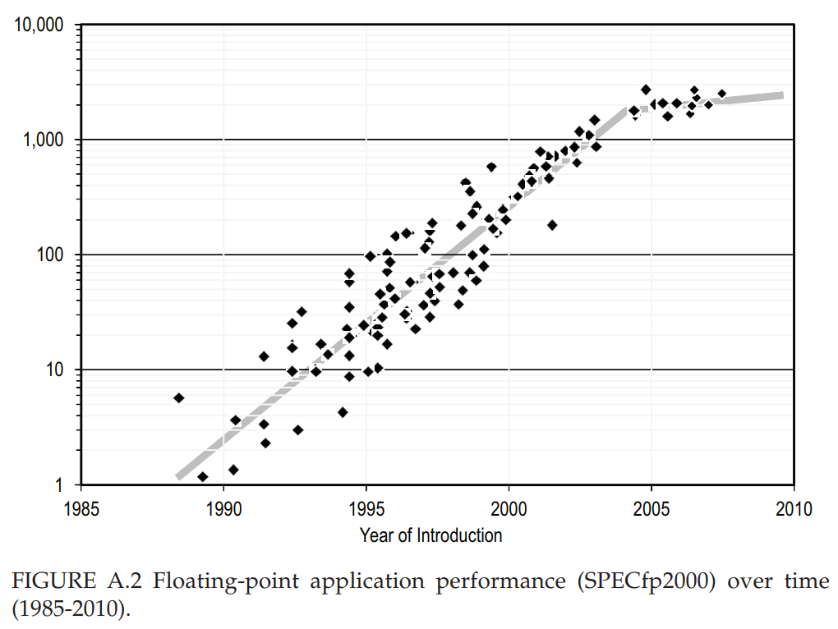

Slide 32
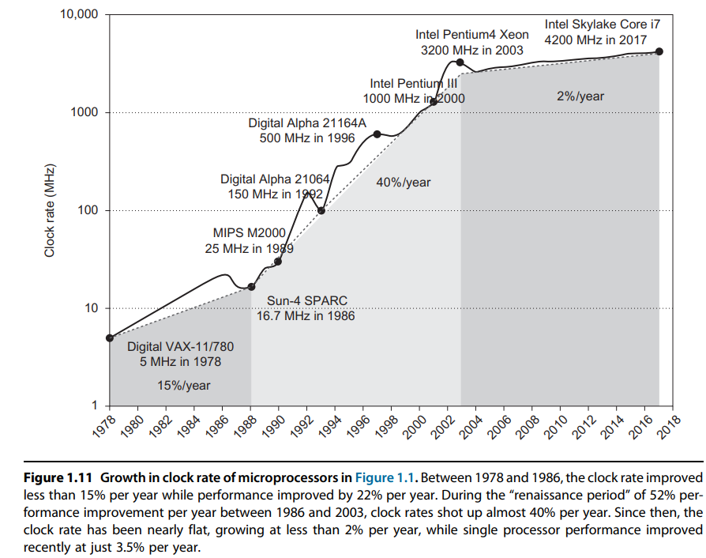
Clock Rate Improvement

Slide 34
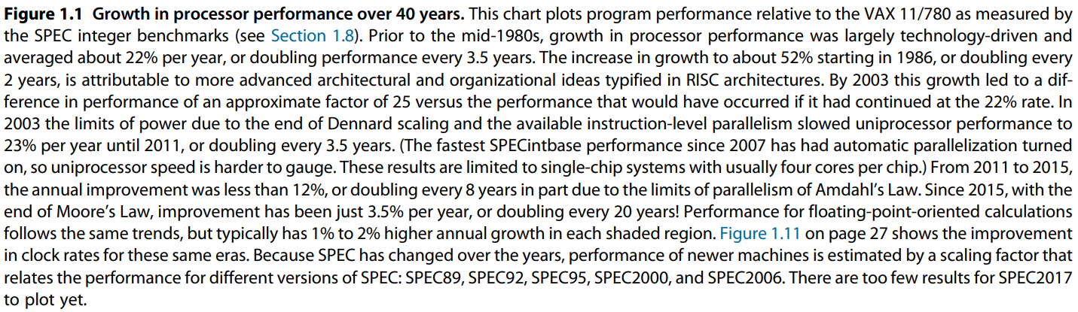
Explanation of Figure

Slide 35
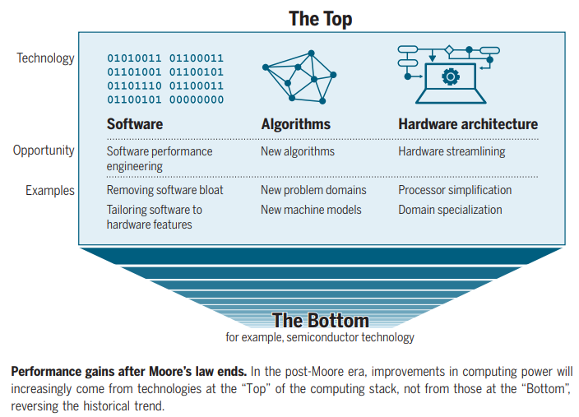
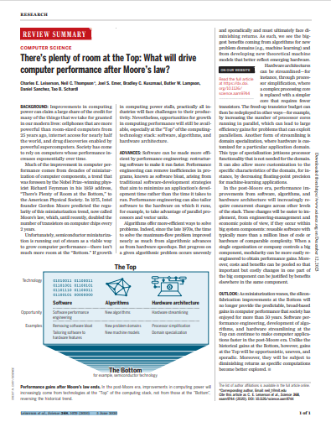
Future Improvements in Computer Performance
Ref: Leiserson et al., Science 368, 1079 (2020) 5 June 2020

Slide 36
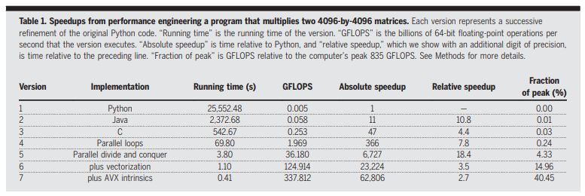
Example of Performance Gains through Architecture
AVX = Intel Advanced Vector Extension

Slide 37
How does Architecture Impact Performance?
Impact of Architectural Differences on Processor Performance and Energy Efficiency
Architectural differences in processors can have a significant impact on their performance and energy efficiency. These differences can include variations in the design of the instruction set architecture (ISA), microarchitecture, pipeline structure, cache hierarchy, and power management features. Below, we will explore how these architectural variances influence the performance and energy efficiency of processors.
Instruction Set Architecture (ISA)
The ISA defines the set of instructions that a processor can execute. Different ISAs can impact performance and energy efficiency in several ways. For example, Reduced Instruction Set Computing (RISC) architectures typically have a smaller and more streamlined instruction set, which can lead to improved performance due to simpler decoding and execution. On the other hand, Complex Instruction Set Computing (CISC) architectures often have more complex instructions, which can reduce the number of instructions needed to accomplish a task, potentially improving performance in certain scenarios. However, the complexity of CISC instructions can also lead to higher power consumption.
Microarchitecture
Microarchitecture refers to the internal design of the processor, including the organization of functional units, pipelines, and execution units. Differences in microarchitecture can have a profound impact on performance and energy efficiency. For instance, out-of-order execution, a feature found in many modern processors, allows instructions to be executed in a more efficient order, potentially improving performance by utilizing idle execution units. However, this feature also requires additional hardware and can increase power consumption.
Pipeline Structure
The pipeline structure determines how instructions are processed within the processor. Deeper pipelines allow for higher clock speeds and potentially better performance by enabling more instructions to be processed simultaneously. However, deeper pipelines can also lead to higher power consumption due to increased pipeline stages and associated overhead. In contrast, a shallower pipeline may reduce power consumption but could limit the maximum clock speed and overall performance.
Cache Hierarchy
The cache hierarchy, including L1, L2, and L3 caches, plays a crucial role in processor performance and energy efficiency. A larger and more sophisticated cache hierarchy can reduce the average memory access time, improving performance by reducing the time spent waiting for data from main memory. However, larger caches also consume more power, so there is a trade-off between performance and energy efficiency. Additionally, the design of the cache coherence protocol can impact both performance and energy efficiency, especially in multi-core processors.
Power Management Features
Modern processors incorporate various power management features to improve energy efficiency. These features include dynamic voltage and frequency scaling (DVFS), which allows the processor to adjust its operating frequency and voltage based on workload demands. Additionally, techniques such as clock gating and power gating can selectively disable parts of the processor to conserve power when they are not in use. Processors with more advanced power management features can dynamically adapt to workload variations, improving energy efficiency without sacrificing performance.
In conclusion, architectural differences in processors have a profound impact on their performance and energy efficiency. Design choices related to ISA, microarchitecture, pipeline structure, cache hierarchy, and power management features all contribute to the overall behavior of the processor. Balancing performance and energy efficiency requires careful consideration of these architectural differences, as trade-offs often exist between the two. As technology continues to advance, future architectural innovations will likely continue to shape the performance and energy efficiency of processors.

Slide 38
Why is Computer Architecture Important?
What is computer architecture and why is it important?
Computer architecture is a crucial aspect of understanding and optimizing computer performance. It encompasses the design and organization of computer systems, including the hardware and software components that work together to execute tasks efficiently. By studying computer architecture, we gain insights into how computers function and how to enhance their performance.
From a hardware perspective, computer architecture involves the design of the central processing unit (CPU), memory systems, input/output devices, and the interconnections between these components. It focuses on factors such as instruction set architecture, data representation, and the flow of data within the system. By optimizing these hardware elements, we can improve the speed, efficiency, and reliability of computer operations.
On the software side, computer architecture influences the development of programming languages, compilers, and operating systems. Understanding the underlying architecture helps software developers write efficient code that takes advantage of the hardware's capabilities. It also enables them to optimize algorithms and data structures to enhance overall system performance.
1. Performance Optimization: Computer architecture plays a vital role in optimizing the performance of computer systems. By designing efficient hardware and software components, we can achieve faster execution times, reduced energy consumption, and improved overall system responsiveness.
2. Compatibility and Interoperability: Computer architecture ensures compatibility and interoperability between different hardware and software components. It establishes standards and protocols that enable seamless communication and integration between various devices and systems.
3. Scalability and Upgradability: A well-designed computer architecture allows for scalability and upgradability. It enables the addition of new hardware components or the enhancement of existing ones without disrupting the overall system functionality. This flexibility is crucial in adapting to evolving technological advancements.
4. Reliability and Fault Tolerance: Computer architecture incorporates mechanisms for error detection, correction, and fault tolerance. Redundancy, error-checking codes, and fault recovery techniques are implemented to ensure reliable operation and minimize system failures.
5. Security: Computer architecture plays a significant role in ensuring system security. It involves the design of secure hardware and software components, including encryption algorithms, access control mechanisms, and secure communication protocols. By considering security at the architectural level, we can mitigate potential vulnerabilities and protect sensitive data.
To illustrate the importance of computer architecture, let's consider an example. Imagine a high-performance gaming computer. Its architecture determines the speed and efficiency of rendering graphics, processing game logic, and handling input/output operations. A well-designed architecture with optimized hardware and software components can provide a smooth gaming experience with high frame rates, realistic visuals, and minimal lag.
Computer architecture is a fundamental aspect of understanding and optimizing computer performance. It encompasses the design of hardware and software components, ensuring compatibility, scalability, reliability, and security. By studying and improving computer architecture, we can enhance the efficiency and effectiveness of computer systems in various domains.

Slide 39
Performance Gains from Architecture
Complex Operations: For complex tasks and applications, architectural improvements often offer more substantial performance gains. Optimizations in instruction handling, pipelining, and parallelism can significantly enhance processing efficiency and throughput.
Long-Term Benefits: Architectural advancements tend to provide long-term benefits by addressing fundamental inefficiencies and enabling new capabilities. Improved architecture can lead to sustained performance improvements and support for emerging applications and workloads.
Historical Examples
Intel Pentium vs. Pentium Pro: In the late 1990s, Intel’s Pentium processors focused on increasing clock speeds, while the Pentium Pro emphasized architectural improvements such as enhanced pipelining and out-of-order execution. The Pentium Pro demonstrated that architectural advancements could offer superior performance compared to simple clock speed increases.
AMD Ryzen Processors: AMD’s Ryzen processors, with their advanced architecture and multiple cores, showcased significant performance improvements over previous generations, even at lower clock speeds compared to competitors. The architectural innovations in Ryzen processors, such as enhanced cache designs and multi-core support, contributed to their competitive performance.
4.2 Modern Examples
Apple M1 Chip: Apple’s M1 chip emphasizes architectural advancements, including a unified memory architecture and efficient core designs. The M1 chip delivers impressive performance and efficiency without relying solely on high clock speeds, demonstrating the impact of modern architectural innovations.
NVIDIA GPUs: NVIDIA’s GPUs, such as the RTX 30 series, leverage architectural improvements in their CUDA cores and tensor cores. These advancements enhance performance in tasks like machine learning and graphics rendering, showing that architecture can significantly impact specialized computing tasks.

Slide 40

Amdahl’s Law
Some part of code can be processed in parallel
The remaining part of code can only be processed in a sequential fashion

Slide 41

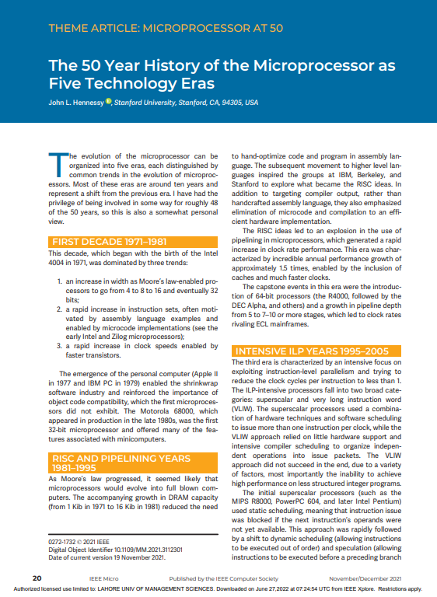
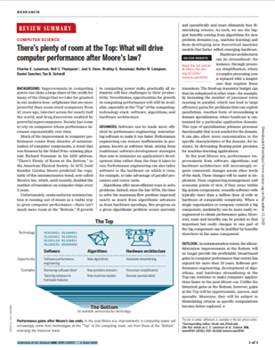
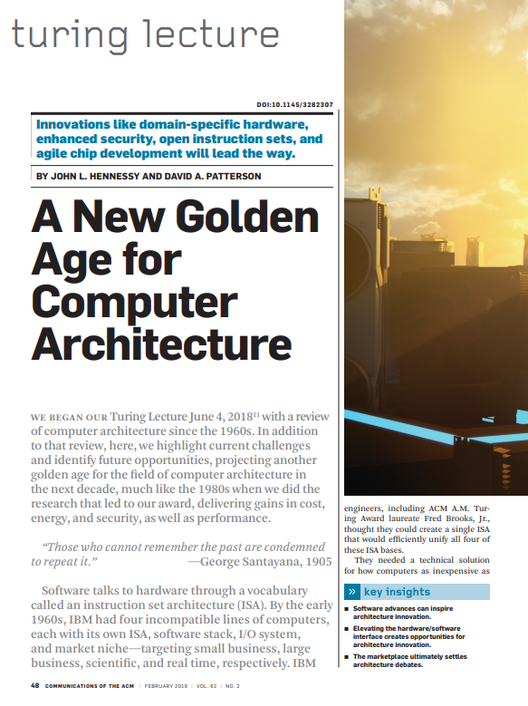
Look at some recent research papers for inspiration

Slide 42
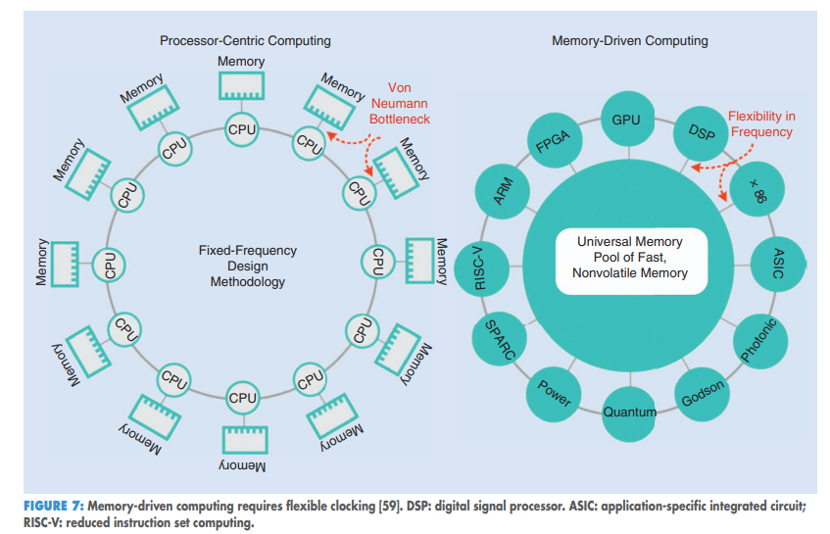
Processor Driver vs Memory Driven Computing

Slide 43
Parallelism in Computer Architecture

Slide 44

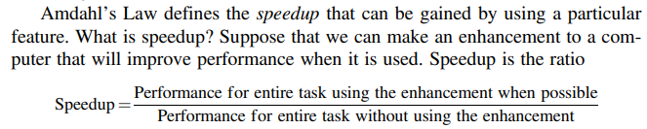
Amdahl’s Law – Parallel or Accelerator

Slide 45
Example of Performance Gains through Architecture
AVX = Intel Advanced Vector Extension

Slide 46
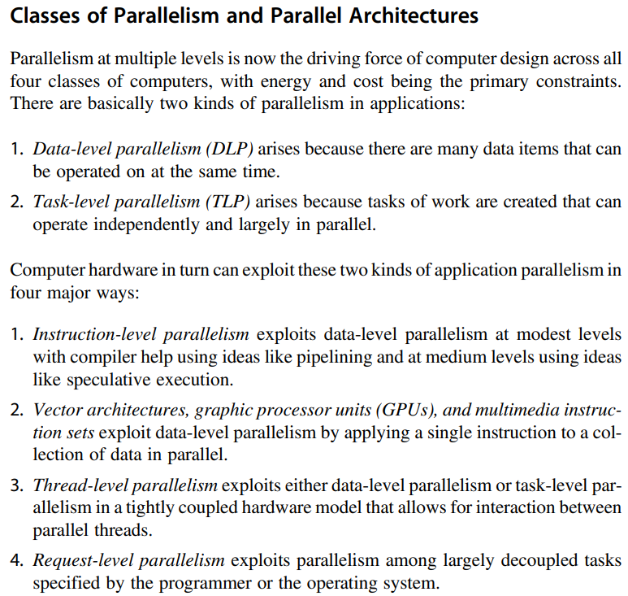
Parallelism and Parallel Computers

Slide 47
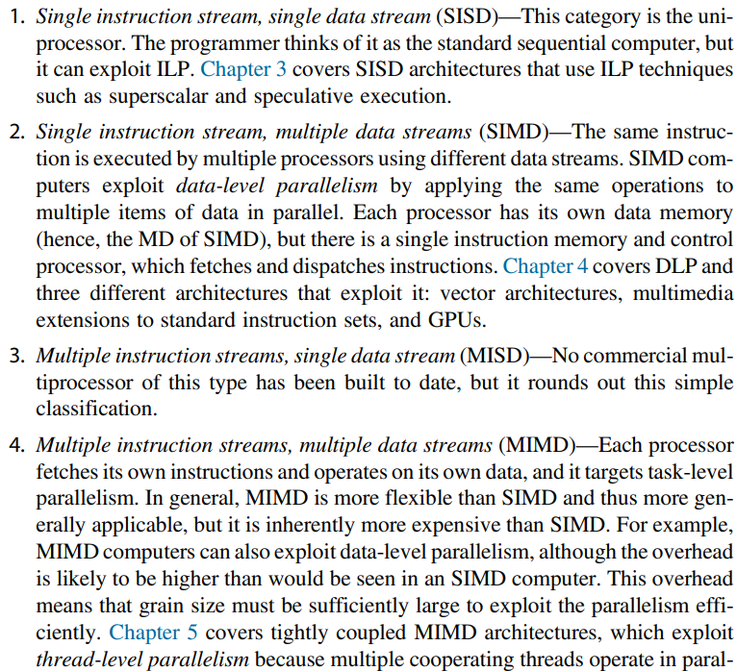
Flynn’s Taxonomy

Slide 48
How does computer architecture impact performance?
1. Processor Clock Speed: The faster the processor, the quicker the system can execute instructions
2. Number of Cores: Modern processors often have multiple cores, which allow them to perform multiple tasks simultaneously. This can improve performance for multitasking and multi-threaded applications.
3. Memory: The amount and type of memory (RAM, DRAM) in a system can also affect performance by reducing the need to retrieve data from slower storage devices.
4. Storage Devices: Some type of storage devices like Solid-state drives (SSDs) are much faster than traditional hard disk drives (HDDs), leading to quicker boot times, faster file transfers, and quicker loading times for applications.
5. Bus Design: Bus connects the different parts of the computer. A faster bus allows data to be transferred more quickly between the processor, memory, and other components.
6. Cache Size and Levels: Processors often have a small amount of 'cache' memory, which is used to store frequently accessed data. A larger cache can improve performance by reducing the need to fetch data from main memory.
7. Instruction Set Architecture (ISA): Some ISAs are more efficient than others, allowing the processor to perform more work in the same amount of time.
8. Graphics Processing Unit (GPU) / Accelerators: The performance of the GPU can significantly affect overall system performance. Other accelerators can have significant effect on performance.
9. Cooling and Energy Requirements: Overheating can cause a computer to slow down or even shut down to prevent damage. An inadequate power supply can lead to system instability and crashes, which can affect performance. A good power supply ensures all components receive the power they need to operate correctly.

Slide 49
Seven Great Ideas in Computer Architecture

Slide 50
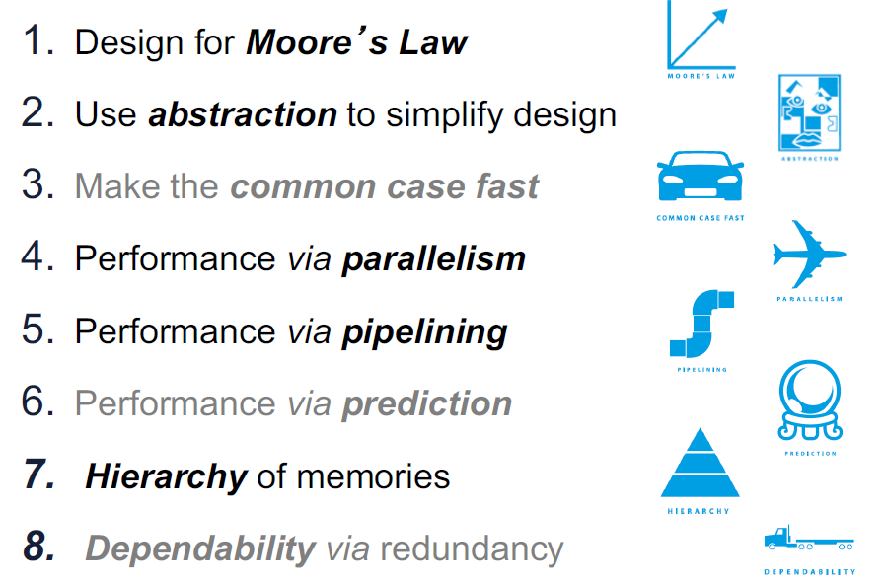
Significant Involvement in Computer Architecture
Explore further
In this course

Slide 51
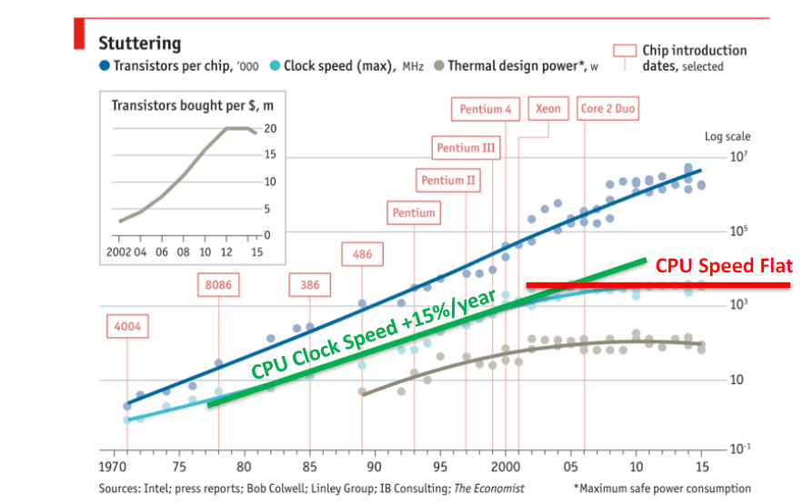
Why is Computer Architecture Exciting Today?

Slide 52
Remaining Lecture

Slide 53
Interesting Topics
1. Discussion on Moore’s Law, through paper ‘MORE THAN MOORE’ by M. Mitchell Waldrop, published
In Nature, February 2016
2. Computer Performance Graphs from National Academy, USA, report
3. Introduction to the specialization area of ‘Computer Architecture’ through paper by
Hennessy and Patterson, ‘A New Golden Age for Computer Architecture’, published in Communications
of the ACM, February 2019, pages 48 to 60.
  Important Directions for Computers of the future:
  Moore’s Law failing to keep up
  More Energy dissipation – too hot chips
  Domain Specific Architectures
  Enhanced security features inside microprocessors
  Open Instruction Sets and Extension of Instruction Sets through Customized Accelerators
  Agile Hardware Design for Microprocessors
  Combination of Domain Specific Languages and Domain Specific Architectures
4. Intel Processor Timeline
5. Reviewed course outline including detailed topics and grading breakup of lectures and labs.

Slide 54
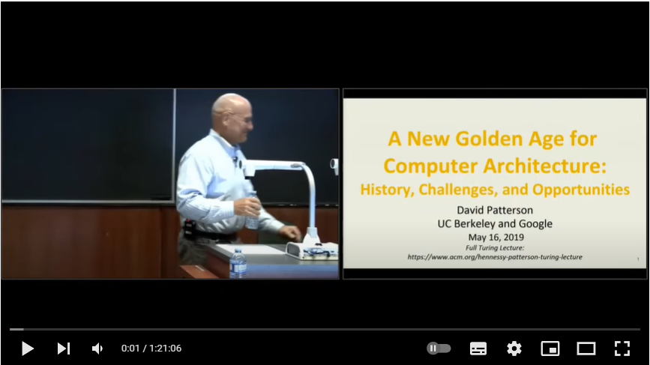
Video of Turing Lecture by Patterson, 2019
https://dl.acm.org/doi/10.1145/3282307
David Patterson - A New Golden Age for Computer Architecture: History, Challenges and Opportunities – YouTube

Slide 55






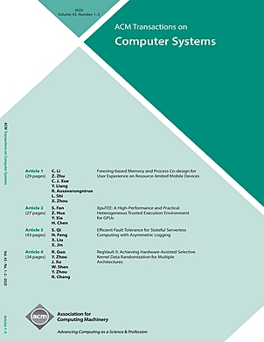
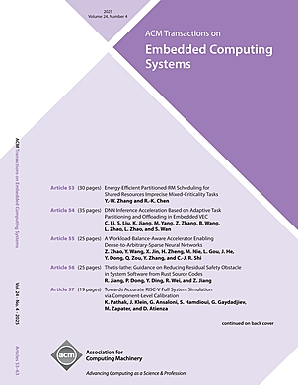
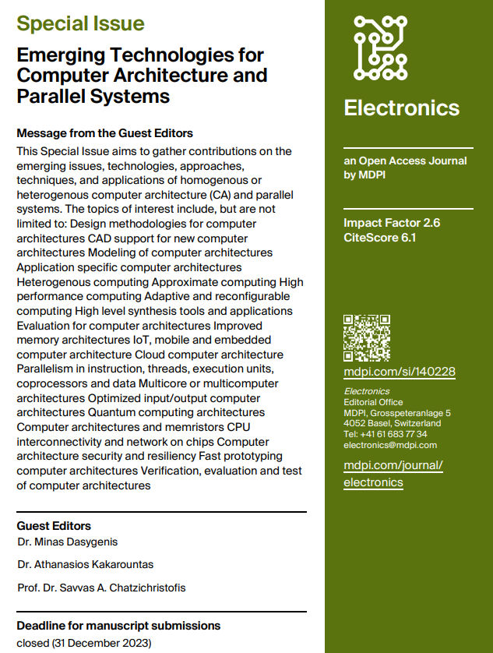
Some Computer Architecture Journals
IEEE Computer Society
ACM SIGARCH

Slide 56
Discuss Course Outline and Grading etc.

