Slide 1
Computer Architecture
CS 622 / EE 520
Spring 2026
Lecture 13
Shahid Masud

Slide 2
Topics
Review Superscalar, Multi-Issue, and ILP
VLIW
Solve two examples
  Step through Reorder Buffer
Branch Prediction Buffer Cache
Quiz 3
Next Lecture
Midterm
Week 9
Assignment 2 Soon

Slide 3
Further Readings
Reading Notes
Readings:
Chapter 3 of course textbook

Slide 4
Hardware Based Speculation – Using Reorder Buffer
Recap – Done Last time

Slide 5
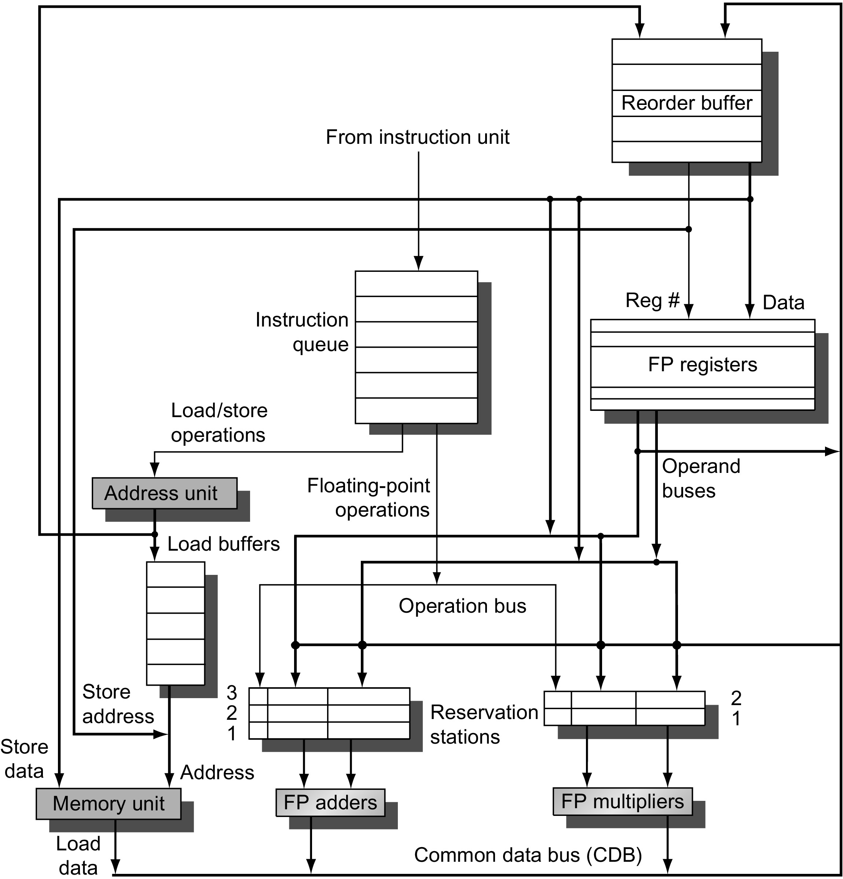



Tomasulo with Speculation
Figure 3.15 The basic structure of a FP unit using Tomasulo's algorithm and extended to handle speculation. Comparing this to Figure 3.10 on page 198, which implemented Tomasulo's algorithm, we can see that the major change is the addition of the ROB and the elimination of the store buffer, whose function is integrated into the ROB. This mechanism can be extended to allow multiple issues per clock by making the CDB wider to allow for multiple completions per clock.

Slide 6
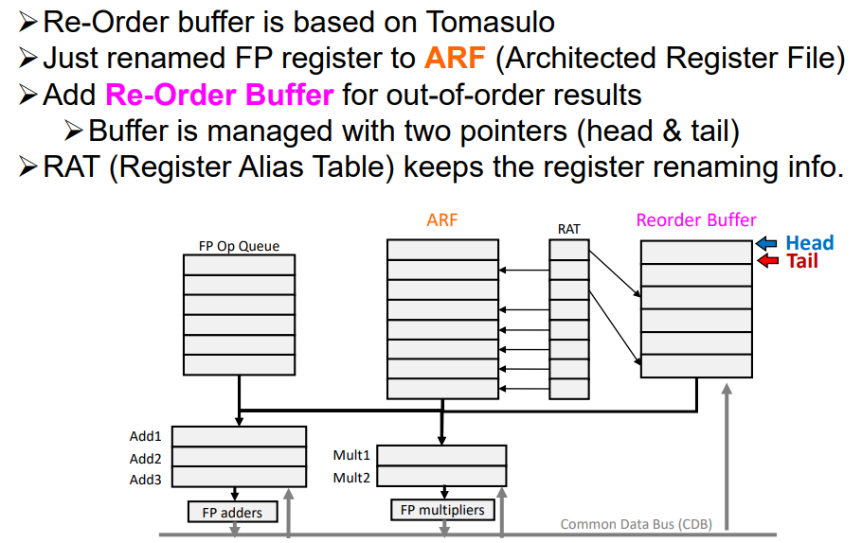
Tomasulo with ROB Organization

Slide 7
4 Steps for Speculative Tomasulo Algorithm
Instruction Issue
Execution
  Start
  Complete
Write Back
Commit

Slide 8
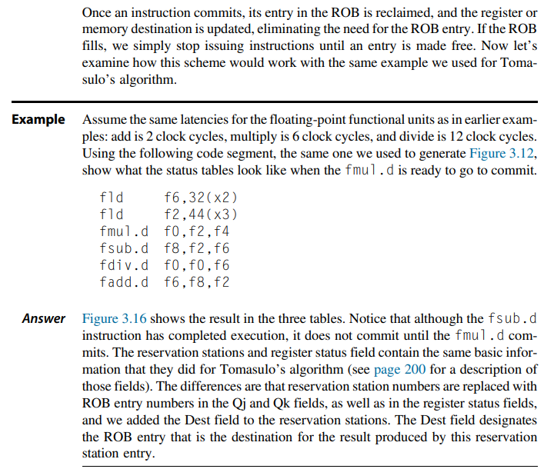

Example page 212 (come back later after examples)

Slide 9
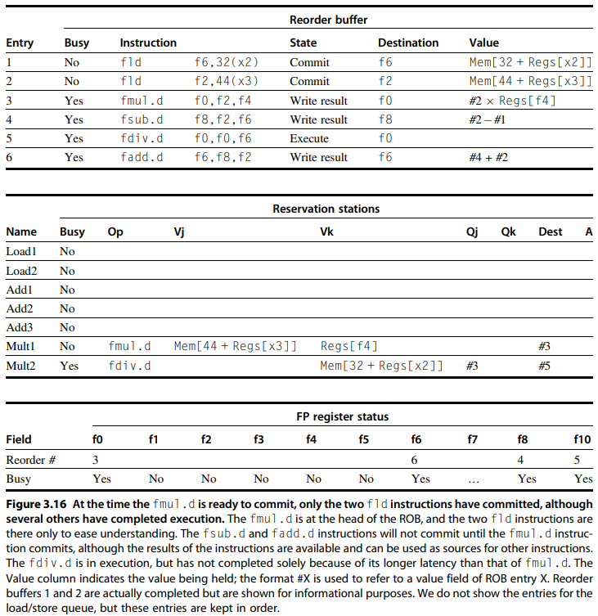
Solution

Slide 10
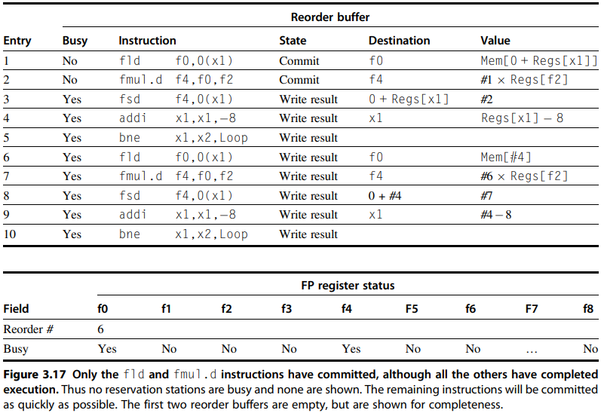






Solution - contd

Slide 11
Example 1 of ROB

Slide 12
Example 2 of ROB

Slide 13
Exceptions in Speculative Execution

Slide 14
Register Renaming and Exceptions in ROB
Register Renaming
In the presence of a ROB, the renaming function of the reservation stations is replaced by the ROB. A result is tagged using the ROB entry number rather than using the reservation station number.
Exceptions
The use of a ROB with in-order instruction commit provides precise exceptions, in addition to supporting speculative execution.
Exceptions are handled
By not recognizing the exception until it is ready to commit. If a speculated instruction raises an exception, the exception is recorded in the ROB. If a branch misprediction arises and the instruction should not have been executed, the exception is flushed along with the instruction when the ROB is cleared. If the instruction reaches the head of the ROB, then we know it is no longer speculative, and the exception should really be taken.

Slide 15
Handling Incorrect Speculation
Instructions following mispredicted branch, i.e. those in decode/issue buffers & RSs, are invalidated
ROB entries of these instructions are deallocated
Restart fetch at correct branch successor
Inject correct PC
Branch
Prediction
Branch
Resolution
Kill
update
Kill
Kill
PC
Fetch
Decode
Reorder Buffer
Commit
Complete
Execute

Slide 16
Handling Precise Exception / Interrupt
Instructions fetched and decoded into ROB in-order
Execution is out-of-order → OOO completion
Commit (write-back to architectural state, i.e., register file and memory) is in-order
In-order
Out-of-order
In-order
Fetch
Decode
Reorder Buffer
Commit
Kill
Kill
Kill
Exception?
Execute
Inject handler PC

Slide 17
Steps 1 – 2 in Dynamic Scheduler with Speculation
Apart from the three steps in the dynamic scheduler, an additional step of commit is introduced when there is support for speculation. Total four steps in a dynamic scheduler with speculation are below:
Issue
  Get next instruction from FIFO queue
  If available RS entry and ROB entry, issue the instruction
  If a RS or ROB entry is not available, it becomes a structural hazard and the instruction stalls
  If an earlier instruction is not issued, then subsequent instructions cannot be issued
  If operands are available read them and store them in the reservation station\
  Operands can be read from the register file (already committed instructions) or from the ROB (executed but not yet committed)
  Operands dependent on an earlier instruction are identified by their corresponding ROB tag in the Q field and such instructions will have to stall till data becomes available
Execute
  The CDB broadcasts data with an ROB tag and when an operand becomes available, store it in any reservation station waiting for it
  When all operands are ready, issue the instruction for execution
  Free the reservation station entry once the instruction moves into execution
  Loads and store are maintained in program order through the effective address
  Even with pending branches, instructions are speculatively executed

Slide 18
Steps 3 – 4 in Dynamic Scheduler with Speculation
Write result
  Write result on CDB into reservation stations and ROB
Commit
  An instruction is committed when it reaches the head of the ROB and its result is present in the buffer
  If it is an ALU or Load instruction, update the register with the result and remove the instruction from the ROB
  Committing a store is similar except that memory is updated rather than a result register
  If a branch with incorrect prediction reaches the head of the ROB, it indicates that the speculation was wrong
  ROB is ﬂushed and execution is restarted at the correct successor of the branch
  If the branch was correctly predicted, the branch is removed from ROB
  Once an instruction commits, its entry in the ROB is reclaimed
  If the ROB ﬁlls, we simply stop issuing instructions until an entry is made free.

Slide 19


ROB Example 1
Let us consider the sequence of instructions below.
Assume the latencies for the Add, Mul and Div instructions to be 2, 6 and 12 respectively.
Shows how the status will look like when the MUL.D is ready to go to commit
L.D F6,32(R2)
L.D F2,44(R3)
MUL.D F0,F2,F4
SUB.D F8,F6,F2
DIV.D F10,F0,F6
ADD.D F6,F8,F2

Slide 20
Solution
Figure shows how the status tables will look like when the MUL.D is ready to go to commit.
Observe that though the Sub and Add instructions have written the result, they have not yet committed.
This is because the Mul instruction has not yet committed.
The Destination field designates the ROB entry that is the destination for the result produced by a particular
reservation station entry.
The complete schedule is given in following Table.
Note that the instructions are issued in-order, executed out-of-order, completed out-of-order, but committed in-order.
Instruction | Issues at | Executes at | Writes result at | Commits at
L.D F6,32(R2) | 1 | 2-3 | 4 | 5
L.D F2,44(R3) | 2 | 3-4 | 5 | 6
MUL.D F0,F2,F4 | 3 | 6-11 | 12 | 13
SUB.D F8,F6,F2 | 4 | 6-7 | 8 | 14
DIV.D F10,F0,F6 | 5 | 13-24 | 25 | 26
ADD.D F6,F8,F2 | 6 | 9-10 | 11 | 27
‘In Order’ Commit,
Same as Instructions

Slide 21
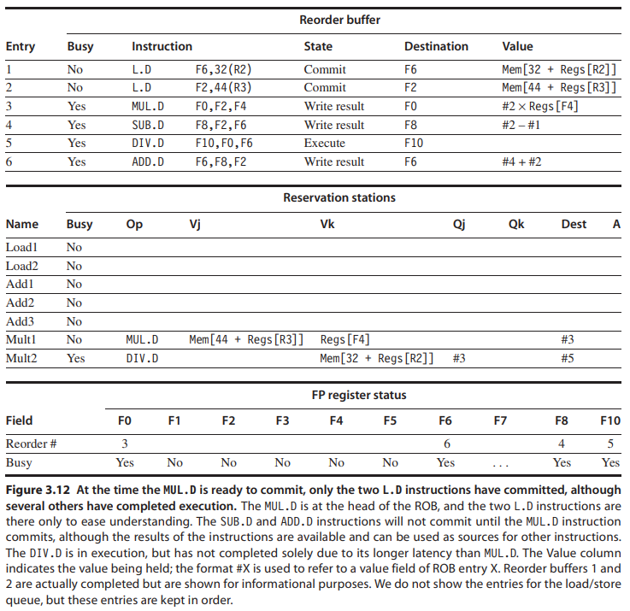

Solution - contd

Slide 22
Tomasulo w/ ROB Organization
Re-Order buffer is based on Tomasulo
Just renamed FP register to ARF (Architected Register File)
Add Re-Order Buffer for out-of-order results
  Buffer is managed with two pointers (head & tail)
RAT (Register Alias Table) keeps the register renaming info.
ARF Reorder Buffer
FP registers
RAT
Head Tail
FP Op Queue
Add1
Add2 Add3
Mult1
Mult2
FP adders
FP multipliers
Common Data Bus (CDB)

Slide 23

Four Stages of Tomasulo w/ ROB
Stage1: Issue
Read an instruction from the buffer
Check if resources available (RS entry & ROB entry)
Read RAT
Sources: read (available) sources Destination: update RAT
Stall if any target resource is unavailable
Where the tail pointer indicates
Write to RS and ROB (the tail of ROB) & update the tail of ROB
ARF RAT
FP Op Queue
val1
R1
Reorder Buffer
div ROB1 val3
val4
val2
ROB1
div
R2
val3
val4
div
R3 R
4
div
R2
R3
R4
R2
R2
mul | R1 | R2 | R6
add | R3 | R7 | R8
mul | R1 | R1 | R3
sub | R4 | R1 | R5
add | R1 | R4 | R2
val3
R3
val4
R4
val5
R5
val6
R6
val7
R7
val8
R8
Add1
Add2 Add3
Mult1
Mult2
FP adders
FP multipliers
Common Data Bus (CDB)

Slide 24





Four Stages of Tomasulo w/ ROB
Stage2: Exec
➔ Different behaviors based on the target instruction status
For “a not-ready instruction” → Wait for all operands to arrive
For “a new instruction” → Compete to use the functional unit
For “an all-ready instruction” → Execute!
Stall!
^{FP Op Queu}(S^{e} tructural
ARF
RAT
val1
R1
Reorder Buffer
hazard)
val2
R2
ROB1
val3
R3
ROB2
val4
R4
ROB3
mul | R1 | R1 | R3
sub | R4 | R1 | R5
add | R1 | R4 | R2
val5
R5
val6
R6
val7
R7
val8
R8
1
2
39
Add1
add ROB3 val7 val8
40
Add2
Mult1
div ROB1 val3
val4
Add3
Mult2
mul ROB2 ROB1 val6
FP adders
FP multipliers
Common Data Bus (CDB)

Slide 25

Four Stages of Tomasulo w/ ROB
Stage3: Write Result
Broadcast result on CDB
  (any dependents will grab the value)
Write result back to your ROB entry
  The ARF holds the “official” register state, which we will only update in the program order
  Mark ready/finished bit in ROB (note that this instruction has completed execution)
Reservation station can be freed
ARF
RAT
FP Op Queue
val1
R1
Reorder Buffer
val2
R2
v3+v4
ROB1
val3
R3
ROB2
val4
R4
ROB3
mul | R1 | R1 | R3
sub | R4 | R1 | R5
add | R1 | R4 | R2
val5
R5
val6
R6
val7
R7
val8
R8
0
Add1 Add2 Add3
1
Mult1 Mult2
ROB1=val3+val4
mul ROB2 v3+v4 val6
FP adders
FP multipliers
Common Data Bus (CDB)

Slide 26
Four Stages of Tomasulo w/ ROB
Stage4: Commit
When the oldest instruction is completed in the ROB
  i.e., ROB’s head points to it
Write the result (if ready/finished bit is set)
Advance ROB’s head to the next instruction
This is what the outside world sees
  And it’s all in-order
ARF RAT
FP Op Queue
val1
R1
Reorder Buffer
val2
R2
vR3O+Bv14
val3
R3
ROB2
val4
R4
ROB3
mul | R1 | R1 | R3
sub | R4 | R1 | R5
add | R1 | R4 | R2
val5
R5
val6
R6
val7
R7
val8
R8
Add1 Add2 Add3
Mult1 Mult2
mul ROB2 v3+v4 val6
FP adders
FP multipliers
Common Data Bus (CDB)

Slide 27
Exploiting ILP Using Superscalar, Multiple Issue and Static Scheduling

Slide 28
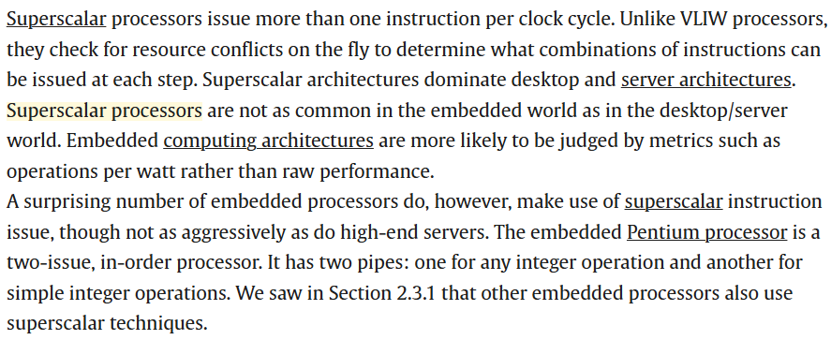
Superscalar Architecture

Slide 29
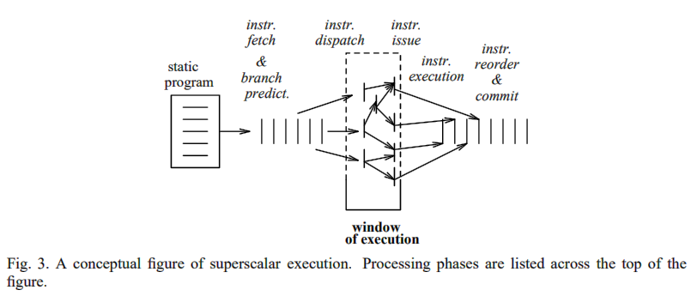
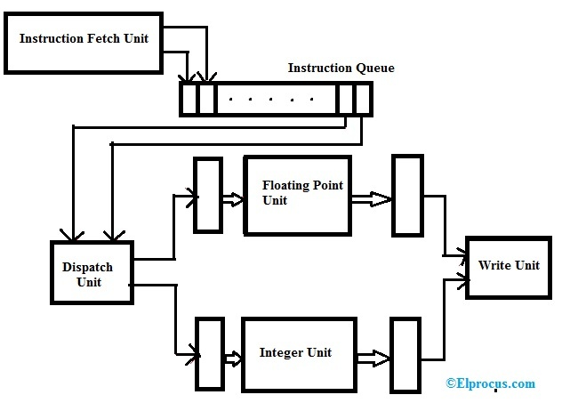
Superscalar Example

Slide 30
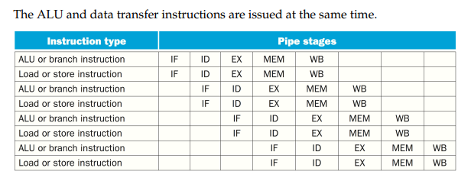
Multiple Instructions Issued

Slide 31
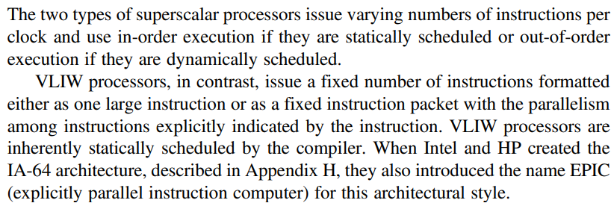
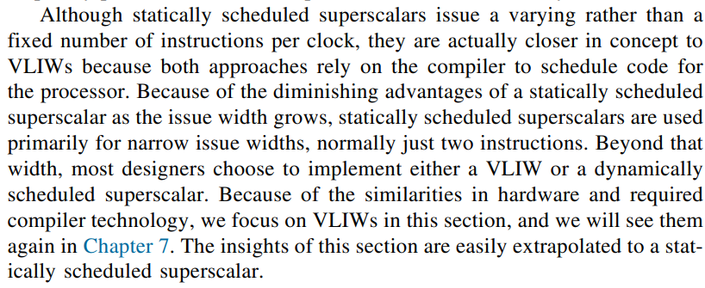


Superscalar Processor Types

Slide 32
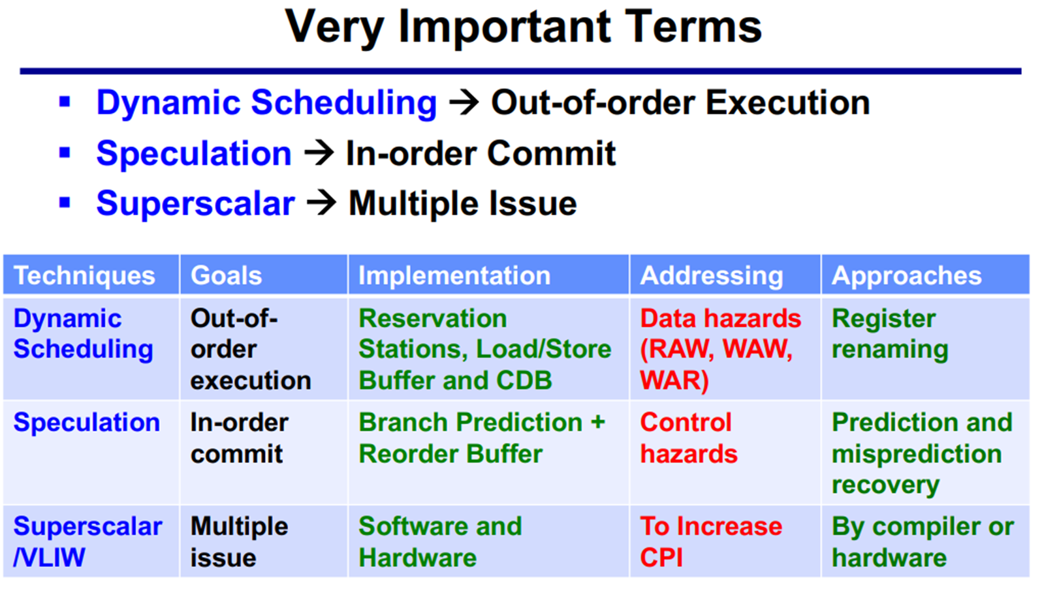
ILP Differences

Slide 33
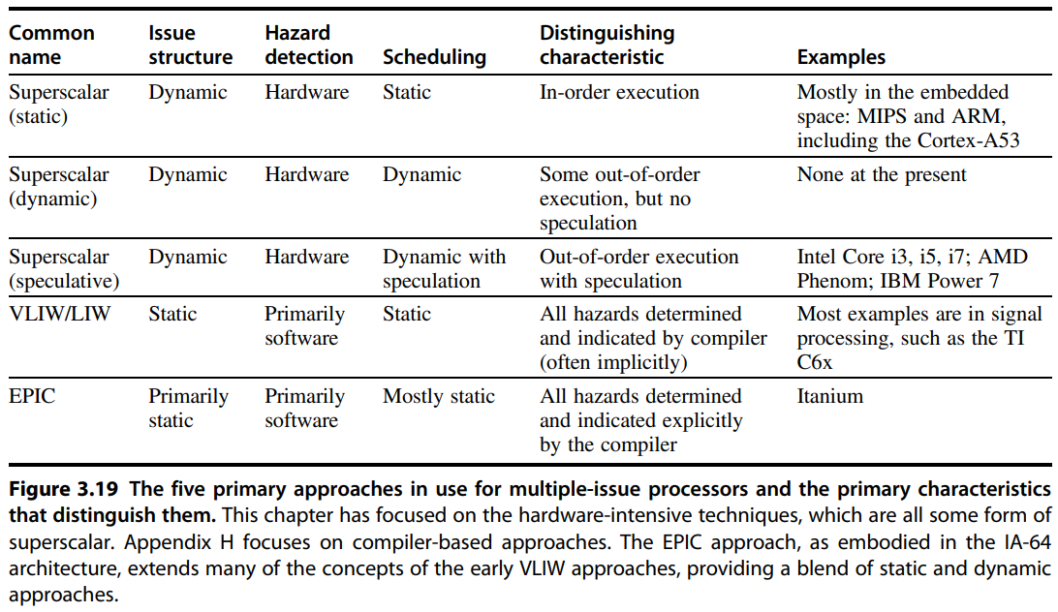










5 Primary Approaches for Multi-issue Processor

Slide 34
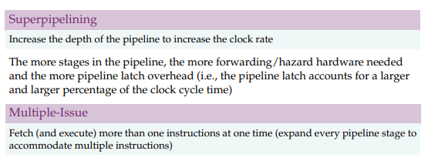
Superpipelining vs Multiple Issue

Slide 35
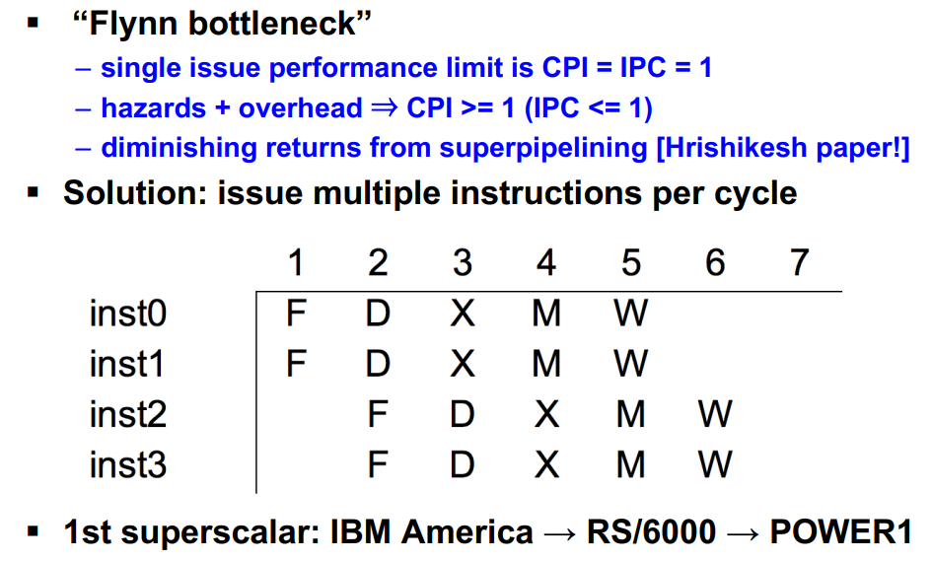
Multiple Issue

Slide 36
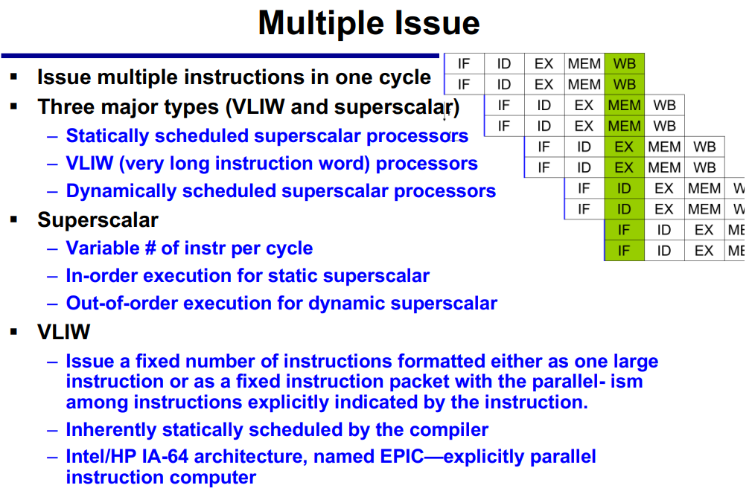
Multiple Issue, Superscalar and VLIW

Slide 37
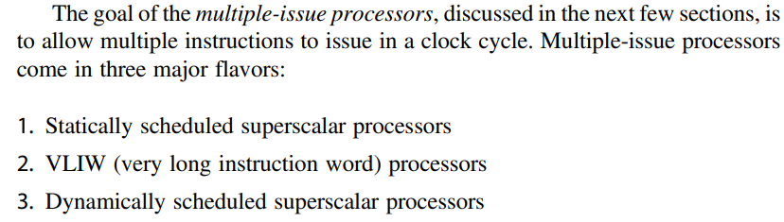
Goal of Multiple-Issue Processors

Slide 38
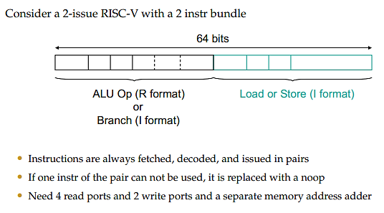
2 Issue RISC

Slide 39
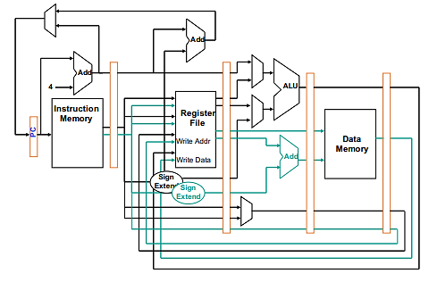
2 Issue Datapath

Slide 40
VLIW

Slide 41
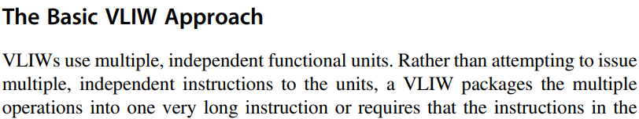
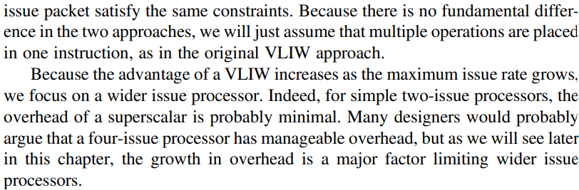
Basic VLIW Approach

Slide 42
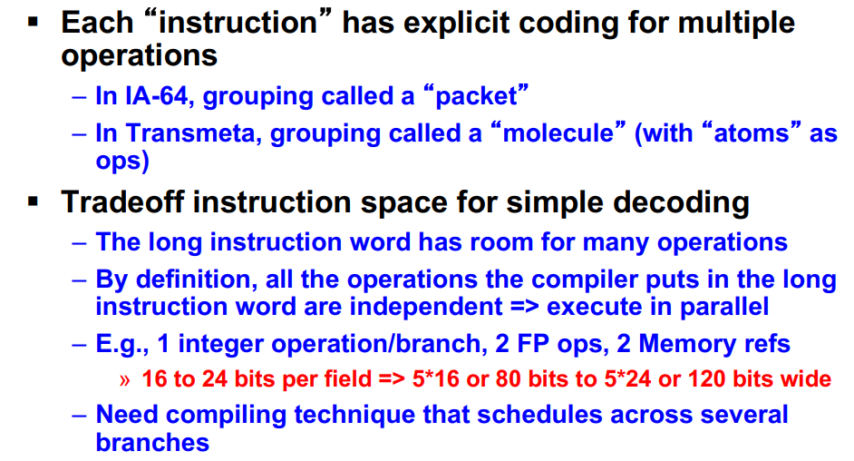
Very Long Instruction Word

Slide 43
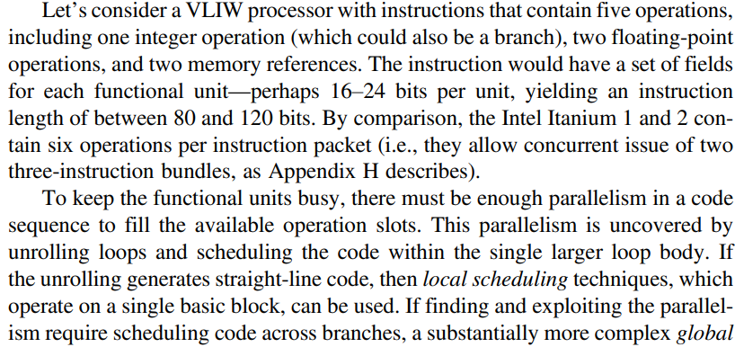
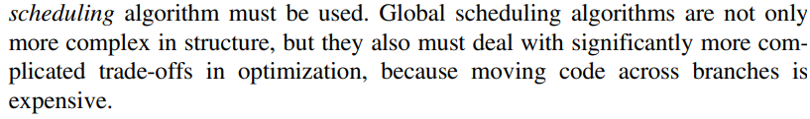
Parallelism needed for VLIW

Slide 44
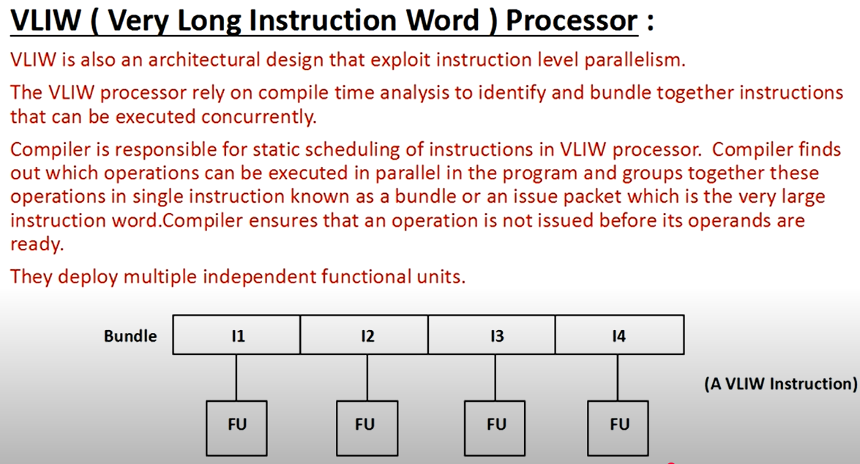
VLIW Processor

Slide 45
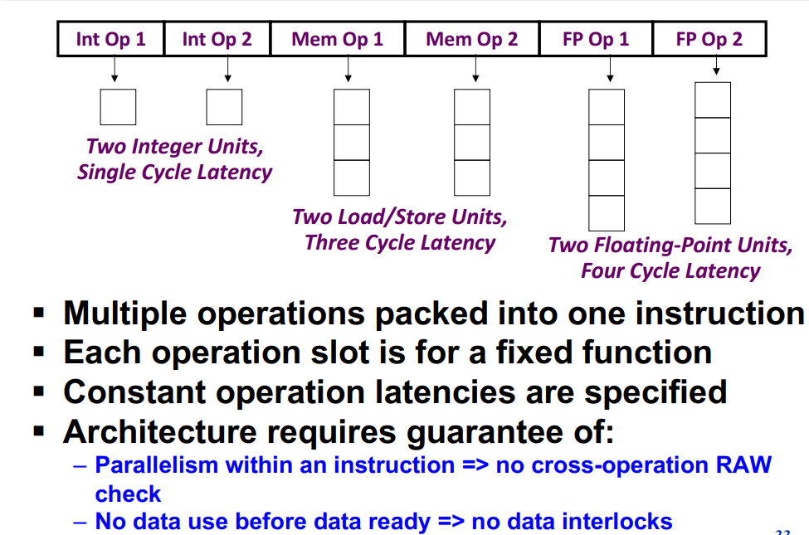
Form VLIW Instruction Word

Slide 46
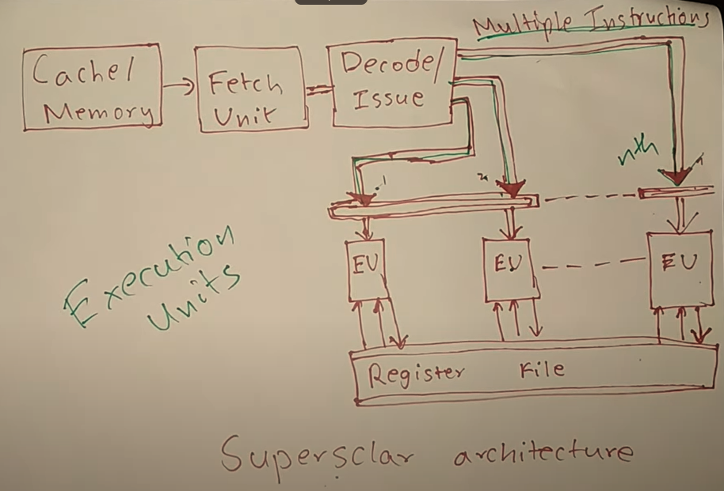
Superscalar Architecture

Slide 47
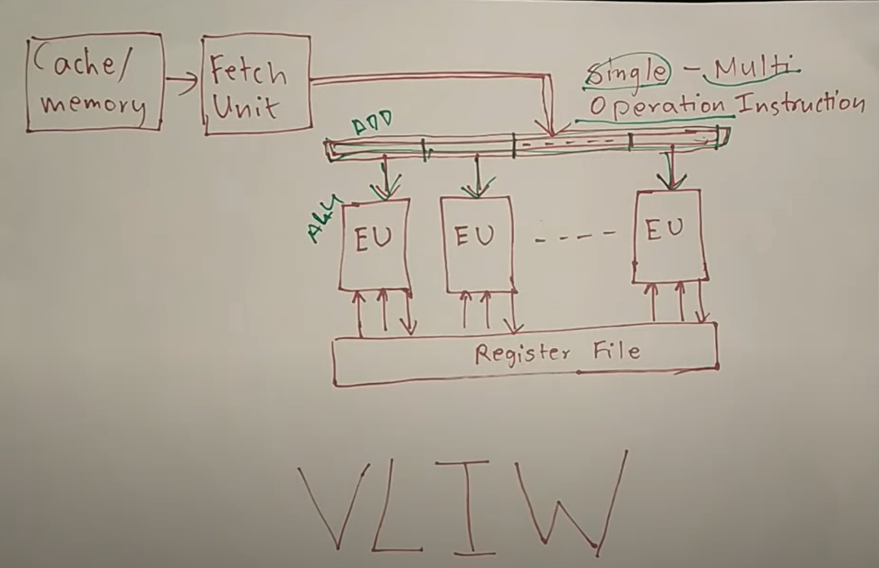
VLIW Architecture

Slide 48
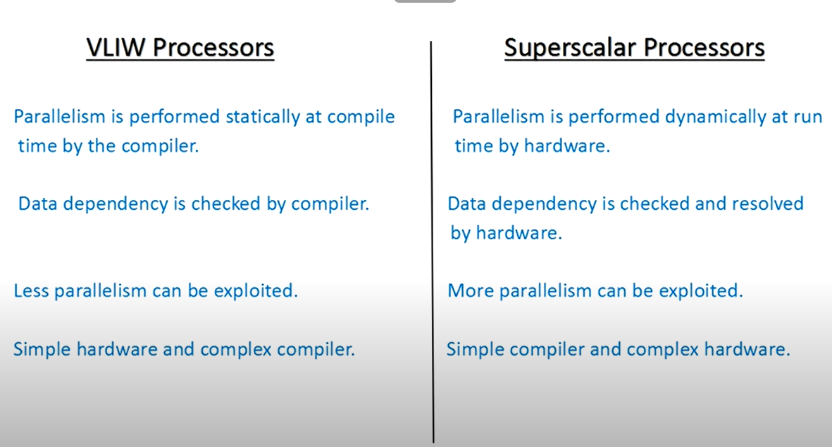
Compare VLIW and Superscalar

Slide 49
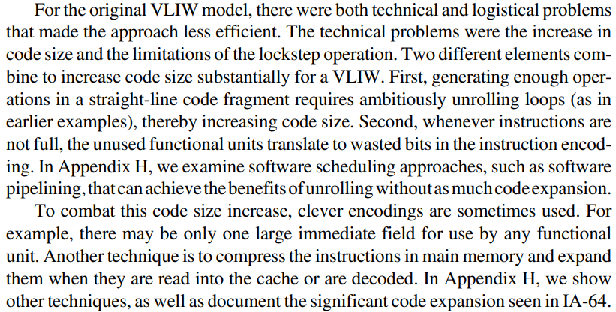


Problems in VLIW Approach

Slide 50
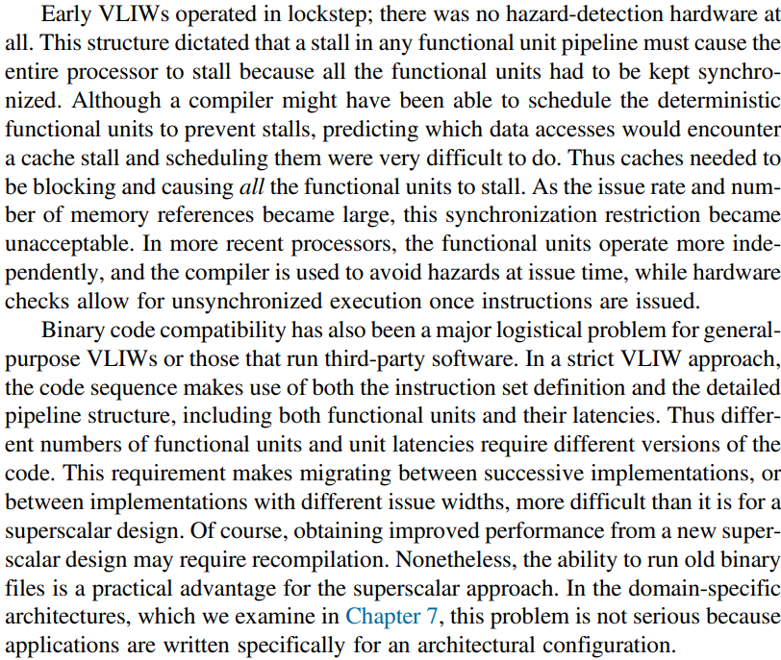

Hazard Detection in VLIW, Code Compatibility

Slide 51
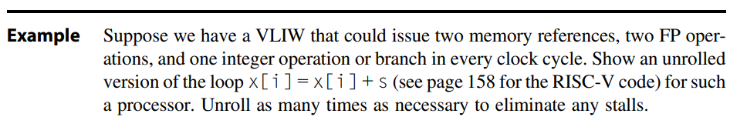
Example page 220 (come back later after examples)

Slide 52
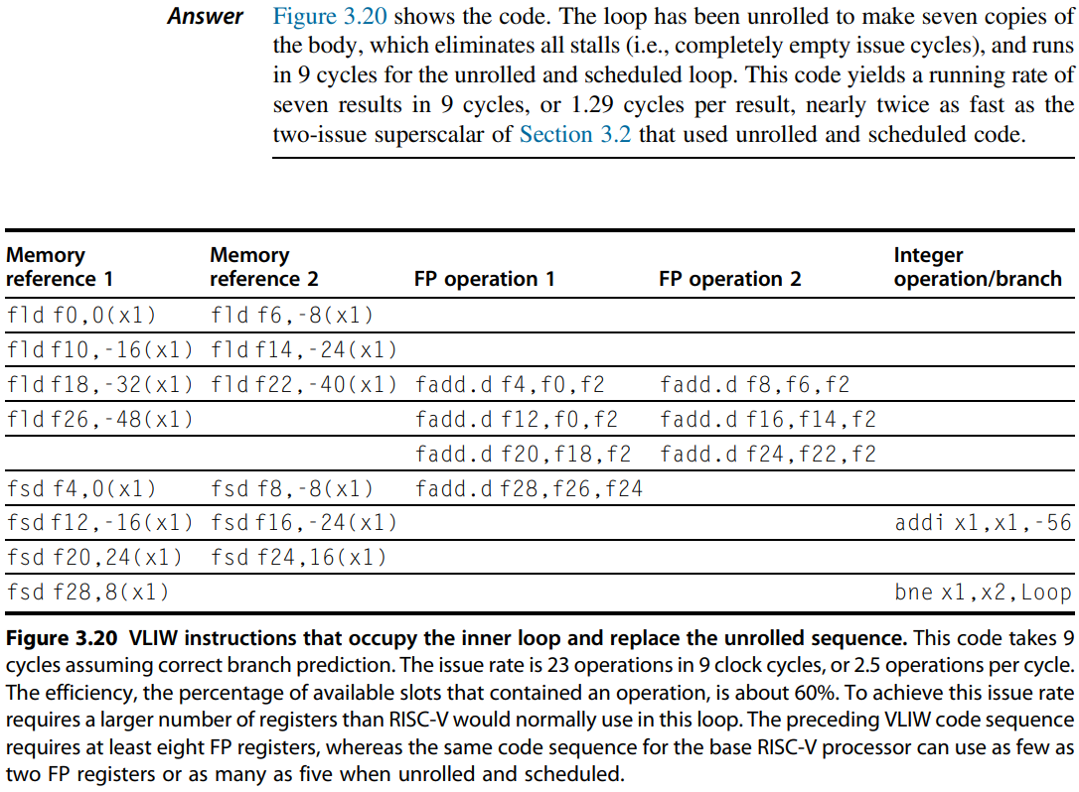
Solution (come back later)

Slide 53
Branch Target Buffer (Cache)

Slide 54
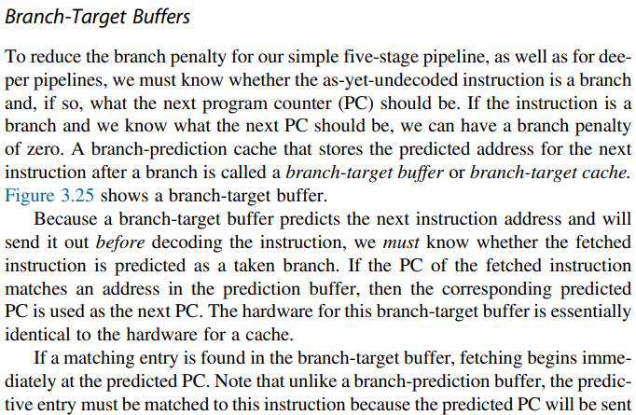
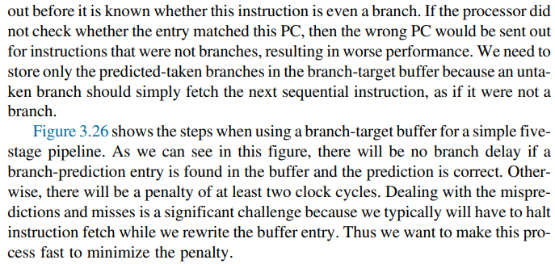




Branch Target Buffers

Slide 55
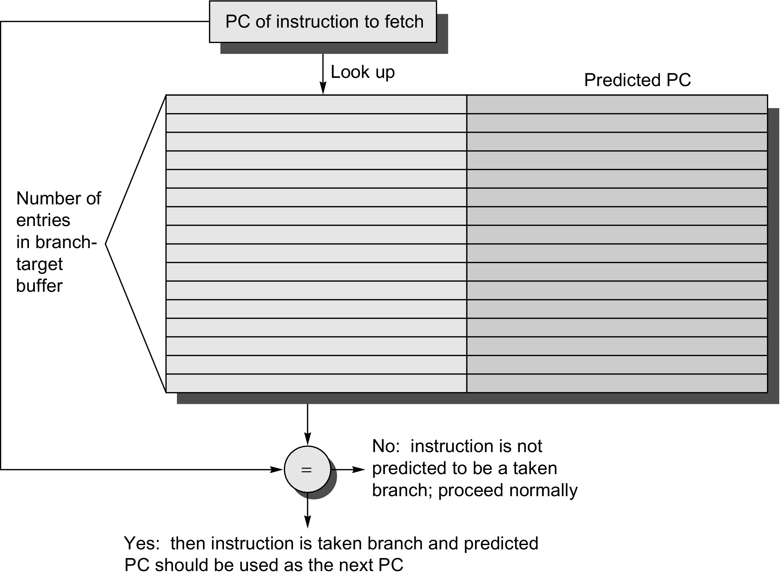
Branch Target Buffer Architecture
Figure 3.25 A branch-target buffer. The PC of the instruction being fetched is matched against a set of instruction addresses stored in the first column; these represent the addresses of known branches. If the PC matches one of these entries, then the instruction being fetched is a taken branch, and the second field, predicted PC, contains the prediction for the next PC after the branch. Fetching begins immediately at that address. The third field, which is optional, may be used for extra prediction state bits.

Slide 56
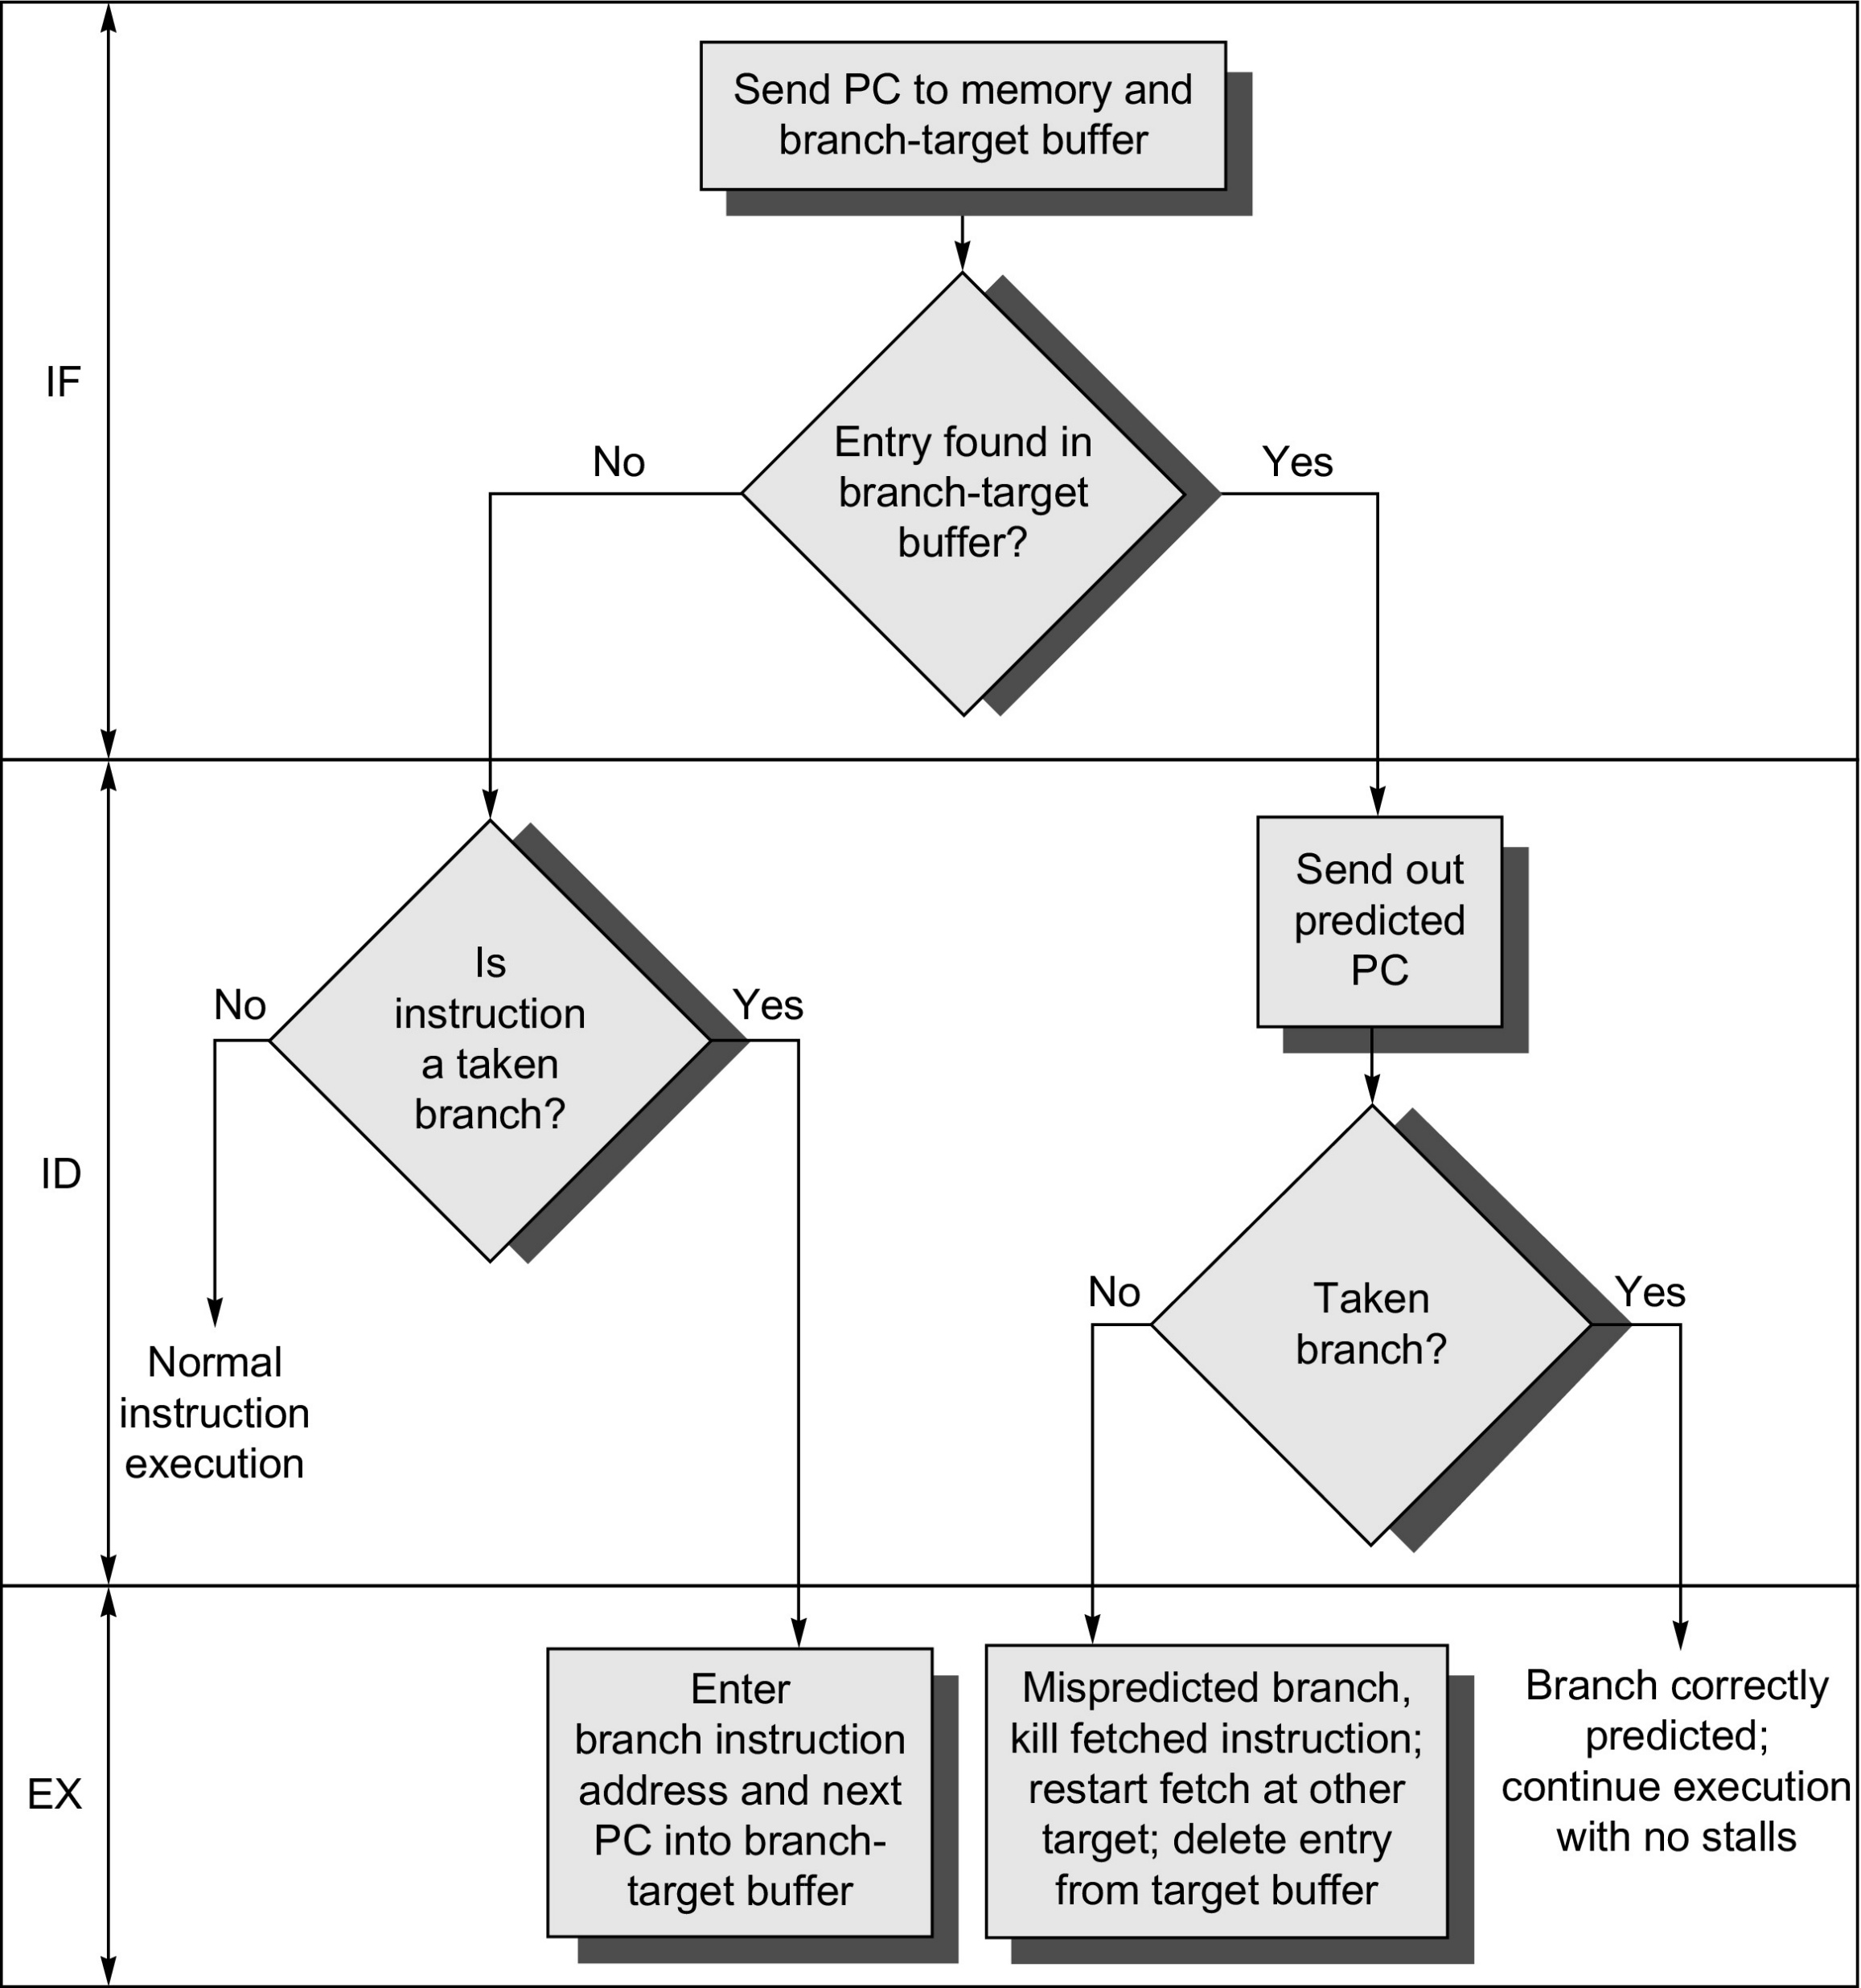
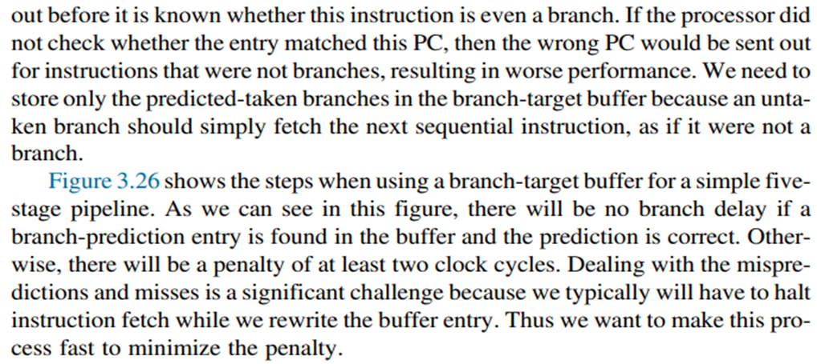
3 Steps in BTB
Figure 3.26 The steps involved in handling an instruction with a branch-target buffer.

Slide 57
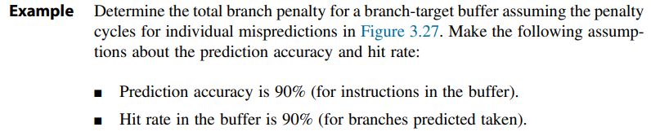
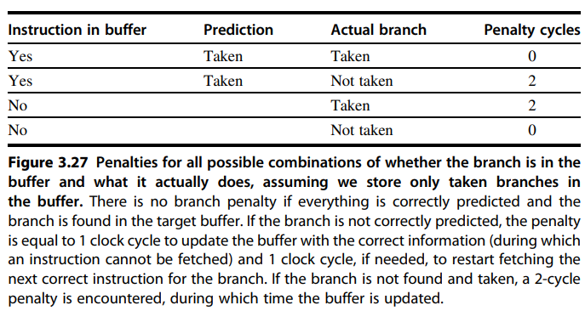
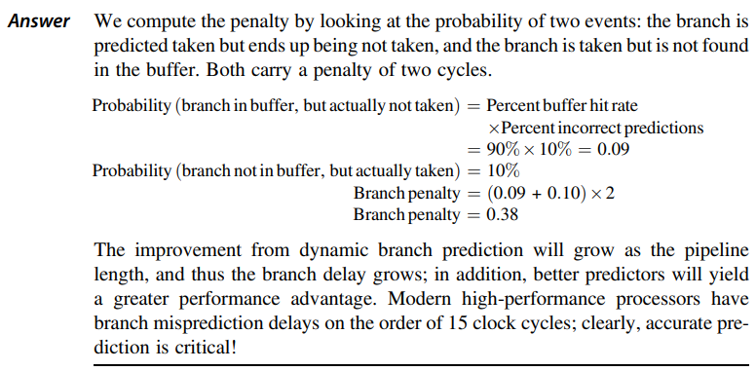
Example page 230 (come back later)

