Slide 1
Example: Status after n clocks
Tomasulo with Reorder Buffer

Slide 2
Tomasulo with Reorder
Example 1
Tomasulo with Reorder Buffer: Cycles 1 to 3 | Video 10c
https://www.youtube.com/watch?v=umeqKe0o6nA&list=WL&index=10&t=34s
https://www.youtube.com/watch?v=ihW5uuEVabE&list=PLNrZ57svi8FpW1ibXjM6gZnTN7UFGiMT3&index=20

Slide 3
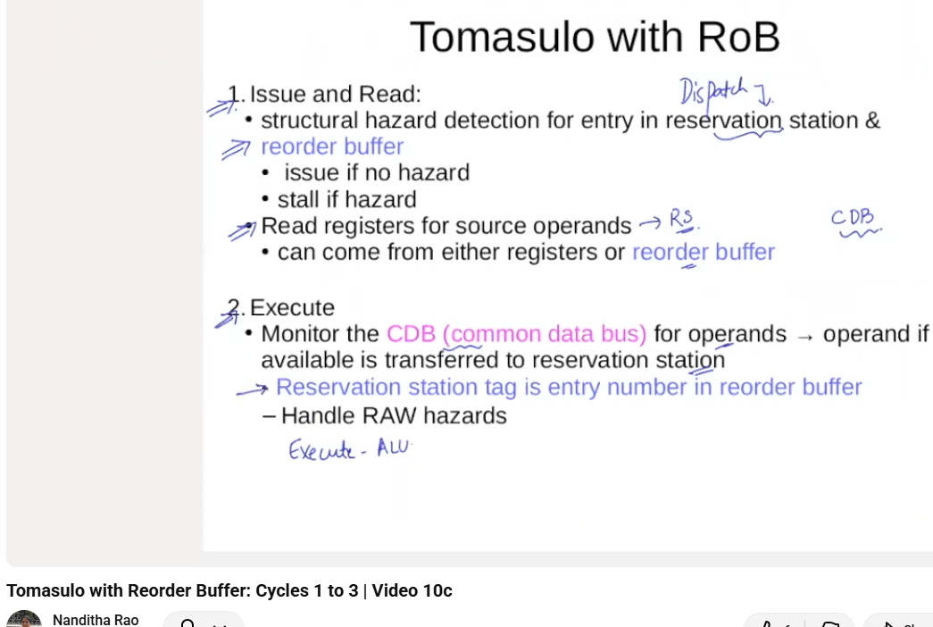

Slide 4
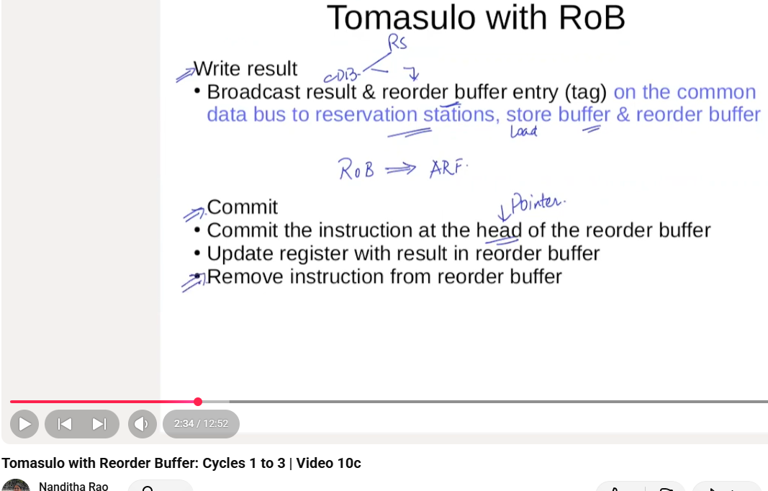

Slide 5
Load=2 Units Delay
Add=2 Units Delay
Mul=10 Units Delay
Div=20 Units Delay

Slide 6
Instr | ISU | EX ST | EX CMP | WR | COM
Load=2 Units Delay
Add=2 Units Delay
Mul=10 Units Delay
Div=40 Units Delay
Load Buffers /
RS
 | BUSY | ADDR
LOAD 1
LOAD 2
LOAD 3
Architecture Features
ROB
 | INST | DEST | VAL
ROB1
ROB2
ROB3
ROB4
ARF
F0
F1
F2
F3
F4
F5
F6
F7
F8
F9
F10
R2
R3
RAT
F0
F1
F2
F3
F4
F5
F6
F7
F8
F9
F10
RS
TYPE | BUSY | OP | S1 | S2 | W1 | W2

Slide 7
 | ISU | EXST | EXCM | WR | COM
LD F6, 32(R2)
LD F2, 45(R3)
MUL F0, F2, F4
SUB F8, F6, F2
DIV F10, F0, F6
ADD F6, F8, F2
Load Buffers / RS
Load=2 Units Delay
Add=2 Units Delay
Mul=10 Units Delay
Div=40 Units Delay
 | BUSY | ADDR
LOAD 1
LOAD 2
LOAD 3
In-order Issue
Single Issue
ROB
 | INST | DEST | VAL
ROB1
ROB2
ROB3
ROB4
ARF
F0
F1
F2
F3
F4
F5
F6
F7
F8
F9
F10
R2
R3
RAT
F0
F1
F2
F3
F4
F5
F6
F7
F8
F9
F10
RS
TYPE | BUSY | OP | S1 | S2 | W1 | W2

Slide 8
 | ISU | EXST | EXCM | WR | COM
LD F6, 32(R2)
LD F2, 45(R3)
MUL F0, F2, F4
SUB F8, F6, F2
DIV F10, F0, F6
ADD F6, F8, F2
Load Buffers / RS
Load=2 Units Delay
Add=2 Units Delay
Mul=10 Units Delay
Div=40 Units Delay
 | BUSY | ADDR
LOAD 1
LOAD 2
LOAD 3
Showing
Cycles
In-order Issue
Single Issue
ROB
 | INST | DEST | VAL
ROB1
ROB2
ROB3
ROB4
ROB5
ROB6
ARF
F0
F1
F2
F3
F4
F5
F6
F7
F8
F9
F10
R2
R3
RAT
F0
F1
F2
F3
F4
F5
F6
F7
F8
F9
F10
Architecture
Register
File
Register
Allocation
Table
RS
TYPE | BUSY | OP | S1 | S2 | W1 | W2
Add1
Add2
Add3
Mul1
Mul2
Add or
Sub
Mul or
Div

Slide 9
Dispatch | ISU | EXST | EXCM | WR | COM
LD F6, 32(R2) | 1
LD F2, 45(R3)
MUL F0, F2, F4
SUB F8, F6, F2
DIV F10, F0, F6
ADD F6, F8, F2
Load Buffers / RS
Load=2 Units Delay
Add=2 Units Delay
Mul=10 Units Delay
Div=40 Units Delay
 | BUSY | ADDR
LOAD 1 | LD | 32+R2
LOAD 2
LOAD 3
Showing
Cycles
In-order Issue
Single Issue
ROB
 | INST | DEST | VAL
ROB1
ROB2
ROB3
ROB4
ROB5
ROB6
Cycle 1
Issue LD
ARF
F0
F1
F2
F3
F4
F5
F6
F7
F8
F9
F10
R2 | Read
R3
RAT
F0
F1
F2
F3
F4
F5
F6 | ROB1
F7
F8
F9
F10
Architecture
Register
File
Register
Allocation
Table
RS
TYPE | BUSY | OP | S1 | S2 | W1 | W2
Add1
Add2
Add3
Mul1
Mul2
Add or
Sub
Mul or
Div

Slide 10
Dispatch | ISU | EXST | EXCM | WR | COM
LD F6, 32(R2) | 1 | 2
LD F2, 45(R3) | 1
MUL F0, F2, F4
SUB F8, F6, F2
DIV F10, F0, F6
ADD F6, F8, F2
Load Buffers / RS
Load=2 Units Delay
Add=2 Units Delay
Mul=10 Units Delay
Div=40 Units Delay
 | BUSY | ADDR
LOAD 1 | LD | 32+R2
LOAD 2 | LD | 45+R3
LOAD 3
Showing
Cycles
In-order Issue
Single Issue
ROB
 | INST | DEST | VAL
ROB1 | LD | F6
ROB2 | LD | F2
ROB3
ROB4
ROB5
ROB6
Cycle 2
Start LD,
Issue LD
ARF
F0
F1
F2
F3
F4
F5
F6
F7
F8
F9
F10
R2 | Read
R3 | Read
RAT
F0
F1
F2 | ROB2
F3
F4
F5
F6 | ROB1
F7
F8
F9
F10
Architecture
Register
File
Register
Allocation
Table
RS
TYPE | BUSY | OP | S1 | S2 | W1 | W2
Add1
Add2
Add3
Mul1
Mul2
Add or
Sub
Mul or
Div

Slide 11
Dispatch | ISU | EXST | EXCM | WR | COM
LD F6, 32(R2) | 1 | 2 | 3
LD F2, 45(R3) | 2 | 3
MUL F0, F2, F4 | 3
SUB F8, F6, F2
DIV F10, F0, F6
ADD F6, F8, F2
Load Buffers / RS
Load=2 Units Delay
Add=2 Units Delay
Mul=10 Units Delay
Div=40 Units Delay
 | BUSY | ADDR
LOAD 1 | LD | 32+R2
LOAD 2 | LD | 45+R3
LOAD 3
Showing
Cycles
In-order Issue
Single Issue
ROB
 | INST | DEST | VAL
ROB1 | LD | F6
ROB2 | LD | F2
ROB3 | MUL | F0
ROB4
ROB5
ROB6
Cycle 3
LD1 Complete
LD2 Operands Available
Start EX
Free up RS
ARF
F0
F1
F2
F3
F4 | Avalbl
F5
F6
F7
F8
F9
F10
R2 | Read
R3 | Read
RAT
F0 | ROB3
F1
F2 | ROB2
F3
F4
F5
F6 | ROB1
F7
F8
F9
F10
Architecture
Register
File
Register
Allocation
Table
Connection
ARF to RAT
TYPE | BUSY | OP | S1 | S2 | W1 | W2
Add1
Add2
Add3
Mul1 | YES | MUL |  | F4 | ROB2
Mul2
RS
Add or
Sub
Mul or
Div

Slide 12
Dispatch | ISU | EXST | EXCM | WR | COM
LD F6, 32(R2) | 1 | 2 | 3 | 4
LD F2, 45(R3) | 2 | 3 | 4
MUL F0, F2, F4 | 3
SUB F8, F6, F2 | 4
DIV F10, F0, F6
ADD F6, F8, F2
Load Buffers / RS
Load=2 Units Delay
Add=2 Units Delay
Mul=10 Units Delay
Div=40 Units Delay
 | BUSY | ADDR
LOAD 1 | LD | 32+R2
LOAD 2 | LD | 45+R3
LOAD 3
Showing
Cycles
In-order Issue
Single Issue
ROB
 | INST | DEST | VAL
ROB1 | LD | F6 | M(A1)
ROB2 | LD | F2
ROB3 | MUL | F0
ROB4 | SUB | F8
ROB5
ROB6
Cycle 4
LD1 writes ROB
Update RAT F6
ARF
F0
F1
F2
F3
F4 | Avalbl
F5
F6
F7
F8
F9
F10
R2 | Read
R3 | Read
RAT
F0 | ROB3
F1
F2 | ROB2
F3
F4
F5
F6 | M(A1)
F7
F8 | ROB4
F9
F10
Architecture
Register
File
Register
Allocation
Table
Connection
ARF to RAT
TYPE | BUSY | OP | S1 | S2 | W1 | W2
Add1 | YES | SUB | M(A1) |  |  | ROB2
Add2
Add3
Mul1 | YES | MUL |  | F4 | ROB2
Mul2
RS
Add or
Sub
Mul or
Div

Slide 13
Dispatch | ISU | EXST | EXCM | WR | COM
LD F6, 32(R2) | 1 | 2 | 3 | 4 | 5
LD F2, 45(R3) | 2 | 3 | 4 | 5
MUL F0, F2, F4 | 3
SUB F8, F6, F2 | 4
DIV F10, F0, F6 | 5
ADD F6, F8, F2
Load Buffers / RS
Load=2 Units Delay
Add=2 Units Delay
Mul=10 Units Delay
Div=40 Units Delay
ROB to ARF
 | BUSY | ADDR
LOAD 1 | LD | 32+R2
LOAD 2 | LD | 45+R3
LOAD 3
Showing
Cycles
In-order Issue
Single Issue
ROB
 | INST | DEST | VAL
ROB1 | LD | F6 | M(A1)
ROB2 | LD | F2 | M(A2)
ROB3 | MUL | F0
ROB4 | SUB | F8
ROB5 | DIV | F10
ROB6
Cycle 5
Commit LD1 F6 to ARF
Free up ROB1
Update RAT Entry F6, F2
ARF
F0
F1
F2
F3
F4 | Avalbl
F5
F6 | M(A1)
F7
F8
F9
F10
R2 | Read
R3 | Read
RAT
F0 | ROB3
F1
F2 | M(A2)
F3
F4
F5
F6 | M(A1)
F7
F8 | ROB4
F9
F10 | ROB5
Architecture
Register
File
Register
Allocation
Table
Connection
ARF to RAT
TYPE | BUSY | OP | S1 | S2 | W1 | W2
Add1 | YES | SUB | M(A1) | M(A2)
Add2
Add3
Mul1 | YES | MUL | M(A2) | F4 | M(A2)
Mul2 | YES | DIV | M(A1) |  | ROB3
RS
Add or
Sub
Mul or
Div

Slide 14
Dispatch | ISU | EXST | EXCM | WR | COM
LD F6, 32(R2) | 1 | 2 | 3 | 4 | 5
LD F2, 45(R3) | 2 | 3 | 4 | 5 | 6
MUL F0, F2, F4 | 3 | 6
SUB F8, F6, F2 | 4 | 6
DIV F10, F0, F6 | 5
ADD F6, F8, F2 | 6
Load Buffers / RS
Load=2 Units Delay
Add=2 Units Delay
Mul=10 Units Delay
Div=40 Units Delay
ROB to ARF
 | BUSY | ADDR
LOAD 1 | LD | 32+R2
LOAD 2 | LD | 45+R3
LOAD 3
Showing
Cycles
In-order Issue
Single Issue
ROB
 | INST | DEST | VAL
ROB1 | LD | F6 | M(A1)
ROB2 | LD | F2 | M(A2)
ROB3 | MUL | F0
ROB4 | SUB | F8
ROB5 | DIV | F10
ROB6 | ADD | F6
Cycle 6
Commit LD2 F2 to ARF
Free up ROB2
Update RAT Entry F2
ARF
F0
F1
F2 | M(A2)
F3
F4 | Avalbl
F5
F6 | M(A1)
F7
F8
F9
F10
R2 | Read
R3 | Read
RAT
F0 | ROB3
F1
F2 | M(A2)
F3
F4
F5
F6 | ROB6
F7
F8 | ROB4
F9
F10 | ROB5
Architecture
Register
File
Register
Allocation
Table
Connection
ARF to RAT
TYPE | BUSY | OP | S1 | S2 | W1 | W2
Add1 | YES | SUB | M(A1) | M(A2)
Add2 | YES | MUL |  | M(A2) | ROB4
Add3
Mul1 | YES | MUL | M(A2) | F4 | M(A2)
Mul2 | YES | DIV | M(A1) |  | ROB3
RS
Add or
Sub
Mul or
Div

Slide 15
Dispatch | ISU | EXST | EXCM | WR | COM
LD F6, 32(R2) | 1 | 2 | 3 | 4 | 5
LD F2, 45(R3) | 2 | 3 | 4 | 5 | 6
MUL F0, F2, F4 | 3 | 6 | 15 | 16 | ?
SUB F8, F6, F2 | 4 | 6 | 7 | 8
DIV F10, F0, F6 | 5 | 17 | 56 | 57
ADD F6, F8, F2 | 6 | 9 | 10 | 11
Load Buffers / RS
Load=2 Units Delay
Add=2 Units Delay
Mul=10 Units Delay
Div=40 Units Delay
ROB to ARF
 | BUSY | ADDR
LOAD1
LOAD2
LOAD3
Showing
Cycles
In-order Issue
Single Issue
ROB
 | INST | DEST | VAL
ROB1
ROB2
ROB3 | MUL | F0
ROB4 | SUB | F8
ROB5 | DIV | F10
ROB6 | ADD | F6
Cycle ---
Commit LD2 F2 to ARF
Free up ROB2
Update RAT Entry F2
ARF
F0
F1
F2 | M(A2)
F3
F4 | Avalbl
F5
F6 | M(A1)
F7
F8
F9
F10
R2 | Read
R3 | Read
RAT
F0 | ROB3
F1
F2
F3
F4
F5
F6
F7
F8 | ROB4
F9
F10 | ROB5
Architecture
Register
File
Register
Allocation
Table
Connection
ARF to RAT
TYPE | BUSY | OP | S1 | S2 | W1 | W2
Add1
Add2 | YES | MUL |  | M(A2) | ROB4
Add3
Mul1 | YES | MUL | M(A2) | F4 | M(A2)
Mul2
RS
Add or
Sub
Mul or
Div

