Slide 1
Computer Architecture
CS 622 / EE 520
Spring 2026
Lecture 15
Shahid Masud

Slide 2
Topics
Advanced Topics in ILP, Multi-issue, and Speculation
Some Cross Cutting Issues
Architecture Study
  ARM Cortex A53
  Intel Core i7 6700
Midterm
Next week
Assignment
Due 9 Nov

Slide 3
Further Readings
Reading Notes
Readings:
Chapter 3 of course textbook

Slide 4
Exploiting ILP Using Dynamic Scheduling, Multiple Issue, and Speculation

Slide 5
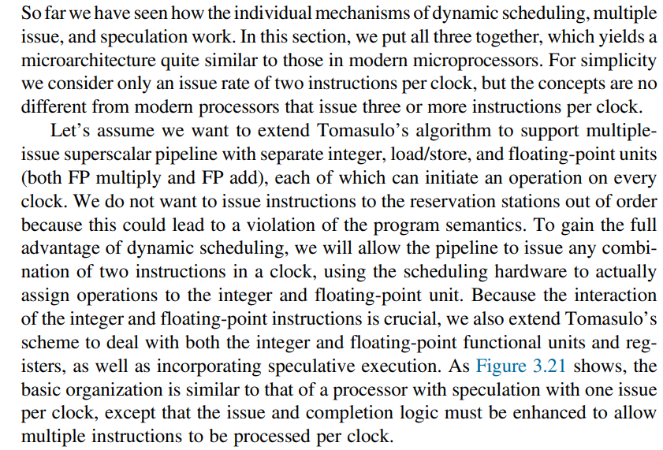
ILP Using Dynamic Schedule, Multiple Issue and Speculation – Put all together

Slide 6
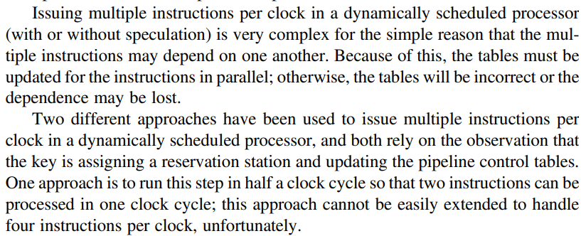
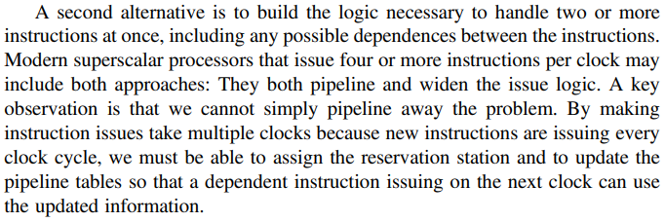




Dealing with Multiple Instruction Issue per clock

Slide 7
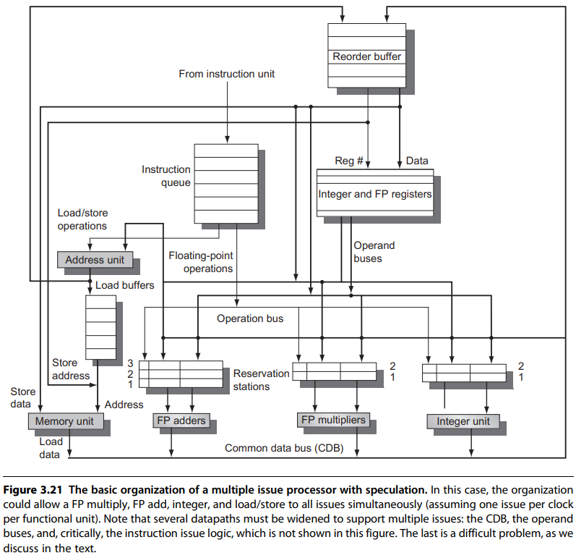




Multiple Issue Processor with Speculation

Slide 8

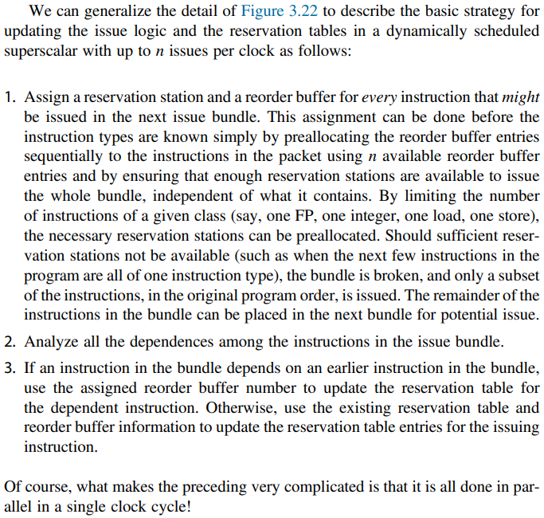

Strategy for Dynamically Scheduled Superscalar
ISSUE Step is a major bottleneck
In a modern superscalar, every possible
combination of dependent instructions
that is allowed to issue in the same clock
cycle must be considered.
Because the number of possibilities climbs as the square of the number of instructions that can be issued in a clock, the issue step is a likely bottleneck for attempts to go beyond four instructions per clock.

Slide 9
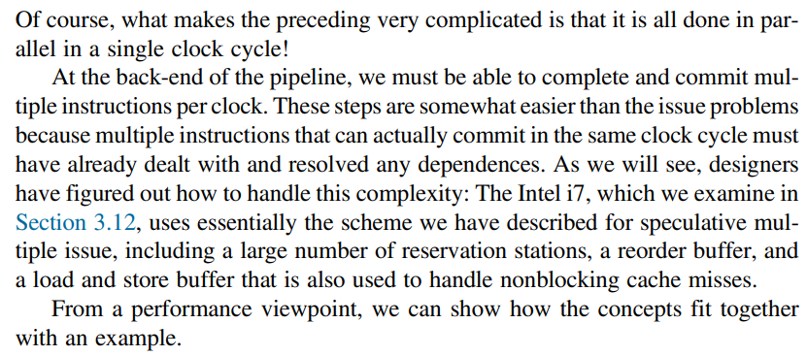
Commit Strategy - continued

Slide 10
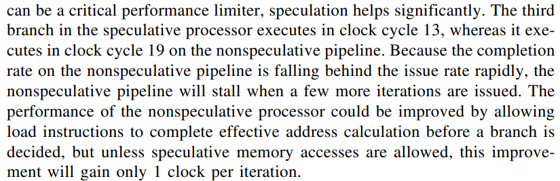
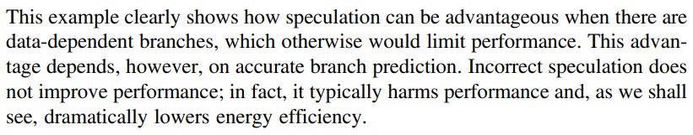
Observations from the Example (following slides)
Discussed separately in solved examples

Slide 11
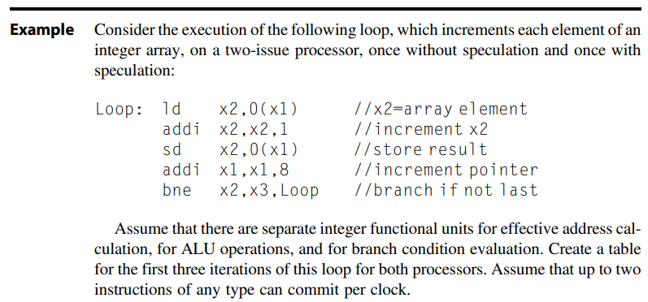
Example page 226

Slide 12
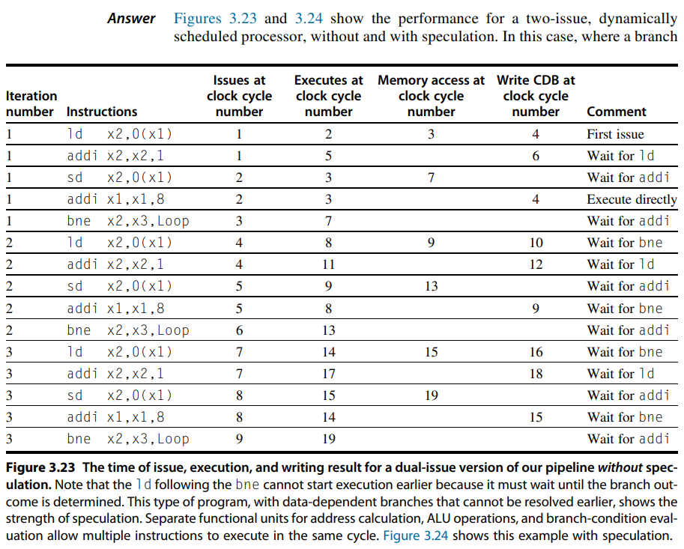
Solution: 2 Issue Processor Without Speculation
Dynamically
Scheduled

Slide 13
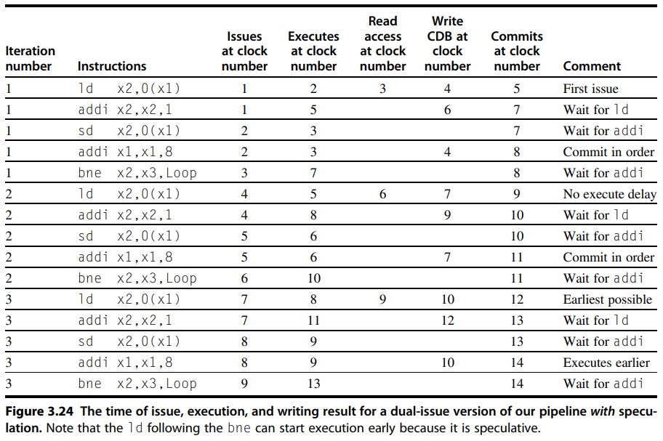
Solution: 2 Issue Proc with Speculation
Dynamically
Scheduled

Slide 14
Advanced Techniques for Instruction Fetch, Issue, and Speculation

Slide 15
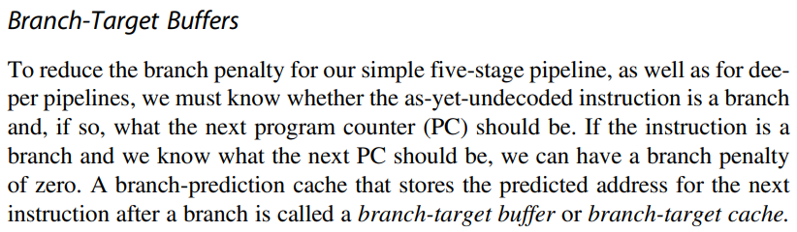
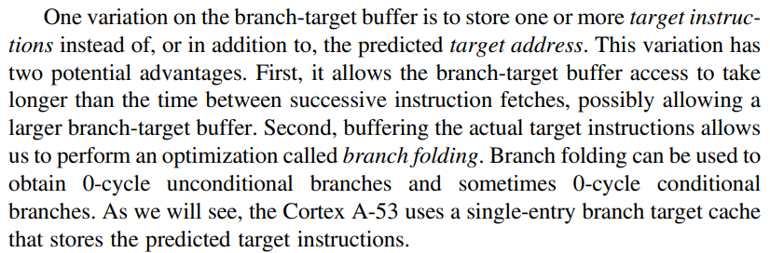






Dealing With Branches
Branch
Folding

Slide 16
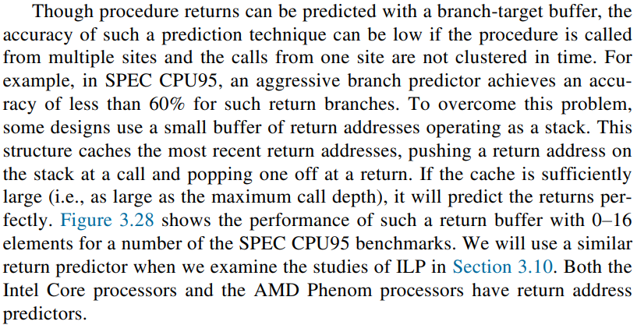
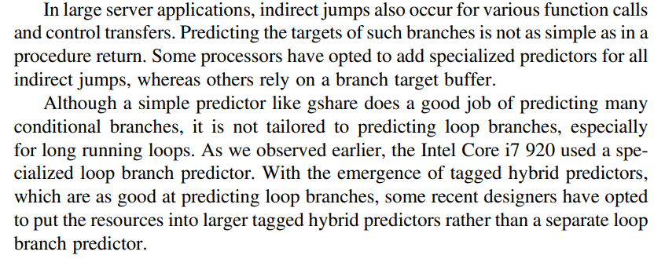
Procedure Return Address Buffer

Slide 17
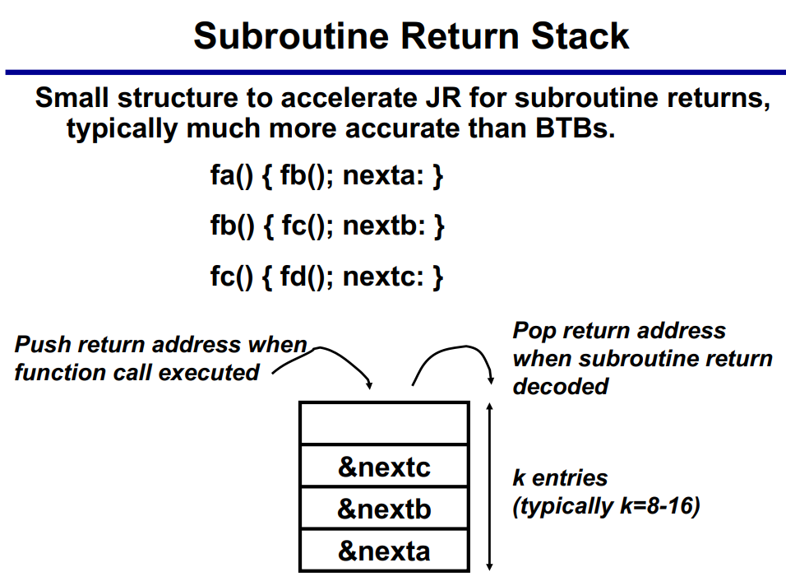
Subroutine Return Stack - Diagram

Slide 18
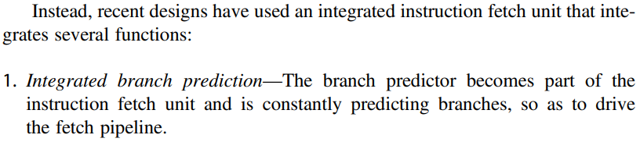
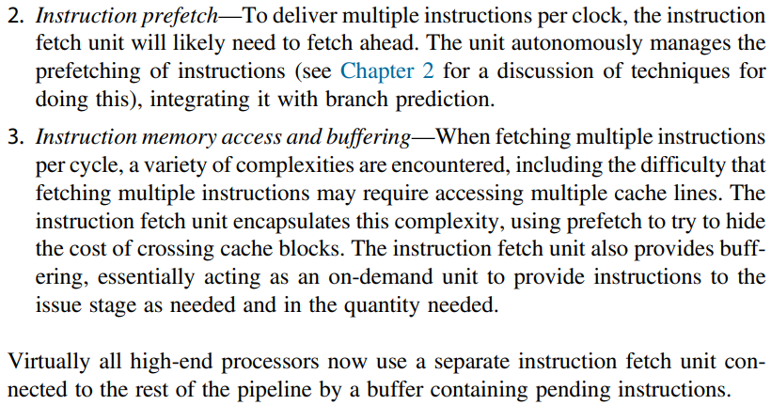
Integrated Instruction Fetch Unit

Slide 19
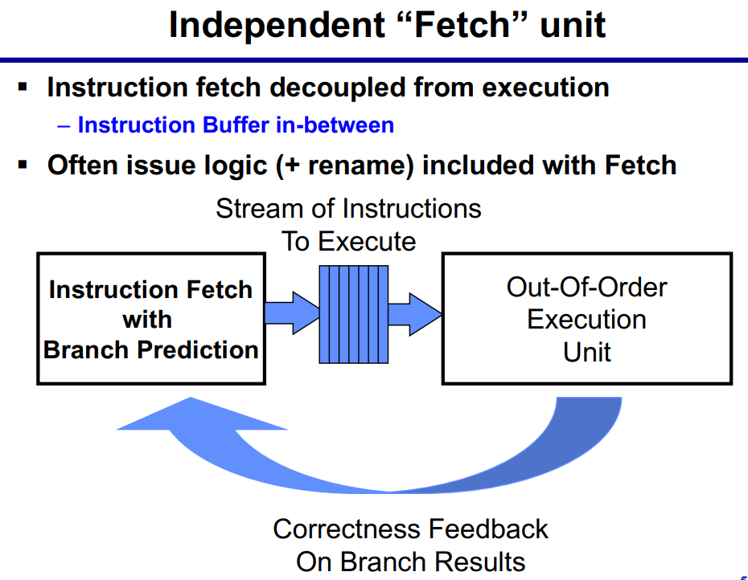
Independent Fetch Unit for Prefetching

Slide 20
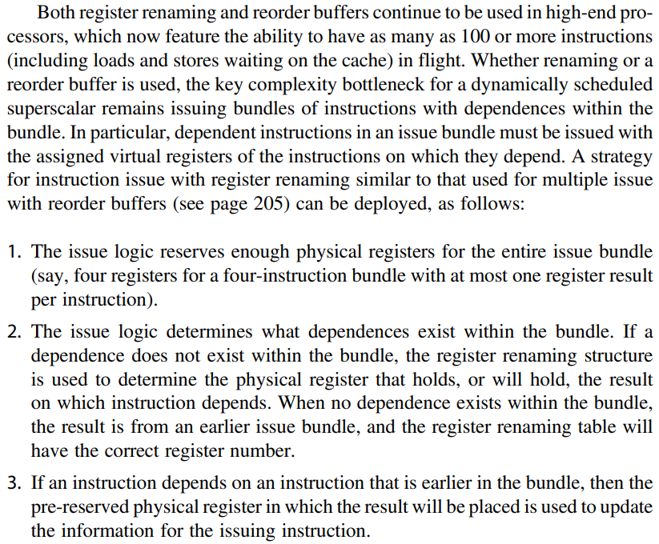
Issuing Bundle of Instructions

Slide 21
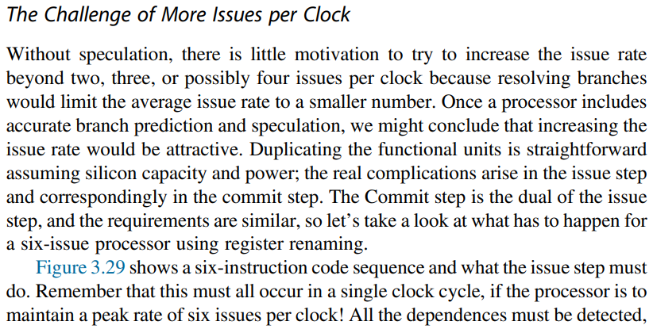
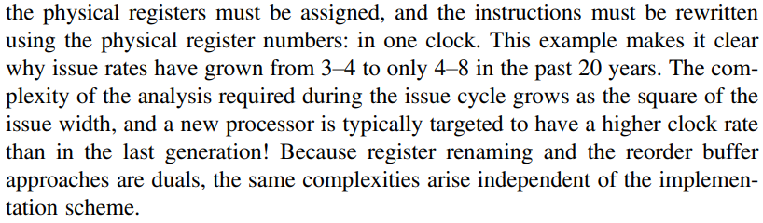
Challenge of More Instruction Issues per Clock

Slide 22
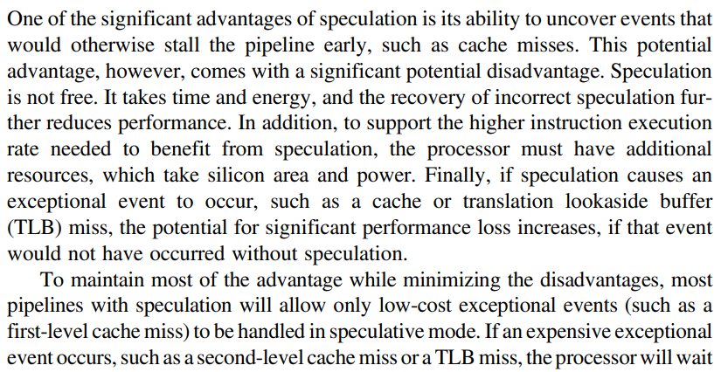
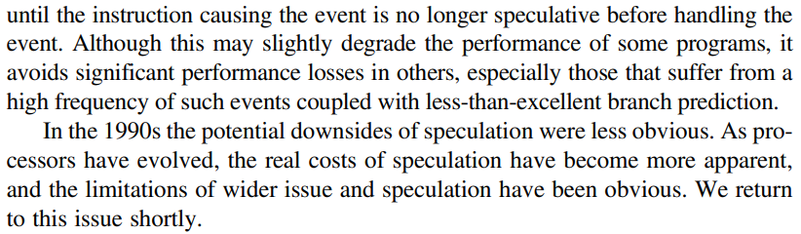
How much to Speculate?

Slide 23
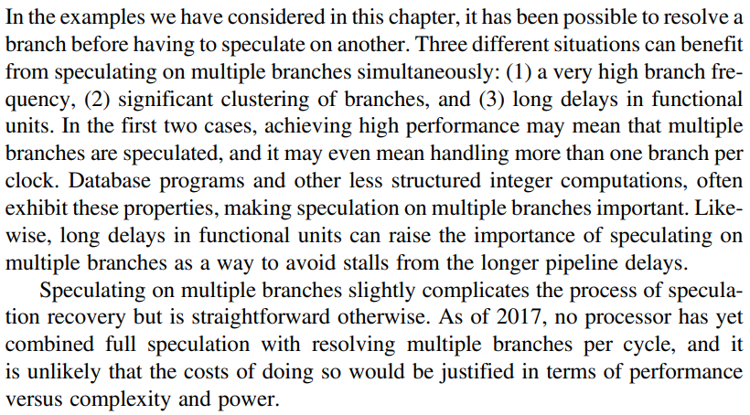




Speculating through Multiple Branches

Slide 24
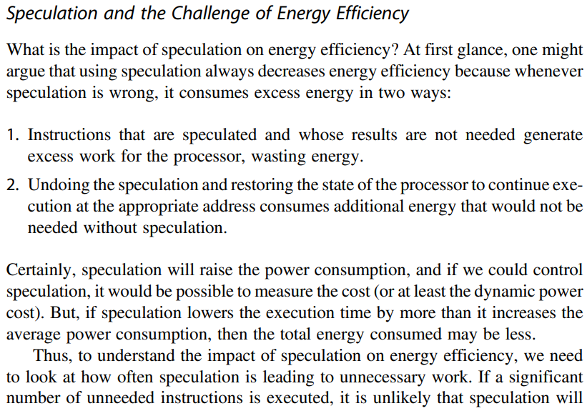
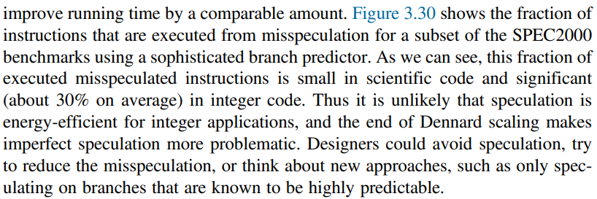
Speculation and Energy Efficiency

Slide 25
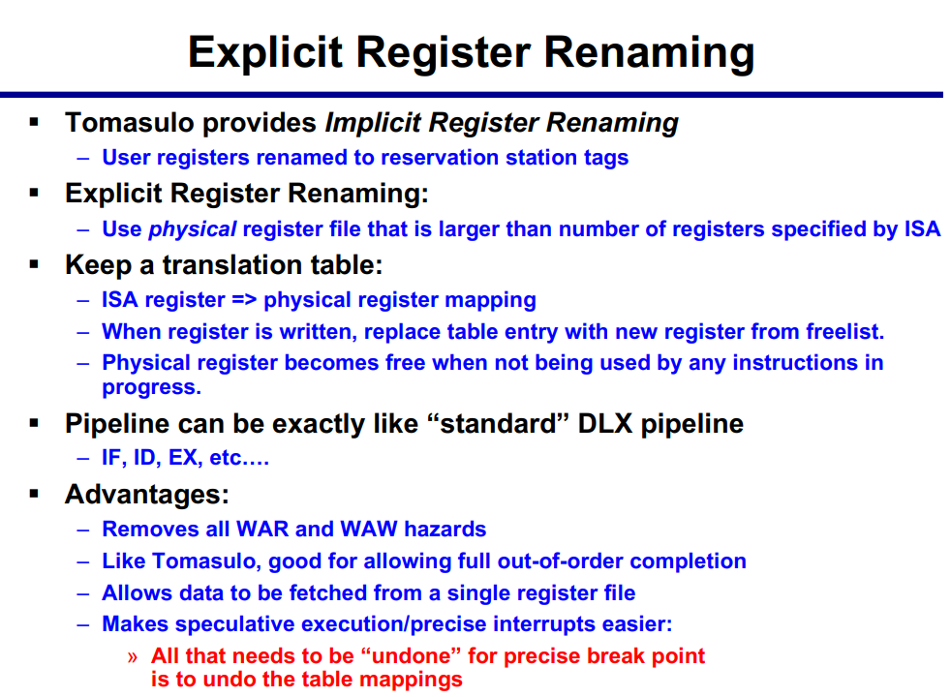
Explicit Register Renaming Process

Slide 26
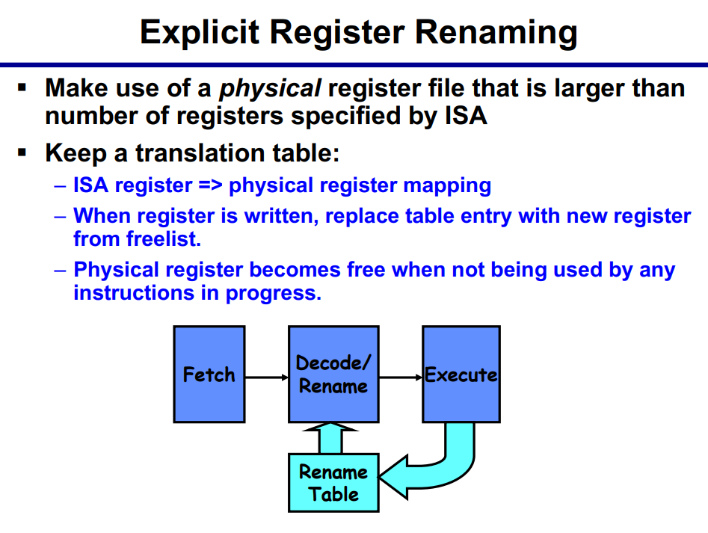
Register Renaming Architecture

Slide 27
Questions and Answers
Solved Examples
  VLIW Eg 1
  VLIW Eg 2
  VLIW Eg 3

Slide 28
Cross-Cutting Issues

Slide 29
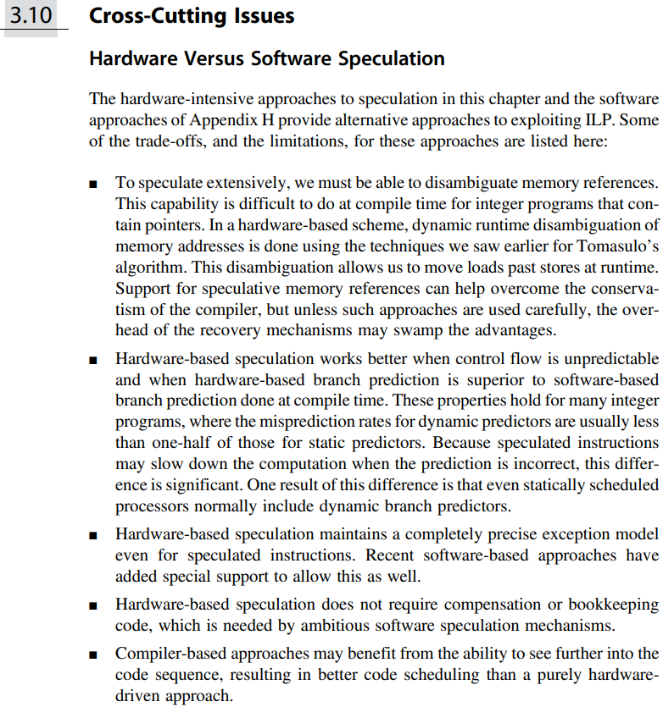
Cross-Cutting Issues
Hardware Speculation
Vs
Software Speculation

Slide 30
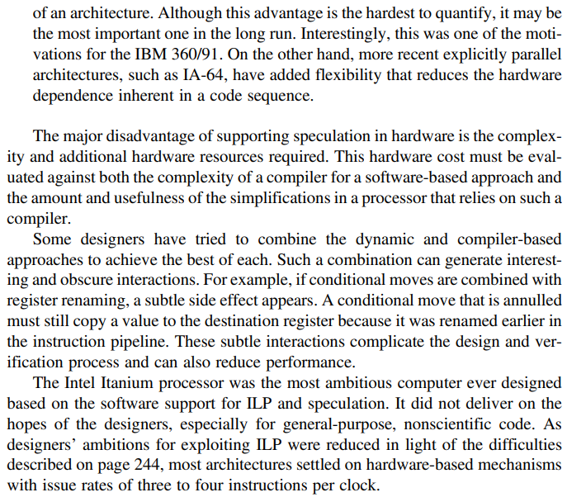
Issues - continued
Hardware Speculation
Vs
Software Speculation

Slide 31
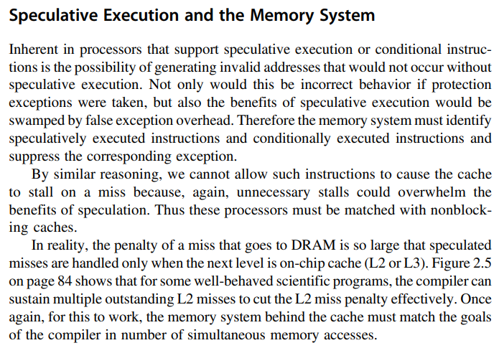

Slide 32
Putting It All Together: The Intel Core i7 6700 and ARM Cortex-A53 247
(Memory System to be discussed later, after midterm)

Slide 33
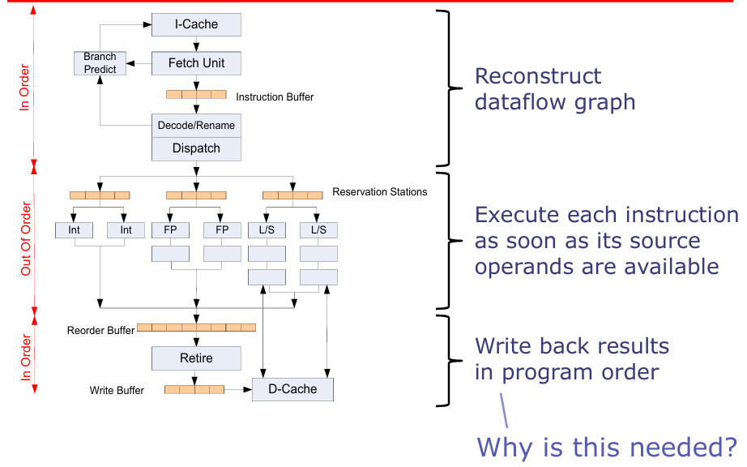
A Modern out-of-order Superscalar Processor

Slide 34
ARM Cortex A53 Architecture and Performance

Slide 35
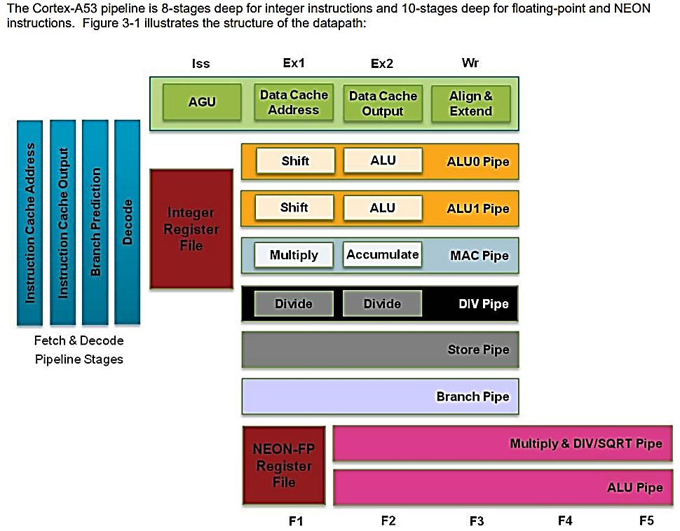
Cortex A53
Block Level Diagram

Slide 36
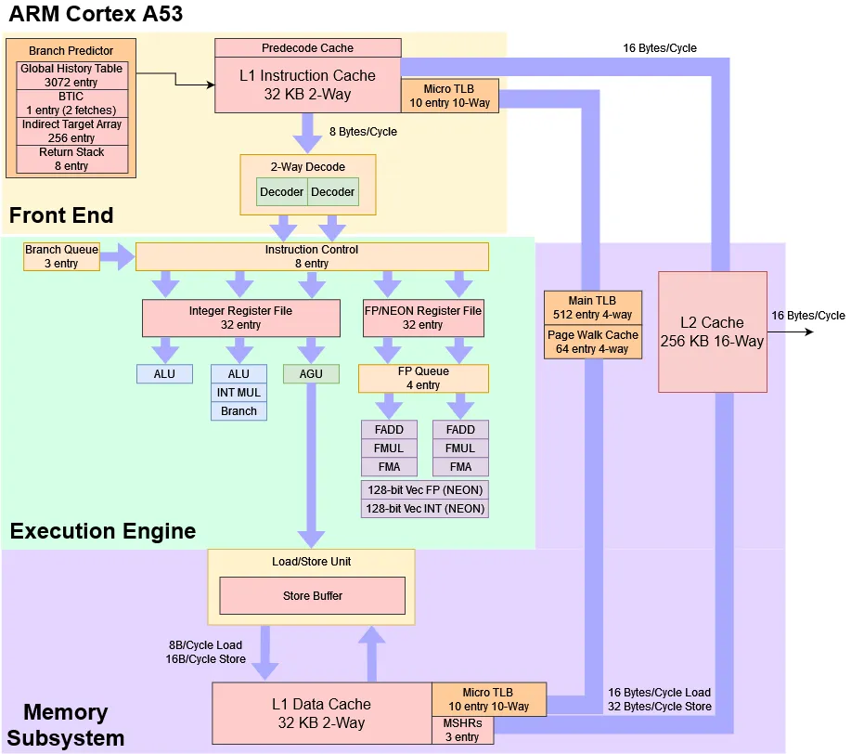



Cortex A53
Architecture Details

Slide 37
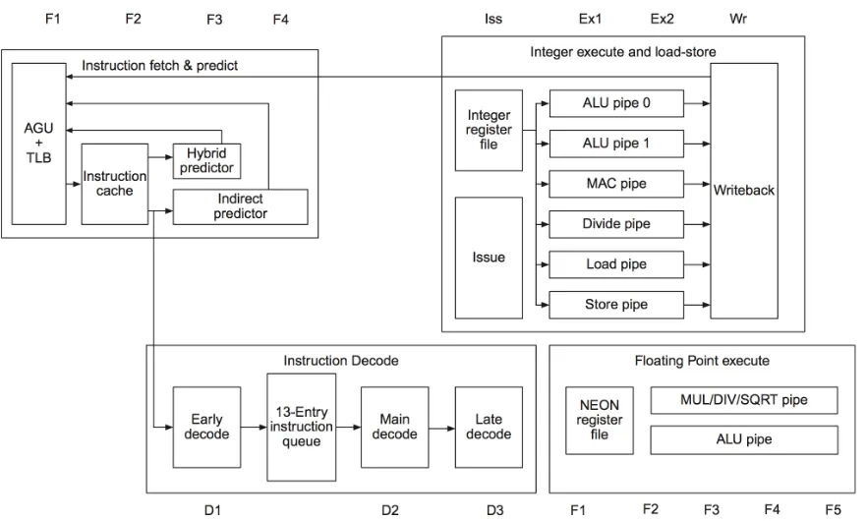
ARM Cortex A53 Architecture
AGU = Address Generation Unit
TLB = Translation Lookahead Buffer

Slide 38
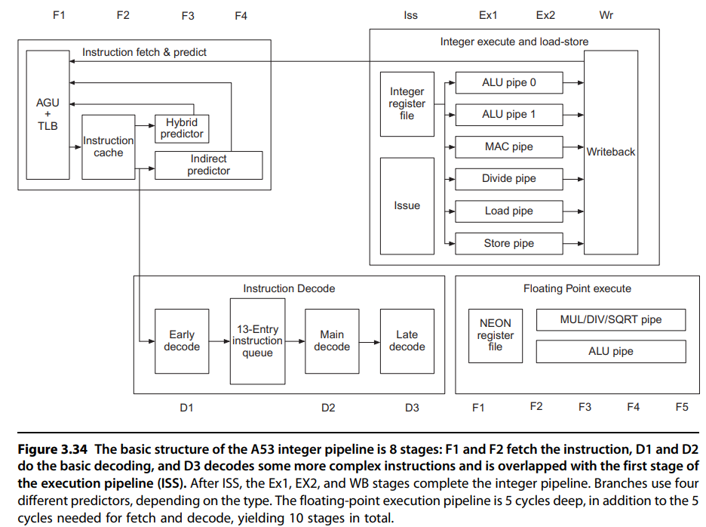
A53 Integer Pipeline
The basic structure of the A53 integer pipeline is 8 stages:
F1 and F2 fetch the instruction,
D1 and D2 do the basic decoding, and D3 decodes some more complex instructions and is overlapped with the first stage of the execution pipeline (ISS).
After ISS, the Ex1, EX2, and WB stages complete the integer pipeline.
Branches use four different predictors, depending on the type.
The floating-point execution pipeline is 5 cycles deep, in addition to the 5 cycles needed for fetch and decode, yielding 10 stages in total.

Slide 39
Architecture Overview ARM Cortex A53
8-stage pipelined processor with 2-way superscalar, in-order execution pipeline
DSP and NEON SIMD extensions are mandatory per core
VFPv4 Floating Point Unit onboard (per core)
Hardware virtualization support
TrustZone security extensions
64-byte cache lines
10-entry L1 TLB, and 512-entry L2 TLB
4 KiB conditional branch predictor, 256-entry indirect branch predictor

Slide 40
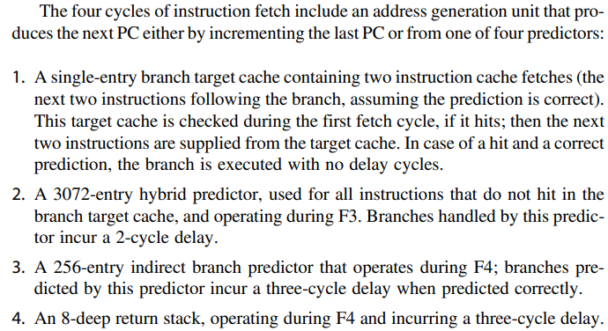
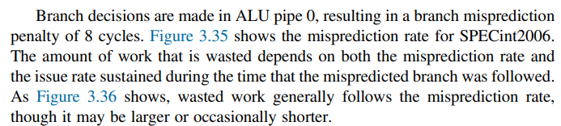








Architecture Details of A53
F3, F4 are variants
Of microarchitecture

Slide 41
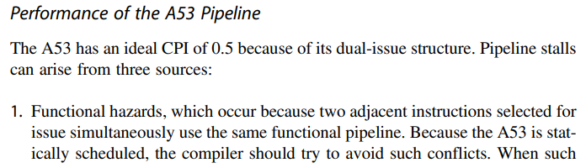
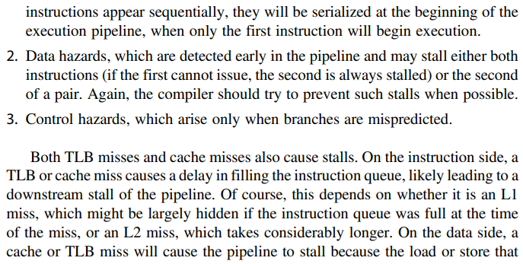
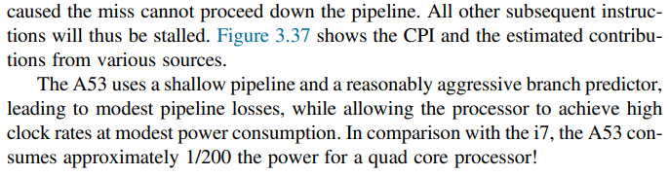






Performance of A53 Pipeline Stalls

Slide 42
Cortex A53 Pipeline Architecture and Stages
The Cortex-A53 processor, a member of ARM’s Cortex-A series, is designed with an 8-stage pipeline to balance performance and power efficiency. The pipeline stages are meticulously crafted to handle instruction processing with minimal stalls and maximum throughput. Each stage has a specific role in the instruction execution process, and understanding these stages is crucial for optimizing software and diagnosing performance bottlenecks.
The Cortex-A53 pipeline can be broadly divided into three phases: Front-End, Execution, and Back-End. The Front-End is responsible for fetching and decoding instructions, the Execution phase handles the actual computation, and the Back-End manages memory access and write-back operations. Below is a detailed breakdown of the 8 pipeline stages:
Fetch Stage 1 (F1): The first stage of the pipeline is responsible for fetching instructions from the instruction cache (I-cache) or memory. The program counter (PC) is used to determine the address of the next instruction to be fetched. The Cortex-A53 employs branch prediction to minimize stalls caused by control flow changes.
Fetch Stage 2 (F2): In this stage, the fetched instructions are aligned and prepared for decoding. The Cortex-A53 can fetch up to two instructions per cycle, depending on the alignment and availability of instructions in the I-cache.

Slide 43
Cortex A53 Pipeline Architecture and Stages
Decode Stage 1 (D1): The first decode stage begins the process of translating the fetched instructions into micro-operations (µOps). This stage identifies the instruction type and prepares it for further decoding.
Decode Stage 2 (D2): The second decode stage completes the translation of instructions into µOps. The Cortex-A53 uses a dual-issue pipeline, meaning it can decode and issue up to two instructions per cycle to the execution units.
Issue Stage (IS): The issue stage is responsible for dispatching the decoded µOps to the appropriate execution units. The Cortex-A53 has multiple execution units, including integer ALUs, floating-point units, and load/store units. The issue stage ensures that dependencies are resolved and that instructions are issued in the correct order.
Execute Stage 1 (E1): The first execute stage performs the actual computation or operation specified by the instruction. This stage includes arithmetic logic unit (ALU) operations, address generation for memory access, and other computational tasks.
Execute Stage 2 (E2): The second execute stage completes any remaining computation and prepares the results for write-back. For memory operations, this stage includes data cache (D-cache) access and alignment.
Write-Back Stage (WB): The final stage of the pipeline writes the results of the executed instructions back to the register file or memory. This stage ensures that the architectural state of the processor is updated correctly.

Slide 44

Load/Store Unit in Cortex A53 (Memory – later)
A CPU’s load/store unit has a very complex job, especially on out-of-order CPUs where it has to track a lot of memory operations in flight and make them appear to execute in program order. The A53’s load/store unit is simpler thanks to in-order execution, but handling memory operations still isn’t easy.
It still has to handle instructions that address memory with byte granularity and varying sizes, with a L1 data cache that accesses a larger, aligned region under the hood. It still has to handle memory dependencies. Even though the A53 is in-order, pipelining means a load can need data from a store that hasn’t committed yet.
The A53 appears to access its data cache in 8 byte (64-bit) aligned chunks. Accesses that span a 8-byte boundary incur a 1 cycle penalty. Forwarding similarly incurs a 1 cycle penalty, but notably, there is no massively higher cost if a load only partially overlaps a store.
In the worst case, forwarding costs 6 cycles when the load partially overlaps the store and the load address is higher than the store address.

Slide 45
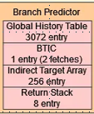
ARM Branch Predictor
A53 is a particularly interesting case both because it targets very low power and area, and because branch prediction accuracy matters less for it. That’s because A53 can’t speculate as far as out-of-order CPUs.
ARM has designed a tiny branch predictor that emphasizes low power and area over speed and accuracy. The A53 Technical Reference Manual states that the branch predictor has a global history table with 3072 entries. For comparison, AMD’s Athlon 64 from 2003 had a 16384 entry history table.
BTIC = Branch Target Instruction Cache

Slide 46
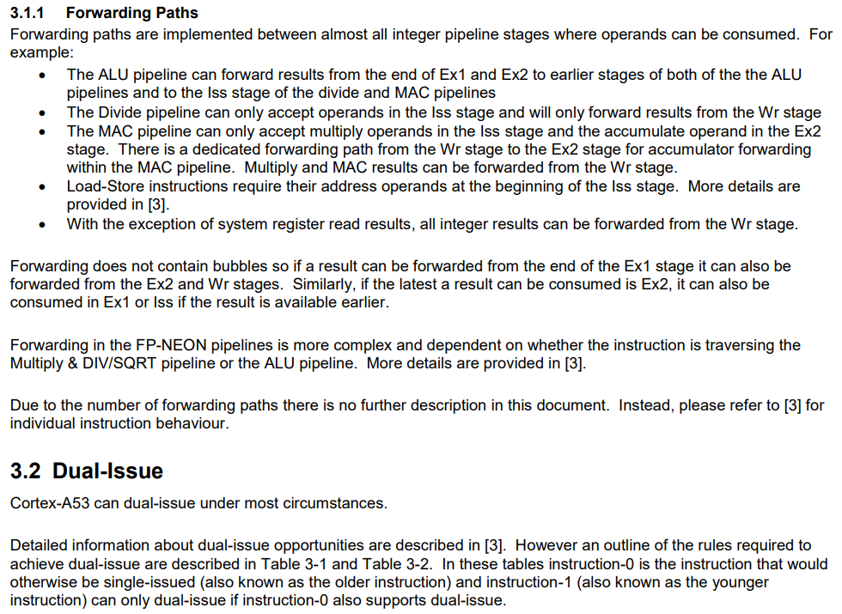
Forwarding and Dual-Issue

Slide 47
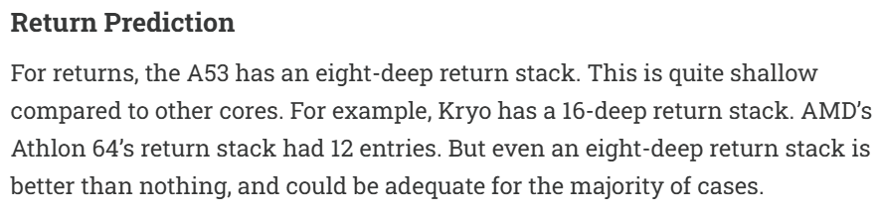
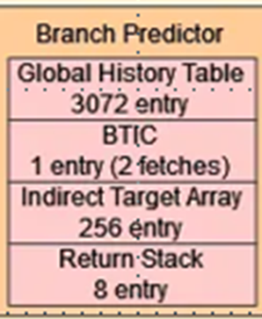
Return Prediction Stack

Slide 48
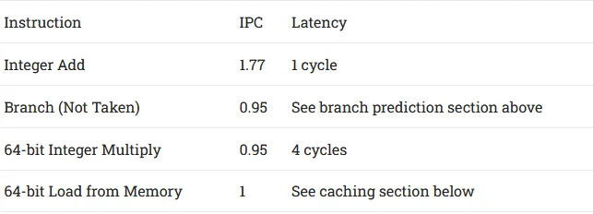
Integer Execution Units
A53 can dual-issue the most common operations like integer adds, register to register MOVs, and bitwise operations. Less common operations like integer multiplies and branches can’t be dual issued but can issue alongside another type of instruction.

Slide 49
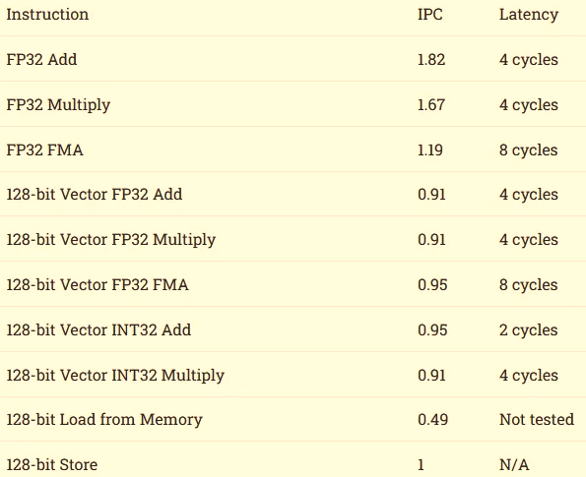

Floating Point and Vector Execution
Unlike the original Pentium, which only had one FP pipe, the A53 uses modern transistor budgets to dual issue common floating-point instructions like FP adds and multiplies.
That’s a nice capability to have because Javascript’s numbers are all floating point, and A53 may have to deal with a lot of Javascript in phones.
Unfortunately, latency is 4 cycles, which isn’t good considering the A53’s low clock speed. It’s even worse because the A53 doesn’t benefit from a big out-of-order engine, which means the core must stall to resolve execution dependencies.
FMA = Fused Multiply Add

Slide 50
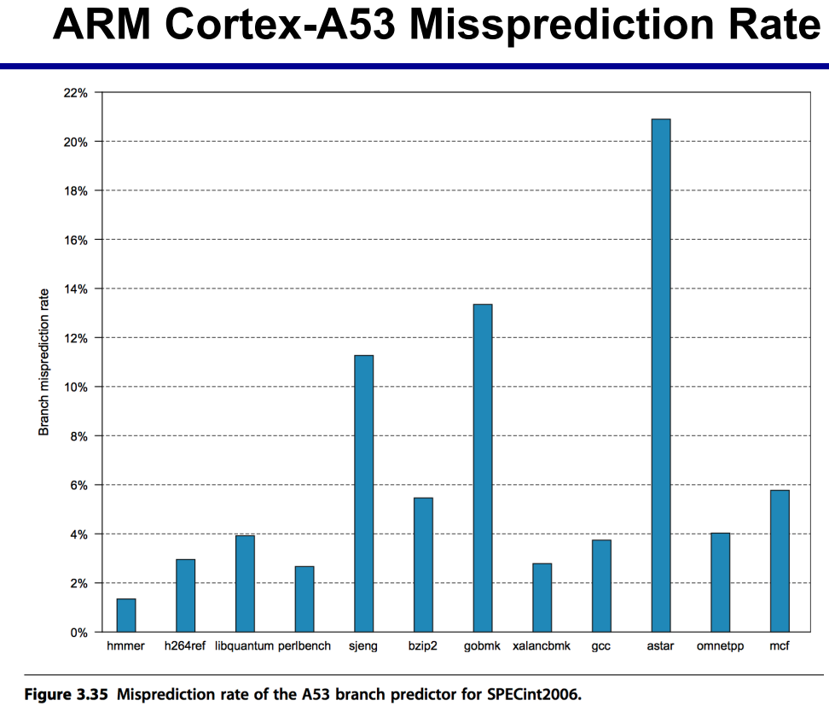

Misprediction

Slide 51
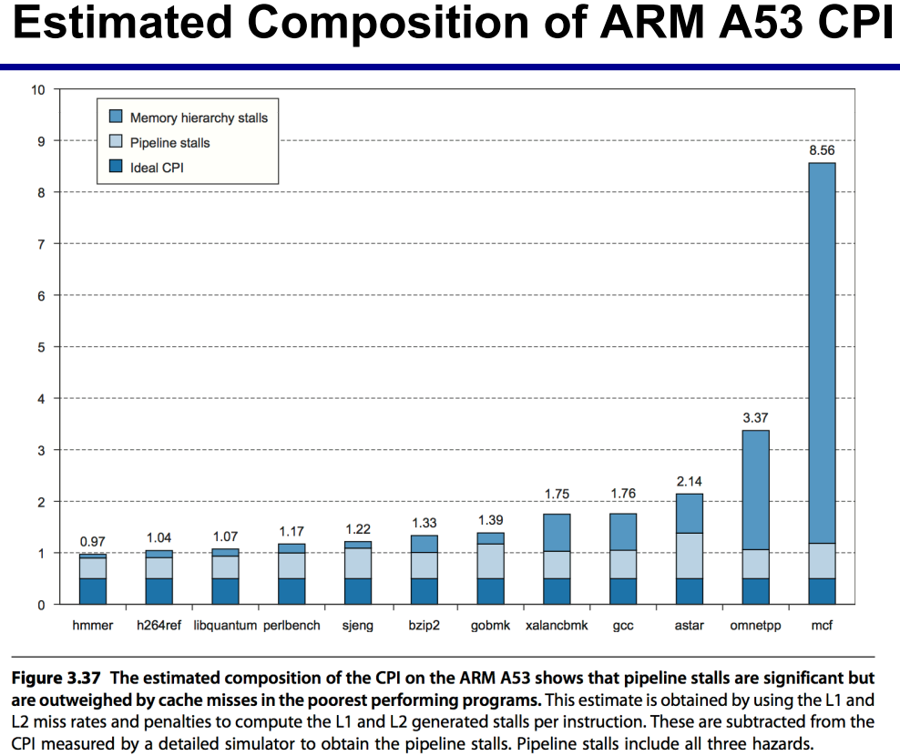

CPI Analysis

Slide 52
Architecture Details of A53

Slide 53
Intel Core i7 6700

Slide 54

Chip view – Intel core i7 processor

Slide 55

Core i7 Pipeline
Figure 3.38 The Intel Core i7 pipeline structure shown with the memory system components. The total pipeline depth is 14 stages, with branch mispredictions typically costing 17 cycles, with the extra few cycles likely due to the time to reset the branch predictor. The six independent functional units can each begin execution of a ready micro-op in the same cycle. Up to four micro-ops can be processed in the register renaming table.

Slide 56







Core i7

Slide 57

Intel Core i7
The Intel Core i7 pipeline structure shown with the memory system components.
The total pipeline depth is 14 stages,
with branch mispredictions typically costing 17 cycles, with the extra few cycles likely due to the time to reset the branch predictor.
The six independent functional units can each begin execution of a ready micro-op in the same cycle.
6 Wide Superscalar
48 Load and 3 Store Buffers
Up to four micro-ops can be processed in the register renaming table.

Slide 58

Core i7 Pipeline Instruction Fetch Stage

Slide 59

Core i7 Architecture Features

Slide 60

Core i7 Pipeline Issue

Slide 61

Dispatch / Execute Unit

Slide 62

Pipeline EXE Unit

Slide 63
8 Steps in Instruction Execution (1 to 4)
Below are the eight steps an x86 instruction goes through for execution.
1. Instruction fetch—The processor uses a multilevel branch target buffer to achieve a balance between speed and prediction accuracy. There is also a return address stack to speed up function return. Mispredictions cause a penalty of about15 cycles. Using the predicted address, the instruction fetch unit fetches 16 bytesfrom the instruction cache.
2. The 16 bytes are placed in the predecode instruction buffer— The predecode stage transforms the 16 bytes into individual x86 instructions. This predecode is nontrivial since the length of an x86 instruction can be from 1 to 15 bytes and the predecoder must look through a number of bytes before it knows the instruction length. Individual x86 instructions are placed into the 18-entry instruction queue.
3. Micro-op decode—Individual x86 instructions are translated into microoperations (micro-ops). Three of the decoders handle x86 instructions that translate directly into one micro-op. For x86 instructions that have more complex semantics, there is a microcode engine that is used to produce the micro-op sequence; it can produce up to four micro-ops every cycle and continues until the necessary micro-op sequence has been generated. Th e micro-ops are placed according to the order of the x86 instructions in the 28-entry micro-op buffer.
4. The micro-op buffer performs loop stream detection—If there is a small sequence of instructions (less than 28 instructions or 256 bytes in length) that comprises a loop, the loop stream detector will find the loop and directly issue the micro-ops from the buffer, eliminating the need for the instruction fetch and instruction decode stages to be activated.

Slide 64
8 Steps in Instruction Execution (5 to 8)
5. Perform the basic instruction issue—Looking up the register location in the register tables, renaming the registers, allocating a reorder buffer entry, and fetching any results from the registers or reorder buff er before sending the micro-ops to the reservation stations.
6. The i7 uses a 36-entry centralized reservation station shared by six functional units. Up to six micro-ops may be dispatched to the functional units every clock cycle.
7. The individual function units execute micro-ops and then results are sent back to any waiting reservation station as well as to the register retirement unit, where they will update the register state, once it is known that the instruction is no longer speculative. The entry corresponding to the instruction in the reorder buffer is marked as complete.
8. When one or more instructions at the head of the reorder buffer have been marked as complete, the pending writes in the register retirement unit are executed, and the instructions are removed from the reorder buffer. Hardware in the second and fourth steps can combine or fuse operations together to reduce the number of operations that must be performed. Macro-op fusion in the second step takes x86 instruction combinations, such as compare followed by a branch, and fuses them into a single operation. Microfusion in the fourth step combines micro-operation pairs such as load/ALU operation and ALU operation/store and issues them to a single reservation station (where they can still issue independently), thus increasing the usage of the buffer. In a study of the Intel Core architecture, which also incorporated microfusion and macrofusion, Bird etal. [2007] discovered that microfusion had little impact on performance, while macrofusion appears to have a modest positive impact on integer performance and little impact on floating-point performance.

Slide 65


Pipeline Performance Core i7

Slide 66

Buffers and Queues in Core i7

Slide 67


CPI for i7 6700 and i7 920 versions

Slide 68

Core i7 Performance

Slide 69

Core i7 Predictor

Slide 70

Integer Benchmarks Comparison i7 6700 vs 920

Slide 71

Three Different Intel Processors

Slide 72

Compare ARM and Intel Processors

