Slide 1
Computer Architecture
CS 622 / EE 520
Spring 2026
Lecture 10
Shahid Masud

Slide 2
Topics
Loop Unrolling
Dynamic Scheduling
Introducing Tomasulo Architecture
Quiz 2
TODAY

Slide 3
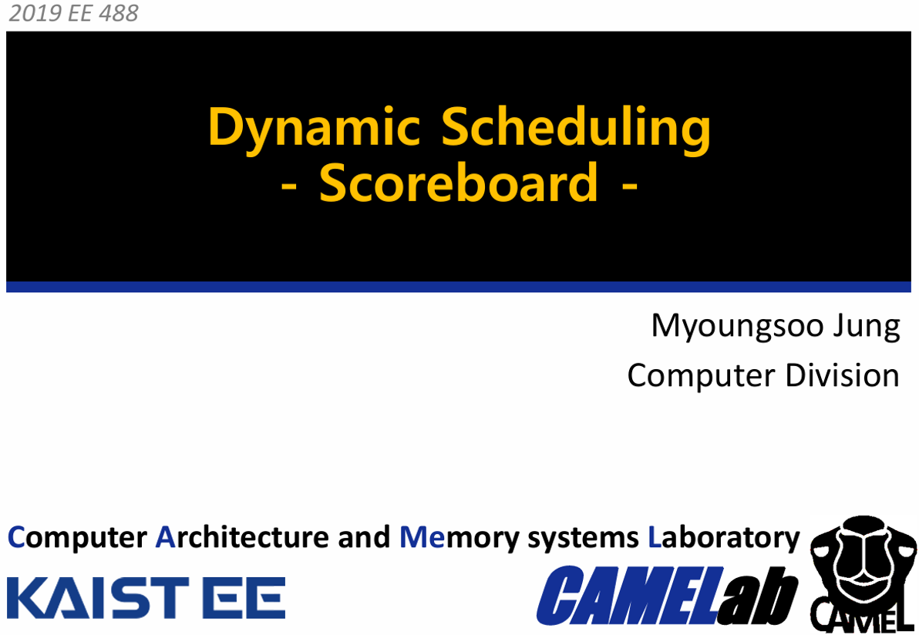
Further Readings
Reading Notes
Readings:
Chapter 3 of course textbook

Slide 4
Recap: Instruction Level Parallelism
Starting Chapter 3 of textbook

Slide 5


How to go about ILP
Pipelining become universal technique in 1985
  Overlaps execution of instructions
  Exploits “Instruction Level Parallelism”
Beyond this, there are two main approaches:
  Hardware-based dynamic approaches
    Used in server and desktop processors
    Not used as extensively in IoT, Low Power, processors
  Compiler-based static approaches
    Not as successful outside of scientific applications

Slide 6
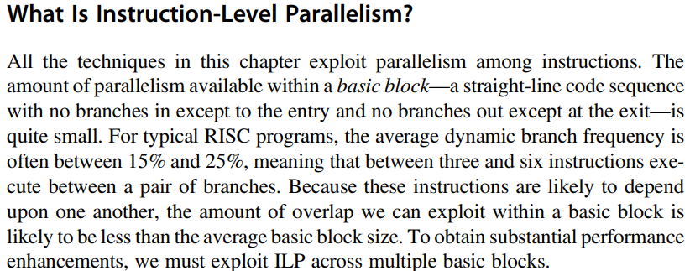

A Block of Code for ILP

Slide 7

Data Dependence
Dependencies are a property of programs
Pipeline organization determines if dependence is detected and if it causes a stall
Data dependence conveys:
  Possibility of a hazard
  Order in which results must be calculated
  Upper bound on exploitable instruction level parallelism
Dependencies that flow through memory locations are difficult to detect

Slide 8
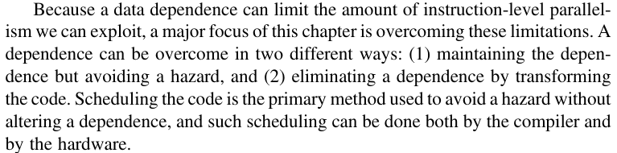


Overcome Dependence

Slide 9
Dependence types – code examples
7
RAW (Read After Write) = “true dependence”
mul r0 * r1 -> r2
…
add r2 + r3 -> r4
WAW (Write After Write) = “output dependence”
mul r0 * r1-> r2
…
add r1 + r3 -> r2
WAR (Write After Read) = “anti-dependence”
mul r0 * r1 -> r2
…
add r3 + r4 -> r1
WAW & WAR are “false”, Can be totally eliminated by “renaming”

Slide 10
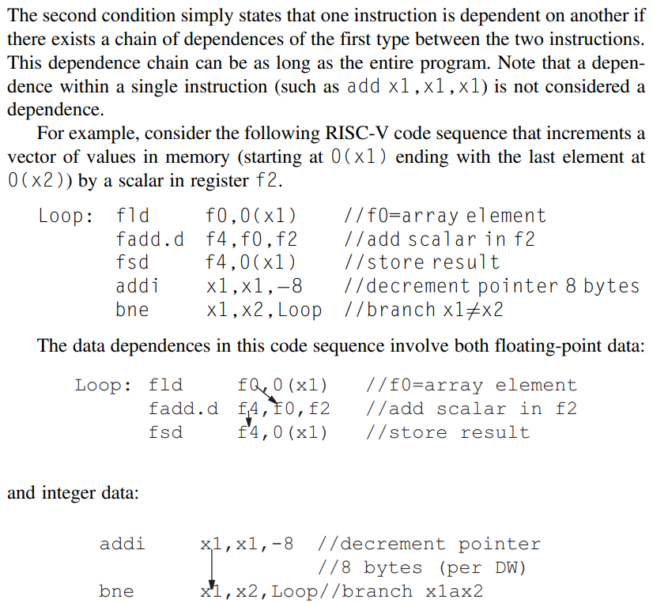




Dependence Chain

Slide 11
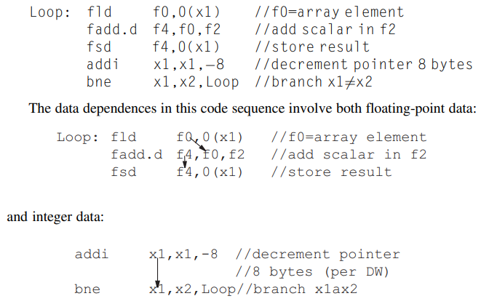


Name Dependence and Output Dependence
An Antidependence between instruction i and instruction j occurs when instruction j writes a register or memory that instruction i reads.
  The original ordering must be preserved to ensure that i reads the correct value. In example, there is antidependence between fsd and addi on register x1.
An Output dependence occurs when instruction i and instruction j write the same register or memory location.
  The ordering between the instruction must be preserved to ensure that
  value finally written corresponds to instruction j.
Both Antidependence and Output Dependence are
Name Dependences, as opposed to True Dependences, as no
value is being transmitted between the two instructions.

Slide 12
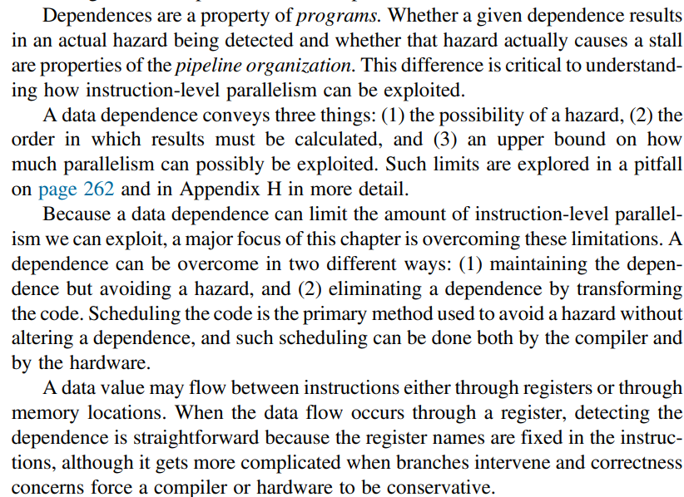

More on Data Dependences

Slide 13
Scoreboard Scheduling Technique

Slide 14
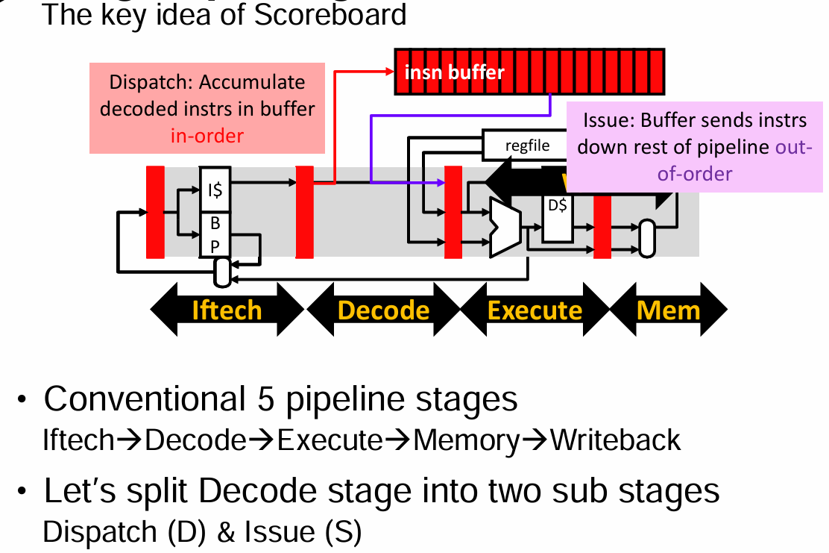
Scoreboard Hardware

Slide 15
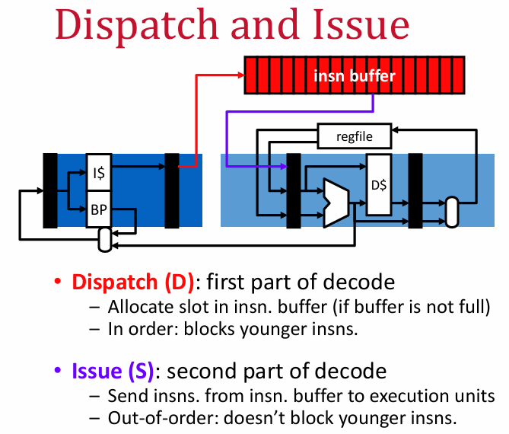

Slide 16
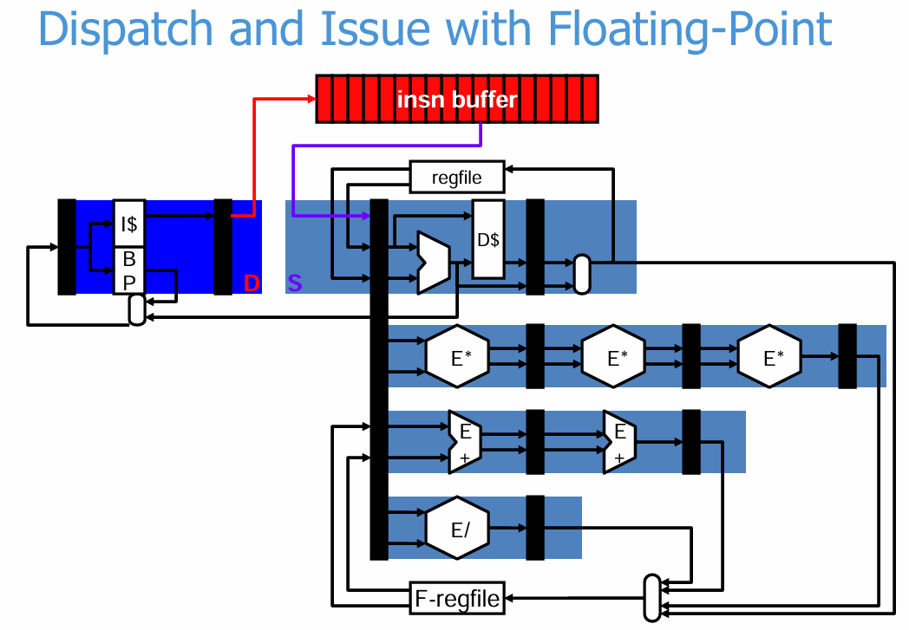

Slide 17
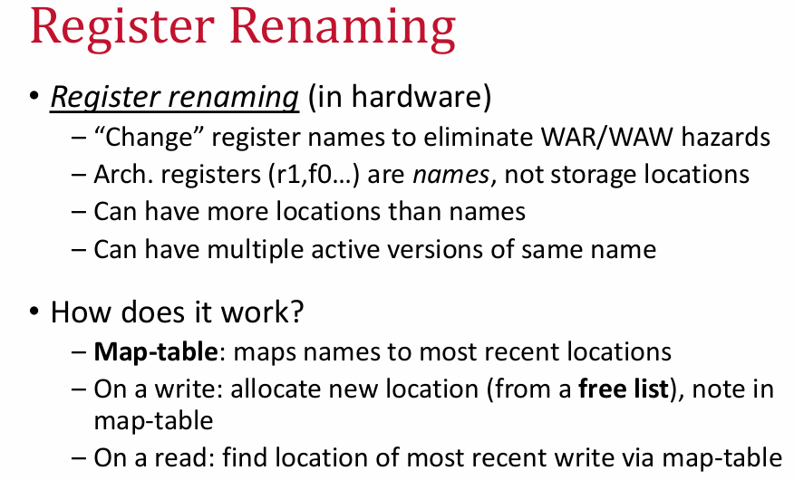

Slide 18
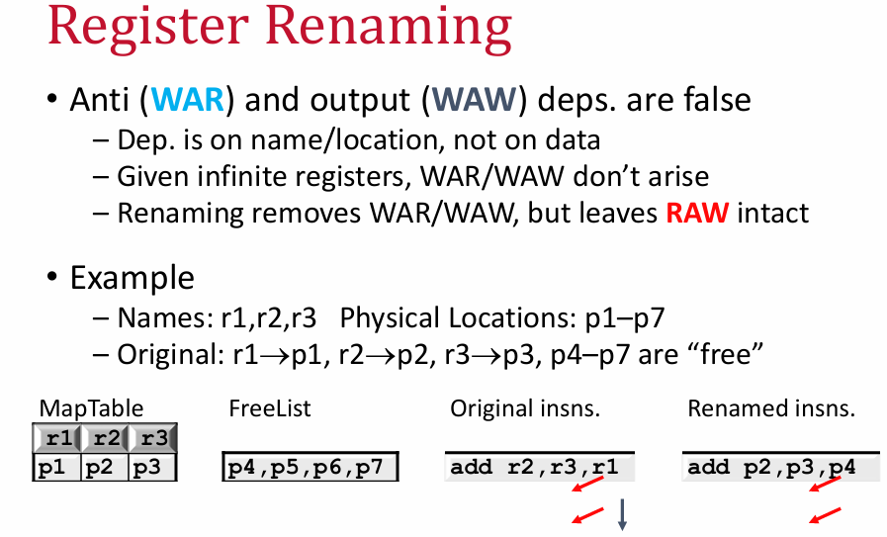

Slide 19
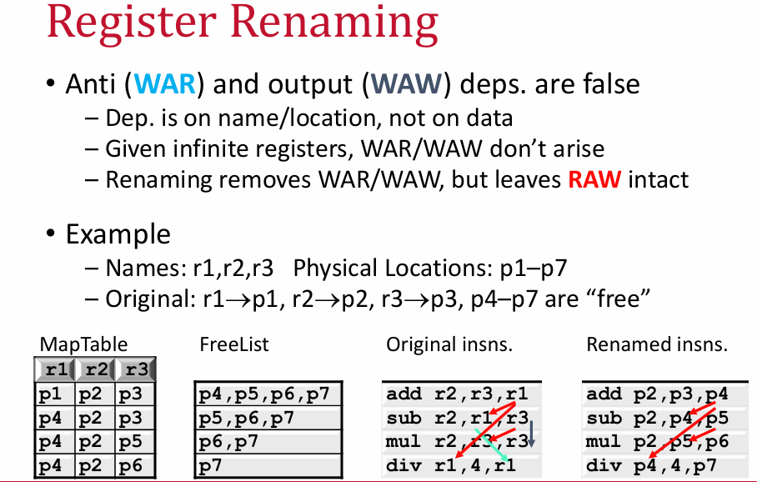

Slide 20
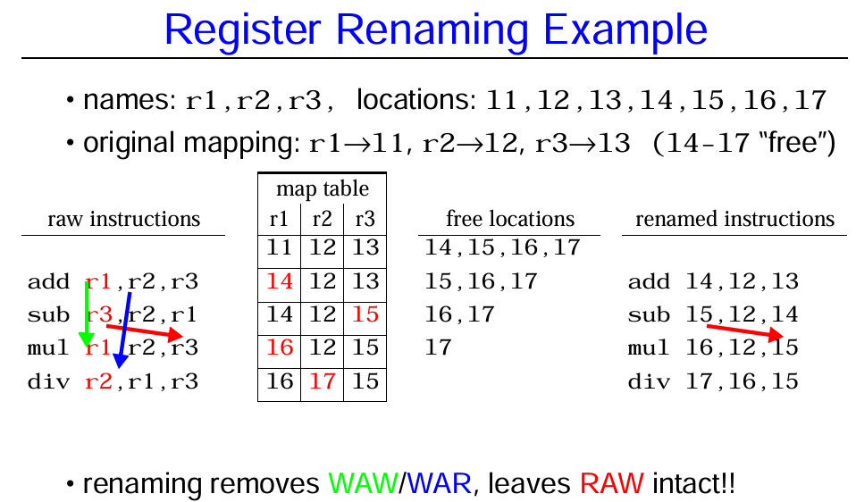

Slide 21
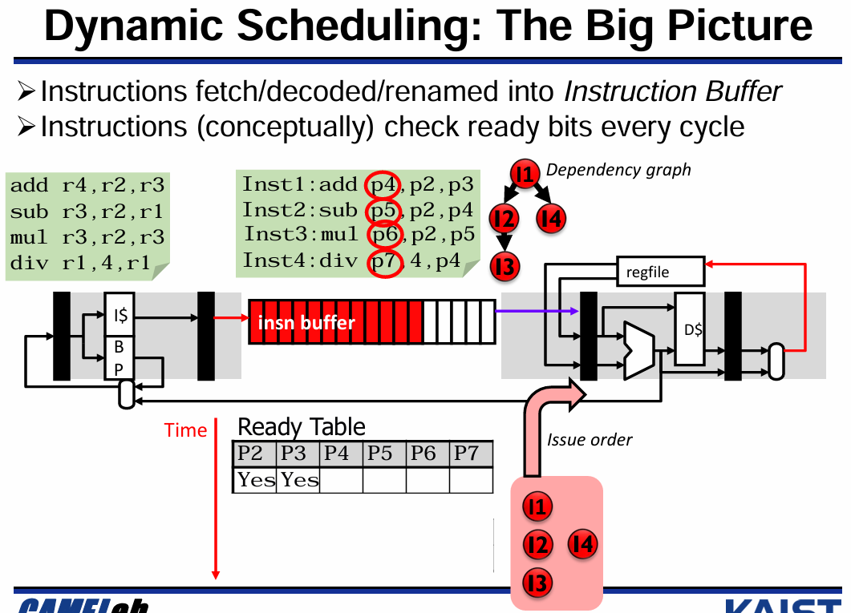

Slide 22
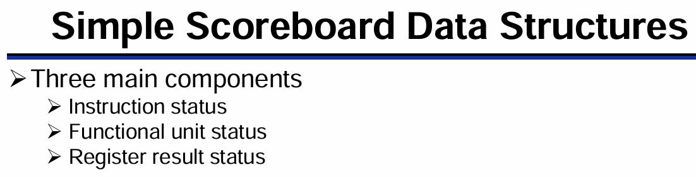
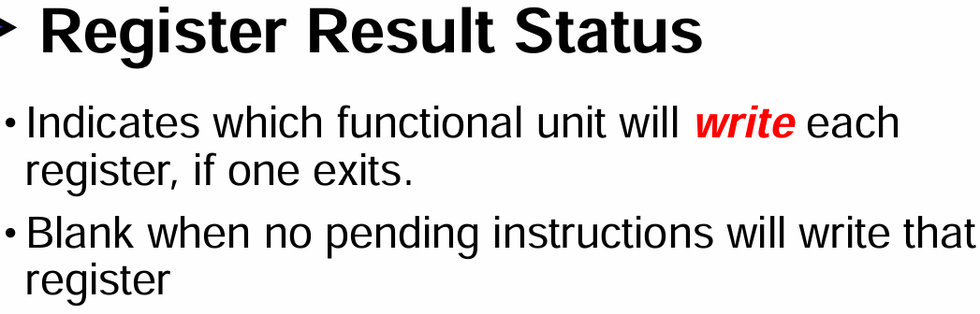
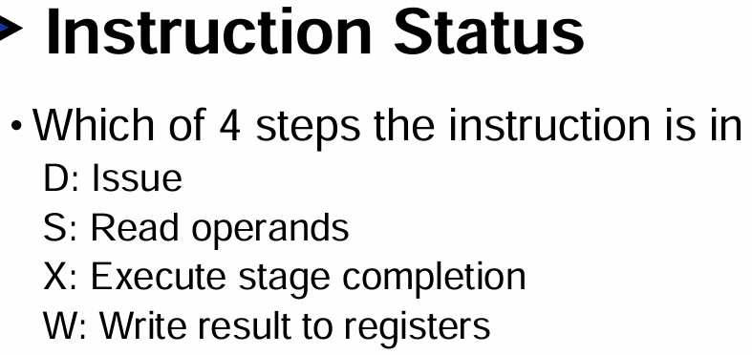
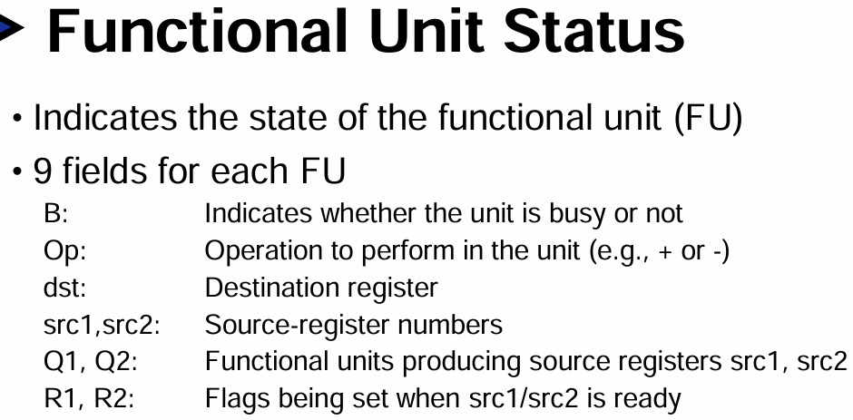

Slide 23
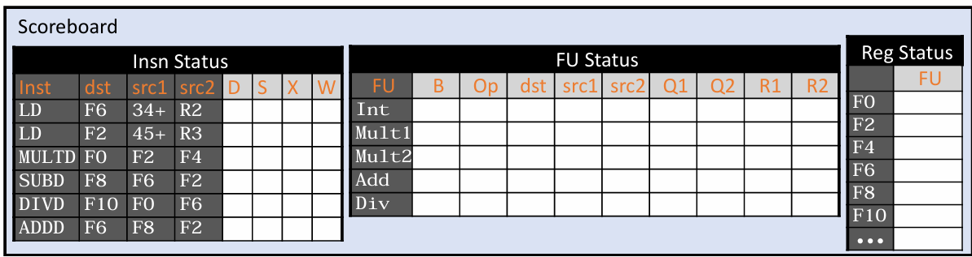
Example Scoreboard

Slide 24
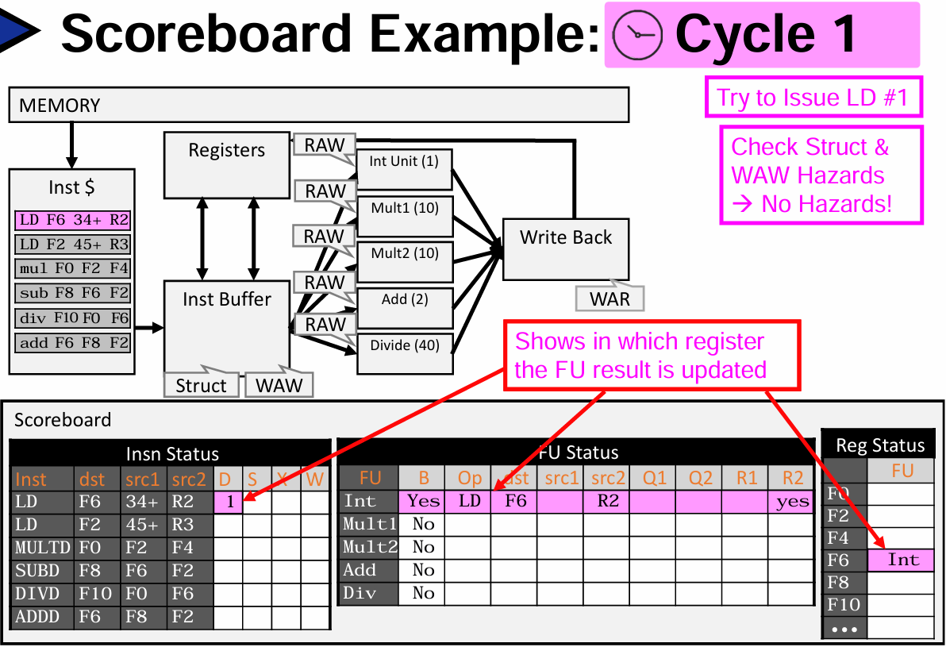
Scoreboard Cycle 1

Slide 25
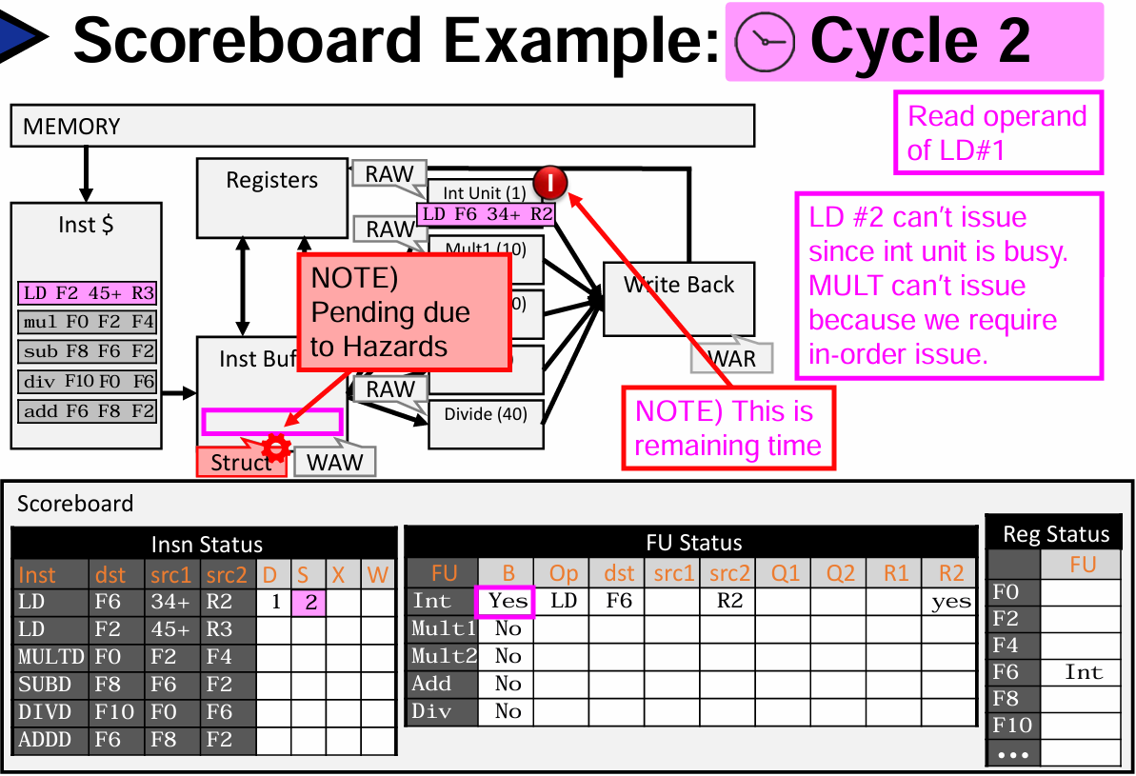

Slide 26
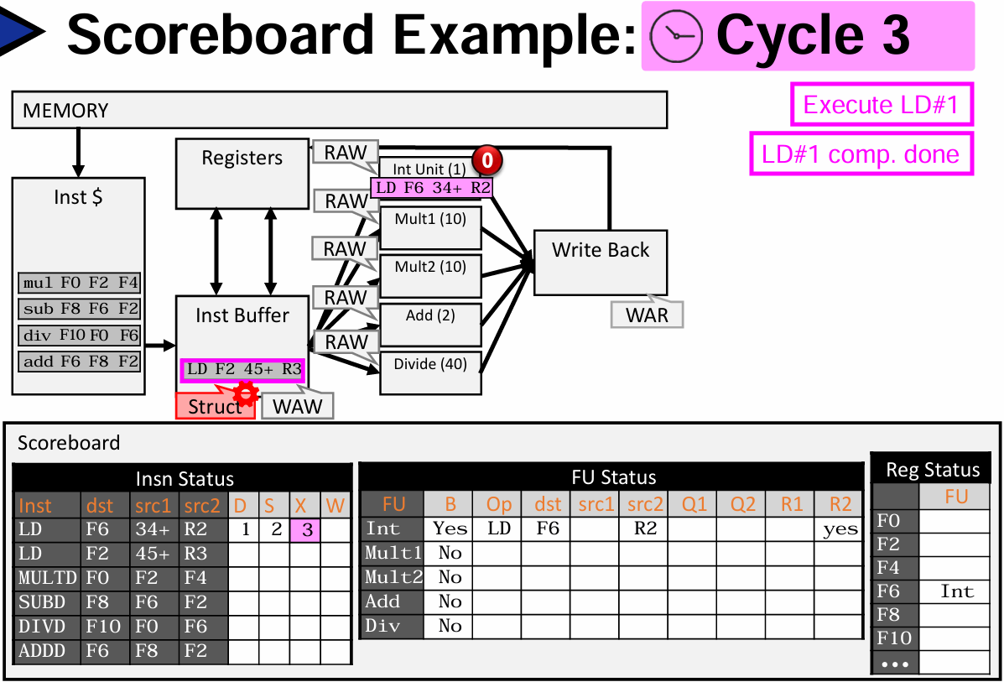
Scoreboard Cycle 3

Slide 27
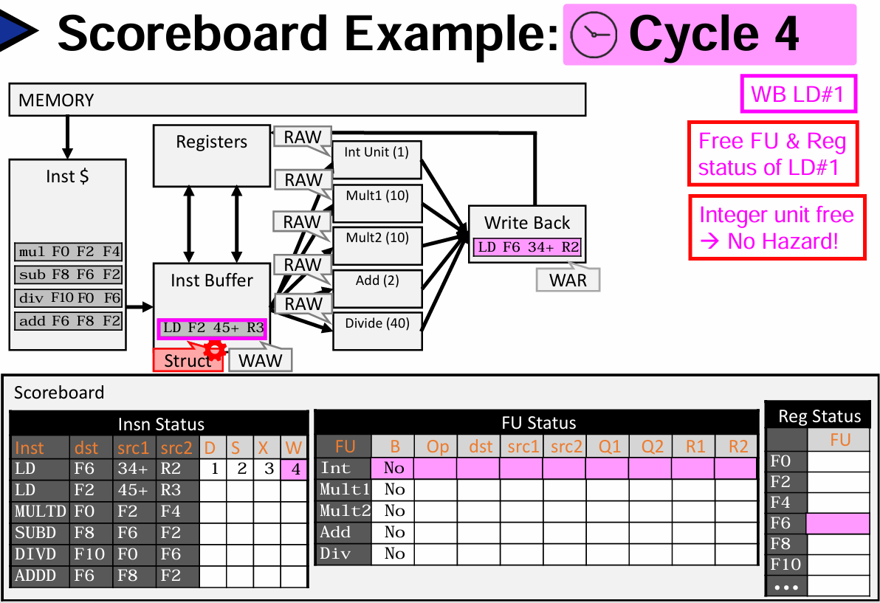
Scoreboard Cycle 4

Slide 28
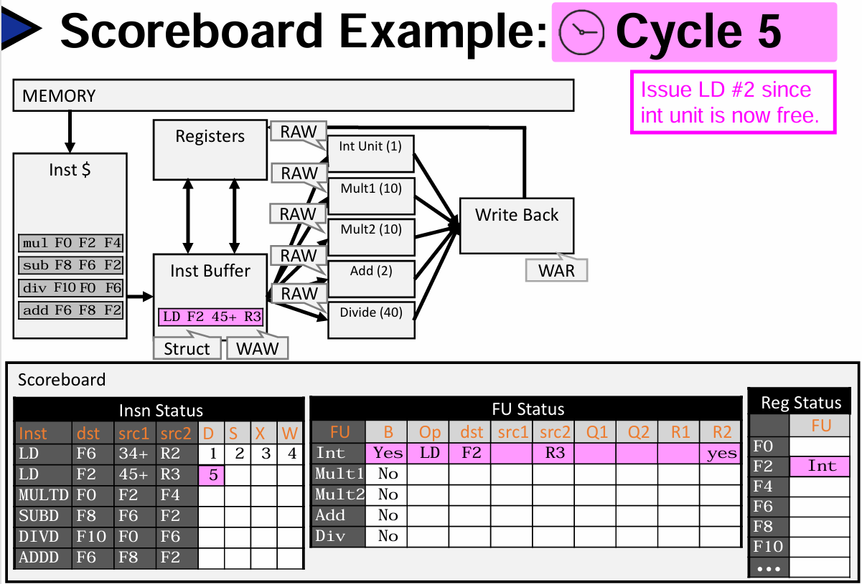
Scoreboard Cycle 5

Slide 29
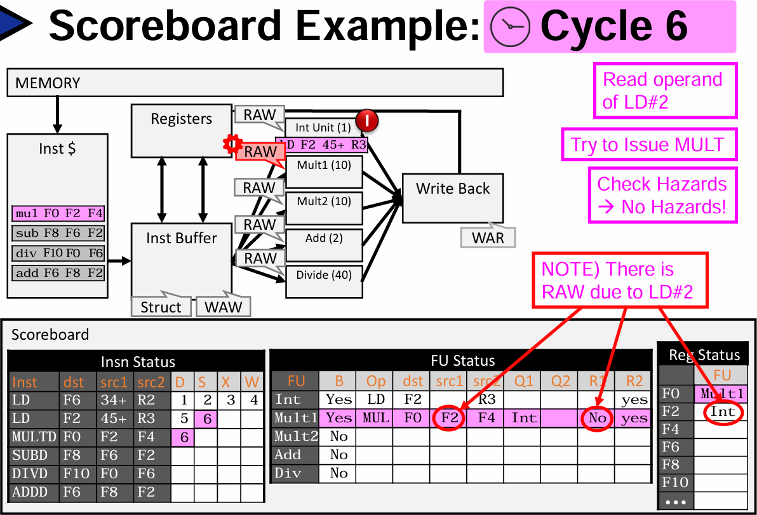
Scoreboard Cycle 6

Slide 30
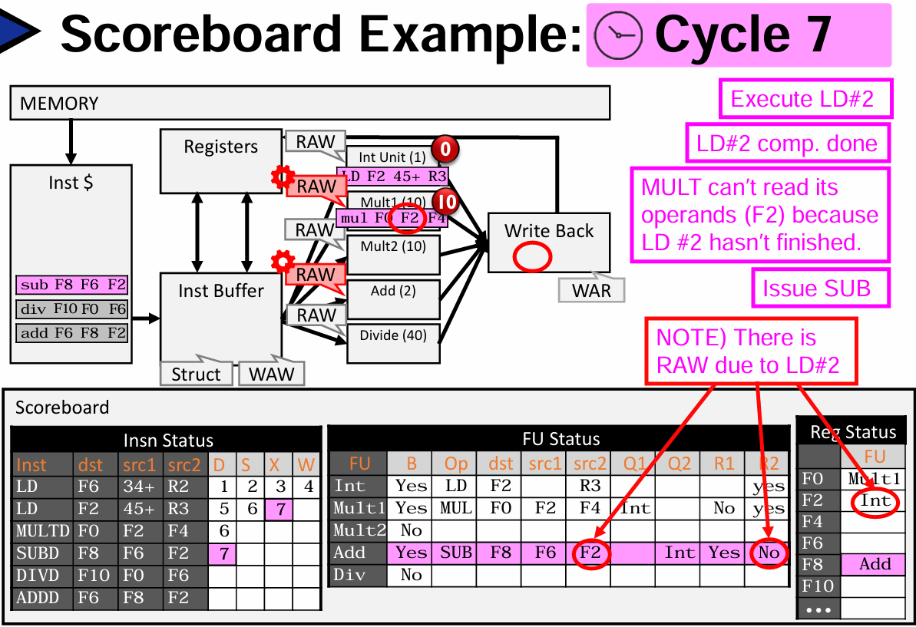
Scoreboard Cycle 7

Slide 31
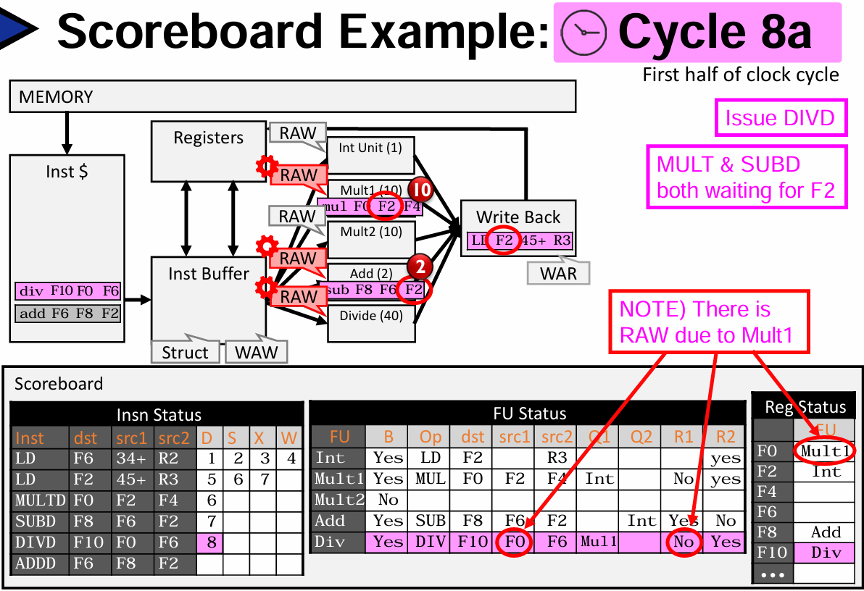
Scoreboard Cycle 8a

Slide 32
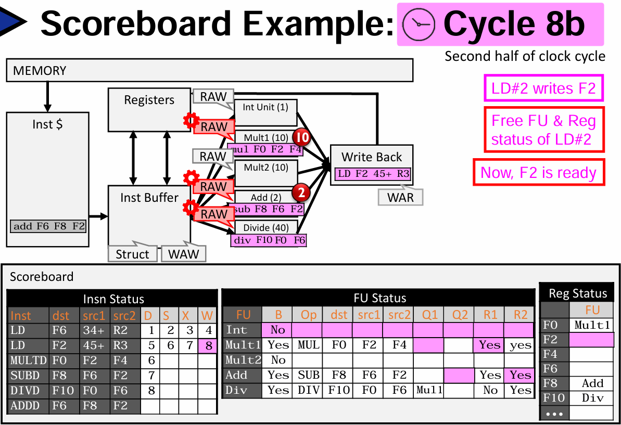
Scoreboard Cycle 8b

Slide 33
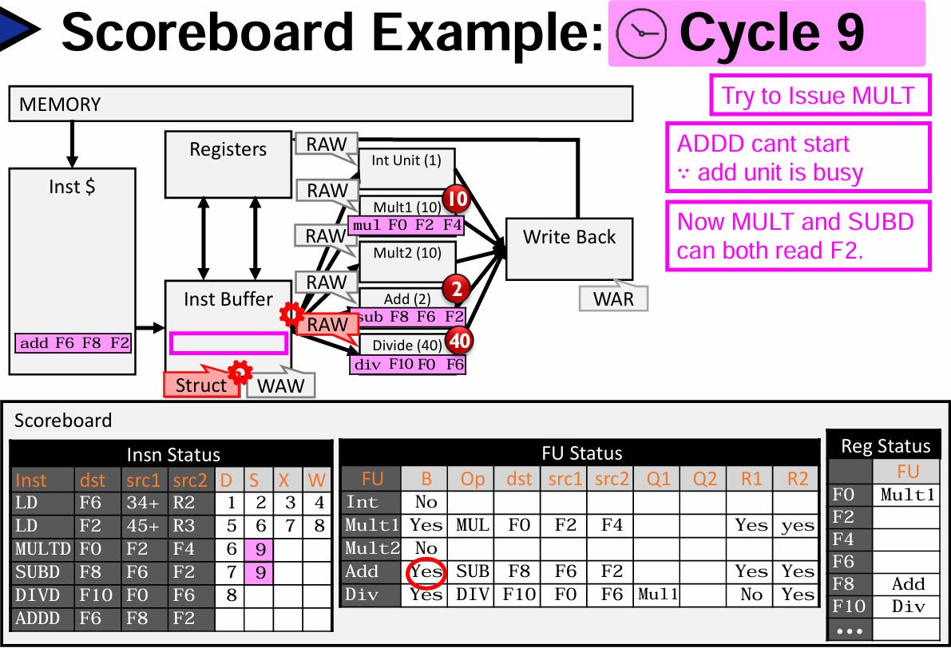
Scoreboard Cycle 9

Slide 34
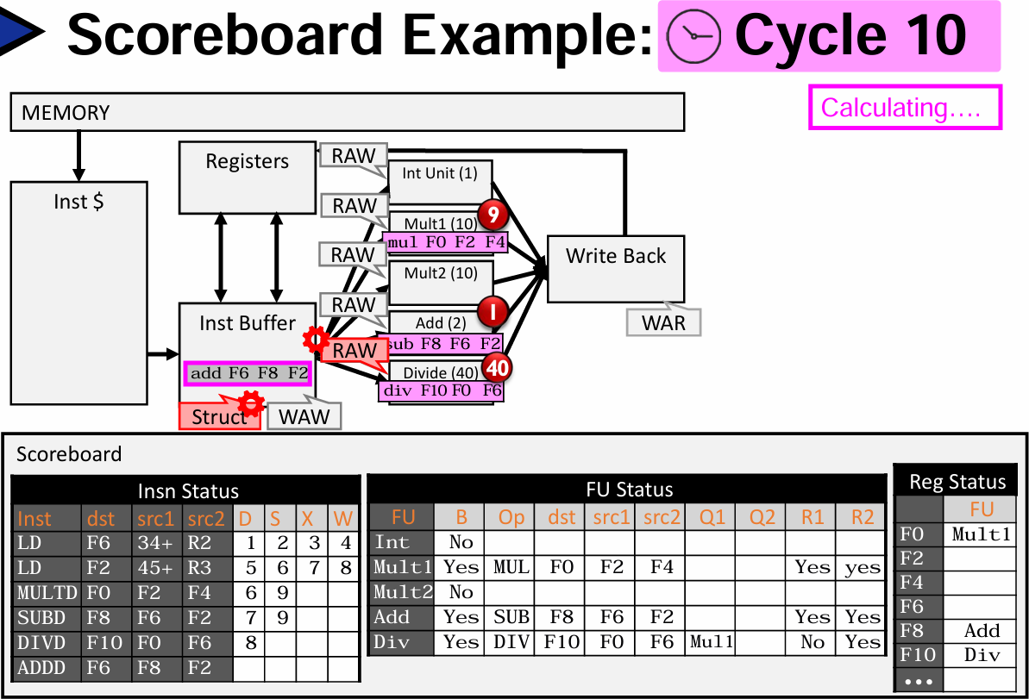
Scoreboard Cycle 10

Slide 35

Refer to this slide deck

Slide 36
Loop Unrolling ILP

Slide 37
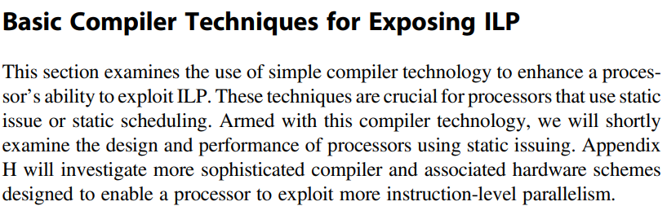
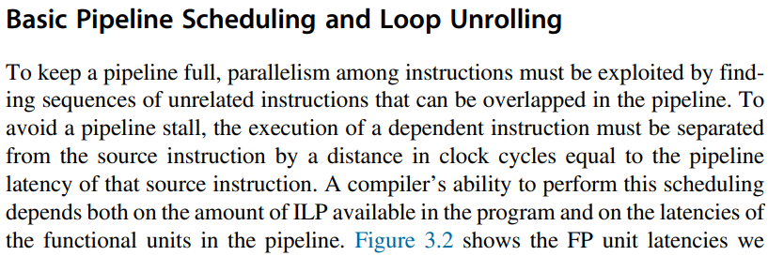
Basic Compiler ILP – Loop Unrolling

Slide 38
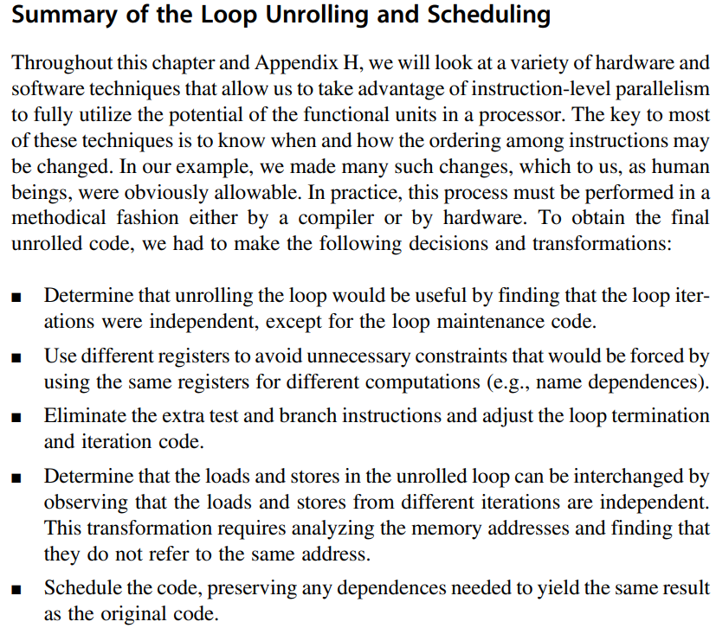


Summary of Loop Unrolling and Scheduling

Slide 39
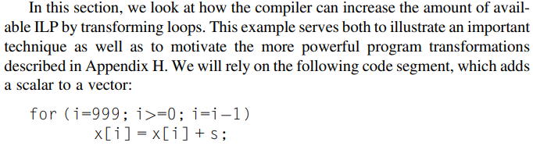
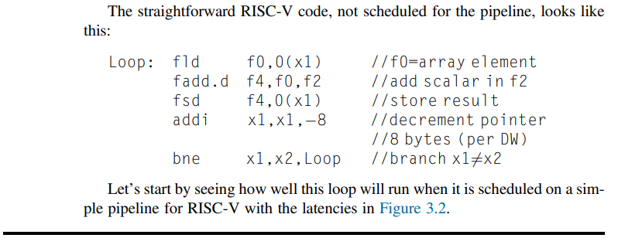
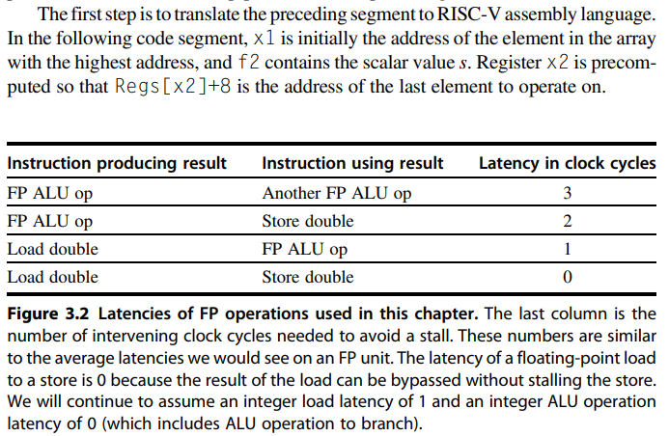

Assembly Code of a Loop

Slide 40
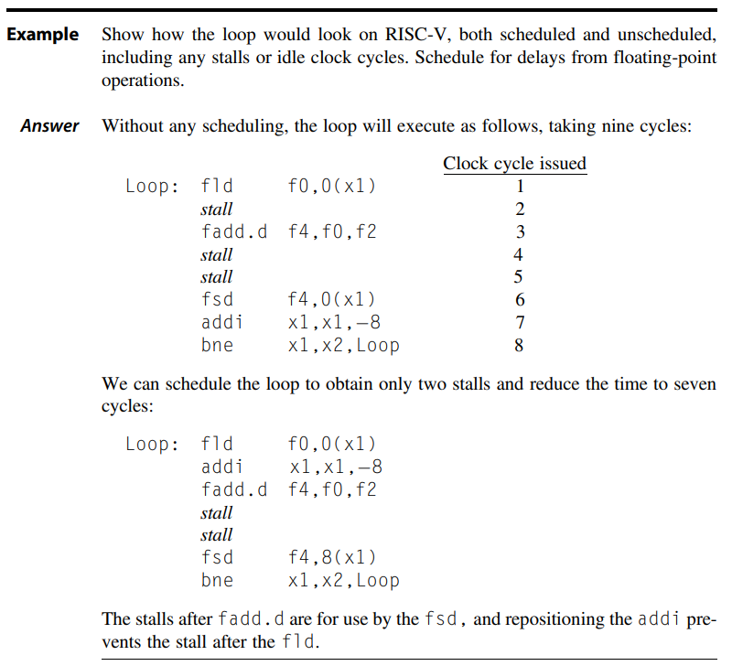





Scheduling of Assembly Code

Slide 41
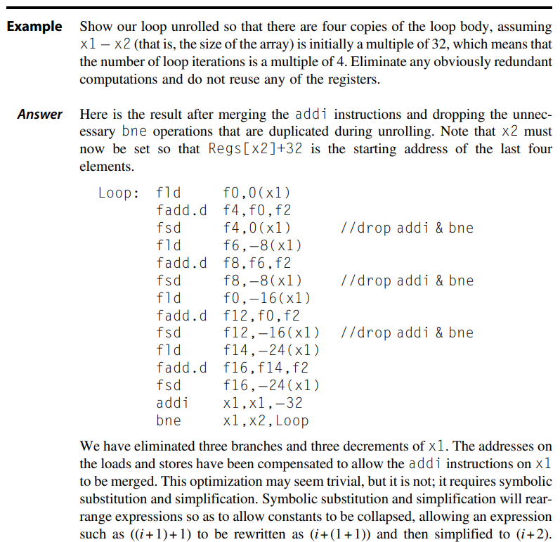


Loop Unrolled Assembly Code

Slide 42
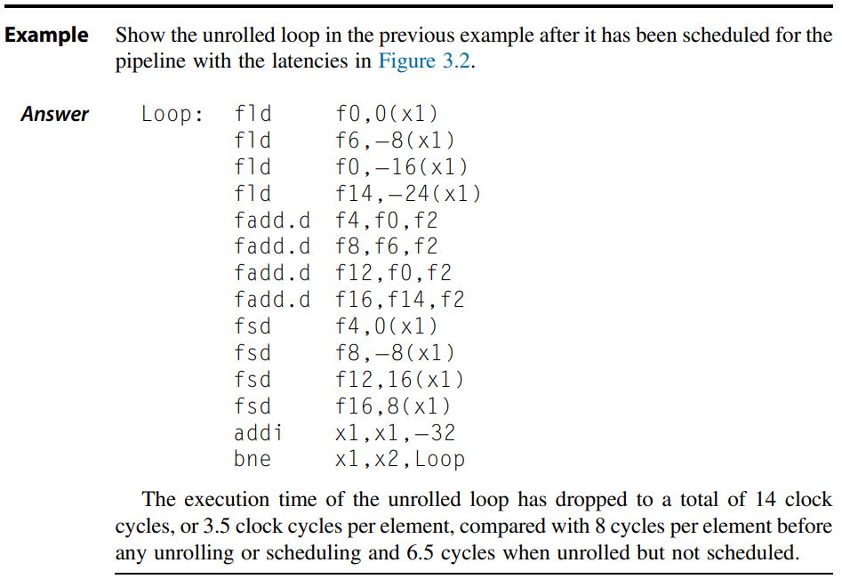
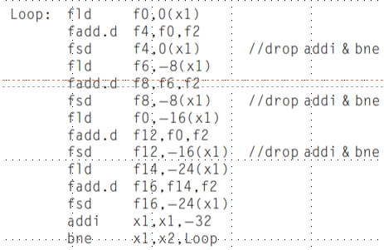

Incorporating Scheduling in Unrolled Code

Slide 43
Loop Unrolling
Loop unrolling
  Unroll by a factor of 4 (assume # elements is divisible by 4)
  Eliminate unnecessary instructions
Loop: fld f0,0(x1)
fadd.d f4,f0,f2
fsd f4,0(x1) //drop addi & bne
fld f6,-8(x1)
fadd.d f8,f6,f2
fsd f8,-8(x1) //drop addi & bne
fld f0,-16(x1)
fadd.d f12,f0,f2
fsd f12,-16(x1) //drop addi & bne
fld f14,-24(x1)
fadd.d f16,f14,f2
fsd f16,-24(x1)
addi x1,x1,-32
bne x1,x2,Loop
Compiler Techniques
note: number of live registers vs. original loop

Slide 44
Loop Unrolling/Pipeline Scheduling
Pipeline schedule the unrolled loop:
Loop: fld f0,0(x1)
fld f6,-8(x1)
fld f8,-16(x1)
fld f14,-24(x1)
fadd.d f4,f0,f2
fadd.d f8,f6,f2
fadd.d f12,f0,f2
fadd.d f16,f14,f2
fsd f4,0(x1)
fsd f8,-8(x1)
fsd f12,-16(x1)
fsd f16,-24(x1)
addi x1,x1,-32
bne x1,x2,Loop
Compiler Techniques
14 cycles
3.5 cycles per element

Slide 45
Advanced Branch Predictors

Slide 46
Branch Prediction
Static Predictor
  Taken / No-Taken
Basic 1-bit predictor
Basic 2-bit predictor
  For each branch:
    Predict taken or not taken
    If the prediction is wrong two consecutive times, change prediction
Correlating predictor
  Multiple 2-bit predictors for each branch
  One for each possible combination of outcomes of preceding n branches
    (m,n) predictor: behavior from last m branches to choose from 2^{m} n-bit predictors
Tournament predictor
  Combine correlating predictor with local predictor

Slide 47
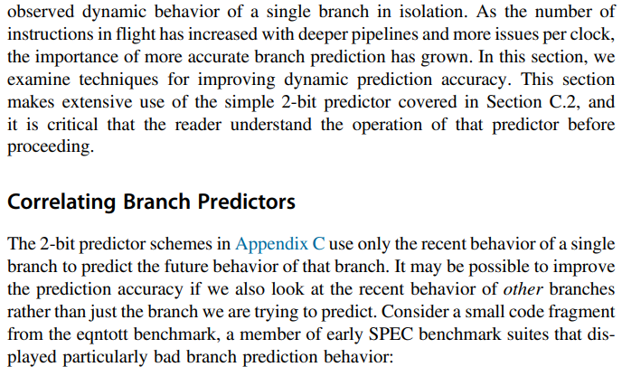
Reducing Branch Costs with Advanced Predictors

Slide 48
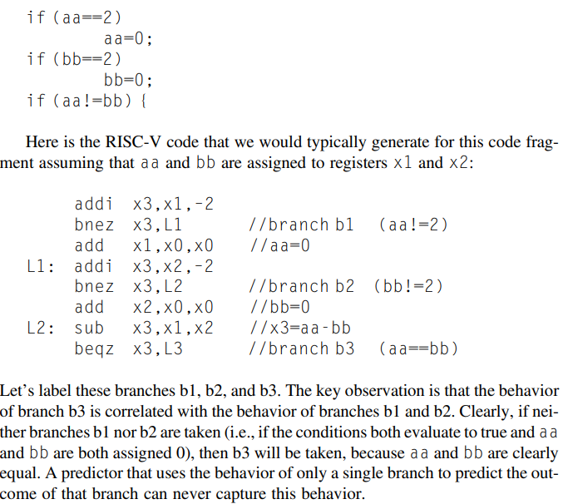
Looking at Other Branch Decisions

Slide 49
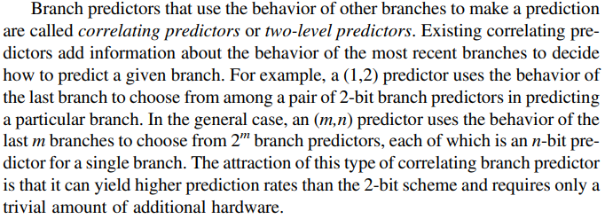
Correlating / 2 Level Branch Predictors

Slide 50
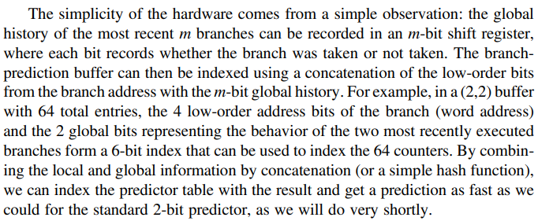
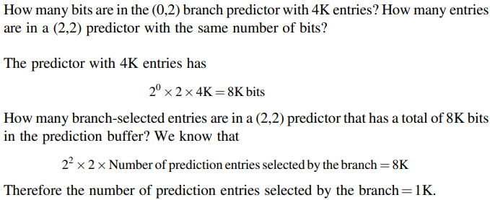
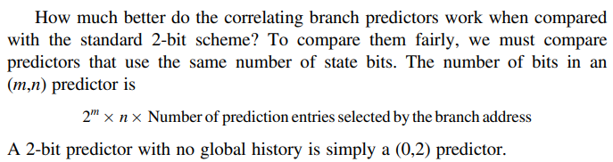
Example of Correlating Predictor

Slide 51
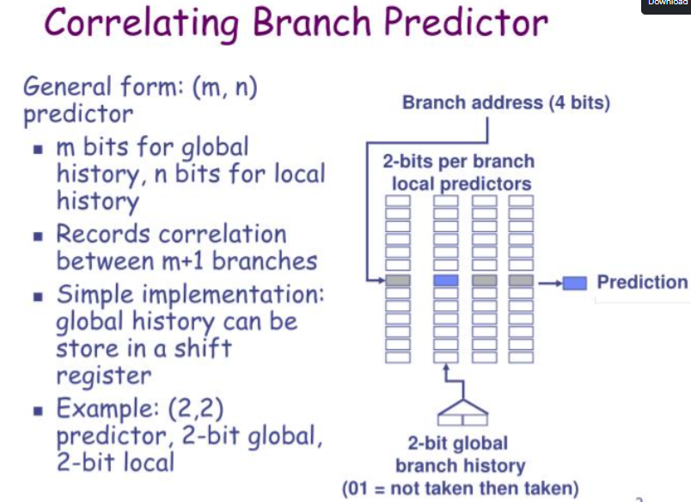
Correlation Predictor Details

Slide 52
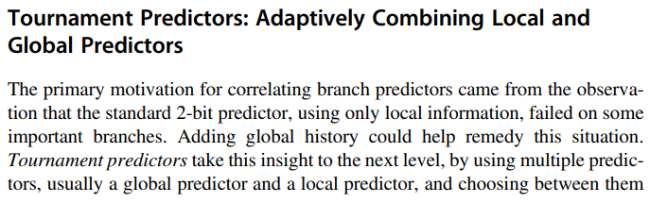
Tournament Predictor

Slide 53
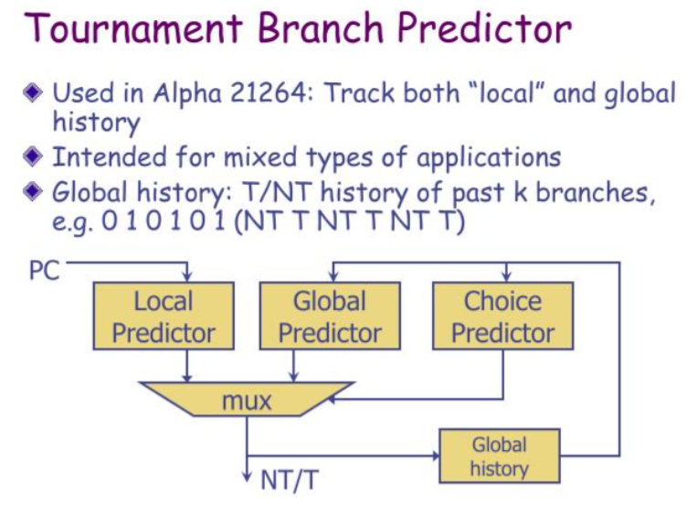
Principle of Tournament Branch Predictor

Slide 54
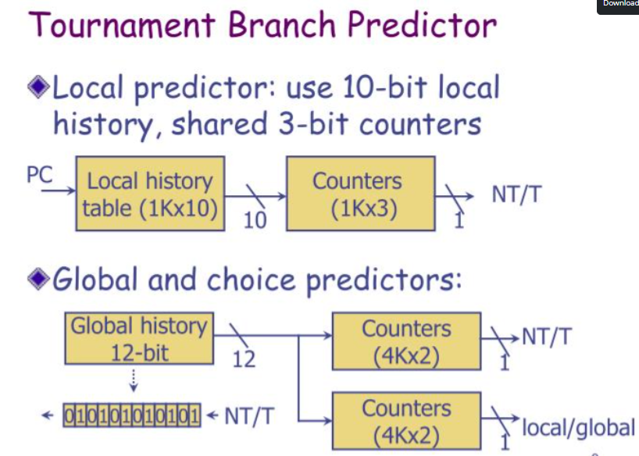
Details of Local and Global Predictors

Slide 55

Comparing Global and Tournament Predictors

Slide 56

Gshare 2-bit Predictor
Figure 3.4 A gshare predictor with 1024 entries, each being a standard 2-bit predictor.

Slide 57

Tournament Global Predictor
Figure 3.5 A tournament predictor using the branch address to index a set of 2-bit selection counters, which choose between a local and a global predictor. In this case, the index to the selector table is the current branch address. The two tables are also 2-bit predictors that are indexed by the global history and branch address, respectively. The selector acts like a 2-bit predictor, changing the preferred predictor for a branch address when two mispredicts occur in a row. The number of bits of the branch address used to index the selector table and the local predictor table is equal to the length of the global branch history used to index the global prediction table. Note that misprediction is a bit tricky because we need to change both the selector table and either the global or local predictor.

Slide 58


Diagram of Global and Tournament Predictor
Gshare 2-Bit Predictor
Tournament Global Predictor

Slide 59

Tagged Hybrid Predictors

Slide 60

Tagged Predictor Example

Slide 61

Tagged Hybrid Predictor
Figure 3.7 A five-component tagged hybrid predictor has five separate prediction tables, indexed by a hash of the branch address and a segment of recent branch history of length 0–4 labeled “h” in this figure. The hash can be as simple as an exclusive-OR, as in gshare. Each predictor is a 2-bit (or possibly 3-bit) predictor. The tags are typically 4–8 bits. The chosen prediction is the one with the longest history where the tags also match.

Slide 62


A few words about ISCA Conference
https://www.iscaconf.org/isca2025/program/workshops.php

Slide 63

Example of Core i7 Predictor

Slide 64
Data Hazards and Dynamic Scheduling

Slide 65

Advantages of Dynamic Schedule

Slide 66

The Idea behind Dynamic Scheduling

Slide 67

Checking Hazards in out of order

Slide 68

Exceptions in out of order

Slide 69


Modifications for out of order Execution

Slide 70




Scoreboarding technique – discussed earlier
In Dynamic Schedule Pipeline, all instructions pass through the Issue Stage “in-order”

Slide 71


Introduce Tomasulo

Slide 72
Dependence types
7
RAW (Read After Write) = “true dependence”
mul r0 * r1 -> r2
…
add r2 + r3 -> r4
WAW (Write After Write) = “output dependence”
mul r0 * r1-> r2
…
add r1 + r3 -> r2
WAR (Write After Read) = “anti-dependence”
mul r0 * r1 -> r2
…
add r3 + r4 -> r1
WAW & WAR are “false”, Can be totally eliminated by “renaming”

Slide 73
Instruction Scheduling - recap
I₁
I₂ I₃ I₄ I₅ I₆
FDIV.D f6, f6, f4
FLD f2, 45(x3)
FMULT.D f0, f2, f4
FDIV.D f8, f6, f2
FSUB.D f10, f0, f6
FADD.D f6, f8, f2
I₁
I₂
I₃
I₄
Valid orderings:
in-order
out-of-order out-of-order
I
I₁
I₂
I₃
I₄
I₅
I₆
5
I₂ | I₁ | I₃ | I₄ | I₅ | I₆
I₁ | I₂ | I₃ | I₅ | I₄ | I₆
I₆

Slide 74
Register Renaming Summary
Purpose of Renaming: removing “Anti-dependencies”
  Get rid of WAR and WAW hazards, since these are not “real” dependencies
Implicit Renaming: i.e. Tomasulo
  Registers changed into values or response tags
  We call this “implicit” because space in register file may or may not be used by results!
Explicit Renaming: more physical registers than needed by ISA.
  Rename table: tracks current association between architectural registers and physical registers
  Uses a translation table to perform compiler-like transformation on the fly

Slide 75


Register Renaming

Slide 76


Register Renaming Eliminates WAR, WAW

Slide 77
Register Renaming for Eliminating WAR and WAW Dependencies
Example:
DIV.D ADD.D S.D SUB.D MUL.D
F0,F2,F4 F6,F0,F8 F6,0(R1) F8,F10,F14 F6,F10,F8
DIV.D ADD.D S.D SUB.D MUL.D
F0,F2,F4 F6,F0,F8 F6,0(R1) T2,F10,F14 T1,F10,T2
Now only RAW hazards remain, which can be strictly ordered

Slide 78


Reservation Stations for Register Renaming

Slide 79

Basic Architecture of Tomasulo

Slide 80
Hardware Solution for Addressing Data Hazards
Dynamic Scheduling of Instructions:
  In-order issue
  Out-of-order execution
  Out-of-order completion
Data Hazard via Register Renaming
  Dynamic RAW hazard detection and scheduling in data-flow fashion
  Register renaming for WRW and WRA hazard (name conflict)
Implementations
  Scoreboard (CDC 6600 1963)
» Centralized register renaming
  Tomasulo’s Approach (IBM 360/91, 1966)
» Distributed control and renaming via reservation station, load/store buffer and common data bus (data+source)

Slide 81
Three Stages of Tomasulo Algorithm
Issue—get instruction from FP Op Queue
If reservation station free (no structural hazard),
control issues instr & sends operands (renames registers).
Execution—operate on operands (EX)
When both operands ready then execute;
if not ready, watch Common Data Bus for result
Write result—finish execution (WB)
Write on Common Data Bus to all awaiting units; mark reservation station available
  Normal data bus: data + destination (“go to” bus)
  Common data bus: data + source (“come from” bus)
    64 bits of data + 4 bits of Functional Unit source address
    Write if matches expected Functional Unit (produces result)
    Does the broadcast

Slide 82














Three Steps in Tomasulo

Slide 83

Organizations of Tomasulo’s Algorithm in RISC-V
Load/Store buffer
Reservation station
Common data bus

Slide 84
Tomasulo Example Cycle 3
Instruction status:
Exec
Write
Instruction |  | j | k | Issue | Comp Result |  | Busy | Address
LD | F6 | 34+ | R2 | 1 | 3 | Load1 | Yes | 34+R2
LD | F2 | 45+ | R3 | 2 |  | Load2 | Yes | 45+R3
MULTD | F0 | F2 | F4 | 3 |  | Load3 | No
SUBD | F8 | F6 | F2
DIVD | F10 | F0 | F6
ADDD | F6 | F8 | F2
Reservation Stations:
Time Name Busy Op
S1
Vj
S2
Vk
RS RS
Qj Qk
Add1 No
Add2 No
Add3 No
Mult1 Yes MULTD Mult2 No
R(F4) Load2
Register result status:
Note: registers names are removed (“renamed”) in Reservation Stations
Clock |  | F0 | F2 | F4 | F6 | F8 | F10 | F12 ... F30
3 | FU | Mult1 | Load2 |  | Load1

Slide 85

Tomasulo in RISC-V
Figure 3.10 The basic structure of a RISC-V floating-point unit using Tomasulo's algorithm. Instructions are sent from the instruction unit into the instruction queue from which they are issued in first-in, first-out (FIFO) order. The reservation stations include the operation and the actual operands, as well as information used for detecting and resolving hazards. Load buffers have three functions: (1) hold the components of the effective address until it is computed, (2) track outstanding loads that are waiting on the memory, and (3) hold the results of completed loads that are waiting for the CDB. Similarly, store buffers have three functions: (1) hold the components of the effective address until it is computed, (2) hold the destination memory addresses of outstanding stores that are waiting for the data value to store, and (3) hold the address and value to store until the memory unit is available. All results from either the FP units or the load unit are put on the CDB, which goes to the FP register file as well as to the reservation stations and store buffers. The FP adders implement addition and subtraction, and the FP multipliers do multiplication and division.

