Slide 1
Lecture 27
EE 421 / CS 425
Digital System Design
Fall 2025
Shahid Masud
Quiz 6 next lecture

Slide 2
Topics
Phase Detector, PLL, DPLL and their Applications
Using LUT for Speech Recording and Playback
  Sample Rate
  Different Sound Effects
Direct Digital Frequency Synthesis
  Concept
  Lookup Table Values
  Phase Accumulator
  DAC and Output Filter
Asynchronous Sequential Circuits
Types of Asynchronous Circuits:
  Pulse mode Asynchronous Circuits
  Fundamental Mode Asynchronous Circuits

Slide 3
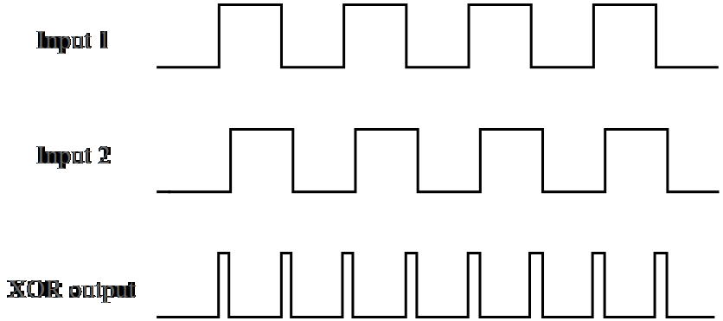
Phase Detector 1
Input 1
Input 2
Ø Detected

Slide 4
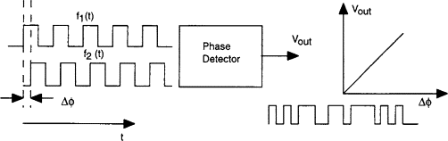
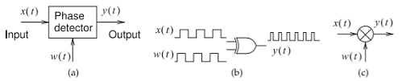
Phase Detector 2
Phase to Voltage Conversion
XOR based Phase Detection

Slide 5
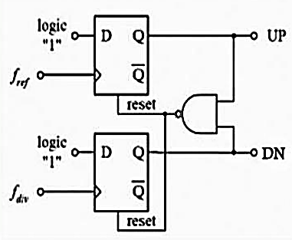
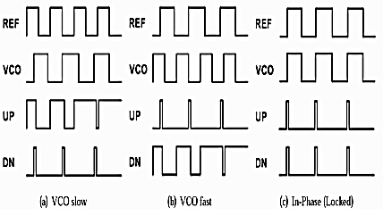
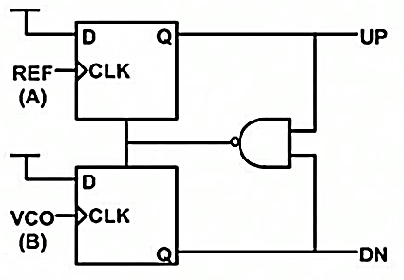
Phase Detector 3
Nand Based Phase Detector and Possible Outputs
Reference: T. SUPRAJA, K. BABURAO,K. Kishore, R. Reddy, International Journal of Computer Application (2250-1797) Volume 7– No.4, July-August 2017

Slide 6
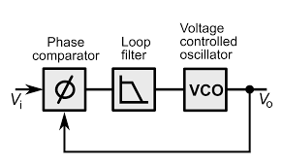
Phase Locked Loops PLL
Minimize Phase Error
Simple Analog PLL
Three Components of PLL:
Phase Comparator
Loop Filter
Voltage Controlled Oscillator

Slide 7
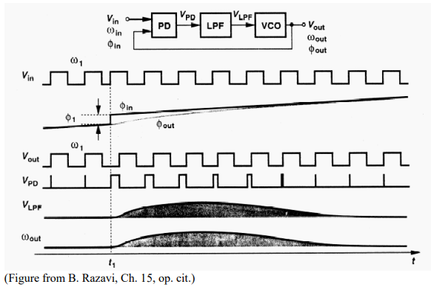
PLL Operation

Slide 8

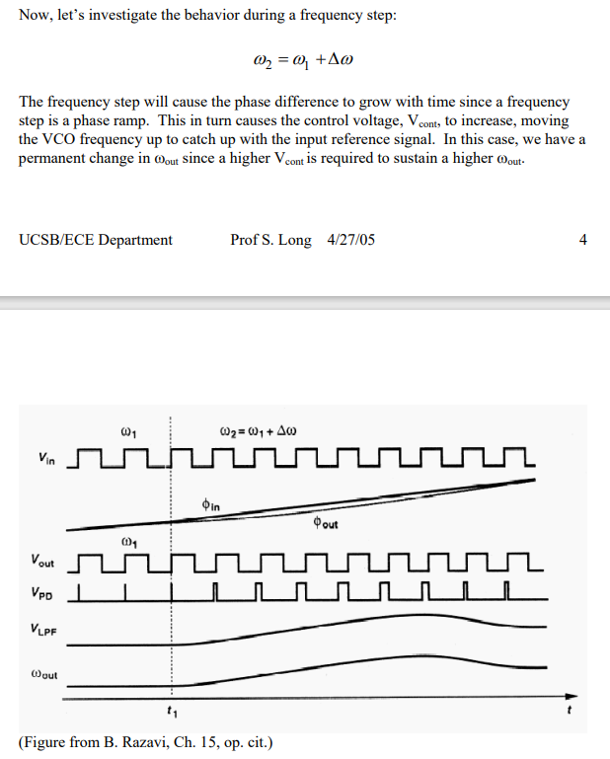
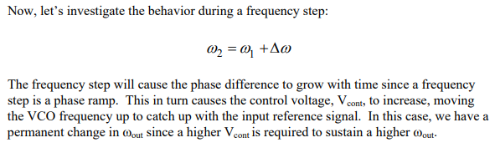
PLL Behavior with a step change in Phase

Slide 9
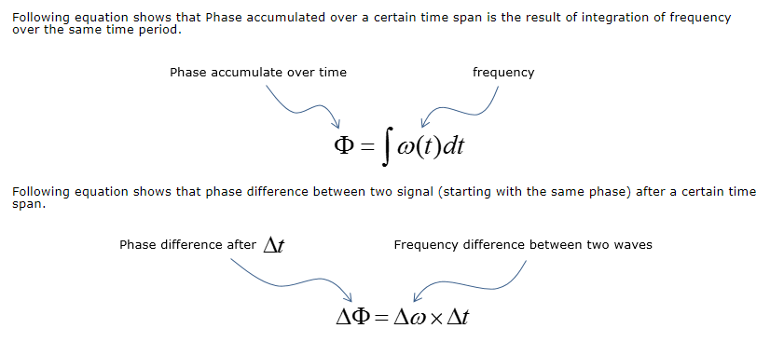
PLL Mechanism – for those into Maths

Slide 10
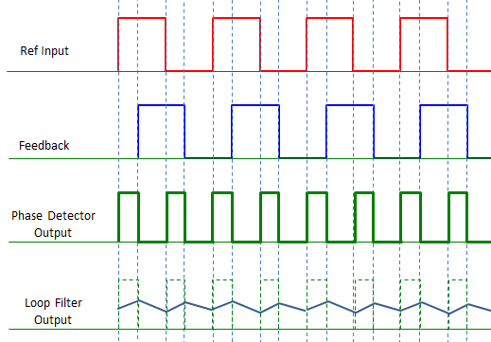
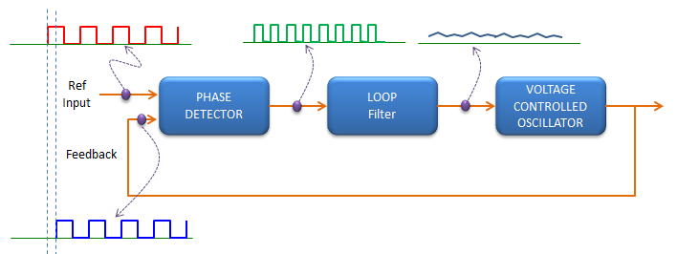
PLL Waveforms

Slide 11
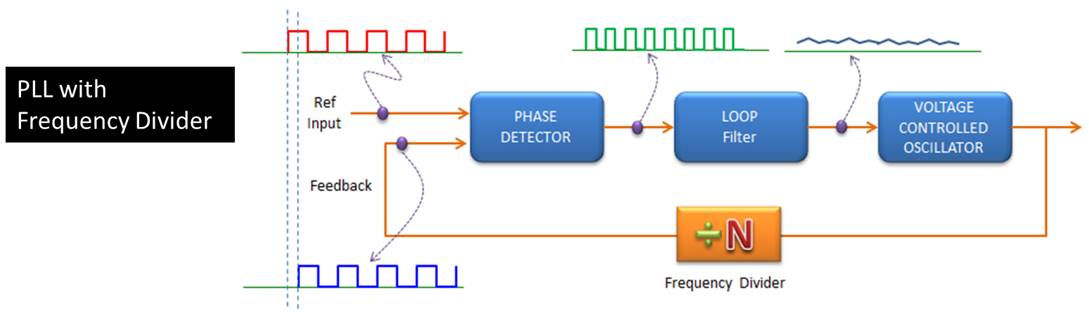
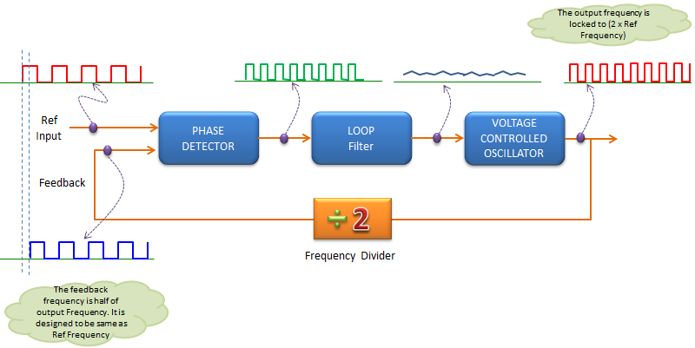
PLL with Frequency Divider

Slide 12
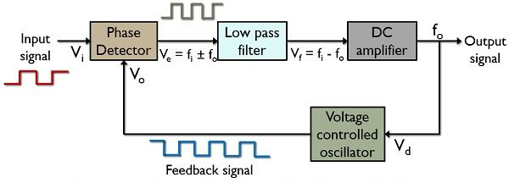
Digital PLL

Slide 13
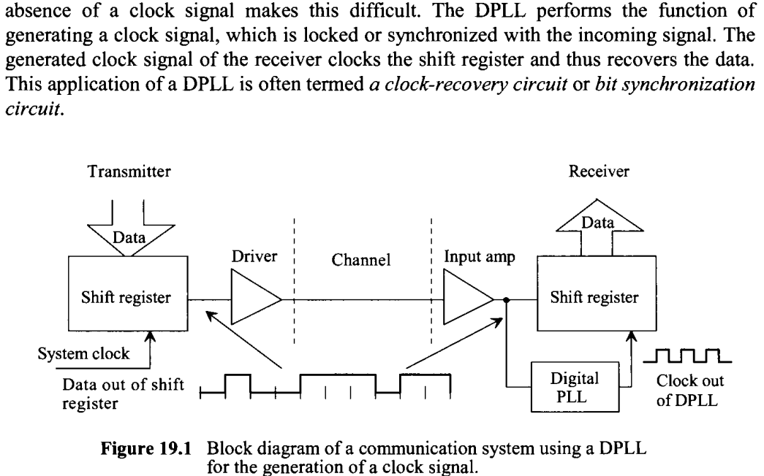
DPLL Application

Slide 14
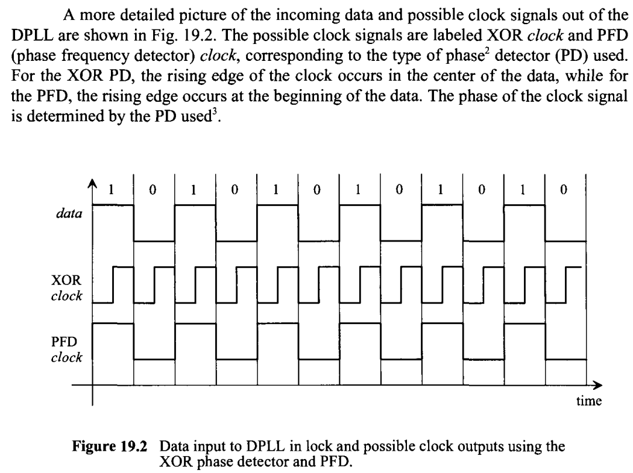
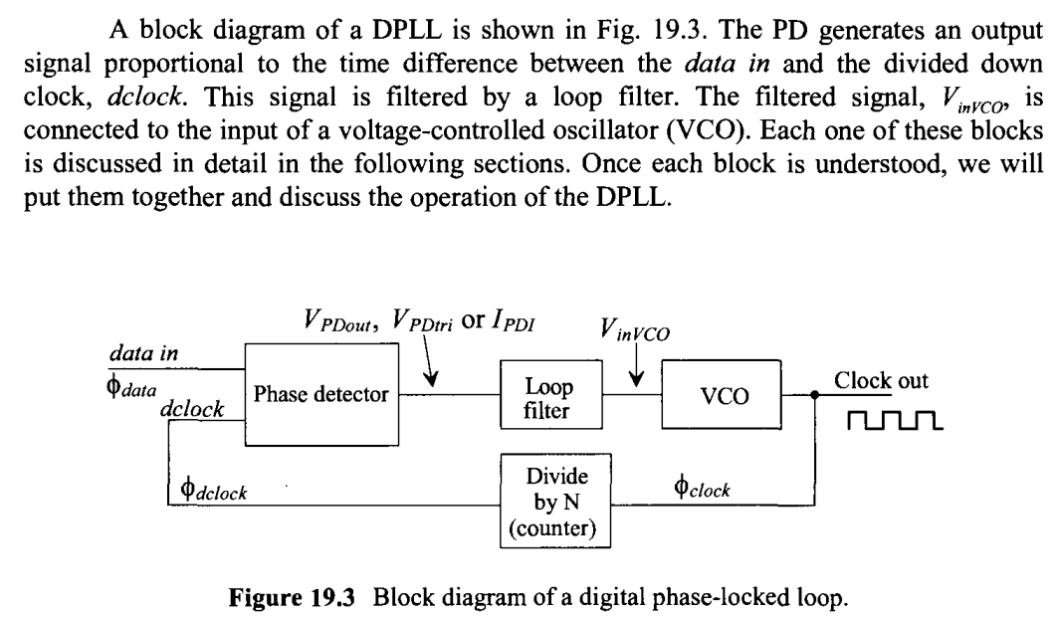
DPLL Design

Slide 15
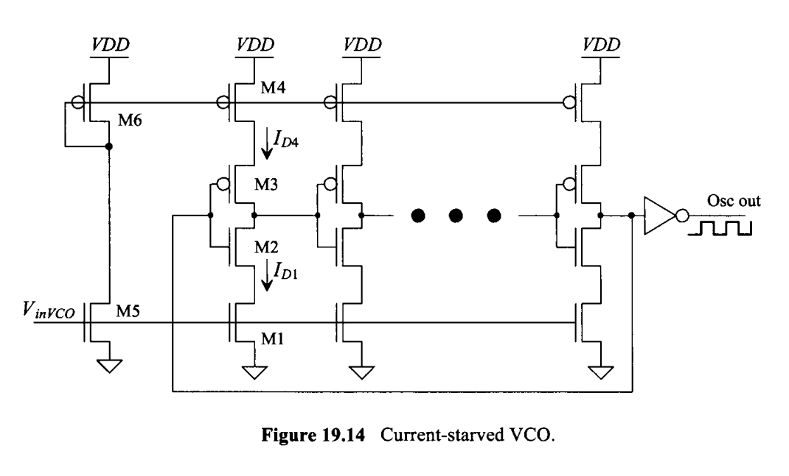
An Example Voltage Controlled Oscillator

Slide 16
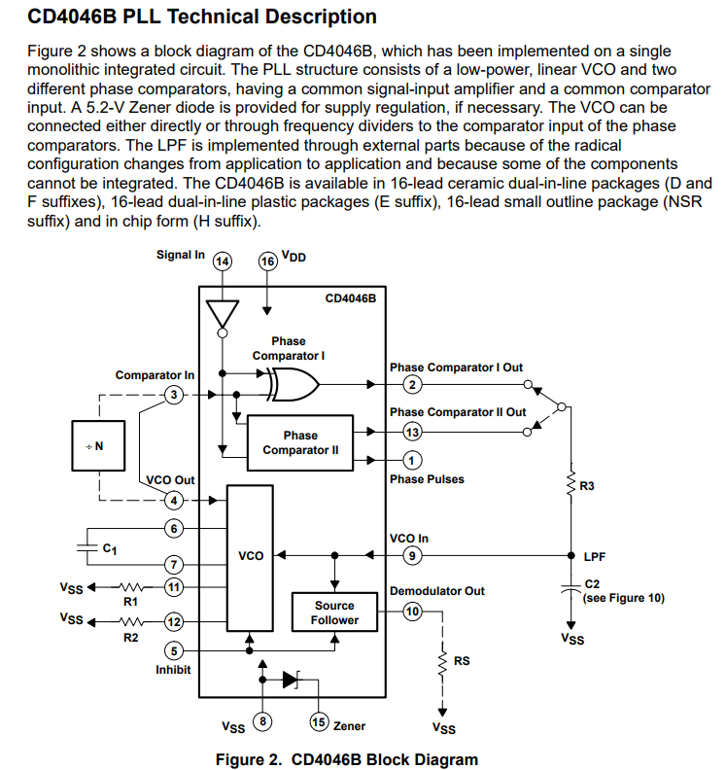
CD4046B PLL Chip

Slide 17
PLL Based Synthesizer

Slide 18
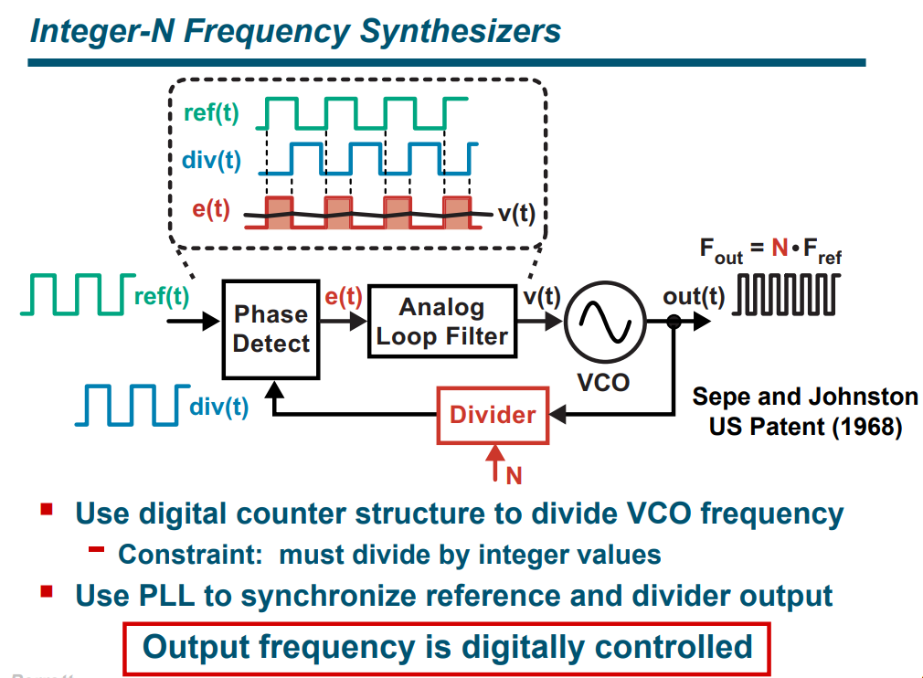
Integer-N Frequency Synthesizer

Slide 19
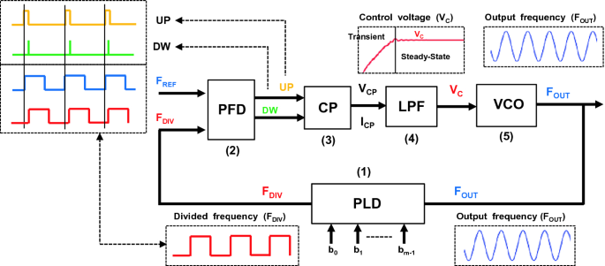
Digital Frequency Synthesizer Waveform
Programmable Divider

Slide 20
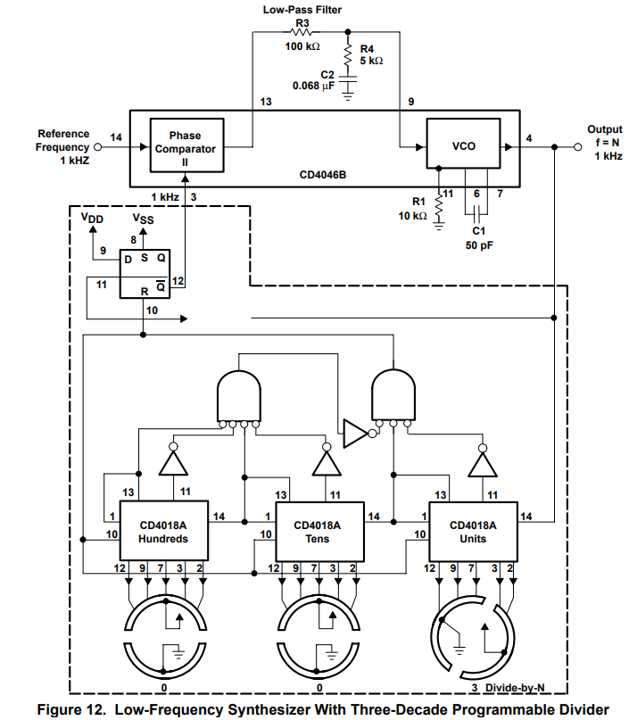
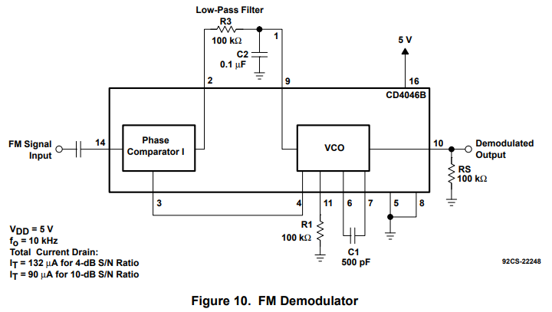





CD4046B in USE

Slide 21
Speech Processing using Memory

Slide 22


Speech Recording on Memory
Read Speech Samples
Store Speech Samples
Read Data
Data in Mem
D/A Converter
A/D Converter
LPF
Sampling
Frequency
Sampling
Frequency
Addresses
Counter
Counter
Different Recordings of Speech, Music, Effects, can be combined before playing on loud speaker
No. of stored samples depends on sampling rate and length of recording in seconds.
Counter is cyclic so the sequence will repeat after some time.

Slide 23
Speech Effects with Memory
Voice Changing through changing sampling frequency at readout
Varying amplitude through scaling of output
Mixing sound from two memories
Mixing memory sound with some synthesized signal
Mixing sinusoids to generate ring tones, sirens etc.
….. More such ideas

Slide 24
Direct Digital Synthesis

Slide 25
Introduction to Digital Frequency Synthesis
DDS generates analog waveforms using digital methods, allowing it to take advantage of digital’s programmability and higher levels of integration and lower cost.
Additionally, DDS allows a nearly instantaneous change in frequency or phase, making it a primary source for advanced digital modulation techniques such as frequency shift keying (FSK) and spread spectrum, use of interference mitigation techniques such as frequency hopping.
replacing or augmenting traditional phase locked loops (PLLs) while still offering high stability and signal purity.
A "template" containing the signal's amplitude values for all waveform phases is stored in memory and used to recreate the signal.
Different frequencies are produced by changing the rate the phase values are processed and using techniques to add, multiply and scale signals, various waveforms can be generated.
The synthesized signals are repeatable, and the frequencies are precise.

Slide 26
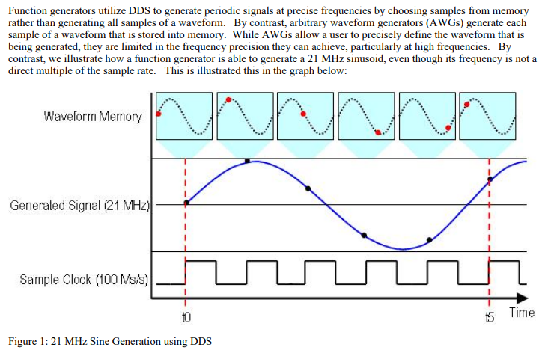
What is DDS?
Function Generators utilize DDS to generate periodic signals at precise frequencies by choosing samples from
Memory rather than generating new samples of desired waveform.
We can generate a waveform even though its frequency is not a direct multiple of sample rate of stored wave.
16384 Samples are stored in memory.
With each clock cycle, the appropriate sample is chosen from a lookup table and then generated.
As a result, we are able to generate signals at precise frequencies while supplying the digital-to-analog converter (DAC) with a constant 100 MHz clock.
21 MHz
Sine wave
Generation

Slide 27
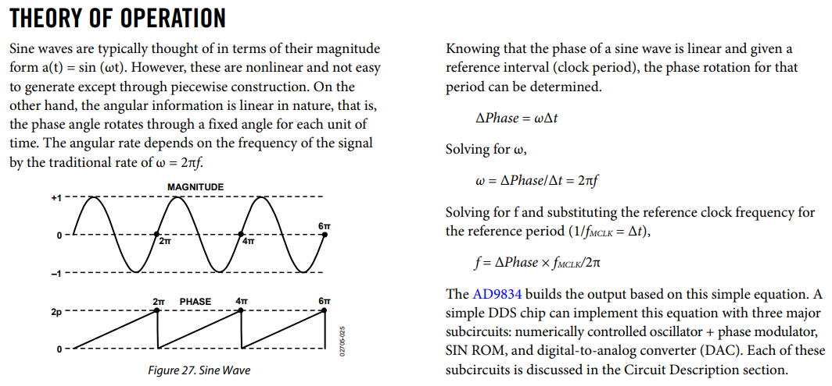
Theory of DDS Operation

Slide 28
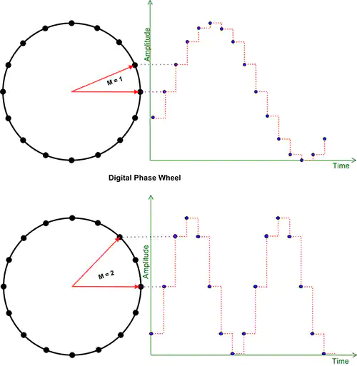
Phase Accumulator in Sinusoid
The phase accumulator
The phase accumulator is a modulo N counter that has 2^{N} digital states which are incremented for each system clock input pulse. The size of the increment depends on the value of the tuning word, M, applied to the accumulator adder stage. The tuning word fixes the step size of the counter increment. This will determine the frequency of the output waveform.
The phase accumulator generally has from 24 to 48 bits; at 24 bits there are 2²⁴ or 16,777,216 states. This number represents the number of phase values between 0 and 2p radians, or the achievable phase increment. For a 24-bit phase accumulator, the phase resolution is 3.74 E-7 radians. If a larger phase accumulator is used, the phase increment becomes even finer.
One way of visualizing the operation of the phase accumulator is to look at the accumulator operation as a phase wheel.
In the lower diagram the tuning word value is set to two. With this setting, every other state on the phase wheel is selected. The analog output now consists of two cycles, each with eight amplitudes, giving a total of sixteen states. With the tuning word set to two, the output frequency is now twice the previously obtained value.

Slide 29
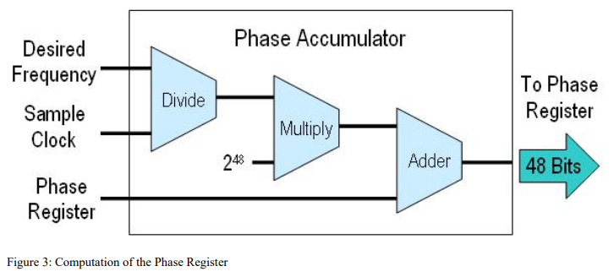
Phase Accumulator Operation
The phase accumulator combines the reference frequency and the value in the tuning word register.
Since the phase accumulator provides the phase value for the phase-amplitude lookup, the tuning word controls
the number of values retrieved from the phase-amplitude table for a cycle.
With a tuning word of 1, every value in the table is retrieved. A tuning word of 2 reads every other value and also
causes the accumulator to clock through to zero twice as fast, with the result that the output frequency has been doubled.
This remainder enables the DDS precision by ensuring that the lookup table will return the appropriate phase
information after the phase register rolls over (once period of the waveform).

Slide 30
Example Phase Accumulator
As an example, consider a DDS designed with a phase-amplitude table of 360 entries, holding the amplitude (voltage) values for each one of the 360 degrees of a sine wave.
The accumulator resets after 360 clock cycles. The reference frequency will be pulled from the system clock, so everything is clocked and updated at the same rate. With a tuning word of 1, the phase accumulator is incremented by 1 for every clock, and the table values are retrieved in order.
Every 360 reference clocks, the accumulator resets and another waveform is created.
Setting the tuning word to 2 has the result of reading every other value from the phase-amplitude table; the accumulator clocks through twice as fast and the output frequency is doubled.
Of course, using only 360 values would produce a choppy output and the jitter would make it unusable. DDS systems typically have phase-amplitude tables with thousands of data points and 16-bit registers for the tuning register and phase accumulators.

Slide 31
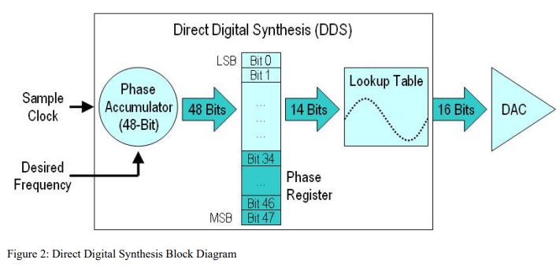
Block Diagram of DDS
Implementation of DDS requires a look-up table to determine the phase output signal at any point in time.
Building blocks for DDS based waveform generation are shown below.
Bit-widths represent a commercial chip from Analog Devices.

Slide 32
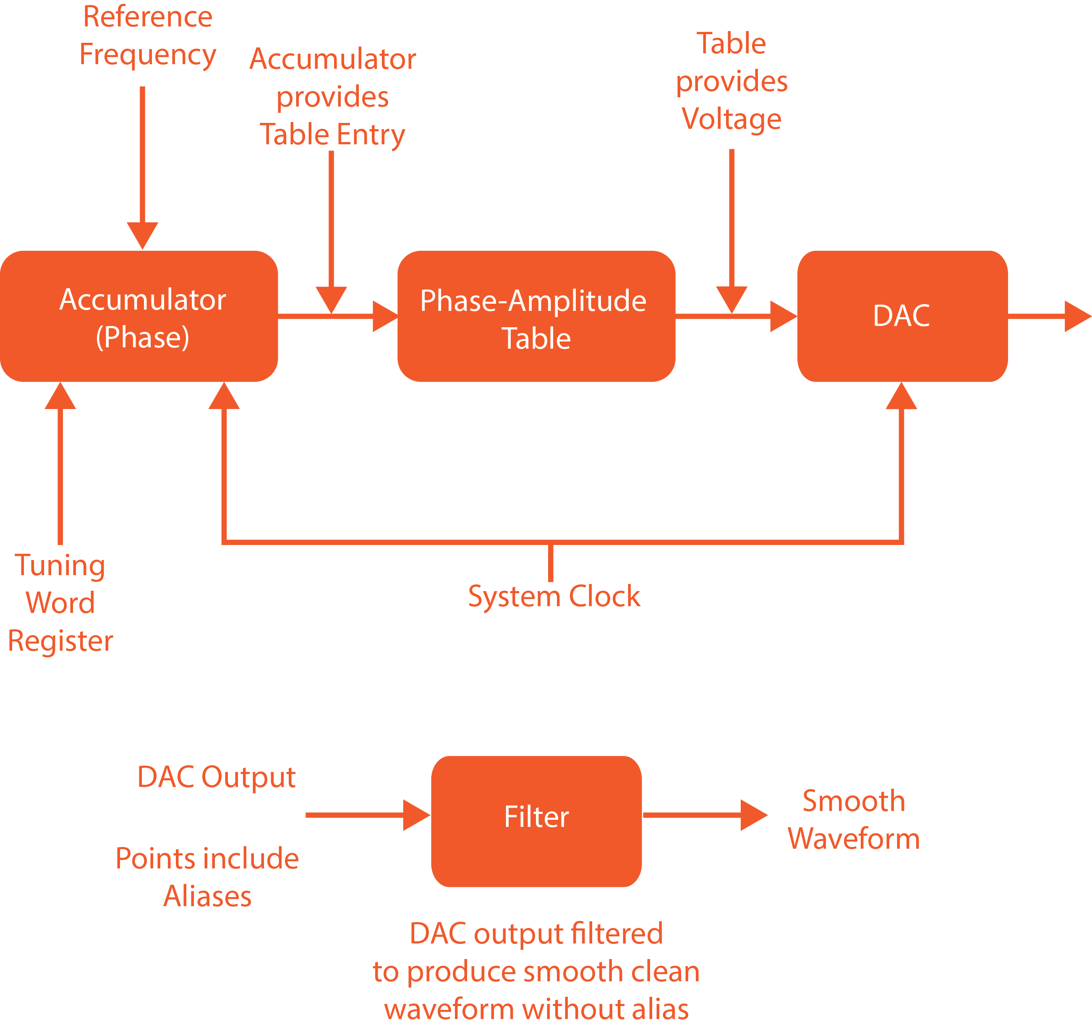
Another view of DDS Blocks

Slide 33
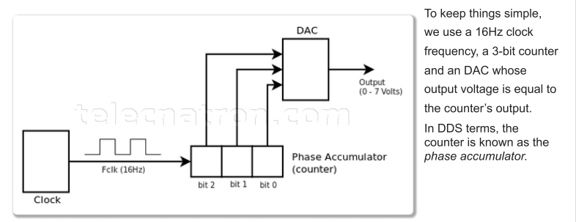
Example of Fixed Freqency DDS Design
We start with a Clock source which generates fixed frequency square wave.
This clock is used to get output from Binary Counter.
Output of Binary Counter is connected to Digital to Analog Converter (DAC).
In this example, we use 16 Hz clock frequency, 3 Bit Binary Counter.
In DDS terms, the counter is known as the ‘phase accumulator’

Slide 34
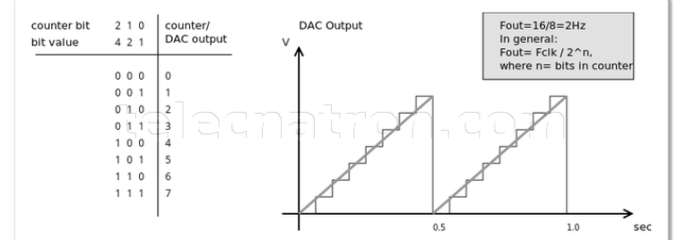
Counter to DAC waveform
On each clock pulse the counter counts up by one until it reaches its maximum value, when it resets and starts again from 0 on the next pulse.
The counter has 8 discrete output values and there are 16 clock pulses per second. Hence, two complete wave cycles for a frequency of 2 Hz.
The output frequency is determined by dividing the clock frequency by two raised to the power of the Number of bits in the counter.

Slide 35
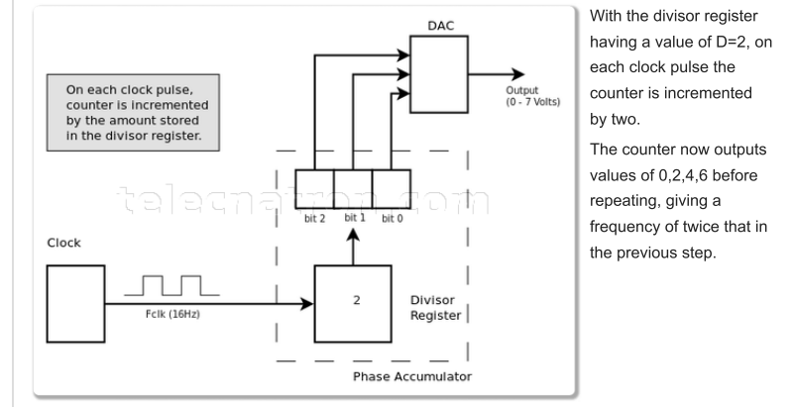
Divisor Register in DDS
To be able to generate other frequencies besides Fclk/2, a Divisor Register is added to the phase accumulator.
Now, on each clock pulse, the counter is incremented by the value in the divisor register.
Eg. With divisor register having a value of D=2, on each clock pulse, the counter is incremented by 2.
The counter now outputs values of 0,2,4,6 before repeating. This gives a frequency of twice that in the previous case without divisor.

Slide 36
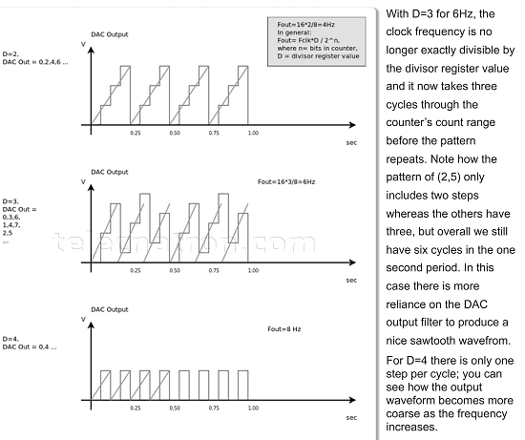
Waveforms with different values of Divisor
With D=2, we now have 4 Hz. The output frequency is determined by multiplying the clock frequency by the divisor register value and dividing by two raised to the power of the number of bits in the counter.

Slide 37
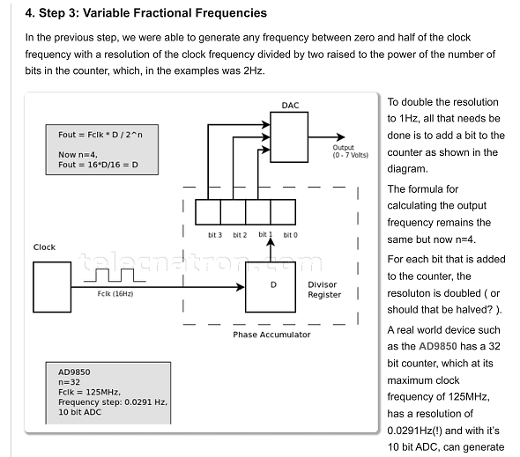
Variable Fractional Frequencies

Slide 38
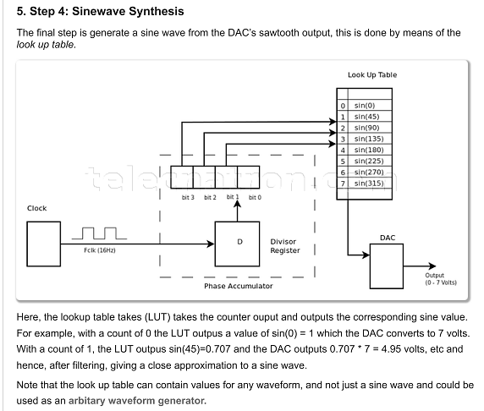
Sinewave Synthesis

Slide 39
Few Extra Slides

Slide 40
Operation of DDS Building Blocks
A Phase Accumulator compares the sample clock and desired frequency to increment a phase register.
The idea is that we can generate signals with precise frequencies by generating an appropriate sample based
on the phase of that frequency at any point in time.
In addition, by representing our waveform with 2¹⁴ (16,384) points, we can represent exactly 16,384
phase increments with our lookup table.
The phase accumulator uses simple arithmetic operations to calculate the lookup table address for each
generated sample.
It does this by dividing the desired frequency by the sample clock and multiplying the result by 2⁴⁸. This number is based on the bit-resolution of the phase register. A 48 bit is used for maximum precision. Of these, 34 bits are used to store remainder phase and 14 bits are used to choose a sample from the lookup table.
Thus, the phase accumulator produces a 14-bit address that corresponds to the exact phase of the signal. For example, address ‘0000 0000 0000 00’ corresponds to 0⁰.
On the other hand, an address of ‘1111 1111 1111 11’ corresponds to 359.978⁰. Thus the signal generator can use this address to control the phase of the signal at any point in time.

Slide 41

Determine the Output Frequency
The output frequency of the DDS is set by the tuning word value and increases proportionally to the value of the tuning word. The sample rate remains fixed at the system clock rate, and the time between output samples is constant.
The output frequency depends on the tuning word increment, so as the tuning word value increases, there are fewer steps in each output cycle, thereby increasing the frequency.
The tuning word can be increased until there are only two samples per cycle, which brings the DDS output to its Nyquist frequency, or half the system clock rate.
The output frequency of the DDS is dependent upon the tuning word value, and the length of the accumulator.
It is expressed by Equation:
Where:
f_{out} is the DDS output frequency
M is the tuning word value
f_{c} is the system clock frequency
N is the length of the phase accumulator
The output of the phase accumulator, which is the instantaneous phase of the output waveform, is used to drive the phase to amplitude converter. The phase to amplitude converter outputs a digital word, the value of which is the amplitude of the sine waveform for the input phase.
Note that the number of bits used to drive the phase to amplitude converter is less than that used for the phase accumulator. This is referred to as phase truncation and is used to reduce the hardware of digital stages after the phase accumulator.

Slide 42
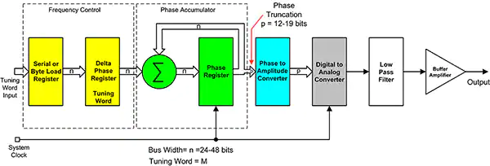
How does Digital Synthesis work?
Digital synthesis is based on a phase accumulator which generates a series of digital states (instantaneous
phase), the value of which increases linearly, forming a numeric ramp.
This signal is made periodic and represents the instantaneous phase of the output waveform, from zero to 2p radians.
This is the digital input to a lookup table that provides the phase to amplitude conversion which is applied
to a digital-to-analog converter (DAC), producing the desired analog output after filtering.
While the most common DDS output waveform is the sine wave; ramps, triangle waves, and square
waves are also easily generated.
Since the input to the DAC is a series of sampled values, the output has quantization steps. These steps produce spectral
images at multiples of the sample rate in the frequency domain which are not desired. A low-pass filter, placed after the DAC,
suppresses these unwanted spectral responses.

Slide 43
Benefits of DDS
The benefits of DDS are:
The ability to generate arbitrary frequencies with accuracy and stability, limited only by the oscillator used to clock the phase accumulator. Crystal oscillators, depending on their specifications, can deliver tolerances of 50 parts per million to ~0.1 part per billion, making DDS extremely accurate. Analog signal generators can only deliver accuracy and stability of a few tenths of a percent unless using a high-end device.
The frequencies provided by DDS are repeatable. Loading the tuning word register with the value corresponding to frequency F1 generates a signal at frequency F1. If the tuning register is then loaded with the value for frequency F2, the output signal is quickly changed to frequency F2. When the tuning register is reloaded with the value for F1, the exact the same frequency F1 is provided as was generated before. Analog generators can't guarantee this precision.
High frequency resolution can be achieved with the digital techniques used in DDS. Increasing the resolution is as simple as adding more bits to the least significant end of the phase accumulator and tuning register. Analog waveform generators, which depend on mechanical components like potentiometers and variable capacitors to tune the oscillator, are limited in the resolution they can provide.

Slide 44
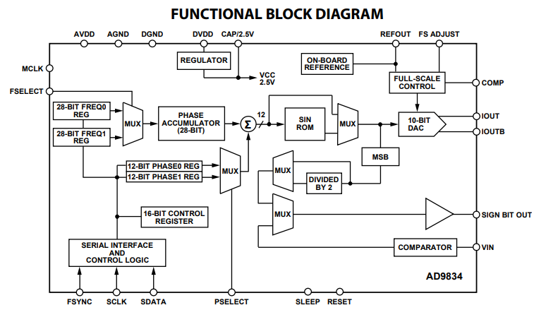
Commercial DDS Chip AD9834 Analog Devices

Slide 45
ASYNCHRONOUS SEQUENTIAL CIRCUITS

Slide 46
Asynchronous Sequential Circuits
A clock is not utilized to synchronize state changes
Only external inputs and current states are available to cause state changes

Slide 47
Fundamental Mode Asynchronous Circuits
These circuits have level inputs and unclocked memory elements
Uses inherent delays present in logic circuit elements
Assume that each delay element has same delay Δt
X1….Xn
Combinational
Logic Circuit
Z1….Zm
yr..….y1
Y1.……Yr
Delay, Δt
Delay, Δt

Slide 48
Other conditions for Fundamental Mode cct
All delays in a circuit branch are lumped to a single Δt
The delay is always Δt
Inputs are restricted so that only one input variable is allowed to change value at a given instant to ensure correct behavior
For predictable operations, input changes should be spaced in time by at least Δt; the time needed for the circuit to settle down to a stable state following an input change

Slide 49
Pulse Mode Asynchronous Circuits
Pulses will not occur simultaneously on two or more input lines
Memory element transitions are limited only by input pulses
Input variables are used either only in uncomplemented or in the complemented forms, but not both together
X1….Xn
Combinational
Logic Circuit
Z1….Zm
yr.……y2 y1
D1
D2………Dr
Flip flop
memory

Slide 50
Pulse Mode Asynchronous Sequential
Pulse Mode Asynchronous Circuits :
In the pulsed mode, the input variables are allowed to be applied in the form of pulses, rather than in the form of levels.
But the width of input pulses is a critical parameter. There are two restrictions on the width of the input pulses.
  The first requirement is that the pulses should be long enough so that the circuit can respond to them.
  The second requirement is that the pulses should not be too long so that they are still present after the new secondary state is reached.
The base of calculating the minimum pulse width is the propagation delay of the excitation logic.
The maximum pulse width is calculated based on the total propagation delay through the excitation logic and the memory.

Slide 51
Conditions for Pulse mode circuits
Input pulses should be spaced in time by at least the response time of the slowest memory element
No memory element will be in process of changing state when a new input pulse arrives

