Slide 1
Lecture 24
EE 421 / CS 425
Digital System Design
Fall 2025
Shahid Masud

Slide 2
Topics
Recap: BIST and its Components
SISR – Serial Input Shift Signature Register
MISR – Multi Input Signature Register
BILBO – Built-In Logic Block Observer
Boundary Scan
JTAG Standard
QUIZ 5 on Tuesday
QUIZ 6 on Last Lecture

Slide 3



Recap: Designing with BIST Circuits
x₁
…
x_{n}
Combinational
Logic
Z₁
….
Z_{m}
Chip
I/O Pins
u₁…..…..u_{n}
MISR
S
y1….yr
Yr….Y1
$$Pass/\overline{Fail}$$
ALFSR
Memory
Memory
Test Data Out
$$Test/\overline{Normal}$$
SISR
ALFSR
Test Data In
$$Pass/\overline{Fail}$$

Slide 4
General Structure of ALFSR
C_{n-1}
C_{n-2}
C₁
C₀
Dn
Dn-1
D1
D0
D Q
D Q
D Q
a₁
D Q
a_{n}
a_{n-1}
a_{n-2}
a₀
Clk
f(x)=a_{n}x^{n}+………. + a₃x³ + a₂x² + a₁x¹ + a₀

Slide 5



Check ALFSR Sequence with given circuit or polynomial and seed value
Polynomial
P(x)=x⁴+x+1
Or f(x)=a₄x⁴ + a₃x³ + a₂x² + a₁x¹ + a₀x⁰
x¹
x⁰
x⁴
x³
x²
D0 Q0
D1 Q1
D2 Q2
D3 Q3
a₄
a₃
a₂
a₁
a₀
D3=y3 ⨁ y2
y1
y2
y3
Use some seed value like y3y2y1y0 = 1000
that is preset at start
y0
Clk
+
Q3 D3
Q2 D2
Q1 D1
Q0 D0
Another way of drawing

Slide 6
Generated sequence from this ALFSR circuit
Clock | D0=(y3⨁y2) | y3 | y2 | y1 | y0
1 | 0 | 1 | 1 | 1 | 1
2 | 0 | 1 | 1 | 1 | 0
3 | 0 | 1 | 1 | 0 | 0
4 | 1 | 1 | 0 | 0 | 0
5 | 0 | 0 | 0 | 0 | 1
6 | 0 | 0 | 0 | 1 | 0
7 | 1 | 0 | 1 | 0 | 0
8 | 1 | 1 | 0 | 0 | 1
9 | 0 | 0 | 0 | 1 | 1
10 | 1 | 0 | 1 | 1 | 0
11 | 0 | 1 | 1 | 0 | 1
12 | 0 | 1 | 1 | 1 | 1
13 | 1 | 1 | 0 | 1 | 0
14 | 1 | 0 | 1 | 0 | 1
15 | 1 | 1 | 0 | 1 | 1
16 | 1 REPEAT | 0 | 1 | 1 | 1
Seed Value 1111
D3=y3 ⨁ y2

Slide 7
SISR – Serial Input Signature Register
X=Q0 ⨁ Q2
DFF0
DFF1
DFF2
D0 Q0
D1 Q1
D2 Q2
Serial IN
Y=X ⨁ IN
Clk
The flip flops and feedback XOR gate form an ALFSR with some seed value
The output from XOR is taken through another XOR with Serial IN bit stream
The circuit continues to advance one bit at a time, with each clock edge
Once all bits have been read through Serial IN, final status of Q0, Q1, and Q2 represents a signature pattern
The pattern will only re-appear if the same bit pattern is presented at input
No other pattern will produce the same final signature output at registers

Slide 8
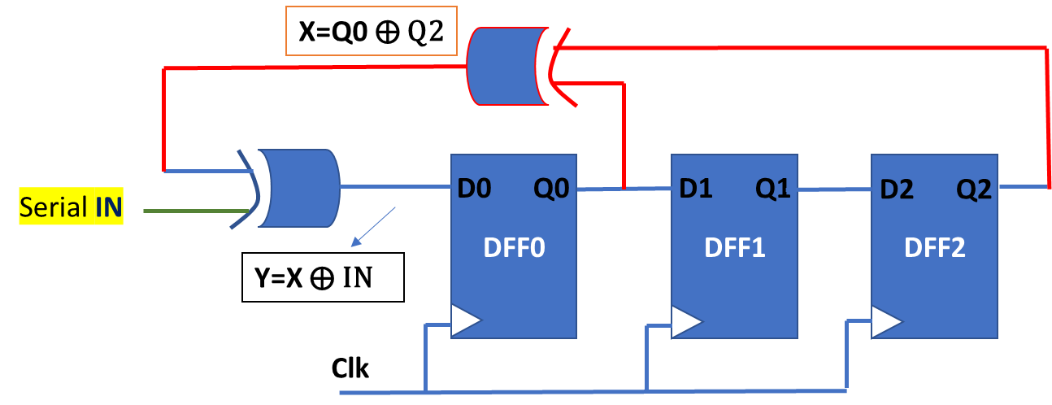
SISR Example
Eg., Let seed value = ‘000’
Generate Signature for input bit patterns ‘011101”
⨁
⨁
Clk | IN | X | Y | Q0 | Q1 | Q2
1 | 0 | 0 | 0 | 0 | 0 | 0
2 | 1 | 0 | 1 | 0 | 0 | 0
3 | 1 | 1 | 0 | 1 | 0 | 0
4 | 1 | 0 | 1 | 0 | 1 | 0
5 | 0 | 0 | 0 | 1 | 0 | 1
6 | 1 | 0 | 1 | 0 | 1 | 0
7 | END |  |  | 1 | 0 | 1
Signature produced
More register bits, and different seed value and different feedback XOR will generate new signatures

Slide 9

SISR Example 2 – Use sequence ‘011110’, Seed value ‘111’
⨁
⨁
Clk | IN | X | Y | Q0 | Q1 | Q2
1 | 0 | 0 | 0 | 1 | 1 | 1
2 | 1 | 1 | 0 | 0 | 1 | 1
3 | 1 | 1 | 0 | 0 | 0 | 1
4 | 1 | 0 | 1 | 0 | 0 | 0
5 | 1 | 1 | 0 | 1 | 0 | 0
6 | 0 | 0 | 0 | 0 | 1 | 0
7 |  |  |  | 0 | 0 | 1
Final Signature

Slide 10
MISR – Multi Input Signature Register
X=Q0 ⨁ Q2
DFF0
DFF1
DFF2
D0 Q0
D1 Q1
D2 Q2
Clk
IN0
IN1
IN2
Parallel
Inputs
After all parallel inputs have been applied, one input set on each clock, the last status at Q0,Q1,Q2 is the signature
Example: Determine ‘signature’ when inputs {010, 101, 110, 111, 011} are applied at {IN0,IN1,IN2}

Slide 11
BILBO – Built-In Logic Block Observer
Combine the following into one circuit:
  Pseudo Random Pattern Generator (ALFSR)
  Serial Input Signature Register (SISR)
  Multi-Input Signature Register (MISR)
  Scan Registers

Slide 12
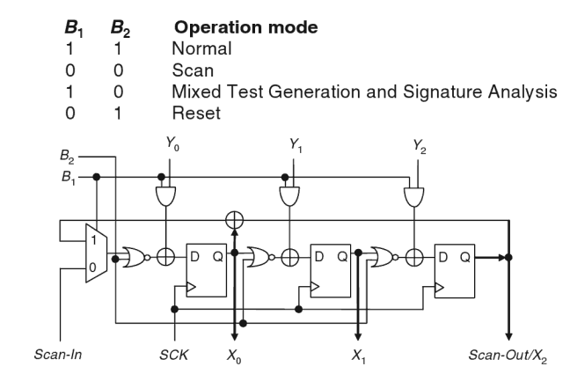
BILBO Implementation with 3 Registers

Slide 13
A BILBO Circuit
Example
1
0
Sin
DFF1
B2
D Q
Z1
B1 | B2 | Operating Mode
0 | 0 | Shift Register
0 | 1 | PR PG (Pattern Gen)
1 | 0 | Normal
1 | 1 | MISR
DFF2
D Q
Z2
D Q
DFF3
Line Colour
Red = feedback ALFSR
Orange = Control Selection
Navy Blue = MISR
Green = Scan Chain Sin to Sout
Brown = Select MUX input
Red and Green = SISR
PR PG = Pseudo Random Patr Gen
Z3
Sout
D Q
DFF4
Z4
B1
B1
B2

Slide 14
BILBO Application – all inside a chip
BILBO 1
Combinational Circuit 1
BILBO 2
Combinational Circuit 2
Set as PRPG
Set as MISR
To Test Combinational Circuit 1, BILBO 1 is used as PRPG and BILBO 2 is used as MISR
In the Normal mode, both BILBO serve as registers for associated combinational logic block
To Scan data IN and OUT, both BILBO operate in Shift Register mode

Slide 15
Boundary Scan – Concept
Place Scan cells along the boundary I/O Ports of an ASIC or PCB. They can be connected in the form of a Scan
Chain to apply test vectors to internal circuit or PCB modules.
Scan IN
Boundary Scan Cells
Boundary Scan Cells
Boundary Scan Cells
Boundary Scan Cells
Boundary Scan Cells
Boundary Scan Cells
I/O
Boundary Scan Cells
Scan OUT
Internal Circuit or PCB Modules
Boundary Scan Cells
Boundary Scan Cells
Boundary Scan Cells
Boundary Scan Cells
Boundary Scan Cells
Boundary Scan Cells
Boundary Scan Cells

Slide 16
Boundary Scan Implementation
Test Data In (TDI)
Test Clock (TCK)
Complex Digital Circuit within Chip or PCB
Test Model Select (TMS)
Test Data Out (TDO)
PI
PI = Parallel In
PO = Parallel Out
SI = Serial IN
SO = Serial OUT
SI
SO
PO
A Boundary Scan Cell

Slide 17
Boundary Scan Cell
PI
PI = Parallel In
PO = Parallel Out
SI = Serial IN
SO = Serial OUT
SI
Each Boundary Scan Cell provides the functions:
Capture data on parallel input PI
Updates data on parallel output PO
Serially Scan data from SO to its connected SI
Transparently passes data from PI to PO
SO
PO
A Boundary Scan Cell
Data In
PI
Scan Out SO
Capture
Scan Cell
Update
Hold Cell
Data Out
PO
DFF
DFF
Mode
Select
ShiftDR
Scan In SI
Capture CLK
Update Clk
Four modes of operations: 1. NORMAL, 2. UPDATE, 3. CAPTURE, 4. SERIAL SHIFT

Slide 18
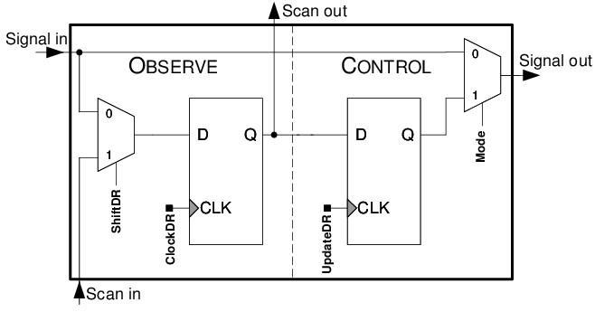
Boundary Scan Cell – Modes of Operation
Normal / Transparent: Data In (PI) is passed
Out to Data Out (PO)
Capture: Test Data In will be captured into the
‘Capture Scan Cell’ in next Capture Clk
Update: Data stored in ‘Capture Scan Cell’ is
propagated to ‘Update Hold Cell’ when
Update Clk appears
Serial Shift: Test data is shifted from Serial In (SI)
and test response can be scanned through
Serial Out (SO)

Slide 19
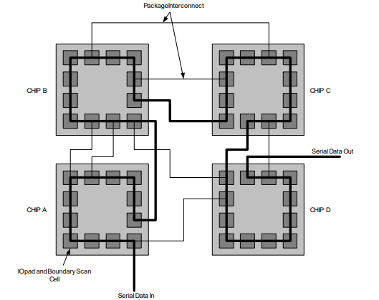
Boundary Scan Example – Testing Multiple Chips

Slide 20
JTAG Standard
IEEE Joint Test Action Group (JTAG) Standard 1149.1 was finalized in 1990. Latest release was in 2001
The standard is based on Boundary Scan and Test Access Port architecture
Allows complete controllability and observability of the boundary pins of a JTAG compatible device under software control
During test modes, all input signals are captured for analysis and all output signals are preset to test internal devices.
The operation of these scan cells is software controlled through the Test Access Port (TAP) Controller and the instruction register
See block diagram next page

Slide 21
JTAG Arrangement
Boundary
Scan Cell
Core Logic
TDI
Bypass Register
TDO
Instruction Register
Optional Data Register
TCK
TAP Controller
TMS

Slide 22
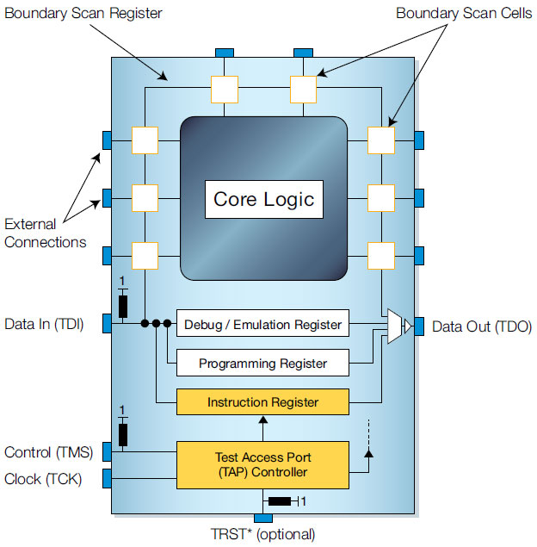
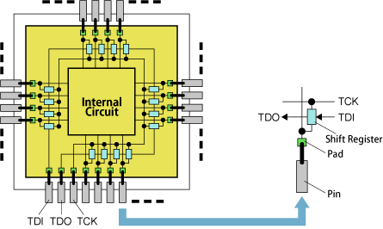
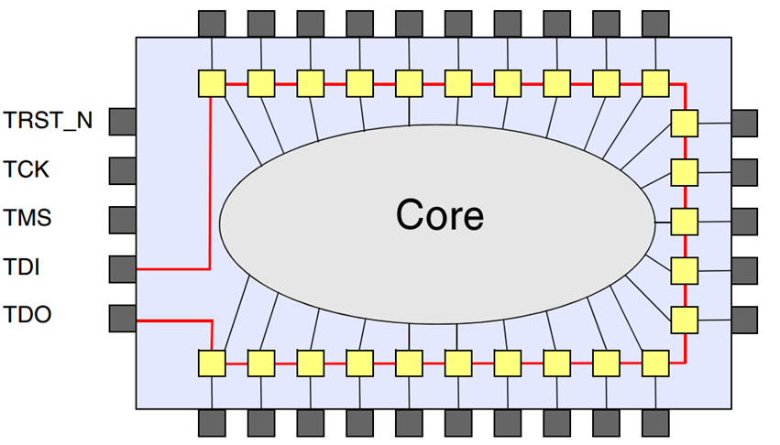
JTAG
Ref: from web

Slide 23
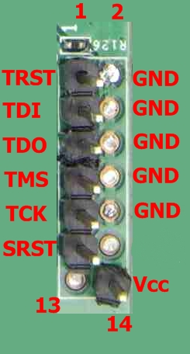
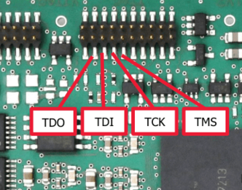
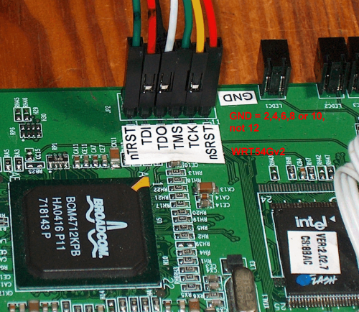
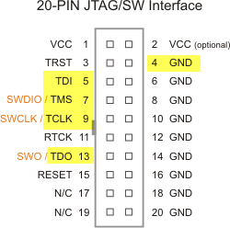
Test Signals in JTAG TAP – Test Access Port
4 or 5 Pin connections are provided for TAP – Test Access Port
TDI: Test Data Input, this data is sifted serially into Boundary Scan Registers
TCK: Test clock signal
TMS: Test Mode Select
TDO: Test Data Out, this is serial output from Boundary Scan Registers
TRST: Test Reset, resets the TAP controller and test logic, optional pin

Slide 24
Boundary Scan TAP Architecture
From pins or core logic
To pins or core logic
From TDI
BSR 1
BSR 2
MUX
Bypass Register
Instruction Decode Register
To TDO
MUX
Instruction Shift Register
TMS
TAP Controller
State Machine
TCLK

Slide 25
Basic JTAG Instructions
BYPASS: This instruction allows TDI serial data to through a 1-bit Bypass register on the IC instead of boundary can registers. In this way, one or more IC on the PCB may be bypassed while other IC are being tested.
SAMPLE/PRELOAD: This instruction is used to scan (read) the boundary scan registers without interfering with the normal operation of core logic. Data is transferred to or from the core logic from or to the IC pins without interference. Test data can be shifted into the BSR.
EXTEST: This instruction allows board-level interconnect testing. Test data is shifted into the BSR and then it goes to the output pins. Data from the input pins is captured by the BSR.
INTEST (optional): To test core logic, data shifted into BSR takes place of data from input pins, and output data from core logic is loaded into BSR.
RUNBIST (optional): This instruction causes special BIST logic within the IC to execute. PRPG, SISR and MISR can be invoked.

Slide 26
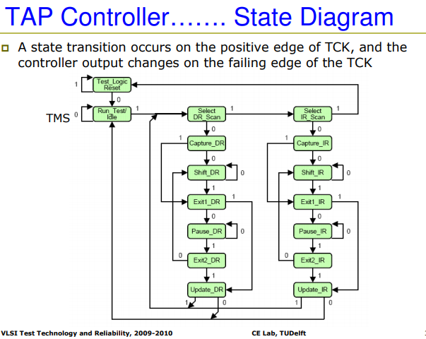
TAP Controller State Machine – In Standard
Ref:

Slide 27
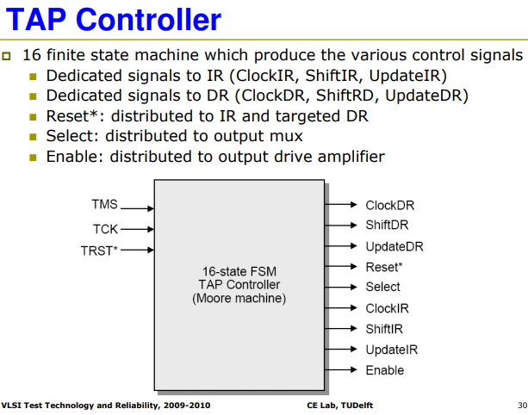
TAP Controller
Ref:

Slide 28
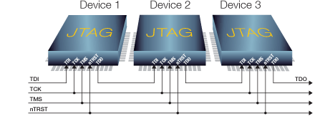
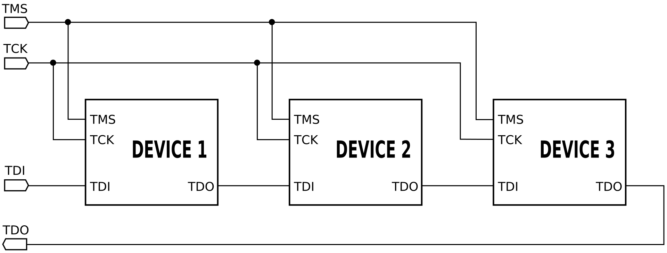
Daisy Chain JTAG – for multiple devices

Slide 29
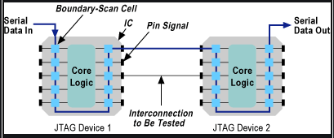
Testing Chip Interconnections
Pre-load the data on BSR of IC1
Transfer through PCB connections to IC2
Read the data from BSR of IC2

Slide 30
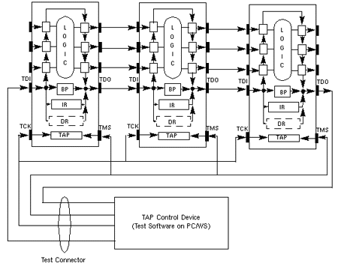
TAP Controller for multiple devices
Ref: from web

Slide 31
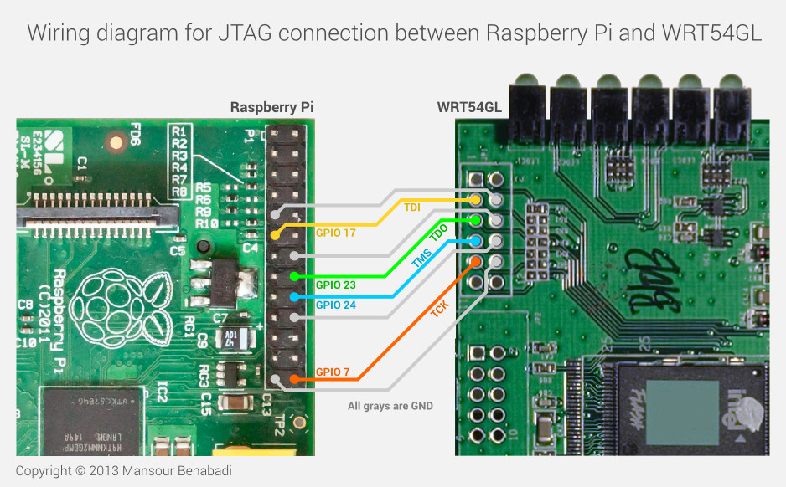
JTAG for R-Pi PCB
Ref: https://blog.oxplot.com/debrick-wrt54gl-raspberrypi/

Slide 32
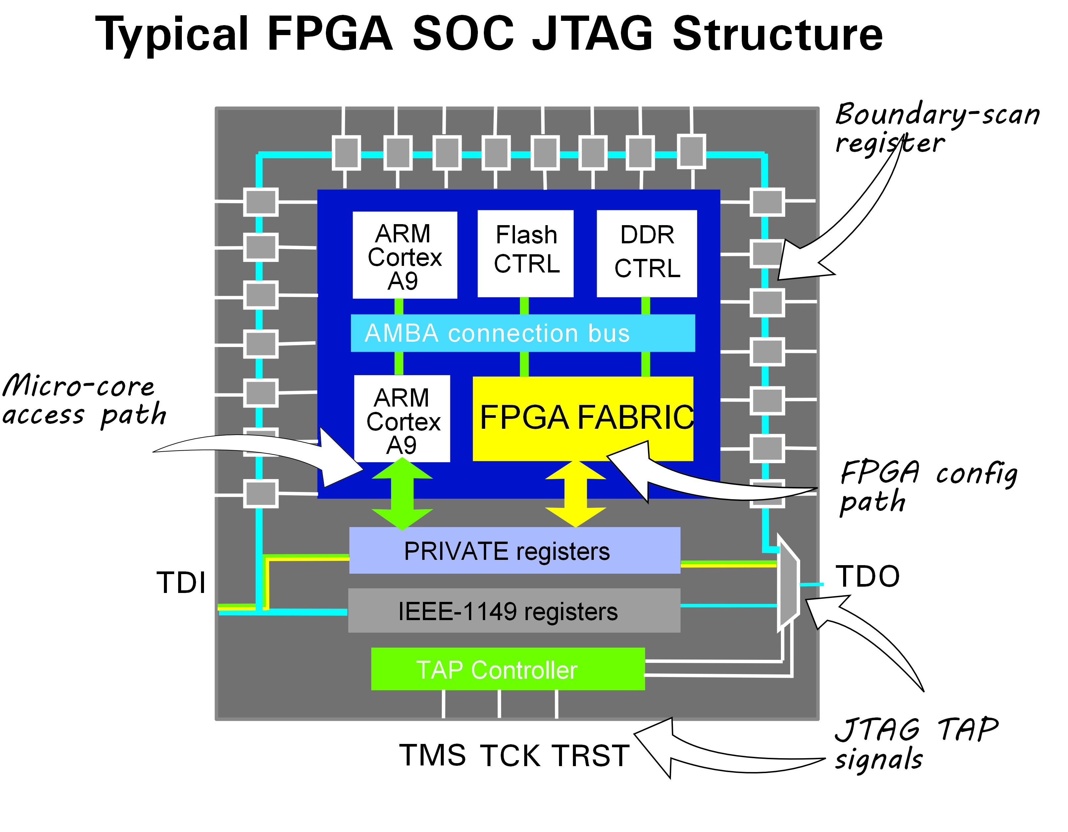
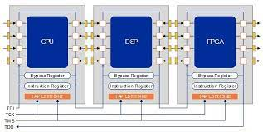
JTAG Examples
From web:

Slide 33
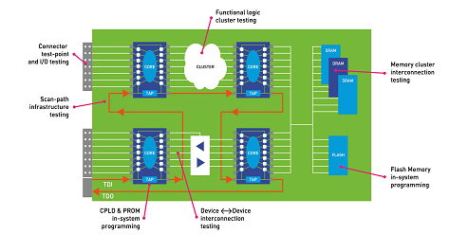
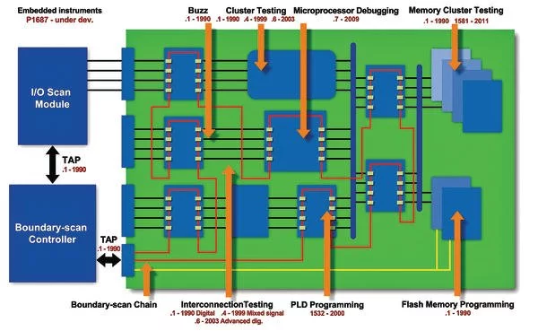
JTAG for PCB Testing Examples

