Slide 1
Lecture 22
EE 421 / CS 425
Digital System Design
Fall 2025
Shahid Masud

Slide 2
Topics
Special Features in FPGA
Sequential Implementation on CLB
Memory
Multipliers
DSP Slices
FIR and Symmetric Filters
Faults and Testing
Examples of Path Sensitization Method
EXOR Method for Fault Generation
What is Design for Testability?
BIST and SCAN technique
Recap and Summarize

Slide 3
Specialized Modules in FPGAs
Dedicated Memory
  Single Port and Dual Port Embedded Memory Blocks – Block RAM
Dedicated Arithmetic Units
  Adders, Multipliers, Multipliers – Accumulators, Fast Carry Logic
Digital Signal Processing Blocks – DSP Slice
  FFT Butterfly Modules, FIR / IIR Filters, ALU, Floating Point Arithmetic
  IP Core Libraries for Encryption, Video Compression, Cloud Applications, etc.
Embedded Microprocessors
  PowerPC, Microblaze, NIOS, ARM, MIPS, etc.
Content Addressable Memory (CAM)
  used in Branch Prediction, Caches inside CPU
More and more features keep appearing in new FPGA devices
  High Speed Interfaces, Security Features, RISC-V Support, etc.

Slide 4
DSP Features in modern FPGA
Some Example Implementations

Slide 5
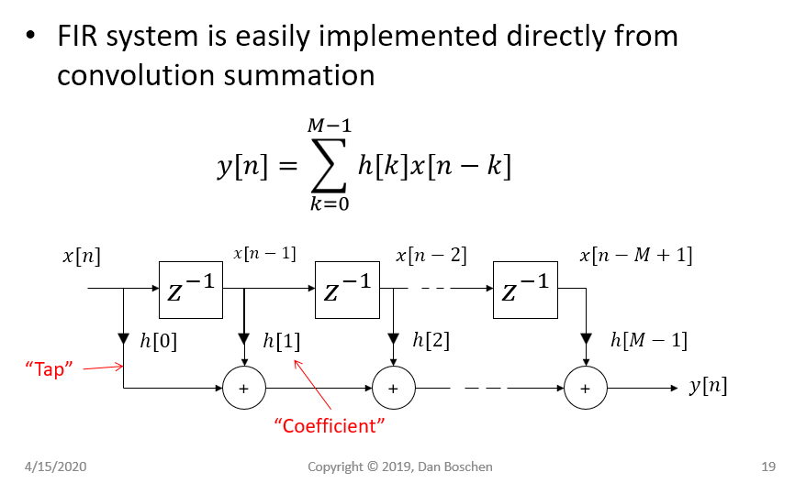
FIR Filter Design
Registers For Delay
Multipliers

Slide 6
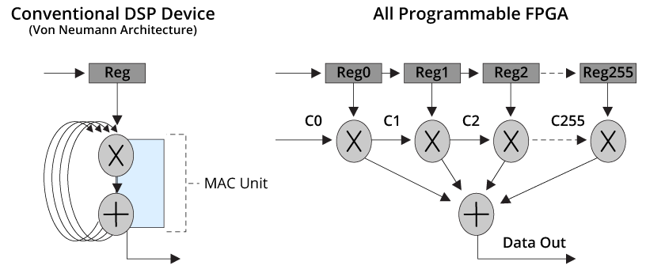
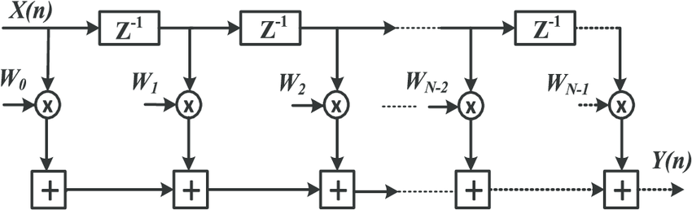
Implementation of DSP Filters
Implementation of FIR filters in Digital Signal Processing
MAC – Multiplier Accumulator
Coefficients
Memory
FIF filter mapping on
Software Programmable Device
FIF filter mapping on
a configurable Hardware Device

Slide 7
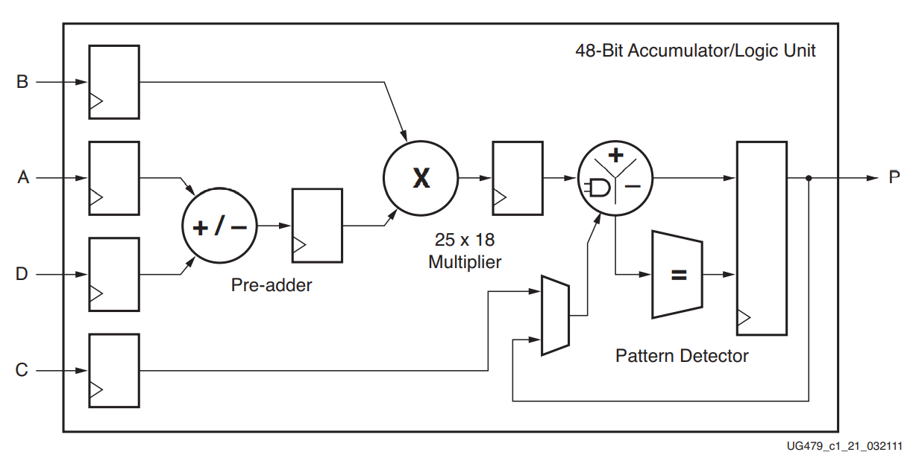
Basic Xilinx DSP48 Slice Architecture
https://www.controlpaths.com/2021/01/11/using-dsp48e1-slice/

Slide 8
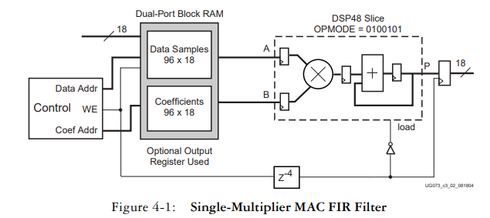


MAC for Folded FIR Filter

Slide 9
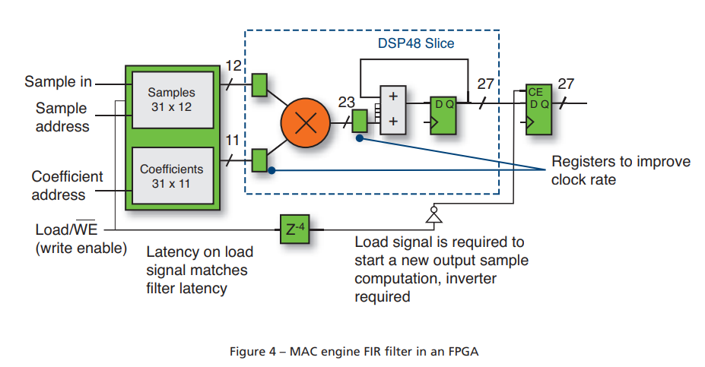





MAC Engine for FIR Filter in FPGA

Slide 10
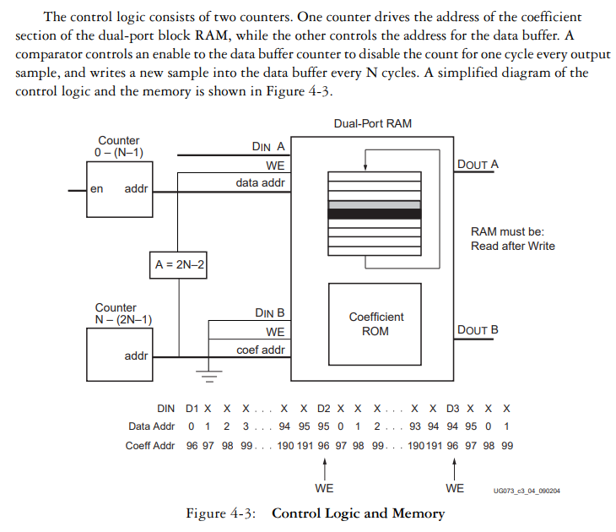
Coefficients Control

Slide 11
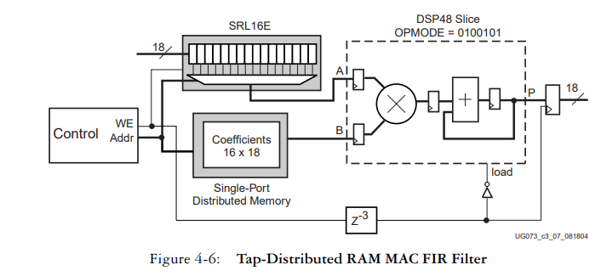
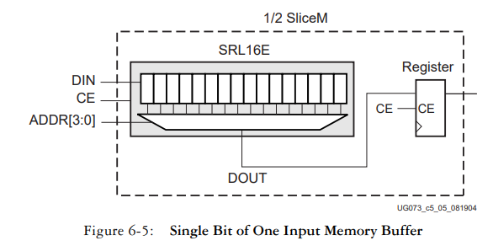
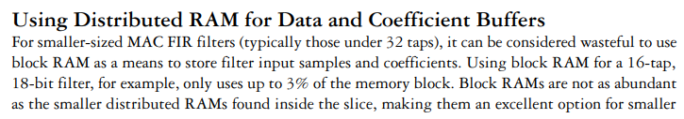





Distributed RAM MAC Based FIR

Slide 12
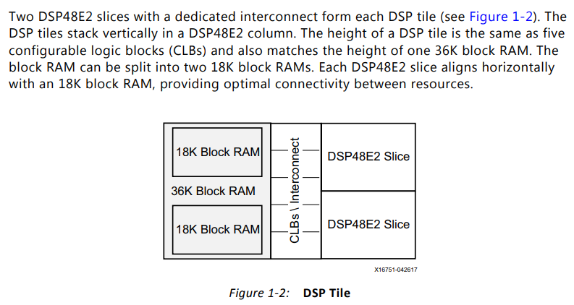
Block RAM and DSP Slice

Slide 13
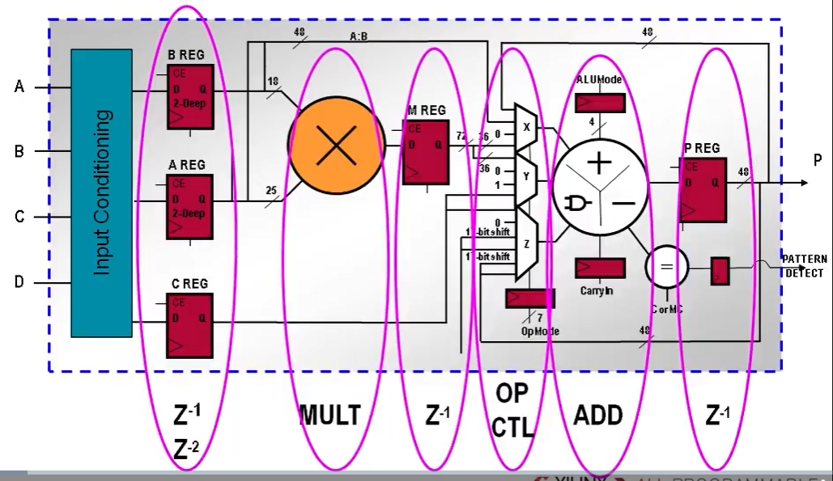
DSP Slice Features
Check wordlenghts

Slide 14
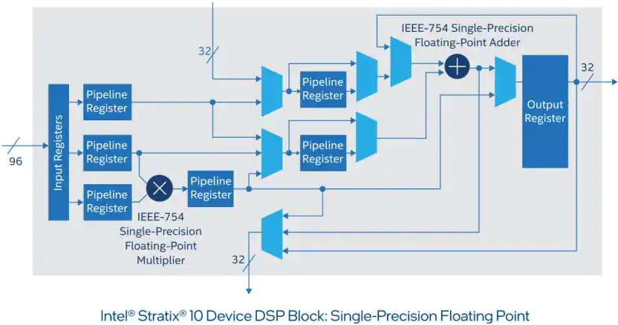
Intel Stratix DSP Slice with Floating Point
Intel Stratix DSP with Floating Point Support

Slide 15
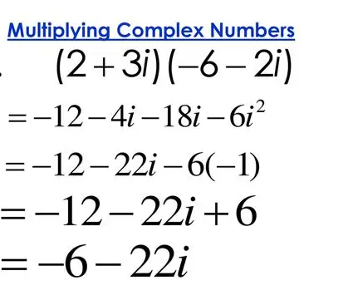
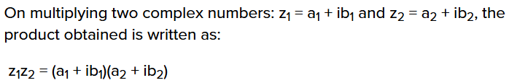
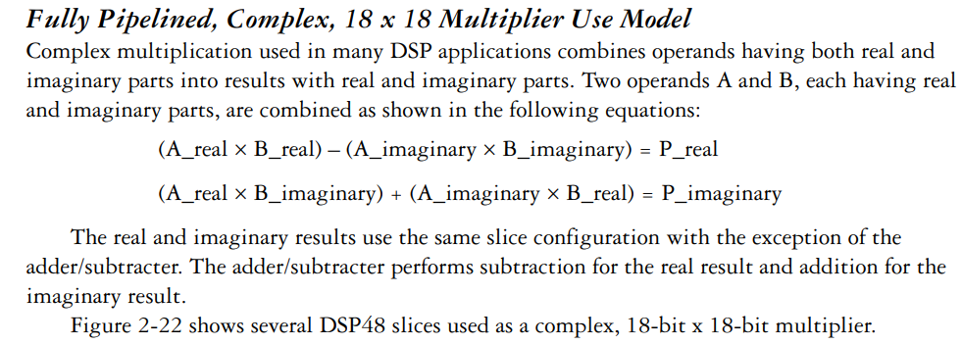
Complex Multiplier Approach

Slide 16
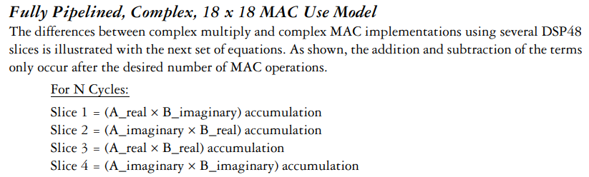
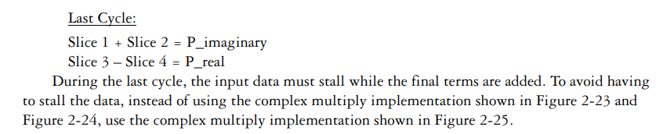
Pipeline Complex Multiplication

Slide 17
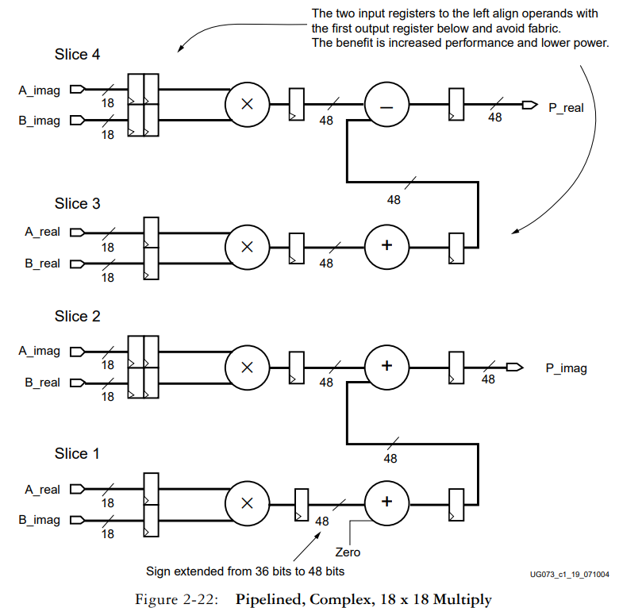
Pipeline Cplx Mult

Slide 18
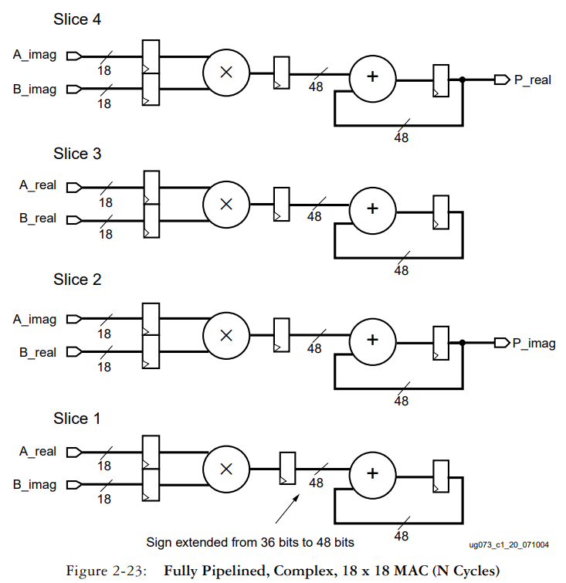
Pipel Cmplx Mu N cy

Slide 19
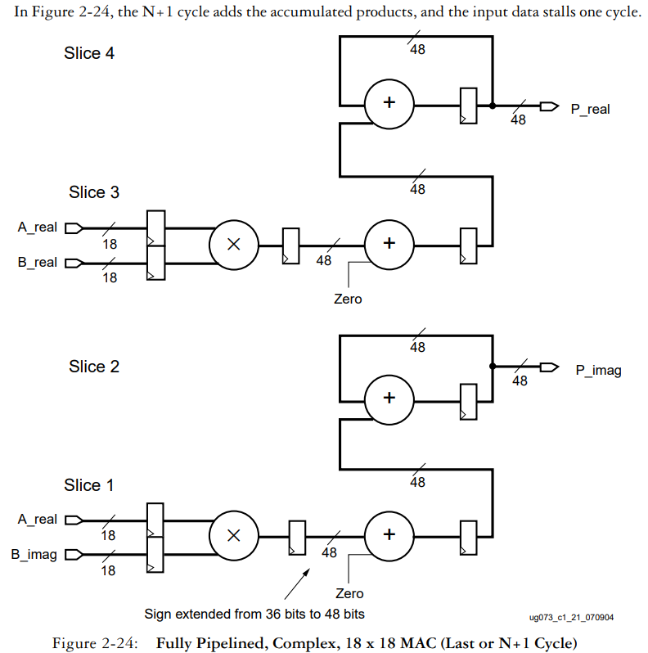
Last Cycle

Slide 20
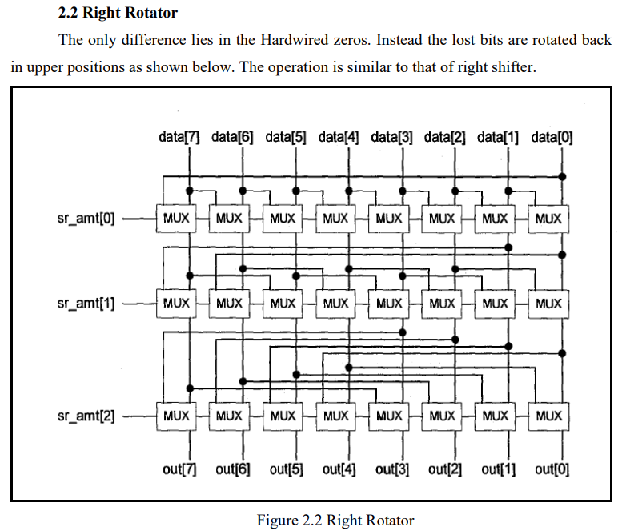
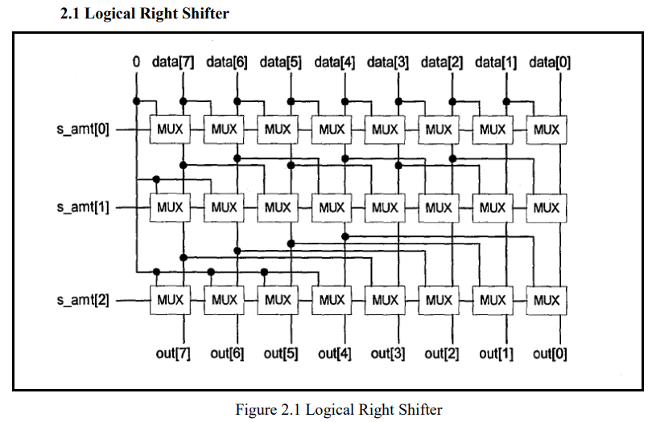
Barrel Shifter Operation
https://github.com/trivedidvijen/Design-and-Optimization-of-Barrel-Shifter/blob/master/Project%20Report.pdf

Slide 21
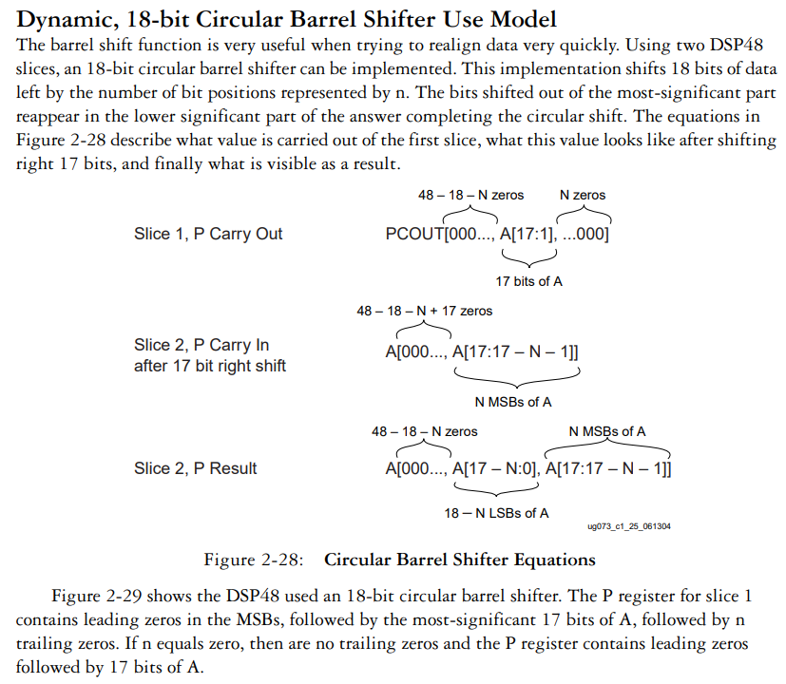
Barrel Shifter Model

Slide 22
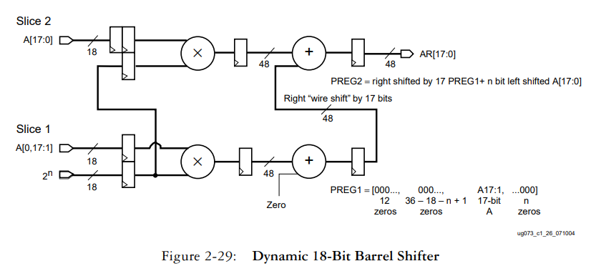
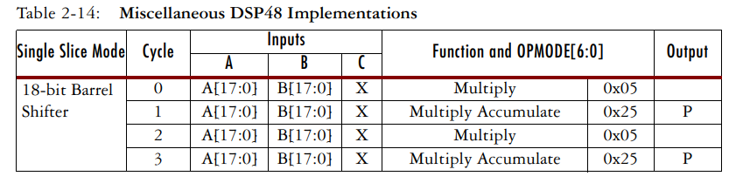

Barrel Shifter Using DSP Slice

Slide 23
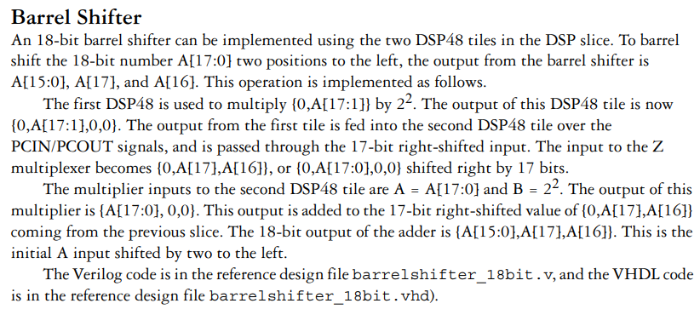



Barrel Shifter Operation

Slide 24
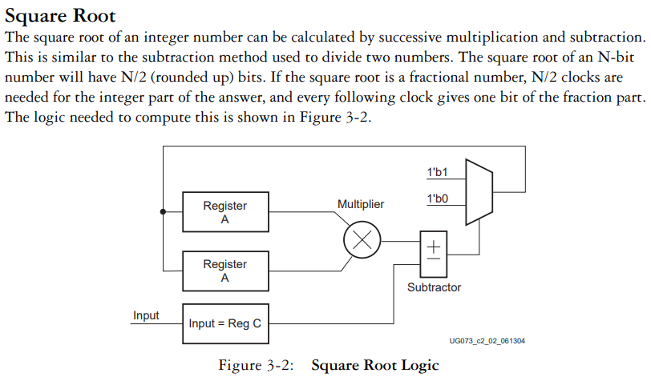
Square Root Architecture

Slide 25
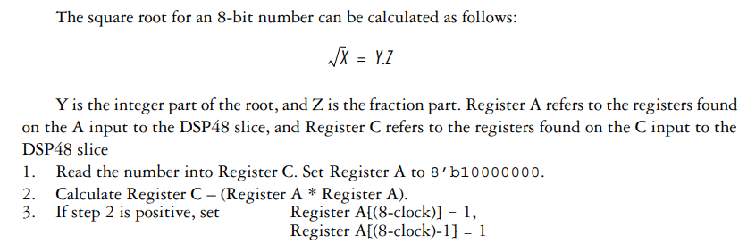
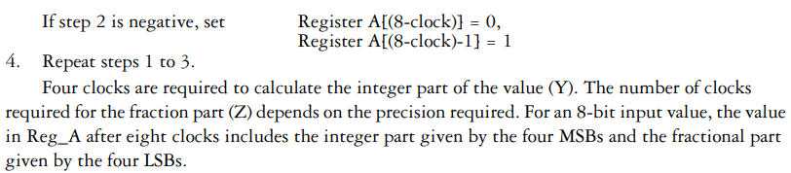
Square Root Method using DSP Slice

Slide 26
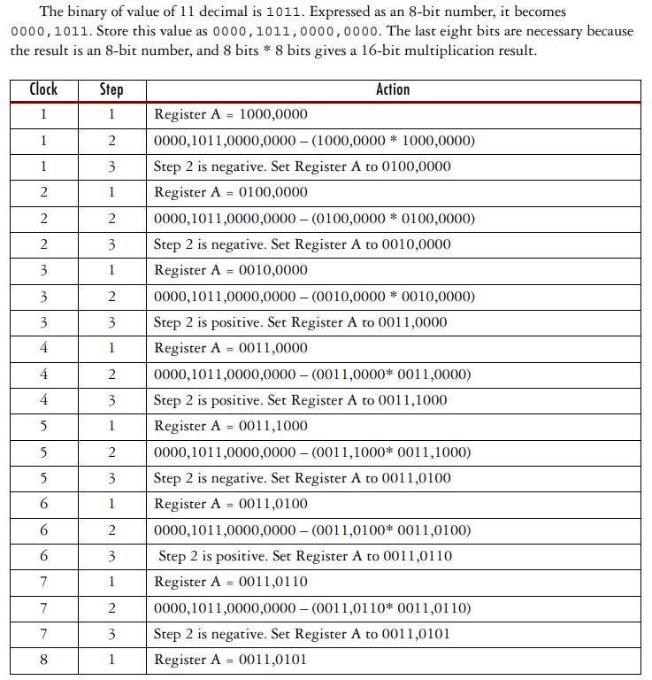
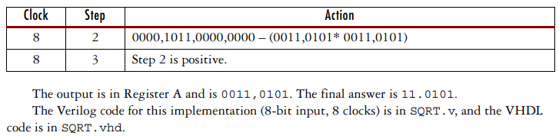
Square Root Example

Slide 27
Faults, Testing and Testability

Slide 28
Topics: Faults and Testing, Examples of path sensitization method for fault tests, EX-OR method truth table, EX-OR method Boolean expression, testing of sequential elements using Scan cells

Slide 29
Types of Circuit Failure
The domain of hardware related failure
Permanent Failure: Incorrect behaviour at all times
Intermittent Failure: Occurs randomly for finite time duration
Transient Failure: Occurs in presence of certain environmental conditions such as high temperature, radiation, etc.
Reasons for Failure: Wafer defects, impurities in clean room, mask mis-alignment, process imperfections, vibrations in equipment

Slide 30
Faults and Failure in Logic Circuit Chip
I/O Pins
Logic Modules
Logic Modules
Logic Modules
Logic Modules
Logic Modules
Silicon Wafer
Logic Modules
Logic Modules
Number of internal inputs and outputs is much more than the number of physical I/O pins available

Slide 31
Production testing
Detection of permanent errors caused by manufacturing defects. Involves two major steps:
  Test Generation, and
  Fault Simulation
Failure modes are called ‘Faults’
Set of vectors generated to detect ‘Faults’ is called ‘Fault-Simulation’
‘Fault-Models’ consider the logic effects that result from the physical faults in a circuit
When a circuit fails to behave correctly, implies that the logic realized is different from logic that was specified for design

Slide 32
Chip Level Faults
Chip Level Fault Type | Degradation Fault | Open Circuit | Short Circuit
Leakage or Short between package leads | Yes |  | Yes
Broken or missing wire bonding |  | Yes
Surface contamination or moisture | Yes
Metal migration, stress peeling |  | Yes | Yes
Metallization |  | Yes | Yes

Slide 33
Gate Level Faults
Gate Level Fault Type | Degradation Fault | Open Circuit | Short Circuit
Contact Open |  | Yes
Gate to Source short circuit | Yes |  | Yes
Field Oxide Parasitic Device | Yes |  | Yes
Gate Oxide Flaw, Spiking | Yes |  | Yes
Mask Misalignment | Yes |  | Yes

Slide 34
Fault Types
Stuck Faults: A signal line is shorted to supply or ground permanently
Bridging Faults: Short circuits in the interconnects between transistors in a logic cell are called bridging faults.
Bridging faults are detected by measuring the quiescent current through the CMOS logic circuit. It takes more time to detect Bridging faults whereas Stuck-At faults are easier to locate.
Problem: The fault sites are typically located in the middle of the logic circuit and their inputs or outputs are not directly accessible from i/o pins.
There are maximum 100s of i/o pins vs the number of gates and their interconnects is in millions.

Slide 35
Un-Testable Faults
Redundant Logic
Un-Controllable Nets
Un-Observable Nets that cannot be sensitized through I/O pins

Slide 36
Typical Test Setup
Circuit Under Test
Result Capture
Microprocessor / Computer
+
Result
Test Pattern Memory
Expected Response Memory

Slide 37
Automated Test Setup
Circuit Under Test
Response Compression
Automatic Test Pattern Generator
Compare
Result
Signature Memory

Slide 38
Exhaustive Testing
Combinational
Logic Chip
N bits
Outputs
Inputs
Requires 2^{N} test vectors to exhaustively test all input combinations
Exhaustive Testing compares correct and faulty outputs for each input combination
This is a very slow approach

Slide 39
Single Stuck-At Fault Models
Stuck-At Fault Model: Assumes that there is just one stuck-at fault in circuit under test. Hope that single fault removal will remove multiple faults as well.
Stuck at 0 / Stuck at 1 (SA0/SA1) faults: Only two types of logical faults assumed in the model at gate level.
Observability: The degree to which one can observe a node at the output pins of an IC package.
Given that only a limited number of nodes could be directly observed, alternative methods such as JTAG are used to observe all outputs with some delays.
Controllability: Measure of the ease of setting the node to ‘1’ or ‘0’ state. Easiest would be directly settable by an input pin on IC package.

Slide 40
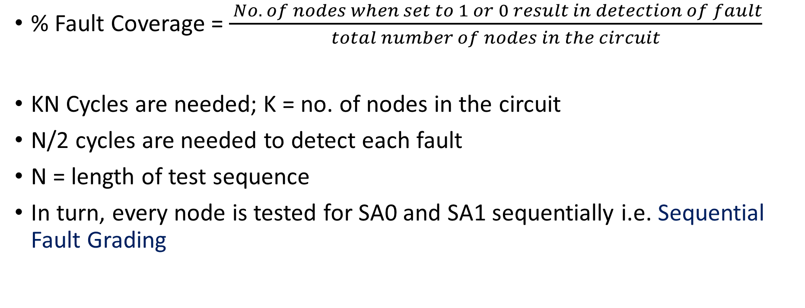
Fault Coverage
% Fault Coverage = $\frac{ No. of nodes when set to 1 or 0 result in detection of fault}{total number of nodes in the circuit}$
KN Cycles are needed; K = no. of nodes in the circuit
N/2 cycles are needed to detect each fault
N = length of test sequence
In turn, every node is tested for SA0 and SA1 sequentially i.e. Sequential Fault Grading

Slide 41
Fault Representation
f(x_{n}) = f(x₁, x₂, x₃, ….., x_{n}) represents a fault-free circuit
f^{p/d} (x_{n}) represents the same circuit with fault p/d;
Where p is a wire label, d is ‘0’ or ‘1’ representing SA0 or SA1 respectively
n is the no. of input variables

Slide 42
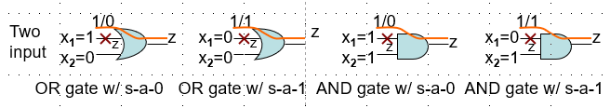
Different Faults and Input vectors
How to observe different faults at outputs of gates?

Slide 43
Example of fault representation
x₁
x₂
x₃
1
2
4
Z=f(x₁,x₂,x₃)
3
Stuck at 0 (SA0) fault at node 3:
f ^{3/0} (x₃) = x₁.x₂
Stuck at 1 (SA1) fault at node 2:
f ^{2/1} (x₂) = x₁ + x₃
x₁
x₂
x₃
1
x₁
x₂
x₃
1
X
Z=f(x₁, x₂, x₃)
Z=f(x₁, x₂, x₃)
SA1
2
4
2
4
3
3
SA0

Slide 44
Path Sensitization
Purpose is to sensitize the path so that inputs can help observe effects of SA0 or SA1 faults at the outputs
In multi-level circuits, one set of test vector can act as test for faults in several paths

Slide 45
Three Steps in Path Sensitization Method
Fault Excitation: Which vector to be induced to detect the suspected SA0 or SA1 fault at the suspicious path
Fault Propagation: Identify path/s through which fault can be propagated to the observable output
Back tracking: Move back from output towards all inputs and assign appropriate test values

Slide 46
Path Sensitization – how to
x₁
a
G1
b
x₂
G2
c
x₃
f
G3
x₄
To sensitize a path through an input of AND gate or NAND gate,
all other inputs must be set to ‘1’
To sensitize a path through an input of OR gate or NOR gate,
all other inputs must be set to ‘0’

Slide 47
Path Sensitization – Example 1
x₁
x₂
x₃
x₄
1
G1
5
2
7
G3
3
1(0)
f
1(0)
X
G2
1(0)
4
6
Fault Propagation
Purpose: To detect SA0 fault at wire 3 connected to input of OR gate
Input x₃ is selected opposite to Stuck-At fault (eg. SA0), written as x₃=1(0)
This is fault generation or excitation

Slide 48
Test Vectors for Example 1
x₁ = 1
x₂ = 1
x₃ = 1(0)
x₄ = 0
1
G1
5
1
1
7
1(0)
G3
3
1(0)
1(0)
X
G2
4
6
Sensitized path = 3 → 6→ 7
Back tracking reveals inputs to all gates to ensure fault propagation
Required test vector to detect SA0 at wire 3 is “1110”

Slide 49
Path Sensitization – Example 2
To detect SA1 fault at wire 2
Two possible paths can be excited
1
x₁
x₂
x₃
x₄
G1
7
X
2
5
G3
9
10
G4
6
G2
3
8
4

Slide 50
… continued
Detect SA1 at path 2
Fault propagation by supplying input x₂=0(1)
1
x₁
x₂
x₃
x₄
G1
7
Case 1:
Back tracking reveals:
First Selected path = 2→7 → 9 → 10
But path 8=1 due to path 2 input x₂
This is not correct to have ‘1’ at
Path 9. Hence ‘0’ cannot be justified
at line 8 and line 2 simultaneously
This situation is ‘Inconsistent’ hence
Some other path is thus required
0(1)
0(1)
X
2
5
G3
9
0(1)
10
G4
0(1)
???
0(1)
6
G2
3
8
4

Slide 51
Continued – final test vectors
Selected path = 2 → 6 → 8 → 9 → 10
Test Vector = “0011”
This test vector can also reveal other
faults in wires 6, 8 and 9
In NAND and NOR, reverse fault is
propagated
1
X₁=0
X₂=0
X₃=1
X₄=1
7
0(1)
X
2
5
9
1(0)
10
0(1)
1(0)
6
1(0)
3
8
4

Slide 52
Untestable Fault
x₁
x₂
x₃
1
4
9
11
2
5
6
f(x₁,x₂,x₃)
7
10
8
X
3
Look at SA1 fault on path 8
This fault cannot be distinguished (sensitized) by changing inputs x1 to x3
Mathematically:
An untestable fault exists when f^{8/1} ⨁ f⁸ = 0
This condition means it is not possible to test this path

