Slide 1
Lecture 18
EE 421 / CS 425
Digital System Design
Fall 2025
Shahid Masud

Slide 2
Topics
Floating Point Adder and Multiplier Operation (quick recap)
Digital Circuit Design for Floating Point Module
Introduction to Programmable Logic Hardware Device
Nomenclature and types
Logic Array Circuits
PLA and PAL
Programmable Logic Devices – PLD

Slide 3
Floating Point Arithmetic – Digital Design
N=(-1)^{S} x (1+F)x2E
E.g. 91.820734 × 10⁻³⁴
A signed-magnitude system for the fractional part and a biased notation for the exponent
Three subfields
  Sign S
  Fraction F (or Significand or Mantissa)
  Exponent E
Sign bit is 0 for positive numbers, 1 for negative numbers
Fractions always start from 1.xxxx, hence the integer 1 is not written (register has xxxx)
Exponent is biased by +127 (add 127 to whatever is in register bits)
Normalize: Express numbers is the standard format by shifting of bits and
adding / subtracting from Exponent register

Slide 4
IEEE 754 Floating Point Representation
Single Precision IEEE 754
Sign | Exponent | Fraction
1 bit | 8 bits | 23 bits
1 or 2 bits
Guard Bits
32 bits
Double Precision IEEE 754
Sign | Exponent | Fraction
1 bit | 11 bits | 52 bits
1 or 2 bits
Guard Bits
64 bits

Slide 5
Examples of Floating Point Representation
-(13.45)₁₀
= (1101.01 1100 1100 1100 ……..)² ; this is un-normalized
= (1.10101 1100 1100 1100 1100 1) x 2³; normalized
Fraction part is 10101 1100 1100 1100 1
Biased Exponent is 3+127 = 130
Sign = 1
5.0345
= 101 . 0000 1000 1101 0100 1111 110; this is un-normalized
= 1. 01 0000 1000 1101 0100 1111 110 x 2²; normalized
Biased Exponent = 2+127 = 129 = (1000 0001)₂
Fraction = 01 0000 1000 1101 0100 1111 110
Sign = 0

Slide 6
Floating Point Arithmetic – Digital Design
N=(-1)^{S} x (1+F)x2E
E.g. 91.820734 × 10⁻³⁴
A signed-magnitude system for the fractional part and a biased notation for the exponent
Three subfields
  Sign S
  Fraction F (or Significand or Mantissa)
  Exponent E
Sign bit is 0 for positive numbers, 1 for negative numbers
Fractions always start from 1.xxxx, hence the integer 1 is not written (register has xxxx)
Exponent is biased by +127 (add 127 to whatever is in register bits)
Normalize: Express numbers is the standard format by shifting of bits and
adding / subtracting from Exponent register

Slide 7
Floating Point Multiplication
Denormalize
Consider two floating point numbers:
(F₁ x 2^{E1}) and (F₂ x 2^{E2})
The product of these two numbers is:
= (F₁ x 2^{E1}) x (F₂ x 2^{E2})
= (F₁ x F₂) x 2^{(E1+E2)}
= F x 2E
Sign of result depends on Sign of the two numbers
Normalize

Slide 8
Data Path of Floating Point Multiplier
8-bits
8-bits
23-bits
23-bits
Exponent 1
Exponent 2
Mantissa 1
Mantissa 2
1-bit
1-bit
Sign 1
Sign 2
Pre Normalizer
Pre Normalizer
Pre Normalizer
Pre Normalizer
Find Sign
Shift Register
Shift Register
Shift Register
Shift Register
+
X
Exception Unit
Bias (+/-)
+
? Bits
? Bits
Post Normalizer
Special Conditions
NaN, Inf, Zero, etc.
Result Register
1 bit 8 bits 23 bits

Slide 9
Floating Point Addition
Consider two floating point numbers:
(F₁ x 2^{E1}) and (F₂ x 2^{E2})
Initial Denormalize
The addition of these two numbers is:
= (F₁ + F2) x (2^{Enew})
Enew is obtained by Shl or Shr of F1 and F2 so that E1 becomes same as E2
= F x 2^{Enew}
Final Normalize
Take into account Guard Bits
Sign of result depends on Sign of the two numbers

Slide 10
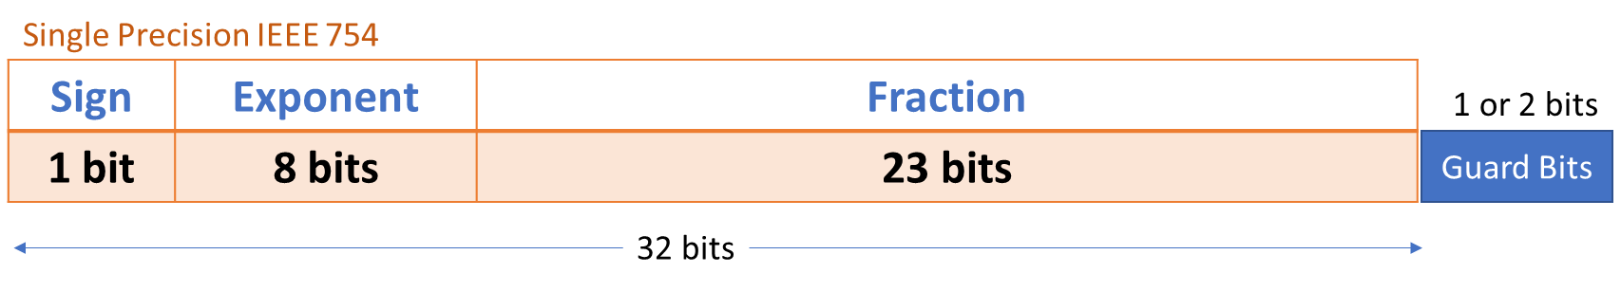
Complexity of Normalize and DeNormalize
Shift Right →
Shift Left ←
What is the Complexity, in terms of time and area?
Can this be improved?

Slide 11
Programmable Logic
Reconfigurable Logic

Slide 12
Definition of Programmable Logic
A family of semiconductor integrated circuits that can be reconfigured through:
  special hardware-description-languages, and
  associate Electronic Design Automation tools
  Special configuration equipment
to produce a variety of hardware functionality from the same integrated circuit chip.
The functionality in hardware can be erased and reconfigured in a manner analogous to design of a software system using microprocessor.
All other types of semiconductors have fixed and pre-defined functionality.
Performance vs Flexibility tradeoffs exist, as with any other digital system.

Slide 13
Programmable Logic Broad Classification
Programmable Logic Families
vs
Factory Programmable Devices
Field Programmable Devices
ROM
MPGA
SPLD
CPLD
FPGA
Read only Memory technology
Mask Programmable Gate Array
PROM
PLA
PAL
GAL
Simple and Complex Programmable Logic Devices
Field Programmable Gate Array
Generic Array Logic (complex PAL by lattice semi), Programmable Logic Array

Slide 14
Diode – Principle of operation
P
N
+
-
-
+
Current flow
X Current flow
Forward Biased
Reverse Biased

Slide 15
Diode in logic gates
+VDD
+VDD
A
Y
When A=1, Diode is Reverse Biased
Hence Output Y = 1 through +VDD
When A=0, Diode is Forward Biased
Hence Output Y = 0 through A = 0 Volt

Slide 16
Diode based AND Logic Array
+VDD
+VDD
Inputs
A=1, B=0, C=0
A
A
+VDD
Y = F(A,B,C)
B
Y = F(A,B,C)
B
C
C
DA = Diode A
DB = Diode B
DC = Diode C
DA=Open Circuit, DB = Forward Biased Short, DC = Forward Biased Short
Y= Logic ‘0’ as it is Shorted to Zero due to DB or DC

Slide 17
Diode based OR array
Inputs A = 0, B = 1, C = 0
A
A
B
Y = F(A,B,C)
B
Y = F(A,B,C)
+VDD
C
C
DA and DC = Open Circuit due to Zero input, DB = Short Circuit due to +VDD input
Y = +VDD Logic ‘1’ due to DB being short circuit, other paths are open circuit

Slide 18
Diode based AND-OR Array
+VDD
OR Gate
A
A
AND Gate
B
Y = F(A,B,C)
B
Y = F(A,B,C)
C’
F= (A.B.C’) + (B’.C)
+VDD
B’
AND Gate
C
Y = F(B,C)

Slide 19
Diode as fuse
Momentarily apply a higher voltage where open circuit path is required
+20V
↔
-20V
Desired paths from AND gates and OR gates will be retained, others will be blown out
Desired Paths are selected through a MASK during final stages of FABRICATION PROCESS

Slide 20
MOS Transistor as Switch
Drain
D
Gate
G
S
Source
Programming is achieved through controlling GATE Voltage
High GATE Voltage will ensure flow of current, like a short circuit
Low GATE Voltage will ensure no flow of current, like an open circuit

Slide 21
Logic Gates Design with Transistor Switches
A
B
+V
Y output
A
B

Slide 22
Transistors as Programmable Logic Switches
Inputs
A
B
C
+V
+V
+V
+V
+V
+V
F0
F1
F2
F3
Different logic functions are realized through transistor switches
outputs

Slide 23
AND-OR Logic Array
PLA = Programmable
Logic Array
Comprises Programmable
AND-OR Gates
A
X
B
X
P
X
C
X
X
Y output
X
X

Slide 24
Fuse Programmable Logic Array
+VDD
Y = F(A,B,C)
A
B
C

Slide 25
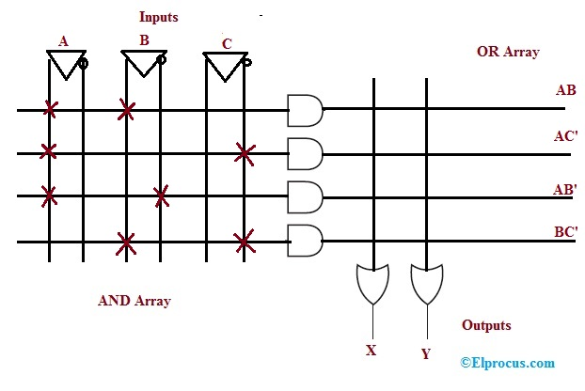
PAL – Programmable Array Logic
Programmable AND
Array
Fixed
OR
Array
n inputs
m outputs
https://www.elprocus.com/what-are-pal-and-pla-design-and-differences/

Slide 26
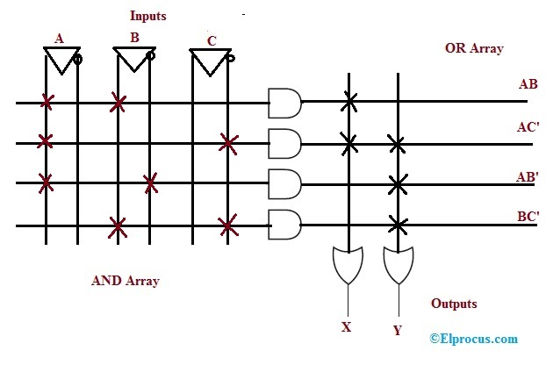
PLA – Programmable Logic Array
Programmable AND
Array
Programmable
OR
Array
n inputs
m outputs
https://www.elprocus.com/what-are-pal-and-pla-design-and-differences/

Slide 27
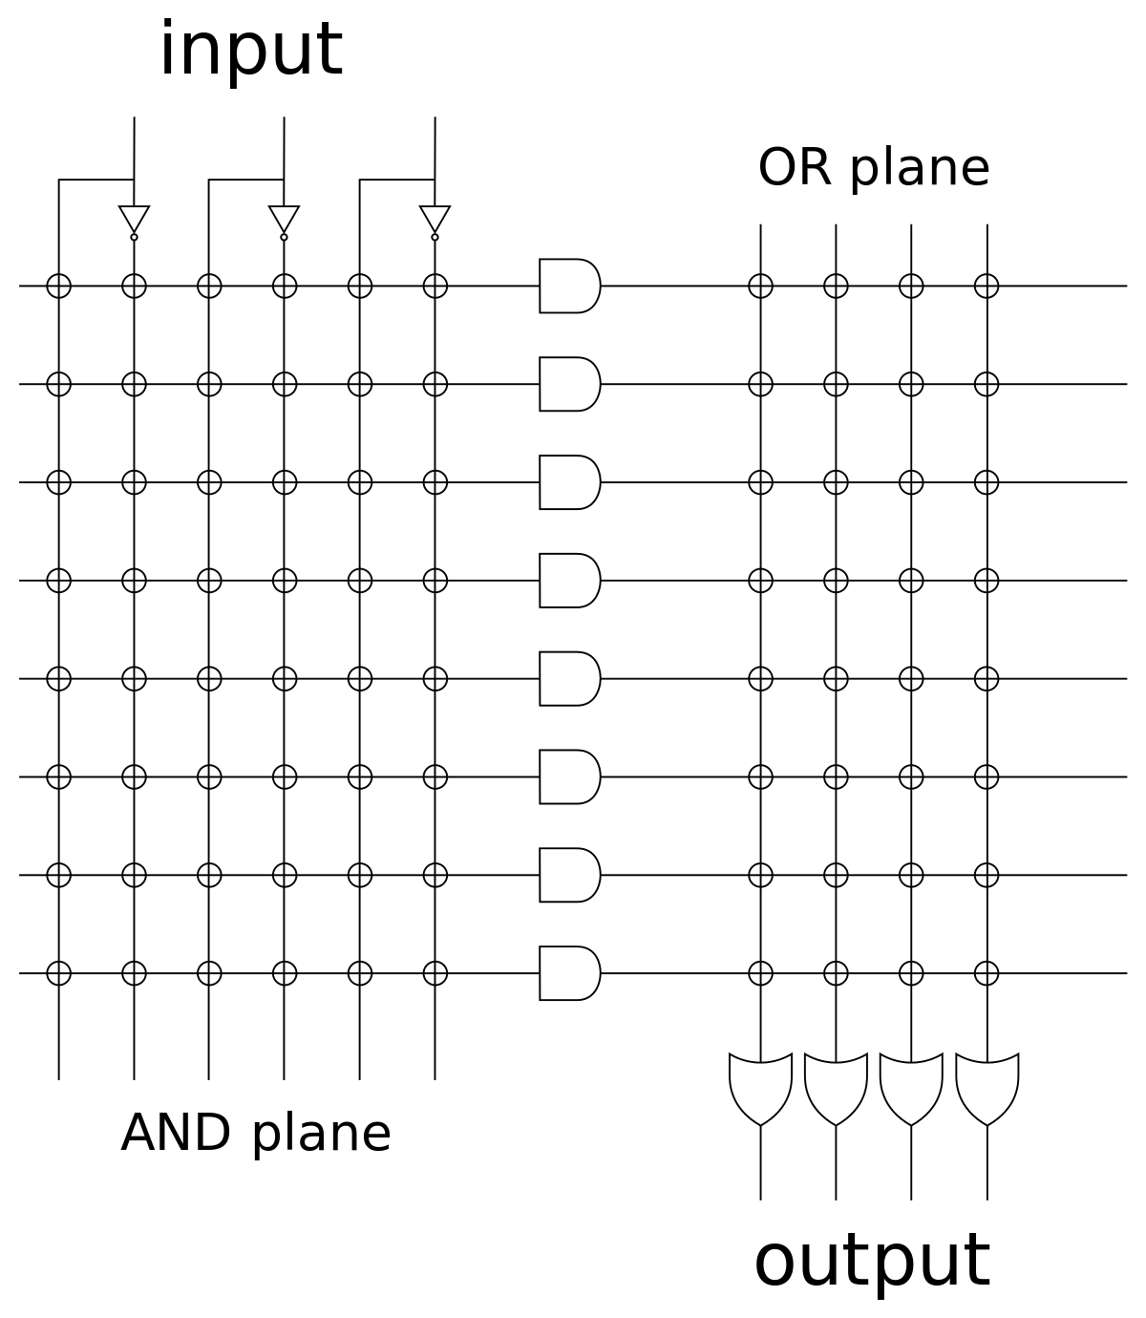
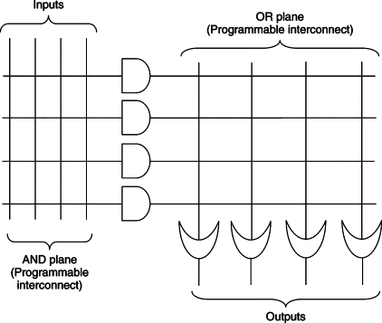
For Exercise

Slide 28
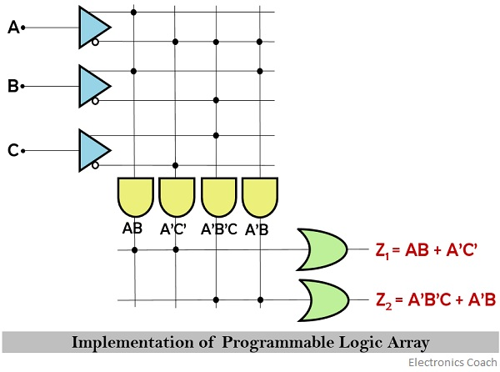
Example of PLA
https://electronicscoach.com/programmable-logic-array.html

Slide 29
PAL – Programmable Array Logic
Programmable AND
Array
Fixed
OR
Array
n inputs
m outputs
https://www.elprocus.com/what-are-pal-and-pla-design-and-differences/

Slide 30
PLA – Programmable Logic Array
Programmable AND
Array
Programmable
OR
Array
n inputs
m outputs
https://www.elprocus.com/what-are-pal-and-pla-design-and-differences/

Slide 31
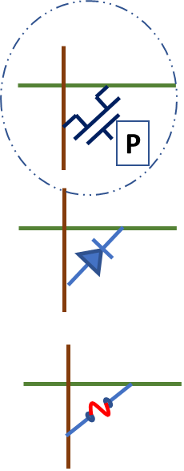
For Exercise
How to Configure?

Slide 32
Example of PLA
https://electronicscoach.com/programmable-logic-array.html

Slide 33
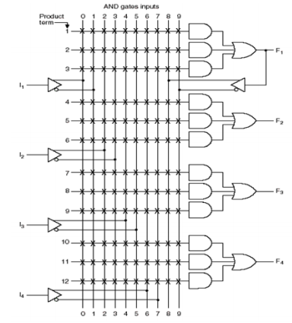
PAL – Programmable Array Logic Example
PAL Device is a PLD with fixed OR array and
a programmable AND array
As only AND gates are programmable, PAL is easier to program
but it is less flexible compared to PLA devices
Example device:
This device has 4 inputs and 4 outputs.
Each input has a buffer and inverter, output is from
fixed OR gate
The device has 4 sections: Each section comprises 3 wide
AND-OR array, meaning three programmable AND arrays
in each section
Each AND gates has 10 programmable input connections
One of the outputs (see F1) can be fed back to the inputs
of AND gate through programmable connections
https://faculty.kfupm.edu.sa/COE/aimane/coe202/PLDs.pdf

Slide 34
Sequential Circuits with PLD – Mealy Machine
X1
X2
X3
AND Array
Bank of
Flipflops
OR
Array
DFF
DFF
DFF
Y1
Y2

Slide 35
Sequential Circuits with PLD – Moore Machine
X1
X2
X3
AND Array
Bank of
Flipflops
DFF
Y1
OR
Array
Y2
DFF
Y3
DFF

Slide 36
Output Polarity Control
Si
Fuse Intact → Oi = Si
Fuse Blown → Oi = Si’
Oi
PLA Logic
R
Fuse – for output polarity control
Two states – intact or blown
+VDD

Slide 37
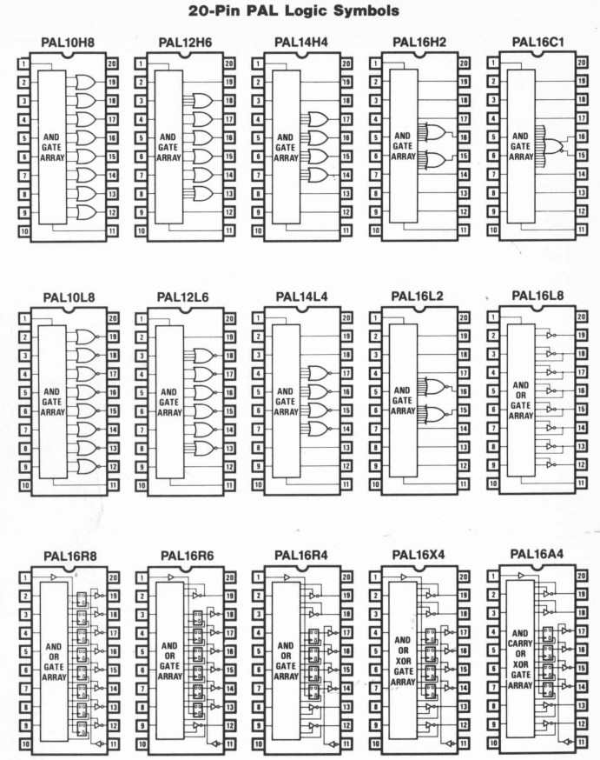
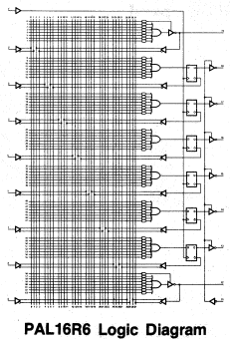
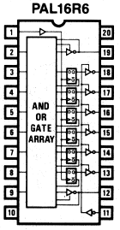
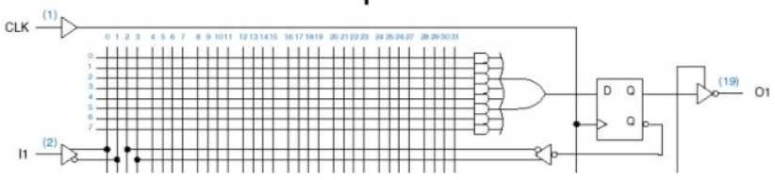
PLA Family Examples

