Slide 1
Lecture 3
EE 421 / CS 425
Digital System Design
Fall 2025
Shahid Masud

Slide 2
Topics
Quine McCluskey method of Logic Minimization
Boolean Simplification using n-cube
WinLogiLab Software Demo
Examples using WinLogiLab Software Tool

Slide 3




Problem with Logic Minimization
Boolean Algebra and K-Maps can easily solve 4 variables.
Beyond 5 or 6 input variables, we have to look for some other scalable techniques.
The techniques should be systematic and programmable

Slide 4
Quine McCluskey Method – Example 1
$$f\left(A, B, C, D\right)=\sum{m \left(2, 4, 6, 8, 9, 10, 12, 13, 15\right)}$$
Minterms | Binary | No of 1s
2 | 0010 | 1
4 | 0100 | 1
6 | 0110 | 2
8 | 1000 | 1
9 | 1001 | 2
10 | 1010 | 2
12 | 1100 | 2
13 | 1101 | 3
15 | 1111 | 4
Make Table of Minterms
Count No of 1s

Slide 5
Quine McCluskey – Example 1 - contd
List 1
$$f\left(A, B, C, D\right)=\sum{m\left(2, 4, 6, 8, 10, 12, 13, 15\right)}$$
Minterms | Binary | No of 1s
2 | 0010 | 1
4 | 0100 | 1
8 | 1000 | 1
6 | 0110 | 2
9 | 1001 | 2
10 | 1010 | 2
12 | 1100 | 2
13 | 1101 | 3
15 | 1111 | 4
Table of Minterms
Group as per number of 1s
Group of one 1s
Group of two 1s
Group of three 1s
Group of four 1s

Slide 6
Quine McCluskey – Example 1 - contd
$$f\left(A, B, C, D\right)=$$
$$\sum{m\left(2, 4, 6, 8, 9, 10, 12, 13, 15\right)}$$
List 1
List 2
Minterm | Binary | Combine or PI
2 | 0010
4 | 0100
8 | 1000
6 | 0110
9 | 1001
10 | 1010
12 | 1100
13 | 1101
15 | 1111
Minterm | Binary | Combined or PI
2, 6 | 0-10
2, 10 | -010
4, 6 | 01-0
4, 12 | -100
8, 9 | 100-
8, 10 | 10-0
8, 12 | 1-00
9, 13 | 1-01
12, 13 | 110-
13, 15 | 11-1
Check each entry with an entry in higher block.
See if there is any entry with One bit change only. These entries can be combined.
If any entry cannot be combined, it is a Prime Implicant.
Mark a tick ✓ where combined.
In Combined terms, put a ‘–’ where both 1 and 0 exist in the two terms
✓
✓
✓
✓
✓
✓
✓
✓
✓

Slide 7
Quine McCluskey – Example 1 - contd
List 1
List 2
List 3
Minterm | Binary | Combine or PI
2 | 0010 | ✓
4 | 0100 | ✓
8 | 1000 | ✓
6 | 0110 | ✓
9 | 1001 | ✓
10 | 1010 | ✓
12 | 1100 | ✓
13 | 1101 | ✓
15 | 1111 | ✓
Minterm | Binary | Combined or PI
2, 6 | 0-10
2, 10 | -010
4, 6 | 01-0
4, 12 | -100
8, 9 | 100-
8, 10 | 10-0
8, 12 | 1-00
9, 13 | 1-01
12, 13 | 110-
13, 15 | 11-1
Minterm | Binary | Combined or PI
(8, 9), (12, 13) | 1-0-
(8, 12), (9, 13) | 1-0-
PI2
PI1
PI3
PI4
Same PI1
PI5
✓
PI6
✓
✓
✓
PI7

Slide 8
Quine McCluskey – Example 1 - contd
List 1
List 2
List 3
Minterm | Binary | Combine or PI
2 | 0010 | ✓
4 | 0100 | ✓
8 | 1000 | ✓
6 | 0110 | ✓
9 | 1001 | ✓
10 | 1010 | ✓
12 | 1100 | ✓
13 | 1101 | ✓
15 | 1111 | ✓
Minterm | Binary | Combined or PI
2, 6 | 0-10
2, 10 | -010
4, 6 | 01-0
4, 12 | -100
8, 9 | 100-
8, 10 | 10-0
8, 12 | 1-00
9, 13 | 1-01
12, 13 | 110-
13, 15 | 11-1
Minterm | Binary | Combined or PI
(8, 9), (12, 13) | 1-0-
(8, 12), (9, 13) | 1-0-
PI2
PI1
PI3
PI4
Same PI1
PI5
✓
PI6
✓
✓
✓
PI7

Slide 9
Quine McCluskey – Example 1 - contd
List 1
List 2
List 3
Minterm | Binary | Combine or PI
2 | 0010 | ✓
4 | 0100 | ✓
8 | 1000 | ✓
6 | 0110 | ✓
9 | 1001 | ✓
10 | 1010 | ✓
12 | 1100 | ✓
13 | 1101 | ✓
15 | 1111 | ✓
Minterm | Binary | Combined or PI
2, 6 | 0-10
2, 10 | -010
4, 6 | 01-0
4, 12 | -100
8, 9 | 100-
8, 10 | 10-0
8, 12 | 1-00
9, 13 | 1-01
12, 13 | 110-
13, 15 | 11-1
Minterm | Binary | Combined or PI
(8, 9), (12, 13) | 1-0-
(8, 12), (9, 13) | 1-0-
PI2
PI1
PI3
PI4
Same PI1
PI5
✓
PI6
✓
✓
✓
PI7

Slide 10
Quine McCluskey Method - contd
PI1=1-0-, PI2=0-10, PI3=-010
PI4=01-0, PI5=-100, PI6=10-0
PI7=11-1
To find minimum number of Prime Implicants, make a PI Chart. PI vs Minterms covered
PI Needed | Minterm to cover | 2 | 4 | 6 | 8 | 9 | 10 | 12 | 13 | 15
✓ | PI1 |  |  |  | X | X → Ⓧ |  | X | X
Eliminate | PI2 | X |  | X
✓ | PI3 | X |  |  |  |  | X
✓ | PI4 |  | X | X
Eliminate | PI5 |  | X |  |  |  |  | X
Eliminate | PI6 |  |  |  | X |  | X
✓ | PI7 |  |  |  |  |  |  |  | X | X → Ⓧ
✓
✓
✓
✓
✓
✓
✓
✓
✓
This symbol Ⓧ means this PI is the only cover for this particular Minterm

Slide 11
Quine McCluskey Method - contd
PI1=1-0-, PI2=0-10, PI3=-010
PI4=01-0, PI5=-100, PI6=10-0
PI7=11-1
To find minimum number of Prime Implicants, make a PI Chart. PI vs Minterms covered
PI Needed | Minterm to cover | 2 | 4 | 6 | 8 | 9 | 10 | 12 | 13 | 15
✓ | PI1 |  |  |  | X | X → Ⓧ |  | X | X
Eliminate | PI2 | X |  | X
✓ | PI3 | X |  |  |  |  | X
✓ | PI4 |  | X | X
Eliminate | PI5 |  | X |  |  |  |  | X
Eliminate | PI6 |  |  |  | X |  | X
✓ | PI7 |  |  |  |  |  |  |  | X | X → Ⓧ
✓
✓
✓
✓
✓
✓
✓
✓
✓
This symbol Ⓧ means this PI is the only cover for this particular Minterm

Slide 12
Quine McCluskey Method - contd
PI1=1-0-, PI2=0-10, PI3=-010
PI4=01-0, PI5=-100, PI6=10-0
PI7=11-1
To find minimum number of Prime Implicants, make a PI Chart. PI vs Minterms covered
PI Needed | Minterm to cover | 2 | 4 | 6 | 8 | 9 | 10 | 12 | 13 | 15
✓ | PI1 |  |  |  | X | X → Ⓧ |  | X | X
Eliminate | PI2 | X |  | X
✓ | PI3 | X |  |  |  |  | X
✓ | PI4 |  | X | X
Eliminate | PI5 |  | X |  |  |  |  | X
Eliminate | PI6 |  |  |  | X |  | X
✓ | PI7 |  |  |  |  |  |  |  | X | X → Ⓧ
✓
✓
✓
✓
✓
✓
✓
✓
✓
This symbol Ⓧ means this PI is the only cover for this particular Minterm

Slide 13
Quine McCluskey Method - contd
$$f\left(A, B, C, D\right)=\sum{m\left(2, 4, 6, 8, 9, 10, 12, 13, 15\right)}$$
= PI1 + PI3 + PI4 + PI7
= 1-0- + -010 + 01-0 + 11-1
= AC’ + B’CD’ + A’BD’ + ABD
Minterm | Binary | Combine or PI
2, 6 | 0-10 | PI2
2, 10 | -010 | PI3
4, 6 | 01-0 | PI4
4, 12 | -100 | PI5
8, 9 | 100- | ✓
8, 10 | 10-0 | PI6
8, 12 | 1-00 | ✓
9, 13 | 1-01 | ✓
12, 13 | 110- | ✓
13, 15 | 11-1 | PI7
Minterm | Binary | Combineor PI
(8, 9), (12, 13) | 1-0- | PI1
(8, 12), (9, 13) | 1-0- | Same PI1

Slide 14
Quine McCluskey – Example 1 - contd
$$f\left(A, B, C, D\right)=\sum{m\left(2, 4, 6, 8, 10, 12, 13, 15\right)}$$
Answer:
f(A,B,C,D) = PI1 + PI3 + PI4 + PI7
= 1-0- + -010 + 01-0 + 11-1
= $A\overline{C}+ \overline{B}C\overline{D}+ \overline{A}B\overline{D}+ABD$

Slide 15
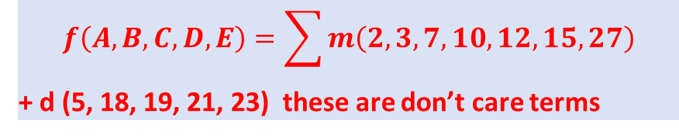
QM with Don’t Care and 5 Variables
List all Minterms, note number of 1’s
$$f\left(A, B, C, D, E\right)=\sum{m\left(2, 3, 7, 10, 12, 15, 27\right)}$$
+ d (5, 18, 19, 21, 23) these are don’t care terms
Minterms | Binary | No of 1s
2 | 00010 | 1
3 | 00011 | 2
7 | 00111 | 3
10 | 01010 | 2
12 | 01100 | 2
15 | 01111 | 4
27 | 11011 | 5
5 | 00101 | 2
18 | 10010 | 2
19 | 10011 | 3
21 | 10101 | 3
23 | 10111 | 4
Include don’t care terms in logic simplification
Don’t Care Terms

Slide 16
QM with Don’t Care and 5 Variables - contd
Group minterms as per number of 1s
$$f\left(A, B, C, D, E\right)=\sum{m\left(2,3,7,10,12,15,27\right)}$$
+ d (5, 18, 19, 21, 23) these are don’t care terms
Minterms | Binary | No of 1s
2 | 00010 | 1
3 | 00011 | 2
5 | 00101 | 2
10 | 01010 | 2
12 | 01100 | 2
18 | 10010 | 2
7 | 00111 | 3
19 | 10011 | 3
21 | 10101 | 3
15 | 01111 | 4
23 | 10111 | 4
27 | 11011 | 4
Include don’t care terms in logic simplification

Slide 17
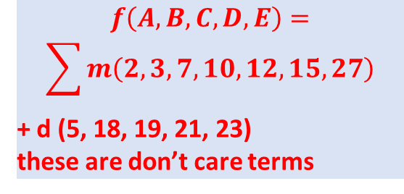
QM with Don’t Care and 5 Variables - contd
List 1 – Combine with next higher block
List 2
$$f\left(A, B, C, D, E\right)=$$
$$\sum{m\left(2, 3,7,10,12,15,27\right)}$$
+ d (5, 18, 19, 21, 23)
these are don’t care terms
Minterms | Binary | Combine or PI
2 | 00010 | ✓
3 | 00011 | ✓
5 | 00101 | ✓
10 | 01010 | ✓
12 | 01100 | make PI
18 | 10010 | ✓
7 | 00111 | ✓
19 | 10011 | ✓
21 | 10101 | ✓
15 | 01111 | ✓
23 | 10111 | ✓
27 | 11011 | ✓
Minterms | Binary | Combine or PI
2, 3 | 0001-
2, 10 | 0-010
2, 18 | -0010
3, 7 | 00-11
3, 19 | -0011
5, 7 | 001-1
5, 21 | -0101
18, 19 | 1001-
7, 15 | 0-111
7, 23 | -0111
19, 23 | 10-11
19, 27 | 1-011
21, 23 | 101-1

Slide 18
QM with Don’t Care and 5 Variables - contd
List 1 – Combine with next higher block
List 2 – Combine next higher block
List 3
Minterms | Binary | Combine or PI
2 | 00010 | ✓
3 | 00011 | ✓
5 | 00101 | ✓
10 | 01010 | ✓
12 | 01100 | Make PI7
18 | 10010 | ✓
7 | 00111 | ✓
19 | 10011 | ✓
21 | 10101 | ✓
15 | 01111 | ✓
23 | 10111 | ✓
27 | 11011 | ✓
Minterms | Binary | Combine or PI
2, 3 | 0001- | ✓
2, 10 | 0-010 | Make PI4
2, 18 | -0010 | ✓
3, 7 | 00-11 | ✓
3, 19 | -0011 | ✓
5, 7 | 001-1 | ✓
5, 21 | -0101 | ✓
18, 19 | 1001- | ✓
7, 15 | 0-111 | PI5
7, 23 | -0111 | ✓
19, 23 | 10-11 | ✓
19, 27 | 1-011 | PI6
21, 23 | 101-1 | ✓
Minterms | Binary | Combine or PI
(2, 3) , (18, 19) | -001- | PI1
(3, 7), (19, 23) | -0-11 | PI2
(5, 7), (21, 23) | -01-1 | PI3

Slide 19
QM with 5 Variable, don’t care - contd
To find minimum number of Prime Implicants, make a PI Chart. PI vs Minterms covered
 |  | ✓ | ✓ | ✓ | ✓ | ✓ | ✓ | ✓
PI Needed | Minterm | 2 | 3 | 7 | 10 | 12 | 15 | 27
✓ | PI1 | X | X
Eliminate | PI2 |  | X | X
Eliminate | PI3 |  |  | X
✓ | PI4 | X |  |  | X →Ⓧ
✓ | PI5 |  |  | X |  |  | X →Ⓧ
✓ | PI6 |  |  |  |  |  |  | X →Ⓧ
✓ | PI7 |  |  |  |  | X →Ⓧ
PI1 = -001-
PI2 = -0-11
PI3 = -01-1
PI4 = 0-010
PI5 = 0-111
PI6 = 1-011
PI7 = 01100
This symbol Ⓧ means this PI is the only cover for this particular Minterm

Slide 20
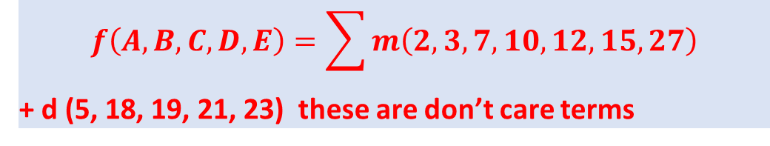
QM with Don’t Care and 5 Variables
$$f\left(A, B, C, D, E\right)=\sum{m\left(2, 3,7,10,12,15,27\right)}$$
+ d (5, 18, 19, 21, 23) these are don’t care terms
Answer f = PI1 + PI4 + PI5 + PI6 + PI7
= -001- + 0-010 + 0-111 + 1-011 + 01100
= $\overline{B}\overline{C}D+ \overline{A}\overline{C}D\overline{E}+\overline{A}CDE+A\overline{C}DE+ \overline{A}BC\overline{D}\overline{E}$

Slide 21
Boolean Algebra on n-cube

Slide 22
Boolean Expression on n-cube
b
c
Edge
011
111
001
101
Vertex
1
c
0
b
0 b 1
010
110
000
100
a
0 a 1

Slide 23
Minimization using Boolean n-cube
Repeatedly Combine Cubes that differ in only one literal
Eliminate Redundant Implicants
Grouping along multiple dimensions is possible

Slide 24
Example 1 using n-cube
On-Set
Off-Set
011
111
F=abc + abc’
= 111 + 110
c is changing in this
vertex so c can be
eliminated
Each Edge of Graph is
a minterm
Connection through Vertex
Shows some Adjacent term can be
eliminated
001
101
Answer:
F = ab
010
110
abc = 000
100

Slide 25
Example 2 using n-cube
c
011
111
F=abc + a’bc + abc’ + a’b’c + ab’c’ + a’b’c’
= 111 + 011 + 110 + 001 + 100 + 000
001
101
b
010
110
a
000
100

Slide 26
First solution - Example 2 using n-cube
011
111
F=abc + a’bc + abc’ + a’b’c + ab’c’ + a’b’c’
= 111 + 011 + 110 + 001 + 100 + 000
001
101
010
Ignore Redundant Cover of
ab and a’b’
110
Combine Adjacent Vertex into one implicant
Answer:
F= a’c + bc + b’c’ + ac’
000
100

Slide 27
Second solution - Example 2 using n-cube
011
111
F=abc + a’bc + abc’ + a’b’c + ab’c’ + a’b’c’
= 111 + 011 + 110 + 001 + 100 + 000
001
101
Ignore Redundant Cover of
a’c and ac
010
110
000
100
Answer:
F= a’b’ + b’c’ + bc + ab

Slide 28
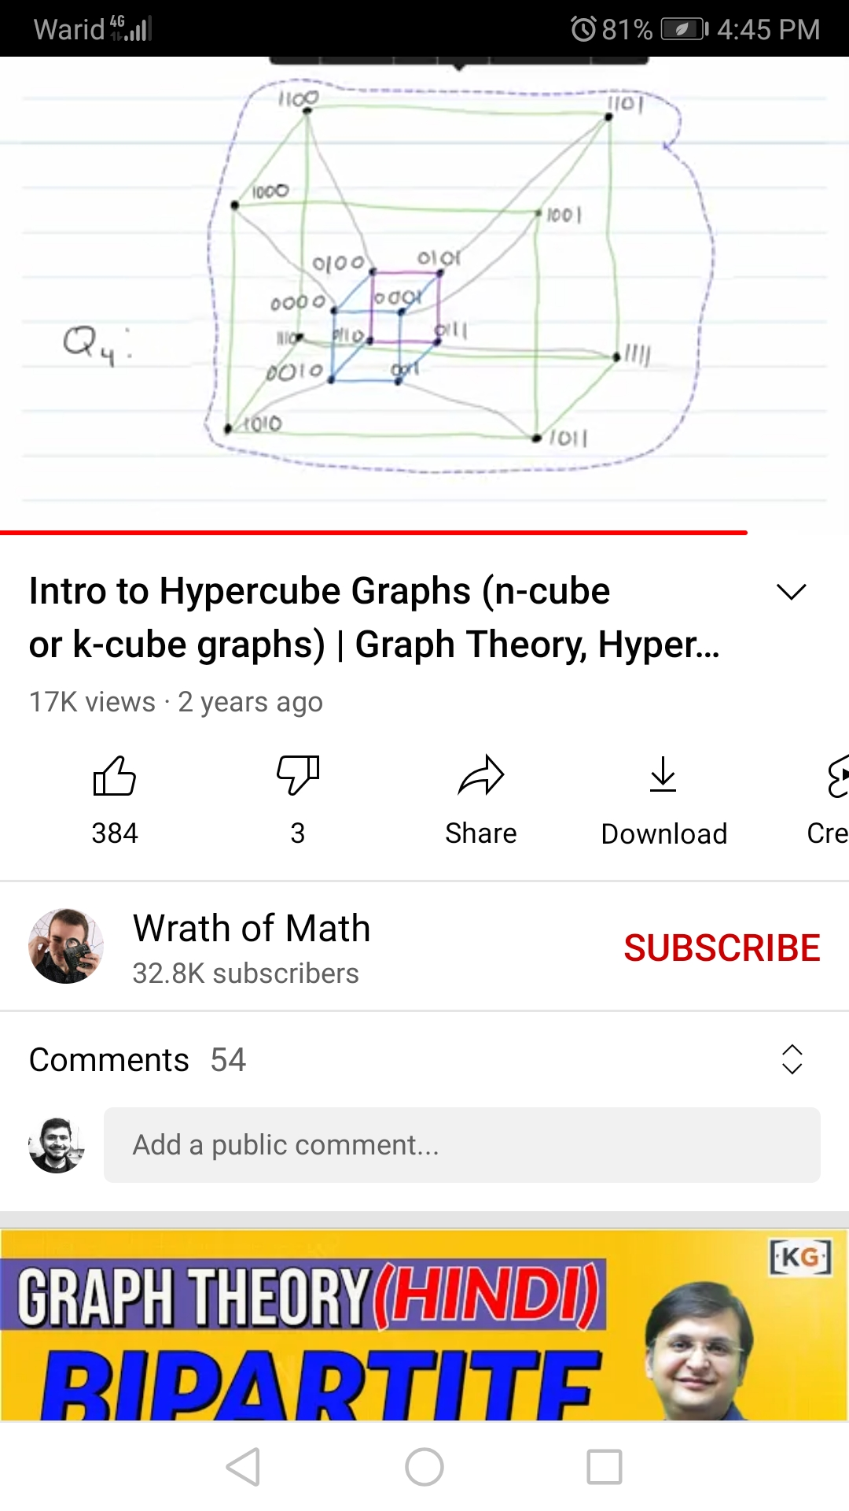
A Boolean n-Cube Graph for 4-variables
Add ‘0’ at MSB of
3-Cube graph
Extend all Edges of
3-Cube by adding
‘1’ at MSB to make
4-cube graph
Ref:
Youtube channel
‘Wrath of Math’

Slide 29
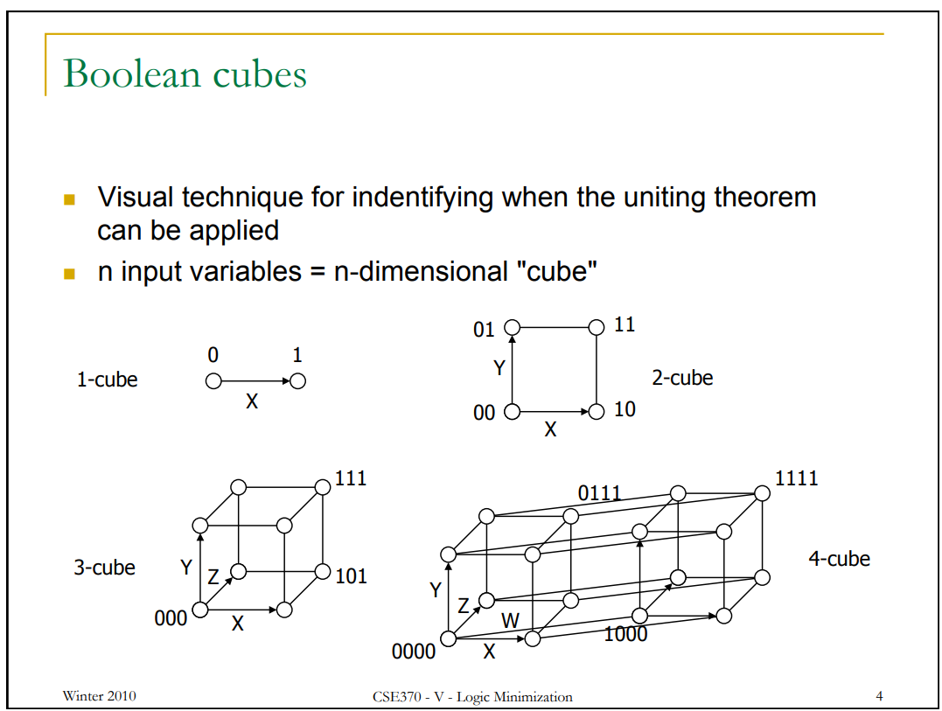
Graphs for 1 to 4 variables

Slide 30
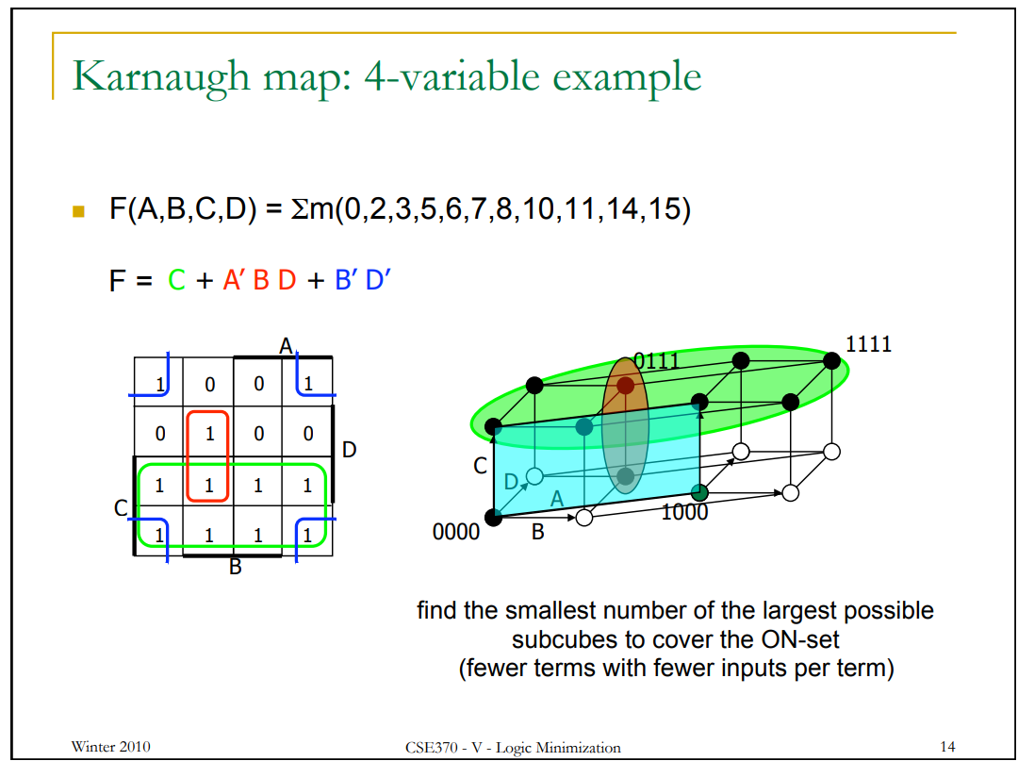
Example Graph for 4 variables
Identify?

Slide 31
Little bit about Espresso tool
Uses Graph Theory to represent Boolean variables
Finds different groupings to determine local and global minima
Keeps trying for optimal solution until some defined time-limit is reached
PyEDA library has logic minimization and synthesis tools in Python
https://pyeda.readthedocs.io/en/latest/overview.html
https://pyeda.readthedocs.io/en/latest/2llm.html

Slide 32
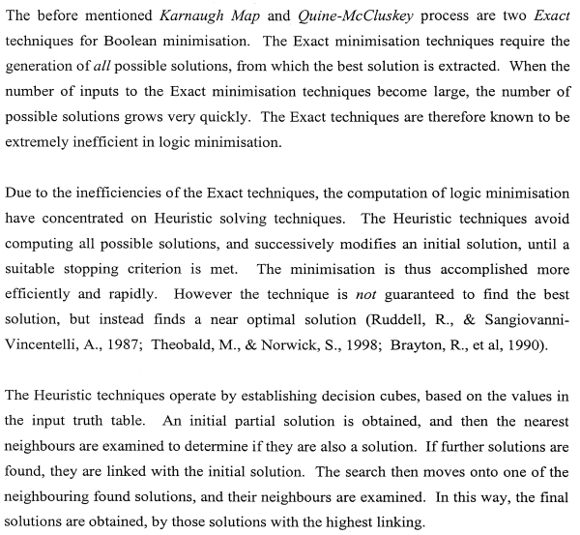












Exact techniques vs Heuristics based
Reference: MS Thesis by Hacker, 2001

Slide 33
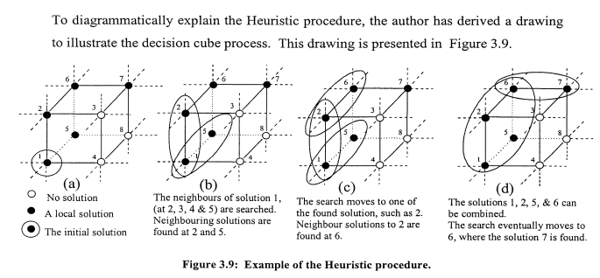


An Example of Heuristic solution
Reference: MS Thesis by Hacker, 2001

Slide 34
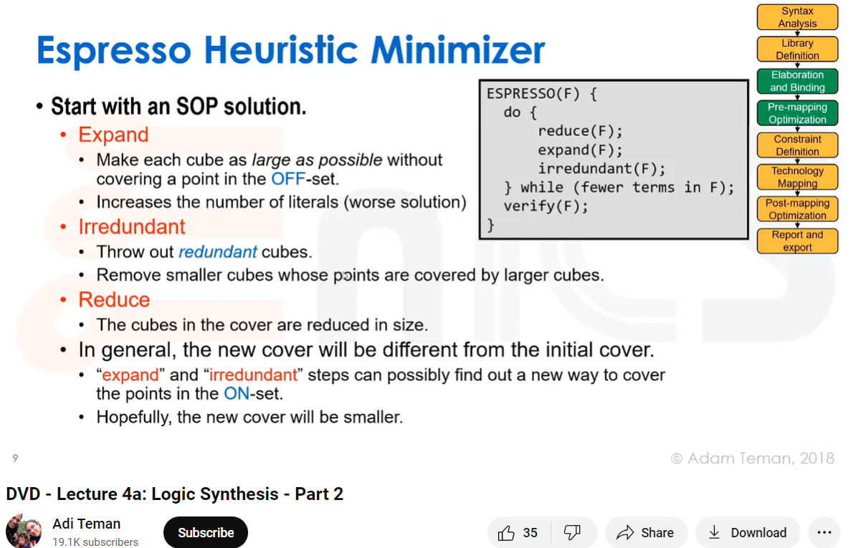
Espresso - 1

Slide 35
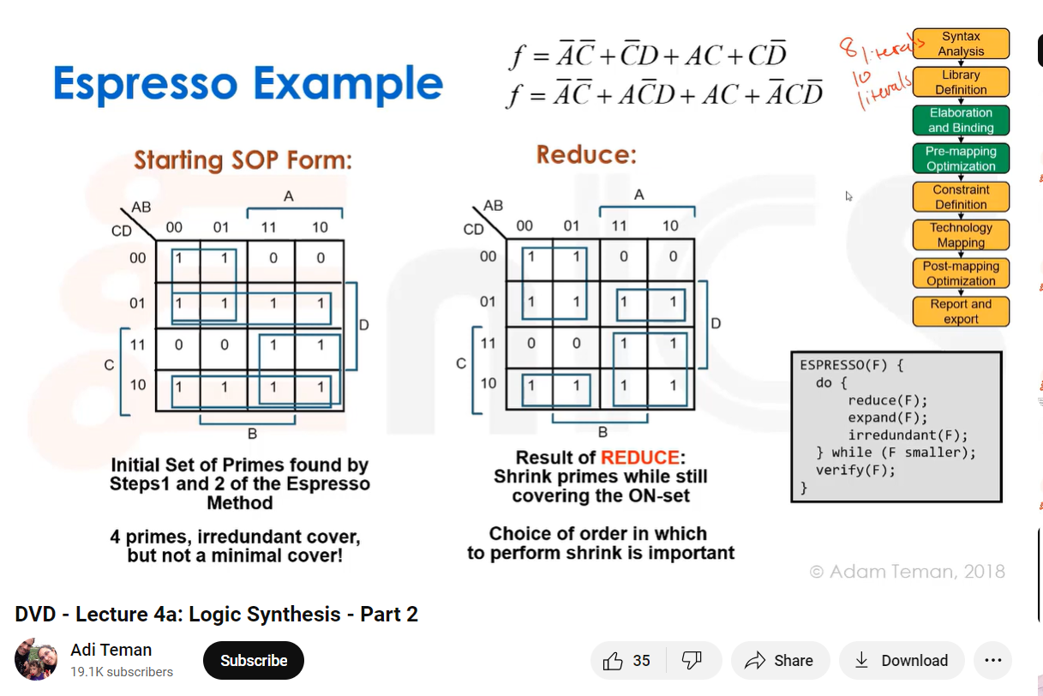
Espresso - 2

Slide 36
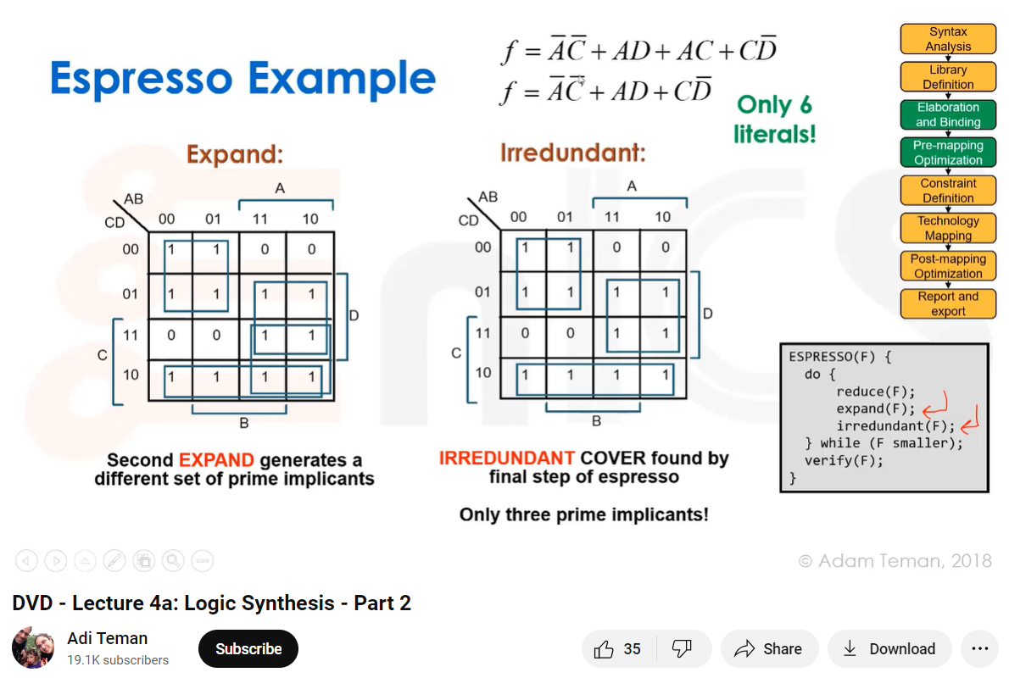
Espresso - 3

Slide 37
Espresso - 4

Slide 38
Learn More on Espresso
DVD - Lecture 4a: Logic Synthesis - Part 2 (youtube.com)
https://www.youtube.com/watch?v=yJ5CaAk7Nq8&list=WL&index=1
Lec 13: ESPRESSO-Heuristic Based Switching Function Minimization (youtube.com)
https://www.youtube.com/watch?v=NRAoJ8eKIgM

