Slide 1
EE 421 / CS 425 Digital System Design Laboratory 2
Fall 2025
Shahid Masud

Slide 2
Today’s Topics
Learn Questa (or Modelsim) Simulation Tool in the Lab Manual
Introduction to SystemVerilog HDL
Structural SystemVerilog Design
Writing Simple Test Benches
Examining the Output of Simulation Tool
Lab Tasks and Lab Deliverables

Slide 3




Step Through EDA Tools
Design Capture
Text Editor
Functional Simulation
Questa or
Modelsim
Synthesis
SIMULATION
Xilinx Vivado
Post-Synthesis Simulation
Modelsim
SYNTHESIS
Timing, Power, Area
Place and Route
Xilinx Vivado
Product FPGA / ASIC

Slide 4


Simulation Tool Questa

Slide 5
Hardware Description Languages
Specialized Computer Language for Capturing Hardware Design Idea
Can be used to describe structure and behavior of digital circuits
HDL include notion of hardware specific time or delay
They have support for Concurrency which is peculiar to hardware

Slide 6
Design Capture in SystemVerilog HDL
SystemVerilog Allows Design Capture at Various Hierarchy Levels:
Switch Level (NMOS and PMOS transistors)
Gate Level (Describing Circuit as Logic Gates)
Data Flow (RTL) Level
Dataflow Level
Behavior Level
The Design is Captured in a text file or obtained from
schematic diagram

Slide 7
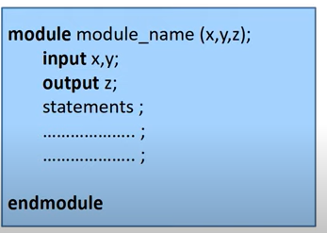
Modular Approach in SystemVerilog
Module is a basic building block
Module can be a collection of multiple low level logic blocks
Modules are interconnected through Port Interface
Internal functionality of any Module can be altered without affecting any other Module
module top_Level (a, b, c…..)
…
…
module use_1 (a_wire, b_wire,…);
module use_2 (c_wire,d_wire,…);
endmodule

Slide 8
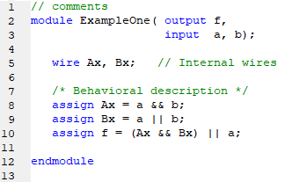
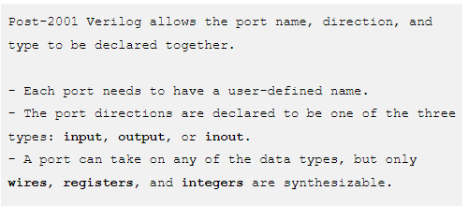
SystemVerilog Syntax
In new syntax, the input, output is defined as above.
In old syntax, this definition was after the module (…);
input a, b, …..;
output c,d,….;

Slide 9
SystemVerilog Basics – Comments and Number System
Verilog uses a C-like syntax. It is case sensitive, and all keywords are in lower case letters. Declarations, assignments, and statements end with a semicolon. It also uses C-style comments:
// comment to end of line
/* closed comment */
Numbers are represented as <number_of_bits>'<base><number>, where base can be b, o, d, or h, for binary, octal, decimal, or hex, respectively. Some examples:
8'hFF //8-bit hex number FF
5'b101 //5-bit binary number 00101
1 //decimal number 1 (decimal is the default base)
3'o5 //3-bit octal number 5
4’b1101 //4-bit binary number 1101
16’d255 //16 bit decimal number 255

Slide 10
Primitive Data Types in SystemVerilog
The data types that you will use are reg (register) and wire.
Wires cannot hold a value; they are used to connect modules of combinational logic.
Regs are used to store values. Since regs keep state, a reg cannot be the output of combinational logic.
Regs are only used in behavioral Verilog.
Declare regs and wires as follows:
reg a,b; //two scalar registers a, b
reg [0:7] byte; //8-bit vector, bit 0 is MSB
wire u; //one bit wire called u
wire [31:0] word; //32-bit vector called word, bit 31 is MSB

Slide 11
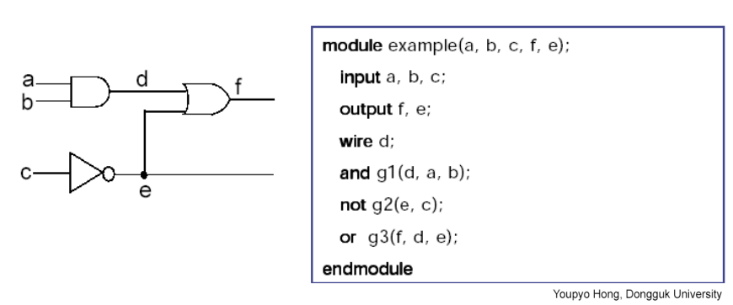
Structural SystemVerilog (port mapping)
Components available in library (primitives) are port mapped

Slide 12
Values of reg and wire in SystemVerilog
Standard logic values
0 and 1 represent logic 0 (false) and logic 1 (true)
x or z values are useful in modeling
Unknown value is denoted by x
High Impedance value is denoted by z
6’hx //6-bit hex number with unknown value
32’bz //32-bit binary number in high impedance state

Slide 13
Port Assignment in SystemVerilog
Ports can be:
input port – Internally a wire
output port – Internally a reg or a wire
combined input and output port – only a wire
Inside module
Inside module
Inside module
reg or wire
wire
wire
wire
reg or wire
wire
input port
output port
inout port

Slide 14
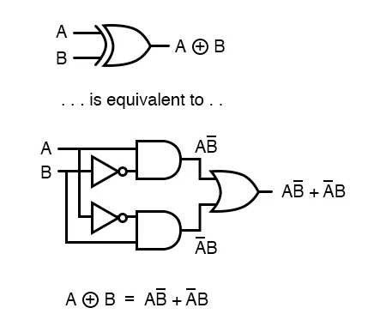
Structural View of an XOR gate

Slide 15
SystemVerilog Instantiation of Primitive Gates
/* An example of building a basic XOR function of two single bit inputs a and b */
module build_xor (a, b, c);
input a, b;
output c;
wire c, a_not, b_not;
not a_inv (a_not, a);
not b_inv (b_not, b);
and a1 (x, a_not, b);
and a2 (y, b_not, a);
or out (c, x, y);
endmodule
/* Structural description of a half adder composed of four, 2 input nand modules */
module halfadd (X, Y, C, S);
input X, Y;
output C, S;
wire S1, S2, S3;
nand NANDA (S3, X, Y);
nand NANDB (S1, X, S3);
nand NANDC (S2, S3, Y);
nand NANDD (S, S1, S2);
assign C = S3;
endmodule

Slide 16
Key Reserved Words for Structural Design
and(output, input 1, input 2, …..)
or()
not()
nand()
nor()
xor()
xnor()
wire // to interconnect inputs or outputs
//comment in code
and (y,a,b); //instantiate AND gate with output y and inputs a,b

Slide 17
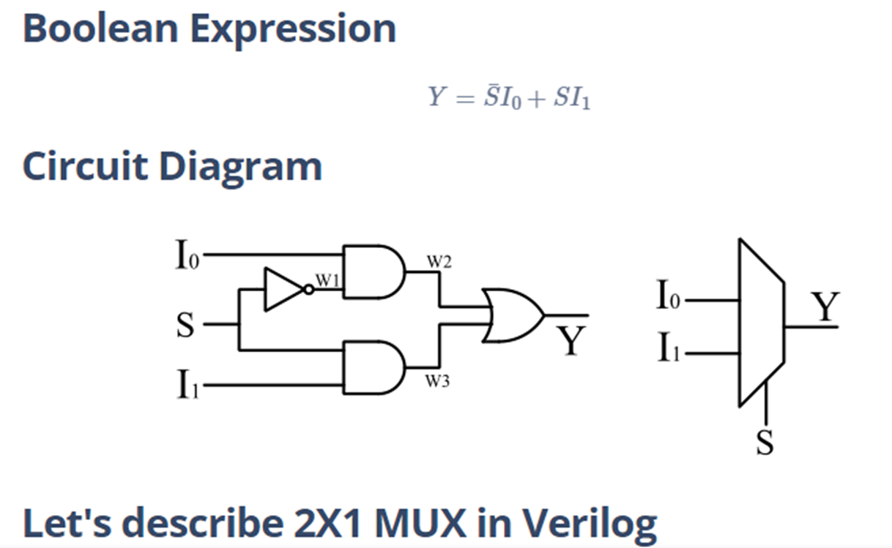
Structural SystemVerilog for 2:1 MUX
module mux2x1(
input I0,I1,S,
output Y
);
wire w1,w2,w3;
not my_not(w1,S);
and my_and1(w2,I0,w1);
and my_and2(w3,I1,S);
or my_or(Y,w2,w3);
endmodule

Slide 18
Test Bench
Used for Functional as well as Post-Synthesis Testing
Timing Information can be added through Gate Models
Stimulus through Test Bench or External File
Design Under Test DUT
Monitor
Timing Diagrams, File Comparison

Slide 19
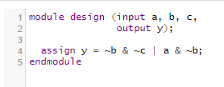
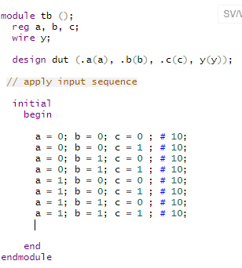
Writing Test Benches in SystemVerilog
Wrapper Verilog Module
Stimulus
Signals
Input Ports
Verilog Module
Clock
Screen Display
or File Write
Output Ports

Slide 20
Testbench Examples 1
`timescale 1ns/10ns
module testbench1(); // Testbench has no inputs, outputs
reg a, b, c; // Will be assigned in initial block
wire y;
// instantiate device under test
sillyfunction dut (.a(a), .b(b), .c(c), .y(y) );d
// apply inputs one at a time
initial begin // sequential block
a = 0; b = 0; c = 0; #10; // apply inputs, wait 10ns
c = 1; #10; // apply inputs, wait 10ns
b = 1; c = 0; #10; // etc .. etc..
c = 1; #10;
a = 1; b = 0; c = 0; #10;
end
endmodule

Slide 21
Timescale in Questa (or Modelsim) Simulations
At the top of test bench Verilog code, a compiler directive:
`timescale 2 ns / 1000 ps is included
This line is vital in a Verilog simulation because it sets up the timescale and operational precision for a design.
It sets the unit delays to be in nanoseconds (ns) and the accuracy at which the simulator will round the procedures down to 1000 ps.
This causes a #2 or #4 in a Verilog test bench assignment to be a 2 ns or 4 ns delay, respectively.

Slide 22
More on `timescale
`timescale <time_unit>/<time_precision>
// for example
`timescale 1ns/1ps
`timescale 10us/100ns
`timescale 10ns/1ns
The time_unit is the measurement of delays and simulation time, while the time_precision specifies how delay values are rounded before being used in the simulation.

Slide 23
Example of `timescale
`timescale 10ns/10ns
module tim( );
reg i;
initial
begin
i=0;
#7.7212;
i=1;
$display("STATEMENT 1 :: time is ",$stime);
#7.123;
$finish;
end
endmodule
In the `timescale statement, the first value is the time unit and the second is the precision for the simulation. So with the time unit, when the simulator displays a value, you just have to multiply the value by this time unit to get the real time. With a 10ns time unit, a delay of #7.7212, that means that it is 77.212ns delay.

Slide 24
Testbench of AND gate
`timescale 10ns/10ns
module basic_and_tb();
reg [3:0] a, b;
wire [3:0] out;
basic_and #(.WIDTH(4)) DUT (
.a(a), .b(b), .out(out)
);
initial begin
a = 4'b0000;
b = 4'b0000;
#20
a = 4'b1111;
b = 4'b0101;
#20
a = 4'b1100;
b = 4'b1111;
#20
a = 4'b1100;
b = 4'b0011;
#20
a = 4'b1100;
b = 4'b1010;
#20
$finish;
end
endmodule

Slide 25
Lab 2 Task – Design Capture and Questa (or Modelsim) Simulations
Refer to Lab Manual 2.
Lab Deliverables Document needs to be completed and submitted for each lab.
Upload the Lab Deliverables Document on LMS Dropbox.

