Slide 1
Lecture 20
EE 421 / CS 425
Digital System Design
Fall 2025
Shahid Masud

Slide 2
Topics
Recap – CPLD Architecture and Some Examples
FPGA Architectures
Configurable Logic Block
Configurable I/O Blocks
Distributed RAM, Block RAM, Dual Port Memory
Special Features and DSP Slice in FPGA
Quiz on Tuesday

Slide 3
Recap from last lecture
CPLD from Xilinx and Altera
Architecture Differences between CPLD Families
Important Building Blocks of CPLD
Limitations of CPLD
Predictable Timing Performance of CPLD
How can logic complexity of CPLD macrocell be enhanced?
  Expanders, etc.
Programmable Output, Registered Output

Slide 4
Description of Basic (Registered) Macrocell
Each section of an SPLD is called a macrocell that contains SOP combinational logic and an optional Flipflop
A typical SPLD has from 8 to 10 macrocells within one chip
All Flipflops are connected to common CLK input
All three-state buffers at Flipflop output are controlled by a common OE input

Slide 5
Generic CPLD Configuration
PLD
PLD
PLD
PLD
I/O
Block
I/O
Block
Programmable Switch Matrix
PLD
PLD
PLD
PLD

Slide 6
Details of Generic CPLD Configuration
Collection of individual PLD gate arrays on a single integrated circuit
Each I/O pin is driven by a 3-state buffer and can be programmed to act as Input or Output pin
Each PLD typically contains 8 to 16 macrocells
If a macrocell has unused product terms, they can be used by nearby macrocells
The outputs of macrocells can be routed to inputs of other macrocells to form complex multi-level logic functions - expanders
Different manufactures offer variations in PLD design, programmable switching matrix and different types of I/O blocks

Slide 7
Basic Macrocell Logic
PAL that includes a DFF is called a
Registered PAL
CLK
OE
DFF
D
CLK
Q
Q’
Inputs

Slide 8
Altera 7000 Series CPLD Architecture
Input/GClk
Input/GClkn
Input/OE1
Input/OE2
I/O Control Block
LAB A
PIA
Programmable Interconnect Array
LAB B
I/O Control Block
8 to
16
Macrocells
1 to 8
Macrocells
17 to 24
8 to
16
.
.
.
.
36
36
.
.
.
.
8 to 16
I/O Pins
8 to 16
I/O Pins
Macrocells
9 to 16
Macrocells
25 to 32
16
16
8 to 16
8 to 16
I/O Control Block
LAB C
LAB D
I/O Control Block
8 to
16
Macrocells
33 to 40
Macrocells
49 to 56
8 to
16
.
.
.
.
36
36
.
.
.
.
8 to 16
I/O Pins
8 to 16
I/O Pins
Macrocells
41 to 48
Macrocells
57 to 64
16
16
8 to 16
8 to 16

Slide 9
PIA and I/O
The PIA provides full connectivity with predictable timing between LAB, dedicated inputs and I/O Pins
The I/O Control block establishes connectivity between I/O Pins and PIA and LABs
From 8 to 16 LAB outputs can be programmed to route through I/O Pins; and from 8 to 16 I/O Pins can be programmed to route through the I/O Control block to the PIA
Altera architecture uses a PIA to connect LABs and I/O Pins. All signals are available throughout the device. The timing is thus predictable. The alternative is ‘Channel-Routed Architecture’ that is more denser but the timing is un-predictable as delays are routing-dependent

Slide 10
Shareable Expander in Altera 7000 CPLD
Product term select matrix
Product term select matrix
36 Signals
From PIA
16 Shared Expanders

Slide 11
Parallel Expander in Altera 7000 CPLD
From Previous Macrocell
Product term select matrix
Parallel Expander
Product term select matrix
To Next
Macrocell
36 Signals
From PIA
16 Shared Expanders

Slide 12
Altera 7000 Series Macrocell Architecture
Parallel Logic
Expanders
Global
Clear
Global
Clk
Reg
Byps
Product term select matrix
DFF
CLK
Clk Sel
M
CLR
CLR
Sel
M
36 Signals
From PIA
Shared Logic
Expanders
To
PIA
16 Expander
Product Terms
M

Slide 13
Xilinx XC9500 CPLD Architecture
JTAG
3
JTAG
Controller
In-System
Programming Controller
Port
54
I/O Blocks
Switch
Matrix
Function Block 1
1 – 18 Macrocells
I/O
18
I/O
I/O
54
Function Block 1
1 – 18 Macrocells
18
I/O
54
Function Block 1
1 – 18 Macrocells
I/O Global Clk
18
I/O Global Set/Rst
I/O Global Tristate
54
Function Block 1
1 – 18 Macrocells
18
3
2 or 4

Slide 14
Details of Xilinx 9500 CPLD
Flash based EEPROM Technology
Comprises Few (4) Functional Blocks
Each functional block contains 18 independent macrocells
Each functional block has 54 inputs and 18 outputs
Product-term-allocator allocates upto 90 product terms in each macrocell in a functional block to form SOP expressions
Each macrocell can receive five direct product terms from the AND array and up to 10 more product terms can be made available from other un-committed product terms in other macrocells from same functional block
Partial SOP terms can be combined from several macrocells
Each macrocell can be independently configured for combinational or sequential functionality

Slide 15
Xilinx XC9500 Macrocell Architecture
54
Global
Set/Rst
Global
Clk
16 Expander
Product Terms
Additional Product
Terms from other macrocells
Set
To FastConnect
II Switch Matrix
Product term select matrix
DFF
D
CLK
Rst
Product-term Clk
Product-term Rst
To I/O Blocks

Slide 16
Field Programmable Gate Arrays
FPGA

Slide 17
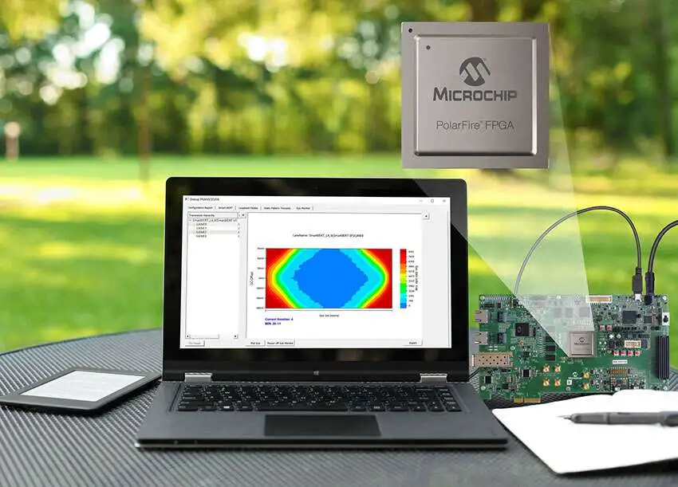
Field Programmable Gate Arrays
Generic Architecture
I/O Resources
Interconnect
FG
FG
FG
FG = function generator
for
Logic implementation
Interconnect
FG
FG
FG
Interconnect
FG
FG
FG
I/O Blocks
Interconnect
USB or
JTAG Cable
SRAM Configuration Memory

Slide 18
Lookup Table (LUT) based Configurable Logic Blocks
Pre
X1
X2
X3
X4
X Function Generator
LUT4
DFF
D Q
X output
Clk
Clr
M
Pre
Y1
Y2
Y3
Y4
X Function Generator
LUT4
DFF
D Q
Y output
Clk
Clr
M

Slide 19
Details of LUT based CLB
Uses a four-variable look-up table and a flipflop as the basic configurable hardware element. Several of these are combined in different families and types
Any two functions X and Y of four variables each can be generated in the LUT
Flipflops at the output can be used. DFF have external preset and clear as well as clock selection mechanism
Output multiplexer selects from un-registered or registered output

Slide 20
Configurable Logic Blocks based on Multiplexers
Where is
Distributed Memory?
SRAM Cells
M
A0
A1
S0
M
DFF
M
D Q
X output
M
B0
B1
S1
M
Clk
M
M
M
S2
4:1 MUX to generate required SOP Expression

Slide 21
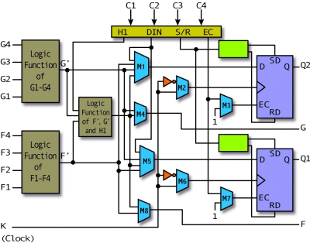
Xilinx 4000 CLB

Slide 22
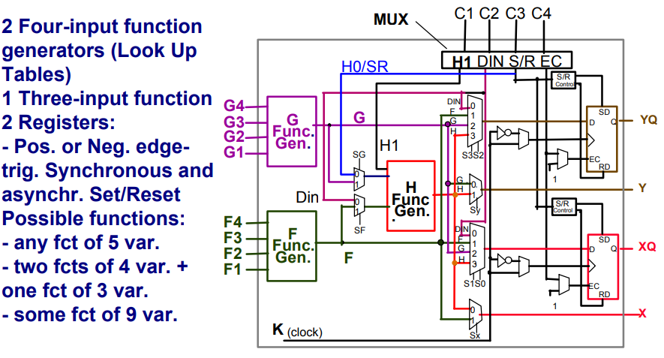
LUT Configuration and Extension

Slide 23
Interconnects
FPGA in Symmetric Array Configuration (Eg Xilinx)
  General Purpose Interconnect
  Direct Interconnects
  Global Lines
FPGAs in hierarchical interconnect routing architecture (Eg Altera)
FPGA in Row Based Configuration (Eg Actel)
FPGAs in Sea of Gates Fine-Grained Configuration (Eg IBM)

Slide 24
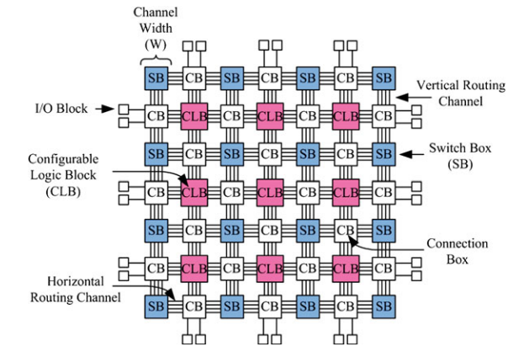
Mesh Based FPGA Routing Architecture

Slide 25
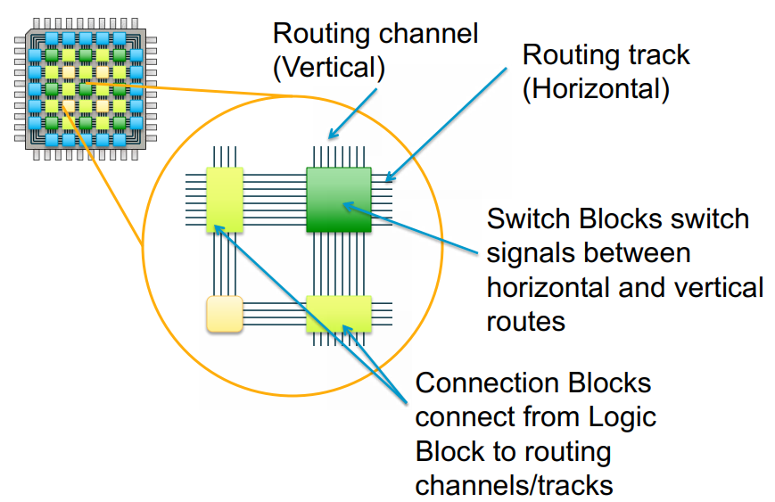
Switching Blocks and Connection Blocks

Slide 26
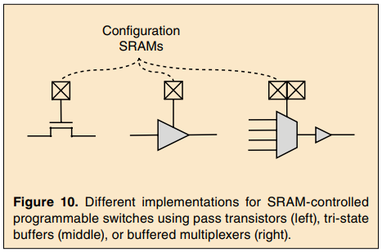
Configuration SRAM for Routing
Early FPGA used pass gate transistors controlled by SRAM cells to connect wires
This results in slow speed for large FPGA
Adding some tri-state buffers improves speed but costs area
Recent FPGA use a multiplexer built out of pass gates followed by a buffer that cannot be tri-stated
The pass transistors in this direct-drive approach switch can be small as they are lightly loaded, while the buffer can be larger to drive the significant capacitance of a routing wire segment

Slide 27
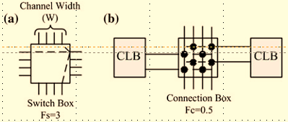
Connection Box and Switching Box - Example
FPGA routing occupies 80% of total area, logic is 20%
In Mesh based routing, horizontal and vertical routing tracks are interconnected through Switch Boxes (SB)
Logic Blocks are connected to the routing network through Connection Boxes (CB)
Flexibility of Connection Box (FC) is the number of routing tracks of adjacent channels which are connected to pin of a block
An FC(in) of 1.0 means that all the tracks of adjacent routing channel are connected to the input pin of the logic block
Flexibility of Switch (FS) is the total number of tracks with which every track entering in the switch box connects to
Channel Width (CW) is the number of tracks in a routing channel, used in all horizontal and vertical channels of the architecture
FS=3 means each track incident on it is connected to 3 tracks of adjacent routing channels
FC(in) =0.5 means each input of the logic block is connected to 50% of the tracks of adjacent routing channels

Slide 28
Symmetric (Matrix) Based FPGA Configuration
Logic
Block
Logic Block
Logic Block
Switch
Matrix
Switch
Matrix
Logic Block
Logic Block
Logic Block

Slide 29
Routing Matrix for General Purpose Interconnection in FPGA
C1 C2 C3 C4
A1
A2
A3
A4
1
6
2
B1
B2
B3
B4
5
4
3
Six-way connectivity
D1 D2 D3 D4

Slide 30
Direct Interconnection to Neighboring Blocks
Logic Block
Logic Block
Logic Block
Logic Block
Logic Block
Logic Block
Logic Block
Logic Block
Logic Block

Slide 31
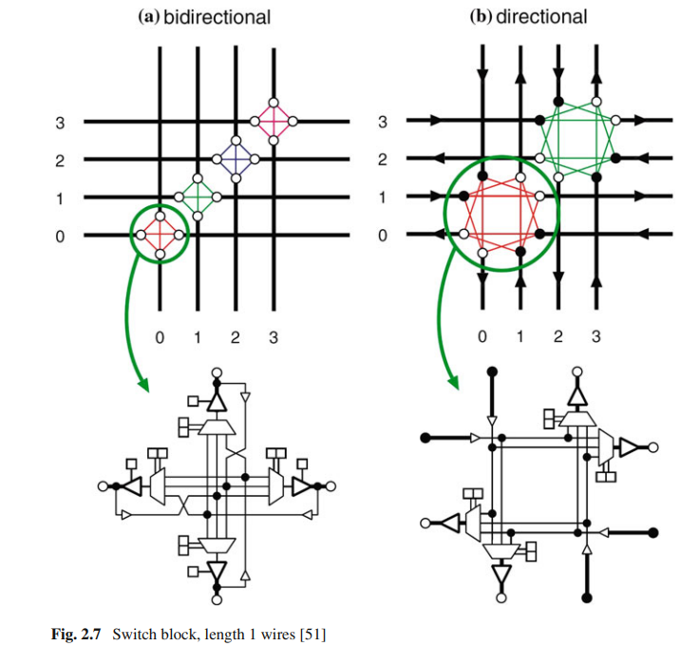
Switch Block Architecture

Slide 32
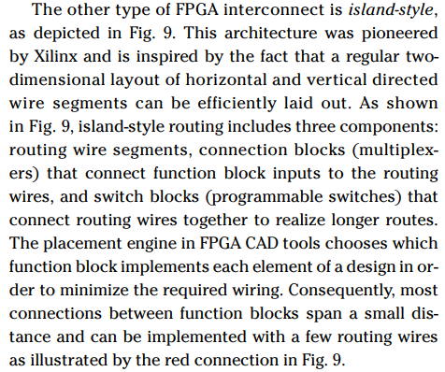
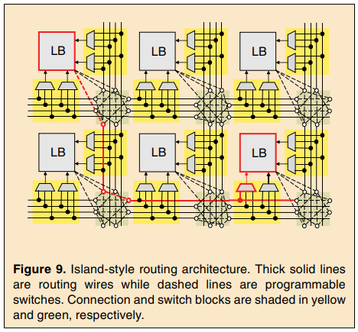
Island Style Routing Architecture

Slide 33
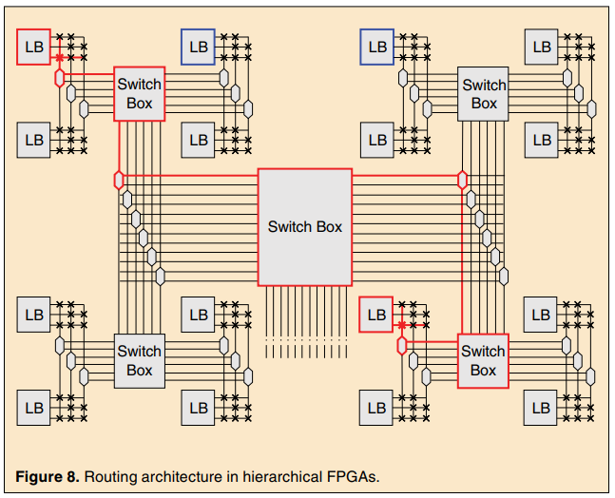
Hierarchical Routing Architecture in FPGA
Hierarchical Routing is inspired by the fact that:
(i) higher level modules instantiate lower level modules; and
(ii)Communication is more frequent between modules that are closer in hierarchy

Slide 34
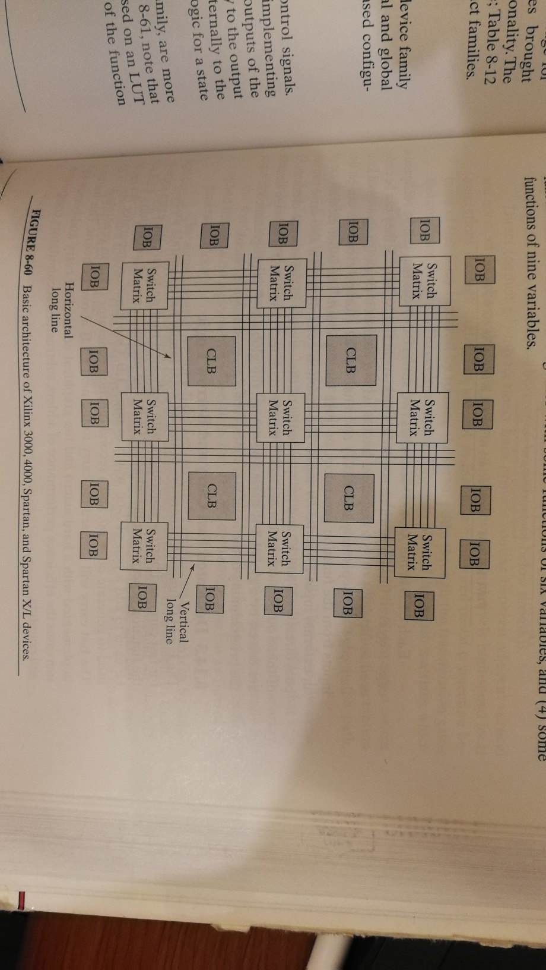
Xilinx 4000 FPGA Top Level Architecture

Slide 35
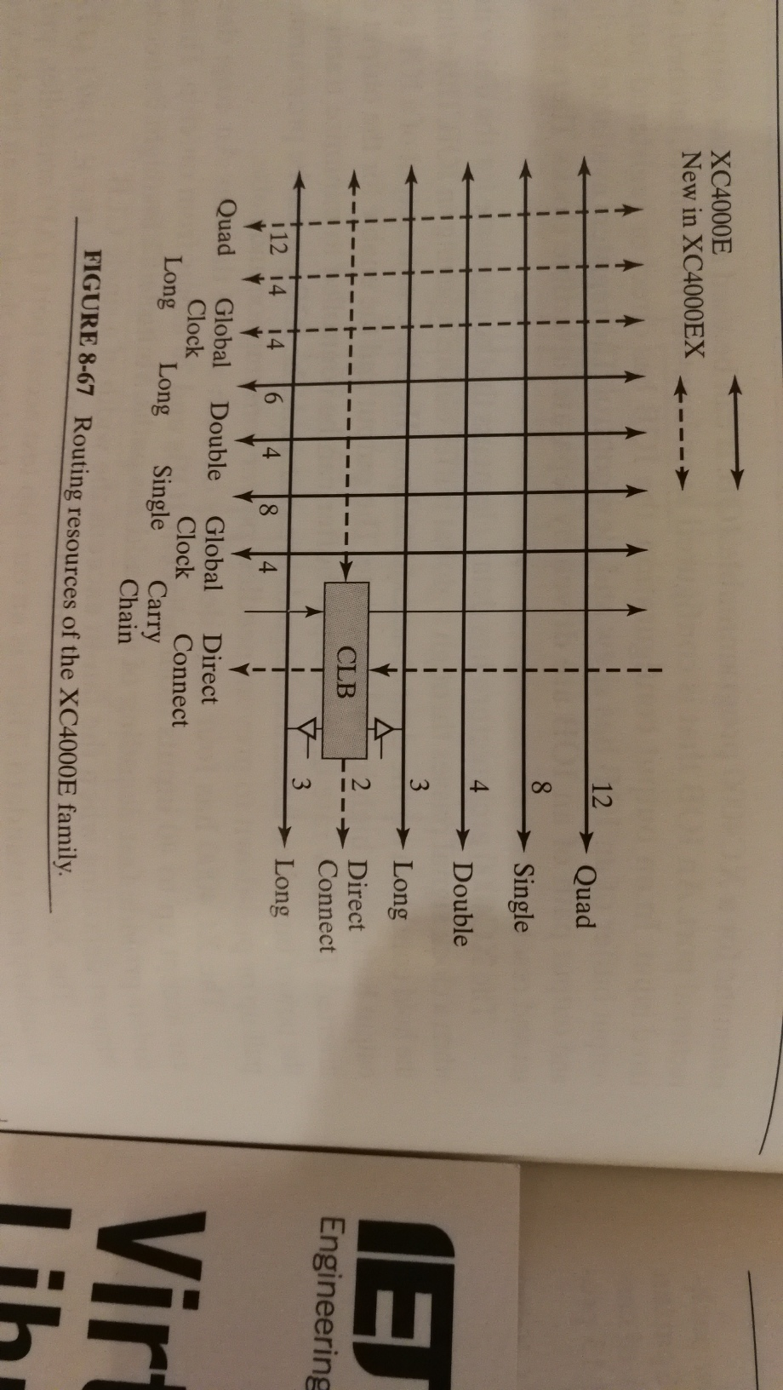
Xilinx 4000 Routing Resources with CLB

Slide 36
Global Interconnection Lines in FPGA
Tristate
Global Lines
Logic Block
Logic Block
Logic Block
Logic Block

Slide 37
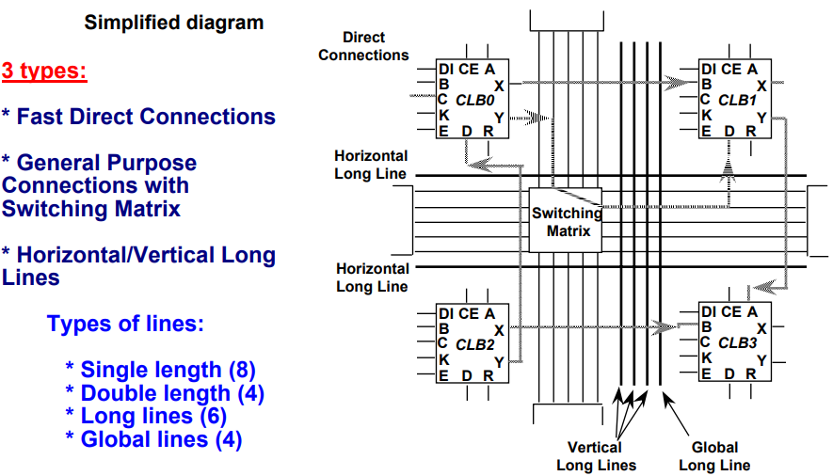
Xilinx 4000 Different types of Interconnects

Slide 38
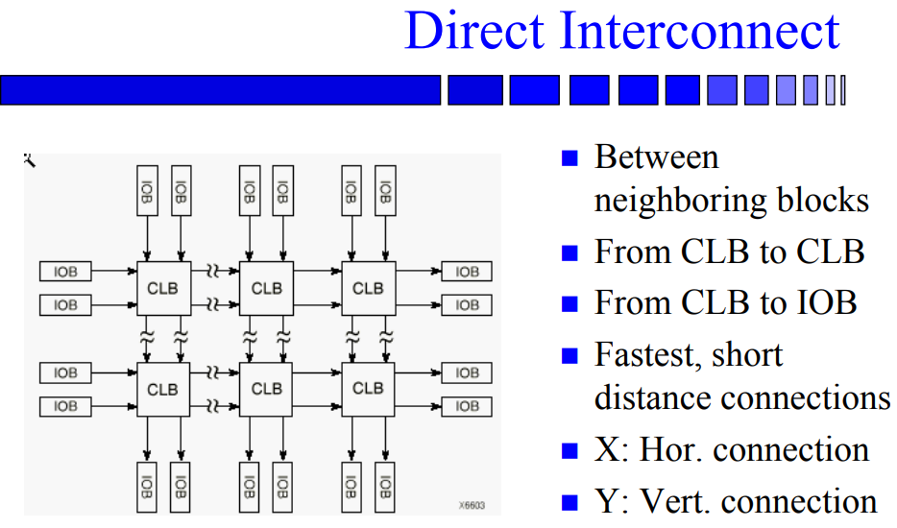
Direct Interconnect in Xilinx 4000

Slide 39
Programmable I/O Blocks in FPGA
Memory Storage for Configuration
+Vcc
Out Invert
3-State Invert
Latched Output
Slew Rate
Passive Pull Up
OUT Signal
3 State Enable
I/O
PAD
DFF
D Q
Enable
CLK
IN Signal (Un-registered)
IN Signal (Registered)
DFF
Q D
Voltage
Reference (CMOS/TTL)
Enable
CLK
Global Reset

Slide 40
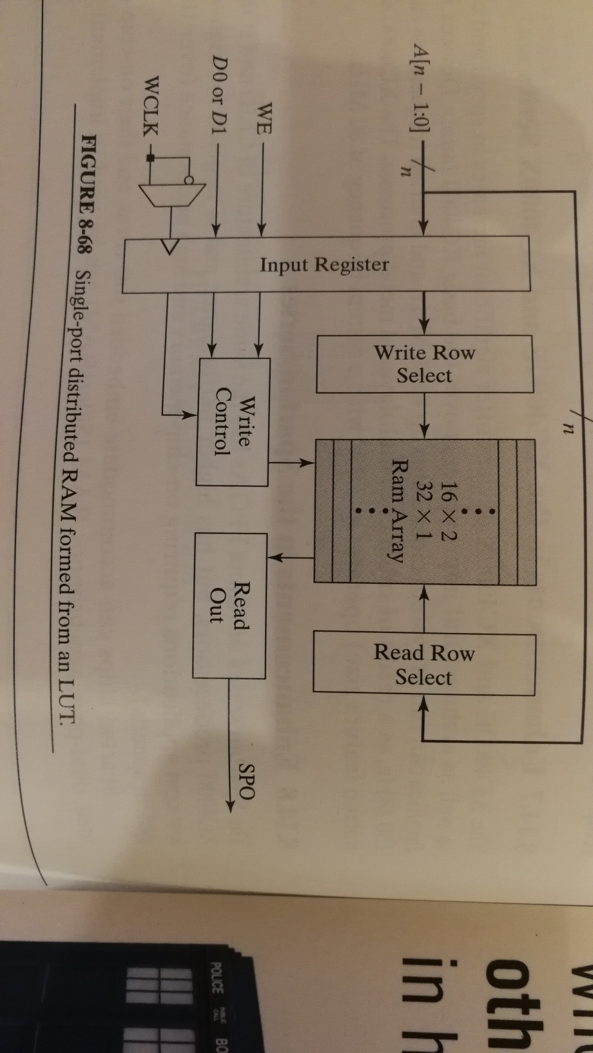
Single Port Distributed RAM from LUT based CLB

Slide 41
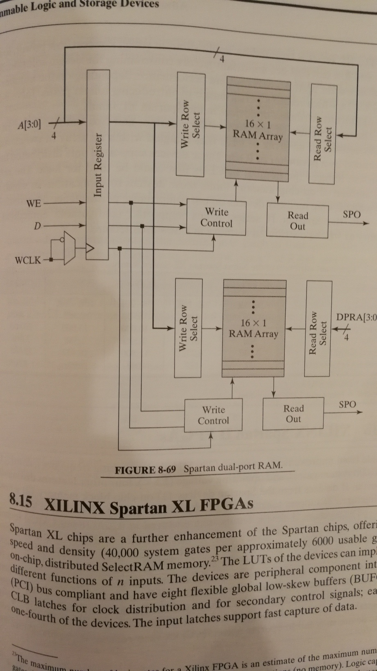
Dual Port RAM in Xilinx Spartan FPGA

Slide 42
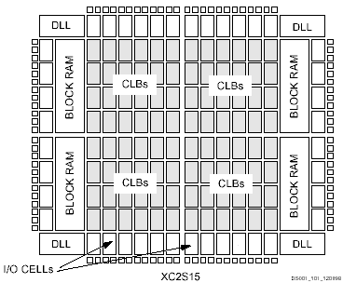
Xilinx Spartan Architecture
Block RAM ?
DLL = Delay Locked Loop
For Clock Management

Slide 43
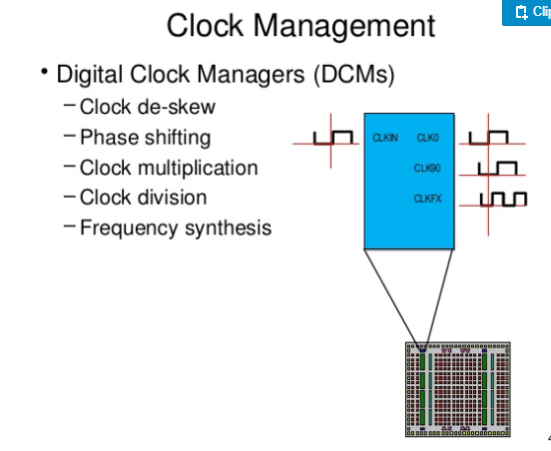
Digital Clock Module in Xilinx FPGA

