Slide 1
Lecture 25
EE 421 / CS 425
Digital System Design
Fall 2025
Shahid Masud

Slide 2
Topics
QUIZ 5 TODAY
Data Scramblers
Data Un-Scramblers
Scrambler Applications
Scrambler Examples
Binary Rate Multipliers – Maybe next lecture

Slide 3

Rescheduled Lectures
Rescheduled lecture: Academic Block SS Auditorium has been reserved for Make-up Class of EE 421 from
10:00 AM to 11:30 AM on Saturday, 6th December 2025.
As per RO’s below email, Academic Block-SS Auditorium has been reserved for reserved class of EE 421L/CS 425L on
Monday, 8th December 2025 from 2:00 PM to 4:50 PM.
Details will be announced
Quiz 6 in Last lecture

Slide 4
What is a Scrambler?
Scramblers → circuits that pseudo-randomly change the values of some bits in a data stream with the purpose of ‘whitening’ its spectrum to dilute strong spectral components.
This will reduce electromagnetic interference and introduce data security as part of an encryption algorithm.
In natural signals, e.g. voice, image, transducer, energy is concentrated in some bands. Scrambling → spread the energy to reduce interference and spikes.
An ALFSR forms backbone of scrambling operation.
There are two main types:
  Additive Scrambler
  Multiplicative Scrambler

Slide 5
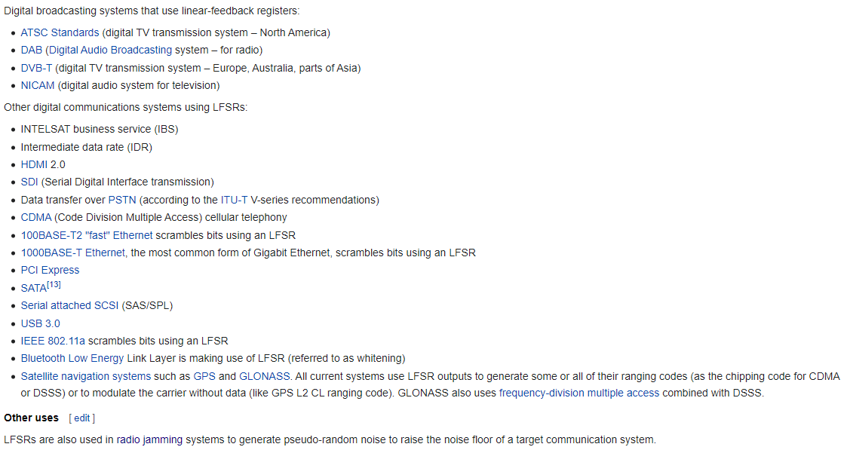
Example Applications of LFSR
Ref: from Wikipedia page

Slide 6
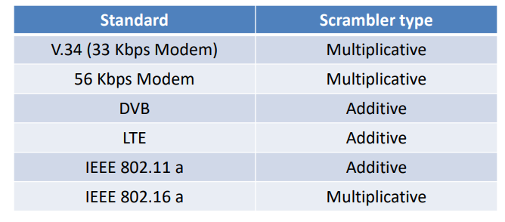
Types of Scramblers
1+x⁴+X⁷ is polynomial for 802.11

Slide 7
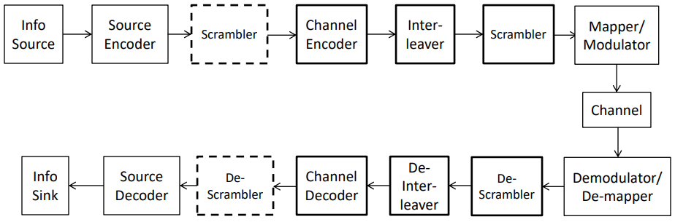












Typical Communication System

Slide 8



PRPG using ALFSR
+
Uses a seed value to produce a pseudo random pattern
Another symbol for XOR
d
Observe d to find out a pseudo random sequence
q3 ⨁ q4
+
D3 Q3
D2 Q2
D 1 Q1
D0 Q0
q₁
q₂
q₃
q₄
Polynomial is:
1+x³+x⁴
The taps are derived
From 3rd and 4th DFF
Pre
Pre
Pre
Pre
Serial Input
Bit stream as
In SISR
Clk
Preset to Seed Value

Slide 9
Simplified Representation
q1 | q2 | q3 | q4 | d
1 | 1 | 1 | 1 | 0
0 | 1 | 1 | 1 | 0
0 | 0 | 1 | 1 | 0
0 | 0 | 0 | 1 | 1
1 | 0 | 0 | 0 | 0
0 | 1 | 0 | 0 | 0
0 | 0 | 1 | 0 | 1
1 | 0 | 0 | 1 | 1
1 | 1 | 0 | 0 | 0
0 | 1 | 1 | 0 | 1
1 | 0 | 1 | 1 | 0
0 | 1 | 0 | 1 | 1
1 | 0 | 1 | 0 | 1
1 | 1 | 0 | 1 | 1
1 | 1 | 1 | 0 | 1
1 | 1 | 1 | 1 | 0
Preset
d is serial pseudorandom bit stream
+
DFF1 | DFF2 | DFF3 | DFF4
Characteristic Polynomial
1+x³+x⁴
The sequence observed at q3q2q1q0 =
{15,7,3,1,8,4,2,9,12,6,11,5,10,13,14,15,…..}

Slide 10
Changing seed value with same polynomial
Question:
What happens when seed value is changed from ‘1111’ to ‘1000’?
Answer:
With seed value of ‘1111’
The sequence observed at q3q2q1q0 = {15,7,3,1,8,4,2,9,12,6,11,5,10,13,14,15,….}
With seed value of ‘1000’
The sequence observed at q3q2q1q0 = {8,4,2,9,12,6,11,5,10,13,14,15,7,3,1,8,….}
Both sequences are equal in a circle, just the starting point is different

Slide 11
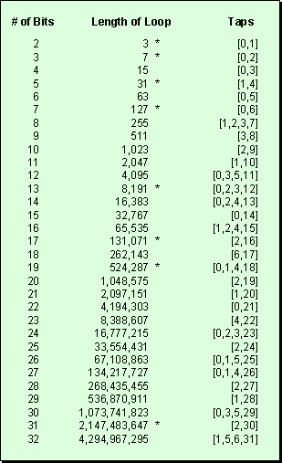
PRPG Cycle length vs
Register length

Slide 12


Additive Scrambler and Descrambler
Synchronous scramblers because they require the initial state of the scrambler and descrambler to be the same
They are non-recursive because they do not have any feedback loop in the process
LFSR is connected to the data stream by means of an additional modulo-2 adder (XOR) gate
Used in 100Base-TX interface which repeats its sequence after 2^{N}-1 = 2047 bits; with N=11
Usually employed where a fixed size frame is to be transmitted

Slide 13
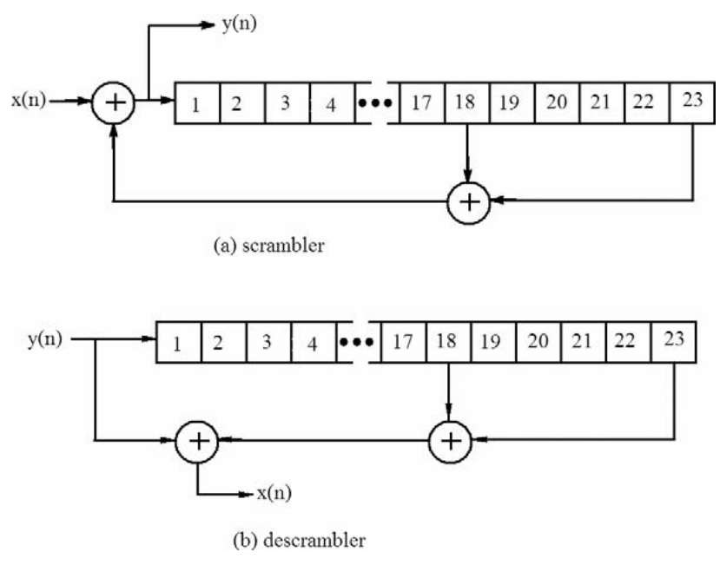
Additive Scrambler Eg. from Web

Slide 14
Additive Scrambler Example
Data Stream
c(n)
channel
⊕
Characteristic polynomial
1+x⁹+x¹¹
x(n)
Scrambled output data stream
k(n)
⊕
DFF1 | DFF2 | DFF3 | DFF4 | DFF5 | DFF6 | DFF7 | DFF8 | DFF9 | DFF10 | DFF11
x(n) represents the data to be scrambled at time n
k(n) represents the ‘key’ produced by the LFSR
c(n) represents the scrambled code word

Slide 15
Corresponding Additive Descrambler
from
channel
Characteristic polynomial
1+x⁹+x¹¹
Same seed value as Scrambler
⊕
y(n)
c(n)
Descrambled output
⊕
k(n)
DFF1 | DFF2 | DFF3 | DFF4 | DFF5 | DFF6 | DFF7 | DFF8 | DFF9 | DFF10 | DFF11
y(n) represents the data de-scrambled at time n
k(n) represents the ‘key’ produced by the LFSR
c(n) represents the scrambled code word

Slide 16
Multiplicative Scramblers
They are Asynchronous because they do not require LFSR synchronization.
They are recursive as they have feedback loops.
The pair of scrambler-descrambler is self-synchronizing. They do not need to start from same initial value.
The self-synchronizing process could take up to N bits (or N clock cycles) so the first N values of y(n) should be discarded.
With this approach, the transmission errors are multiplied by T+1, where T is the number of taps used in LFSR. Thus if one bit is flipped due to some error, the descrambler will result in 3 bit error.

Slide 17
Multiplicative Scrambler - Descrambler
Characteristic polynomial
1+x⁹+x¹¹
⊕
⊕
x(n)
k(n)
DFF1 | DFF2 | DFF3 | DFF4 | DFF5 | DFF6 | DFF7 | DFF8 | DFF9 | DFF10 | DFF11
c(n)
Scrambled
output
Channel for
Data communication
Seed value can be different at transmit and receive
y(n)
Descrambled output
⊕
⊕
k(n)
c(n)
DFF1 | DFF2 | DFF3 | DFF4 | DFF5 | DFF6 | DFF7 | DFF8 | DFF9 | DFF10 | DFF11

Slide 18
Example – Multiplicative Scrambler
⨁
⨁
x(n)
⊕
⊕
Registers output “q1q2q3q4” |  |  |  | k | x | c
0 | 0 | 0 | 0 | 0 | 1 | 1
1 | 0 | 0 | 0 | 0 | 0 | 0
0 | 1 | 0 | 0 | 0 | 1 | 1
1 | 0 | 1 | 0 | 1 | 1 | 0
0 | 1 | 0 | 1 | 1 | 0 | 1
1 | 0 | 1 | 0 | 1 | 0 | 1
1 | 1 | 0 | 1 | 1 | 0 | 1
1 | 1 | 1 | 0 | 1 | 1 | 0
0 | 1 | 1 | 1 | 0 | 0 | 0
0 | 0 | 1 | 1 | 0 | 1 | 1
1 | 0 | 0 | 1 | 1 | 1 | 0
0 | 1 | 0 | 0 | 0 | 0 | 0
k(n)
DFF1 | DFF2 | DFF3 | DFF4
c(n)
Transmitted Scrambled
Stream to Receiver
LFSR Using polynomial 1 + x³ + x⁴
Scrambler Seed Value “0000”
Input Data stream:
“101100010110”

Slide 19
Continue to – Multiplicative De-Scrambler
⨁
⨁
y(n)
Descrambled Output Stream
Registers output “q1q2q3q4” |  |  |  | k | c | y
1 | 1 | 1 | 1 | 0 | 1 | 1
1 | 1 | 1 | 1 | 0 | 0 | 0
0 | 1 | 1 | 1 | 0 | 1 | 1
1 | 0 | 1 | 1 | 0 | 0 | 0
0 | 1 | 0 | 1 | 1 | 1 | 0
1 | 0 | 1 | 0 | 1 | 1 | 0
1 | 1 | 0 | 1 | 1 | 1 | 0
1 | 1 | 1 | 0 | 1 | 0 | 1
0 | 1 | 1 | 1 | 0 | 0 | 0
0 | 0 | 1 | 1 | 0 | 1 | 1
1 | 0 | 0 | 1 | 1 | 0 | 1
0 | 1 | 0 | 0 | 0 | 0 | 0
+
+
k(n)
Seed
N=4
DFF1 | DFF2 | DFF3 | DFF4
c(n)
y=x
Input
String
From
here
Received from channel
LFSR Using polynomial 1 + x³ + x⁴
Scrambler Seed Value “0000”
De-Scrambler Seed Value “1111”
Input Data stream:
“101100010110”

Slide 20
Multiplicative De-Scrambler with Error Detection
⨁
⨁
y(n)
Descrambled Output Stream
Registers output “q1q2q3q4” |  |  |  | k | c | y
1 | 1 | 1 | 1 | 0 | 1 | 1
1 | 1 | 1 | 1 | 0 | 0 | 0
0 | 1 | 1 | 1 | 0 | 1 | 1
1 | 0 | 1 | 1 | 0 | 0 | 0
0 | 1 | 0 | 1 | 1 | 1 | 0
1 | 0 | 1 | 0 | 1 | 0 | 1
1 | 1 | 0 | 1 | 1 | 1 | 0
1 | 1 | 1 | 0 | 1 | 0 | 1
0 | 1 | 1 | 1 | 0 | 0 | 1
0 | 0 | 1 | 1 | 0 | 1 | 0
1 | 0 | 0 | 1 | 1 | 0 | 1
0 | 1 | 0 | 0 | 0 | 0 | 0
+
+
k(n)
Seed
N=4
DFF1 | DFF2 | DFF3 | DFF4
c(n)
y=x
Input
String
From
here
Received from channel
LFSR Using polynomial 1 + x³ + x⁴
Scrambler Seed Value “0000”
De-Scrambler Seed Value “1111”
Input Data stream:
“101100010110”
T is the number of TAPS used in ALFSR
One error in blue was introduced in c(n)
This error resulted in T+1 = 3 errors in y(n) shown in red

Slide 21
Case Study: Binary Rate Multipliers

Slide 22
Binary Rate Multipliers - BRM
Definition: A circuit module that transforms a stream of input clock pulses into another stream of output clock pulses
Let Ni = no. of input pulses for a particular time period
Let No = no. of output clock pulses for the same time period
$$Binary Fractional Rate Multiplier ⟹No= \frac{B}{2^{n}}Ni$$
B = Rate Constant Input to module
B = (B_{n-1}, B_{n-2}, ……., B₂, B₁, B₀)₂
n = no. of binary counter stages controlling the module
The clock input drives an n-bit binary counter whose outputs are labelled (Xn,Xn-1,….,X2,X1).
Will do next lecture due to quiz today

