Slide 1
Lecture 28
EE 421 / CS 425
Digital System Design
Fall 2025
Shahid Masud

Slide 2
Topics
Barrel Shifter
Asynchronous Sequential Circuits
Types of Asynchronous Circuits:
  Pulse mode Asynchronous Circuits
Analysis of Pulse Mode Circuits
Design of Pulse Mode Circuits
Quiz 6 Today

Slide 3
Barrel Shifter

Slide 4
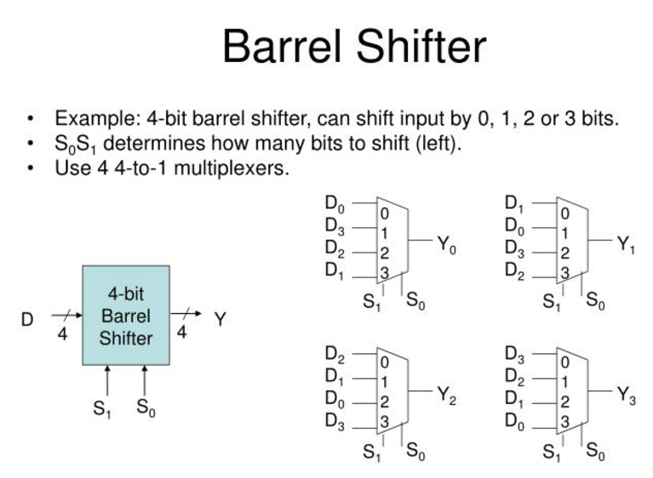
What is a Barrel Shifter?

Slide 5
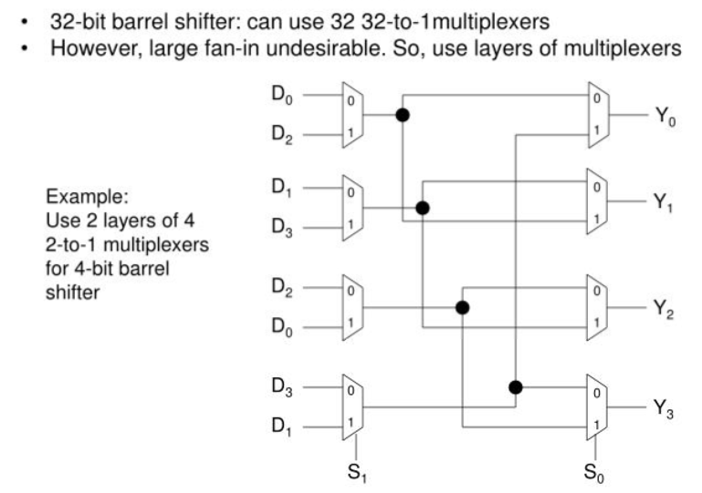
An Architecture of a Barrel Shifter

Slide 6
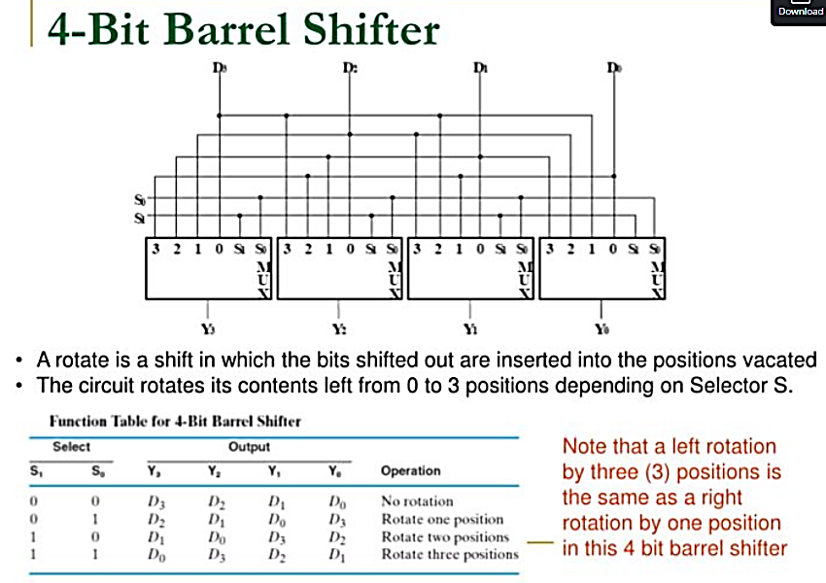



A 4-bit Barrel Shifter Design

Slide 7
Asynchronous Digital Design

Slide 8
Asynchronous Sequential Circuits
A clock is not utilized to synchronize state changes
Only external inputs and current states are available to cause state changes

Slide 9
Fundamental Mode Asynchronous Circuits
These circuits have level inputs and unclocked memory elements
Uses inherent delays present in logic circuit elements
Assume that each delay element has same delay Δt
X1….Xn
Combinational
Logic Circuit
Z1….Zm
yr..….y1
Y1.……Yr
Delay, Δt
Delay, Δt

Slide 10
Other conditions for Fundamental Mode cct
All delays in a circuit branch are lumped to a single Δt
The delay is always Δt
Inputs are restricted so that only one input variable is allowed to change value at a given instant to ensure correct behavior
For predictable operations, input changes should be spaced in time by at least Δt; the time needed for the circuit to settle down to a stable state following an input change

Slide 11
Pulse Mode Asynchronous Circuits
Pulses will not occur simultaneously on two or more input lines
Memory element transitions are limited only by input pulses
Input variables are used either only in uncomplemented or in the complemented forms, but not both together
X1….Xn
Combinational
Logic Circuit
Z1….Zm
yr.……y2 y1
D1
D2………Dr
Flip flop
memory

Slide 12
Pulse Mode Asynchronous Sequential
Pulse Mode Asynchronous Circuits :
In the pulsed mode, the input variables are allowed to be applied in the form of pulses, rather than in the form of levels.
But the width of input pulses is a critical parameter. There are two restrictions on the width of the input pulses.
  The first requirement is that the pulses should be long enough so that the circuit can respond to them.
  The second requirement is that the pulses should not be too long so that they are still present after the new secondary state is reached.
The base of calculating the minimum pulse width is the propagation delay of the excitation logic.
The maximum pulse width is calculated based on the total propagation delay through the excitation logic and the memory.

Slide 13
Conditions for Pulse mode circuits
Input pulses should be spaced in time by at least the response time of the slowest memory element
No memory element will be in process of changing state when a new input pulse arrives

Slide 14
Analysis of a Pulse Mode Ascnchronous Sequential Circuit
Input States
X
Z
x=1
x=0
Input X is made up of asynchronous pulses
Initial state y1=y2=0
Present states = y1, y2 (small y)
Next states = Y1, Y2 (capital Y)
Logic Equations:
D1=y1’
D2=y1’
Z=X.y1.y2
C1=X.y2
C2=X
DFF1
Y1
y1
Q
Q’
D
Clk
y1’
DFF2
Y2
y2
Q
Q’
D
Clk

Slide 15
Contd: Analysis Pulse Mode Ascynch Seq Cct
Define:
Inputs:
  I₀ = no pulse on X
  I₁ = pulse on X
States:
  A = 00 (y1y2)
  B = 01
  C = 10
  D = 11
Outputs:
  Z = 0
  Z = 1

Slide 16
Timing Diagram of Pulsed Sequential Circuit
Logic Equations:
D1=y1’
D2=y1’
Z=X.y1.y2
C1=X.y2
C2=X
x
y1
y2
D1=D2
C1
C2
z
t1
t2
t3
t4
time

Slide 17
State Table and STG for Pulsed Sequential Circuit
I₀/0
I₀/0
I₁/0
A
B
Present state |  | I₀ | I₁
 | A | A/0 | B/0
 | B | B/0 | D/0
 | C | C/0 | C/0
 | D | D/0 | A/1
I₁/0
I₁/1
I₁/0
C
Next State / Output
D
  I₀ = no pulse on X
  I₁ = pulse on X
I₀/0
I₀/0

Slide 18
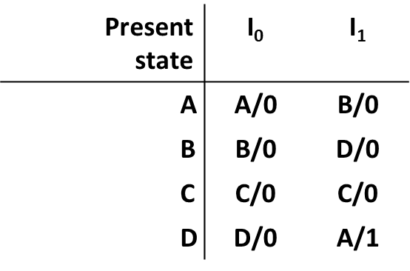
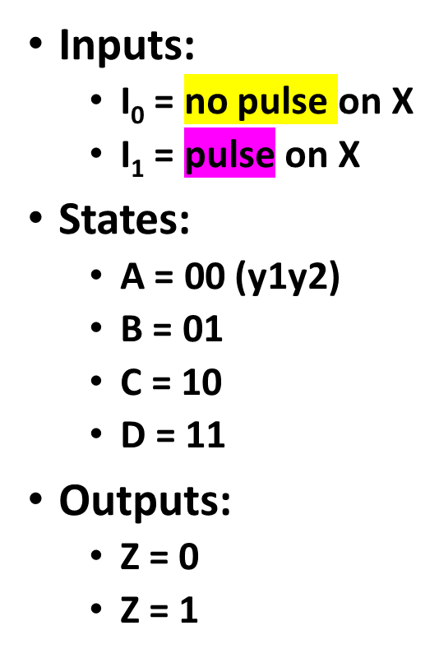
K-maps
For Y1
y1y2 | X=0 | X=1
00 | 0 | 0
01 | 0 | 1
11 | 1 | 0
10 | 1 | 1
For D1
For C1
y1y2 | X=0 | X=1
00 | 1 | 1
01 | 1 | 1
11 | 0 | 0
10 | 0 | 0
y1y2 | X=0 | X=1
00 | 0 | 0
01 | 0 | 1
11 | 0 | 1
10 | 0 | 0
For Y2
y1y2 | X=0 | X=1
00 | 0 | 1
01 | 1 | 1
11 | 1 | 0
10 | 0 | 0
For D2
For C2
y1y2 | X=0 | X=1
00 | 1 | 1
01 | 1 | 1
11 | 0 | 0
10 | 0 | 0
y1y2 | X=0 | X=1
00 | 0 | 1
01 | 0 | 1
11 | 0 | 1
10 | 0 | 1
For Z
y1y2 | X=0 | X=1
00 | 0 | 0
01 | 0 | 0
11 | 0 | 1
10 | 0 | 0

Slide 19
Design of Pulse Mode Asynchronous Circuits
To remember:
  No clock is present
  Inputs occur as pulses on any one input line at one time
  Only un-complemented or complemented forms are used as inputs throughout
  Triggering of Latches or flip flops is accomplished by utilizing information in input pulses

Slide 20
Design Steps in Pulse Mode Asynchronous
Derive a state diagram or a state table
Minimize the state table through State Reduction
Choose a state assignment and generate the transition/output table
Select the type of flipflop and determine the excitation equations
Determine the output equations
Choose appropriate circuit elements and draw the circuit diagram

Slide 21
Example – Design of Pulse Mode circuit
Problem Statement: Design a pulse mode circuit that has two input lines, X1 and X2. There is one output line Z.
The circuit should produce an output pulse to coincide with the last input pulse in the sequence X1 – X2 – X2 (Sequence Detector)
No other input sequence should produce an output pulse
X1
X2
Pulse Mode Asynchronous
Circuit
Z output
Block diagram of the desired system

Slide 22
Example – Pulse mode – Step 1
Define the following three states of the circuit:
A: indicates that the last input was X1
B: indicates that the sequence X1 – X2 has occurred
C: indicates that the sequence X1 – X2 – X2 has occurred
X1
X2
Pulse Mode Asynchronous
Circuit
Z output
Block diagram of the desired system

Slide 23
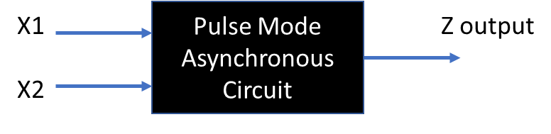
Example – Pulse Mode – STG and State Table
X1/0
A
A indicates Last Input was X1
B indicates sequence X1 – X2 has appeared
C indicates sequence X1 – X2 – X3 has appeared
X2/0
X1/0
X1/0
Present State | Next State/Output
 | X1 appears | X2 appears
A | A/0 | B/0
B | A/0 | C/1
C | A/0 | C/0
B
C
X2/1
X2/0
Mealy FSM

Slide 24
Example Pulse Mode – State Assignments
Assign States: A=00, B=01, C=10 and generate the transition/output table
Present State | Next State/Output
 | When X1 appears | When X2 appears
A | A/0 | B/0
B | A/0 | C/1
C | A/0 | C/0
Present State | Next State/Output Y1Y2/Z
y1y2 | When X1 appears | When X2 appears
00 | 00/0 | 01/0
01 | 00/0 | 10/1
10 | 00/0 | 10/0

Slide 25
Example – Pulse mode implement using T FF
State Table for Y1
State Table for T1
Present State | Next State/Output Y1Y2/Z
y1y2 | When X1 appears | When X2 appears
00 | 00/0 | 01/0
01 | 00/0 | 10/1
10 | 00/0 | 10/0
Present State | Next State
y1y2 | X1 | X2
00 | 0 | 0
01 | 0 | 1
11 | d | d
10 | 0 | 1
Present State | Next State Y1, Y2
y1y2 | When X1 | When X2
00 | 0 | 0
01 | 0 | 1
11 | d | d
10 | 1 | 0
T1 = X1.y1 + X2.y2

Slide 26
Example – Pulse Mode Implement using TFF (contd)
State Table for Y2
State Table for T2
Present State | Next State
y1y2 | When X1 | When X2
00 | 0 | 1
01 | 0 | 0
11 | d | d
10 | 0 | 0
Present State | Next State
y1y2 | When X1 | When X2
00 | 0 | 1
01 | 1 | 1
11 | d | d
10 | 0 | 0
Present State | Next State/Output Y1Y2/Z
y1y2 | When X1 appears | When X2 appears
00 | 00/0 | 01/0
01 | 00/0 | 10/1
10 | 00/0 | 10/0
State Table for Z output
Present State | Next State
y1y2 | When X1 | When X2
00 | 0 | 0
01 | 0 | 1
11 | d | d
10 | 0 | 0
T2 = X1.y2 + X2.y1’
Z=X2.y2

Slide 27
Example – Pulse mode Circuit diagram
T1 = X1.y1 + X2.y2
T2 = X1.y2 + X2.y1’
y1
Z=X2.y2
X1
TFF
1
T1
Q
Q’
y1’
Z
TFF
2
T2
Q
Q’
y2
X2
T1, T2 are in toggle mode
Toggle Input is enabled to ‘1’

