Slide 1
Lecture 19
EE 421 / CS 425
Digital System Design
Fall 2024
Shahid Masud

Slide 2
Topics
PAL, PLA, Examples, Polarity Control Circuit in I/O (Recap)
Datasheet of PLA/PAL
Example of an I/O Block for SPLD
Field Programming technology
CPLD Architecture
CPLD Examples from Xilinx and Altera
Logic Expander – Shareable and Parallel
Output Block of PLD
FPGA Architecture
QUIZ NEXT
Tuesday

Slide 3
AND-OR Logic Array
PLA = Programmable
Logic Array
Comprises Programmable
AND-OR Gates
A
X
B
X
P
X
C
X
X
Y output
X
X

Slide 4
Fuse Programmable Logic Array
+VDD
Y = F(A,B,C)
A
B
C

Slide 5
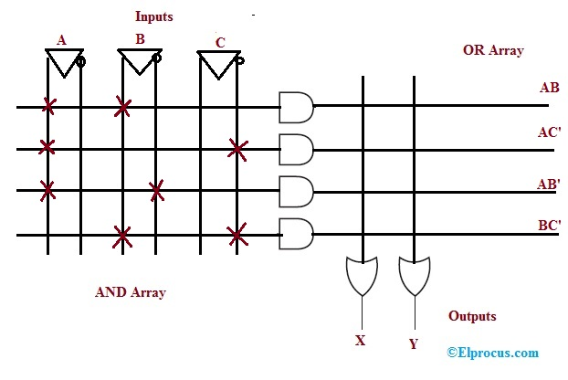
PAL – Programmable Array Logic
Programmable AND
Array
Fixed
OR
Array
n inputs
m outputs
https://www.elprocus.com/what-are-pal-and-pla-design-and-differences/

Slide 6
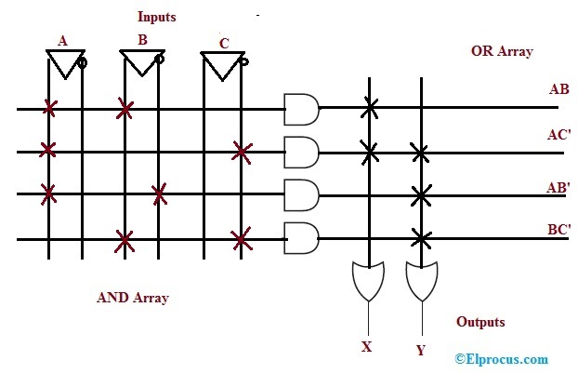
PLA – Programmable Logic Array
Programmable AND
Array
Programmable
OR
Array
n inputs
m outputs
https://www.elprocus.com/what-are-pal-and-pla-design-and-differences/

Slide 7
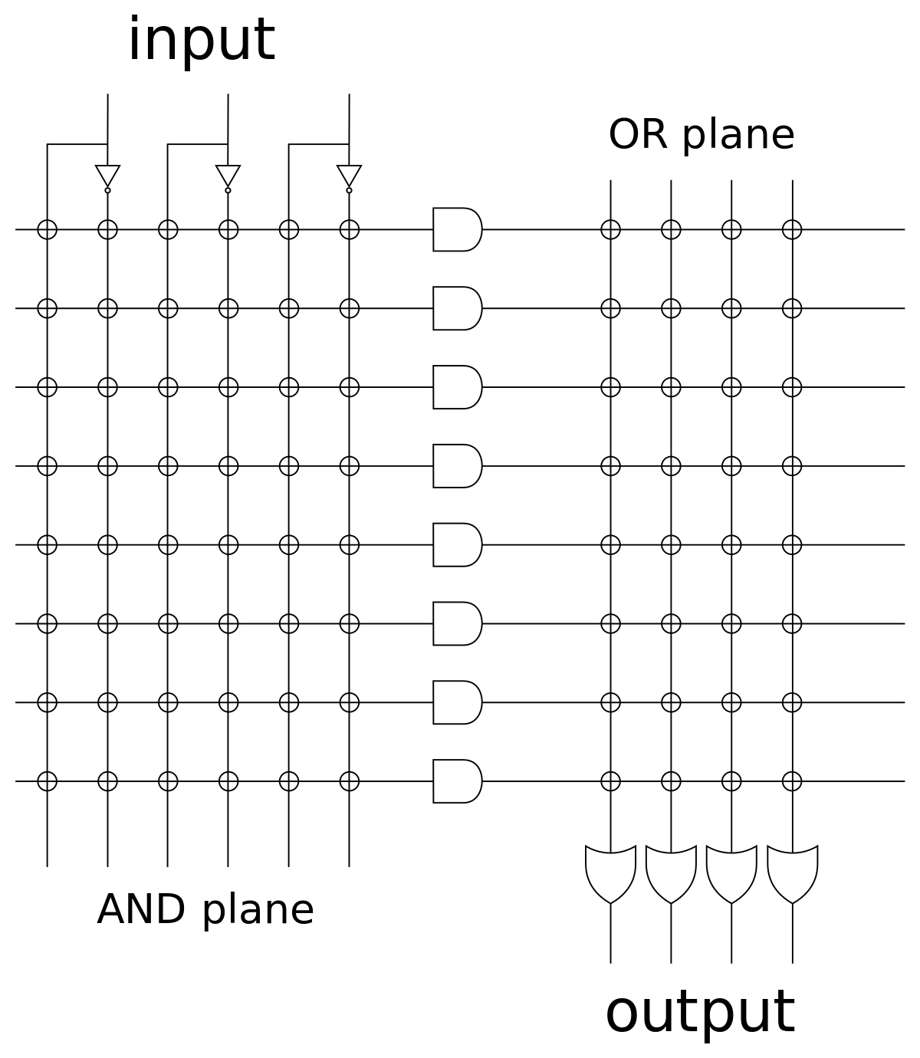
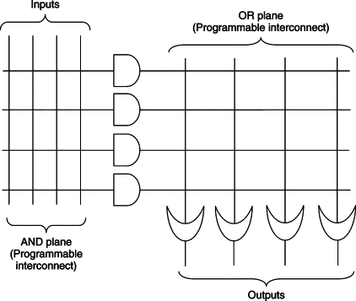
For Exercise

Slide 8
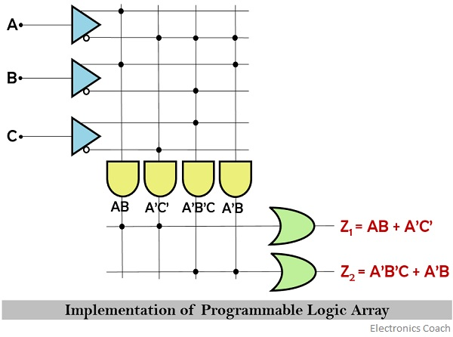
Example of PLA
https://electronicscoach.com/programmable-logic-array.html

Slide 9
Sequential Circuits with PLD – Mealy Machine
X1
X2
X3
AND Array
Bank of
Flipflops
OR
Array
DFF
DFF
DFF
Y1
Y2

Slide 10
Output Polarity Control
Si
Fuse Intact → Oi = Si
Fuse Blown → Oi = Si’
Oi
PLA Logic
R
Fuse – for output polarity control
Two states – intact or blown
+VDD

Slide 11
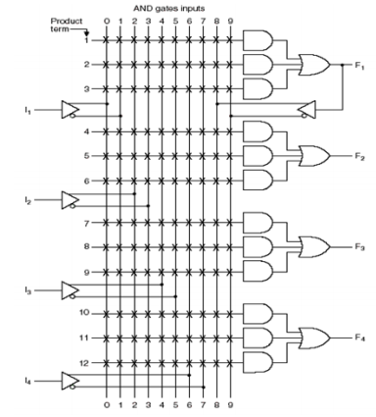
PAL – Programmable Array Logic Example
PAL Device is a PLD with fixed OR array and
a programmable AND array
As only AND gates are programmable, PAL is easier to program
but it is less flexible compared to PLA devices
Example device:
This device has 4 inputs and 4 outputs.
Each input has a buffer and inverter, output is from
fixed OR gate
The device has 4 sections: Each section comprises 3 wide
AND-OR array, meaning three programmable AND arrays
in each section
Each AND gates has 10 programmable input connections
One of the outputs (see F1) can be fed back to the inputs
of AND gate through programmable connections
https://faculty.kfupm.edu.sa/COE/aimane/coe202/PLDs.pdf

Slide 12
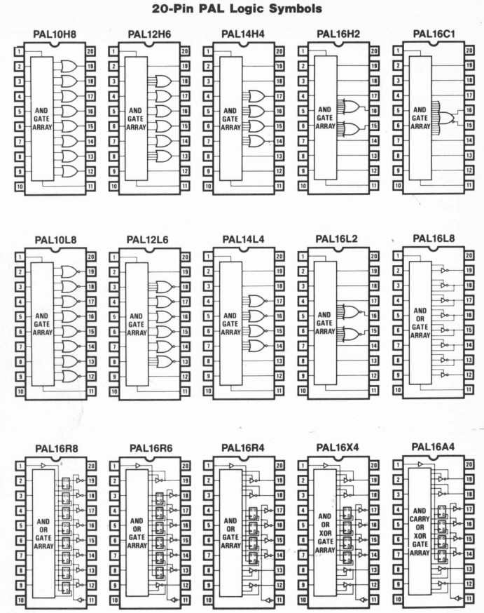
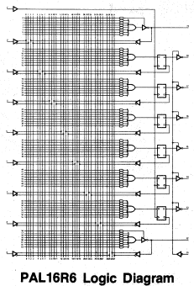
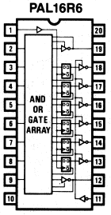
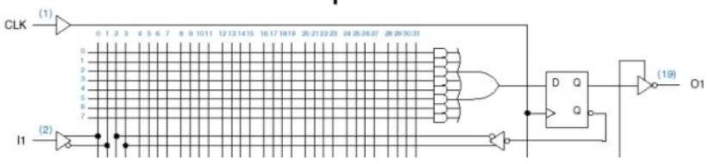
PLA Family Examples

Slide 13
Datasheet of PLA / PAL
Go through PAL and PLA Datasheet for some examples

Slide 14
Programmable Logic Broad Classification
Programmable Logic Family
Factory Programmable Devices
Field Programmable Devices
ROM
MPGA
SPLD
CPLD
FPGA
Read only Memory technology
Mask Programmable Gate Array
PROM
PLA
PAL
GAL
Simple and Complex Programmable Logic Devices
Field Programmable Gate Array
Generic Array Logic (complex PAL by lattice semi), Programmable Logic Array

Slide 15
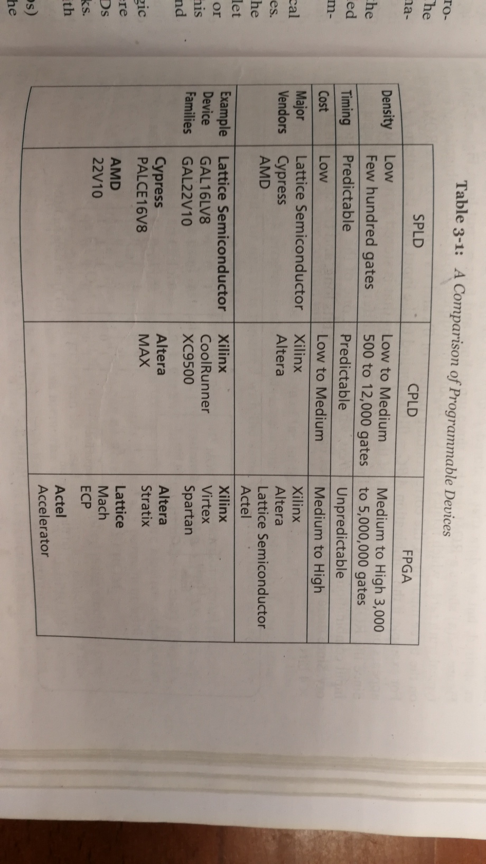
Programmable Hardware Devices Comparison
Ref: Roth &
John Book

Slide 16
Interconnect Technology for Field Programming
EEPROM / FLASH
SRAM
Input wire
+V
SRAM
Cell
Floating Gate
Tunneling process
Used in EEPROM, USB Flash drive, etc.
SRAM Cell is connected to Gate terminal
MOS Switch behaves as per stored value in SRAM

Slide 17
Concept of a Programmable I/O Block
OFF
ENABLE OUTPUT
Output
Buffer
ON
OUT
Input
Buffer
I/O
Pin
IN
DFF
D Q
I/O Clock
Select either
Clocked synchronous input, or
Direct asynchronous input

Slide 18
Introducing CPLD – Complex Programmable Logic Devices

Slide 19
Description of Basic (Registered) Macrocell
Each section of an SPLD is called a macrocell that contains SOP combinational logic and an optional Flipflop
A typical SPLD has from 8 to 10 macrocells within one chip
All Flipflops are connected to common CLK input
All three-state buffers at Flipflop output are controlled by a common OE input

Slide 20
Basic Macrocell Logic
PAL that includes a DFF is called a
Registered PAL
CLK
OE
DFF
D
CLK
Q
Q’
Inputs

Slide 21
Generic CPLD Configuration
PLD
PLD
PLD
PLD
I/O
Block
I/O
Block
Programmable Switch Matrix
PLD
PLD
PLD
PLD

Slide 22
Description of CPLD
Structured Array of PLD blocks
Programmable On-Chip Interconnection Fabric
Have higher number of inputs without much increase in area
100% connectivity between macrocells, BUT not all outputs of macrocells are connected to OUTPUT
Wide Fan-In AND gates are used at INPUTS
Outputs of macrocells can be routed within the chip to form more complex logic blocks
The Interconnect Array selects signals from I/O blocks or macrocell outputs and connects them back to function block inputs
The I/O blocks provide an interface between bidirectional physical I/O pins and the interior of the CPLD

Slide 23
Details of Generic CPLD Configuration
Collection of individual PLD gate arrays on a single integrated circuit
Each I/O pin is driven by a 3-state buffer and can be programmed to act as Input or Output pin
Each PLD typically contains 8 to 16 macrocells
If a macrocell has unused product terms, they can be used by nearby macrocells
The outputs of macrocells can be routed to inputs of other macrocells to form complex multi-level logic functions
Different manufactures offer variations in PLD design, programmable switching matrix and different types of I/O blocks

Slide 24
Altera 7000 Series CPLD Architecture
Input/GClk
Input/GClkn
Input/OE1
Input/OE2
I/O Control Block
LAB A
PIA
Programmable Interconnect Array
LAB B
I/O Control Block
8 to
16
Macrocells
1 to 8
Macrocells
17 to 24
8 to
16
.
.
.
.
36
36
.
.
.
.
8 to 16
I/O Pins
8 to 16
I/O Pins
Macrocells
9 to 16
Macrocells
25 to 32
16
16
8 to 16
8 to 16
I/O Control Block
LAB C
LAB D
I/O Control Block
8 to
16
Macrocells
33 to 40
Macrocells
49 to 56
8 to
16
.
.
.
.
36
36
.
.
.
.
8 to 16
I/O Pins
8 to 16
I/O Pins
Macrocells
41 to 48
Macrocells
57 to 64
16
16
8 to 16
8 to 16

Slide 25
Details of Altera 7000 CPLD
Floating gate EEPROM Configuration memory cells
Architecture consists of an array of logic array blocks (LAB), programmable interconnect array (PIA) and an array of programmable I/O blocks
Each LAB has 36 inputs and 16 outputs
Each LAB consists of 16 macrocells providing both combinational and sequential logic
PIA provides full connectivity between LAB and I/O Cells
I/O Control block connects I/O Pins and PIA and LAB
Global input clk (GCLK) and Global Clear (GCLR) connect to all macrocells
Each macrocell can provide five product terms to its product-term-select matrix

Slide 26
PIA and I/O
The PIA provides full connectivity with predictable timing between LAB, dedicated inputs and I/O Pins
The I/O Control block establishes connectivity between I/O Pins and PIA and LABs
From 8 to 16 LAB outputs can be programmed to route through I/O Pins; and from 8 to 16 I/O Pins can be programmed to route through the I/O Control block to the PIA
Altera architecture uses a PIA to connect LABs and I/O Pins. All signals are available throughout the device. The timing is thus predictable. The alternative is ‘Channel-Routed Architecture’ that is more denser but the timing is un-predictable as delays are routing-dependent

Slide 27
Shareable Expander in Altera 7000 CPLD
Product term select matrix
Product term select matrix
36 Signals
From PIA
16 Shared Expanders

Slide 28
Parallel Expander in Altera 7000 CPLD
From Previous Macrocell
Product term select matrix
Parallel Expander
Product term select matrix
To Next
Macrocell
36 Signals
From PIA
16 Shared Expanders

Slide 29
Altera 7000 Series Macrocell Architecture
Parallel Logic
Expanders
Global
Clear
Global
Clk
Reg
Byps
Product term select matrix
DFF
CLK
Clk Sel
M
CLR
CLR
Sel
M
36 Signals
From PIA
Shared Logic
Expanders
To
PIA
16 Expander
Product Terms
M

Slide 30
Altera 7000 Series I/O Control Block
Each I/O Pin can be configured to
be dedicated input pin, output pin
Or bi-dir under control of OE1, OE2.
VCC will hardwire the I/O pin to
output of macrocell.
GND will isolate macrocell and I/O pin
Will be an input pin only.
+VCC
OE Control
OE1n
OE2n
To I/O Pin
From Macrocell
To PIA

Slide 31
Xilinx XC9500 CPLD Architecture
JTAG
3
JTAG
Controller
In-System
Programming Controller
Port
54
I/O Blocks
Switch
Matrix
Function Block 1
1 – 18 Macrocells
I/O
18
I/O
I/O
54
Function Block 1
1 – 18 Macrocells
18
I/O
54
Function Block 1
1 – 18 Macrocells
I/O Global Clk
18
I/O Global Set/Rst
I/O Global Tristate
54
Function Block 1
1 – 18 Macrocells
18
3
2 or 4

Slide 32
Details of Xilinx 9500 CPLD
Flash based EEPROM Technology
Comprises Few (4) Functional Blocks
Each functional block contains 18 independent macrocells
Each functional block has 54 inputs and 18 outputs
Product-term-allocator allocates upto 90 product terms in each macrocell in a functional block to form SOP expressions
Each macrocell can receive five direct product terms from the AND array and up to 10 more product terms can be made available from other un-committed product terms in other macrocells from same functional block
Partial SOP terms can be combined from several macrocells
Each macrocell can be independently configured for combinational or sequential functionality

Slide 33
Xilinx XC9500 Macrocell Architecture
54
Global
Set/Rst
Global
Clk
16 Expander
Product Terms
Additional Product
Terms from other macrocells
Set
To FastConnect
II Switch Matrix
Product term select matrix
DFF
D
CLK
Rst
Product-term Clk
Product-term Rst
To I/O Blocks

Slide 34
Field Programmable Gate Arrays
FPGA

Slide 35
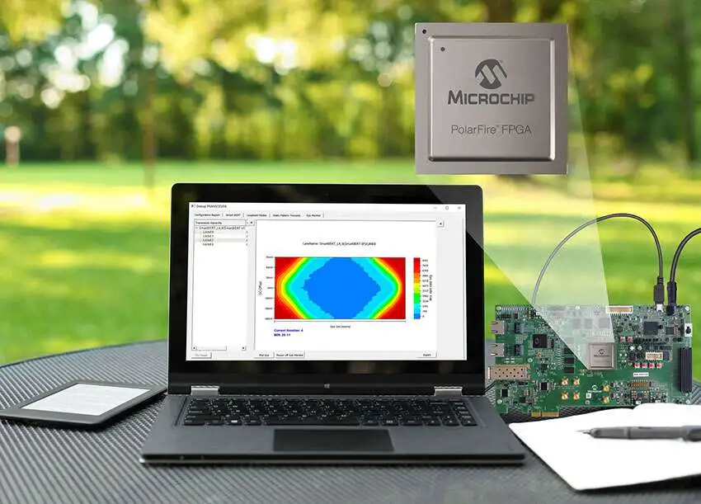
Field Programmable Gate Arrays
Generic Architecture
I/O Resources
Interconnect
FG
FG
FG
FG = function generator
for
Logic implementation
Interconnect
FG
FG
FG
Interconnect
FG
FG
FG
I/O Blocks
Interconnect
USB or
JTAG Cable
SRAM Configuration Memory

Slide 36
Lookup Table (LUT) based Configurable Logic Blocks
Pre
X1
X2
X3
X4
X Function Generator
LUT4
DFF
D Q
X output
Clk
Clr
M
Pre
Y1
Y2
Y3
Y4
X Function Generator
LUT4
DFF
D Q
Y output
Clk
Clr
M

Slide 37
Details of LUT based CLB
Uses a four-variable look-up table and a flipflop as the basic configurable hardware element. Several of these are combined in different families and types
Any two functions X and Y of four variables each can be generated in the LUT
Flipflops at the output can be used. DFF have external preset and clear as well as clock selection mechanism
Output multiplexer selects from un-registered or registered output

Slide 38
Configurable Logic Blocks based on Multiplexers
Where is
Distributed Memory?
SRAM Cells
M
A0
A1
S0
M
DFF
M
D Q
X output
M
B0
B1
S1
M
Clk
M
M
M
S2
4:1 MUX to generate required SOP Expression

Slide 39
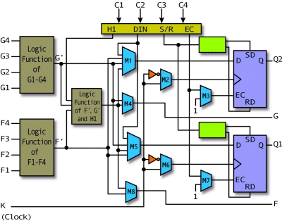
Xilinx 4000 CLB

Slide 40
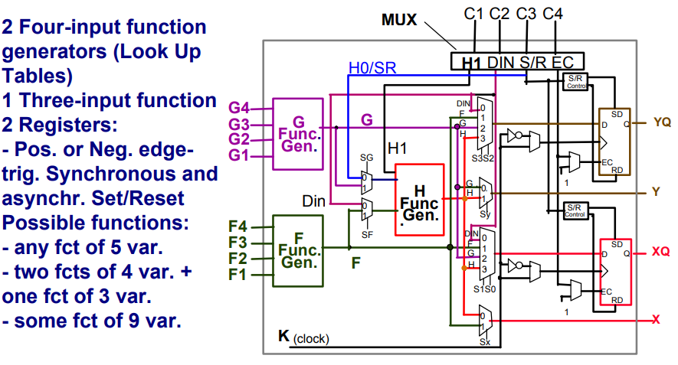
LUT Configuration and Extension

