Slide 1
Lecture 9
EE 421 / CS 425
Digital System Design
Fall 2025
Shahid Masud

Slide 2
Topics
(Leftover) Example of Vending Machine
State Minimization
Row Matching Method
Using Implication Charts
QUIZ 2 in next lecture

Slide 3
Moore State Machine for Vending Machine
(R5’R10’+Reset)
Reset
S0
[0]
R5
R5’R10’
S1
[0]
Reset
R10
R10
R5
R5’R10’
S2;
[0]
R5+R10
S3;
[1]
Reset’
OPEN

Slide 4
Mealy State Machine for Vending Machine
(R5’R10’+Reset)/0
Reset
S0
R5/0
R5’R10’/0
S1
Reset/0
R10/0
R10/1
R5/0
R5’R10’/0
S2
R5+R10/1
S3
Reset’/1
OPEN

Slide 5
Some Comparison Moore vs Mealy
Mealy machine requires fewer states to reach output in comparison with Moore machine
Mealy machine is more susceptible to glitches
Explicit output values are shown in Mealy machine associated with each transition
Output changes after state is changed in Moore machine
Output in Moore machine depends upon state only; inputs can steer the output towards a particular state that affects output
Output depends upon present state and the present value at the input; thus, output can change immediately with the change in input, independent of synchronous clock.

Slide 6
One Hot Encoding – one FF for each state
Present State |  |  |  | Inputs |  | Next State |  |  |  | Output OPEN
Q3 | Q2 | Q1 | Q0 | R10 | R5 | D3 | D2 | D1 | D0 | Y
0 | 0 | 0 | 1 | 0 | 0 | 0 | 0 | 0 | 1
 |  |  |  | 0 | 1 | 0 | 0 | 1 | 0
 |  |  |  | 1 | 0 | 0 | 1 | 0 | 0
 |  |  |  | 1 | 1 | X | X | X | X
0 | 0 | 1 | 0 | 0 | 0 | 0 | 0 | 1 | 0
 |  |  |  | 0 | 1 | 0 | 1 | 0 | 0
 |  |  |  | 1 | 0 | 1 | 0 | 0 | 0 | 1
 |  |  |  | 1 | 1 | X | X | X | X
0 | 1 | 0 | 0 | 0 | 0 | 0 | 1 | 0 | 0
 |  |  |  | 0 | 1 | 1 | 0 | 0 | 0 | 1
 |  |  |  | 1 | 0 | 1 | 0 | 0 | 0 | 1
 |  |  |  | 1 | 1 | X | X | X | X
1 | 0 | 0 | 0 | X | X | 1 | 0 | 0 | 0 | 1
D3 is directly
the Output and
Its State
The Design Becomes Simpler
Less Combinational Logic – At the Expense of Extra DFF

Slide 7
Algorithmic State Machine Description - ASMD
State Name
xyz
State Code
State Box
List Outputs
True
Condition
False
Output
Box
Exit to Other
ASM Blocks
Exit to Other
ASM Blocks

Slide 8
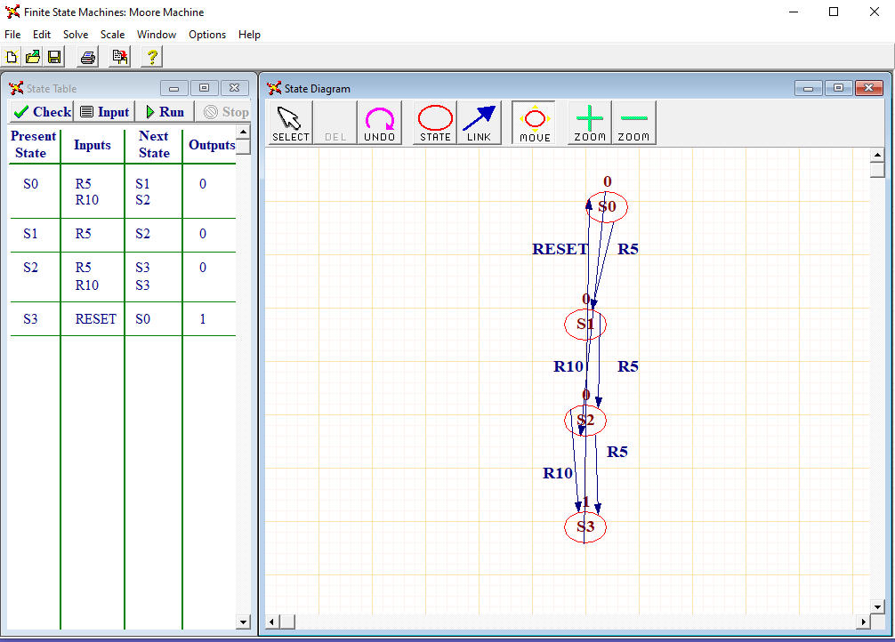

Trying FSM implementation
with WinlogiLab

Slide 9
Advantages of Minimum States
Reduces number of logic gates and flipflops required for the implementation of state machine
With fewer states, there are more don’t care conditions into the next-state and output logic equations, making the implementation simpler.
Simpler and less logic means shorter critical paths and higher achievable clock rate
Fewer components also means shorter design time and lower manufacturing cost

Slide 10
State Minimization and Reduction
State Reduction identifies and combines states that have equivalent behaviour
Two states have equivalent behaviour iff:
  for all input combinations, their outputs are the same, and
  they change to the same or equivalent next state

Slide 11
State Reduction Algorithms
Begin with the symbolic state transition table.
We group together states that have the same state outputs (Moore Machine) or Transition outputs (Mealy Machine). These are potentially equivalent, since states cannot be equivalent if their outputs differ.
Next, examine the transitions to see if they go to the same next state for every input combination. If they do, the states are equivalent and can be combined into a renamed new state.
Then change all transitions into the newly combined states.
Repeat the process until no additional states can be combined.

Slide 12
Row Matching method for State Reduction
Use Case of a Four-Bit Sequence Detector
Specifications:
The machine has a single input X and a single output Z
The output is asserted after each 4-bit input sequence if the sequence contains binary
Strings of “0110” or “1010”
The machine returns to “Reset” State after each 4-bit sequence
Assumptions:
Mealy Implementation
Example:
Input X= 0010 0110 1100 1010 0011 ……. …….
Output Z = 0000 0001 0000 0001 0000 …… ……

Slide 13
Mealy State Machine for 4-Bit Sequence Detector
Reset
S
0
0/0
1/0
S1
S2
0/0
1/0
0/0
1/0
S3
S5
S6
S4
1/0
0/0
1/0
0/0
1/0
0/0
1/0
0/0
S7
S8
S9
S
10
S
11
S
12
S
13
S
14
0/0
1/0
1/0
1/0
0/0
1/0
0/0
1/0
1/0
0/1
0/0
1/0
0/1
0/0
0/0
1/0
Look for Strings of “0110” or “1010” in serial input stream

Slide 14
Initial State Transition Table
Input Sequence | Present State | Next State |  | Output
 |  | When X=0 | When X=1 | When X=0 | When X=1
Reset | S0 | S1 | S2 | 0 | 0
0 | S1 | S3 | S4 | 0 | 0
1 | S2 | S5 | S7 | 0 | 0
00 | S3 | S7 | S8 | 0 | 0
01 | S4 | S9 | S10 | 0 | 0
10 | S5 | S11 | S12 | 0 | 0
11 | S6 | S13 | S14 | 0 | 0
000 | S7 | S0 | S0 | 0 | 0
001 | S8 | S0 | S0 | 0 | 0
010 | S9 | S0 | S0 | 0 | 0
011 | S10 | S0 | S0 | 1 | 0
100 | S11 | S0 | S0 | 0 | 0
101 | S12 | S0 | S0 | 1 | 0
110 | S13 | S0 | S0 | 0 | 0
111 | S14 | S0 | S0 | 0 | 0
Examine table to find rows with
Identical next state and output values
Eg. We can combine S10 and S12;
Both have same next state and
same output

Slide 15
Merge S10 and S12 into one state “S10A” and make new table
Input Sequence | Present State | Next State |  | Output
 |  | When X=0 | When X=1 | When X=0 | When X=1
Reset | S0 | S1 | S2 | 0 | 0
0 | S1 | S3 | S4 | 0 | 0
1 | S2 | S5 | S7 | 0 | 0
00 | S3 | S7 | S8 | 0 | 0
01 | S4 | S9 | S10 | 0 | 0
10 | S5 | S11 | S12 | 0 | 0
11 | S6 | S13 | S14 | 0 | 0
000 | S7 | S0 | S0 | 0 | 0
001 | S8 | S0 | S0 | 0 | 0
010 | S9 | S0 | S0 | 0 | 0
011 or 101 | S10A | S0 | S0 | 1 | 0
100 | S11 | S0 | S0 | 0 | 0
110 | S13 | S0 | S0 | 0 | 0
111 | S14 | S0 | S0 | 0 | 0
Iteration:
States S7, S8, S9 and
S11, S13, S14 have same
Next states and same outputs;
Hence these can be combined

Slide 16
Merge S7, S8, S9, S11, S13, S14 into one new State called S7A
Input Sequence | Present State | Next State |  | Output
 |  | When X=0 | When X=1 | When X=0 | When X=1
Reset | S0 | S1 | S2 | 0 | 0
0 | S1 | S3 | S4 | 0 | 0
1 | S2 | S5 | S7 | 0 | 0
00 | S3 | S7 | S8 | 0 | 0
01 | S4 | S9 | S10 | 0 | 0
10 | S5 | S11 | S12 | 0 | 0
11 | S6 | S13 | S14 | 0 | 0
000, 001, 010, 100, 110, 111 | S7A | S0 | S0 | 0 | 0
011 or 101 | S10A | S0 | S0 | 1 | 0

Slide 17
Replace S7, S8, S9, S11, S13, S14 with S7A in the table; Also S12 with S10A
Input Sequence | Present State | Next State |  | Output
 |  | When X=0 | When X=1 | When X=0 | When X=1
Reset | S0 | S1 | S2 | 0 | 0
0 | S1 | S3 | S4 | 0 | 0
1 | S2 | S5 | S7A | 0 | 0
00 | S3 | S7A | S7A | 0 | 0
01 | S4 | S7A | S10A | 0 | 0
10 | S5 | S7A | S10A | 0 | 0
11 | S6 | S7A | S7A | 0 | 0
000, 001, 010, 100, 110, 111 | S7A | S0 | S0 | 0 | 0
011 or 101 | S10A | S0 | S0 | 1 | 0
Iteration:
States 00 and 11 have same
Next State and Output (S3A)
States 01 and 10 have same
Next State and Output (S4A)
Hence these are equivalent States

Slide 18
Combine States S3 and S6 to S3A; Combine States S4 and S5 to S4A
Input Sequence | Present State | Next State |  | Output
 |  | When X=0 | When X=1 | When X=0 | When X=1
Reset | S0 | S1 | S2 | 0 | 0
0 | S1 | S3A | S4A | 0 | 0
1 | S2 | S4A | S7A | 0 | 0
00, 11 | S3A | S7A | S7A | 0 | 0
01, 10 | S4A | S7A | S10A | 0 | 0
000, 001, 010, 100, 110, 111 | S7A | S0 | S0 | 0 | 0
011 or 101 | S10A | S0 | S0 | 1 | 0
Final Reduced States are only 7:
S0, S1, S2, S3A, S4A, S7A, S10A

Slide 19
Final Reduced State Diagram
S0
0/0
1/0
S1
S2
1/0
1/0
0/0
0/0
S3A
S4A
0/0
1/0
0,1/0
S7A
S10A
0/1
1/0
0,1/0

Slide 20
State Reduction using Implication Charts
Graphical Technique for State Reduction
Definition:
Redundant State:
  One state is equivalent to another (and hence redundant) if the state functions are in-distinguishable
When all states that have (i) different next states and (ii) different outputs, have been identified, the remaining states are considered to be redundant

Slide 21
State Equivalence Theorem
Two states SA and SB are equivalent iff for every possible input X sequence, the outputs are same and the next states are equivalent
Properties of Equivalent States:
Symmetry: If SA=SB, then SB=SA
Reflexivity: SA = SA for any state
Transitivity: If SA=SB, and SB=SC, then SA=SC

Slide 22
Construction of Implication Charts
The Chart is constructed by listing all of the states except the last, along horizontal axis, and
Listing all of the states except the first, along the vertical axix
Intersection of the horizontal and vertical spaces indicates a possible state equivalene
Eg. Total States S0 to S4
Implies the possibility that S0 = S1
Each box indicates State Pair Equivalence Possibility Condition
S1
S2
S3
S4
 | S0 | S1 | S2 | S3

Slide 23
Example of State Reduction using
Implication Charts
Given the State Table as follows:
Present State | Next State |  | Output
 | When X=0 | When X=1 | When X=0 | When X=1
S0 | S4 | S3 | 0 | 1
S1 | S5 | S3 | 0 | 0
S2 | S4 | S1 | 0 | 1
S3 | S5 | S1 | 0 | 0
S4 | S2 | S5 | 0 | 1
S5 | S1 | S2 | 0 | 0
Total 6 states, S0 to S5

Slide 24
Filling the Implication Chart
Place X in squares where outputs are different, as such states cannot be equivalent
For other squares, we look at State Equivalence Pairs, i.e.:
  S0 ≡ S2, iff S1 ≡ S3
  Thus we write S1,S3 in the square at intersection of S0, S2
  S0 ≡ S4, iff S2 ≡ S3, and S3 ≡ S5
  S1 ≡ S5, iff S2 ≡ S3
  S2 ≡ S4, iff S1 ≡ S5
  S3 ≡ S5, iff S1 ≡ S5, and S1 ≡ S2

Slide 25
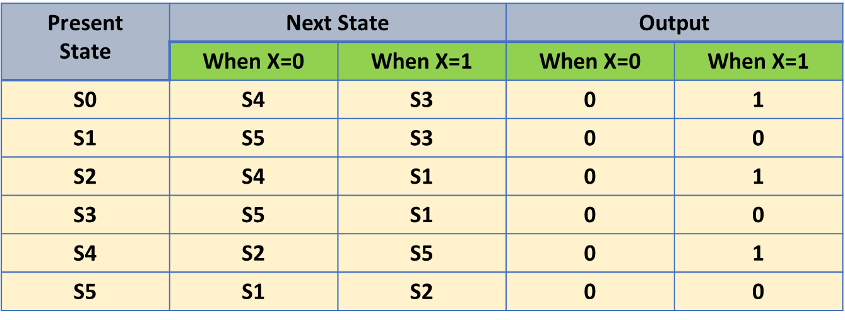
Filled Implication Chart with conditions of equivalent states
S1 | X
S2 |  | X
S3 | X |  | X
S4 |  | X |  | X
S5 | X |  | X |  | X
 | S0 | S1 | S2 | S3 | S4
S1 | X
S2 | S1,S3 | X
S3 | X | S1,S3 | X
S4 | S2,S4 S3,S5 | X | S2,S4 S1,S5 | X
S5 | X | S1,S5 S2,S3 | X | S1,S5 S1,S2 | X
 | S0 | S1 | S2 | S3 | S4
S1
S2
S3
S4
S5
 | S0 | S1 | S2 | S3 | S4
One by one, examine all table entries and refer to the state transition table

Slide 26
X is inserted where outputs of states is different
Check conditions of equivalence in respective squares
S1 | X
S2 | S1,S3 | X
S3 | X | S1,S3 | X
S4 | S2,S4 S3,S5 | X | S2,S4 S1,S5 | X
S5 | X | S1,S5 S2,S3 | X | S1,S5 S1,S2 | X
 | S0 | S1 | S2 | S3 | S4
Present State | Next State |  | Output
 | When X=0 | When X=1 | When X=0 | When X=1
S0 | S4 | S3 | 0 | 1
S1 | S5 | S3 | 0 | 0
S2 | S4 | S1 | 0 | 1
S3 | S5 | S1 | 0 | 0
S4 | S2 | S5 | 0 | 1
S5 | S1 | S2 | 0 | 0
To check for: {S1,S3}, {S1,S5}, {S2,S3}, {S1,S2}

Slide 27
To check for: {S1,S3}, {S1,S5}, {S2,S3}, {S1,S2}
In {S1,S3}:
Outputs are same for S1, and S3
In Next States, When X=1, S1 goes to S3 and S3 goes to S1
Hence S1 and S3 are equivalent
In {S1,S2}, output is different when X=1, hence these cannot
Be equivalent, so this square will get ‘X’
In {S2,S3}, output is different when X=1, hence these cannot
be equivalent, so this square will be ‘X’.
This means that S1 cannot be equivalent to S5 as it is dependent
on S2 and S3 as Next State
Similarly, check all conditions in all squares
Present State | Next State |  | Output
 | When X=0 | When X=1 | When X=0 | When X=1
S0 | S4 | S3 | 0 | 1
S1 | S5 | S3 | 0 | 0
S2 | S4 | S1 | 0 | 1
S3 | S5 | S1 | 0 | 0
S4 | S2 | S5 | 0 | 1
S5 | S1 | S2 | 0 | 0

Slide 28

Updated Implication Chart
This condition is established
So S0 and S2 are Equivalent States
S1 | X
S2 | S1,S3 | X
S3 | X | S1,S3 | X
S4 | S2,S4 S3,S5 | X | S2,S4 S1,S5 | X
S5 | X | S1,S5 S2,S3 | X | S1,S5 S1,S2 | X
 | S0 | S1 | S2 | S3 | S4
S1 and S3 depend on themselves
Hence S1 and S3 are Equivalent states
Result:
S0 ≡ S2
And
S1 ≡ S3

Slide 29
Updated further - Implication Chart
This condition is established
So S0 and S2 are Equivalent States
S1 | X
S2 | S1,S3 | X
S3 | X | S1,S3 | X
S4 | X | X | X | X
S5 | X | X | X | X | X
 | S0 | S1 | S2 | S3 | S4
S1 and S3 depend on themselves
Hence S1 and S3 are Equivalent states
Result:
S0 ≡ S2
And
S1 ≡ S3
Mark X where further
Equivalence is not apparent

Slide 30

Updated State Table
Original table with six states
Only four states are left
Present State | Next State |  | Output
 | When X=0 | When X=1 | When X=0 | When X=1
S0 | S4 | S3 | 0 | 1
S1 | S5 | S3 | 0 | 0
S2 | S4 | S1 | 0 | 1
S3 | S5 | S1 | 0 | 0
S4 | S2 | S5 | 0 | 1
S5 | S1 | S2 | 0 | 0
Present State | Next State |  | Output
 | When X=0 | When X=1 | When X=0 | When X=1
S0 | S4 | S1 | 0 | 1
S1 | S5 | S1 | 0 | 0
S2 | S4 | S1 | 0 | 1
S3 | S5 | S1 | 0 | 0
S4 | S0 | S5 | 0 | 1
S5 | S1 | S0 | 0 | 0
Result:
S0 ≡ S2
And
S1 ≡ S3

Slide 31
Practice Example: 4-Bit Sequence Detector
Input Sequence | Present State | Next State |  | Output
 |  | When X=0 | When X=1 | When X=0 | When X=1
Reset | S0 | S1 | S2 | 0 | 0
0 | S1 | S3A | S4A | 0 | 0
1 | S2 | S4A | S7A | 0 | 0
00, 11 | S3A | S7A | S7A | 0 | 0
01, 10 | S4A | S7A | S10A | 0 | 0
000, 001, 010, 100, 110, 111 | S7A | S0 | S0 | 0 | 0
011 or 101 | S10A | S0 | S0 | 1 | 0

Slide 32
See if states can be reduced further:
S1
S2
S3A
S4A
S7A
S10A
 | S0 | S1 | S2 | S3A | S4A | S7A
Input Sequence | Present State | Next State |  | Output
 |  | When X=0 | When X=1 | When X=0 | When X=1
Reset | S0 | S1 | S2 | 0 | 0
0 | S1 | S3A | S4A | 0 | 0
1 | S2 | S4A | S7A | 0 | 0
00, 11 | S3A | S7A | S7A | 0 | 0
01, 10 | S4A | S7A | S10A | 0 | 0
000, 001, 010, 100, 110, 111 | S7A | S0 | S0 | 0 | 0
011 or 101 | S10A | S0 | S0 | 1 | 0

Slide 33
Filled Implication Chart
S1
S2
S3A
S4A
S7A
S10A
 | S0 | S1 | S2 | S3A | S4A | S7A

Slide 34
Metastability, and
Asynchronous Data Management

Slide 35

Objective – to reduce possible Metastability in capturing Asynchronous Input
Energy barrier to throw
ball on the other side
M
Metastable State
0
1
Logic 0
Logic 1
Synchronizer Failure: When flipflop hangs in a Metastable State
for a long time (indefinitely)
Normally, the flipflop output would settle to a stable 0 or 1 state after some time

Slide 36
Output Behaviour with Metastability
D_In
Logic 1
D Q
Q_Out
Clk
R
Logic 0
DFF is connected to produce metastability
As setup time is violated
Time →
Oscilloscope trace of metastable behaviour
Eventually a stable state is reached
Problem occurs when flipflop is not stable within
One clock period

Slide 37
Synchronizers
Asynchronous inputs are problematic as their transitions are not predictable
High speed digital circuits rely on synchronizers to create a time buffer for recovering from a metastable event; thus reducing the possibility that metastability will cause circuit to malfunction
An asynchronous signal should be synchronized by one synchronizer only. If not, then multiple synchronized signals could be present in the system and one of these could be driven into metastable state

Slide 38







Asynchronous Inputs to a Synchronous Digital System
Asynchronous
Domain
Synch_Out
Synchronizer
(Type I or II)
Asynch_In
Ref Clk
Synchronous
Domain

Slide 39
Synchronizer 1
Condition: The width of asynchronous input pulse is greater than period of the clock
Synchronizer is a multistage shift register
Asynch_In
DFF
Q1
DFF
Synch_Out
D Q
D Q
Clk
R
R
Reset
Reset Input ‘R’ is used as control to bring Synch_Out back to ‘0’, as required

Slide 40
Timing Diagram – Synchronizer 1
Clk
Asynch_In
Q1
Synch_Out (Q2)
Reset (??)
Reset can be used to curtail the width of Q2 if input is too wide

Slide 41
Synchronizer 2
Condition: Width of the asynchronous input pulse is less than the period of the clock
Logic ‘1’
+VCC
Q1
Q2
Q3
DFF
DFF
DFF
D Q
D Q
D Q
Synch_Out
Asynch_In
Clk
Clk
Clk
CLR
CLR
CLR
Clk
CLR Can be used in different ways to
Reduce width of Q1, Q2, and Q3

Slide 42
Timing Diagram – Synchronizer 2
Clk
Asynch_In
Q1
Q2
Q3
Synch_Out
CLR input at DFF1 is used to bring back Q1 and then Q2 to Zero

Slide 43
Self-Timed and Speed Independent Circuits
Having a completed Synchronous system is at times too challenging for a complex and fast digital system
The limiting problem becomes how to distribute a single global clock without introducing intolerable clock skew
The alternate is to partition the digital system into locally clocked pieces that communicate with each other using delay-insensitive signaling techniques (i.e. local clock for local communication)
Each block proceeds at its own speed without the need for a global clock, synchronizing local communication whenever needed
Usually a Request-Response Signalling method is employed

Slide 44
Data Reading across two Clock Domains
Clock Domain 2
Data_In
D Q
D Q
Data_Out
Clk1
R
R
Clk2
Reset
Clock Domain 1
frequency of Clk1 is less than Clk2
Otherwise, the Synchronizer-2 is versatile and can be used here

