Slide 1
Lecture 11
EE 421 / CS 425
Digital System Design
Fall 2025
Shahid Masud

Slide 2
Topics
Communication Signaling across modules at different clock speeds (Revision – How clock is good and can be bad?) Quick Review
----------------------------------------------
Computer Arithmetic Circuits
Basic Element – Full Adder
Ripple Carry Adder – Timing Issues
Bit Serial Adder – Concept of Throughput and Latency
Carry Look Ahead Adder
Carry Select Adder
Quiz 3
Next Week

Slide 3
Self-Timed and Speed Independent Circuits
Having a completed Synchronous system is at times too challenging for a complex and fast digital system
The limiting problem becomes how to distribute a single global clock without introducing intolerable clock skew
The alternate is to partition the digital system into locally clocked pieces that communicate with each other using delay-insensitive signaling techniques (i.e. local clock for local communication)
Each block proceeds at its own speed without the need for a global clock, synchronizing local communication whenever needed
Usually a Request-Response Signaling method is employed

Slide 4
Data Transfer in Complex Modular Design
Module 1
Internal Clock 1
Complexity Level 1
Module 2
Internal Clock 2
Complexity Level 2
Data Transfer 1
Clock tree distribution
3
Data Transfer 3
Module 3
Internal Clock 3
Complexity Level 3
Module 4
Internal Clock 4
Complexity Level 4
Data Interface 2
I/O Port
Universal
Clock

Slide 5
Request / Acknowledge Signaling
Independently clocked Subsystems
Clocked
Subsystem 1
Clocked
Subsystem 2
Communication
Signals
S1
Requester Client
Master
Request
S2
Provider
Server
Slave
Clk 1
Clk 2
Data Flow
Acknowledgement
Req / Ack Signalling

Slide 6
Synchronous Req / Ack Signaling
Req
Data
Ack
Clk
Time →
Req and Ack signals are synchronized to Clk

Slide 7
Synchronous Req with Wait Signaling
Req
Data
Wait
Clk
Time →
Slave can delay the Master by asserting Wait signal as it prepares the data and needs more clock cycles
When the slave un-asserts Wait signal, it acknowledges that data is now available for the Master to read
All interface signals are synchronized with Clock edge

Slide 8
Four Cycle Asynchronous Signaling
RTZ – Return to Zero Signaling with No Clock
Req
4
1
3
Data
2
Ack
5
Time →

Slide 9
Two Cycle Asynchronous Signaling
Non-Return-to-Zero Signalling
Req
2
Data
Data 1
Data 2
1
Ack
3
Initially, both request and acknowledge are at 0
Request line is complemented (to 1)
Slave notices change in Req, provides data, and complements the Ack line (to 1)
Further request and acknowledgement is by complementing the respective state
Time →

Slide 10
Self-Timed Circuits
A self-timed circuit can determine on its own when a request has been serviced by mimicking the worst-case propagation delay path by using special logic to delay the request signal.
This guarantees sufficient time to compute the correct output.
Self Timed module of
a Digital System
Input
Combinational
Logic
Output
Req
Ack
Delay

Slide 11
Computer Arithmetic

Slide 12
Computer Arithmetic
Study Data path and Control path of a
binary hardware arithmetic unit

Slide 13
Computer Arithmetic Circuits
Generally, the digital system design falls into one of the following categories:
  Data handling – acquisition, storage, retrieval, compression, search, etc.
  Data processing – filtering, de-noising, object detection, pattern recognition
Computer Arithmetic is an important functional block of both aspects, especially plays an important part in Data Processing
Efficient arithmetic circuits can improve the speed – area – energy performance nexus in a complex digital system

Slide 14
Basic Functional Block – Full Adder
X_{i} | Y_{i} | C_{i} | C_{i+1} | S_{i}
0 | 0 | 0 | 0 | 0
0 | 0 | 1 | 0 | 1
0 | 1 | 0 | 0 | 1
0 | 1 | 1 | 1 | 0
1 | 0 | 0 | 0 | 1
1 | 0 | 1 | 1 | 0
1 | 1 | 0 | 1 | 0
1 | 1 | 1 | 1 | 1
Sum S_{i}=X_{i} ⨁ Y_{i} ⨁ C_{i}
C_{i+1} = X_{i} . Y_{i} + C_{i} (X_{i} ⨁ Y_{i})
X_{i}
Y_{i}
Full
Adder
C_{i+1}
C_{i}
S_{i}

Slide 15
Full Adder Circuit
X_{i}
Y_{i}
Sum S_{i}=X_{i} ⨁ Y_{i} ⨁ C_{i}
C_{i+1} = X_{i} . Y_{i} + C_{i} (X_{i} ⨁ Y_{i})
X_{i}
Y_{i}
Full
Adder
C_{i+1}
C_{i}
C_{i+1}
C_{i}
C_{i+1} = X_{i}.Y_{i} + C_{i} (X_{i} ⨁ Y_{i})
S_{i}
Sum S_{i} = X_{i} ⨁ Y_{i} ⨁ C_{i}
S_{i}

Slide 16
Multiple Bits – Ripple Carry Adder
Input Numbers {X₃ X₂ X₁ X₀} and {Y₃ Y₂ Y₁ Y₀}, Carry Input at Cin
X₃
Y₃
X₂
Y₂
X₁
Y₁
X₀
Y₀
Cin
Full
Adder
Full
Adder
Full
Adder
Full
Adder
C₄
C₂
C₂
C₂
C₂
C₁
C₁
C₀
S₃
S₂
S₁
S₀
Cout
Sum Bits {S₃ S₂ S₁ S₀}
MSB ….…. LSB

Slide 17
Timing Issues in Ripple Carry Adders
Delay between Yi and Ci+1
= 1 EXOR + 1 AND + 1 OR (= Critical Path)
Suppose delays through gates are:
EXOR = 20ns, AND = 10ns, OR = 10ns
Then Delay between Yi and Ci+1
= 20ns + 10ns + 10ns = 40ns
Worst case delay through N adders
= N × 40ns
For 32-bit data;
Delay through 32-bit RCA =
32 x 40ns = 1280ns = 1.28us
Corresponds to Maximum Data Throughput
= 1/(1.28μs) = 0.78 MHz (too slow in today’s terms
X_{i}
Y_{i}
C_{i+1}
C_{i}
S_{i}

Slide 18
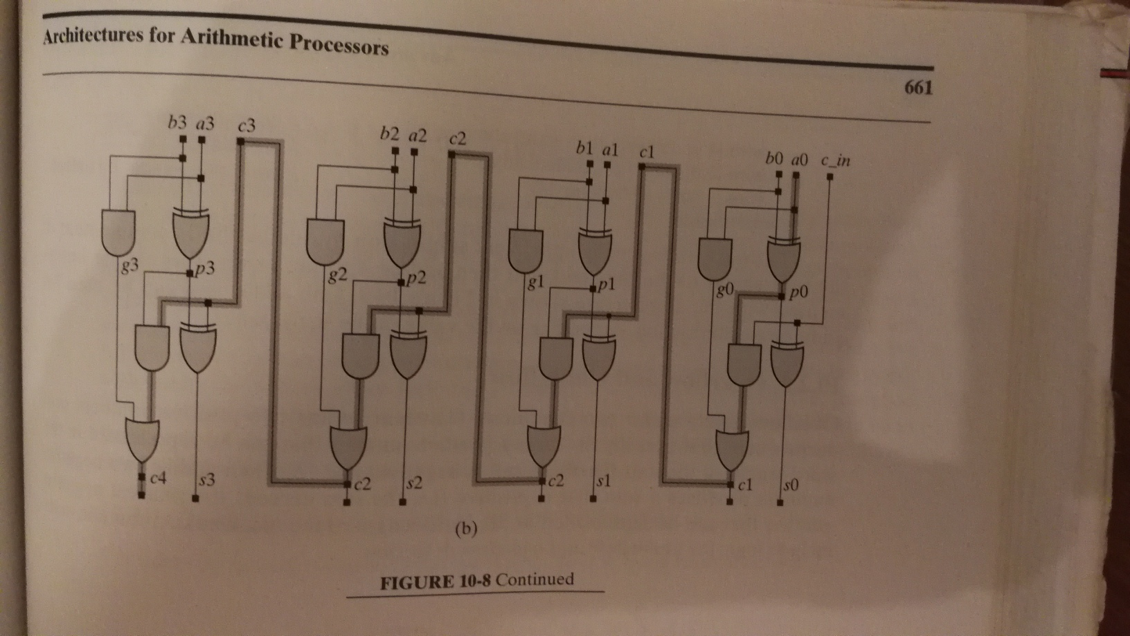
Delay of Ripple Carry Full Adder

Slide 19
Compare with Critical Path of Full Adder
REVIEW
X₃
Y₃
C_{in}
X₂
Y₂
C_{in}
X₁
Y₁
C_{in}
X₀
Y₀
C_{in}
C₄
S₃
C₃
S₂
C₂
S₁
C₁
S₀

Slide 20
Multi-bit Adder – Using 1-Bit Serial Adder
A
One Bit
Full
Adder
Sum
B
All inputs and outputs are one-bit
Cin
Cout
What is the Critical Path?
And Maximum Delay?
And Maximum Throughput?
Q D
Clk

Slide 21
8-Bit, Bit-Serial Full Adder
Shift Register A
Shift Register (Sum)
A7 | A6 | A5 | A4 | A3 | A2 | A1 | A0
A
One Bit
Full
Adder
S7 | S6 | S5 | S4 | S3 | S2 | S1 | S0
Shift Register B
B
Sum
B7 | B6 | B5 | B4 | B3 | B2 | B1 | B0
Cout
Cin
All inputs and outputs are one-bit
Q D
What is the Critical Path?
And Maximum Delay?
And Maximum Throughput?
Clk

Slide 22
Timing Considerations in Bit-Serial Design
It is an extreme example of a pipelined design
What is Critical Path?
What is Latency?
What is Data Throughput?
What is maximum clock speed achievable?

Slide 23
Definitions related to timing performance
Latency: Amount of time before the appearance of first correct output
Throughput: Amount of processed data available at the output port, per unit time
Critical Path: The combinational logic path with maximum number of circuit elements that the input travels before reaching the output
Maximum Achievable Clock Speed: Limited by Critical Path

Slide 24
Carry Lookahead Adder

Slide 25
Carry Lookahead Adder – A type of fast adder
In Ripple Carry Adder, the Carry Input Cin propagates through all Adder circuits before reaching the final Carry Out, Cout. Thus, there is a Long carry chain that makes the Critical Path worse.
In Carry Lookahead Adder (CLA), the Carry Circuit is separated from the Sum circuit and both work independently. This reduces the number of gates in Critical Path and the Adder can work faster.

Slide 26
Basic Functional Block – Full Adder
Truth Table of 1-Bit Full Adder
Boolean Expressions for Sum and Carry Out
A_{i} | B_{i} | C_{i} | C_{i+1} | S_{i}
0 | 0 | 0 | 0 | 0
0 | 0 | 1 | 0 | 1
0 | 1 | 0 | 0 | 1
0 | 1 | 1 | 1 | 0
1 | 0 | 0 | 0 | 1
1 | 0 | 1 | 1 | 0
1 | 1 | 0 | 1 | 0
1 | 1 | 1 | 1 | 1
Sum S_{i}=A_{i} ⨁ B_{i} ⨁ C_{i}
C_{i+1} = A_{i}.B_{i} + C_{i} (A_{i} ⨁ B_{i})

Slide 27
Boolean Algebra formulation of Sum and Cout in Carry Lookahead Adder
Define bits as follows:
A_{i} and B_{i} are data bits at i^{th} cell of the adder
C_{i} is the carry in into the i^{th} cell
S_{i} is Sum output bit of the i^{th} cell
C_{i+1} is the Carry Out of the i^{th} cell
Sum S_{i}=A_{i} ⨁ B_{i} ⨁ C_{i}
C_{i+1} = A_{i}.B_{i} + C_{i} (A_{i} ⨁ B_{i})
Define two signals generate G_{i} and propagate P_{i} :
G_{i} = A_{i} . B_{i}
P_{i} = A_{i} ⨁ B_{i}
S_{i} = (A_{i} ⨁ B_{i}) ⨁ C_{i}
Also
S_{i} = P_{i} ⨁ C_{i}
Carry Out = C_{i+1}
C_{i+1} = ((A_{i} ⨁ B_{i}) ⨁ C_{i}) + (A_{i}. B_{i})
Also
C_{i+1} = (P_{i} . C_{i}) + G_{i}
Algorithmically:
S_{i} = P_{i} ⨁ C_{i}
And
C_{i+1} = (P_{i} . C_{i}) + G_{i}

Slide 28
Carry Look Ahead Boolean Equations – S0, S1
S₀ = P₀ ⨁ C₀
C₁ = (P₀ . C₀) + G₀
S₁ = (P₁ ⨁ C₁)
= P₁ ⨁ ( (P₀ . C₀) + G₀)
C₂ = (P₁ . C₁) + G₁
C₂ = (P₁ . P₀ . C₀) + (P₁ . G₀) + G₁
where C₁ = (P₀ . C₀) + G₀

Slide 29
Carry Lookahead Boolean – S2, C3
S₂ = P₂ ⨁ C₂
S₂ = P₂ ⨁ [P₁ . P₀ . C₀ + P₁ . G₀ + G₁]
C₃ = P₂ . C₂ + G₂
= P₂ .[P₁ . P₀ . C₀ + P₁ . G₀ + G₁] + G₂
C₃ = P₂ . P₁ . P₀ . C₀ + P₂ . P₁ . G₀ + P₂ . G₁ + G₂

Slide 30
Carry Lookahead Boolean – S3 and C4
S₃ = P₃ ⨁ C₃
S₃ = P₃ ⨁ [P₂ . P₁ . P₀ . C₀ + P₂ . P₁ . G₀ + P₂ . G₁ + G₂]
C₄ = (P₃ . C₃) + G₃
C₄ = P₃ . [P₂ . P₁ . P₀ . C₀ + P₂ . P₁ . G₀ + P₂ . G₁ + G₂] + G₃
Recap:
Define two signals generate G_{i} and propagate P_{i} :
G_{i} = A_{i} . B_{i}
P_{i} = A_{i} ⨁ B_{i}
S_{i} = (A_{i} ⨁ B_{i}) ⨁ C_{i}
Also
S_{i} = P_{i} ⨁ C_{i}
Carry Out = C_{i+1}
C_{i+1} = ((A_{i} ⨁ B_{i}) . C_{i}) + (A_{i} . B_{i})
Also
C_{i+1} = (P_{i} . C_{i}) + G_{i}
Since C_{i+1} = G_{i} + P_{i}.C_{i}, therefore:
C₁ = G₀ + P₀.C₀
C₂ = G₁ + P₁.C₁
C₃ = G₂ + P₂.C₂
C₄ = G₃ + P₃.C₃
The Carry Out at any stage can be generated from Pi, Gi and C0;
Without waiting for carry to ripple through all the previous stages

Slide 31
Block Diagram of 4-Bit CLA
A₃
B₃
A₂
B₂
A₁
B₁
A₀
B₀
Evaluate G, P
as per
Boolean Expressions
Evaluate G, P
as per
Boolean Expressions
Evaluate G, P
as per
Boolean Expressions
Evaluate G, P
as per
Boolean Expressions
C₀
G₂ P₂ C₂
G₁ P₁ C₁
G₀ P₀
Carry Lookahead Logic as per Boolean Expression
G₃ P₃ C₃
C4
C₀
Cin
S₃
S₂
S₁
S₀

Slide 32

Delay of 4-Bit CLA Adder
4-Bit CLA Adder
Showing Critical Path
Estimate Maximum Clock Speed?
Diagram from Ciletti course text book

Slide 33
Compare with Critical Path of Full Adder
REVIEW
X₃
Y₃
C_{in}
X₂
Y₂
C_{in}
X₁
Y₁
C_{in}
X₀
Y₀
C_{in}
C₄
S₃
C₃
S₂
C₂
S₁
C₁
S₀

Slide 34
Compare with Critical Path of Full Adder

Slide 35
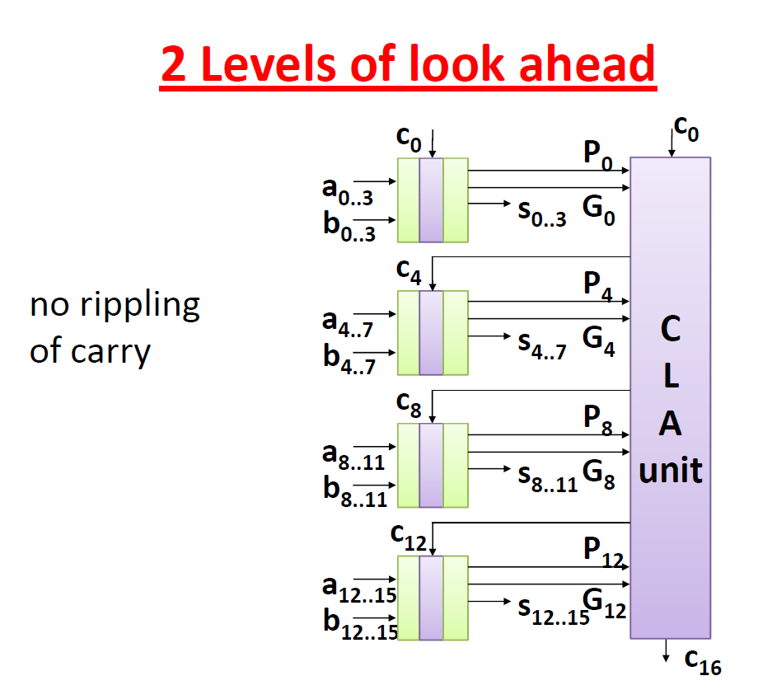
2 Level CLA Generation

Slide 36
16-Bit CLA – Gates with many inputs needed?
A₁₅₋₁₂
B₁₅₋₁₂
A₁₁₋₈
B₁₁₋₈
A₇₋₄
B₇₋₄
A₃₋₀
B₃₋₀
4 Bit CLA
Adder
4 Bit CLA
Adder
4 Bit CLA
Adder
4 Bit CLA
Adder
S G P C
S G P C
S G P C
S G P C
S₁₅₋₁₂
S₁₁₋₈
S₇₋₄
S₃₋₀
C₀
G₂ P₂ C₂
G₁ P₁ C₁
G₀ P₀
Carry Lookahead Logic for 32-Bit Adder
G₃ P₃ C₃
C₀
G_{g} P_{g}
Group Propagate and
Group Generate signals
P_{g} = P₃.P₂.P₁.P₀
G_{g} = G₃ + P₃.G₂ + P₃.P₂.G₁ + P₃.P₂.P₁.G₀

Slide 37
Carry Select Adder

Slide 38
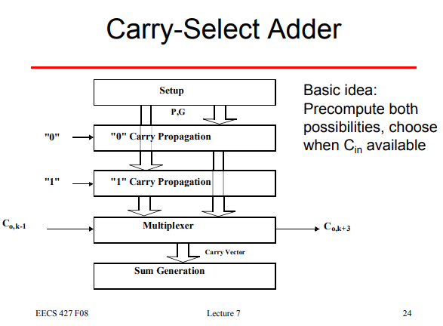
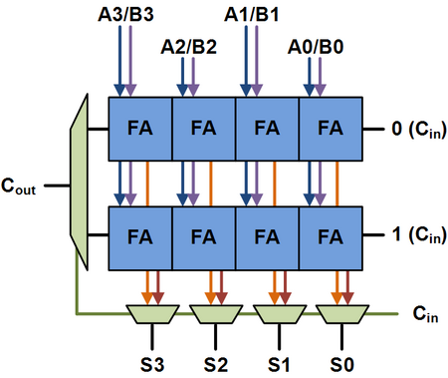
Carry Select Adder - Principle
Ref: https://en.wikipedia.org/wiki/Carry-select_adder

Slide 39
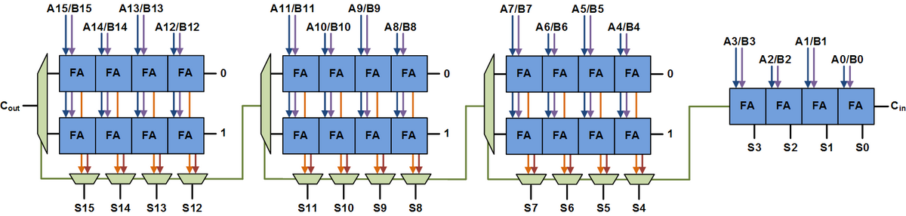
Carry Select Adder – Uniform Size Adders

Slide 40
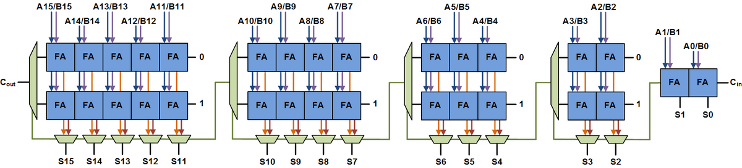
Carry Select Adder – Variable Size Adders

Slide 41
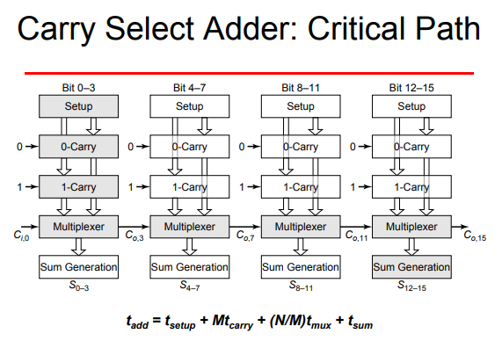




Carry Select Adder Critical Path

Slide 42

Carry Select Adder

