Slide 1
Lecture 23
EE 421 / CS 425
Digital System Design
Quiz No. 5 is
NEXT WEEK
Quiz No. 6 is
In Last Lecture
Fall 2025
Shahid Masud

Slide 2

Topics
Recap – Path Sensitization Method for Fault Test Generation
Examples of XOR based test set generation
Design for testability
BIST and SCAN technique
Pseudorandom test vector generation through ALFSR
Quiz No. 5 is
NEXT WEEK

Slide 3
Three Steps in Path Sensitization Method
Fault Excitation: Which vector to be induced to detect the suspected SA0 or SA1 fault at the suspicious path
Fault Propagation: Identify path/s through which fault can be propagated to the observable output
Back tracking: Move back from output towards all inputs and assign appropriate test values

Slide 4
Path Sensitization – how to
a
x₁
G1
b
x₂
G2
c
x₃
f
G3
x₄
To sensitize a path through an input of AND gate or NAND gate, all other inputs must be set to ‘1’
To sensitize a path through an input of OR gate or NOR gate, all other inputs must be set to ‘0’

Slide 5
Path Sensitization – Example 1
x₁
x₂
x₃
x₄
1
G1
5
2
7
G3
3
1(0)
f
1(0)
1(0)
X
G2
4
6
Fault Propagation
Purpose: To detect SA0 fault at wire 3 connected to input of OR gate
Input x₃ is selected opposite to Stuck-At fault (eg. SA0), written as x₃=1(0)
This is fault generation or excitation

Slide 6
Test Vectors for Example 1
x₁ = 1
x₂ = 1
x₃ = 1(0)
x₄ = 0
1
G1
5
1
1
7
1(0)
G3
3
1(0)
1(0)
X
G2
4
6
Path Sensitization
Sensitized path = 3 → 6→ 7
Back tracing reveals inputs to all gates to ensure fault propagation
Required test vector to detect SA0 at wire 3 is “1110”

Slide 7
Path Sensitization – Example 2
To detect SA1 fault at wire 2
Two possible paths can be excited
1
x₁
x₂
x₃
x₄
G1
7
X
2
5
G3
9
10
G4
6
G2
3
8
4

Slide 8
continued
Detect SA1 at path 2
Fault propagation by supplying input x₂=0(1)
1
x₁
x₂
x₃
x₄
G1
7
Case 1:
Back tracking reveals:
First Selected path = ②→7 → 9 → 10
But path ⑧=1 due to path 2 input x₂
This is not correct to have ‘1’ at
Path ⑨. Hence ‘0’ cannot be justified
at line 8 and line 2 simultaneously
This situation is ‘Inconsistent’ hence
Some other path is required
0(1)
0(1)
X
2
5
G3
9
0(1)
10
G4
0(1)
???
0(1)
6
G2
3
8
4

Slide 9
Continued – final test vectors
Selected path = 2 → 6 → 8 → 9 → 10
Test Vector = “0011”
This test vector can also reveal other
faults in wires ⑥, ⑧ and ⑨
In NAND and NOR, reverse fault is
propagated
1
X₁=0
X₂=0
X₃=1
X₄=1
7
0(1)
X
2
5
9
1(0)
10
0(1)
1(0)
6
1(0)
3
8
4

Slide 10
Untestable Fault
Parallel Propagation Paths are Available
1
4
x₁
x₂
x₃
9
11
2
5
6
f(x₁,x₂,x₃)
7
10
3
8
X
Look at SA1 fault on path 8
This fault cannot be distinguished (sensitized) by changing inputs x1 to x3
Mathematically:
An untestable fault exists when f^{8/1} ⨁ f⁸ = 0
This condition means it is not possible to test this path

Slide 11
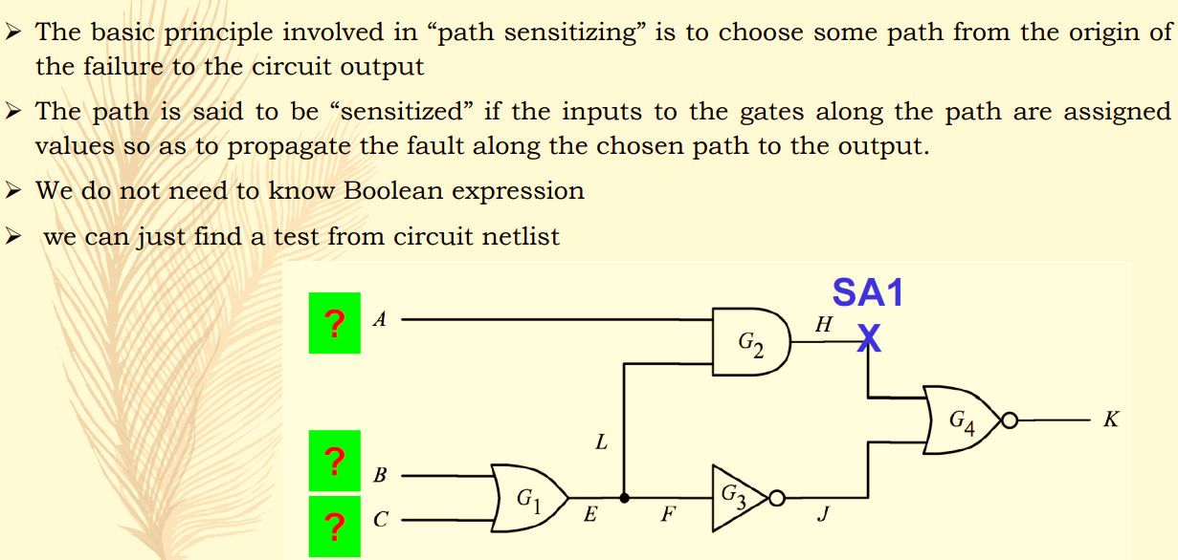
Find test vector - example

Slide 12
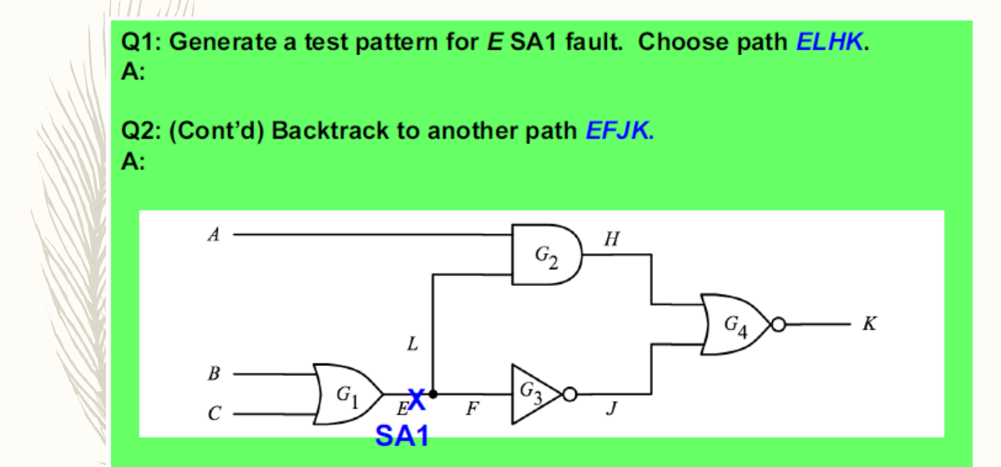
Find the test vectors – another example

Slide 13
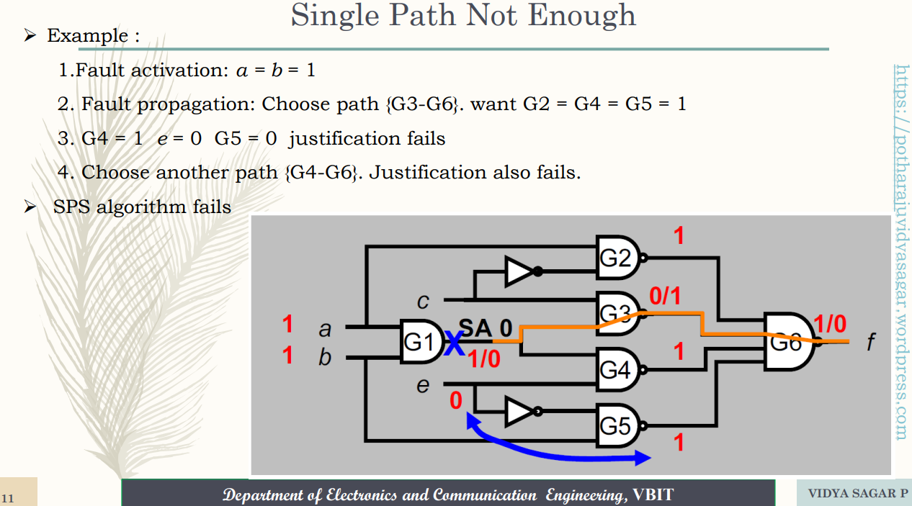
Multipath - 1

Slide 14
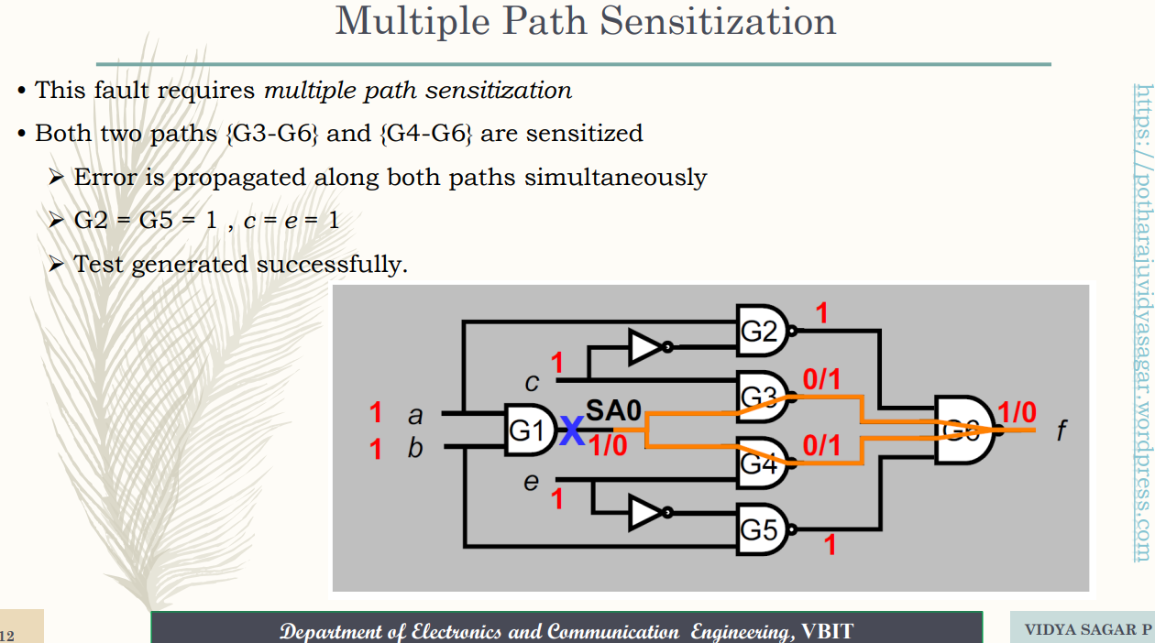
Multipath – 2

Slide 15
EXOR Method for Fault Test Generation

Slide 16
EXOR Method for Fault Test Generation
Define faulty and fault-free circuit as Boolean expressions
The Exclusive OR of the two functions should be ZERO if they are same i.e. NO FAULT
The Exclusive OR of the two functions should be ONE if there is fault, means different fault propagation
Premise:
Faulty Circuit must produce a different response from a fault-free circuit
Example SA0 fault on wire 3, input to OR gate in circuit below:
1
4
x₁
x₂
x₃
2
3
f
X
5
SA0

Slide 17
EXOR method using Boolean Algebra
F^{1/0} = f ⨁ f^{1/0}
=(x1.x2 + x3) ⨁ (x3)
=x1.x2.x3’
⟹ test vector = 110
1
4
x1
x2
x3
2
3
f
X
5
SA0
Similarly, test for 3/0 is:
F^{3/0} = (x1.x2 + x3) ⨁ (x1.x2)
= (x1’ + x2’).x3
= (x1’.x3 + x2’. x3)
Thus tests are: 001, 011, 101

Slide 18
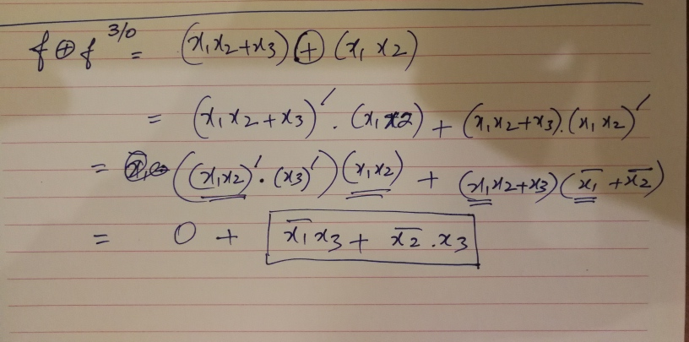
Solution

Slide 19
EXOR Method – The steps involved
Step 1: Construct truth table of fault-free f and faulty f^{p/d}
Step 2: Compute f⨁f^{p/d} for each row of the truth table
Step 3: Tests (input vectors) for fault p/d are indicated by the ones in the columns corresponding to f⨁f^{p/d}
Step 4: By expressing f and f^{p/d} in Boolean algebra, an expression that gives all tests for p/d can be determined

Slide 20
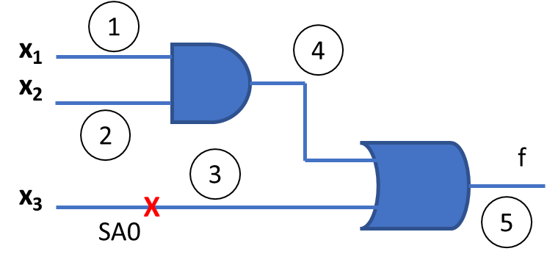
Draw Fault Table – shows a set of faults and a set of inputs
⨁
⨁
⨁
Tests (inputs) |  |  | f output | f^{1/0} | f^{2/1} | f^{3/0} | f⨁f^{1/0} | f⨁f^{2/1} | f⨁f^{3/0}
x₁ | x₂ | x₃ |  | SA0 at 1 | SA1 at 2 | SA0 at 3
0 | 0 | 0 | 0 | 0 | 0 | 0 | 0 | 0 | 0
0 | 0 | 1 | 1 | 1 | 1 | 0 | 0 | 0 | 1
0 | 1 | 0 | 0 | 0 | 0 | 0 | 0 | 0 | 0
0 | 1 | 1 | 1 | 1 | 1 | 0 | 0 | 0 | 1
1 | 0 | 0 | 0 | 0 | 1 | 0 | 0 | 1 | 0
1 | 0 | 1 | 1 | 1 | 1 | 0 | 0 | 0 | 1
1 | 1 | 0 | 1 | 0 | 1 | 1 | 1 | 0 | 0
1 | 1 | 1 | 1 | 1 | 1 | 1 | 0 | 0 | 0

Slide 21
Checking Testability through EXOR Equations
f=(x1+x2+x3+x4)(x5+x6’)
f^{6/0} = (x1+x2+x3+x4).1
Test vector F^{6/0} = f ⨁ f^{6/0}
= [(x1+x2+x3+x4).(x5+x6’)] ⨁ [(x1+x2+x3+x4).1]
=A’.B + A.B’
Note: (x1+x2….).(x5+..).(x1+x2….)’ = 0
= (x1+x2+x3+x4)(x5’.x6)
=x1x5’x6 + x2x5’x6 + x3x5’x6 + x4x5’x6
Many test vectors are there for f^{6/0}
Eg. 100001, 010001, 001001, 000101
x1
x2
x3
x4
x5
x6
1
8
2
10
3
9
12
4
5
SA1 fault at wire 5
11
X
6
7

Slide 22
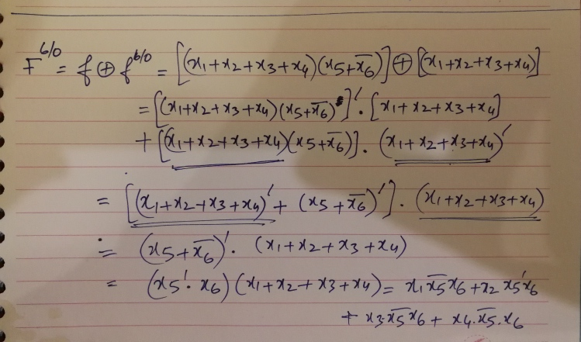
Solving – find test set

Slide 23
Design for Testability – Built-In Self Test BIST

Slide 24
Design for Testability – Built-In Self Test BIST
Design for testability means that the designer introduces such features in design that can be later used for testing and debugging of circuits inside the chip
Special circuit elements that participate in the application of test vectors and capturing of results are integrated into the design
Both sequential and combinational circuits can be tested

Slide 25

Sequential Machines with Scan Circuits
x₁
…
x_{n}
Z₁
….
Z_{m}
Combinational
Logic
Test/Normal’ isolates flipflops from internal
Combinational logic and inputs x1…xn
Special I/O Test Data In and Test Data out
Provide a known signature pattern that is
Driven into the scan chain formed by connecting
Inputs and outputs of all flipflops
The received data at Test Data Out is compared
With string provided at Test Data In after
r clock cycles
y₁….y_{r}
Y_{r}….Y₁
Memory
Memory
$$Test/\overline{Normal}$$
Test Data Out
Test Data In

Slide 26
Scan Path operation for testing state machines
Allows testing of combinational and sequential logic
Set mode to Test
Shift pattern into y1,y2,….,y4 into flip flops through Scan Input to put them into known defined state
Apply input pattern through primary inputs x1,x2,….,xn
Observe primary outputs z1,z2,…,zm
Set to Normal mode
Clock the circuit to force one transition,
….. And so on
$$Test/\overline{Normal}$$
$$Test/\overline{Normal}$$

Slide 27
BIST – Built In Self Test
Test pattern generator at Scan Input port as well as response capture and comparison circuitry is placed inside the chip. Thus, testing can be done without any other external mechanism, setting appropriate test mode on chip
Pseudorandom test patterns are generated using ALFSR (Autonomous Linear Feedback Shift Register) circuits. These are applied at Scan In as well as inputs to combinational logic blocks
Data from primary output is captured and compressed by MISR (Multi Input Signature Register)
Scan Output is captured and compressed by SISR (Serial Input Shift Register)

Slide 28
Designing with BIST Circuits
x₁
…
x_{n}
Combinational
Logic
Z₁
….
Z_{m}
u₁…..…..u_{n}
MISR
S
y1….yr
Yr….Y1
$$Pass/\overline{Fail}$$
ALFSR
Memory
Memory
Test Data Out
$$Test/\overline{Normal}$$
SISR
Test Data In
ALFSR
$$Pass/\overline{Fail}$$

Slide 29
Scan Path Register Design
Y1
Y2
Y3
Yr
DFF
D Q
DFF
D Q
DFF
D Q
DFF
D Q
Scan In
yr
y1
y2
y3
Clk
Test/Normal’
y1, y2, …., yr are inputs to combinational logic
A 2:1 Multiplexer is added to the input of each flip flop
In Normal’ mode, the Y1, Y2,…., Yr inputs are connected to the D input of flip flops
In Test mode, each flip flop is connected to the output of previous flipflop, forming scan chain
Serial shift register formed in Test mode is called ‘Scan Path’

Slide 30
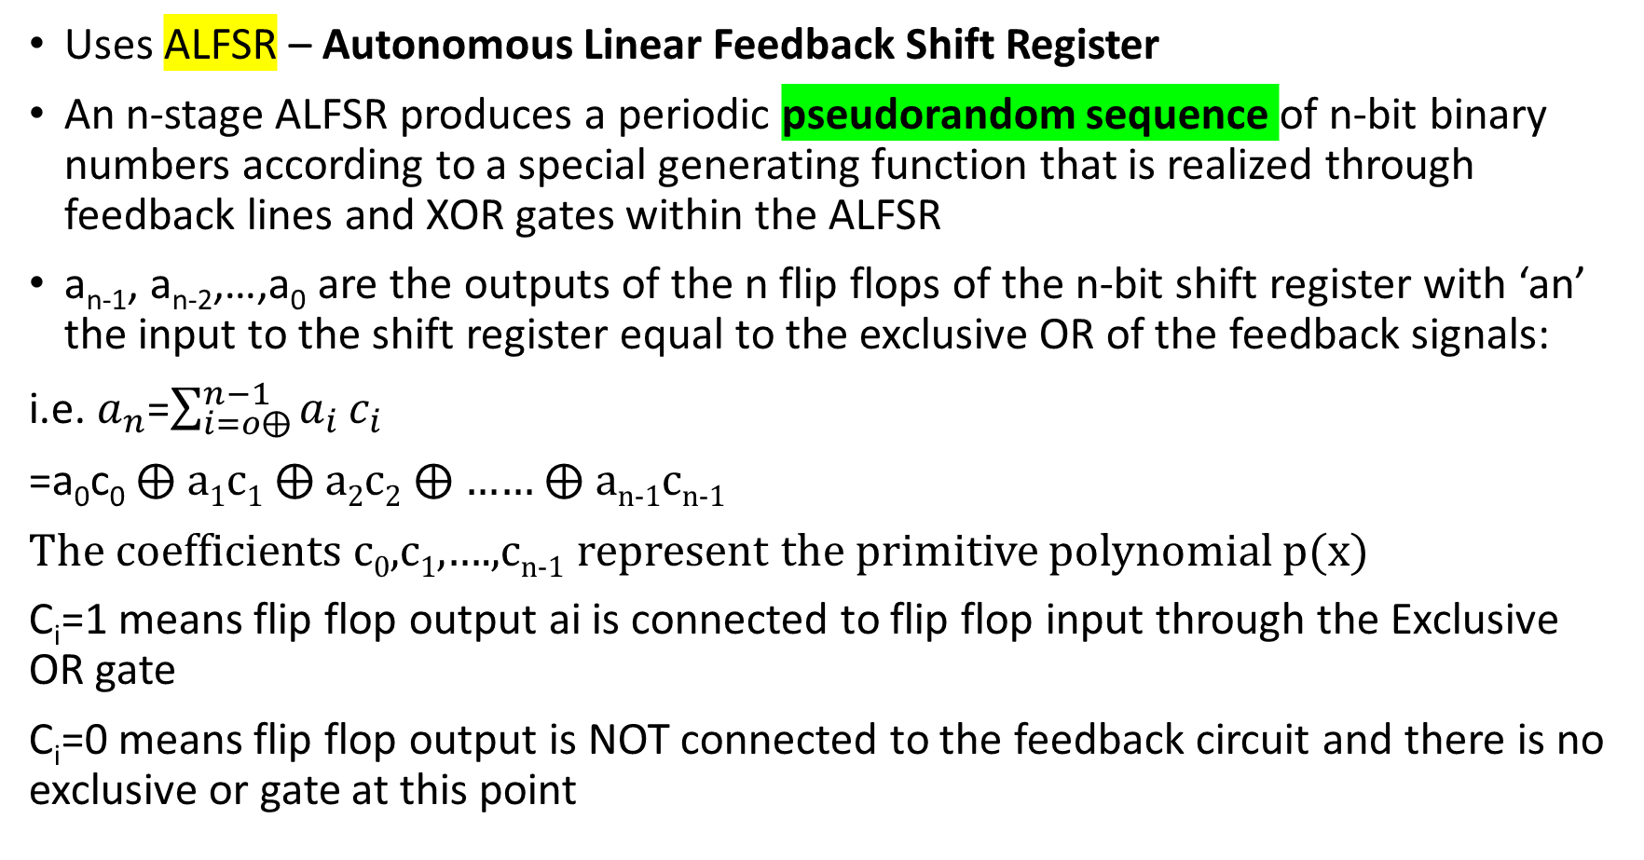
Pseudorandom Test Pattern Generation
Uses ALFSR – Autonomous Linear Feedback Shift Register
An n-stage ALFSR produces a periodic pseudorandom sequence of n-bit binary numbers according to a special generating function that is realized through feedback lines and XOR gates within the ALFSR
a_{n-1}, a_{n-2},…,a₀ are the outputs of the n flip flops of the n-bit shift register with ‘an’ the input to the shift register equal to the exclusive OR of the feedback signals:
i.e. $a_{n}$=$\sum_{i=o⨁}^{n−1}{a_{i}}c_{i}$
=a₀c₀ ⨁ a₁c₁ ⨁ a₂c₂ ⨁ …… ⨁ a_{n-1}c_{n-1}
The coefficients c₀,c₁,….,c_{n-1} represent the primitive polynomial p(x)
C_{i}=1 means flip flop output ai is connected to flip flop input through the Exclusive OR gate
C_{i}=0 means flip flop output is NOT connected to the feedback circuit and there is no exclusive or gate at this point

Slide 31
General Structure of ALFSR
C_{n-1}
C_{n-2}
C₁
C₀
Dn
Dn-1
D1
D0
D Q
D Q
D Q
a₁
D Q
a_{n}
a_{n-1}
a_{n-2}
a₀
Clk
f(x)=a_{n}x^{n}+………. + a₃x³ + a₂x² + a₁x¹ + a₀

Slide 32
Check ALFSR Sequence with given circuit or polynomial and seed value
x¹
x⁰
x⁴
x³
x²
D3 Q3
D2 Q2
D 1 Q1
D0 Q0
a₄
a₃
a₂
a₁
a₀
D3=y1 ⨁ y0
y2
y1
y0
y3
Clk
Polynomial
P(x)=x⁴+x+1
Or f(x)=a₄x⁴ + a₃x³ + a₂x² + a₁x¹ + a₀x⁰
Use seed value y3y2y1y0 = 1000 that is preset
at start

Slide 33
Generated sequence from this ALFSR circuit
Clock | D3=(y1⨁y0) | y3 | y2 | y1 | y0
1 | 0 | 1 | 0 | 0 | 0
2 | 0 | 0 | 1 | 0 | 0
3 | 1 | 0 | 0 | 1 | 0
4 | 1 | 1 | 0 | 0 | 1
5 | 0 | 1 | 1 | 0 | 0
6 | 1 | 0 | 1 | 1 | 0
7 | 0 | 1 | 0 | 1 | 1
8 | 1 | 0 | 1 | 0 | 1
9 | 1 | 1 | 0 | 1 | 0
10 | 1 | 1 | 1 | 0 | 1
11 | 1 | 1 | 1 | 1 | 0
12 | 0 | 1 | 1 | 1 | 1
13 | 0 | 0 | 1 | 1 | 1
14 | 0 | 0 | 0 | 1 | 1
15 | 1 | 0 | 0 | 0 | 1
16 | REPEAT | 1 | 0 | 0 | 0
Seed Value 1000
D3=y1 ⨁ y0

