Slide 1
Lecture 6
EE 421 / CS 425
Digital System Design
Fall 2026
Shahid Masud

Slide 2
Topics
Review of Sequential Digital Logic Circuits
Basics of Latches
Basics of Flipflops
Setup and Hold Times
D Flipflop
Clock Issues

Slide 3
Latches and Flipflops - Definitions
Latches: Level Sensitive storage elements; that can transition at any point in time
Flipflops: Edge Sensitive storage elements, that transition at clock edges, either rising or falling
Asynchronous Sequential Logic: Based on latches and un-clocked transitions
Synchronous Sequential Logic: Based on flipflops and only clocked transitions

Slide 4
Fundamental Element – SR Latch
R (reset)
Q
S (set)
Q
Complement
Q’
R (reset)
Q’
S (set)
SR Latch Using 2 Input NOR Gate – Function Table
SR Latch Using 2 Input NAND Gate – Function Table
S (Set) | R (Reset) | Q | Condition
0 | 0 | Q (=1 after S=1, R=0) | Hold
0 | 0 | Q (=0 after S=0, R=1) | Hold
0 | 1 | 0 | Reset
1 | 0 | 1 | Set
1 | 1 | 0 | Not Allowed
S | R | Q | Condition
0 | 0 | 1 | Not Allowed
0 | 1 | 1 | Set
1 | 0 | 0 | Reset
1 | 1 | Q (=0 after S=1, R=0) | Hold
1 | 1 | Q (=1 after S=0, R=1) | Hold
RACE
Condition
RACE
Condition

Slide 5
Transparent Latch
An additional ‘Enable’ input is provided
Definition: Output of Transparent Latch changes in response to the data input only when the Latch is ‘Enabled’.
Changes in input are straight away visible at the output

Slide 6
Transparent Latch Circuit
Timing Diagram – With Input Inverter
Data
S
Data
U
Q_Out
D
Enable (Level)
Enable
R
V
SR Latch With Enable (Without Inverter)
En | S | R | Next State of Q
0 | X | X | No Change
1 | 0 | 0 | No Change
1 | 0 | 1 | Q=0; Reset State
1 | 1 | 0 | Q=1; Set State
1 | 1 | 1 | Not Allowed
Q_Out
Latched
time
When Enable is ‘0’; U=‘1’ and V=‘1’; Hold Condition in SR Latch
Only these two states are valid when inverter is inserted

Slide 7
Latches and Flipflops - Definitions
Latches: Level Sensitive storage elements; that can transition at any point in time
Flipflops: Edge Sensitive storage elements, that transition at clock edges, either rising or falling
Asynchronous Sequential Logic: Based on latches and un-clocked transitions
Synchronous Sequential Logic: Based on flipflops and only clocked transitions

Slide 8
Fundamental Element – SR Latch
R (reset)
Q
S (set)
Q
Complement
Q’
R (reset)
Q’
S (set)
SR Latch Using 2 Input NOR Gate – Function Table
SR Latch Using 2 Input NAND Gate – Function Table
S (Set) | R (Reset) | Q | Condition
0 | 0 | Q (=1 after S=1, R=0) | Hold
0 | 0 | Q (=0 after S=0, R=1) | Hold
0 | 1 | 0 | Reset
1 | 0 | 1 | Set
1 | 1 | 0 | Not Allowed
S | R | Q | Condition
0 | 0 | 1 | Not Allowed
0 | 1 | 1 | Set
1 | 0 | 0 | Reset
1 | 1 | Q (=0 after S=1, R=0) | Hold
1 | 1 | Q (=1 after S=0, R=1) | Hold
RACE
Condition
RACE
Condition

Slide 9
Transparent Latch
An additional ‘Enable’ input is provided
Definition: Output of Transparent Latch changes in response to the data input only when the Latch is ‘Enabled’.
Changes in input are straight away visible at the output

Slide 10
Transparent Latch Circuit
Timing Diagram – With Input Inverter
Data
S
Data
U
Q_Out
D
Enable (Level)
Enable
R
V
SR Latch With Enable (Without Inverter)
En | S | R | Next State of Q
0 | X | X | No Change
1 | 0 | 0 | No Change
1 | 0 | 1 | Q=0; Reset State
1 | 1 | 0 | Q=1; Set State
1 | 1 | 1 | Not Allowed
Q_Out
Latched
time
When Enable is ‘0’; U=‘1’ and V=‘1’; Hold Condition in SR Latch
Only these two states are valid when inverter is inserted

Slide 11
D Flipflop from Transparent Latch
Preset
D
S
Q
D
D Flipflop
Q
Clock Edges
Q’
Q’
Clk
R
Clear
NOTE: Usually a Master-Slave Arrangement is used where output is available after clock goes 0 to 1 to 0
C
R
Unipolar
Conversion
(from pulse shaping circuit)
Clock edges
RC Differentiator
Bi-polar pulses

Slide 12
Timing Definitions
Setup Time: The duration of time the Data needs to be present before the arrival of clock.
Any Data activity, in tandem with clock edge, violates setup time and will not be recorded in the D flipflop
Hold Time: The time for which data must remain stable after the removal of clock edge.
If the Data changes too soon, the internal circuit may not have settled with the new value.

Slide 13
Setup and Hold Times
Clock transition
From 0 to 1
Clock rising edge
Data change
t setup
t hold
Data removed
time
Maximum clock frequency has to be slower than (t setup + t hold) to maintain correct data
These timings needed both ways, slow data and fast clock; as well as slow clock and fast data

Slide 14
Timing in a simple frequency divider
For maximum clock speed consider → setup time, hold time, relevant propagation delays
Propagation Delay tp
Clk
Preset
Q
D
D Flipflop
Q
D
tp
Clk
Q’
tc
Clear
If the current output of flipflop is 1, a value of 0 will appear at D after propagation delay of inverter
Assuming that next active edge of clock arrives after setup time has elapsed, the output of
flipflop will go to 0
A continuous waveform with period twice the period of Clk is observed at Q

Slide 15
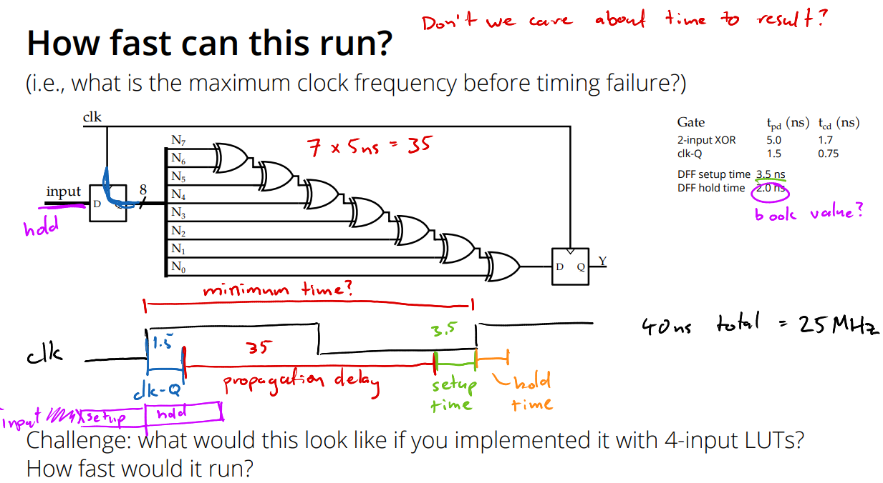
Example of time calculation

Slide 16
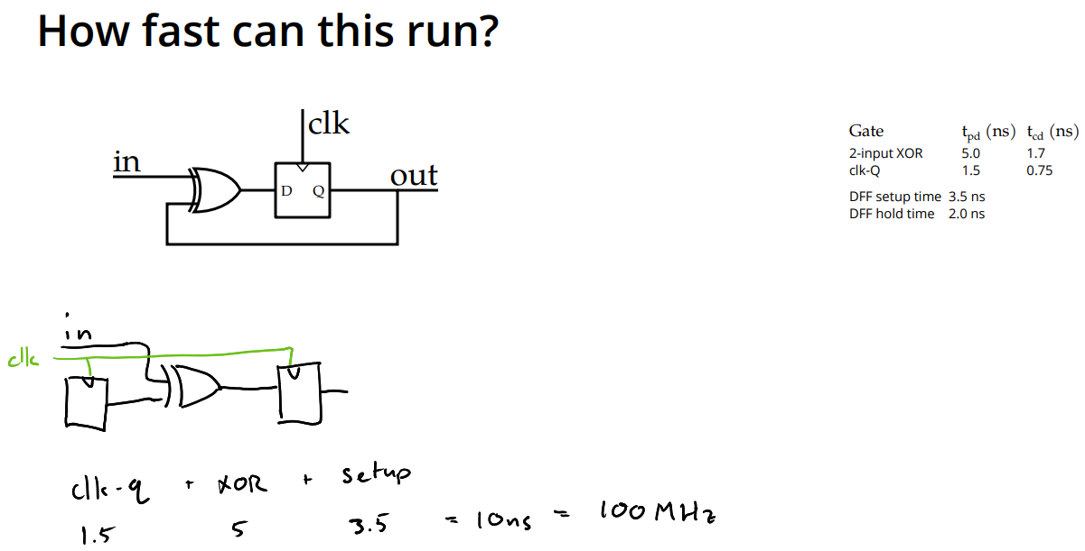
Another Example of time calculation

Slide 17
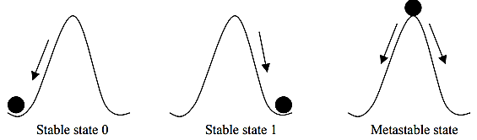
Metastable State
Given a pulse input:
Output reaches a value (or oscillates) somewhere in-between
‘0’ and ‘1’ and stays there, neither ‘0’ nor ‘1’, for some noticeable time
Why?
Too small pulse violates setup and hold times
Too less drive strength available to overcome the intermediate
state
A
U
V
B
Imagine a circuit like this

Slide 18
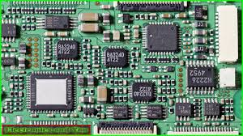



Clock - Problems
Issues:
Too much load
on Clock Input Pin
2. Variable path delay to
Different Chips in circuit
3. Path is prone to picking
up noise from surrounding
Clock is an essential
Signal in Synchronous
Digital Systems
External Clock
Input PIN

Slide 19
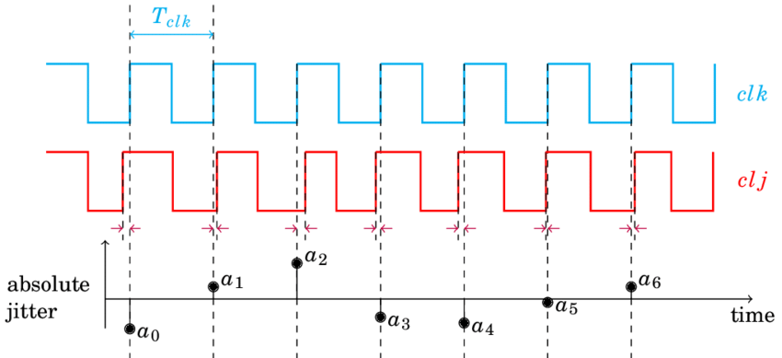
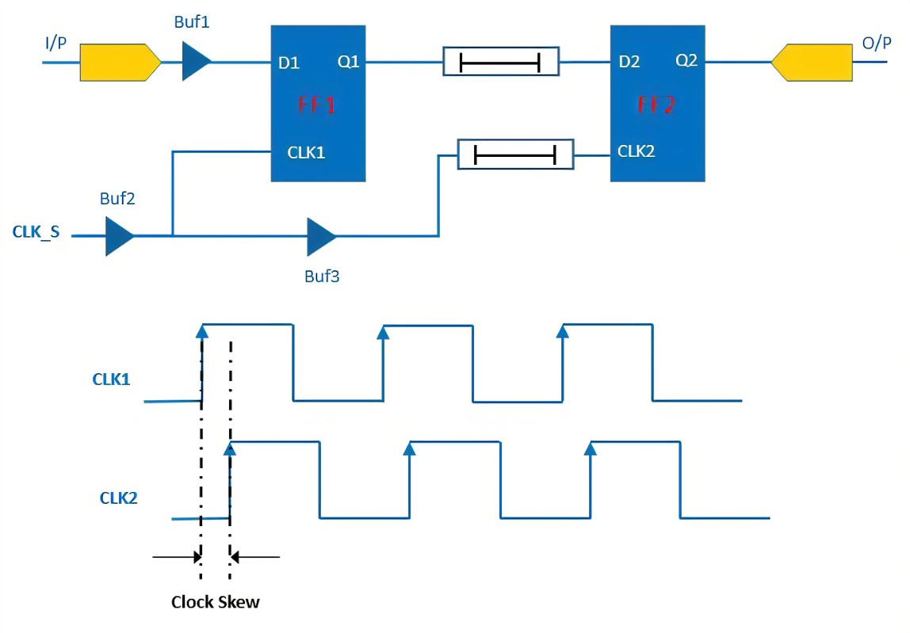
Clock Distribution Circuit
Qualities of a Good Clock Signal:
Clock has to reach each and every module of a complex circuit
Clock needs very high signal drive strength
Clock Edge has to appear at the same instant across all modules (skew)
Clock should be stable and free from jitter (time variations along stable reference point)

Slide 20
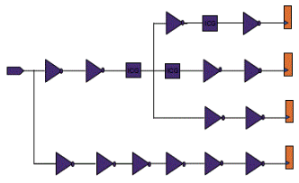
Clock Tree Synthesis
Clock tree synthesis is performed during the physical design process considering the effects of place and route, channel impedance, parasitic loads, etc.
Then through the insertion of buffers or inverters along the clock paths, it minimize or balances skew of important clock signal chains, build a clock tree that achieves proper timing across the entire design.
Ref: https://www.system-to-asic.com/blog/what-is-asic-design/

Slide 21
Some Techniques for Clock Distribution
X
Module 1
Module 1+1
Module 1
Module 1
Module 1
Module 1
Module 1
Module 1
Buffer
Insertion
H-Tree Clock Synthesis
Path is balanced through
Tree structure
Module 1
Module 1
Module 1
Module 1
Module 1
Module 1
Module 1
Module 1
CLK
H Tree Clock Distribution Network
Buffer Insertion for Delay Balancing in un-balanced trees

Slide 22
Hierarchical Clock
Module 2
Module 2
Buffer based Path
Delay Balancing
Module 2
Module 2
Module 2
Module 2
Driver and
Buffer
CLK
Two Level Distributed Clock Buffering

Slide 23
Special Purpose Combinational Circuits

Slide 24
Three State Buffers for Processor Buses
Buses are multi-wire signal paths that connect multiple functional units in a computer system, e.g., Address bus, peripheral bus, etc.
Simplifies design and architecture of a computer system
Tradeoff is that the access to the bus has to be managed to avoid conflicts
Three state hardware devices provide a dynamic interface between a bus and a circuit, providing signals when enabled else an open circuit
The input goes to the output of the tri-state buffer when enable signal is asserted

Slide 25
Three State Bus Drivers
Bus Architecture
Address
Data
x
y
x
y
Control
en
Select Module
en
I/O 1
Storage 1
I/O 2
μProc 1
Typical Bus Structure utilizing 3-state buffers
x | en | y
0 | 0 | Hi_Z
0 | 1 | 0
1 | 0 | Hi_Z
1 | 1 | 1
x | en | y
0 | 0 | 0
0 | 1 | Hi_Z
1 | 0 | 1
1 | 1 | Hi_Z
Inverting and Non-Inverting 3-State Buffers / Drivers Exist
The Enable can be active high or active low
Buffers with Hysterisis Loop are available for better noise immunity
Buffers with Schmitt Trigger

Slide 26
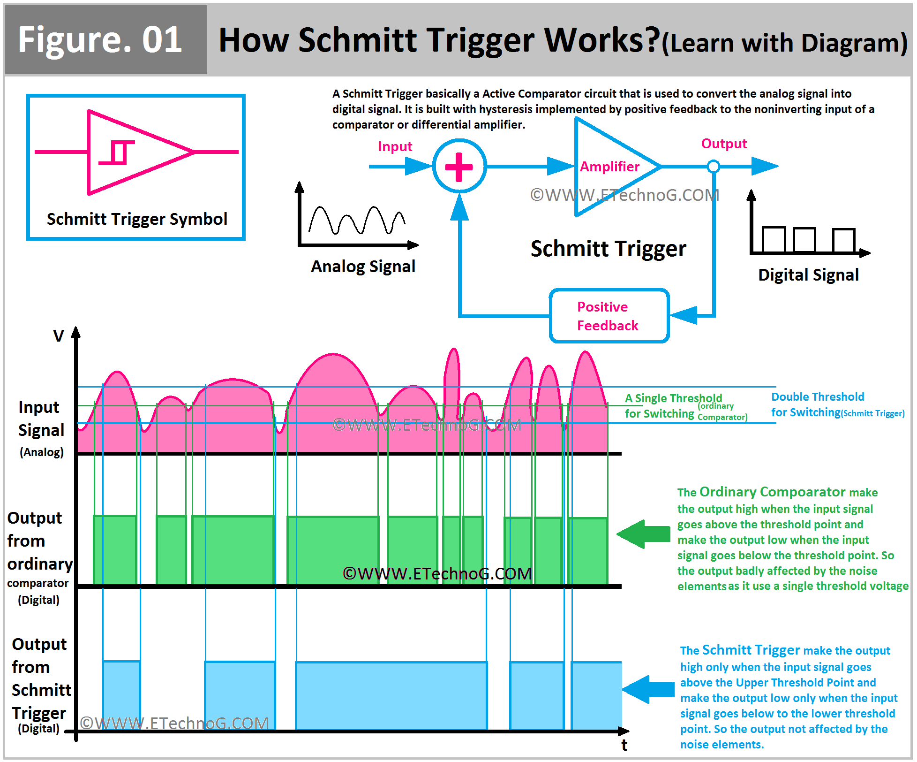
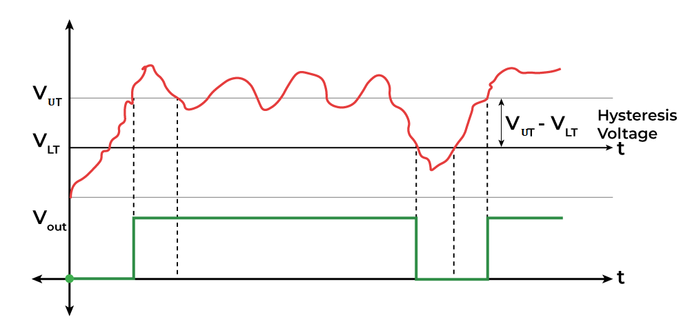
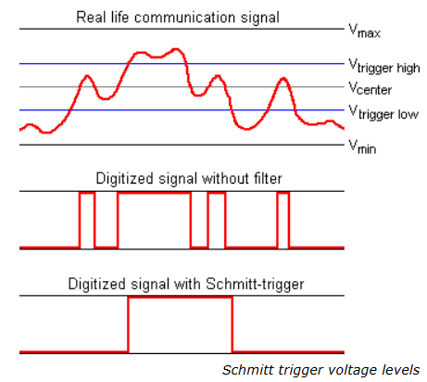
Schmitt Trigger

Slide 27
Sequential Elements and Circuits

Slide 28
D Flipflops – Behavior and Equation
Preset
D
D
D Flipflop
Q
D
D Flipflop
Q
Clk
Clk
Q’
Clk
Q
Clear
Characteristic Equation:
Q(t+1) = D
Q after clock pulse gets value of D
time
Δt = ?
D | Q(t+1)
0 | 0; Reset
1 | 1; Set

Slide 29
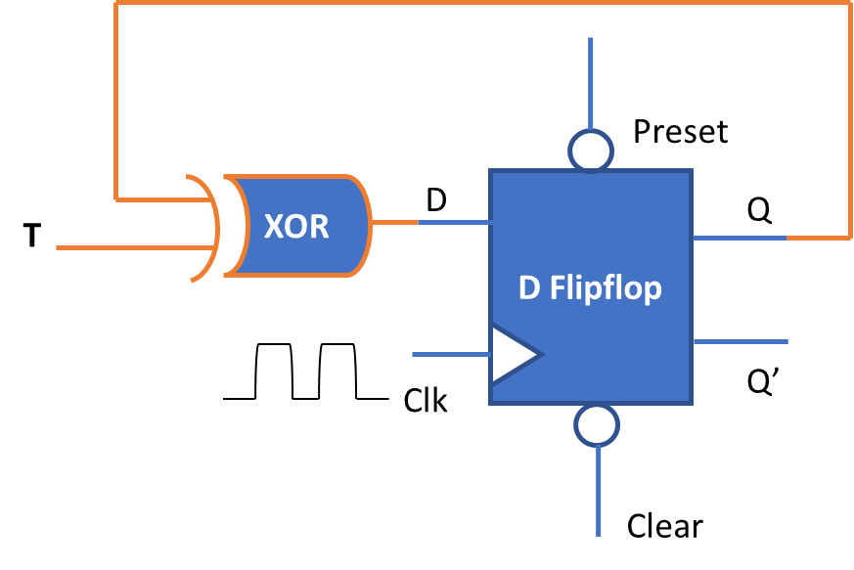
T Flipflop – Behavior and Equation
T
T
Flipflop
Q
Q’
T
Clk
Clk
Characteristic Equation:
Q(t+1) = T ⨁ Q
= T’Q + TQ’
Q
T | Q(t+1)
0 | Q(t); No change
1 | Q’(t); Toggle or Complement
toggle
toggle
toggle
time
Δt = ?

Slide 30
In this course,
We will mostly use D Flipflops and sometimes T Flipflops
We want to study complex and high-speed designs

Slide 31
Sequential Circuits:
Counters, Sequencers, State Machines
Counters: count in a fixed sequence, up or down
Sequencers: sequence through a pre-defined arbitrary sequence
State Machines: Sequential and Combinational Circuits work together to go one of many next states based on current inputs

Slide 32
Moving Through Register Chain
Clk
D1
D1
D Flipflop1
Q1
D2
D Flipflop2
Q2
D3
D Flipflop3
Q3
Q1’
Q1
Q2’
Q3’
Clk
Clk
Clk
Q2
Q3
time
Only ‘EDGES’ of Clocks are important for Flipflops

Slide 33
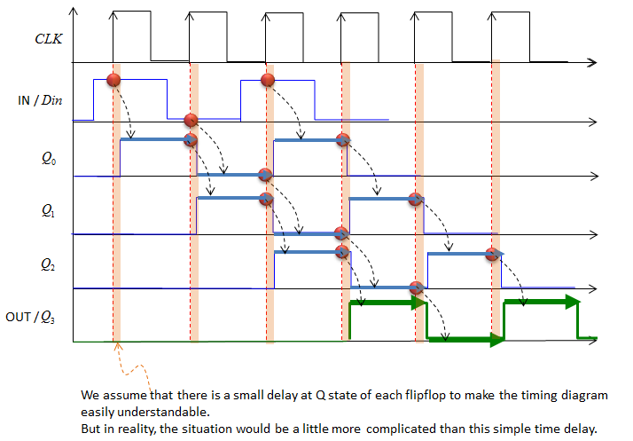
3 DFF Shift Register Timing Diagram from a website
Look closely at the
Area close to
Clock transition,
Shaded pink lines

Slide 34
Cyclic Shift Register using D flipflops
D1
Q1
D2
Q2
D3
Q3
D Flipflop
D Flipflop
D Flipflop
Assume all DFFs are Cleared to 0 at Startup
Clock No. | Q1 | Q2 | Q3
1 | 0 | 0 | 0
2 | 0 | 1 | 1
3 | 1 | 1 | 0
4 | 0 | 0 | 0
5 | 0 | 1 | 1
6 | 1 | 1 | 0
7 | 0 | 0 | 0
CONTINUE | …. | …. | ….
Clk
Clk
Clk
After the clock edge:
Q1(t+1) becomes same as Q3(t)
Q2(t+1) becomes inverse of Q1(t)
Q3(t+1) becomes inverse of Q2(t)

Slide 35
Tail Ring Counter Four Stage
D1
D Flipflop
Q1
D2
D Flipflop
Q2
D3
D Flipflop
Q3
D4
D Flipflop
Q4
Q’
Clk
Clk
Clk
Clk
Sequence No. | Q1 | Q2 | Q3 | Q4
1 | 0 | 0 | 0 | 0
2 | 1 | 0 | 0 | 0
3 | 1 | 1 | 0 | 0
4 | 1 | 1 | 1 | 0
5 | 1 | 1 | 1 | 1
6 | 0 | 1 | 1 | 1
7 | 0 | 0 | 1 | 1
8 | 0 | 0 | 0 | 1
9 | 0 | 0 | 0 | 0
State
Transition
Table

