Slide 1
Lecture 2
EE 421 / CS 425
Digital System Design
Fall 2026
Shahid Masud

Slide 2
Topics in Lecture 2
Quick Review of Digital Systems
Useful number systems, conversion
Introducing RTL Design
The Language and Abstraction of Digital Systems
Review Boolean Algebra
Review K-Maps, 5 and 6 variables ??
Logic Minimization and Synthesis
Introducing WinLogiLab / DEEDS tools
Review material, use reference books:
Digital Systems Principles and Applications, 12th edition, Widmer, Moss, Tocci
Digital Design, Mano and Ciletti

Slide 3
Useful Number Systems
Initial electro-mechanical computers were based on analog and decimal numbers (base 10). The computers were difficult to scale, complex, and expensive.
Binary number system (base 2) along with Boolean Algebra was found to be the most efficient (area↔speed ↔power Δ) mechanism for computer implementation in microelectronics technology.
Switching square waveforms in electronic circuits directly map to ‘1’ and ‘0’ in binary number system.
In computer systems, Hex numbers (base 16) and 2’s Complement numbers are used to represent information in a compact way.
1
0

Slide 4
Review of Useful Number Systems
Decimal to Binary
Eg. Convert 37 (base 10) to a binary number (base 2)
37 ÷ 2 = 18.5 (whole number is 18, remainder is 0.5, so put a 1 here) → 1 (LSB)
18 ÷ 2 = 9 (whole number is 9, remainder is 0 so put a zero here) → 0
9 ÷ 2 = 4.5 (whole number is 4, remainder is 0.5, put a 1 here) → 1
4 ÷ 2 = 2 (whole number is 2, remainder is 0, put a 0 here) → 0
2 ÷ 2 = 1 (whole number is 1, remainder is 0, put a 0 here) → 0
1 ÷ 2 = 0.5 (whole number is 0, remainder is 0.5, put a 1 here) → 1 (MSB)
Write MSB to LSB → 1 0 0 1 0 1
Hence (37)₁₀ = (100101)₂

Slide 5
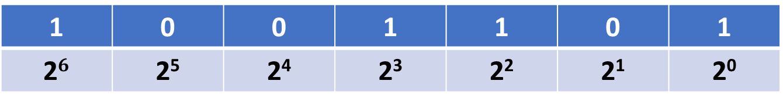
Binary to Decimal conversion
Convert Binary number (1001101)₂ to Decimal number system
Each bit position has a proportional weight in the power of 2
MSB LSB
Add up all the numbers with proportional weights
= 1 x 2⁶ + 0 x 2⁵ + 0 x 2⁴ + 1 x 2³ + 1 x 2² + 0 x 2¹ + 1 x 2⁰
= 64 + 8 + 4 + 1 = (77)₁₀
1 | 0 | 0 | 1 | 1 | 0 | 1
2$6$ | 2⁵ | 2⁴ | 2³ | 2² | 2¹ | 2⁰

Slide 6
Signed Binary Numbers – 2’s Complement
2’s complement of –(0110010)₂ Keep one or more extra ‘0’ bit in MSB
Step 1: Take 1’s complement → (1001101)
Step 2: Add ‘+1’ to the 1’s Complement
1 0 0 1 1 1 0 1
+ 1
________________
(1 0 0 1 1 1 1 1 0)₂ negative numbers will always have MSB = 1
_________________
1’s Complement means invert all bits

Slide 7
Hexadecimal Number System (group of 4 bits)
Hexadecimal | Decimal | Binary
0 | 0 | 0000
1 | 1 | 0001
2 | 2 | 0010
3 | 3 | 0011
4 | 4 | 0100
5 | 5 | 0101
6 | 6 | 0110
7 | 7 | 0111
8 | 8 | 1000
9 | 9 | 1001
A | 10 | 1010
B | 11 | 1011
C | 12 | 1100
D | 13 | 1101
E | 14 | 1110
F | 15 | 1111
7-Segment Display can show Hex Digits
Binary numbers up to 4 bits can be represented as single Hex digit

Slide 8
Converting from Hex Number System
Hex to Decimal Conversion:
(356)₁₆ = 3x16² + 5x16¹ + 6x16⁰
= 768 + 80 + 6
=(854)₁₀
Hex to Decimal Conversion:
(2AF)₁₆ = 2x16² + 10x16¹ + 15x16⁰
= 512 + 160 + 15
= (687)₁₀
Hex to Binary Conversion:
Straightforward
(9F2)₁₆ = 9 F 2
= (1001 1111 0010)₂

Slide 9
Converting into Hex Number System
Binary to Hex Conversion:
Straightforward
(1110100110)₂ = 0011 1010 0110
= 3 A 6
Answer = (3A6)₁₆
Decimal to Hex Conversion:
(378)₁₀ =
378 ÷ 16 = 23 + remainder of 10₁₀ = A₁₆
23 ÷ 16 = 1 + remainder of 7
1 ÷ 16 = 0 + remainder of 1
Answer = (17A)₁₆
In Binary form:
(17A)₁₆ = (0001 0111 1010)₂

Slide 10

RTL View of Digital System Design
Engineering System has Inputs and Outputs
RTL = Register Transfer Logic
Input
Register
Combinational Logic Cloud
Output
Register
External
Inputs
External
Outputs
This is One RTL Module
Trigger
Processing Time
Trigger
A Complex Digital System has many RTL Modules

Slide 11

Combinational Logic Circuits
A system of
combinational
logic gates
Input a
Input b
Input c
Combinational
Output ‘F’ is a function
of inputs a, b, …., n
Input d
Input n

Slide 12
The Language of Digital Systems
Minterms and Maxterms
Truth Table
Boolean Algebra
K-Maps
State Tables
State Machines and Diagrams
Schematic Diagram
HDL Code
Combinational Logic
linking inputs and
outputs
at different
Abstractions and
Hierarchy levels
Sequential Logic
All types of complex Logic Functions

Slide 13

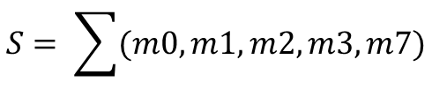



Truth table, minterms, SOP
P | Q | R | S output | Expression
0 | 0 | 0 | 1
0 | 0 | 1 | 1
0 | 1 | 0 | 1
0 | 1 | 1 | 1
1 | 0 | 0 | 0 | 0
1 | 0 | 1 | 0 | 0
1 | 1 | 0 | 0 | 0
1 | 1 | 1 | 1
Minterms
m0
m1
m2
m3
m7
$$\overline{P}\overline{Q}\overline{R}$$
$\overline{P}\overline{Q}$R
$$\overline{P}Q\overline{R}$$
$$\overline{P}QR$$
PQR
$$S=\overline{P}\overline{Q}\overline{R}+\overline{P}\overline{Q}R+\overline{P}Q\overline{R}+\overline{P}QR+PQR$$
Sum of Products Expression
$$S= \sum{(m0, m1, m2, m3, m7)}$$
Minterms Expression

Slide 14


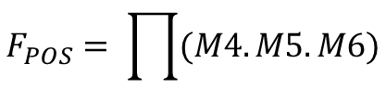

Truth table, Maxterms, POS
P | Q | R | F output (POS) | Expression
0 | 0 | 0 | 1
0 | 0 | 1 | 1
0 | 1 | 0 | 1
0 | 1 | 1 | 1
1 | 0 | 0 | 0
1 | 0 | 1 | 0
1 | 1 | 0 | 0
1 | 1 | 1 | 1
Maxterms
M4
M5
M6
$\overline{P}+Q+$R
$$\overline{P}+Q+\overline{R}$$
$\overline{P}+\overline{Q}+$R
$$F_{POS}=\overline{(P}+Q+R).\left(\overline{P}+Q+ \overline{R} \right).(\overline{P}+\overline{Q}+R)$$
Product of Sum Expression
$$F_{POS}= \prod{(M4.M5.M6)}$$
Maxterms Expression
Output is Zero at F_{POS}

Slide 15









Boolean Algebra theorems
$$x+y=y+x$$
$$x.y=y.x$$
$$x+\left(y+z\right)=\left(x+y\right)+z=x+y+z$$
$$x\left(yz\right)= \left(xy\right)z=xyz$$
$$x\left(y+z\right)=xy+xz$$
$$\left(w+x\right)\left(y+z\right)=wy+xy+wz+xz$$
$$x+xy=x$$
$$x+ \overline{x}y=x+y$$
Prove through truth table
$$\overline{x}+xy= \overline{x}+y$$
$\overline{(x+y)}$= $\overline{x}$ . $\overline{y}$
DeMorgan’s Laws
$\overline{(x.y)}$= $\overline{x}+ \overline{y}$

Slide 16






Logic Minimization – using Boolean Algebra
From truth table example:
$$S=\overline{P}\overline{Q}\overline{R}+\overline{P}\overline{Q}R+\overline{P}Q\overline{R}+\overline{P}QR+PQR$$
Identify and
Eliminate
Common terms
Use theorem
Final simplified expression

Slide 17
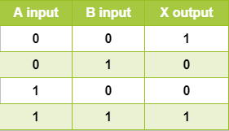
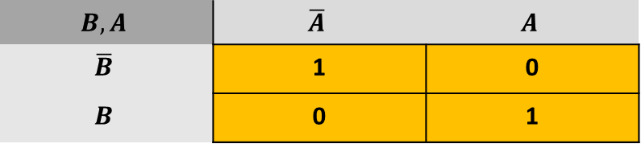
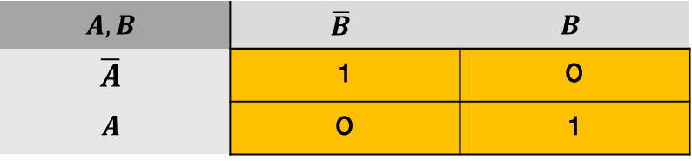
Logic Simplification – using Karnaugh K-Maps
2 Variable K-maps
$$A,B$$ | $$\overline{B}$$ | $$B$$
$$\overline{A}$$ | 1 | 0
$$A$$ | 0 | 1
$$X=\overline{A}\overline{B}+AB$$
$$B,A$$ | $$\overline{A}$$ | $$A$$
$$\overline{B}$$ | 1 | 0
$$B$$ | 0 | 1

Slide 18
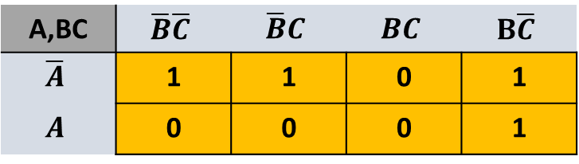
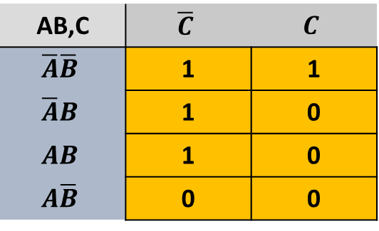
Three Variable K-Maps
AB,C | $$\overline{C}$$ | $$C$$
$$\overline{A}\overline{B}$$ | 1 | 1
$$\overline{A}B$$ | 1 | 0
$$AB$$ | 1 | 0
$$A\overline{B}$$ | 0 | 0
A input | B input | C input | X output
0 | 0 | 0 | 1
0 | 0 | 1 | 1
0 | 1 | 0 | 1
0 | 1 | 1 | 0
1 | 0 | 0 | 0
1 | 0 | 1 | 0
1 | 1 | 0 | 1
1 | 1 | 1 | 0
A,BC | $$\overline{B}\overline{C}$$ | $$\overline{B}C$$ | $$BC$$ | $$B\overline{C}$$
$$\overline{A}$$ | 1 | 1 | 0 | 1
$$A$$ | 0 | 0 | 0 | 1

Slide 19
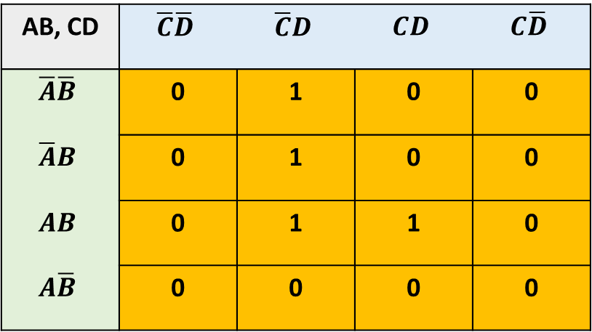
4 Variable K-Maps
A input | B input | C input | D input | X output
0 | 0 | 0 | 0 | 0
0 | 0 | 0 | 1 | 1
0 | 0 | 1 | 0 | 0
0 | 0 | 1 | 1 | 0
0 | 1 | 0 | 0 | 0
0 | 1 | 0 | 1 | 1
0 | 1 | 1 | 0 | 0
0 | 1 | 1 | 1 | 0
1 | 0 | 0 | 0 | 0
1 | 0 | 0 | 1 | 0
1 | 0 | 1 | 0 | 0
1 | 0 | 1 | 1 | 0
1 | 1 | 0 | 0 | 0
1 | 1 | 0 | 1 | 1
1 | 1 | 1 | 0 | 0
1 | 1 | 1 | 1 | 1
AB, CD | $$\overline{C}\overline{D}$$ | $$\overline{C}D$$ | $$CD$$ | $$C\overline{D}$$
$$\overline{A}\overline{B}$$ | 0 | 1 | 0 | 0
$$\overline{A}B$$ | 0 | 1 | 0 | 0
$$AB$$ | 0 | 1 | 1 | 0
$$A\overline{B}$$ | 0 | 0 | 0 | 0

Slide 20

Different orientation - 4 Variable K-Maps
A input | B input | C input | D input | X output
0 | 0 | 0 | 0 | 0
0 | 0 | 0 | 1 | 1
0 | 0 | 1 | 0 | 0
0 | 0 | 1 | 1 | 0
0 | 1 | 0 | 0 | 0
0 | 1 | 0 | 1 | 1
0 | 1 | 1 | 0 | 0
0 | 1 | 1 | 1 | 0
1 | 0 | 0 | 0 | 0
1 | 0 | 0 | 1 | 0
1 | 0 | 1 | 0 | 0
1 | 0 | 1 | 1 | 0
1 | 1 | 0 | 0 | 0
1 | 1 | 0 | 1 | 1
1 | 1 | 1 | 0 | 0
1 | 1 | 1 | 1 | 1
CD, AB | $$\overline{A}\overline{B}$$ | $$\overline{A}B$$ | $$AB$$ | $$A\overline{B}$$
$$\overline{C}\overline{D}$$ | 0 | 0 | 0 | 0
$$\overline{C}D$$ | 1 | 1 | 1 | 0
$$CD$$ | 0 | 0 | 1 | 0
$$C\overline{D}$$ | 0 | 0 | 0 | 0
20

Slide 21
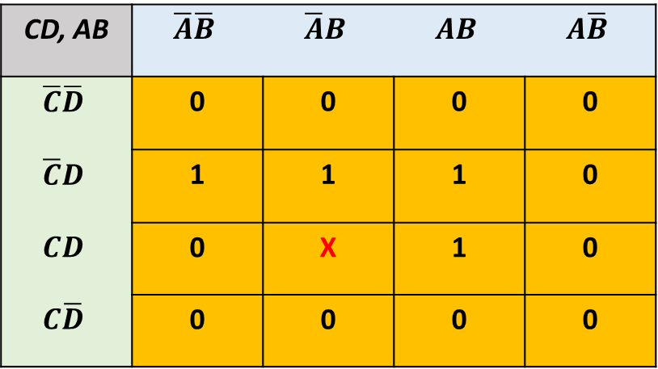
K-Maps with Don’t Care Literals
CD, AB | $$\overline{A}\overline{B}$$ | $$\overline{A}B$$ | $$AB$$ | $$A\overline{B}$$
$$\overline{C}\overline{D}$$ | 0 | 0 | 0 | 0
$$\overline{C}D$$ | 1 | 1 | 1 | 0
$$CD$$ | 0 | X | 1 | 0
$$C\overline{D}$$ | 0 | 0 | 0 | 0
A’C’D
BD

Slide 22
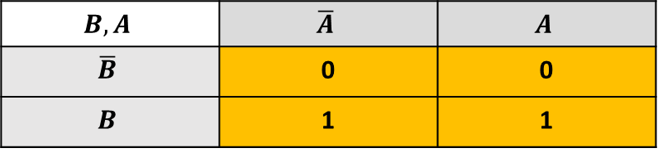
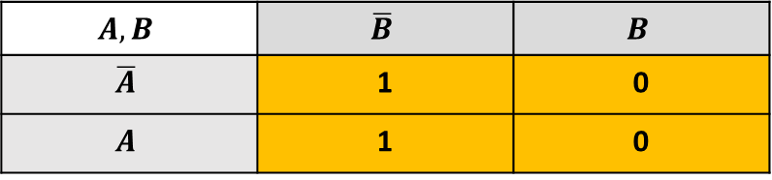
Logic Minimization – using Karnaugh K-Maps
Procedure:
Find biggest groups of adjacent ‘1’s
Edges can be folded
The literals that remain fixed in the group are written down
The literals that change, eg A to A’ are removed
All 1’s to be covered at least once
2 Variable K-maps
Example 1
$$A,B$$ | $$\overline{B}$$ | $$B$$
$$\overline{A}$$ | 1 | 0
$$A$$ | 1 | 0
A and A’ are literals that change, so removed
B’ remains common in the group
The minimized expression is B’
Example 2
$$B,A$$ | $$\overline{A}$$ | $$A$$
$$\overline{B}$$ | 0 | 0
$$B$$ | 1 | 1
A and A’ are literals that change, hence dropped
B remains common in the group, retained
The minimized expression is B
22

Slide 23
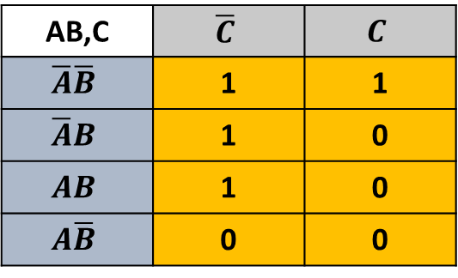
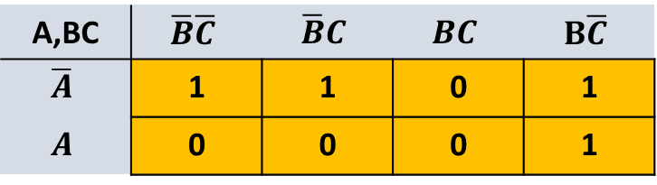
Logic Minimization – 3 variable K-Maps
Example 3-1
A,BC | $$\overline{B}\overline{C}$$ | $$\overline{B}C$$ | $$BC$$ | $$B\overline{C}$$
$$\overline{A}$$ | 1 | 1 | 0 | 1
$$A$$ | 0 | 0 | 0 | 1
AB,C | $$\overline{C}$$ | $$C$$
$$\overline{A}\overline{B}$$ | 1 | 1
$$\overline{A}B$$ | 1 | 0
$$AB$$ | 1 | 0
$$A\overline{B}$$ | 0 | 0
Example 3-2
Three groups containing two 1’s each are identified
One group A’B’C’ and A’BC’ is redundant and can be
Left out
C and C’ can be removed to give A’B’ as one expression
And A and A’ can be removed to give BC’ as the other
Final Minterms expression is A’B’ + BC’
The 1 at A’BC’ is covered in two groups, only one is sufficient
So minimization will be on two non-redundant groups
Minimized Expression is A’B’ (where C and C’ are removed)
And BC’ (where A and A’ are removed).
Hence Answer is A’B’ + BC’ (in the form of Minterms)
23

Slide 24
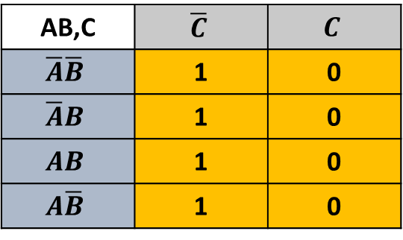
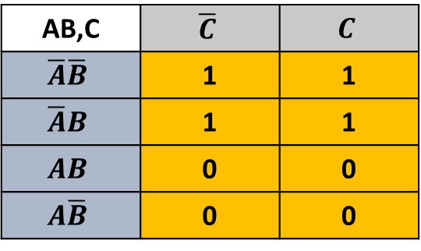
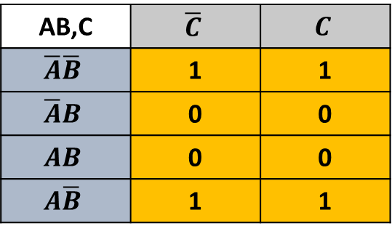
More Examples – 3 variable K-Maps
Example 3-3
Example 3-4
Example 3-5
AB,C | $$\overline{C}$$ | $$C$$
$$\overline{A}\overline{B}$$ | 1 | 1
$$\overline{A}B$$ | 1 | 1
$$AB$$ | 0 | 0
$$A\overline{B}$$ | 0 | 0
AB,C | $$\overline{C}$$ | $$C$$
$$\overline{A}\overline{B}$$ | 1 | 0
$$\overline{A}B$$ | 1 | 0
$$AB$$ | 1 | 0
$$A\overline{B}$$ | 1 | 0
AB,C | $$\overline{C}$$ | $$C$$
$$\overline{A}\overline{B}$$ | 1 | 1
$$\overline{A}B$$ | 0 | 0
$$AB$$ | 0 | 0
$$A\overline{B}$$ | 1 | 1
Group of 4 1’s
C’ and B’ change and can be removed
The answer is only A’
Another group of 4 1’s
A and A’ can be removed
B and B’ can be removed
The answer is only C’
Another group of 4 1’s with folded edges
A and A’ change so can be removed
C and C’ change so can be removed
The answer is only B’

Slide 25
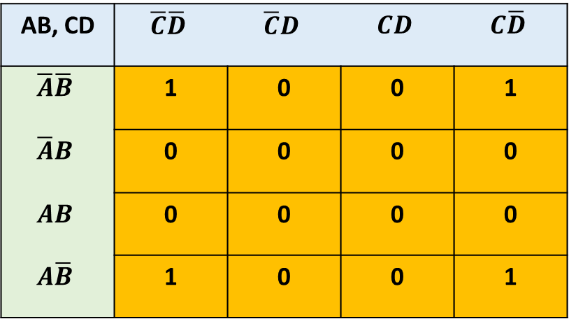
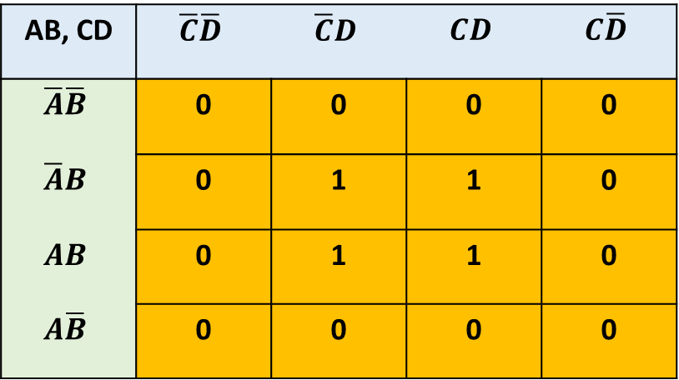
Logic Minimization – 4 Variable K-maps
Example 4-1
Example 4-2
AB, CD | $$\overline{C}\overline{D}$$ | $$\overline{C}D$$ | $$CD$$ | $$C\overline{D}$$
$$\overline{A}\overline{B}$$ | 0 | 0 | 0 | 0
$$\overline{A}B$$ | 0 | 1 | 1 | 0
$$AB$$ | 0 | 1 | 1 | 0
$$A\overline{B}$$ | 0 | 0 | 0 | 0
AB, CD | $$\overline{C}\overline{D}$$ | $$\overline{C}D$$ | $$CD$$ | $$C\overline{D}$$
$$\overline{A}\overline{B}$$ | 1 | 0 | 0 | 1
$$\overline{A}B$$ | 0 | 0 | 0 | 0
$$AB$$ | 0 | 0 | 0 | 0
$$A\overline{B}$$ | 1 | 0 | 0 | 1
Group of 4 1’s
A’ changes along vertical axis
C’ changes along horizontal axis
Answer is remaining terms = BD
Group of 4 1’s with folded edges
C and C’ change along horizontal axis
A and A’ change along vertical axis
Answer is terms that do not change = B’D’

Slide 26


Logic Minimization – 4 Variable K-maps
Example 4-3
Example 4-4
AB, CD | $$\overline{C}\overline{D}$$ | $$\overline{C}D$$ | $$CD$$ | $$C\overline{D}$$
$$\overline{A}\overline{B}$$ | 0 | 0 | 0 | 0
$$\overline{A}B$$ | 1 | 1 | 1 | 1
$$AB$$ | 1 | 1 | 1 | 1
$$A\overline{B}$$ | 0 | 0 | 0 | 0
AB, CD | $$\overline{C}\overline{D}$$ | $$\overline{C}D$$ | $$CD$$ | $$C\overline{D}$$
$$\overline{A}\overline{B}$$ | 1 | 0 | 0 | 1
$$\overline{A}B$$ | 1 | 0 | 0 | 1
$$AB$$ | 1 | 0 | 0 | 1
$$A\overline{B}$$ | 1 | 0 | 0 | 1
Group of 8 1’s
A and A’ change in vertical axis
All variables change in horizontal axis
Answer = B
Group of 8 1’s
Folded along horizontal edges for biggest group
All variables change along vertical axis
C and C’ change along horizontal axis
Answer = D’

Slide 27
K-Maps for 5 variables ??
Starts to look complicated for manual working
For any function X=f{A,B,C,D,E}
Visualize two 4 input truth tables for {B,C,D,E},
First truth table is when A=0, second is when A=1
K-map for {B,C,D,E}
When A=0
A can be eliminated if is common for any
Literal in both K-maps
K-map for {B,C,D,E}
When A=1

Slide 28
K-Maps for 6 or more variables
Generally computer programs are used to model multivariable K-Maps through multidimensional arrays
Conceptually, we can continue to extend 4-variable K-Maps
Eg for X=f{A,B,C,D,E,F}:
Consider there are four K-Maps of 4 variables {C,D,E,F}
There is one dedicated K-Map each for AB=00, AB=01, AB=10 and AB=11
After simplification in K-Maps, further simplification is done through Boolean Algebra
K-map for {C,D,E,F}
K-map for {C,D,E,F}
K-map for {C,D,E,F}
K-map for {C,D,E,F}
K-map for {C,D,E,F}
When AB=00
When AB=01
When AB=10
When AB=11

Slide 29
Key Takeaways
Truth Table and Boolean Algebra are some ways to describe behaviour of digital system
Techniques like K-Map allows simplification of mapping between behaviour and actual physical gate level circuits
We need logic mapping techniques called ‘Synthesis’ to come up with efficient mapping (in terms of area, power, speed)
K-Maps only work for 4 or 5 input variables. Some other methods are needed beyond 5 or 6 variables.

Slide 30
Higher level Logic Minimization
Quine McCluskey Tabular Method is a famous algorithm that is used in many computer programs
Logic Minimizer https://www.logicminimizer.com/ (up to 8 variables, tabular method)
QMC Logic Minimizer https://sourceforge.net/projects/qmclm/ (up to 16 variables, based on QM)
Logic Friday https://logic-friday.software.informer.com/ (up to 16 variables, based on Espresso)
Mini Log https://softwiki.net/Logic_Minimizer.html (up to 40 variables, based on Espresso)
Espresso uses Graph theory and Cubes
https://ptolemy.berkeley.edu/projects/embedded/pubs/downloads/espresso/index.htm
An overview document by digilent https://learn.digilentinc.com/Documents/412
WinLogiLab program can minimize using both QM and Espresso algorithms
All this leads to:
LOGIC SYNTHESIS Synopsys, Cadence (discuss further in labs)
This is built into modern design automation tools for digital design and implementation on FPGA and ASIC
UC Berkeley is considered as the source of many simulation and synthesis tools, Eg SPICE, ESPRESSO and others

Slide 31
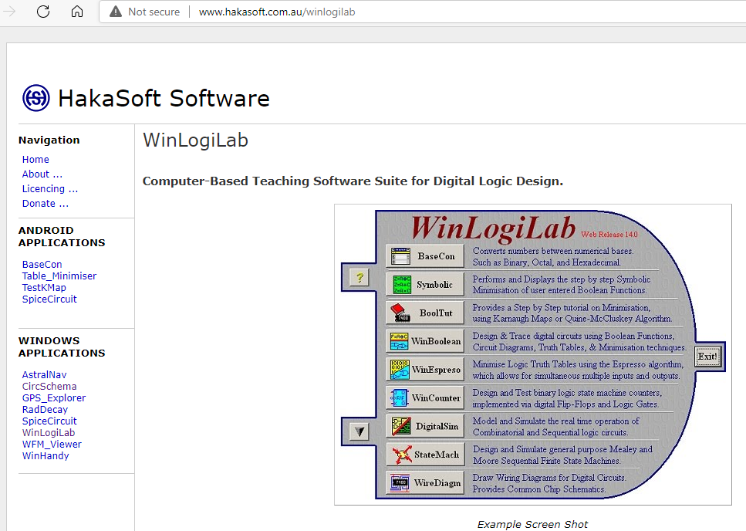

Slide 32
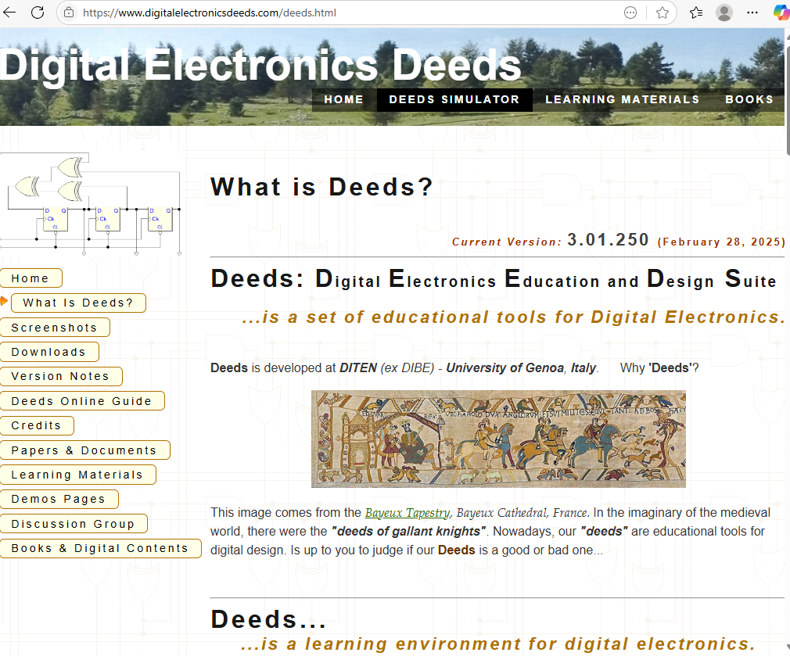
DEEDS DCS
https://www.digitalelectronicsdeeds.com
https://www.digitalelectronicsdeeds.com/deeds.html
https://www.digitalelectronicsdeeds.com/learningmaterials/labtopics.html
https://www.digitalelectronicsdeeds.com/docs/IEDEC_2013_PPT.pdf
https://www.digitalelectronicsdeeds.com/demos/demopage_fsm.html

