Slide 1
An Introduction to
Digital System Design using SystemVerilog and FPGA
Lecture 1, Fall 2026
Digital System Design EE 421 / CS 425
Shahid Masud

Slide 2

Important Goals of this Course
Design Complex and High-Speed Digital Systems
Understand Timing Problems in Complex High-Speed Digital Design
Analyze and Synthesize Complex Digital Systems (combinational and sequential)
Learn some techniques to develop High-Speed Complex Digital Systems using modern tools (Modelsim, Questa, Xilinx) and modern implementation platforms (FPGA)
Introducing SystemVerilog and Verification
LABS
NEW
Questa

Slide 3

I want to design my own hi-tech product!
Previous Courses
Custom PCB Design | Microcontroller/ PLC Based Design | FPGA Programmable Logic Design | ASIC full custom Chip design
Small scale, sub-system level, glue logic, limited functionality as per available chips, specialized skill for PCB design at high-speeds. | Functionality can be upgraded through software, flexible but slow speed. More peripherals can be added or removed. | Faster than microcontroller. Flexible but requires high-level HDL and EDA tools knowledge. Quick design and prototyping. | Very fast and high performance. Design and fabrication time is significant. Produced in large numbers. Rigid functionality. HDL and EDA tools needed.

Slide 4
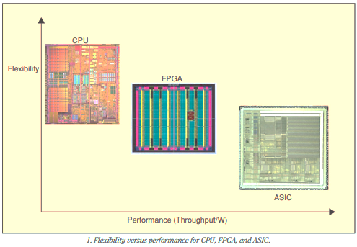
Implementation Platforms
Ref: IEEE Circuits and Devices Magazine, May 2006

Slide 5
Examples of Custom Digital Systems
Special purpose circuits and chips

Slide 6
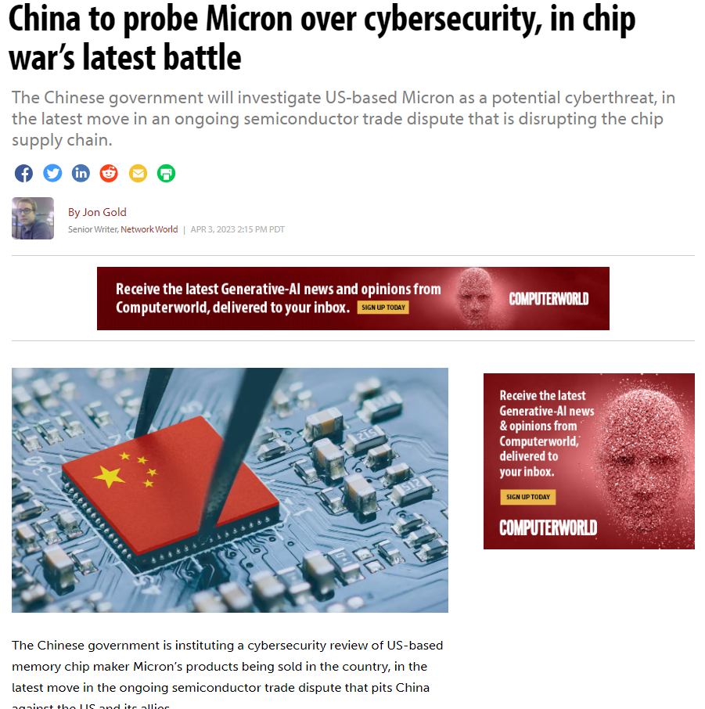
Cybersecurity and Chips

Slide 7
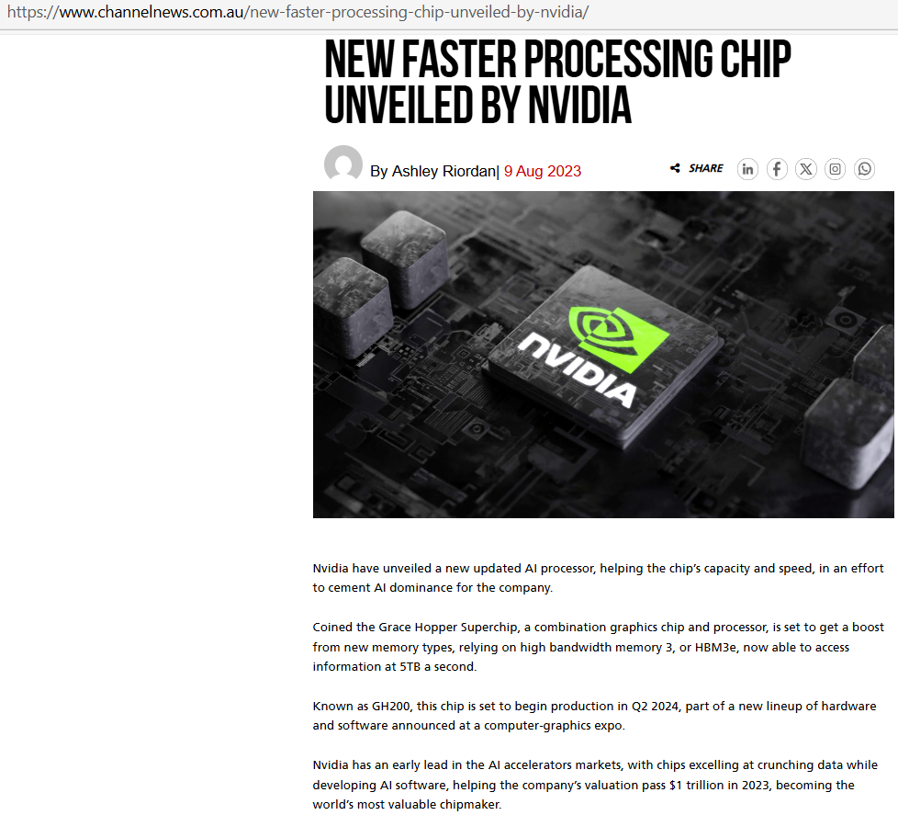

Slide 8
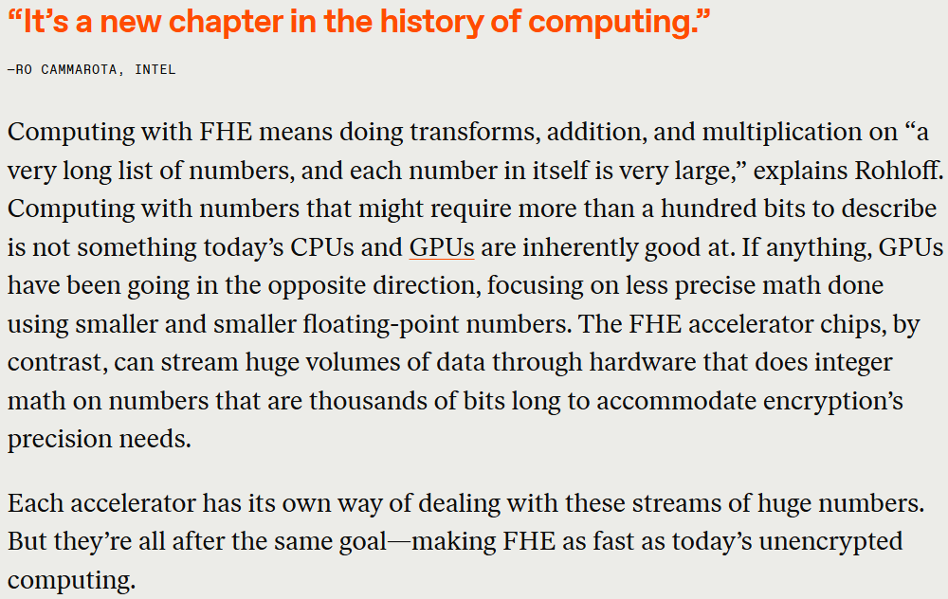


Slide 9
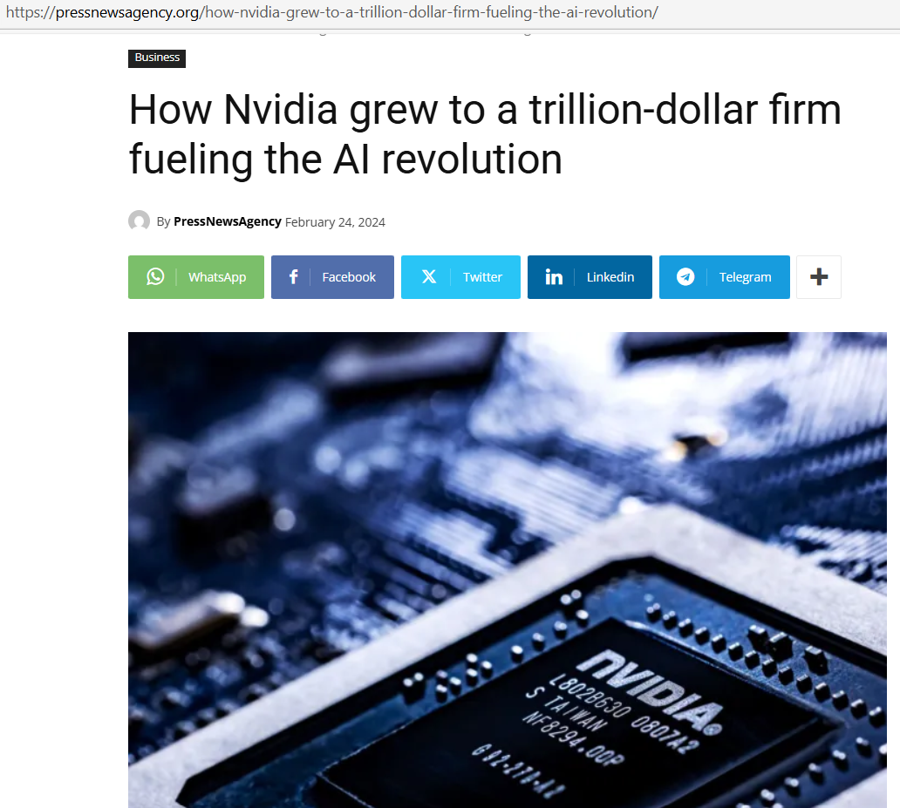
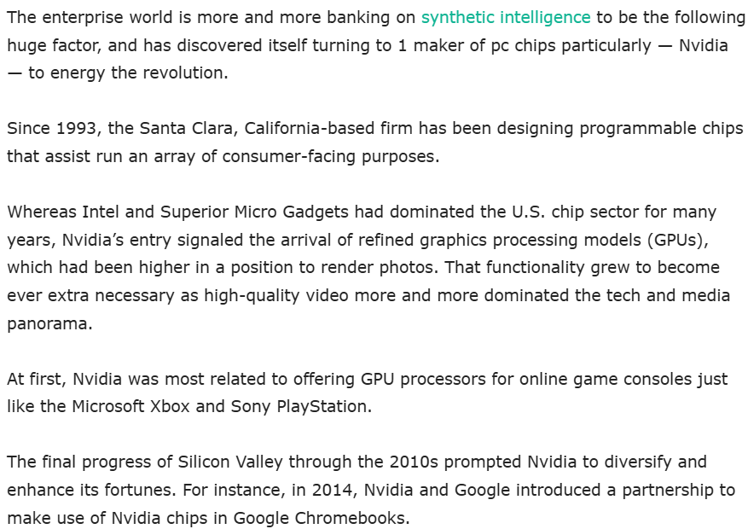
NVIDIA Chips

Slide 10
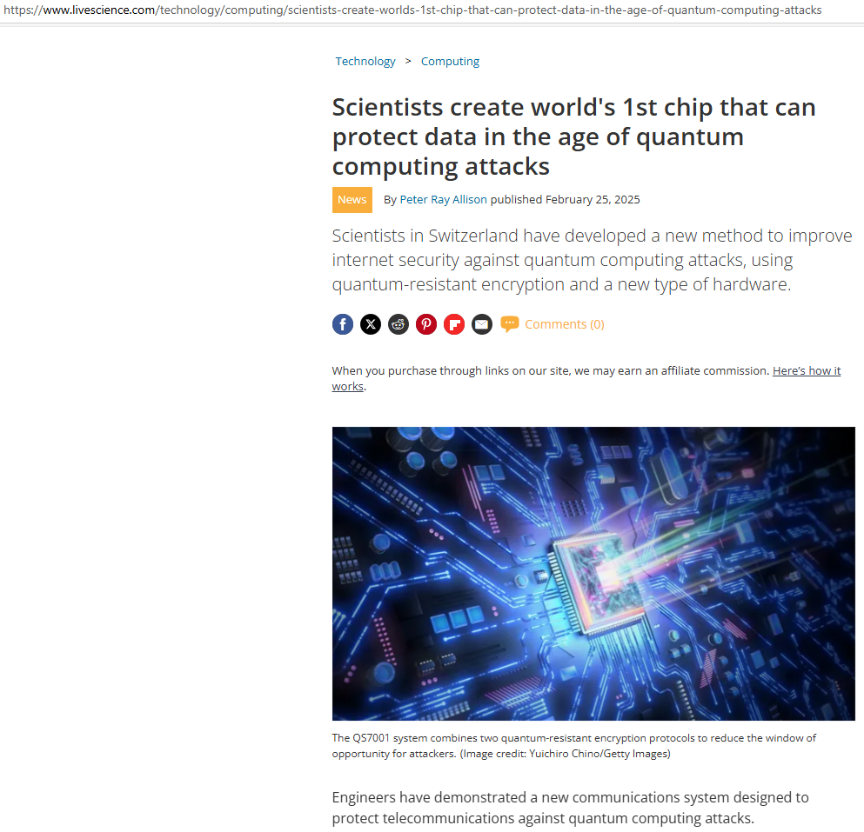

Slide 11
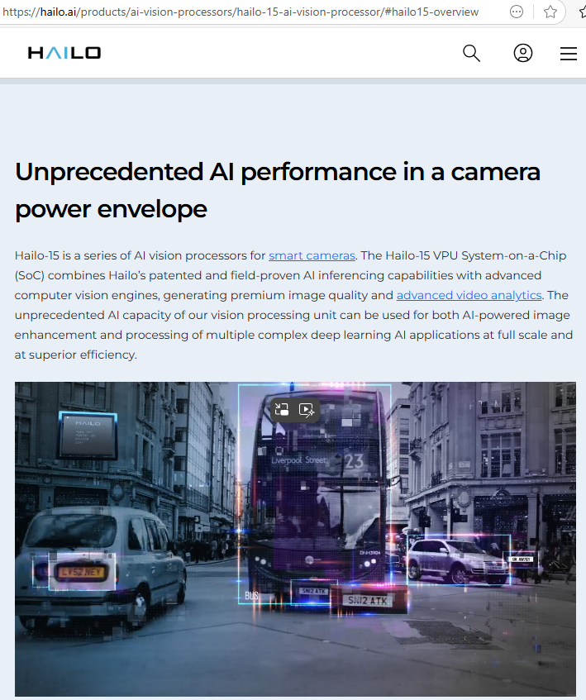

Slide 12
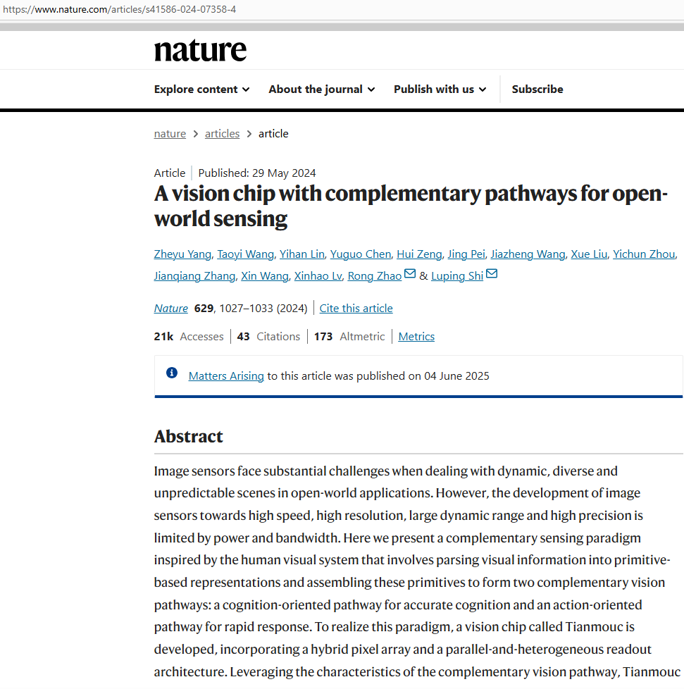

Slide 13
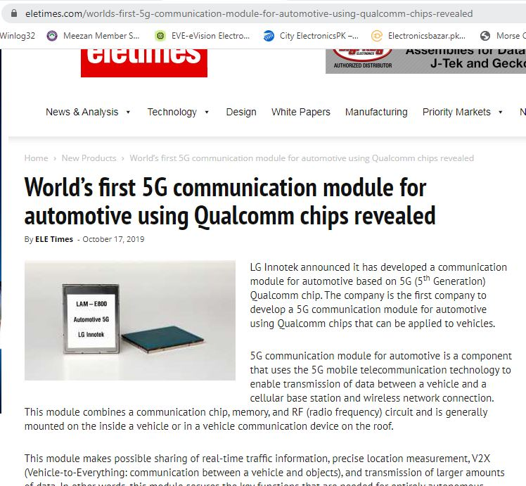
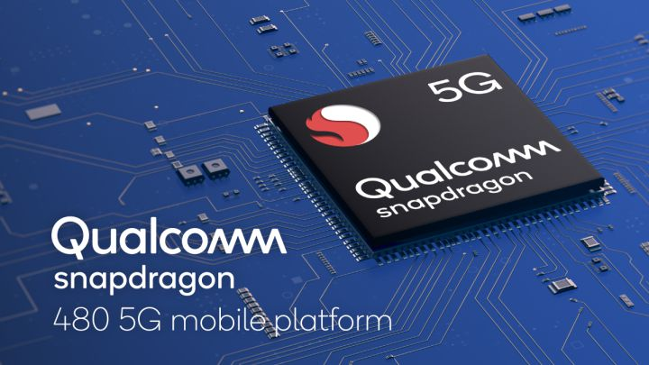
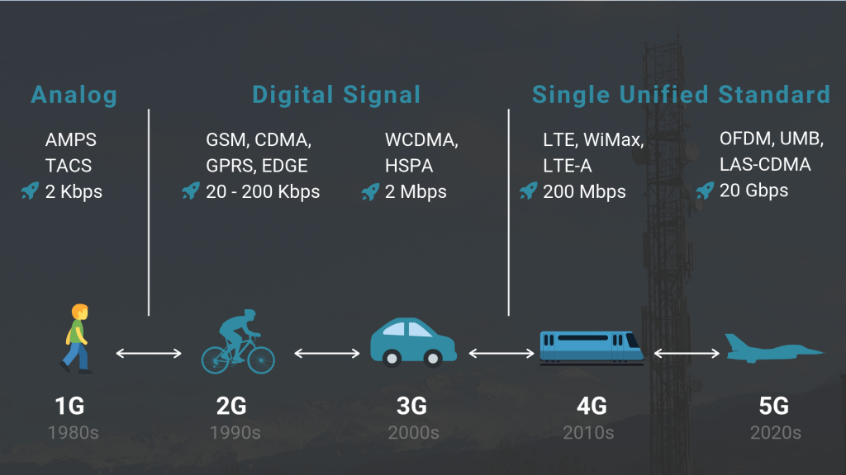

Slide 14
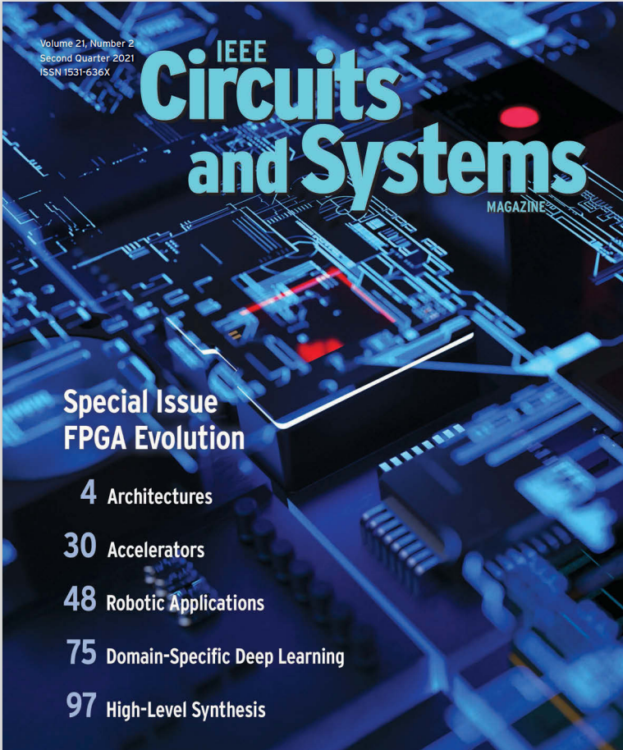
IEEE Circuits and Systems Magazine – Special Issue on FPGA - 2021
FPGA is an Implementation Platform
To facilitate:
Rapid Design
Prototyping New Products
Design Re-Use
Easier Testing and Verification
Predictable Performance
…. Any many other useful features

Slide 15
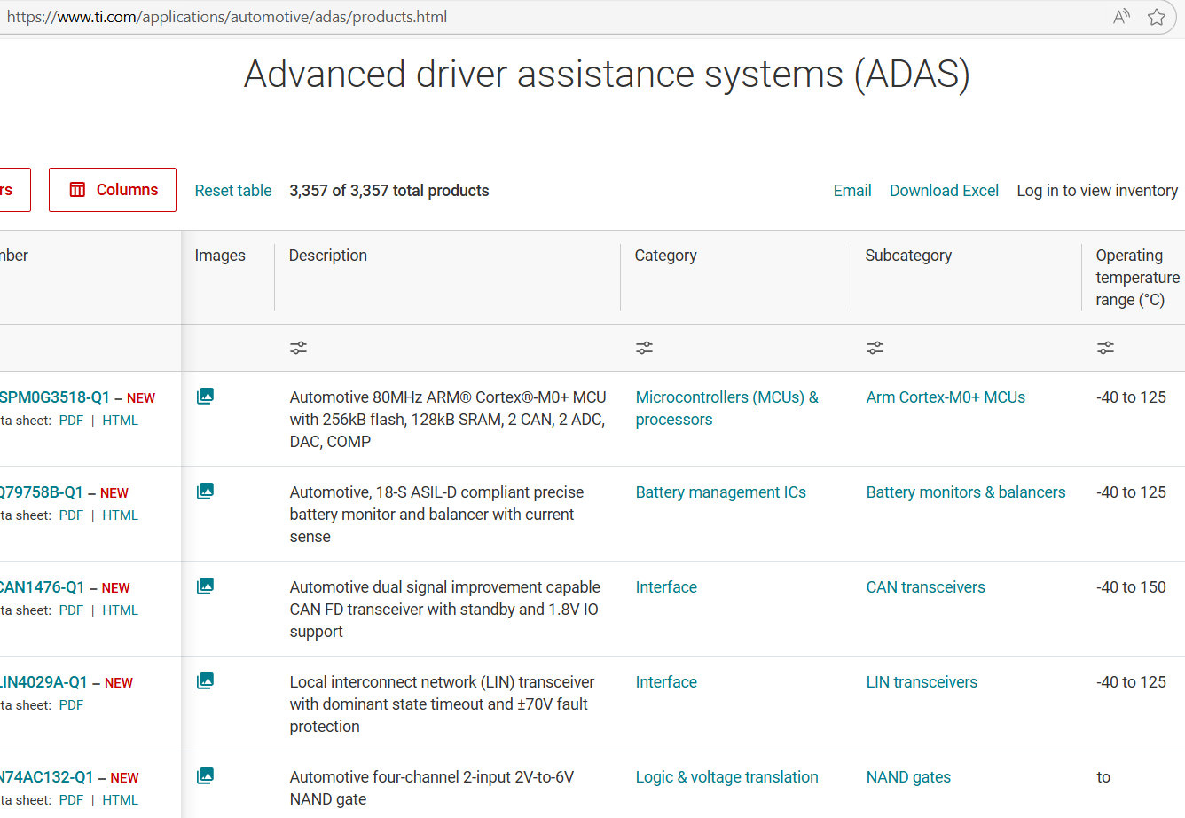
TI Chips

Slide 16
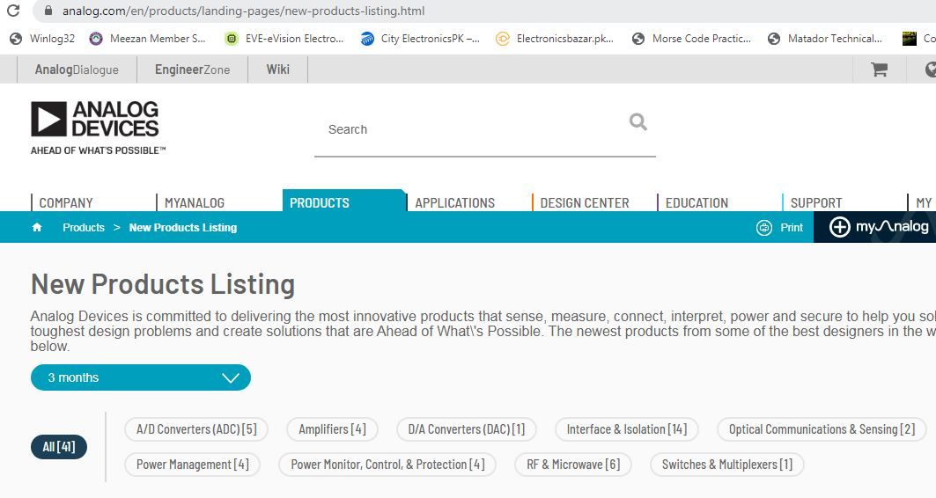

Slide 17
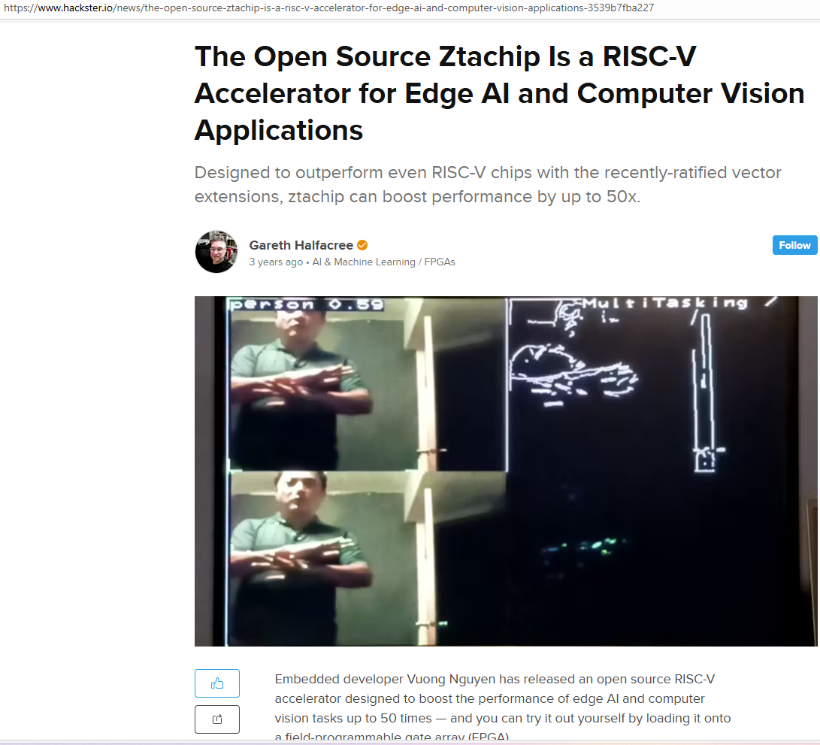

Slide 18
Examples of FPGA Based Custom Digital Systems
Using FPGA as an Implementation Platform for Complex Digital Circuits

Slide 19
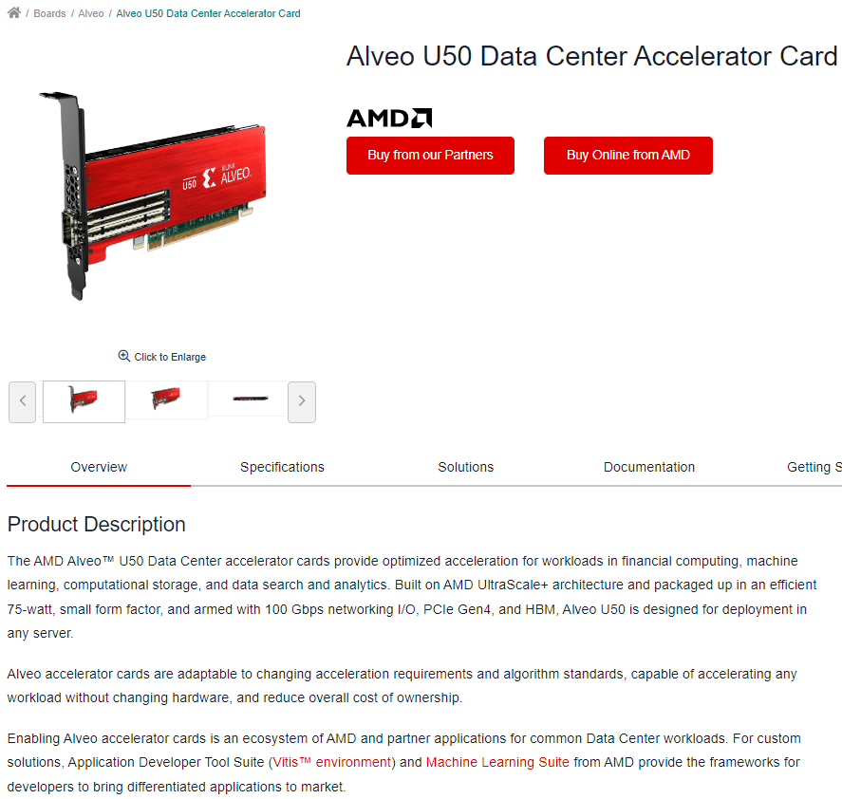
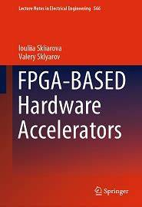
Big Data
Hardware
Accelerator

Slide 20
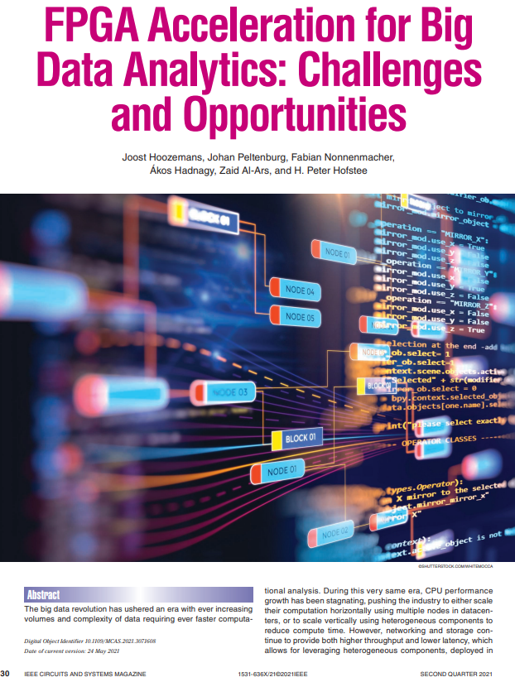

FPGA in Big Data

Slide 21
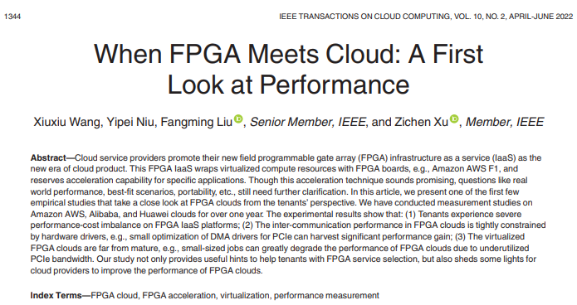
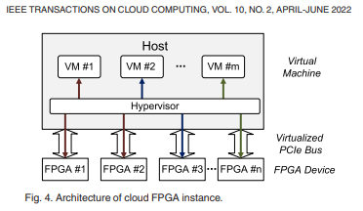
FPGA and the Cloud
FPGA Tools on Amazon Web Services AWS

Slide 22
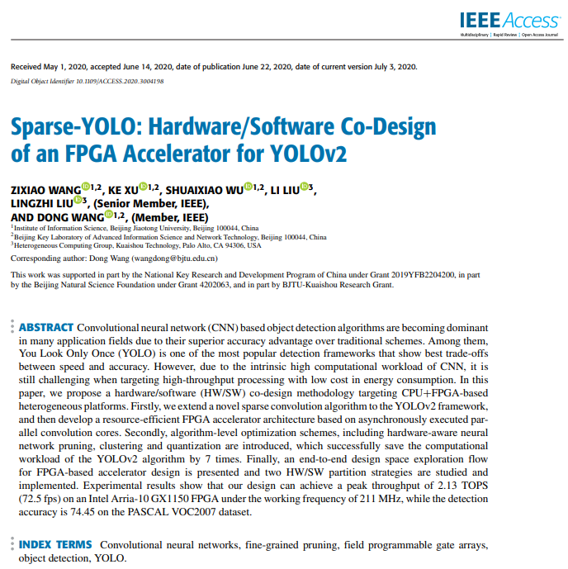
FPGA in CNN – YOLO Example

Slide 23
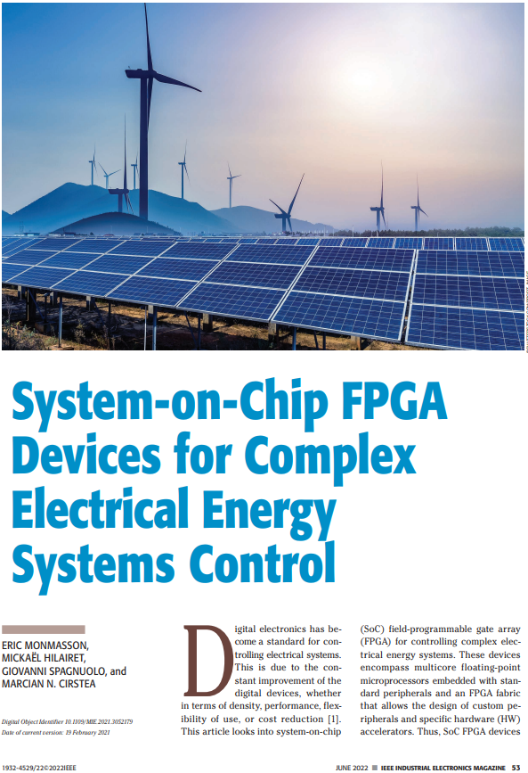
FPGA in Electrical Systems

Slide 24
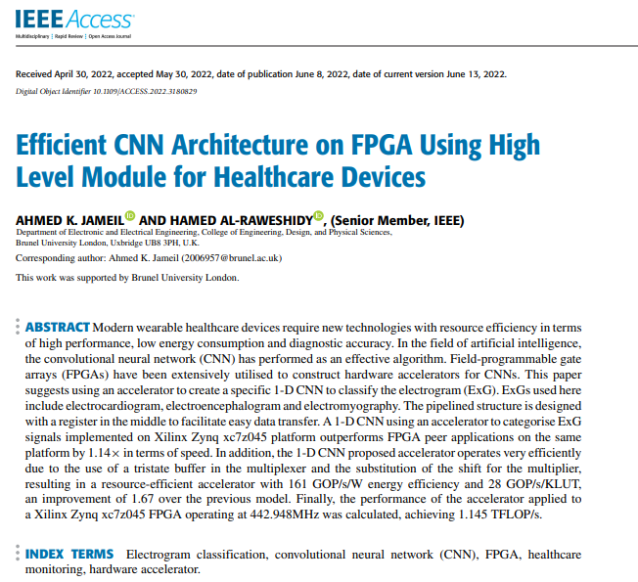
FPGA in Biomedical

Slide 25
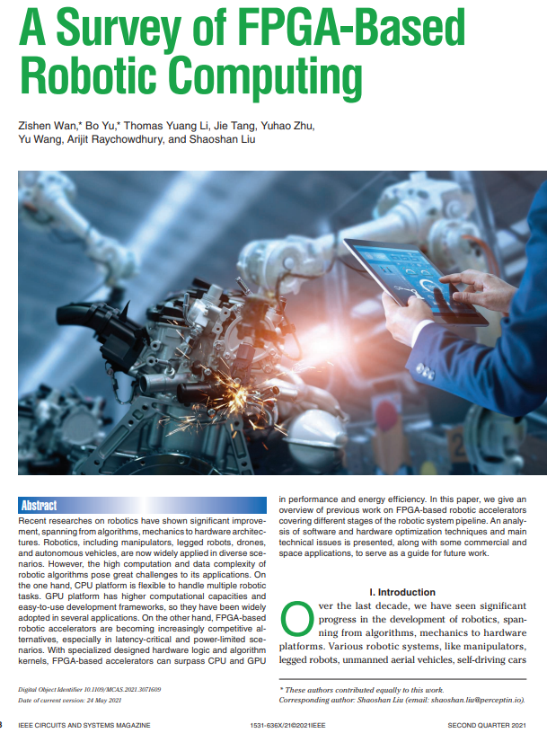
FPGA in Robotics

Slide 26
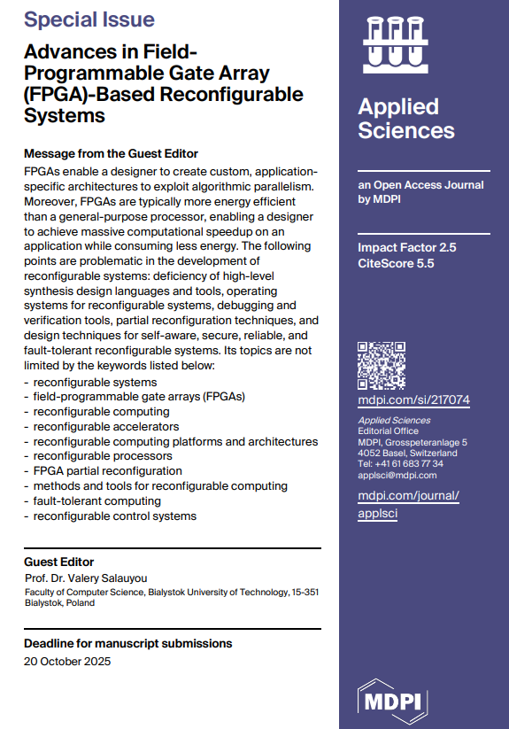

Slide 27
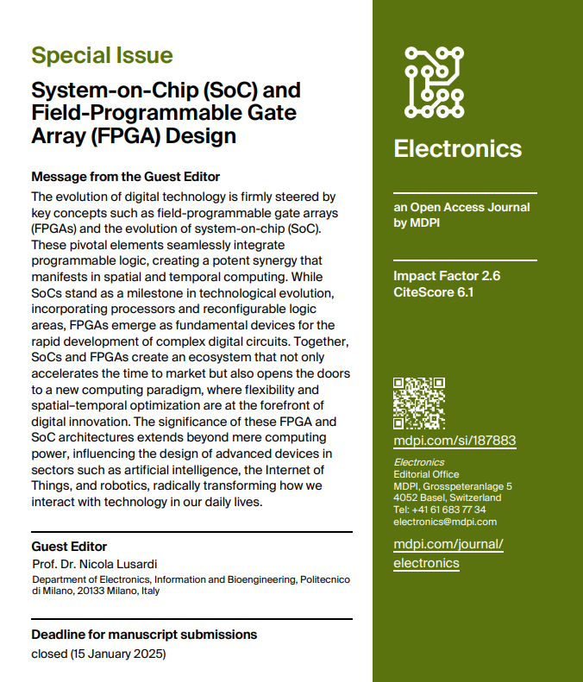

Slide 28
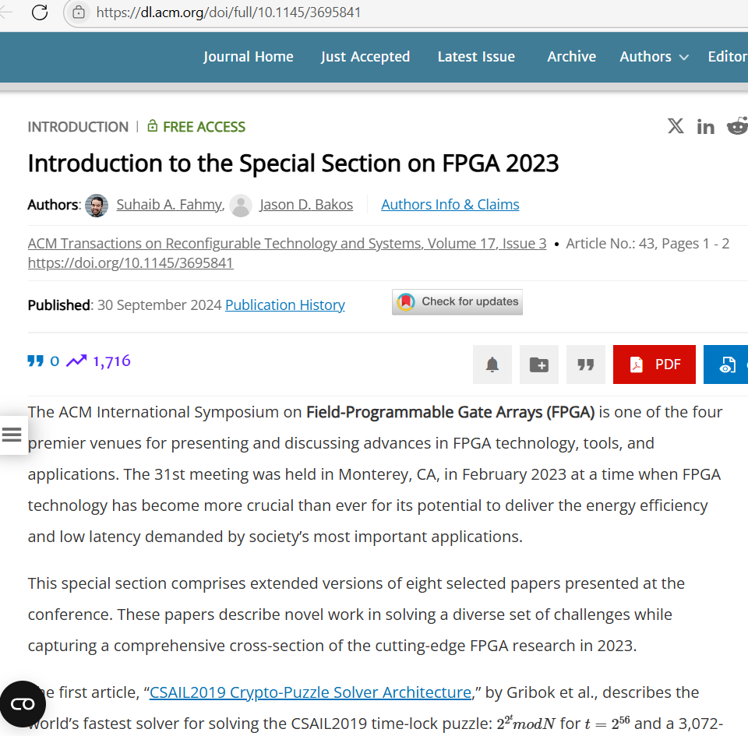
The CS community for FPGA

Slide 29
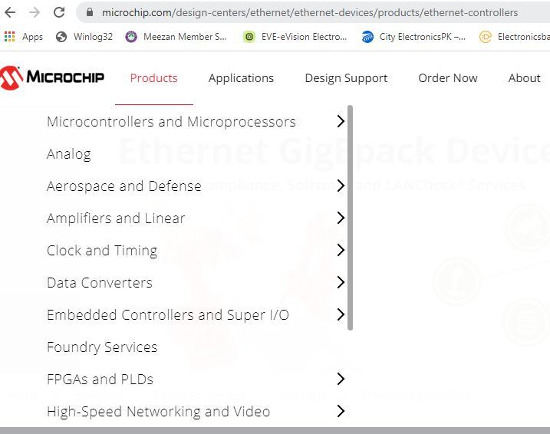

Slide 30
Digital System Design for Everyone!!
Scale of Digital Systems
Logic Gates
Decoders, Mux,
Glue Logic
VGA Controller,
DMA, Interfacing,
Microcontrollers and
Microprocessors
Multicore Processors,
DSP Chips, VR Chips
ASIC – Application
Specific Integrated
Circuits
FPGA – Field
Programmable Gate
Arrays
Small Scale Integration
Medium Scale Integration
VLSI – Very Large-Scale Integration
Large Scale Integration
CMOS
Nano-technology (6nm feature size)
Reconfigurable Hardware

Slide 31

Handling the Complexity –
Design Abstraction
High level abstraction
-details of behaviour
Different hierarchy levels to describe digital systems:
Application Software System
Operating System hardware drivers
Computer Organization and Architecture
Microarchitecture of CPU
Digital System behavior
Logic Gates and Circuits
Discrete Components
Semiconductor Devices
Physics and Nano Technology
Top – Down
Approach
Synthesis
Bottom - Up
Approach
Low level abstraction
-more circuit details
Abstraction – Define circuit behaviour in English language

Slide 32
The HDL ↔ EDA ↔ FPGA connection
Idea
Design Specifications in schematics, behavior, pseudo-code, text
HDL to capture the idea and describe the design, both combinational and sequential
EDA = Electronic Design Automation
CAD = Computer Aided Design
EDA – Simulate the design written in HDL (Verilog or VHDL languages)
EDA – Synthesis tools that map HDL code to physical logic gates
Rapid Prototyping ?
FPGA Chips – Reconfigurable hardware platform implementation of synthesis results
Rapid Prototoyping of
Complete projects

Slide 33
Conclusion
Digital Systems are Ubiquitous
Important Aspects of Digital Systems
  Design Capture, Complexity management
  Simulation
  Synthesis on Different Platforms
Implementation Technologies
Performance matrix – area, speed, power
Modern Design Considerations
Area
Area of
Triangle
Time
Power

Slide 34
Course Outline and Grading

