Slide 1
Lecture 16
EE 421 / CS 425
Digital System Design
Fall 2026
Shahid Masud

Slide 2
Topics
Examples: Online tools for Binary Multiplication
Binary Divider Operation
Binary Divider Circuit
STG of Divider
------------------------ ------ ----
Floating Point Representation and Conversion
Floating Point Multiplier – design and operation
Floating Point Adder
Midterm
Next Lecture

Slide 3
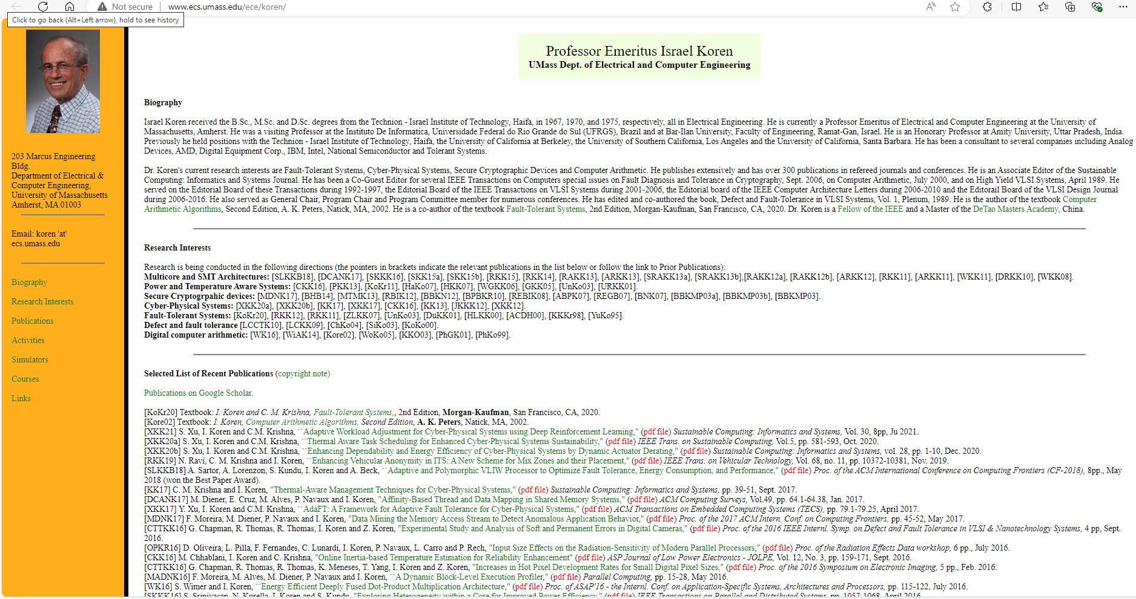
Online Booth Encoding Simulator
http://www.ecs.umass.edu/ece/koren/arith/simulator/Booth/
Prof. Korean Page:
http://www.ecs.umass.edu/ece/koren/
Simulators Tab is on the left
Many simulators of Computer Arithmetic are available:
http://www.ecs.umass.edu/ece/koren/arith/simulator/

Slide 4
Online Modified Booth (Radix 4) Encoding
http://www.ecs.umass.edu/ece/koren/arith/simulator/ModBooth/
Simulator available on Prof Koren’s website

Slide 5
Delay computation in binary array multiplier
Previous topic:
Delay computation in Array Multiplier (binary inputs):
http://www.ecs.umass.edu/ece/koren/arith/simulator/ArrMlt/

Slide 6
Radix 4 Coding for Multiplication
m_{i+1} | m_{i} | m_{i-1} | Code | Multiply Actions
0 | 0 | 0 | 0 | Shift Left by 2
0 | 0 | 1 | 1 | Add Multiplicand, Shift Left by 2
0 | 1 | 0 | 2 | Add Multiplicand, Shift Left by 2
0 | 1 | 1 | 3 | Shift by 1, Add Multiplicand, Shift by 1
1 | 0 | 0 | 4 | Shift by 1, Subtract Multiplicand, Shift by 1
1 | 0 | 1 | 5 | Subtract Multiplicand, Shift Left by 2
1 | 1 | 0 | 6 | Subtract Multiplicand, Shift Left by 2
1 | 1 | 1 | 7 | Shift Left by 2

Slide 7
STG for a 4 Bit Radix 4 Encoded
Sequential 8-bit Multiplier
~Reset/Ready
Reset
S_
idle
Start/Load_word, Ready
S17
Start /Load_word, Ready
S1
3,4/Sh_1
/Sh_1
S16
m_{i+1} | m_{i} | m_{i-1} | Code | Multiply Actions
0 | 0 | 0 | 0 | Shift Left by 2
0 | 0 | 1 | 1 | Add, Shift Left by 2
0 | 1 | 0 | 2 | Add, Shift Left by 2
0 | 1 | 1 | 3 | Shift by 1, Add, Shift by 1
1 | 0 | 0 | 4 | Shift by 1, Subtract, Shift by 1
1 | 0 | 1 | 5 | Subtract, Shift Left by 2
1 | 1 | 0 | 6 | Subtract, Shift Left by 2
1 | 1 | 1 | 7 | Shift Left by 2
2,1/Add
5,6/Sub
S3
/Sh_2
S14
0,7/Sh_2
-01/Add
-10/Sub
0,7/Sh_2
S2
/Add,Sub
5,6/Sub
2,1/Add
S15
/Sh_2
S4
0,7/Sh_2
S13
0,7/Sh_2
S5
4,3/Sh_1
S9
/Sh_1
5,6/Sub
2,1/Add
5,6/Sub
2,1/Add
/Sh_2
/Sh_2
S10
S6
/Sh_1
4,3/Sh_1
4,3/Sh_1
/Sh_1
S12
-01/Add
-10/Sub
S11
S8
-01/Add
-10/Sub
S7

Slide 8
Data Path Architecture of a Radix 4 Sequential Multiplier
Word1
Word2
Controller
Load_word
Datapath
Start
Shift 1
Shift 2
Add
Sub
Clk
Reset
Ready
Product

Slide 9
Radix 4 Multiplication – Example 3
Imagine Zero
Show Radix 4 Encoded multiplication of 76 x 55, using 8 bits for both numbers
55 = 0 0 1 1 0 1 1 1
[0]
76 = 0100 1100
And 2’s Compl is
-76= 1011 0100
55 = 0011 0111
And 2’s Compl is
-55= 1100 1001
RECODED
110 → 0-1
011 → 10
110 → 0-1
001 → 01
Convert 55 = 0011 0111to Radix 4 Encoded bits
76 = Multiplicand
 |  |  |  |  |  |  |  |  | 0 | 1 | 0 | 0 | 1 | 1 | 0 | 0
 |  |  |  |  |  |  |  |  | 0 | 1 | 0 | -1 | 1 | 0 | 0 | -1
1 | 1 | 1 | 1 | 1 | 1 | 1 | 1 | 1 | 1 | 0 | 1 | 1 | 0 | 1 | 0 | 0
0 | 0 | 0 | 0 | 0 | 0 | 0 | 1 | 0 | 0 | 1 | 1 | 0 | 0 | X | X | X
0 | 0 | 0 | 0 | 0 | 0 | 0 | 1 | 0 | 0 | 0 | 0 | 1 | 0 | 1 | 0 | 0
1 | 1 | 1 | 1 | 1 | 1 | 0 | 1 | 1 | 0 | 1 | 0 | 0 | X | X | X | X
1 | 1 | 1 | 1 | 1 | 1 | 1 | 0 | 1 | 0 | 1 | 0 | 1 | 0 | 1 | 0 | 0
0 | 0 | 0 | 0 | 1 | 0 | 0 | 1 | 1 | 0 | 0 | X | X | X | X | X | X
0 | 0 | 0 | 0 | 1 | 0 | 0 | 0 | 0 | 0 | 1 | 0 | 1 | 0 | 1 | 0 | 0
X 55 = Recoded Multiplier
0 -1 = Sub, Shl2
1 0 = Shl1,Add, Shl1
Partial Sum
0 -1 = Sub, Shl2
Partial Sum
0 1 = Add, Shl2
Result
Answer = 0001 0000 0101 0100 = (4+16+64+4096) = (4180)₁₀

Slide 10
Division Operation in Hardware

Slide 11
Division Operation in Decimal Numbers
Division of 274 ÷ 13
Quotient
 |  |  | 2 | 1
1 | 3 | 2 | 7 | 4
 | - | -2 | 6
 |  |  | 1 | 4
 |  | - | 1 | 3
 |  |  |  | 1 | Rem
Divisor
Dividend
Remainder

Slide 12
Division Operation in Decimal Numbers
Division of 299 ÷ 15
Quotient
 |  |  | 1 | 9
1 | 5 | 2 | 9 | 9
 | - | 2 | 8 | 5
 |  |  | 1 | 4 | Rem
Divisor
Dividend
Remainder

Slide 13
Decimal Division – another example
 |  | 1 | 0 | 0 | 4
 | 8 | 8 | 0 | 3 | 5
 | - | 8
 |  | 0 | 0 | 3 | 5
 |  | - |  | 3 | 2
 |  |  |  |  | 3
Quotient
Divisor
Dividend
Remainder

Slide 14
Division Operation in Binary – Example 1
Remainder
Quotient
Division of 274 ÷ 13
Divisor
 |  |  |  |  | 1 | 0 | 1 | 0 | 1
1 | 1 | 0 | 1 | 1 | 0 | 0 | 0 | 1 | 0 | 0 | 1 | 0
 |  |  | - | 0 | 1 | 1 | 0 | 1
 |  |  |  |  |  | 1 | 0 | 0 | 0 | 0
 |  |  |  |  | - |  | 1 | 1 | 0 | 1
 |  |  |  |  |  | 0 | 0 | 0 | 1 | 1 | 1 | 0
 |  |  |  |  |  |  | - |  | 1 | 1 | 0 | 1
 |  |  |  |  |  |  |  |  | 0 | 0 | 0 | 1 | Re
 |  |  | 2 | 1
1 | 3 | 2 | 7 | 4
 | - | -2 | 6
 |  |  | 1 | 4
 |  | - | 1 | 3
 |  |  |  | 1 | Rem
Dividend
Remainder

Slide 15
Division Operation in Binary – Example 2
Quotient
Division of 299 ÷ 15
Divisor
 |  |  |  |  | 1 | 0 | 0 | 1 | 1
1 | 1 | 1 | 1 | 1 | 0 | 0 | 1 | 0 | 1 | 0 | 1 | 1
 |  |  | - |  | 1 | 1 | 1 | 1
 |  |  |  |  | 0 | 0 | 1 | 1 | 1 | 0 | 1
 |  |  |  |  | - | 0 | 0 | 1 | 1 | 1 | 1
 |  |  |  |  |  | 0 | 0 | 1 | 1 | 1 | 0 | 1
 |  |  |  |  |  |  | - |  | 1 | 1 | 1 | 1
 |  |  |  |  |  |  |  |  | 1 | 1 | 1 | 0 | Re
Dividend
 |  |  | 1 | 9
1 | 5 | 2 | 9 | 9
 | - | 2 | 8 | 5
 |  |  | 1 | 4 | Rem
Remainder

Slide 16
Division Operation in Binary – Example 3
 |  |  |  |  |  | 1 | 1 | 0 | 1
1 | 0 | 1 | 1 | 1 | 0 | 0 | 1 | 0 | 0 | 1 | 1
 |  |  | - |  | 1 | 0 | 1 | 1
 |  |  |  |  | 0 | 1 | 1 | 1 | 0
 |  |  | - |  |  | 1 | 0 | 1 | 1
 |  |  |  |  |  | 0 | 0 | 1 | 1 | 1 | 1
 |  |  |  |  | - |  |  | 1 | 0 | 1 | 1
 |  |  |  |  |  |  |  | 0 | 1 | 0 | 0 | Re
Quotient
Divisor
Dividend
Remainder

Slide 17
Block Diagram of Sequential Binary Divider
Sh
X8 | X7 | X6 | X5 | X4 | X3 | X2 | X1 | X0
Ld
Su
Overflow
Indicator V
Subtractor and
Comparator
Controller
0
Y3 | Y2 | Y1 | Y0
S
Start Signal
Dividend Register
Clk
0 | 1 | 0 | 0 | 0 | 0 | 1 | 1 | 1
Overflow V = As a result of a divison operation, if the quotient
requires more bits than are available for storing quotient
Divisor Register
1 | 1 | 0 | 1

Slide 18
Operation of Sequential Binary Divider
Dividing line between
Dividend and Quotient
Dividend
1 | 0 | 0 | 0 | 0 | 1 | 1 | 1 | 0
Show binary division
135 ÷ 13
1 | 1 | 0 | 1
Divisor
After the shift, the right most position
in dividend register is ‘empty’
 |  |  |  |  |  |  | 1 | 0 | 1 | 0
1 | 1 | 0 | 1 | 1 | 0 | 0 | 0 | 0 | 1 | 1 | 1
 |  |  | - |  | 1 | 1 | 0 | 1
 |  |  |  |  |  | 0 | 1 | 1 | 1
 |  |  | - |  |  | 0 | 0 | 0 | 0
 |  |  |  |  |  |  | 1 | 1 | 1 | 1
 |  |  |  |  | - |  | 1 | 1 | 0 | 1
 |  |  |  |  |  |  |  | 0 | 1 | 0 | 1
 |  |  |  |  |  | - |  | 0 | 0 | 0 | 0
 |  |  |  |  |  |  |  |  | 1 | 0 | 1
Growing bits
Subtraction is now carried out. The first quotient digit of 1 is stored in the unused
portion of the dividend register
Reducing bits
First quotient digit
0 | 0 | 0 | 1 | 1 | 1 | 1 | 1 | 1
Next we shift the dividend one place to the left
0 | 0 | 1 | 1 | 1 | 1 | 1 | 1 | 0
1 | 1 | 0 | 1
Since subtraction yields negative result so we shift dividend to the left again, and the
second quotient bit remains 0
0 | 1 | 1 | 1 | 1 | 1 | 1 | 0 | 0
1 | 1 | 0 | 1
Subtraction is now carried out, the third quotient digit of 1 is stored in the unused
portion of the dividend register
0 | 0 | 0 | 1 | 0 | 1 | 1 | 0 | 1
Third quotient digit
A final shift is done and fourth quotient bit is set to 0
Remainder
Quotient
0 | 0 | 1 | 0 | 1 | 1 | 0 | 1 | 0

Slide 19
STG of a Binary Divider
St/0
St/Load
S0
Stop
S1
C’/Sh
S2
C/V
C/Su
C/Su
C’/0
C’/Sh
S5
S5
S3
C’/Sh
C’/Sh
C/Su
C/Su
Su = Subtract Signal
C = Comparator Output
If divisor is greater than 5 leftmost dividend bits (as per given number),
then C=0; otherwise C=1
Whenever C=1, then subtract signal is generated and quotient bit is set to 1
Whenever C=0, then subtraction cannot occur without a negative result so a
Shift signal Sh is generated

Slide 20
Division Examples
Try using 2’s Complement Add instead of Sub in Division operations

Slide 21
Floating Point Operations in Hardware

Slide 22
Floating Point Arithmetic – Digital Design
N=(-1)^{S} x (1+F)x2E
E.g. 91.820734 × 10⁻³⁴
A signed-magnitude system for the fractional part and a biased notation for the exponent
Three subfields
  Sign S
  Fraction F (or Significand or Mantissa)
  Exponent E
Sign bit is 0 for positive numbers, 1 for negative numbers
Fractions always start from 1.xxxx, hence the integer 1 is not written (register has xxxx)
Exponent is biased by +127 (add 127 to whatever is in register bits)
Normalize: Express numbers is the standard format by shifting of bits and
adding / subtracting from Exponent register

Slide 23
IEEE 754 Floating Point Representation
Single Precision IEEE 754
Sign | Exponent | Fraction
1 bit | 8 bits | 23 bits
1 or 2 or 3 bits
Guard Bits
32 bits
Double Precision IEEE 754
Sign | Exponent | Fraction
1 bit | 11 bits | 52 bits
1 or 2 or 3 bits
Guard Bits
64 bits

Slide 24
Examples of Floating Point Representation
-(13.45)₁₀
= (1101.01 1100 1100 1100 ……..)² ; this is un-normalized
= (1.10101 1100 1100 1100 1100 1) x 2³; normalized
Fraction part is 10101 1100 1100 1100 1
Biased Exponent is 3+127 = 130
Sign = 1
5.0345
= 101 . 0000 1000 1101 0100 1111 110; this is un-normalized
= 1. 01 0000 1000 1101 0100 1111 110 x 2²; normalized
Biased Exponent = 2+127 = 129 = (1000 0001)₂
Fraction = 01 0000 1000 1101 0100 1111 110
Sign = 0

Slide 25
Floating Point Multiplication
Consider two floating point numbers:
(F₁ x 2^{E1}) and (F₂ x 2^{E2})
The product of these two numbers is:
= (F₁ x 2^{E1}) x (F₂ x 2^{E2})
= (F₁ x F₂) x 2^{(E1+E2)}
= F x 2E
Sign of result depends on Sign of the two numbers

Slide 26
Floating Point Multiplication Steps
Normalize the two numbers if not done already
The exponents of the Multiplier (E1) and the multiplicand (E2) bits are added and the base value is subtracted from the added result; The subtracted result is put in the exponential field of the result block → E1+E2-bias
Multiply the two fractions (or significands)
S1, the signed bit of the multiplicand is XOR'd with the multiplier signed bit of S2. The result is put into the resultant sign bit.
The mantissa of the Multiplier (M1) and multiplicand (M2) are multiplied and the result is placed in the resultant field of the mantissa (truncate/round the result for 24 bits) → M1 * M2
If the product is 0, adjust the proper representation of answer to 0
If the product fraction is too big, Normalize by shifting it right and incrementing the exponent
If the product fraction is too small, Normalize by shifting left and decrementing the exponent
Round to appropriate number of bits. If rounding results in loss of Normalization, then first Normalize and then do the rounding
If an exponent underflow (below -127) or overflow (above +127) occurs then generate an error condition

Slide 27
Bit-widths required
Multiply the mantissa values including the hidden (guard) bits in rounding register. The resultant product of the 24 bits mantissas (M1 and M2) is 48 bits (2 bits are to the left of binary point)
8 bit adder (subtractor) needed for Exponent

Slide 28
Floating Point Multiplier Block Diagram - Example
Main Controller Module
Definitions:
St: Start of Floating Point multiplication operation
Mdone: Fraction multiplication is complete
FZ: Fraction is Zero
FV: Fraction overflow (too small or too big)
Fnorm: F is normalized
EV: Exponent overflow
Load: Load F1, E1, F2, E2 into respective registers
Adx: Add Exponent; also start of multiplication
SM8: Set exponent to -8 to handle special case of 0
RSF: Shift fraction right; also increment E
LSF: Shift fraction left; also decrement E
V: overflow indicator
Done: Floating Point multiplication is complete
Floating Point
Main
Controller
Load
St
Mdone
Adx
SM8
FZ
RSF = Inc
FV
LSF = Dec
Fnorm
Done
EV
V

Slide 29
Data Path of Floating Point Multiplier
8-bits
8-bits
23-bits
23-bits
Exponent 1
Exponent 2
Mantissa 1
Mantissa 2
1-bit
1-bit
Sign 1
Sign 2
Pre Normalizer
Pre Normalizer
Pre Normalizer
Pre Normalizer
Find Sign
Shift Register
Shift Register
Shift Register
Shift Register
+
X
Exception Unit
Bias (+/-)
+
? Bits
? Bits
Post Normalizer
Special Conditions
NaN, Inf, Zero, etc.
Result Register
1 bit 8 bits 23 bits

Slide 30
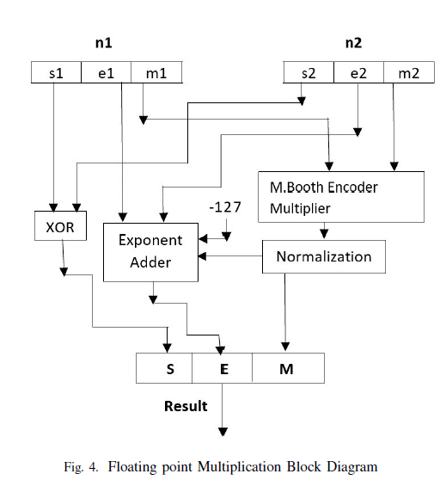
Floating Point with Booth Multiplier

Slide 31
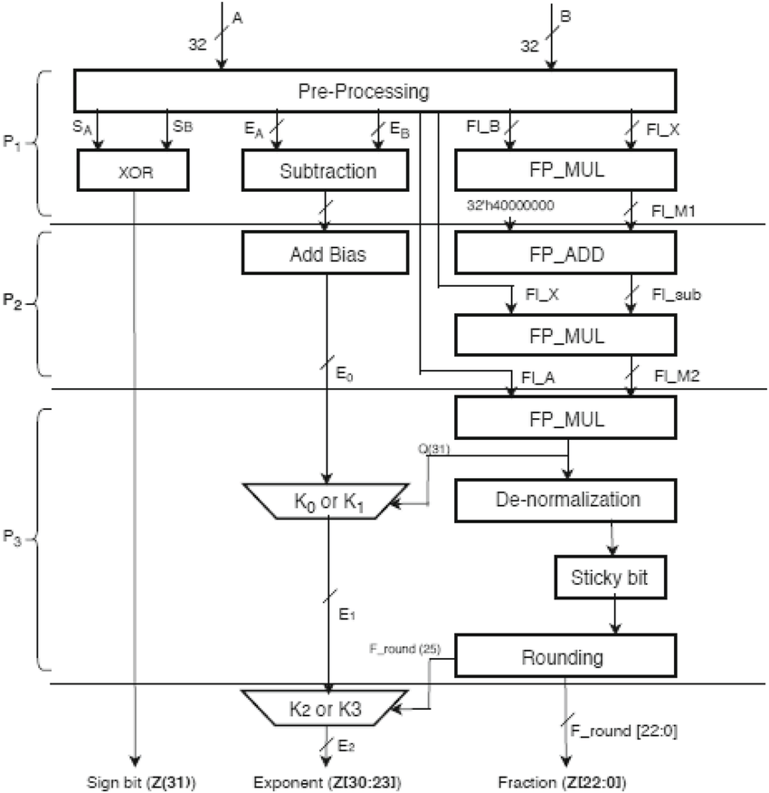
Identifying Pipeline Cuts

Slide 32
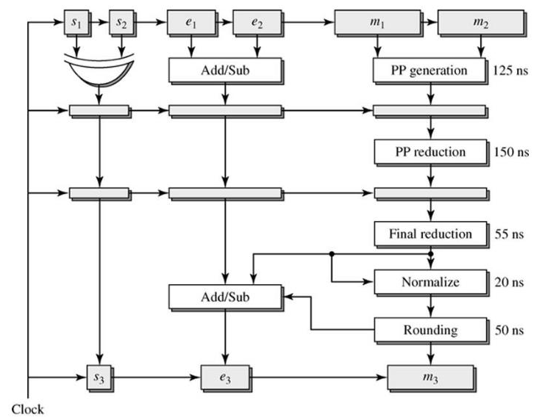
Pipelined Floating Point Architecture

Slide 33
Operation Details of Datapath
Pre Normalize Block for Adder and Subtractor : Calculate the difference between the smaller and larger exponent. Adjust the smaller fraction by right shifting it, determine if the operation is an add or subtract after resolving the sign bits. Check for NaNs on inputs.
Pre Normalize Block for Multiplication: Computes the sum/difference of exponents, checks for exponent overflow, underflow condition and INF value on an input.
Post Normalize and Round Unit - Normalize fraction and exponent. Also do all the roundings in parallel and then pick the output corresponding to the chosen rounding mode.
Exceptions Unit – This unit Generates the exception signals like sNAN, qNAN, Inf and Ine The IEEE standard defines two classes of NaNs(non numbers): i. quiet NaNs (qNaNs) : A qNaN is a NaN with the most significant fraction bit set. ii. signaling NaNs (sNaNs): A sNaN is a NaN with the most significant fraction bit clear.
The single precision floating point format is divided into three main parts corresponding to the sign , exponent and mantissa.
Mutiplication of the two operands is done in three parts and thereby obtaining the Product.
The first part of the product which is the sign is determined by an exclusive OR function of the two input signs.
The exponent of the product which is the second part is calculated by adding the two input exponents. The third part which is the significand of the product is determined by multiplying the two input significands each with a '1'concatenated to it.
A multiplication of two floating-point numbers is done in four steps: • non-signed multiplication of mantissas: it must take account of the integer part, implicit in normalization. The number of bits of the result is twice the size of the operands (48 bits). • normalization of the result, the exponent can be modified accordingly . • addition of the exponents, taking into account the bias. • calculation of the sign.

Slide 34
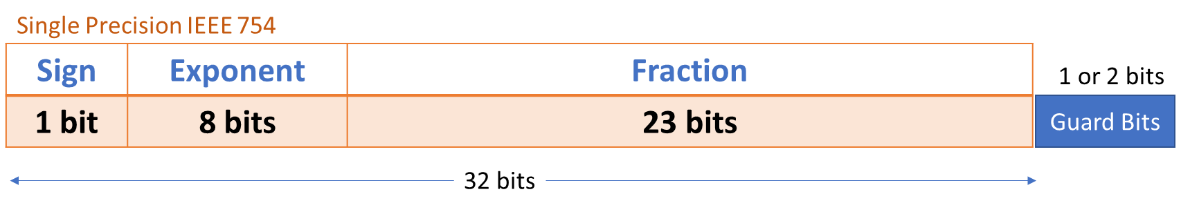
Complexity of Normalize and DeNormalize Steps
Shift Right →
Shift Left ←
What is the Complexity, in terms of time and area?
Can this be improved?

Slide 35
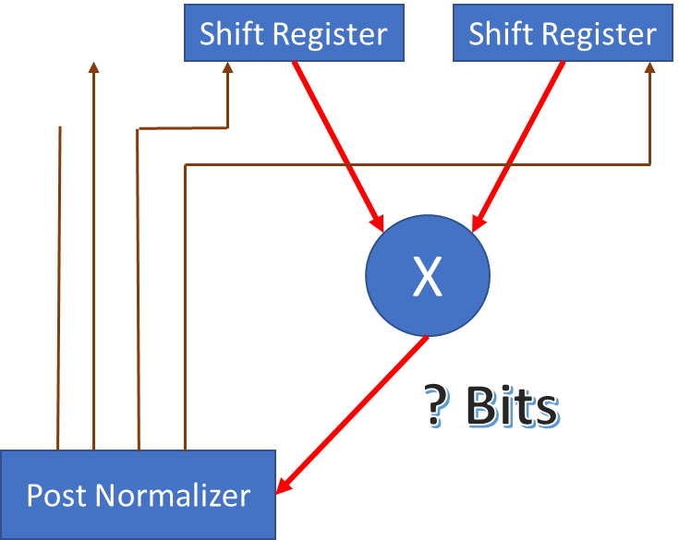
Complexity of Multiplier in Floating-point
What it the Complexity
How to Improve?

Slide 36
Complexity of FP Adder operations
DeNormalize
Shifting to Equalize Exponents
Adder
Normalize the Answer
Take into account Guard Bits
Where to Improve?
https://github.com/ahirsharan/32-Bit-Floating-Point-Adder

Slide 37
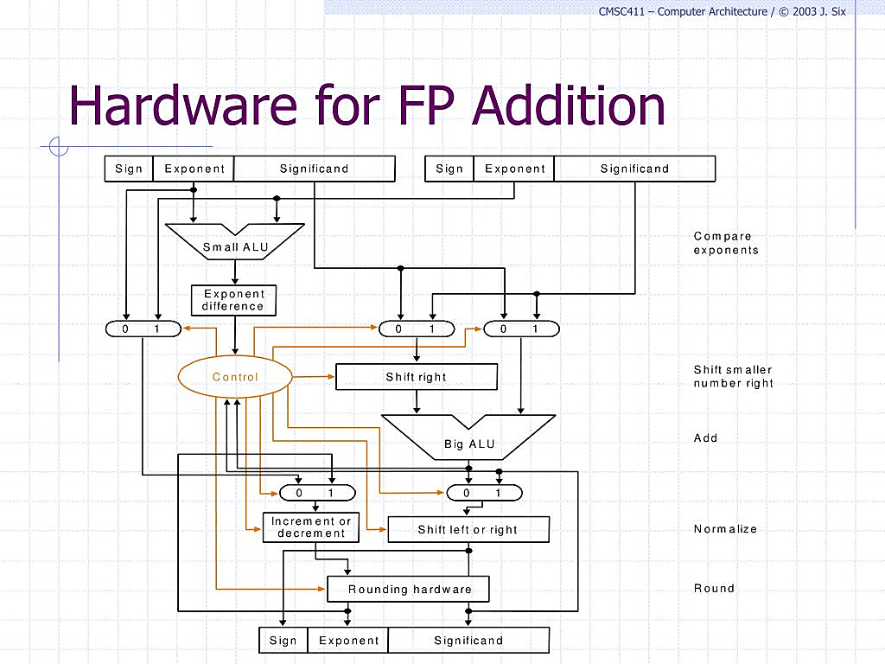
Floating Point Adder Hardware Architecture

Slide 38
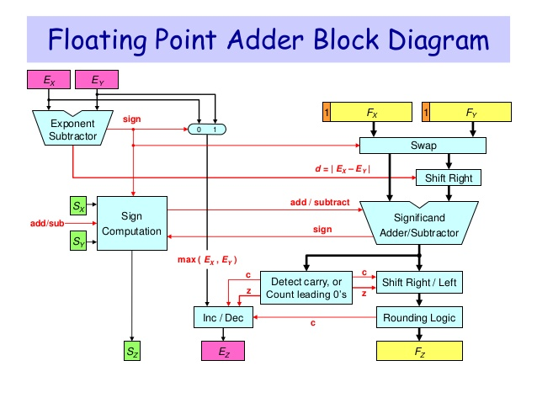
Another FP Adder Block Diagram

