Slide 1
Lecture 5
EE 421 / CS 425
Digital System Design
QUIZ 1
Today
Fall 2026
Shahid Masud

Slide 2
Topics
Pulse Circuits
Timing Related Effects in Combinational Circuits
Glitches
Hazards
Identify and Remove Glitches and Hazards
If we have time, we may start
  Review of Sequential Digital Logic Circuits
  Basics of Latches
  Basics of Flipflops
QUIZ 1 TODAY

Slide 3
Timing Waveforms
Every physical circuit has some processing delay; once the input has settled, the correct output appears
after some time.
Propagation delay from a gate is defined by:
tplh = time delay in output going from low to high
tphl = time delay in output going from high to low
V, logic level
Input
Level
Output
Level
Inverter Circuit Delay
Input Level
Output Level
time
t1
t2
t3
t4

Slide 4
A simple pulse circuit
Input
A
A’
F
A
A’
F
Output
Each gate has Propagation Delay
Time →
Question: What will be the Output if there are two inverters in series?
Question: What will be the Output if there are three inverters in series?

Slide 5
Two and Three Inverters in simple pulse circuit
A
A’
A
For even number of Inverters:
Check input A transitions from
0 to 1 and from 1 to 0
Pulse behaviour is not observed
(Hint: Check whether F is like A?)
F
A
A’
For Odd number of Inverters:
At 0 to 1 transitions at A, a pulse will
appear at F. The pulse width is proportional
to number of inverters as their propagation
delay adds up
F

Slide 6
A Pulse Shaper Circuit
+V
Case 1:
Assume propagation delay of gates as 10ns
Switch is closed at t=0ns, thus:
A goes to ‘0’ at time t=0ns
B goes to ‘1’ at time t=10ns
C goes to ‘0’ at time t=20ns
D goes to ‘1’ at time t=30ns
Since D=‘1’, A=‘0’, hence:
Output B=‘0’ always for A=‘0’ in steady state
R
A
B
t=0
C
D
t≥40ns

Slide 7
Pulse Shaper Circuit – Case 2
Case 2:
Assume propagation delay of gates as 10ns
Output B was in steady state = ‘0’ while
Switch was closed at t=0
Now Switch is opened at t=40ns
So A goes to ‘1’ at t=40ns
B goes to ‘0’ after 10ns at t=50ns
C goes to ‘1’ at t = 60ns
D goes to ‘0’ at t = 70ns
Now D=‘0’ and A=‘1’, hence B=‘1’ at t=80ns
C goes to ‘0’ at t=90ns
D goes to ‘1’ at t=100ns
Since A =‘1’ and D=‘1’ so B=‘0’ at t=110ns
The cycle will start repeating automatically
We get an OSCILLATOR
+V
R
A
B
t=0
C
D
t≥40ns
Time Period of this oscillator is determined by propagation delay of gates
Same behavior can be obtained from a NOR gate circuit with some changes

Slide 8
Glitches and Hazards
Glitch: An Unwanted Pulse at the Output of a Combinational Logic Circuit. Glitch is dependent upon Inputs and how the circuit is configured
Hazard: A Combinational Logic Circuit with a potential to produce Glitches is called a Hazard.
Possible Reasons:
Using Un-Stable Input Signals
Not Considering Propagation Delays in high-speed designs
Using Asynchronous Inputs

Slide 9
Kinds of Hazards
Output
1
Input Changes cause output to change from ‘0’ to ‘1’ to ‘0’
STATIC ZERO HAZARD
0
0
time
Output
1
1
Input Changes cause output to change from ‘1’ to ‘0’ to ‘1’
STATIC ONE HAZARD
0
time
Output
Input Changes cause two or more
changes from ‘1’ to ‘0’ to ‘1’ to ‘0’, Or
changes from ‘0’ to ‘1’ to ‘0’ to ‘1’
DYNAMIC HAZARD
1
1
0
0
time

Slide 10
Circuit with Static 1 Hazard
Z
X
XZ’
Z’
1→0
Z’
Z
F
YZ
Y
YZ
XZ’
F
Static 1 Hazard Observed

Slide 11
Example of Static 0 Hazard
A, B = 0
A=0
0→1
C= 0 → 1
C
0→1→0
F
Fpos
C’
C’= 1 → 0
1→0
Fpos = 0 without glitch
A+C
B=0
(B+C’)
Fpos
Static 0 Hazard
time

Slide 12
K Maps to Identify Hazards
X
XZ’
1→0
Z’
Z
F
XZ’
Y
Z, XY | 00 | 01 | 11 | 10
0 | 0 | 0 | 1 | 1
1 | 0 | 1 | 1 | 0
YZ
F=XZ’ + YZ
YZ

Slide 13
How to Know about Hazards?
A properly designed two level SOP (AND-OR) circuit has no Static-0 Hazard
This type of SOP circuits can have Static-1 Hazards
Look at the K-Map again and we notice that there is no single product term that covers the inputs XYZ=111 and XYZ=110. Thus glitch to 0 is possible if the AND gate covering the other combination goes to 1.
To Eliminate Such Hazards:
Include an extra product term (AND gate) to cover the hazard input. This is where the adjacent 1s exist in K-Maps but are not covered. This is called ‘Adding a Consensus Term’

Slide 14
Hazard Free two level SOP Circuit
X
XZ’
XZ’
Z’
Z, XY | 00 | 01 | 11 | 10
0 | 0 | 0 | 1 | 1
1 | 0 | 1 | 1 | 0
Z
F
Y
YZ
YZ
Consensus Term
XY
X
F including Consensus Term = XY + YZ + XZ’
XZ’
Z
Z’
F
Final Hazard Free Circuit
Including Extra Consensus Circuit
The Adjacent 1s in K-Map are now Covered
Y
YZ
XY

Slide 15
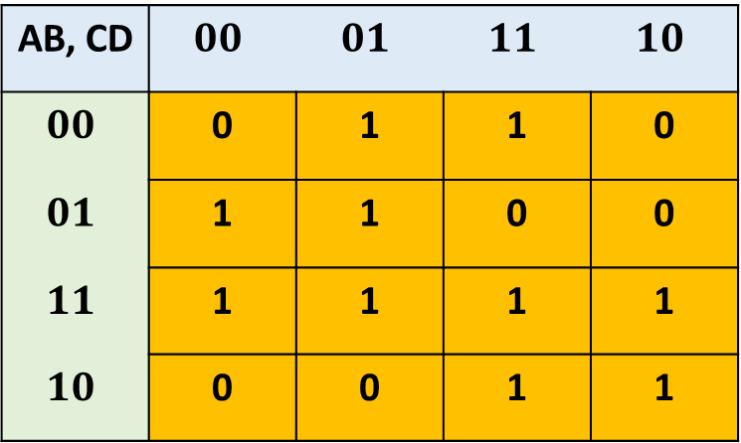
Using K-Map to Identify Static 1 Hazard in 4 input variables
AB, CD | $$00$$ | $$01$$ | $$11$$ | $$10$$
$$00$$ | 0 | 1 | 1 | 0
$$01$$ | 1 | 1 | 0 | 0
$$11$$ | 1 | 1 | 1 | 1
$$10$$ | 0 | 0 | 1 | 1
Identify the Hazards
Adjacent 1s that are not in the same group
Given K-Map with Minimal Grouping

Slide 16

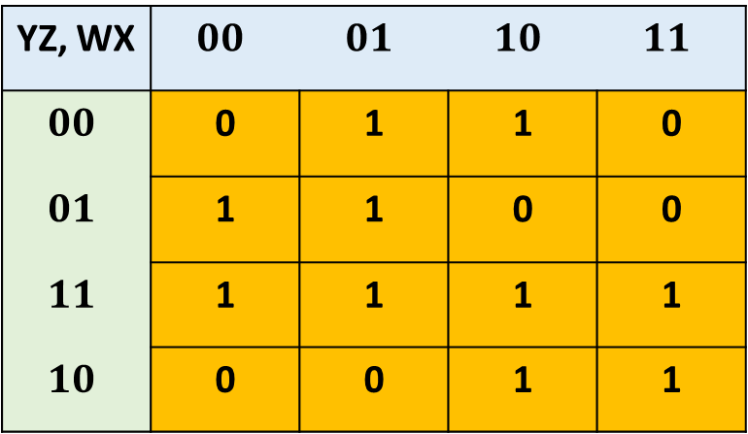
K-Map Groups to Eliminate Static 1 Hazard
WXZ’
XY’Z’
W’XY’
YZ, WX | $$00$$ | $$01$$ | $$10$$ | $$11$$
$$00$$ | 0 | 1 | 1 | 0
$$01$$ | 1 | 1 | 0 | 0
$$11$$ | 1 | 1 | 1 | 1
$$10$$ | 0 | 0 | 1 | 1
AB, CD | $$00$$ | $$01$$ | $$10$$ | $$11$$
$$00$$ | 0 | 1 | 1 | 0
$$01$$ | 1 | 1 | 0 | 0
$$11$$ | 1 | 1 | 1 | 1
$$10$$ | 0 | 0 | 1 | 1
YZ
W’Z
WY
Hazard Free Expression:
F=XY’Z’ + W’Z + WY + W’XY’ + YZ + WXZ’
Minimal Expression:
F=XY’Z’ + W’Z + WY

Slide 17


K-Map Grouping to Eliminate Static 0 Hazard
POS = Grouping of Zeros
AB, CD | $$00$$ | $$01$$ | $$10$$ | $$11$$
$$00$$ | 1 | 1 | 0 | 0
$$01$$ | 1 | 1 | 1 | 1
$$11$$ | 0 | 0 | 1 | 1
$$10$$ | 0 | 0 | 0 | 0
(B + C’)
AB, CD | $$00$$ | $$01$$ | $$10$$ | $$11$$
$$00$$ | 1 | 1 | 0 | 0
$$01$$ | 1 | 1 | 1 | 1
$$11$$ | 0 | 0 | 1 | 1
$$10$$ | 0 | 0 | 0 | 0
(A’+B)
(A’ + C)
Minimal Mapping without Hazard Consideration
Additional Cover for Static 0 Hazard prevention
F=(A’ + C) (B + C’)
F=(A’ + C) (B + C’) (A’ + B)
Now free from Static 0 Hazard

Slide 18
Example of Static 0 Hazard
X=1
0→1
Y = 1 → 0
F = 1 (without glitch)
F
0→1
Z=1
1→0
F=(X+Y’).(Y+Z)
When Y changes from 1 to 0, both inputs of Nand Gate F may be equal to 1,
Causing the output to momentarily go to 0 when it should have stayed at 1.

Slide 19
Dynamic Hazards
Dynamic Hazard is the possibility of an output changing more than once as the result of a single input transition.
These can occur if there are multiple paths with different delays from the input to the output
Dynamic Hazards do not occur in properly designed two level AND-OR or OR-AND Circuits.
Thus remove all Static-1 and Static-0 Hazards in the two-level SOP or POS design and the possibility of Dynamic Hazards is minimized.

Slide 20
Circuit containing Dynamic Hazard
First Reconvergence
A
C
F Static 1 hazard
F Dynamic hazard
F
Try changing
ABC from 110 to 111
C_slow
Second Reconvergence
B
Solution: Make K Map and add redundant cover for C

Slide 21
Redundant Circuit to remove Dynamic Hazard
First Reconvergence
A
AC
C
F Static 1 hazard
F Dynamic hazard
F
C_slow
Second Reconvergence
B
AB

Slide 22
We may start review of Sequential Elements and Circuits

Slide 23
Latches and Flipflops - Definitions
Latches: Level Sensitive storage elements; that can transition at any point in time
Flipflops: Edge Sensitive storage elements, that transition at clock edges, either rising or falling
Asynchronous Sequential Logic: Based on latches and un-clocked transitions
Synchronous Sequential Logic: Based on flipflops and only clocked transitions

Slide 24
Fundamental Element – SR Latch
R (reset)
Q
S (set)
Q
Complement
Q’
R (reset)
Q’
S (set)
SR Latch Using 2 Input NOR Gate – Function Table
SR Latch Using 2 Input NAND Gate – Function Table
S (Set) | R (Reset) | Q | Condition
0 | 0 | Q (=1 after S=1, R=0) | Hold
0 | 0 | Q (=0 after S=0, R=1) | Hold
0 | 1 | 0 | Reset
1 | 0 | 1 | Set
1 | 1 | 0 | Not Allowed
S | R | Q | Condition
0 | 0 | 1 | Not Allowed
0 | 1 | 1 | Set
1 | 0 | 0 | Reset
1 | 1 | Q (=0 after S=1, R=0) | Hold
1 | 1 | Q (=1 after S=0, R=1) | Hold
RACE
Condition
RACE
Condition

Slide 25
Transparent Latch
An additional ‘Enable’ input is provided
Definition: Output of Transparent Latch changes in response to the data input only when the Latch is ‘Enabled’.
Changes in input are straight away visible at the output

Slide 26
Transparent Latch Circuit
Timing Diagram – With Input Inverter
Data
S
Data
U
Q_Out
D
Enable (Level)
Enable
R
V
SR Latch With Enable (Without Inverter)
En | S | R | Next State of Q
0 | X | X | No Change
1 | 0 | 0 | No Change
1 | 0 | 1 | Q=0; Reset State
1 | 1 | 0 | Q=1; Set State
1 | 1 | 1 | Not Allowed
Q_Out
Latched
time
When Enable is ‘0’; U=‘1’ and V=‘1’; Hold Condition in SR Latch
Only these two states are valid when inverter is inserted

