Slide 1
Lecture 10
EE 421 / CS 425
Digital System Design
Fall 2025
Shahid Masud

Slide 2
Topics
Metastability
Synchronizers for capturing Asynchronous Inputs
Signal Transfer with and without Clock
Communication between modules in Complex Digital System
-----------------------
Computer Arithmetic
Adder
  Ripple Carry Adder
  Bit Serial Adder
  Propagation Delay
QUIZ 2
TODAY

Slide 3
Metastability, and
Asynchronous Data Management

Slide 4

Objective – to reduce possible Metastability in capturing Asynchronous Input
Energy barrier to throw
ball on the other side
M
Metastable State
0
1
Logic 0
Logic 1
Synchronizer Failure: When flipflop hangs in a Metastable State
for a long time (indefinitely)
Normally, the flipflop output would settle to a stable 0 or 1 state after some time

Slide 5
Output Behaviour with Metastability
D_In
Logic 1
D Q
Q_Out
Clk
R
Logic 0
DFF is connected to produce metastability
As setup time is violated
Time →
Oscilloscope trace of metastable behaviour
Eventually a stable state is reached
Problem occurs when flipflop is not stable within
One clock period

Slide 6
Synchronizers
Asynchronous inputs are problematic as their transitions are not predictable
High speed digital circuits rely on synchronizers to create a time buffer for recovering from a metastable event; thus reducing the possibility that metastability will cause circuit to malfunction
An asynchronous signal should be synchronized by one synchronizer only. If not, then multiple synchronized signals could be present in the system and one of these could be driven into metastable state

Slide 7




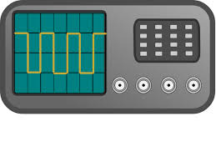
Asynchronous Inputs to a Synchronous Digital System
Asynchronous
Domain
Synch_Out
Synchronizer
(Type I or II)
Asynch_In
Ref Clk
Synchronous
Domain

Slide 8
Synchronizer 1
Condition: The width of asynchronous input pulse is greater than period of the clock
Synchronizer is a multistage shift register
Asynch_In
DFF
Q1
DFF
Synch_Out
D Q
D Q
Clk
R
R
Reset
Reset Input ‘R’ is used as control to bring Synch_Out back to ‘0’, as required

Slide 9
Timing Diagram – Synchronizer 1
Clk
Asynch_In
Q1
Synch_Out (Q2)
Reset (??)
Reset can be used to curtail the width of Q2 if input is too wide

Slide 10
Synchronizer 2
Condition: Width of the asynchronous input pulse is less than the period of the clock
Logic ‘1’
+VCC
Q1
Q2
Q3
DFF
DFF
DFF
D Q
D Q
D Q
Synch_Out
Asynch_In
Clk
Clk
Clk
CLR
CLR
CLR
Clk
CLR Can be used in different ways to
Reduce width of Q1, Q2, and Q3

Slide 11
Timing Diagram – Synchronizer 2
Clk
Asynch_In
Q1
Q2
Q3
Synch_Out
CLR input at DFF1 is used to bring back Q1 and then Q2 to Zero

Slide 12
Self-Timed and Speed Independent Circuits
Having a completed Synchronous system is at times too challenging for a complex and fast digital system
The limiting problem becomes how to distribute a single global clock without introducing intolerable clock skew
The alternate is to partition the digital system into locally clocked pieces that communicate with each other using delay-insensitive signaling techniques (i.e. local clock for local communication)
Each block proceeds at its own speed without the need for a global clock, synchronizing local communication whenever needed
Usually a Request-Response Signalling method is employed

Slide 13
Data Reading across two Clock Domains
Clock Domain 2
Data_In
D Q
D Q
Data_Out
Clk1
R
R
Clk2
Reset
Clock Domain 1
frequency of Clk1 is less than Clk2
Otherwise, the Synchronizer-2 is versatile and can be used here

Slide 14
Communication across modules in Complex SoC
Communication Signaling across modules at different clock speeds
Self-timed circuits

Slide 15
Self-Timed and Speed Independent Circuits
Having a completed Synchronous system is at times too challenging for a complex and fast digital system
The limiting problem becomes how to distribute a single global clock without introducing intolerable clock skew
The alternate is to partition the digital system into locally clocked pieces that communicate with each other using delay-insensitive signaling techniques (i.e. local clock for local communication)
Each block proceeds at its own speed without the need for a global clock, synchronizing local communication whenever needed
Usually a Request-Response Signaling method is employed

Slide 16
Data Transfer in Complex Modular Design
Module 1
Internal Clock 1
Complexity Level 1
Module 2
Internal Clock 2
Complexity Level 2
Data Transfer 1
Clock tree distribution
3
Data Transfer 3
Module 3
Internal Clock 3
Complexity Level 3
Module 4
Internal Clock 4
Complexity Level 4
Data Interface 2
I/O Port
Universal
Clock

Slide 17
Request / Acknowledge Signaling
Independently clocked Subsystems
Clocked
Subsystem 1
Clocked
Subsystem 2
Communication
Signals
S1
Requester Client
Master
Request
S2
Provider
Server
Slave
Clk 1
Clk 2
Data Flow
Acknowledgement
Req / Ack Signalling

Slide 18
Synchronous Req / Ack Signaling
Req
Data
Ack
Clk
Time →
Req and Ack signals are synchronized to Clk

Slide 19
Synchronous Req with Wait Signaling
Req
Data
Wait
Clk
Time →
Slave can delay the Master by asserting Wait signal as it prepares the data and needs more clock cycles
When the slave un-asserts Wait signal, it acknowledges that data is now available for the Master to read
All interface signals are synchronized with Clock edge

Slide 20
Four Cycle Asynchronous Signaling
RTZ – Return to Zero Signaling with No Clock
Req
4
1
3
Data
2
Ack
5
Time →

Slide 21
Two Cycle Asynchronous Signaling
Non-Return-to-Zero Signalling
Req
2
Data
Data 1
Data 2
1
Ack
3
Initially, both request and acknowledge are at 0
Request line is complemented (to 1)
Slave notices change in Req, provides data, and complements the Ack line (to 1)
Further request and acknowledgement is by complementing the respective state
Time →

Slide 22
Self-Timed Circuits
A self-timed circuit can determine on its own when a request has been serviced by mimicking the worst-case propagation delay path by using special logic to delay the request signal.
This guarantees sufficient time to compute the correct output.
Self Timed module of
a Digital System
Input
Combinational
Logic
Output
Req
Ack
Delay

Slide 23
Topics
Communication Signaling across modules at different clock speeds (Revision – How clock is good and can be bad?) Quick Review
----------------------------------------------
Computer Arithmetic Circuits
Basic Element – Full Adder
Ripple Carry Adder – Timing Issues
Bit Serial Adder – Concept of Throughput and Latency
Carry Look Ahead Adder
Carry Select Adder

Slide 24
Self-Timed and Speed Independent Circuits
Having a completed Synchronous system is at times too challenging for a complex and fast digital system
The limiting problem becomes how to distribute a single global clock without introducing intolerable clock skew
The alternate is to partition the digital system into locally clocked pieces that communicate with each other using delay-insensitive signaling techniques (i.e. local clock for local communication)
Each block proceeds at its own speed without the need for a global clock, synchronizing local communication whenever needed
Usually a Request-Response Signaling method is employed

Slide 25
Data Transfer in Complex Modular Design
Module 1
Internal Clock 1
Complexity Level 1
Module 2
Internal Clock 2
Complexity Level 2
Data Transfer 1
Clock tree distribution
3
Data Transfer 3
Module 3
Internal Clock 3
Complexity Level 3
Module 4
Internal Clock 4
Complexity Level 4
Data Interface 2
I/O Port
Universal
Clock

Slide 26
Request / Acknowledge Signaling
Independently clocked Subsystems
Clocked
Subsystem 1
Clocked
Subsystem 2
Communication
Signals
S1
Requester Client
Master
Request
S2
Provider
Server
Slave
Clk 1
Clk 2
Data Flow
Acknowledgement
Req / Ack Signalling

Slide 27
Synchronous Req / Ack Signaling
Req
Data
Ack
Clk
Time →
Req and Ack signals are synchronized to Clk

Slide 28
Synchronous Req with Wait Signaling
Req
Data
Wait
Clk
Time →
Slave can delay the Master by asserting Wait signal as it prepares the data and needs more clock cycles
When the slave un-asserts Wait signal, it acknowledges that data is now available for the Master to read
All interface signals are synchronized with Clock edge

Slide 29
Four Cycle Asynchronous Signaling
RTZ – Return to Zero Signaling with No Clock
Req
4
1
3
Data
2
Ack
5
Time →

Slide 30
Two Cycle Asynchronous Signaling
Non-Return-to-Zero Signalling
Req
2
Data
Data 1
Data 2
1
Ack
3
Initially, both request and acknowledge are at 0
Request line is complemented (to 1)
Slave notices change in Req, provides data, and complements the Ack line (to 1)
Further request and acknowledgement is by complementing the respective state
Time →

Slide 31
Self-Timed Circuits
A self-timed circuit can determine on its own when a request has been serviced by mimicking the worst-case propagation delay path by using special logic to delay the request signal.
This guarantees sufficient time to compute the correct output.
Self Timed module of
a Digital System
Input
Combinational
Logic
Output
Req
Ack
Delay

Slide 32
Computer Arithmetic

Slide 33
Computer Arithmetic
Study Data path and Control path of a
binary hardware arithmetic unit

Slide 34
Computer Arithmetic Circuits
Generally, the digital system design falls into one of the following categories:
  Data handling – acquisition, storage, retrieval, compression, search, etc.
  Data processing – filtering, de-noising, object detection, pattern recognition
Computer Arithmetic is an important functional block of both aspects, especially plays an important part in Data Processing
Efficient arithmetic circuits can improve the speed – area – energy performance nexus in a complex digital system

Slide 35
Basic Functional Block – Full Adder
X_{i} | Y_{i} | C_{i} | C_{i+1} | S_{i}
0 | 0 | 0 | 0 | 0
0 | 0 | 1 | 0 | 1
0 | 1 | 0 | 0 | 1
0 | 1 | 1 | 1 | 0
1 | 0 | 0 | 0 | 1
1 | 0 | 1 | 1 | 0
1 | 1 | 0 | 1 | 0
1 | 1 | 1 | 1 | 1
Sum S_{i}=X_{i} ⨁ Y_{i} ⨁ C_{i}
C_{i+1} = X_{i} . Y_{i} + C_{i} (X_{i} ⨁ Y_{i})
X_{i}
Y_{i}
Full
Adder
C_{i+1}
C_{i}
S_{i}

Slide 36
Full Adder Circuit
X_{i}
Y_{i}
Sum S_{i}=X_{i} ⨁ Y_{i} ⨁ C_{i}
C_{i+1} = X_{i} . Y_{i} + C_{i} (X_{i} ⨁ Y_{i})
X_{i}
Y_{i}
Full
Adder
C_{i+1}
C_{i}
C_{i+1}
C_{i}
C_{i+1} = X_{i}.Y_{i} + C_{i} (X_{i} ⨁ Y_{i})
S_{i}
Sum S_{i} = X_{i} ⨁ Y_{i} ⨁ C_{i}
S_{i}

Slide 37
Multiple Bits – Ripple Carry Adder
Input Numbers {X₃ X₂ X₁ X₀} and {Y₃ Y₂ Y₁ Y₀}, Carry Input at Cin
X₃
Y₃
X₂
Y₂
X₁
Y₁
X₀
Y₀
Cin
Full
Adder
Full
Adder
Full
Adder
Full
Adder
C₄
C₂
C₂
C₂
C₂
C₁
C₁
C₀
S₃
S₂
S₁
S₀
Cout
Sum Bits {S₃ S₂ S₁ S₀}
MSB ….…. LSB

Slide 38
Timing Issues in Ripple Carry Adders
Delay between Yi and Ci+1
= 1 EXOR + 1 AND + 1 OR (= Critical Path)
Suppose delays through gates are:
EXOR = 20ns, AND = 10ns, OR = 10ns
Then Delay between Yi and Ci+1
= 20ns + 10ns + 10ns = 40ns
Worst case delay through N adders
= N × 40ns
For 32-bit data;
Delay through 32-bit RCA =
32 x 40ns = 1280ns = 1.28us
Corresponds to Maximum Data Throughput
= 1/(1.28μs) = 0.78 MHz (too slow in today’s terms
X_{i}
Y_{i}
C_{i+1}
C_{i}
S_{i}

Slide 39
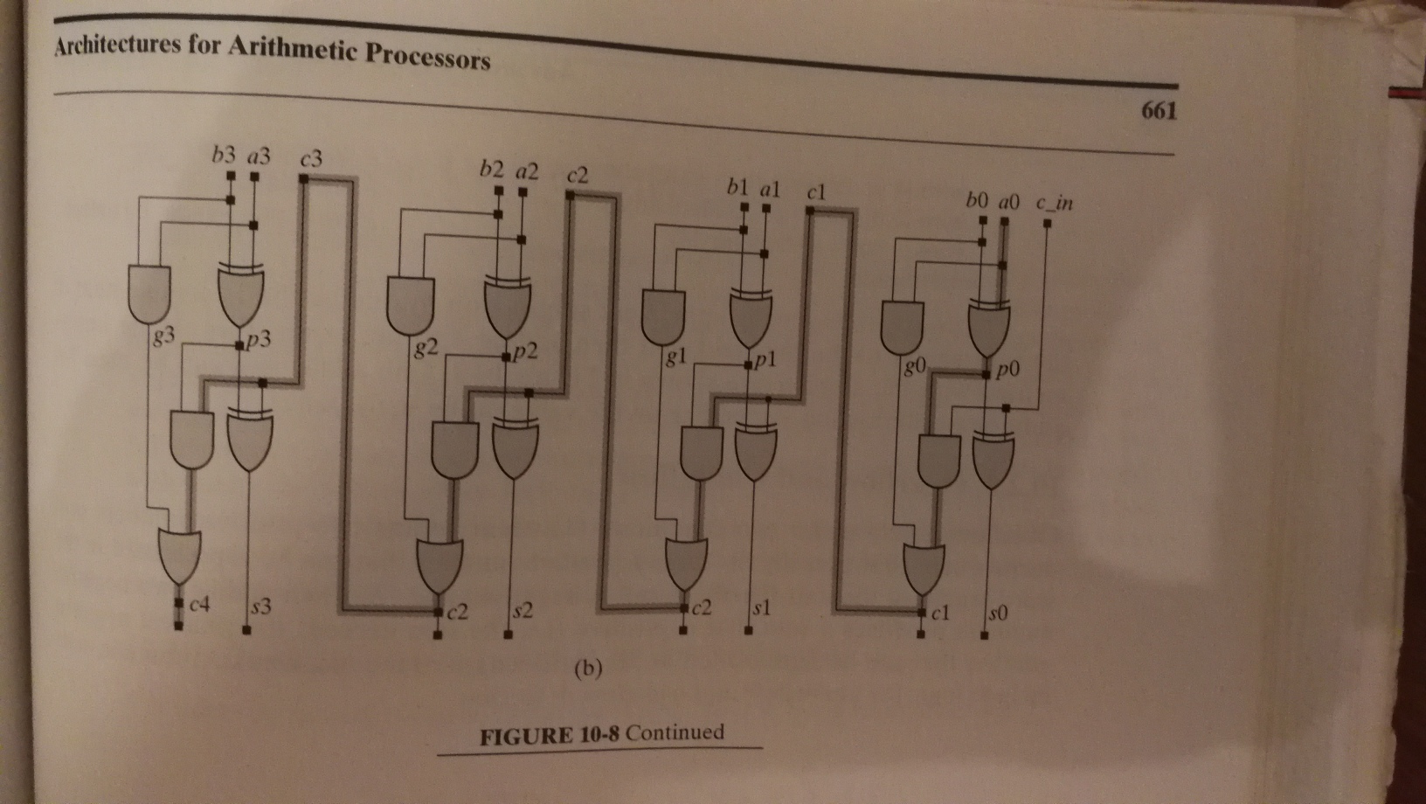
Delay of Ripple Carry Full Adder

Slide 40
Compare with Critical Path of Full Adder
REVIEW
X₃
Y₃
C_{in}
X₂
Y₂
C_{in}
X₁
Y₁
C_{in}
X₀
Y₀
C_{in}
C₄
S₃
C₃
S₂
C₂
S₁
C₁
S₀

