Slide 1
Lecture 9
EE 421 / CS 425
Digital System Design
Fall 2024
Shahid Masud

Slide 2
Topics
(Leftover) Example of Vending Machine
State Minimization
Row Matching Method
Using Implication Charts
QUIZ 2 in this lecture #9

Slide 3
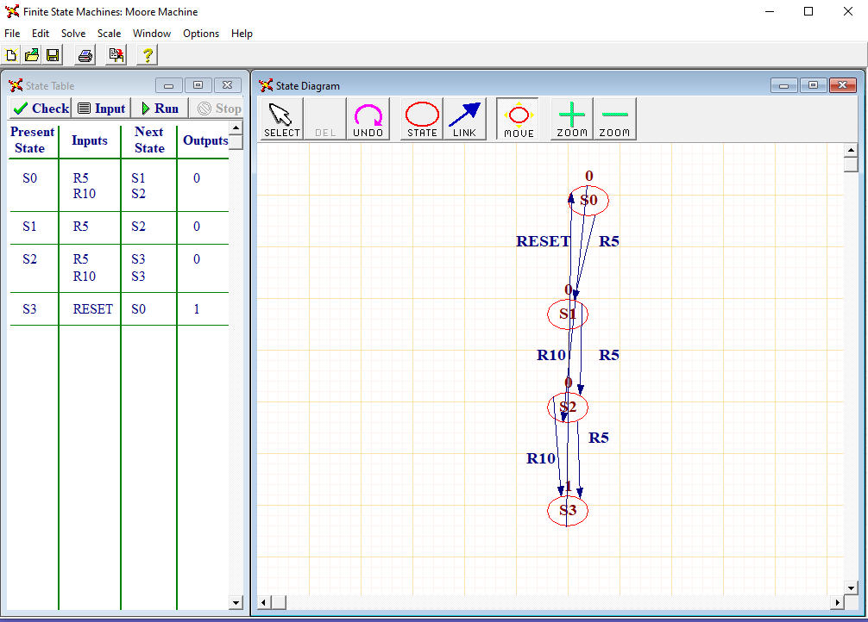

Trying FSM implementation
with WinlogiLab

Slide 4
Advantages of Minimum States
Reduces number of logic gates and flipflops required for the implementation of state machine
With fewer states, there are more don’t care conditions into the next-state and output logic equations, making the implementation simpler.
Simpler and less logic means shorter critical paths and higher achievable clock rate
Fewer components also means shorter design time and lower manufacturing cost

Slide 5
State Minimization and Reduction
State Reduction identifies and combines states that have equivalent behaviour
Two states have equivalent behaviour iff:
  for all input combinations, their outputs are the same, and
  they change to the same or equivalent next state

Slide 6
State Reduction Algorithms
Begin with the symbolic state transition table.
We group together states that have the same state outputs (Moore Machine) or Transition outputs (Mealy Machine). These are potentially equivalent, since states cannot be equivalent if their outputs differ.
Next, examine the transitions to see if they go to the same next state for every input combination. If they do, the states are equivalent and can be combined into a renamed new state.
Then change all transitions into the newly combined states.
Repeat the process until no additional states can be combined.

Slide 7
Row Matching method for State Reduction
Use Case of a Four-Bit Sequence Detector
Specifications:
The machine has a single input X and a single output Z
The output is asserted after each 4-bit input sequence if the sequence contains binary
Strings of “0110” or “1010”
The machine returns to “Reset” State after each 4-bit sequence
Assumptions:
Mealy Implementation
Example:
Input X= 0010 0110 1100 1010 0011 ……. …….
Output Z = 0000 0001 0000 0001 0000 …… ……

Slide 8
Mealy State Machine for 4-Bit Sequence Detector
Reset
S
0
0/0
1/0
S1
S2
0/0
1/0
0/0
1/0
S3
S5
S6
S4
1/0
0/0
1/0
0/0
1/0
0/0
1/0
0/0
S7
S8
S9
S
10
S
11
S
12
S
13
S
14
0/0
1/0
1/0
1/0
0/0
1/0
0/0
1/0
1/0
0/1
0/0
1/0
0/1
0/0
0/0
1/0
Look for Strings of “0110” or “1010” in serial input stream

Slide 9
Initial State Transition Table
Input Sequence | Present State | Next State |  | Output
 |  | When X=0 | When X=1 | When X=0 | When X=1
Reset | S0 | S1 | S2 | 0 | 0
0 | S1 | S3 | S4 | 0 | 0
1 | S2 | S5 | S7 | 0 | 0
00 | S3 | S7 | S8 | 0 | 0
01 | S4 | S9 | S10 | 0 | 0
10 | S5 | S11 | S12 | 0 | 0
11 | S6 | S13 | S14 | 0 | 0
000 | S7 | S0 | S0 | 0 | 0
001 | S8 | S0 | S0 | 0 | 0
010 | S9 | S0 | S0 | 0 | 0
011 | S10 | S0 | S0 | 1 | 0
100 | S11 | S0 | S0 | 0 | 0
101 | S12 | S0 | S0 | 1 | 0
110 | S13 | S0 | S0 | 0 | 0
111 | S14 | S0 | S0 | 0 | 0
Examine table to find rows with
Identical next state and output values
Eg. We can combine S10 and S12;
Both have same next state and
same output

Slide 10
Merge S10 and S12 into one state “S10A” and make new table
Input Sequence | Present State | Next State |  | Output
 |  | When X=0 | When X=1 | When X=0 | When X=1
Reset | S0 | S1 | S2 | 0 | 0
0 | S1 | S3 | S4 | 0 | 0
1 | S2 | S5 | S7 | 0 | 0
00 | S3 | S7 | S8 | 0 | 0
01 | S4 | S9 | S10 | 0 | 0
10 | S5 | S11 | S12 | 0 | 0
11 | S6 | S13 | S14 | 0 | 0
000 | S7 | S0 | S0 | 0 | 0
001 | S8 | S0 | S0 | 0 | 0
010 | S9 | S0 | S0 | 0 | 0
011 or 101 | S10A | S0 | S0 | 1 | 0
100 | S11 | S0 | S0 | 0 | 0
110 | S13 | S0 | S0 | 0 | 0
111 | S14 | S0 | S0 | 0 | 0
Iteration:
States S7, S8, S9 and
S11, S13, S14 have same
Next states and same outputs;
Hence these can be combined

Slide 11
Merge S7, S8, S9, S11, S13, S14 into one new State called S7A
Input Sequence | Present State | Next State |  | Output
 |  | When X=0 | When X=1 | When X=0 | When X=1
Reset | S0 | S1 | S2 | 0 | 0
0 | S1 | S3 | S4 | 0 | 0
1 | S2 | S5 | S7 | 0 | 0
00 | S3 | S7 | S8 | 0 | 0
01 | S4 | S9 | S10 | 0 | 0
10 | S5 | S11 | S12 | 0 | 0
11 | S6 | S13 | S14 | 0 | 0
000, 001, 010, 100, 110, 111 | S7A | S0 | S0 | 0 | 0
011 or 101 | S10A | S0 | S0 | 1 | 0

Slide 12
Replace S7, S8, S9, S11, S13, S14 with S7A in the table; Also S12 with S10A
Input Sequence | Present State | Next State |  | Output
 |  | When X=0 | When X=1 | When X=0 | When X=1
Reset | S0 | S1 | S2 | 0 | 0
0 | S1 | S3 | S4 | 0 | 0
1 | S2 | S5 | S7A | 0 | 0
00 | S3 | S7A | S7A | 0 | 0
01 | S4 | S7A | S10A | 0 | 0
10 | S5 | S7A | S10A | 0 | 0
11 | S6 | S7A | S7A | 0 | 0
000, 001, 010, 100, 110, 111 | S7A | S0 | S0 | 0 | 0
011 or 101 | S10A | S0 | S0 | 1 | 0
Iteration:
States 00 and 11 have same
Next State and Output (S3A)
States 01 and 10 have same
Next State and Output (S4A)
Hence these are equivalent States

Slide 13
Combine States S3 and S6 to S3A; Combine States S4 and S5 to S4A
Input Sequence | Present State | Next State |  | Output
 |  | When X=0 | When X=1 | When X=0 | When X=1
Reset | S0 | S1 | S2 | 0 | 0
0 | S1 | S3A | S4A | 0 | 0
1 | S2 | S4A | S7A | 0 | 0
00, 11 | S3A | S7A | S7A | 0 | 0
01, 10 | S4A | S7A | S10A | 0 | 0
000, 001, 010, 100, 110, 111 | S7A | S0 | S0 | 0 | 0
011 or 101 | S10A | S0 | S0 | 1 | 0
Final Reduced States are only 7:
S0, S1, S2, S3A, S4A, S7A, S10A

Slide 14
Final Reduced State Diagram
S0
0/0
1/0
S1
S2
1/0
1/0
0/0
0/0
S3A
S4A
0/0
1/0
0,1/0
S7A
S10A
0/1
1/0
0,1/0

Slide 15
State Reduction using Implication Charts
Graphical Technique for State Reduction
Definition:
Redundant State:
  One state is equivalent to another (and hence redundant) if the state functions are in-distinguishable
When all states that have (i) different next states and (ii) different outputs, have been identified, the remaining states are considered to be redundant

Slide 16
State Equivalence Theorem
Two states SA and SB are equivalent iff for every possible input X sequence, the outputs are same and the next states are equivalent
Properties of Equivalent States:
Symmetry: If SA=SB, then SB=SA
Reflexivity: SA = SA for any state
Transitivity: If SA=SB, and SB=SC, then SA=SC

Slide 17
Construction of Implication Charts
The Chart is constructed by listing all of the states except the last, along horizontal axis, and
Listing all of the states except the first, along the vertical axix
Intersection of the horizontal and vertical spaces indicates a possible state equivalene
Eg. Total States S0 to S4
Implies the possibility that S0 = S1
Each box indicates State Pair Equivalence Possibility Condition
S1
S2
S3
S4
 | S0 | S1 | S2 | S3

Slide 18
Example of State Reduction using
Implication Charts
Given the State Table as follows:
Present State | Next State |  | Output
 | When X=0 | When X=1 | When X=0 | When X=1
S0 | S4 | S3 | 0 | 1
S1 | S5 | S3 | 0 | 0
S2 | S4 | S1 | 0 | 1
S3 | S5 | S1 | 0 | 0
S4 | S2 | S5 | 0 | 1
S5 | S1 | S2 | 0 | 0
Total 6 states, S0 to S5

Slide 19
Filling the Implication Chart
Place X in squares where outputs are different, as such states cannot be equivalent
For other squares, we look at State Equivalence Pairs, i.e.:
  S0 ≡ S2, iff S1 ≡ S3
  Thus we write S1,S3 in the square at intersection of S0, S2
  S0 ≡ S4, iff S2 ≡ S3, and S3 ≡ S5
  S1 ≡ S5, iff S2 ≡ S3
  S2 ≡ S4, iff S1 ≡ S5
  S3 ≡ S5, iff S1 ≡ S5, and S1 ≡ S2

Slide 20
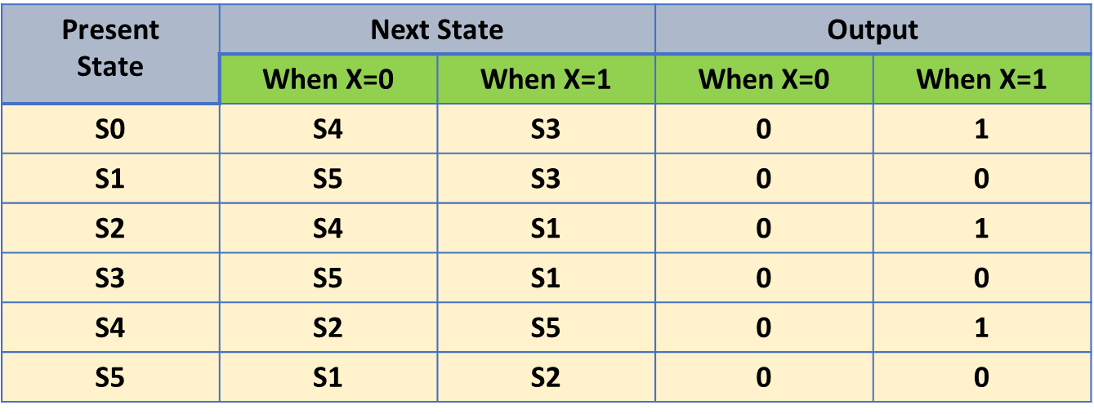
Filled Implication Chart with conditions of equivalent states
S1 | X
S2 |  | X
S3 | X |  | X
S4 |  | X |  | X
S5 | X |  | X |  | X
 | S0 | S1 | S2 | S3 | S4
S1 | X
S2 | S1,S3 | X
S3 | X | S1,S3 | X
S4 | S2,S4 S3,S5 | X | S2,S4 S1,S5 | X
S5 | X | S1,S5 S2,S3 | X | S1,S5 S1,S2 | X
 | S0 | S1 | S2 | S3 | S4
S1
S2
S3
S4
S5
 | S0 | S1 | S2 | S3 | S4
One by one, examine all table entries and refer to the state transition table

Slide 21
X is inserted where outputs of states is different
Check conditions of equivalence in respective squares
S1 | X
S2 | S1,S3 | X
S3 | X | S1,S3 | X
S4 | S2,S4 S3,S5 | X | S2,S4 S1,S5 | X
S5 | X | S1,S5 S2,S3 | X | S1,S5 S1,S2 | X
 | S0 | S1 | S2 | S3 | S4
Present State | Next State |  | Output
 | When X=0 | When X=1 | When X=0 | When X=1
S0 | S4 | S3 | 0 | 1
S1 | S5 | S3 | 0 | 0
S2 | S4 | S1 | 0 | 1
S3 | S5 | S1 | 0 | 0
S4 | S2 | S5 | 0 | 1
S5 | S1 | S2 | 0 | 0
To check for: {S1,S3}, {S1,S5}, {S2,S3}, {S1,S2}

Slide 22
To check for: {S1,S3}, {S1,S5}, {S2,S3}, {S1,S2}
In {S1,S3}:
Outputs are same for S1, and S3
In Next States, When X=1, S1 goes to S3 and S3 goes to S1
Hence S1 and S3 are equivalent
In {S1,S2}, output is different when X=1, hence these cannot
Be equivalent, so this square will get ‘X’
In {S2,S3}, output is different when X=1, hence these cannot
be equivalent, so this square will be ‘X’.
This means that S1 cannot be equivalent to S5 as it is dependent
on S2 and S3 as Next State
Similarly, check all conditions in all squares
Present State | Next State |  | Output
 | When X=0 | When X=1 | When X=0 | When X=1
S0 | S4 | S3 | 0 | 1
S1 | S5 | S3 | 0 | 0
S2 | S4 | S1 | 0 | 1
S3 | S5 | S1 | 0 | 0
S4 | S2 | S5 | 0 | 1
S5 | S1 | S2 | 0 | 0

Slide 23

Updated Implication Chart
This condition is established
So S0 and S2 are Equivalent States
S1 | X
S2 | S1,S3 | X
S3 | X | S1,S3 | X
S4 | S2,S4 S3,S5 | X | S2,S4 S1,S5 | X
S5 | X | S1,S5 S2,S3 | X | S1,S5 S1,S2 | X
 | S0 | S1 | S2 | S3 | S4
S1 and S3 depend on themselves
Hence S1 and S3 are Equivalent states
Result:
S0 ≡ S2
And
S1 ≡ S3

Slide 24
Updated further - Implication Chart
This condition is established
So S0 and S2 are Equivalent States
S1 | X
S2 | S1,S3 | X
S3 | X | S1,S3 | X
S4 | X | X | X | X
S5 | X | X | X | X | X
 | S0 | S1 | S2 | S3 | S4
S1 and S3 depend on themselves
Hence S1 and S3 are Equivalent states
Result:
S0 ≡ S2
And
S1 ≡ S3
Mark X where further
Equivalence is not apparent

Slide 25

Updated State Table
Original table with six states
Only four states are left
Present State | Next State |  | Output
 | When X=0 | When X=1 | When X=0 | When X=1
S0 | S4 | S3 | 0 | 1
S1 | S5 | S3 | 0 | 0
S2 | S4 | S1 | 0 | 1
S3 | S5 | S1 | 0 | 0
S4 | S2 | S5 | 0 | 1
S5 | S1 | S2 | 0 | 0
Present State | Next State |  | Output
 | When X=0 | When X=1 | When X=0 | When X=1
S0 | S4 | S1 | 0 | 1
S1 | S5 | S1 | 0 | 0
S2 | S4 | S1 | 0 | 1
S3 | S5 | S1 | 0 | 0
S4 | S0 | S5 | 0 | 1
S5 | S1 | S0 | 0 | 0
Result:
S0 ≡ S2
And
S1 ≡ S3

Slide 26
Practice Example: 4-Bit Sequence Detector
Input Sequence | Present State | Next State |  | Output
 |  | When X=0 | When X=1 | When X=0 | When X=1
Reset | S0 | S1 | S2 | 0 | 0
0 | S1 | S3A | S4A | 0 | 0
1 | S2 | S4A | S7A | 0 | 0
00, 11 | S3A | S7A | S7A | 0 | 0
01, 10 | S4A | S7A | S10A | 0 | 0
000, 001, 010, 100, 110, 111 | S7A | S0 | S0 | 0 | 0
011 or 101 | S10A | S0 | S0 | 1 | 0

Slide 27
See if states can be reduced further:
S1
S2
S3A
S4A
S7A
S10A
 | S0 | S1 | S2 | S3A | S4A | S7A
Input Sequence | Present State | Next State |  | Output
 |  | When X=0 | When X=1 | When X=0 | When X=1
Reset | S0 | S1 | S2 | 0 | 0
0 | S1 | S3A | S4A | 0 | 0
1 | S2 | S4A | S7A | 0 | 0
00, 11 | S3A | S7A | S7A | 0 | 0
01, 10 | S4A | S7A | S10A | 0 | 0
000, 001, 010, 100, 110, 111 | S7A | S0 | S0 | 0 | 0
011 or 101 | S10A | S0 | S0 | 1 | 0

Slide 28
Filled Implication Chart
S1
S2
S3A
S4A
S7A
S10A
 | S0 | S1 | S2 | S3A | S4A | S7A

