Slide 1
Lecture 25
EE 421 / CS 425
Digital System Design
Fall 2024
Shahid Masud

Slide 2
Topics
QUIZ 5 TODAY
Digital Scramblers
Digital Un-Scramblers
Scrambler Applications
Scrambler Examples
Binary Rate Multipliers – Maybe next lecture

Slide 3
What is a Scrambler?
Scramblers → circuits that pseudo-randomly change the values of some bits in a data stream with the purpose of ‘whitening’ its spectrum to dilute strong spectral components.
This will reduce electromagnetic interference and introduce data security as part of an encryption algorithm.
In natural signals, e.g. voice, image, transducer, energy is concentrated in some bands. Scrambling → spread the energy to reduce interference and spikes.
An ALFSR forms backbone of scrambling operation.
There are two main types:
  Additive Scrambler
  Multiplicative Scrambler

Slide 4
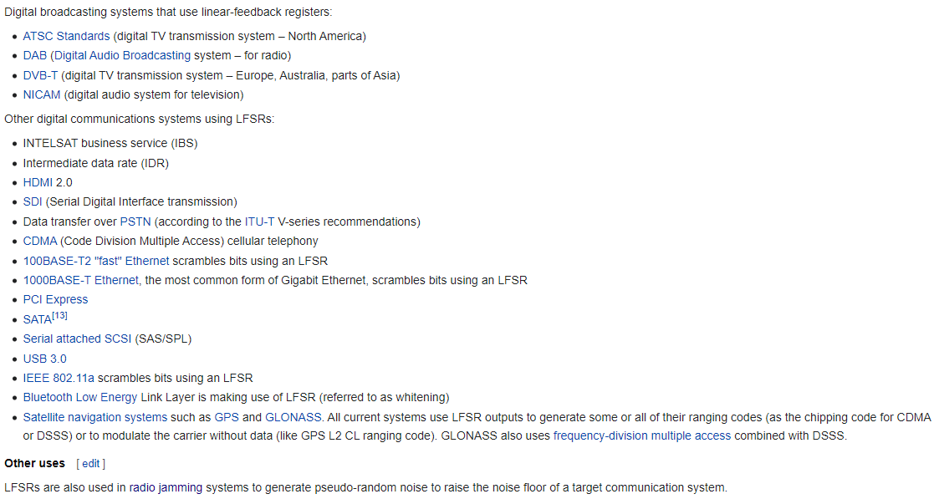
Example Applications of LFSR
Ref: from Wikipedia page

Slide 5
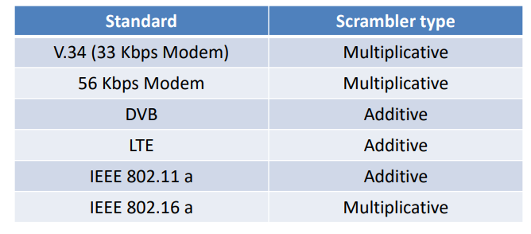
Types of Scramblers
1+x⁴+X⁷ is polynomial for 802.11

Slide 6
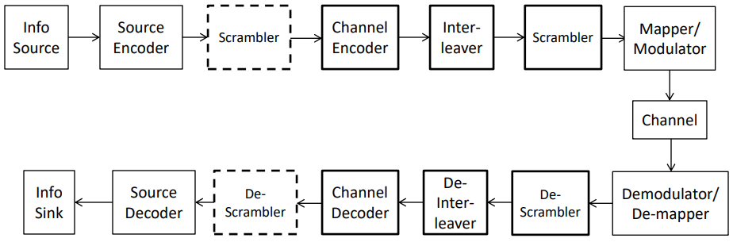












Typical Communication System

Slide 7



PRPG using ALFSR
+
Uses a seed value to produce a pseudo random pattern
Another symbol for XOR
d
Observe d to find out a pseudo random sequence
q3 ⨁ q4
+
D3 Q3
D2 Q2
D 1 Q1
D0 Q0
q₁
q₂
q₃
q₄
Polynomial is:
1+x³+x⁴
The taps are derived
From 3rd and 4th DFF
Pre
Pre
Pre
Pre
Serial Input
Bit stream as
In SISR
Clk
Preset to Seed Value

Slide 8
Simplified Representation
q1 | q2 | q3 | q4 | d
1 | 1 | 1 | 1 | 0
0 | 1 | 1 | 1 | 0
0 | 0 | 1 | 1 | 0
0 | 0 | 0 | 1 | 1
1 | 0 | 0 | 0 | 0
0 | 1 | 0 | 0 | 0
0 | 0 | 1 | 0 | 1
1 | 0 | 0 | 1 | 1
1 | 1 | 0 | 0 | 0
0 | 1 | 1 | 0 | 1
1 | 0 | 1 | 1 | 0
0 | 1 | 0 | 1 | 1
1 | 0 | 1 | 0 | 1
1 | 1 | 0 | 1 | 1
1 | 1 | 1 | 0 | 1
1 | 1 | 1 | 1 | 0
Preset
d is serial pseudorandom bit stream
+
DFF1 | DFF2 | DFF3 | DFF4
Characteristic Polynomial
1+x³+x⁴
The sequence observed at q3q2q1q0 =
{15,7,3,1,8,4,2,9,12,6,11,5,10,13,14,15,…..}

Slide 9
Changing seed value with same polynomial
Question:
What happens when seed value is changed from ‘1111’ to ‘1000’?
Answer:
With seed value of ‘1111’
The sequence observed at q3q2q1q0 = {15,7,3,1,8,4,2,9,12,6,11,5,10,13,14,15,….}
With seed value of ‘1000’
The sequence observed at q3q2q1q0 = {8,4,2,9,12,6,11,5,10,13,14,15,7,3,1,8,….}
Both sequences are equal in a circle, just the starting point is different

Slide 10
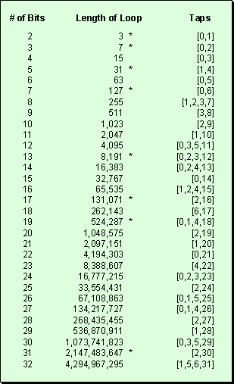
PRPG Cycle length vs
Register length

Slide 11


Additive Scrambler and Descrambler
They are synchronous scramblers because they require the initial state of the scrambler and descrambler to be the same
They are non-recursive because they do not have any feedback loop in the process
LFSR is connected to the data stream by means of an additional modulo-2 adder (XOR) gate
Used in 100Base-TX interface which repeats its sequence after 2^{N}-1 = 2047 bits; with N=11
Usually employed where a fixed size frame is to be transmitted

Slide 12
Additive Scrambler Example
c(n)
⊕
channel
Characteristic polynomial
1+x⁹+x¹¹
x(n)
Scrambled output
k(n)
⊕
DFF1 | DFF2 | DFF3 | DFF4 | DFF5 | DFF6 | DFF7 | DFF8 | DFF9 | DFF10 | DFF11
x(n) represents the data to be scrambled at time n
k(n) represents the ‘key’ produced by the LFSR
c(n) represents the scrambled code word

Slide 13
Corresponding Additive Descrambler
from
channel
Characteristic polynomial
1+x⁹+x¹¹
Same seed value as Scrambler
⊕
y(n)
c(n)
Descrambled output
⊕
k(n)
DFF1 | DFF2 | DFF3 | DFF4 | DFF5 | DFF6 | DFF7 | DFF8 | DFF9 | DFF10 | DFF11
x(n) represents the data to be scrambled at time n
k(n) represents the ‘key’ produced by the LFSR
c(n) represents the scrambled code word

Slide 14
Multiplicative Scramblers
They are asynchronous because they do not require LFSR synchronization.
They are recursive as they have feedback loops.
The pair of scrambler-descrambler is self-synchronizing. They do not need to start from same initial value.
The self-synchronizing process could take up to N bits (or N clock cycles) so the first N values of y(n) should be discarded.
With this approach, the transmission errors are multiplied by T+1, where T is the number of taps used in LFSR. Thus if one bit is flipped due to some error, the descrambler will result in 3 bit error.

Slide 15
Multiplicative Scrambler - Descrambler
Characteristic polynomial
1+x⁹+x¹¹
⊕
⊕
x(n)
k(n)
DFF1 | DFF2 | DFF3 | DFF4 | DFF5 | DFF6 | DFF7 | DFF8 | DFF9 | DFF10 | DFF11
c(n)
Scrambled
output
Channel for
Data communication
Seed value can be different at transmit and receive
y(n)
Descrambled output
⊕
⊕
k(n)
c(n)
DFF1 | DFF2 | DFF3 | DFF4 | DFF5 | DFF6 | DFF7 | DFF8 | DFF9 | DFF10 | DFF11

Slide 16
Example – Multiplicative Scrambler
⨁
⨁
x(n)
⊕
⊕
Registers output “q1q2q3q4” |  |  |  | k | x | c
0 | 0 | 0 | 0 | 0 | 1 | 1
1 | 0 | 0 | 0 | 0 | 0 | 0
0 | 1 | 0 | 0 | 0 | 1 | 1
1 | 0 | 1 | 0 | 1 | 1 | 0
0 | 1 | 0 | 1 | 1 | 0 | 1
1 | 0 | 1 | 0 | 1 | 0 | 1
1 | 1 | 0 | 1 | 1 | 0 | 1
1 | 1 | 1 | 0 | 1 | 1 | 0
0 | 1 | 1 | 1 | 0 | 0 | 0
0 | 0 | 1 | 1 | 0 | 1 | 1
1 | 0 | 0 | 1 | 1 | 1 | 0
0 | 1 | 0 | 0 | 0 | 0 | 0
k(n)
DFF1 | DFF2 | DFF3 | DFF4
c(n)
Transmitted to Receiver
LFSR Using polynomial 1 + x³ + x⁴
Scrambler Seed Value “0000”
Input Data stream:
“101100010110”

Slide 17
Continue to – Multiplicative De-Scrambler
⨁
⨁
y(n)
Registers output “q1q2q3q4” |  |  |  | k | c | y
1 | 1 | 1 | 1 | 0 | 1 | 1
1 | 1 | 1 | 1 | 0 | 0 | 0
0 | 1 | 1 | 1 | 0 | 1 | 1
1 | 0 | 1 | 1 | 0 | 0 | 0
0 | 1 | 0 | 1 | 1 | 1 | 0
1 | 0 | 1 | 0 | 1 | 1 | 0
1 | 1 | 0 | 1 | 1 | 1 | 0
1 | 1 | 1 | 0 | 1 | 0 | 1
0 | 1 | 1 | 1 | 0 | 0 | 0
0 | 0 | 1 | 1 | 0 | 1 | 1
1 | 0 | 0 | 1 | 1 | 0 | 1
0 | 1 | 0 | 0 | 0 | 0 | 0
+
+
k(n)
Seed
N=4
DFF1 | DFF2 | DFF3 | DFF4
c(n)
y=x
Input
String
From
here
Received from channel
LFSR Using polynomial 1 + x³ + x⁴
Scrambler Seed Value “0000”
De-Scrambler Seed Value “1111”
Input Data stream:
“101100010110”

Slide 18
Multiplicative De-Scrambler with Error Detection
⨁
⨁
y(n)
Registers output “q1q2q3q4” |  |  |  | k | c | y
1 | 1 | 1 | 1 | 0 | 1 | 1
1 | 1 | 1 | 1 | 0 | 0 | 0
0 | 1 | 1 | 1 | 0 | 1 | 1
1 | 0 | 1 | 1 | 0 | 0 | 0
0 | 1 | 0 | 1 | 1 | 1 | 0
1 | 0 | 1 | 0 | 1 | 0 | 1
1 | 1 | 0 | 1 | 1 | 1 | 0
1 | 1 | 1 | 0 | 1 | 0 | 1
0 | 1 | 1 | 1 | 0 | 0 | 1
0 | 0 | 1 | 1 | 0 | 1 | 0
1 | 0 | 0 | 1 | 1 | 0 | 1
0 | 1 | 0 | 0 | 0 | 0 | 0
+
+
k(n)
Seed
N=4
DFF1 | DFF2 | DFF3 | DFF4
c(n)
y=x
Input
String
From
here
Received from channel
LFSR Using polynomial 1 + x³ + x⁴
Scrambler Seed Value “0000”
De-Scrambler Seed Value “1111”
Input Data stream:
“101100010110”
T is the number of TAPS used in ALFSR
One error in blue was introduced in c(n)
This error resulted in T+1 = 3 errors in y(n) shown in red

Slide 19
Case Study: Binary Rate Multipliers

Slide 20
Binary Rate Multipliers - BRM
Definition: A circuit module that transforms a stream of input clock pulses into another stream of output clock pulses
Let Ni = no. of input pulses for a particular time period
Let No = no. of output clock pulses for the same time period
$$Binary Fractional Rate Multiplier ⟹No= \frac{B}{2^{n}}Ni$$
B = Rate Constant Input to module
B = (B_{n-1}, B_{n-2}, ……., B₂, B₁, B₀)₂
n = no. of binary counter stages controlling the module
The clock input drives an n-bit binary counter whose outputs are labelled (Xn,Xn-1,….,X2,X1).

Slide 21
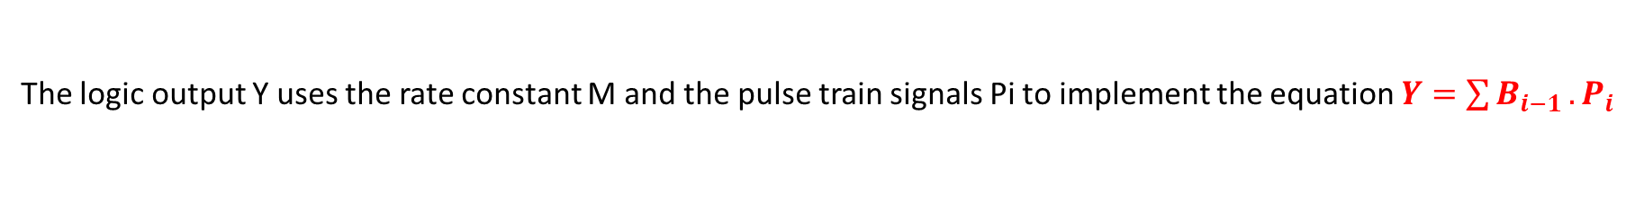
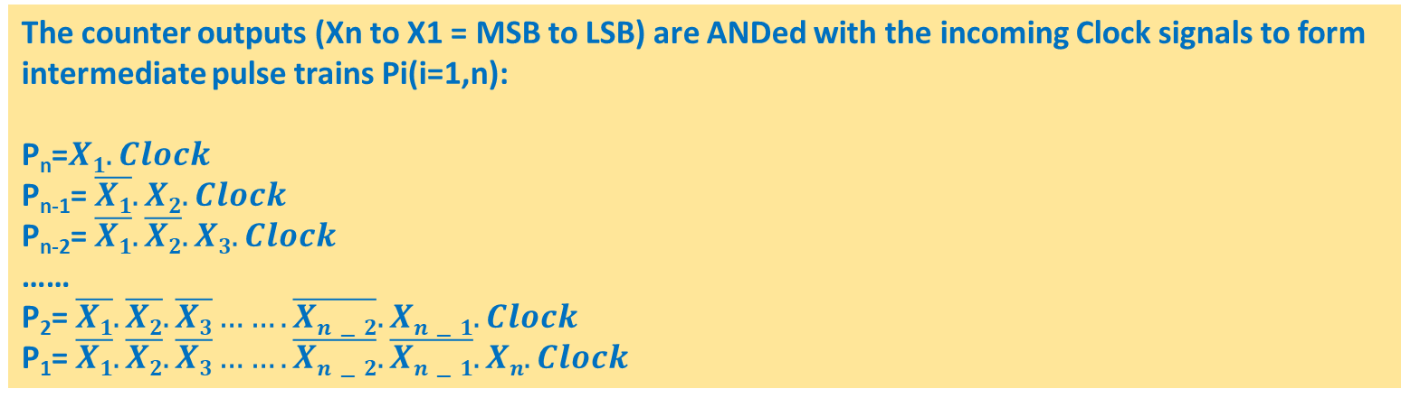
Digital Fractional Rate Multiplier - Principle
The counter outputs (Xn to X1 = MSB to LSB) are ANDed with the incoming Clock signals to form
intermediate pulse trains Pi(i=1,n):
P_{n}=$X1. Clock$
P_{n-1}= $\overline{X1}.X2. Clock$
P_{n-2}= $\overline{X1}.\overline{X2}.X3.Clock$
……
P₂= $\overline{X1}.\overline{X2}.\overline{X3}……. \overline{Xn−2}.Xn−1. Clock$
P₁= $\overline{X1}.\overline{X2}.\overline{X3}…….\overline{Xn−2}. \overline{Xn−1}.Xn. Clock$
The logic output Y uses the rate constant M and the pulse train signals Pi to implement the equation $Y=\sum{B_{i−1}}.P_{i}$
This output configuration will deliver the proper number of output pulses (N_{o}) as specified by rate constant B

Slide 22
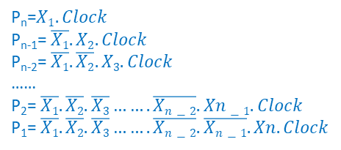
Basic Circuit Diagram – DFRM
Clk
Input
Pulses
n-Bit Binary Counter
X₁
X₂
X_{n}
(MSB)
P_{n}=$X1. Clock$
P_{n-1}= $\overline{X1}.X2. Clock$
P_{n-2}= $\overline{X1}.\overline{X2}.X3.Clock$
……
P₂= $\overline{X1}.\overline{X2}.\overline{X3}……. \overline{Xn−2}.Xn−1. Clock$
P₁= $\overline{X1}.\overline{X2}.\overline{X3}…….\overline{Xn−2}. \overline{Xn−1}.Xn. Clock$
AND Products
P_{n}
P_{n-1}
P₁
B₀
LSB
Y
B =Rate
Constant
B_{n-2}
B_{n-1}
MSB

Slide 23
Example and timing diagram of BRM
BRM using a 3-Bit counter
Rate Constant B = 7₁₀
Counter generates 8 pulses per time period. Due to B=7 , 7 pulses appear at the output and one pulse is eliminated

Slide 24
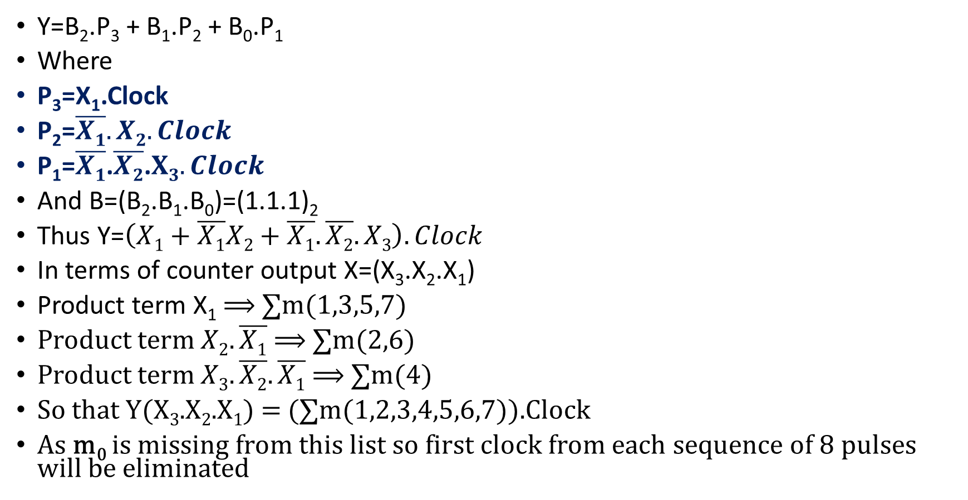
Analysis of timing diagram 3 bit BRM, B=7
Y=B₂.P₃ + B₁.P₂ + B₀.P₁
Where
P₃=X₁.Clock
P₂=$\overline{X1}.X2. Clock$
P₁=$\overline{X1}$.$\overline{X2}$.$X3.Clock$
And B=(B₂.B₁.B₀)=(1.1.1)₂
Thus Y=$\left(X1+\overline{X1}X2+\overline{X1}.\overline{X2}.X3\right). Clock$
In terms of counter output X=(X₃.X₂.X₁)
Product term X₁ ⟹ ∑m(1,3,5,7)
Product term $X2.\overline{X1}$ ⟹ ∑m(2,6)
Product term $X3.\overline{X2}.\overline{X1}$ ⟹ ∑m(4)
So that Y(X₃.X₂.X₁) = (∑m(1,2,3,4,5,6,7)).Clock
As m₀ is missing from this list so first clock from each sequence of 8 pulses will be eliminated

Slide 25
Timing Diagram of DFRM
Clock
Counter
LSB
X1
0
0
0
1
0
0
0
1
0
1
1
0
0
0
1
1
0
1
0
1
1
1
1
1
0
0
0
X2
MSB
X3
Counter.B.Clk
Pn
Pn-1
Pn-2
time

Slide 26
How many pulses are produced?
From the timing diagram, each of the pulse trains P_{i} generates 2^{i-1} pulses during during one counter sequence period (2^{n} clock pulses)
Thus P₁ generates 1 pulse, P₂ generates 2 pulses, P₃ generates 4 pulses, and so on
Note that pulses do not overlap in time
We may OR the respective pulses to produce desired output stream
The output pulses can be irregularly spaced
The output pulses are synchronized with input clock pulses

Slide 27
Serially Cascaded Binary Rate Multiplier BRM
Design a BRM to implement Nout = $\frac{63}{320}$ . Nin
Break into binary powers (63 x 2 = 126; and 320 x 2 = 640) :
Nout = $\frac{(7⨯18)}{(10⨯64)}$ . Nin
Nout = ($\frac{7}{10}$).($\frac{18}{64}$) . Nin
Use:
1 x Decade Counter BRM
1 x 6-Bit Binary Counter BRM
Set B for Decade Counter = 0111
Set B for 6-Bit BRM = 10010
B0,….,B3
B0,…,B5
Decade
BRM
6 Bit
Binary BRM
Nout
Clk
Y1
Y2
Clk
Nin

Slide 28
Example 2: Serially Cascaded BRM
Design a BRM circuit that produces: 0.56 of input clock rate
We use two Decade BRMs with
Value of B is set as 7 and 8 respectively
$Nout= \frac{56}{100}$. Nin
$N= \frac{7}{10}$.$\frac{8}{10}$. Nin
B=0111
B=1000
Decade
BRM
Decade
BRM
Y2
Clk
Nout
Clk
Y1
Nin
$Y1=(\frac{7}{10}$) . Clk
$Y2=(\frac{7}{10}$).($\frac{8}{10}$).Clk

Slide 29
Eg 3: Parallel Cascaded Binary Rate Multiplier
Design a BRM circuit to produce N_{out} = (0.297)N_{in}
Clk
B=0010
B=1001
B=0111
Decade
BRM
Decade
BRM
Decade
BRM
Eout Ein
Eout Ein
Y2
Y1
Y3
$$Y=\left(\frac{2}{10}+\frac{9}{100}+\frac{7}{1000}\right)⋅Clk$$
Yout

